Slide 1
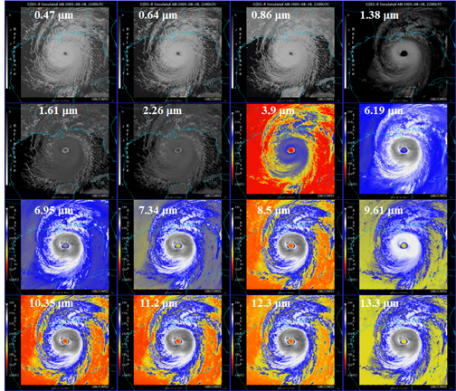
The improved imagery of the ABI on GOES-R Timothy J. Schmit
NOAA/NESDIS Advanced Satellite Products Branch (ASPB)
Madison, WI
The ABI on the GOES-R series will greatly improve over the current instrument
Spectral, spatial, and temporal on orders of improvement of 3, 4 and 5, respectively
Improved image navigation and registration and radiometer performance
These critical improvements will provide for a host of applications and new products
Simulated ABI (Advanced Baseline Imager) data

