Slide 1
Predictable Results
GPS Staking and Machine Guidance on the Mitchell Interchange Project
Edgerton Contractors
Oak Creek, WI
August, 2012

Slide 2
Edgerton GPS Program – Stats
10 years experience with GPS Staking / Machine Guidance
Machines: 28 Trimble, 1 TopCon – Backhoes, Dozers and a Grader
Rovers: 8 Trimble, 1 TopCon
TerraModel, Trimble Business Center, Civil 3D
VRS Corrections and remote data transfer for all rovers
Notes:
Based in Oak Creek
50 years, GPS for 10 of those years
Used TerraModel exclusively until one year ago.
Transitioning to TBC.
One year from now will be exclusively TBC.
C3D – need rudimentary skills for working with WisDOT CAD in its native format
VRS for machines – upgrading / beta testing

Slide 3
Edgerton GPS Program - Investment
GPS represents 15% to 25% of the cost of new machines
GPS machines require more frequent maintenance: pins, bushings, cutting edges
Three full-time personnel: Program Manager, Survey Manager, Engineering Manager
GPS Machine Guidance Training – creation and distribution of ‘YouTube’ style videos via the internet
GPS Rover Training - annual classroom session, one-on-one, regular assessments, 12 month process
Three year hardware development cycle
Continuous software and hardware beta testing for Trimble
Notes:
15% to 25% represents the cost of just the hardware on the machine
We are not surveyors or engineers – we use the terms loosely for lack of a better shorthand
Training – consistency is exponentially harder when you quickly grow from 3 to 30 systems across the state, learn by doing, support with distribution of basic information
Need to find the balance of information transfer / experiential learning, carrot / stick, metrics and reward for effort
Almost $3 million
Put these costs against overall profit margins – left with qualitative justifications for the capital investment

Slide 4
Edgerton GPS Program Impact on Project Management
Pre-build the project – plan check and RFI’s
Night Work
Alignment-based design alternatives
Design and Visualization of interim surfaces which provide drainage, construction access without over-excavating
Match existing grades for temporary wideners or cross-overs
Existing Grade to subgrade in one operation
Planning tools / confidence to execute ever challenging construction sequences

Slide 5
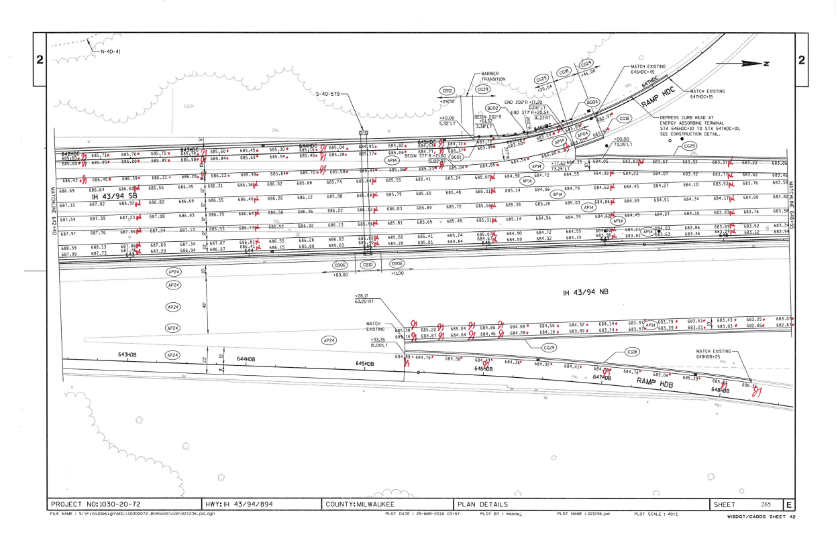
Pre-Build the Project - Checks
Notes:
Model must be a true representation of the contract document
Focus on labels, dimensions, numbers
Focus on alignments – agonize over the 0.01-ft

Slide 6
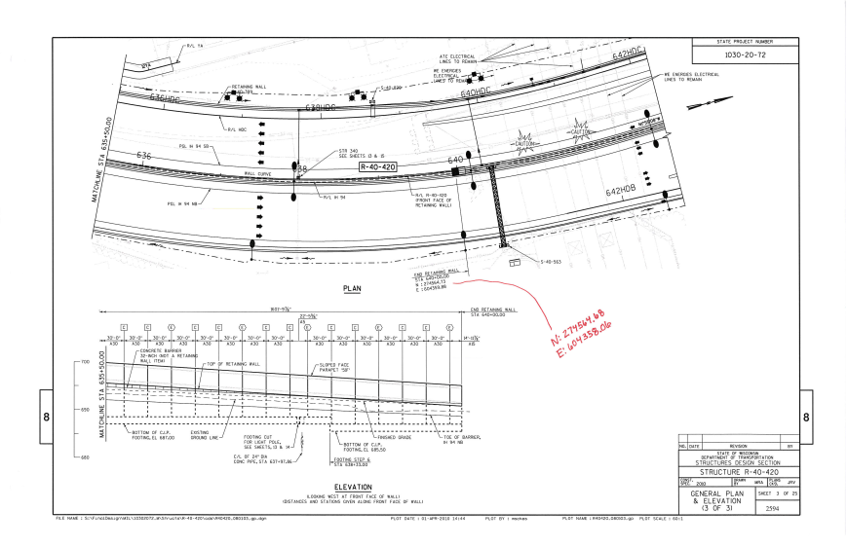
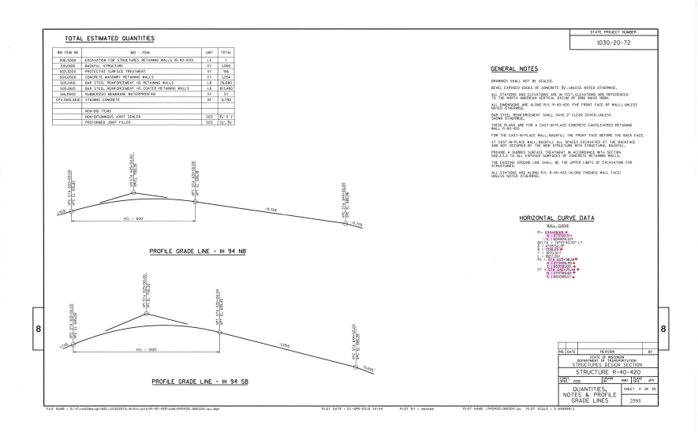
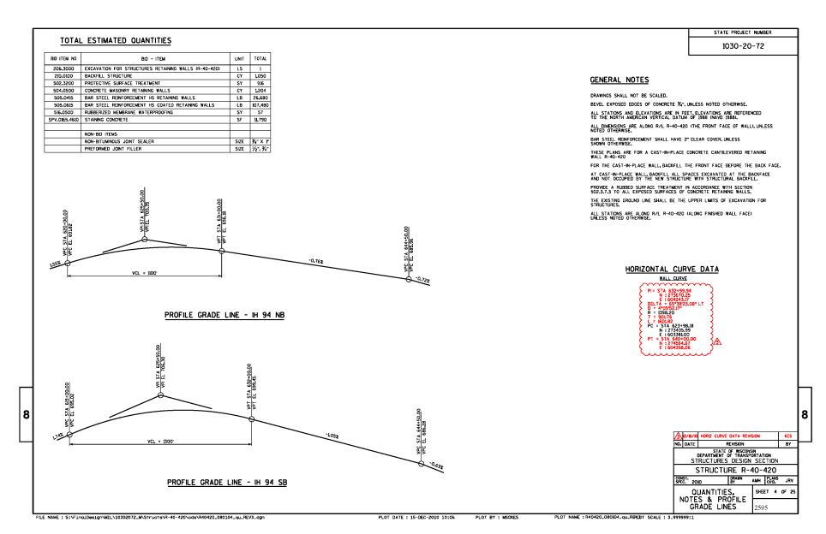
Pre-Build the Project - RFI
RFI: ECI-042, Wall 420
Horizontal Alignment of Wall
Curve Table inconsistent with coordinate callout.
N 0.05-ft, E 1.82-ft
Notes:
Cost savings? Perhaps zero, perhaps a lot.
Do as much work as possible Pre-Construction – biggest benefits to GPS

Slide 7
Night Work
Advantages of GPS at night:
Accurate grading in spite of reduced visibility
Increased safety due to fewer personnel on the ground

Slide 8
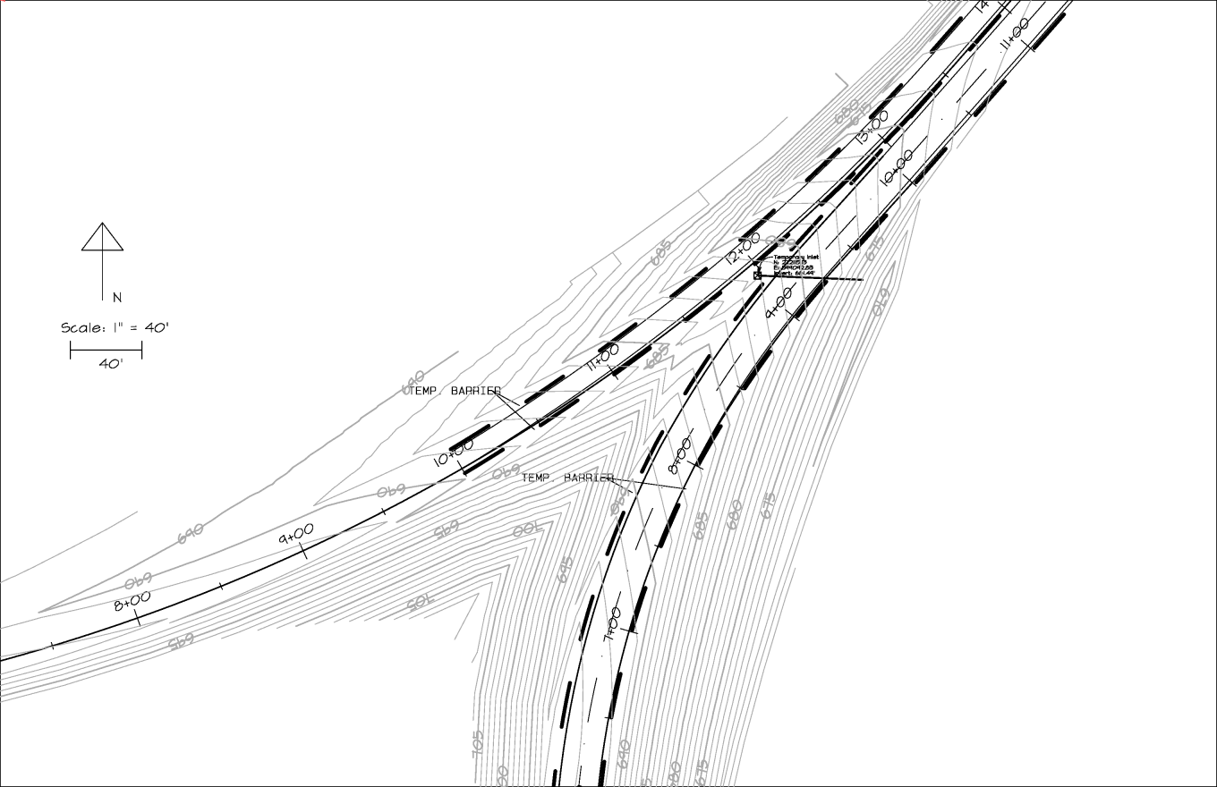
Design Alternatives
Temporary Alignments: NSB-NWA
Eliminated a traffic switch.
Saved three weeks on the schedule.
Notes:
Alternative based on horizontal alignment, vertical alignment, cross-sections – same as engineer
Crude presentation - Did it in a day.

Slide 9
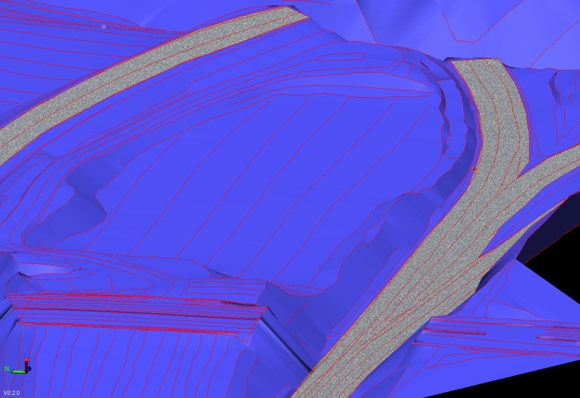
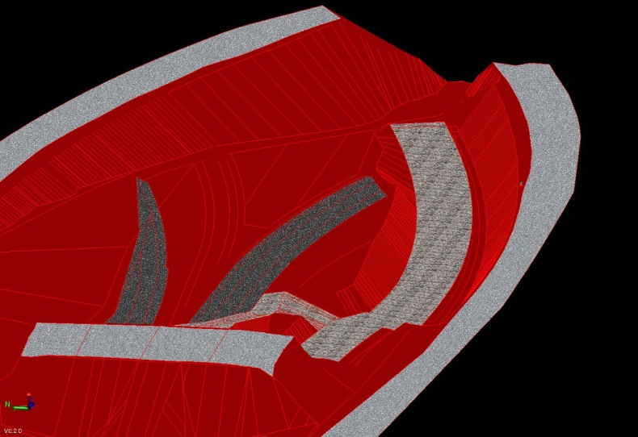
Interim Surfaces
Proposed Surface
Existing Surface
20th Street – Looking East
Safe Slopes
Excavate for proposed structures
Temporary Crane Access
Site Drainage
Construction Staging
Minimize over-excavation
Interim Surface
Notes:
Location – above 20th street, looking east, along the WN alignment, looking into the west end of tunnels #1 and #2
Finish grade model is an important starting point. Planning also requires the existing surface and interim surfaces.

Slide 10
Interim Surfaces
Visualization during planning
Means and Methods
Confirm safe slopes and adequate storm water control
Notes:
Existing Traffic
Center area lowered to below traffic
Safe slopes!
Don’t flood the crane
Don’t move any more dirt than necessary – portions of staging are 1-ft above subgrade, portions are pitched to drain

Slide 11
Match Existing Grades for Temporary Work
Match Grades for Temp Ramp WSB:
Load 2D plan into GPS rover, take shots along match lines
Tweak surface to match existing
Differences, in this case, ranged from 0.18 to 0.29-ft

Slide 12
Existing to Sub-Grade in One Operation
One GPS Hoe, One GPS Dozer
No Stakes or Grade Laborer
Clean, straight, geometric
slope with sharp breaks.
Safe Slope
Sub-Grade
Step
Sub-Grade
Notes:
This is how it looks when everything is going right.

Slide 13
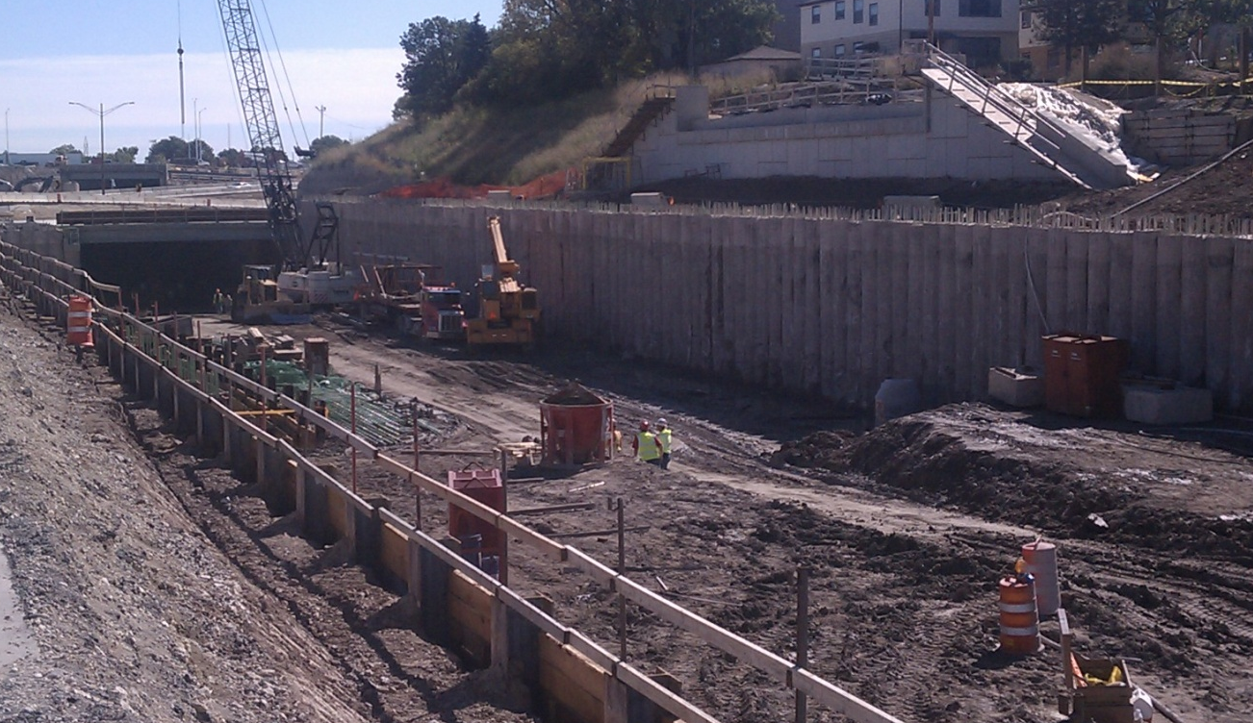
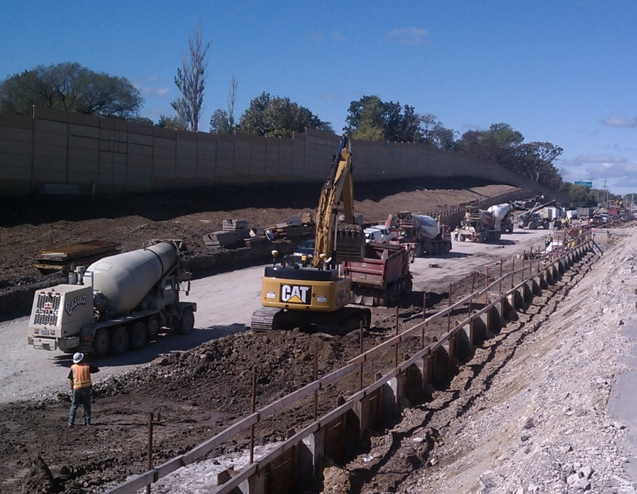
Mitchell Interchange – Staged Excavations
Staged excavation for tieback installation
WN Ramp – Schedule required tunnel construction / tie back installation simultaneously with 1000’ one way access thru a 4 staged excavation

Slide 14
GPS Value to the Client
Higher quality earthwork product
“One” Pass excavation achieving higher production rates at lower unit cost
Eliminated grade stakes for crews
Bid Item savings against traditional bid items
Data driven decisions and negotiations
Increased level of confidence to accelerated schedule execution

Slide 15
Edgerton / Kapur Template
Success on previous projects:
Marquette Interchange - $800 million, multi-phase interchange project in downtown Milwaukee
Wind Farm Project – Design / Build, more than 80 unique turbine sites, 40 square miles
8 Year working relationship based on a shared approach to this kind of work.
The Mitchell Interchange is simply the latest application of the Edgerton / Kapur Template.
Results are predictable.
Notes:
Acknowledge Kapur as craftsmen in their trade – listen to their ideas.

Slide 16
Team Effort
The Team:
Owner and contractor representatives
CAD operators, surveyors, inspectors
Skilled, take pride in their work, just want to build a good project
Operational framework:
Divide the work.
Collaboration – not competition.
Share everything.
Trust but verify.
Success in this step solves half the problems.
Notes:
I like GPS because of the technology.
Technology is easy. People are hard.
Successful GPS is first and foremost a people problem.

Slide 17
Template for Project GPS
Surveyor
Control and
Calibration
Share
Verify
DOT Inspector
Contractor
Inspection
Model
Pre-Construction
Notes:
Circles of responsibility
Division of labor, some overlap –
Contractor and Surveyor work together to decide point locations, set semi-permanent points
DOT provides CAD files as a starting point, Contractor verifies and augments consistent with means and methods
All held together by the idea that we will share our work and check each other’s work and do as much of it as possible pre-construction.

Slide 18
Share Everything?
Notes:
Not very macho…
Socialism?

Slide 19
Doesn’t that mean that the
Blind are leading the Blind?
Notes:
Answer: YES – if you ignore the people problem
If you have the right people in the right framework, this is the most efficient, worry-free approach.
Sharing is a difficult concept for lawyers and accountants – do this right and what they don’t know won’t hurt them.

Slide 20
The Goal: One Site
In order of Importance…
One set of survey control points.
One GPS calibration.
One set of construction surfaces.
One GPS infrastructure.
Notes:
“Reasonable people will disagree.”
More significantly…“Highly skilled, careful, earnest technicians will disagree.”
Examples: GPS survey control network (measurement errors), Finish Grade Model (contract document interpretation)
Why have multiple creators of these things? How are inevitable variations a check? How are they anything other than a distraction?
Sidestep all these potential sources of inconsistency and work to get to ‘One Site’.

Slide 21
Survey Control Points
Specification 650.3.3.5 Site Calibration:
“Designate a set of control points including a total of at least 6
horizontal and vertical points…”
Contractor and surveyor share the responsibility of selecting / setting points.
Contractor to set base station locations.
Surveyor measures and then publishes NEZ and LLH coordinates on each point for all GPS users on the project.
Notes:
Two equally qualified, conscientious surveyors will get slightly different results on a given level loop – eliminate that source of discrepancy by having only one surveyor.
All users check for internal consistency within a given tolerance.

Slide 22
Survey Control Points - Comments
Include base station points in the list of control points.
Digital level loops, robotic total station traverses are the minimally acceptable approach.
Consider establishing GPS staking and machine guidance control in the project design phase.
Notes:
Techniques are the minimum required. Kapur has more advanced techniques.

Slide 23
Site Calibration
Goal: Provide the generic information that can be used by anyone using any GPS system to stake or grade the site consistent with the surveyor-of-record.
Definition: Published list of the NEZ coordinates and LLH coordinates for each control point.
All users of the data must verify internal consistency of the data before using for construction.

Slide 24
Site Calibration - Comments
Every control point should be checked.
Results of the check should be shared with the surveyor-of-record.

Slide 25
Construction Surfaces
Definition: Electronic representation of the contract document that can be loaded into survey and machine guidance instruments.
Contractor is responsible for the creation and distribution of Construction Surfaces.
All users check that the surfaces match the contract document before using in the field.
Any and all errors are fixed by the Contractor prior to construction.

Slide 26
Construction Surfaces - Comments
Construction surface should incorporate every line and label in the contract document.
List of construction surfaces:
Finish Grade – required.
SubGrade – required.
Interim grading surfaces.
Bridge / retaining wall excavation.
Storm sewer excavation.
Stone or other material surfaces.

Slide 27
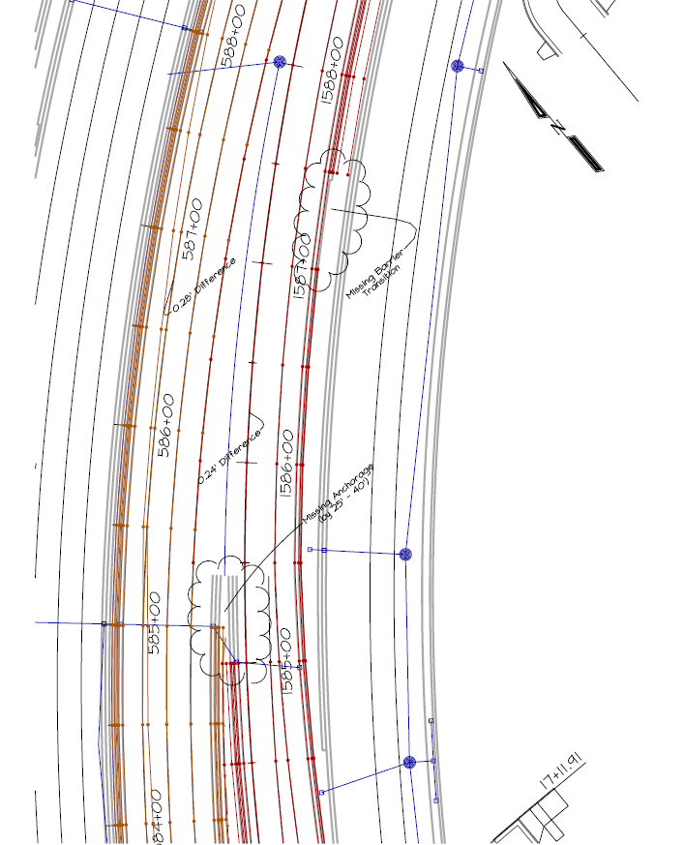
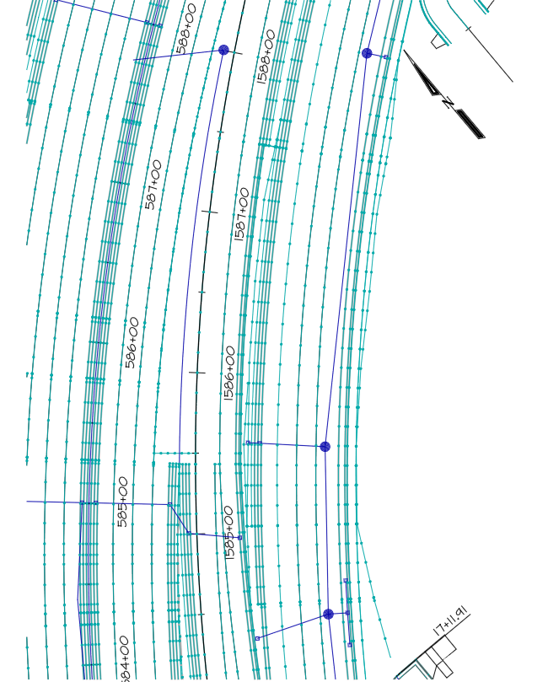
Construction Surfaces - Comments
SOE reports are not models.
SOE Report
Edgerton Surface
Notes:
Horizontal error – 0.25-ft
Vertical error – less than 0.06-ft
Considerations:
This is error on top of the GPS measurement error
Tapers don’t start on even 50-ft stations
Future – GPS Paving
Landscape areas

Slide 28
Construction Surfaces - Comments
CAD files reduce model costs significantly.
Format: LandXML, Civil3D
Include:
Alignments – Horizontal and Vertical
All lines on Plan Details
Pre-Construction Topographic Survey
Finish Grade Surface: breaklines, not triangles
ROW limits
Utilities
Structure lines, example: CL of bearing for bridge abutments
Coordinate call-outs for truncated arcs, vertical and horizontal

Slide 29
Construction Surfaces - Comments
Send in an RFI on all inconsistencies.
Visual checks are not adequate. Numerical checks to the 0.01-ft are required.
Inspectors benefit by taking a high-profile role in checking the surface.
The project gets built and inspected twice- once in the office and a second time in the field.
Notes:
Benefit of Pre-Construction Inspection
Catch errors early
Confirm the model matches the contract document
Once you do this you have a document you can believe in.
You can check anything, anywhere, anytime

Slide 30
Construction Surfaces - Comments
Contractors want this responsibility…
Highest repair / downtime risks.
Interim surfaces.
Means and Methods.
Duck-walking and landscape contours.
Construction-phase design changes.
Knowledge and control of operators.
Notes:
Operators need to have complete faith in the model.
Do not expect them to ‘figure it out in the field’.

Slide 31
GPS Infrastructure
Reasonable effort should be made to accommodate the hardware of all players to enable everyone to use the same source of GPS corrections.
Edgerton can configure base stations to broadcast corrections to TopCon, Trimble and Leica – all from one base.
Kapur has purchased survey instruments with radios compatible with machine radios.
VRS simplifies the effort to standardize GPS correction sources.

Slide 32
Benefits
Multiple sets of eyes checking single-source information.
Eliminate small discrepancies due to measurement tolerances or plan interpretation.
Focus everyone on what they do best.
Perform as much of the process as possible pre-construction – when everything is cheap.

Slide 33
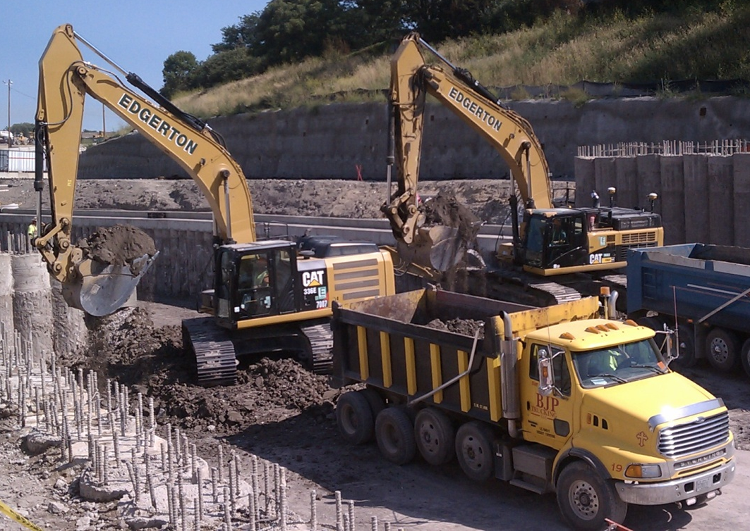
Discussion
Edgerton Contractors, Inc.
545 W. Ryan Road
Oak Creek, WI
Brady Frederick
414-349-0432
bfrederick@edgertoncontractors.com
Jeremy Craven
414-406-3974
jcraven@edgertoncontractors.com

