Slide 1


How are Highway Designs Actually Represented in Surface Models for Automated Machine Guidance and How Should We Control Them?
Alan Vonderohe
Construction and Materials Support Center
University of Wisconsin – Madison
August 21, 2012

Slide 2
Smooth Curves vs. Triangulated Irregular Networks (TINs)
Geometric highway design objects consist of mathematically-continuous curves and lines described by equations.
Surface models (TINs), in design software and used for construction by AMG, consist of discrete points connected by straight-line segments that become edges of triangles.
  There are no second-order curves.
  The only things described by equations are the triangles.
Notes:
-Streamlining of information flow, paperless, stakeless construction.
-Contractors are in the process of adopting the technology. Industry sees benefits.
-State Departments around the country have begun to implement the technology with a few reservations.
-Data compatibility at model level and file level is an issue.
-Procedures and measurement of QA/QC for this technology must be addressed.

Slide 3
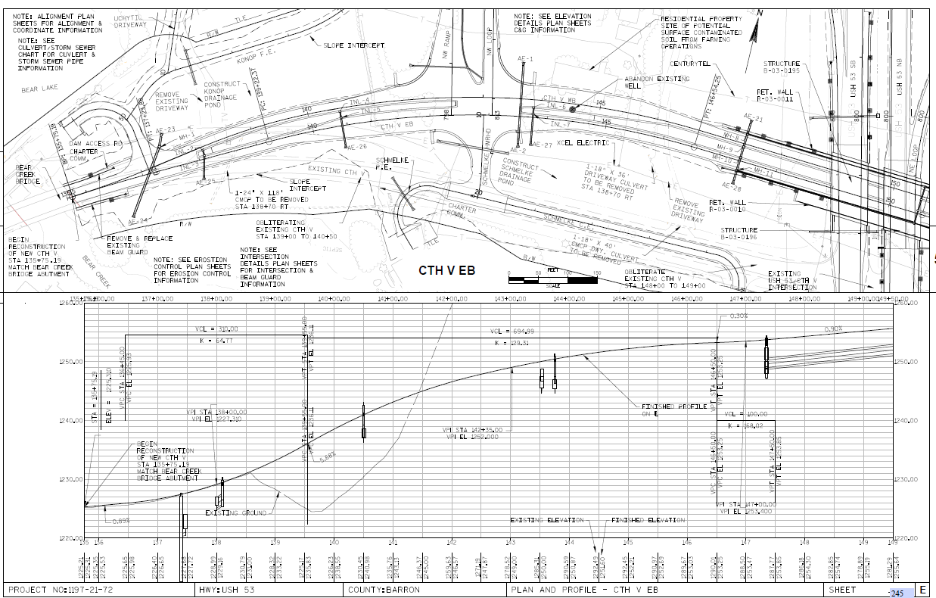
Circular Horizontal Curves; Parabolic Vertical Curves

Slide 4
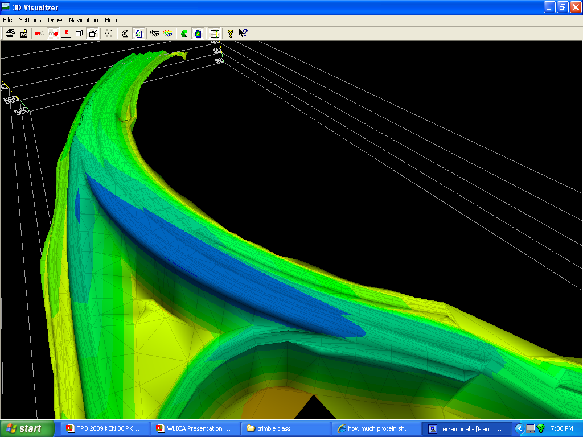
A Mesh of Triangles

Slide 5
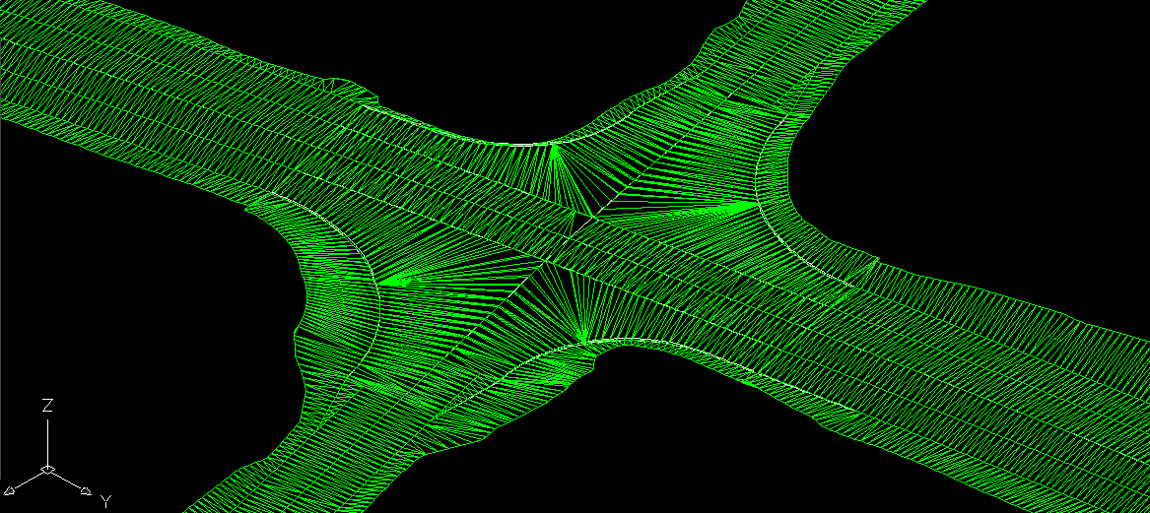
Curves Appear Smooth

Slide 6
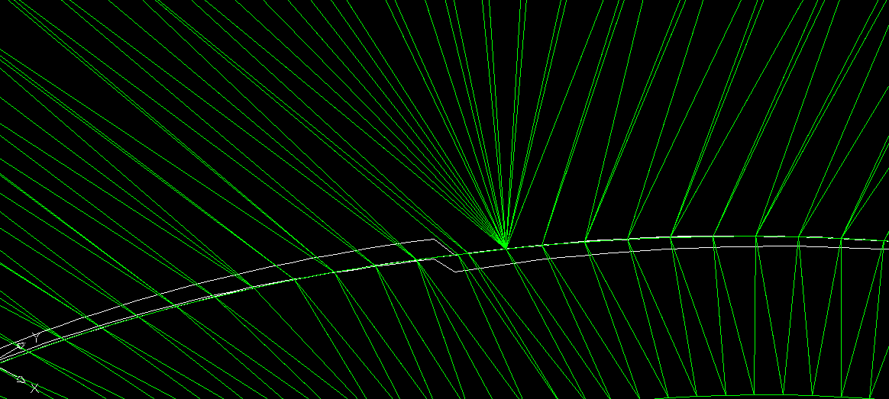
Curves are Not Smooth
(They are Not Curves)

Slide 7
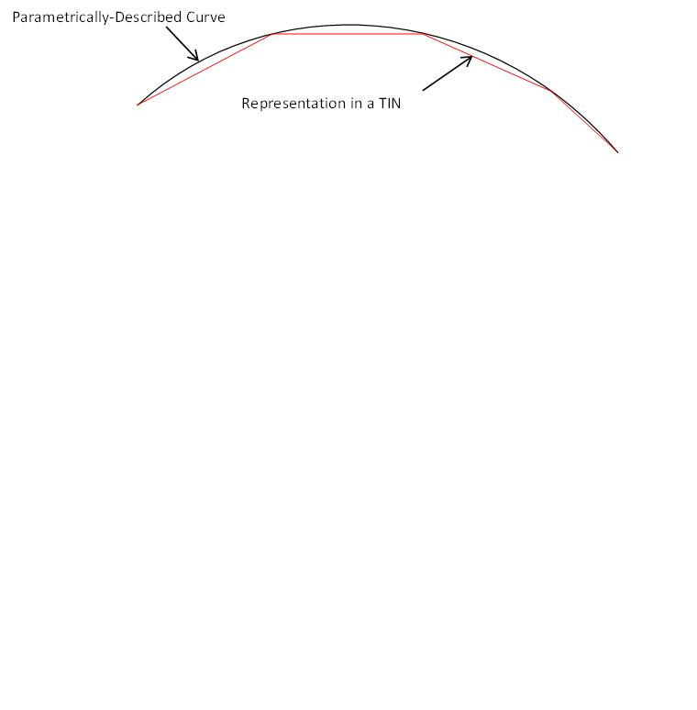
Model Development
Issue
Short line segments:
  More accurate representation; larger file sizes; greater compute times; greater data transfer times; more data management issues.
Long line segments:
  Decreased data management issues but increased risk of under-representation of design.
Optimum line segment length (data frequency / data density):
  Maximum length that yields threshold tolerable error.

Slide 8
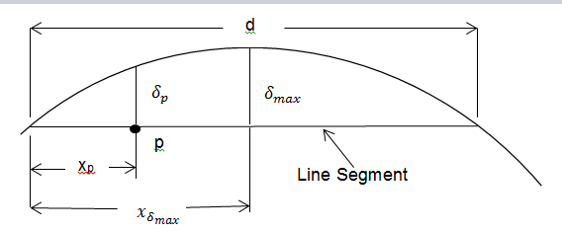

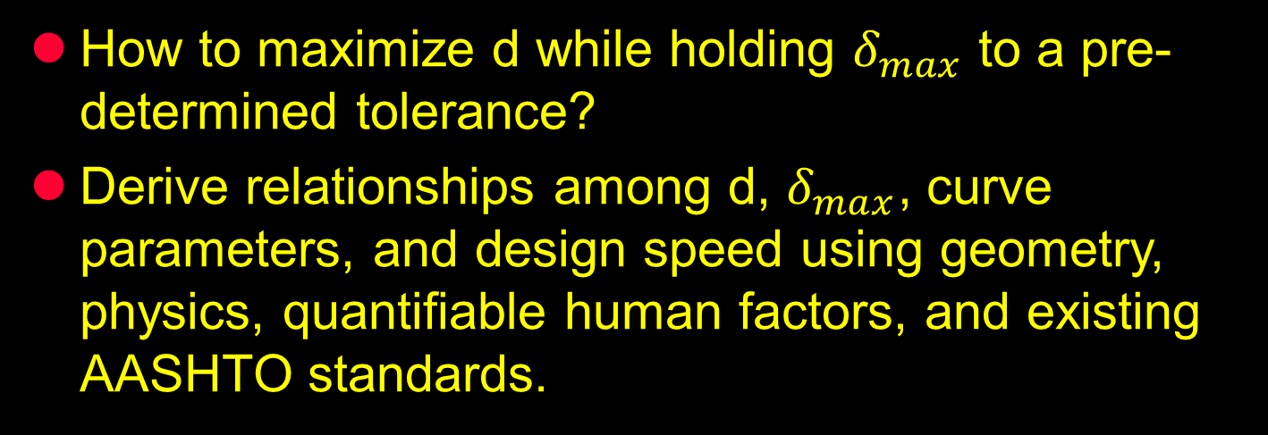
Curve; Line Segment; and Errors ($δ$)
How to maximize d while holding $δ_{max}$ to a pre-determined tolerance?
Derive relationships among d, $δ_{max}$, curve parameters, and design speed using geometry, physics, quantifiable human factors, and existing AASHTO standards.

Slide 9
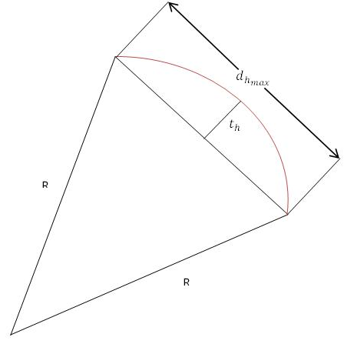
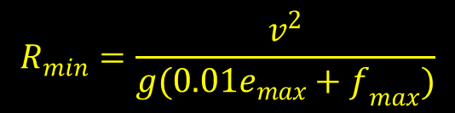
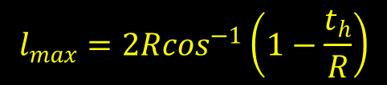

Circular Horizontal Curves
Chord length:
$$d_{h_{max}}=2\sqrt{t_{h}\left(2R−t_{h}\right)}$$
Curve length (station difference):
$$l_{max}=2R\cos^{−1}\left(1−\frac{t_{h}}{R}\right)$$
Minimized when R is minimized:
$$R_{min}=\frac{v^{2}}{g(0.01e_{max}+f_{max})}$$
Function of design speed (V):

Slide 10


$$t_{h}=0.25 ft$$
$e_{max}=6$%

Slide 11

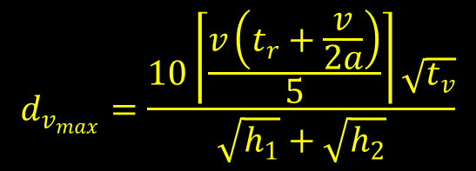
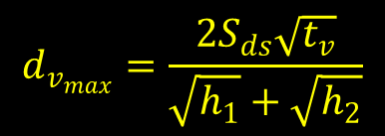
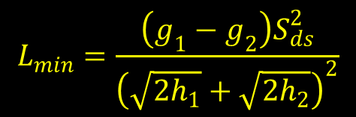
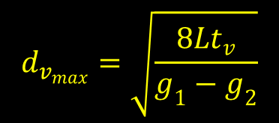
Parabolic Crest Vertical Curves
Reaction time and braking time:
$$d_{v_{max}}=\frac{10\left\lceil \frac{v\left(t_{r}+\frac{v}{2a}\right)}{5}\right\rceil \sqrt{t_{v}}}{\sqrt{h_{1}}+\sqrt{h_{2}}}$$
AASHTO values yield function of design speed (V):
$$d_{v_{max}}=u_{1}\left\lceil u_{2}V+u_{3}V^{2}\right\rceil \sqrt{t_{v}}$$
Station difference by curve length:
$$d_{v_{max}}=\sqrt{\frac{8Lt_{v}}{g_{1}−g_{2}}}$$
$$d_{v_{max}}=\frac{2S_{ds}\sqrt{t_{v}}}{\sqrt{h_{1}}+\sqrt{h_{2}}}$$
Minimized when L is minimized:
$$L_{min}=\frac{\left(g_{1}−g_{2}\right)S_{ds}^{2}}{{\left(\sqrt{2h_{1}}+\sqrt{2h_{2}}\right)}^{2}}$$
Depends on stopping sight distance and heights of eye and object.

Slide 12
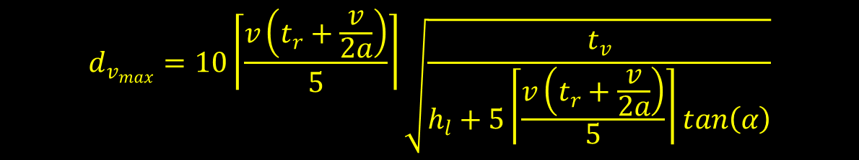
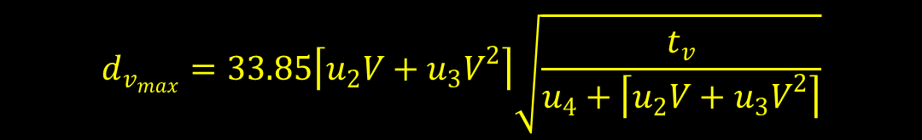
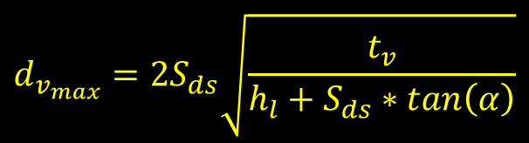
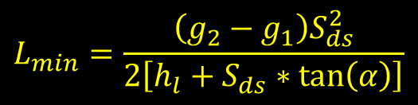
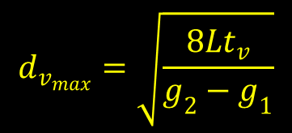
Parabolic Sag Vertical Curves
Station difference by curve length:
Depends on stopping sight distance and characteristics of headlights:
$$d_{v_{max}}=\sqrt{\frac{8Lt_{v}}{g_{2}−g_{1}}}$$
$$d_{v_{max}}=2S_{ds}\sqrt{\frac{t_{v}}{h_{l}+S_{ds}∗tan\left(α\right)}}$$
Minimized when L is minimized:
$$L_{min}=\frac{\left(g_{2}−g_{1}\right)S_{ds}^{2}}{2\left[h_{l}+S_{ds}∗tan\left(α\right)\right]}$$
$$d_{v_{max}}=10\left\lceil \frac{v\left(t_{r}+\frac{v}{2a}\right)}{5}\right\rceil \sqrt{\frac{t_{v}}{h_{l}+5\left\lceil \frac{v\left(t_{r}+\frac{v}{2a}\right)}{5}\right\rceil tan\left(α\right)}}$$
Reaction time and braking time:
AASHTO values yield function of design speed (V):
$$d_{v_{max}}=33.85\left\lceil u_{2}V+u_{3}V^{2}\right\rceil \sqrt{\frac{t_{v}}{u_{4}+\left\lceil u_{2}V+u_{3}V^{2}\right\rceil }}$$

Slide 14
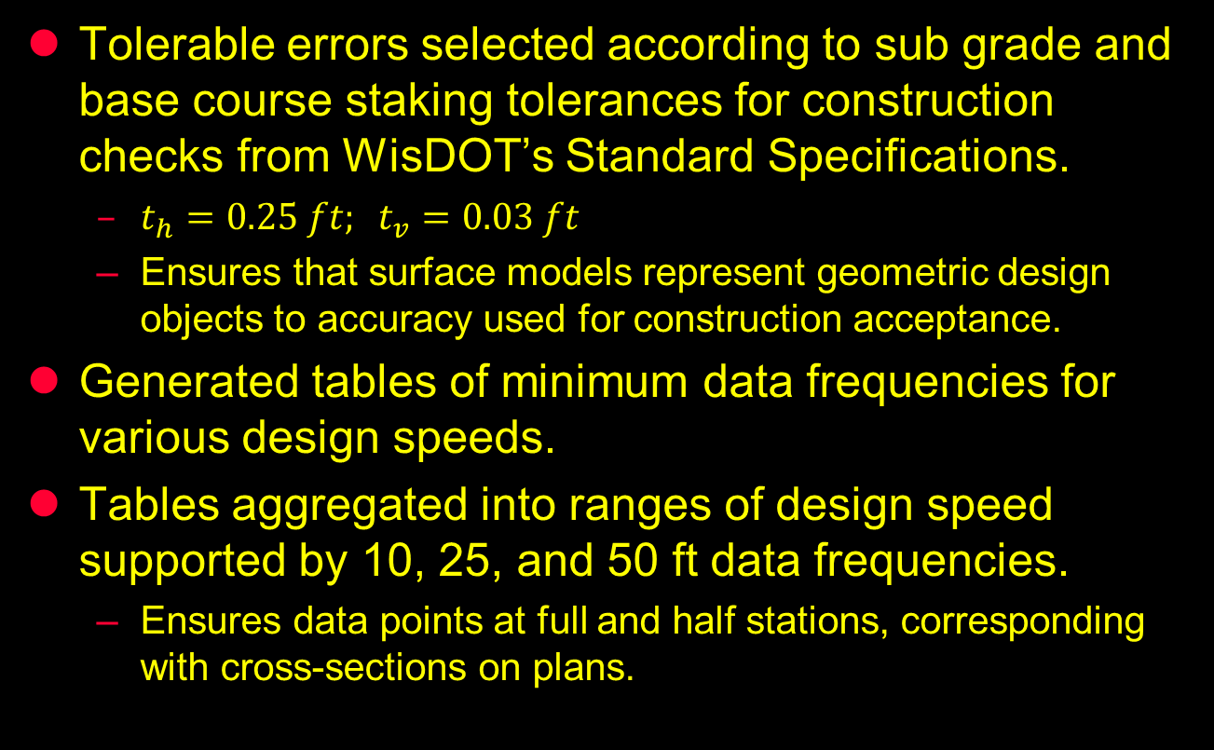
2011 Pilot Project Data Frequency Standard
Tolerable errors selected according to sub grade and base course staking tolerances for construction checks from WisDOT’s Standard Specifications.
  $t_{h}=0.25 ft; t_{v}=0.03 ft$
  Ensures that surface models represent geometric design objects to accuracy used for construction acceptance.
Generated tables of minimum data frequencies for various design speeds.
Tables aggregated into ranges of design speed supported by 10, 25, and 50 ft data frequencies.
  Ensures data points at full and half stations, corresponding with cross-sections on plans.
Notes:
-Streamlining of information flow, paperless, stakeless construction.
-Contractors are in the process of adopting the technology. Industry sees benefits.
-State Departments around the country have begun to implement the technology with a few reservations.
-Data compatibility at model level and file level is an issue.
-Procedures and measurement of QA/QC for this technology must be addressed.

Slide 15
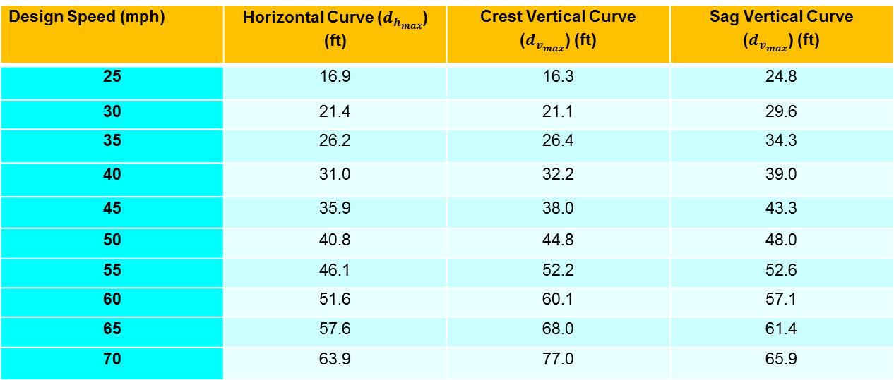
Design Speed (mph) | Horizontal Curve ($d_{h_{max}}$) (ft) | Crest Vertical Curve ($d_{v_{max}}$) (ft) | Sag Vertical Curve ($d_{v_{max}}$) (ft)
25 | 16.9 | 16.3 | 24.8
30 | 21.4 | 21.1 | 29.6
35 | 26.2 | 26.4 | 34.3
40 | 31.0 | 32.2 | 39.0
45 | 35.9 | 38.0 | 43.3
50 | 40.8 | 44.8 | 48.0
55 | 46.1 | 52.2 | 52.6
60 | 51.6 | 60.1 | 57.1
65 | 57.6 | 68.0 | 61.4
70 | 63.9 | 77.0 | 65.9
Line Segment Length (ft) | Design Speed Range (mph) Horizontal Curves Crest Vertical Curves Sag Vertical Curves
10 | <=30 | <=30 | <=25
25 | 35–55 | 35-50 | 30-50
50 | >=60 | >=55 | >=55
No issues with data frequency reported on four 2011 pilot projects.

Slide 16
Utility of Data Frequency Functions
Two possible implementation approaches:
1. A priori standards for corridors, projects, or project components, based upon design speeds.
- Ensures all curves are adequately (and consistently) represented but there will be more data than required.
2. A posteriori software function computes required data frequency for each design object based upon its own characteristics.
- Data frequencies will vary (and be optimal) along an alignment.
Parametric forms of developed functions can be used even if AASHTO standards for parameter values change.
Notes:
-

Slide 17
Construction-Side Findings from Four 2011 Data Sharing and HMA Base Course Pilot Projects
Alan Vonderohe
Construction and Materials Support Center
University of Wisconsin – Madison
August 21, 2012

Slide 18
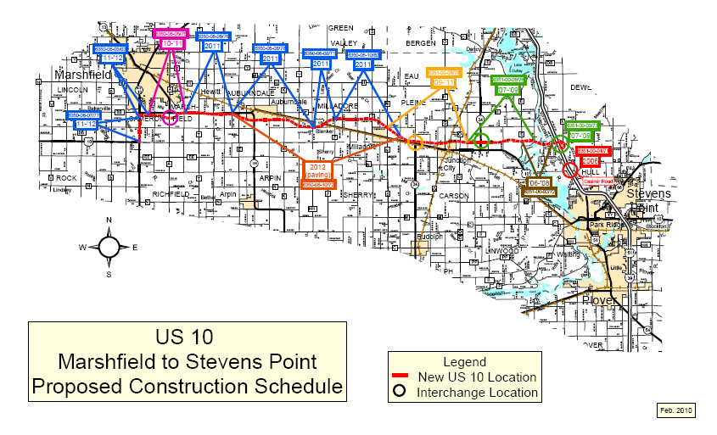
USH 10 Re-Alignment, Bi-Directional to Divided Capacity Expansion.

Slide 19
2011 Pilot Project Goals
Determine benefits of providing 3D roadway models at pre-bid.
Determine utility of 3D models for bid preparation.
Establish requirements for “construction–ready” 3D models flowing from design process.
Field test “construction readiness” of 3D models.
Evaluate AMG QA/QC specification components for HMA base course.

Slide 20
2011 Pilot Project Methods
Interviewed all parties requesting pre-bid packages to determine pre-bid uses.
Follow-up interviews with winning contractors and sub-contractors to determine post-bid office and field construction uses.
Interviewed WisDOT design engineers, construction engineers, and supervisors.
Site visits to all projects.
Return site visits to two projects.

Slide 21
Contractors’ Pre-Bid Use and Benefits of AMG Roadway Models
  All nine parties requesting models were able to import data.
  Pre-bid availability frees contractor personnel for preparation of more bids…hence, more competition.
  Better conveyance of design intent reduces risk-taking in bidding.
  Earlier and more effective identification of cost-reduction incentives.

Slide 22
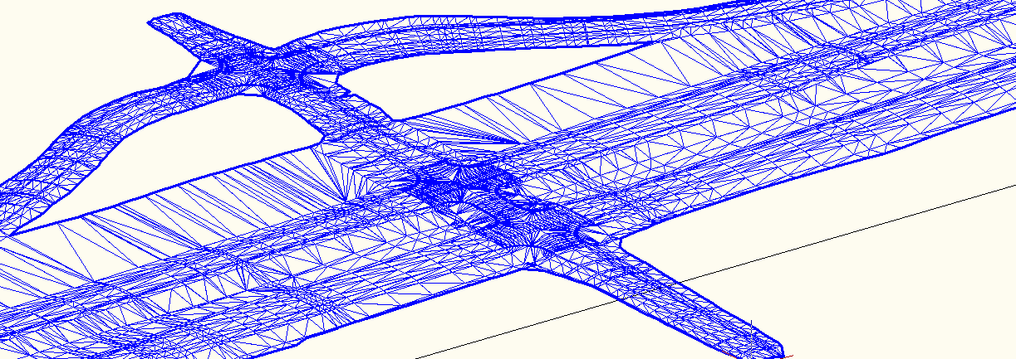
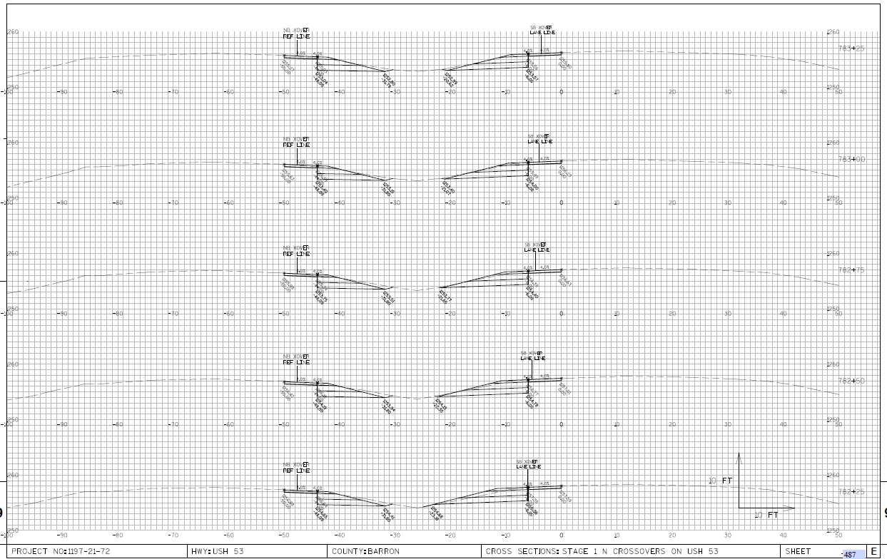
Contractors’ Pre-Bid Use and Benefits of AMG Roadway Models
  Inspection and checking of models, against plans and for constructability, enhanced by 3D visualization.

Slide 23
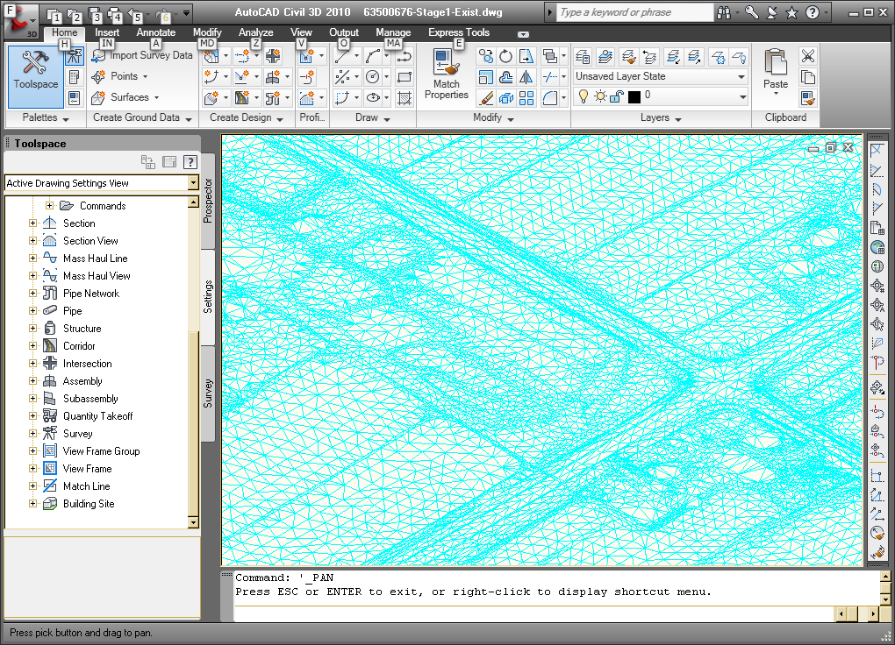
Contractor Pre-Bid Use of Models
Utility of existing surface is extensive.
  Visualization of surrounding area – beyond ROW.
    Reduces uncertainty in project planning.
  Can identify candidate areas for borrow and waste and compute volumes.
    Eliminates need for preliminary site survey.

Slide 24
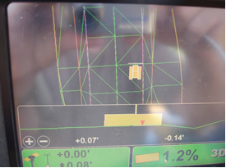
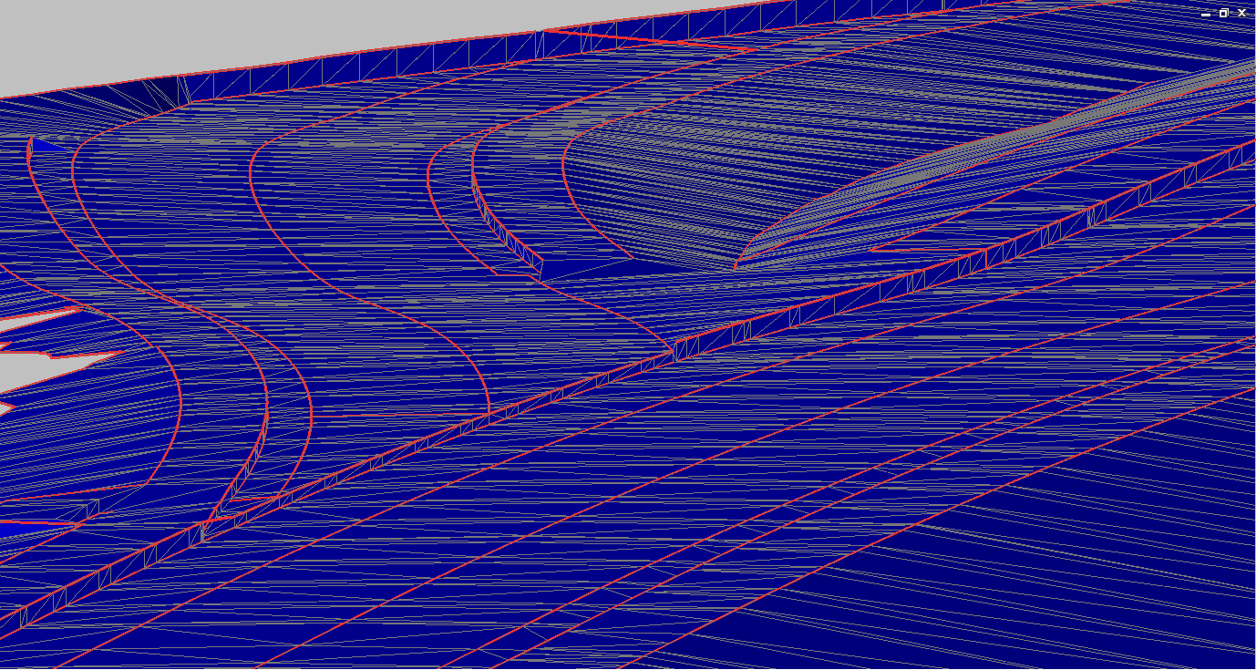
Post-Award and Construction Use and Needs of AMG Roadway Models
  Linear features (e.g., edge of pavement, shoulder breaks, ditch flow lines) needed for construction operations.
    Serve as break lines in models but need separate identification.
  Provide all AMG surfaces (e.g., top of select crushed material).

Slide 25
Construction Activities
All earthwork and some HMA base course by AMG.
Prime contractor, subs, and project engineer use same control for site calibration.
Very little staking.
  Slope stakes, string lines for concrete base course and for paving.
Notes:
al
25

Slide 26
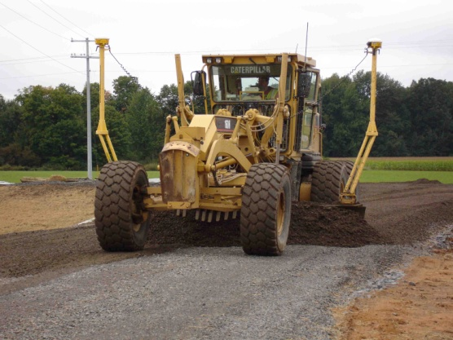
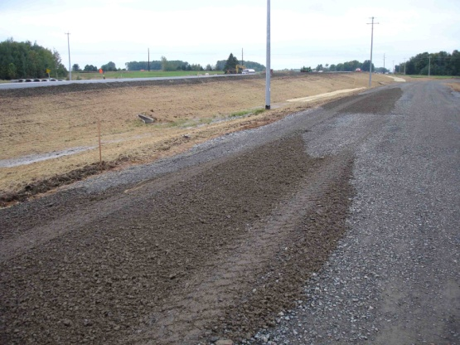
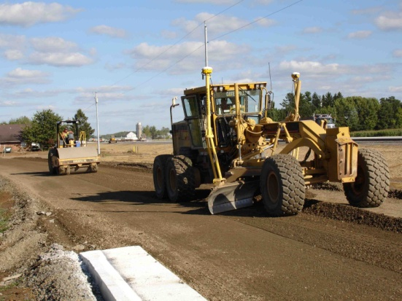
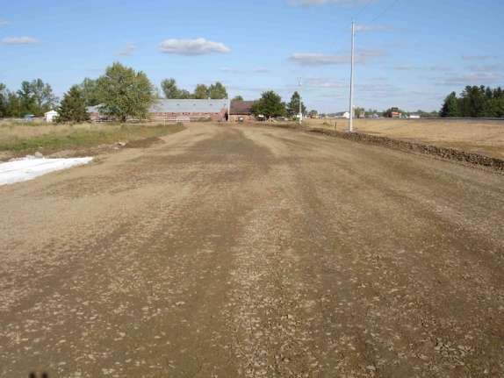
Construction Activities
HMA Base Course Fine Grading First Pass Last Pass
Finished Surface
Notes:
Brad
AhHah – It’s all about the model! We’d been stressing model development throughout all our training sessions and User Group Meetings, but still weren’t fully embracing it. We came from a world where we develop our design data, and then produce our primary deliverable (the plan sheets). We carried that thought process through so that we spend much time using our corridor design tools, and then we get into model development. This old way of thinking isn’t the best way to embrace 3D Design. A better way is to develop the Roadway Model objects at the very beginning of corridor design, and monitor model development as the corridor work progresses. This will prevent any structural problems in the design data which could make surface extraction difficult because the structural problem will be identified when it is created, and will be fixed early on – preventing possible need for rework later in the design process.
26

Slide 27
Construction Activities
HMA base course finished surface checks against plan elevations (ft):
Station Left Center Right
152+50 16’lt (-.03) 0’ (-.04) 16’rt (-.02)
158+00 16’lt (+.02) 0’ (+.05) 16’rt (+.04) 12+50 12’lt (-.06) 0’ (-.03) 12’rt (-.03) 16+00 12’lt (+.01) 0’ (+.03) 12’rt (+.04)
Meets specification but sample is small.
Notes:
Brad
AhHah – It’s all about the model! We’d been stressing model development throughout all our training sessions and User Group Meetings, but still weren’t fully embracing it. We came from a world where we develop our design data, and then produce our primary deliverable (the plan sheets). We carried that thought process through so that we spend much time using our corridor design tools, and then we get into model development. This old way of thinking isn’t the best way to embrace 3D Design. A better way is to develop the Roadway Model objects at the very beginning of corridor design, and monitor model development as the corridor work progresses. This will prevent any structural problems in the design data which could make surface extraction difficult because the structural problem will be identified when it is created, and will be fixed early on – preventing possible need for rework later in the design process.
27

Slide 28
Other Construction Benefits
One model for all AMG operations – all players on same page.
Fewer design revisions during construction – fewer delays.
Engineer can check construction work at will – fewer delays.
Data flows begin to lower barriers between design and construction.
Notes:
Brad
AhHah – It’s all about the model! We’d been stressing model development throughout all our training sessions and User Group Meetings, but still weren’t fully embracing it. We came from a world where we develop our design data, and then produce our primary deliverable (the plan sheets). We carried that thought process through so that we spend much time using our corridor design tools, and then we get into model development. This old way of thinking isn’t the best way to embrace 3D Design. A better way is to develop the Roadway Model objects at the very beginning of corridor design, and monitor model development as the corridor work progresses. This will prevent any structural problems in the design data which could make surface extraction difficult because the structural problem will be identified when it is created, and will be fixed early on – preventing possible need for rework later in the design process.
28

Slide 29
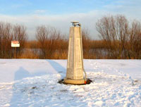
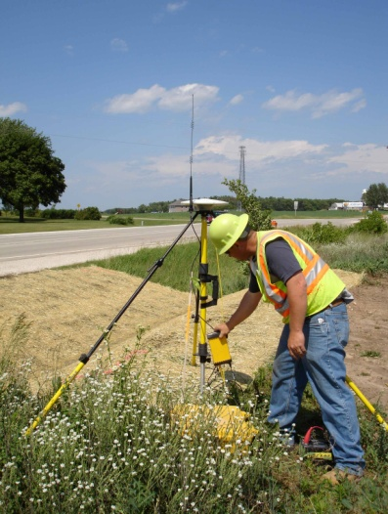
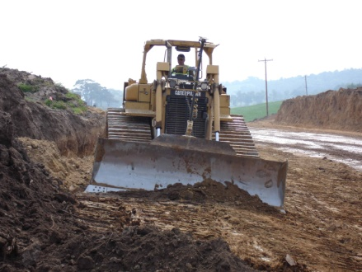
Other Findings from 2011 Pilots
Well-configured, corridor-consistent geodetic control is essential.
WisCORS (real-time network) used extensively for rovers and beginning to be used on machines (potential for elimination of local base station).

