Slide 1
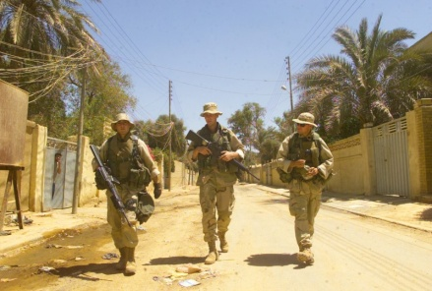


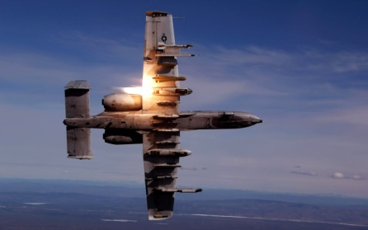

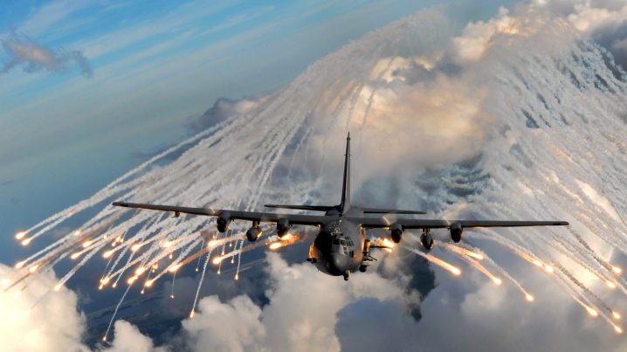

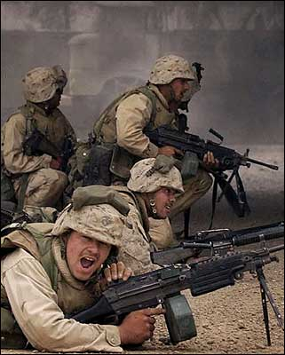
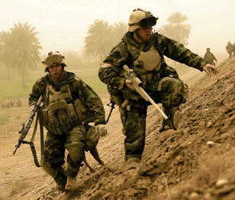
Office of the
Assistant Secretary of Defense
Reserve Affairs
America’s National Guard and Reserve Force
An indispensable, valuable, and operational force for the 21st century
1
Notes:
1

Slide 2


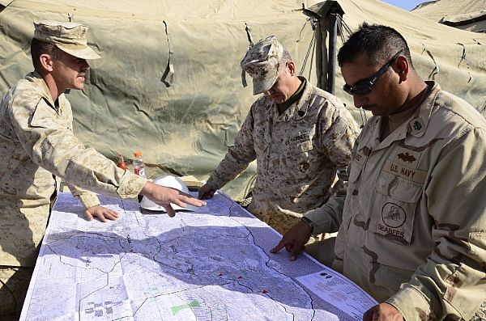



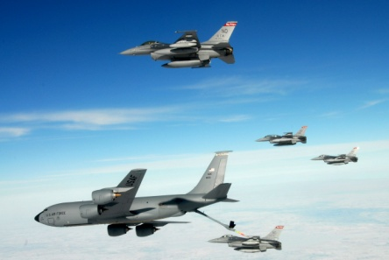
Agenda
Chain of Command
Mission, Vision, & Focus Areas
Organization
Current Major Efforts
Recent Accomplishments
Notes:
2
Next slide, Evolution of USJFCOM

Slide 3




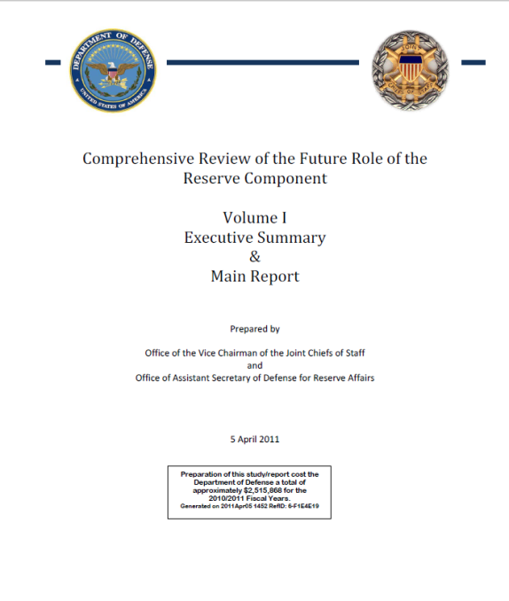
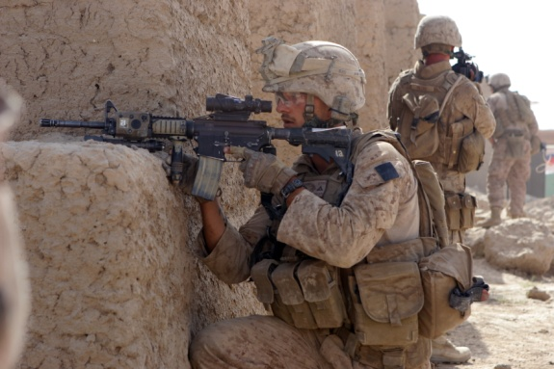
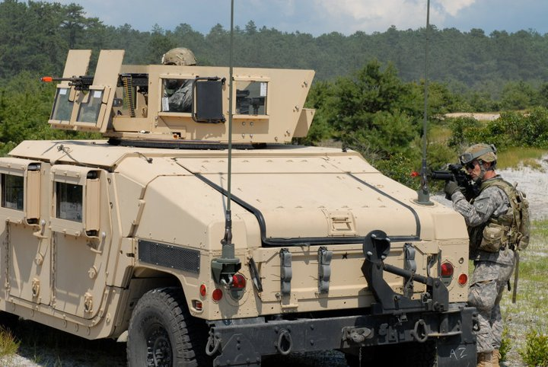
Reserve Affairs Role
Principal advisor to the Secretary of Defense with responsibility for policy, oversight, and support of the seven Reserve Components as part of the Total Force
Notes:
3
Slide owner: Front Office & SIG Members for notes section
The United States Reserve Components complement our military strategy by adding cost effective flexibility. With 1.1 million service members in seven components, they comprise approximately 45% of our nation’s total military force.
The Reserve Components have an operating budget of about $32 billion dollars a year with over $7.7 billion in procurement. They also have over $144 billion dollars in equipment located in nearly 5,000 cities across the United States.
Integrated into our total military force, the part-time nature of their duties requires special laws, regulations, and policies. Because of the special dual role they play as both professional military personnel and responsible civilian citizens in their communities, Reserve Component personnel are a vital link between the military and America's citizenry.
Each Reserve Component contributes to the Total Force in different ways, spanning the spectrum from dedicated peacetime and wartime roles allocated to Reserve Component Forces to contributory support working alongside their Active Service counterparts.
OASD/RA responsibilities are to advise the SECDEF on RC issues and exercise policy oversight over the National Guard and Reserve. The National Guard and Reserve Chiefs report directly to the Chiefs of Staff of their respective Service.
The Reserve Components report directly to the Service Chiefs in their responsibilities to organize, train, man and equip the force. When activated the Reserve units and individuals report to their combatant commander just like the Active force does.
The National Guard Bureau (NGB) is a joint staff of the Departments of the Army and of the Air Force. It is the channel of communications between the Departments of Army and Air Force and the States on all matters pertaining to the National Guard. The primary functions of the NGB deal with coordination between the Services and the States on the policy and resourcing of the National Guard in its federal/national security mission.
The Directors of the Army and Air National Guard are dual-hatted as Service Staff officers and members of the NGB.

Slide 4
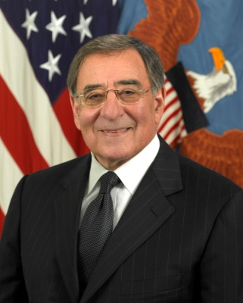
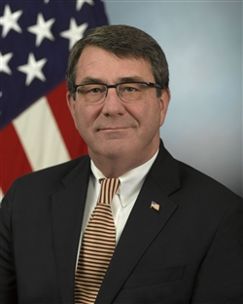
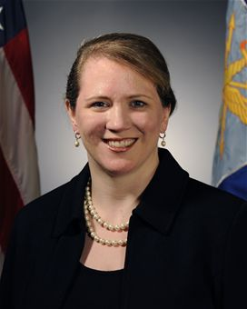
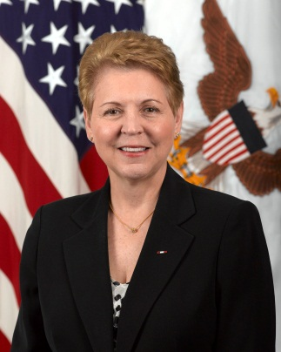
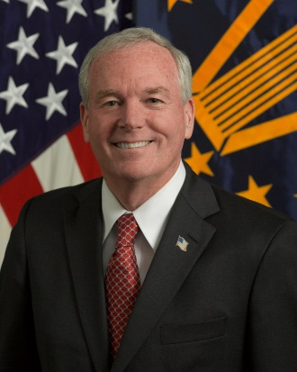
Office of the
Assistant Secretary of Defense
for Reserve Affairs
Chain of Command
Hon. Leon E. Panetta
Secretary of Defense
Hon. Ashton B. Carter
Deputy Secretary of Defense
Hon. Jessica L. Wright
Acting Under Secretary of Defense
Personnel and Readiness
Mr. Richard O. Wightman
Acting Assistant Secretary
of Defense Reserve Affairs
4
Notes:
Slide owner: Front Office & SIG Members for notes section
This is our chain of command. Our office works under the USD/P&R.

Slide 5
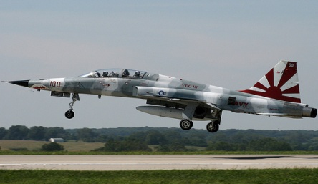
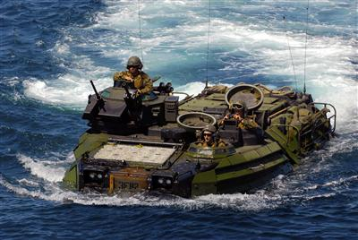

Assistant Secretary of Defense
for Reserve Affairs
Mission
Our mission is to serve as the principal advisor to the Secretary of Defense with responsibility for
policy, oversight, and support of the seven Reserve Components as part of the Total Force.
Vision
Through policy and legislative development, ensure operational and strategic Reserve Components
that are seamlessly integrated with the Total Force supporting national security at home and abroad.
Focus Areas
          Support National Security at Home and Abroad
          Support RC Members, Families, and DoD Outreach in Communities
          Engage in and Improve Existing Processes
          Support Total Force Policies
          Leverage Strategic Communications
Notes:
SIG

Slide 6
Organization
Office of the
Assistant Secretary of Defense for Reserve Affairs
Mr. Richard O. Wightman
Manpower & Personnel
Ms. Elizabeth Wilson
Readiness, Training, & Mobilization
Mr. Paul Patrick
Resources
Mr. John Hastings
Family & Employer Programs & Policy
Mr. Ron Young
Reserve Forces Policy Board
Maj Gen
James Stewart
Senior Enlisted Advisor
SGM
Mike Schultz
Acting Principal Dep.
Materiel & Facilities
Mr. Rich Wightman
Principal Military Stakeholders
Principal Military Stakeholders
Chief, National Guard Bureau
Chief, National Guard Bureau
Chief of Army Reserve
Chief of Navy Reserve
Chief of Air Force Reserve
Chief of Army Reserve
Chief of Navy Reserve
Chief of Air Force Reserve
Director, Army National Guard
Commander, Marine Forces Reserve
Director, Air National Guard
Director, Army National Guard
Commander, Marine Forces Reserve
Director, Air National Guard
Director of Reserve & Leadership, USCG
Director of Reserve & Leadership, USCG
6
Notes:
Slide owner: Front Office
5

Slide 7

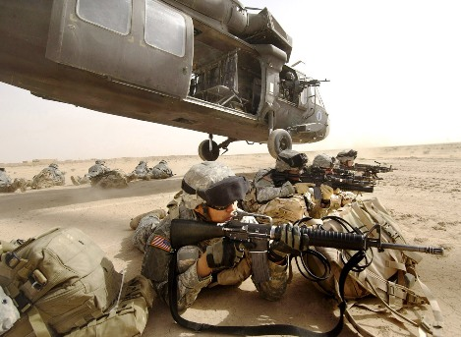
Manpower & Personnel
(M&P)
Mission: The Manpower and Personnel Deputate is responsible for all Reserve component manpower, personnel, compensation, and medical matters, and is responsible for the following functions: Personnel and Medical Policy and Procedure Development, Manpower Program Analysis, Reserve Component Personnel Program Management and Reserve component personnel related legislative change proposals.
Manpower, Legislation and Systems Directorate
Manpower Policy
Manpower Accountability
Personnel and Pay Systems
Congressional Manpower Compliance
Reserve Components Common Personnel Data System (RCCPDS) Management
Reserve Component Legislative Proposals
Military Personnel Directorate
Personnel Policy
Pay and Compensation
Military Education
Recruiting and Retention Policy
Attrition and Reenlistment Policy
Congressional Reporting
Medical Policy Directorate
Individual Medical Readiness
Individual Dental Readiness
Reserve Component Medical Policy
Reserve Component Screening
Integrated Disability Evaluation System
7
7
Notes:
Slide owner: M&P (Mr. Tom Liuzzo)
Manpower, Legislation and Systems Directorate (DoDD 1200.7, DoDI 1200.15, DoDD 1205.5, DoDI 1205.19, DoDI 1215.06, DoDI 7730.54, DoDI 7730.54-M, Vol 1&2, & DoDI 7770.3)
Military Personnel Directorate (DoDI 1205.18, DoDD 1205.20, DoDI 1215.07, DoDI 1215.13, DoDI 1215.17, DoDI 1235.09, DoDI 1235.11, DoDD 1235.13, DoDI 1235.14, DoDI 1304.25, DoDI 1322.17 & DoDD 1352.1)
Medical Policy Directorate (DoDD 1241.1 & DoDI 1241.2)
5

Slide 8
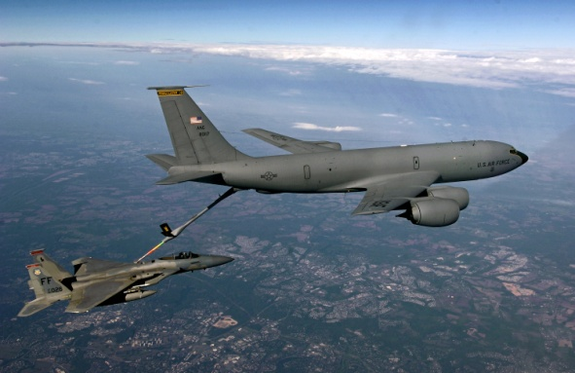

Readiness, Training, & Mobilization
(RT&M)
Mission: Advise the Assistant Secretary of Defense for Reserve Affairs on policies, programs and legislative proposals pertaining to the readiness, training, and mobilization of the Reserve Components for both domestic and expeditionary missions.
Readiness Directorate
Promote effective use of the Reserve Components (RC) as part of the operational force for planned and emerging missions
Promote RC positions in DoD strategic guidance documents
Provide expertise, promote RC roles and represent P&R in Intelligence and Cyber forums
Develop concepts for future RC roles and missions
Promote sufficient readiness and resourcing of RC forces to meet national requirements
Provide advice and recommendations on force structure and force mix
Training Directorate
Review and evaluate DoD Training and Education programs for RC suitability
Evaluate Force Generation training practices for RC effectiveness
Manage the Innovative Readiness Training program
Manage international programs: Reserve Officer Foreign Exchange Program;
NATO National Reserve Forces Committee; RC attendance at NATO School
Mobilization Directorate
              Manage RC access (mobilization) policy
Analyze and report Reserve mobilization utilization and operational support
Provide senior leadership with mobilization decision support via the SECDEF Orders Book
Monitor the global security environment to ensure documentation to access the RC is prepared
Defense Support to Civil Authorities (DSCA) Directorate
Provide RC DSCA and Homeland Defense utilization and policy advice to senior leadership and the interagency
Advise the ASD(HD) on RC matters within the Council of Governors
Support RC involvement in the Chemical, Biological, Radiological, Nuclear Consequence Management Enterprise
8
Notes:
Slide Owner: CAPT Baxter
Readiness Directorate (DoDD 1200.17)
Training Directorate (DoDD 1100.20, DoDD 1200.16 and DoDD 1215.15)
Mobilization Directorate (DoDD 1235.10 & DoDI 1235.12)
Defense Support of Civil Authorities (DSCA) Policy Directorate (DoDD 5105.83)
5

Slide 9
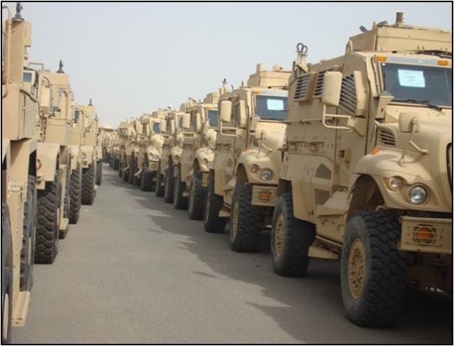

Materiel & Facilities
(M&F)
Mission: The Materiel & Facilities Deputate serves as the advisor to the Assistant Secretary of Defense (Reserve Affairs), with specific responsibility for exercising policy guidance and overall supervision of Guard and Reserve materiel, maintenance, equipment support and sustainability, construction, and facilities.
Materiel Directorate
Responsible for developing Department of Defense (DoD) materiel policies which support
and promote Total Force readiness goals and objectives.
Focuses on materiel, maintenance, and logistical matters.
Analyzes, reviews and evaluates policies, plans, programs, and issues affecting the RCs.
Oversight and supervision of an inventory of $172 billion of RC equipment. Oversight includes
new procurement, distribution, maintenance, overhaul, and final disposition.
~$7 billion/year in new procurement, and ~ $21 billion in procurement cycle at a given time.
Oversight of $2.5 billion of Depot Maintenance funding.
Facilities Directorate
Responsible for developing DoD facility policies which support and promote joint construction
requirements per U.S. Code, Title 10
Military Construction (MILCON).
Facility Sustainment, Restoration and Modernization (S/RM).
Sustainability, Energy, and Environment.
Policy and oversight responsibility for over $1.23 billion in RC MILCON, $1.34 billion in RC
Facility S/RM, $2.69 billion in RC Base Operating Support (BOS), and $229 million in RC
Environmental programs.
Policy and oversight responsibility for an $85 billion Reserve component facilities inventory,
which includes 43,475 buildings at 4,921 locations.
Participates as member of OSD Base Realignment and Closure (BRAC) working groups;
provides cradle-to-grave review and analysis of recommended RC facilities/installations
Notes:
Slide owner: Materiel & Facilities (Mr. Matt Dubois)
Materiel Directorate (DoDD 1225.6 and DoDI 4140.58)
Facilities Directorate (DoDD 1225.07 AND DoDI 1225.8)--Oversight for monitoring compliance to Title 10 U.S.C., Chapter 1803, Facilities for RCs
5

Slide 10
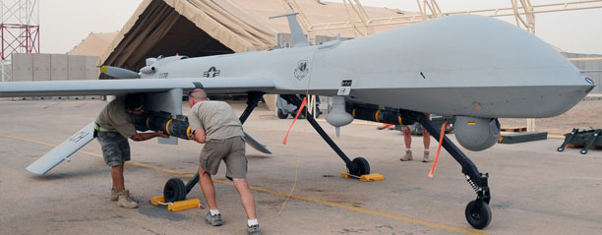

Resources
Mission: The Resources Deputate serves as the advisor to the Assistant Secretary of Defense (Reserve Affairs) on all matters pertaining to Planning, Programming, Budgeting and Execution System within the Department of Defense, and is responsible for policy and funding oversight of the Reserve Components’ budget to seek efficiencies in current and future financial operations.
Program and Budget Directorate
Oversight of the PPBES process for the development of the $50 billion annual
Guard and Reserve Component appropriations, supporting over one million personnel.
Set the resourcing conditions for a sustainable, seamlessly integrated and
complementary total force.
Program Integration Directorate
Reserve Affairs integration and liaison for Congressional Oversight and Appropriations Committees in coordination with USD (Comptroller) and ASD (Legislative Affairs).
  To ensure fair consideration of RC programs and resources at all levels through targeted congressional and legislative activities.
Youth Programs Directorate
Policy and funding oversight of National Guard Youth Challenge Program and
DoD STARBASE Youth Program.
Human Resources and Enterprise Support Directorate
Maintain administrative services, support and operations for Reserve Affairs .
Responsible for the planning and support functions for Reserve Affairs.
Systems Directorate
Monitor Defense Information Management and Information Technology Programs.
Responsible for administrative and technical support of RA’s information technology systems.
Notes:
Slide owner: Resources (LTC Mike O’Toole)
5

Slide 11




Family & Employer Programs & Policy
(FEPP)
Vision: To foster a culture in which all employers support and value the employment and military service of members of the National Guard and Reserve in the United States.
Mission: ESGR facilitates and promotes a cooperative culture of employer support for National Guard and Reserve service by developing and advocating mutually beneficial initiatives; recognizing outstanding employer support; increasing awareness of applicable laws and policies; resolving potential conflicts between employers and service members; and acting as the employer’ principal advocate within DoD.
Vision: A ready and resilient National Guard and Reserve Force successfully navigating the challenges of deployments.
Mission: To promote the well-being of National Guard and Reserve members, their families and communities, by connecting them with resources throughout the deployment cycle.
www.esgr.mil
www.yellowribbon.mil
Vision: Ready and resilient National Guard, Reserve members and families.
Mission: Advocate for policies and programs that support a ready and resilient Guard and Reserve Component Force. Facilitate the linking of and access to those community resources that support military members and families.
Notes:
Slide owner: FEPP (Mr. Ted Fessel)
The Family & Employer Programs & Policy (FEPP) stood up in 2010 as directed by, then, Secretary McCarthy where he placed these three programs under one Director.
- Purpose to allow for an opportunity to have these three programs and mission areas to work closely together, collaborate and coordinate in order to find synergy and efficiencies as a result, ultimately enhancing all three programs productivity and mission success.
- This new Directorate is responsible for the “TRIAD of SUPPORT”: Family, Service and Civilian Employer. Bottom line, a lot of compatibility inherent in all three missions and programs.
5

Slide 12

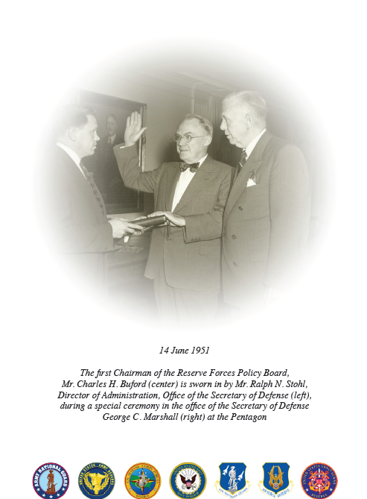

Reserve Forces Policy Board
(RFPB)
Congressional Statute: Title 10, United States Code, Section 10301
Mission: The RFPB shall serve as an independent adviser to the Secretary of Defense to provide advice and recommendations to the Secretary on strategies, policies, and practices designed to improve and enhance the capabilities, efficiency, and effectiveness of the reserve components.
The RFPB acts independently to monitor, review and evaluate proposals, actions and situations impacting the National Guard and Reserve forces and, as provided in 10 USC 113, reports annually (transmitted by the Secretary of Defense) to the President and Congress.
Independent entity that closely coordinates with Assistant Secretary of Defense for Reserve Affairs, but not within the organizational structure.
  Composition:
  RFPB consists of 20 members, including the Chairman, Senior Military Executive, Senior Enlisted Advisor, representatives from each of the seven Reserve & National Guard Components as well as 10 at-large members selected from both civilian and military communities.
Serving in a position of Trust and Confidence for 60 years:
The RFPB has been a valued advisory group to the Secretary of Defense since June 1951.
Just as the military has evolved to meet the challenges of the 21st Century, the RFPB’s transition will better address the challenges of the Operational Reserve component of the Total Force.
At-large members facilitate input by relevant stakeholders such as families, employers, and caregivers.
http://ra.defense.gov/rfpb
Notes:
Slide owner: RFPB (Col Obata)
5

Slide 13







The Seven Reserve Components
1.1 Million Soldiers, Sailors, Airmen, Marines and Coast Guardsmen
Federal Missions
7 Reserve Components
Federal and State Missions
Notes:
Slide owner: Front Office
There are seven Federal Reserve Components in three military Departments. Without a presidential declaration of national emergency, Federal military forces cannot be directly used for law enforcement.
The seventh Reserve Component, the Coast Guard Reserve, although a naval force, belongs to the Department of Homeland Security in time of Peace, just like the Active Coast Guard. Upon declaration of war, or when directed by the President, the Coast Guard reverts to the Department of the Navy. In their Homeland Security role, they can and do participate in law enforcement.
The Army and Air National Guard also comprise the organized militias. They are unique in that they have both a Federal and a State mission. In their state status, they can be used to enforce state laws.
Within this briefing, the term “Reserves” refers to the National Guard and the Service Reserves, including the Coast Guard Reserve, unless specified otherwise.
The Ready Reserve consists of the Selected Reserve and Individual Ready Reserve. The Selected Reserve is comprised of units (companies, battalions, squadrons, brigades, wings, groups and divisions) and individuals designated as essential to contingency or wartime missions. They are paid and train a minimum of 39 days per year.

Slide 14

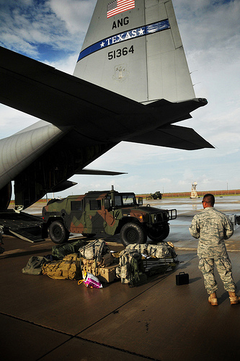
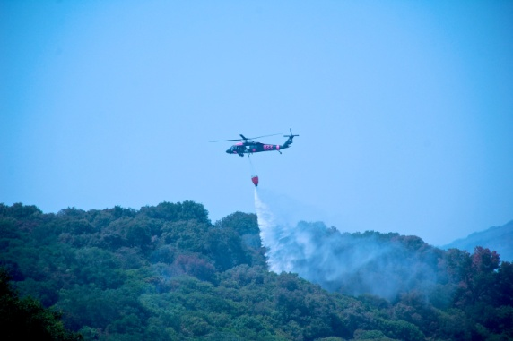
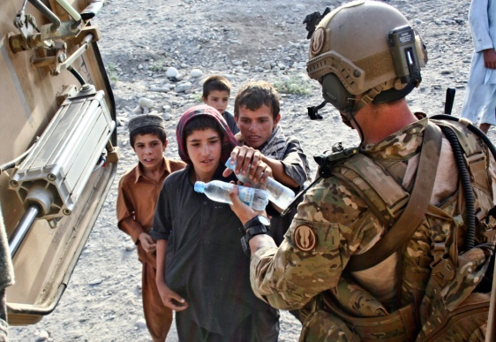
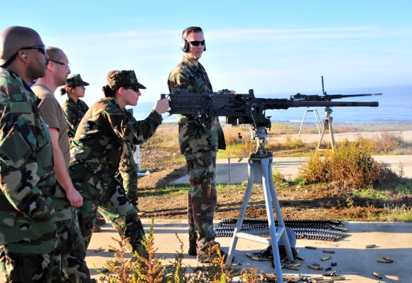
Reserve Component
Key Statistics
U.S. Reserve Components (FY 2011):
People: 1.1 million members of the Ready Reserve
Budget: $49.6 billion
Equipment: $162 billion in inventory with $7.1billion in new procurement
Facilities: $85 billion in inventory in 43,475 structures at 4,921 locations
Force Manpower: About 43% of Total Military Force
Reserve Components differ from Active Components:
Special laws, regulations and policies
Role of citizen-warrior and State domestic missions
Each Reserve Component has different characteristics:
Seven components in five branches of the military
Differing State and territorial laws shape National Guard peacetime use
As of 1 OCT 10
Notes:
Slide owner: Front Office
Statistics from the Deputates’ respective SIG Team member
5

Slide 15
Ongoing RA Engagements
(1 OF 2)
Readiness Management Group
Military Intelligence General Officer Steering Committee
Security Force Assistance General Officer Steering
Committee
Defense Planning Guidance
Council of Governors Consultative Process
Department of Homeland Security (DHS) – DoD
Collaboration Group
Complex Catastrophes Senior Steering Committee
Reserve Component Chiefs Meeting
RFPB & Service Reserve Policy Board Meetings
Legislative Engagements
Compensation Reform
Unified Legislation and Budgeting Process Initiatives FY15
Collaboration with VA on Health Benefits System Architecture
15
Notes:
Manpower, Legislation and Systems Directorate (DoDD 1200.7, DoDI 1200.15, DoDD 1205.5, DoDI 1205.19, DoDI 1215.06, DoDI 7730.54, DoDI 7730.54-M, Vol 1&2, & DoDI 7770.3)
Military Personnel Directorate (DoDI 1205.18, DoDD 1205.20, DoDI 1215.07, DoDI 1215.13, DoDI 1215.17, DoDI 1235.09, DoDI 1235.11, DoDD 1235.13, DoDI 1235.14, DoDI 1304.25, DoDI 1322.17 & DoDD 1352.1)
Medical Policy Directorate (DoDD 1241.1 & DoDI 1241.2)
5

Slide 16
Ongoing RA Engagements
(2 OF 2)
Army FORSCOM/TRADOC RC GO Conference
Army FORSCOM Training Conferences / Training GOSC
Credentialing & Licensing Task Force
OSD/Joint Staff Study Groups (AC-RC Mix)
Decades of War Lessons Learned
Defense Support of Civil Authorities
BRAC and Potential RC Implications
New Equipping the Reserve Forces Instruction and Equipment
Transparency
Program of Memorandum (POM-14) Issue Teams
Oversight of RC Development of FY-14 President’s Budget
Yellow Ribbon Reintegration Program
Quadrennial Defense Review (QDR)
Defense Readiness Reporting System (DRRS)
16
Notes:
Manpower, Legislation and Systems Directorate (DoDD 1200.7, DoDI 1200.15, DoDD 1205.5, DoDI 1205.19, DoDI 1215.06, DoDI 7730.54, DoDI 7730.54-M, Vol 1&2, & DoDI 7770.3)
Military Personnel Directorate (DoDI 1205.18, DoDD 1205.20, DoDI 1215.07, DoDI 1215.13, DoDI 1215.17, DoDI 1235.09, DoDI 1235.11, DoDD 1235.13, DoDI 1235.14, DoDI 1304.25, DoDI 1322.17 & DoDD 1352.1)
Medical Policy Directorate (DoDD 1241.1 & DoDI 1241.2)
5

Slide 17
Recent RA Accomplishments
Comprehensive Review of the Future Role of the Reserve
Component implementation plan
12304a domestic response legislation
  Hurricane Sandy
12304b preplanned use of RC for COCOM missions; DPG
service requirements to report on implementation plans
Hero to Hire (H2H) program
Denmark added to Reserve Officer Foreign Exchange
Program (ROFEP)
Electronic-Based Distributed Learning & AT/GMT initiative
JPME II credit for senior service college distance learning
courses
Regionally Integrated Training Environment (RITE)
17
Notes:
Manpower, Legislation and Systems Directorate (DoDD 1200.7, DoDI 1200.15, DoDD 1205.5, DoDI 1205.19, DoDI 1215.06, DoDI 7730.54, DoDI 7730.54-M, Vol 1&2, & DoDI 7770.3)
Military Personnel Directorate (DoDI 1205.18, DoDD 1205.20, DoDI 1215.07, DoDI 1215.13, DoDI 1215.17, DoDI 1235.09, DoDI 1235.11, DoDD 1235.13, DoDI 1235.14, DoDI 1304.25, DoDI 1322.17 & DoDD 1352.1)
Medical Policy Directorate (DoDD 1241.1 & DoDI 1241.2)
5

Slide 18
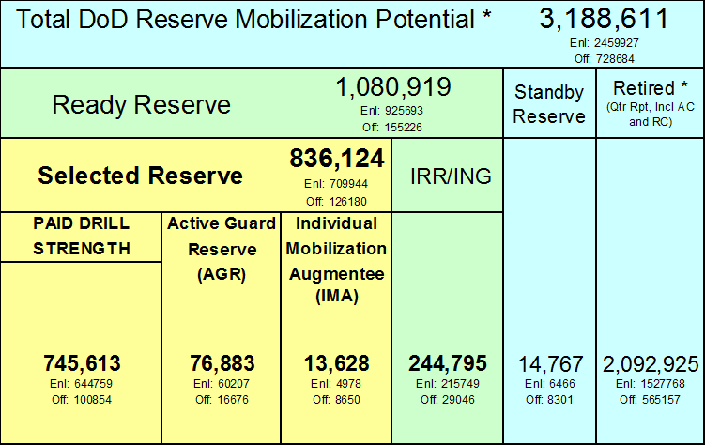
Department of Defense
Reserve Component Strength
Source: DMDC Strength Summary Report – December 2012
Notes:
Slide owner: M&P (Mr. Tom Liuzzo)
5

Slide 19
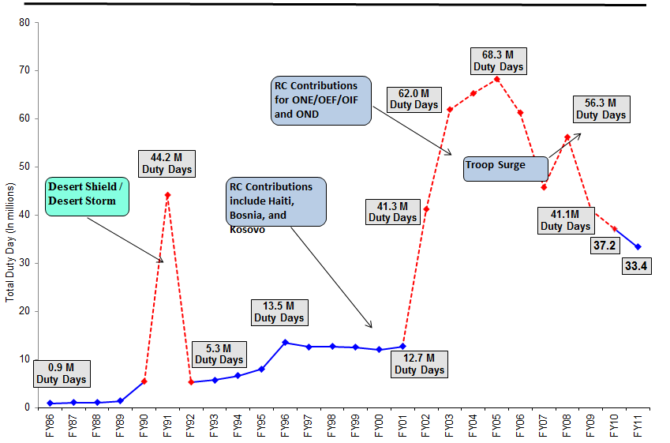
Reserve Component Contributions
(Evolving Operational Force)
Notes:
Slide owner: M&P (Mr. Tom Liuzzo)
Duty Days are the summation (in days) of all the Reserve components who contributed support to Counter Drug Operations, Domestic Emergencies, exercise support, and support to the COCOMs. This includes mobilizations in support of contingencies

Slide 20
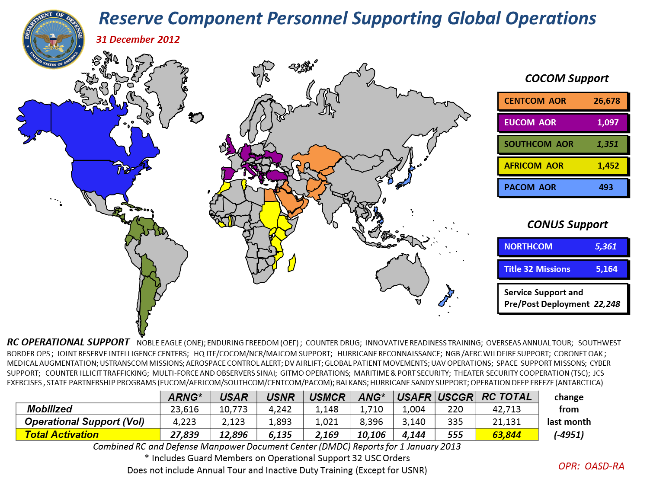
Notes:
Slide owner: COL Patriquin

Slide 21
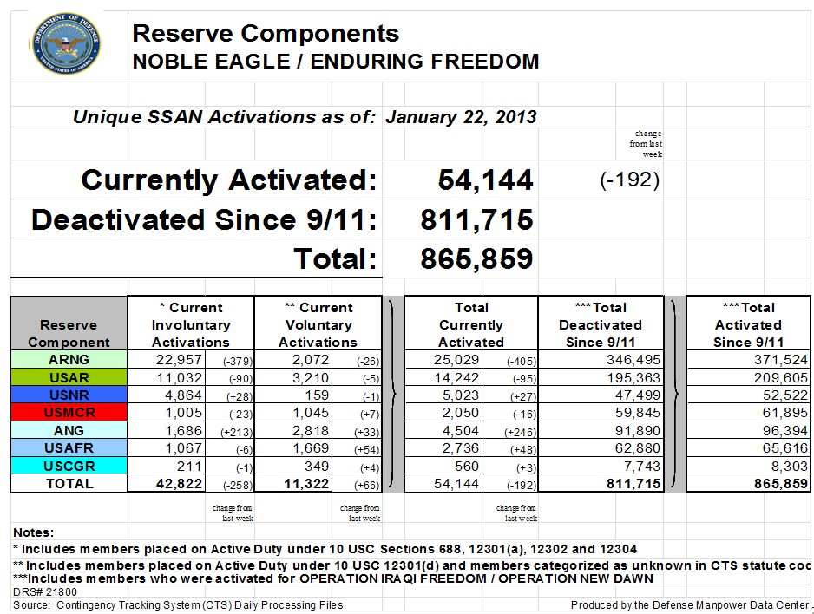
Notes:
OPR: Col Louis Patriquin

Slide 22
RC Casualties
NOBLE EAGLE / ENDURING FREEDOM / IRAQI FREEDOM / NEW DAWN
As of January 3, 2012
Total Cumulative 9/11 to date:
RC KIA: 901
Deaths: 1,223
Currently Mobilized: 55,217
Source for Casualty Data: DMDC OCO Casualties by Component Report. From Oct 7, 2001 thru Jan 3, 2013.
Source for Currently Mobilized: DMDC Contingency Tracking System. From Oct 7, 2001 thru Jan 1, 2013.
Notes:
Slide owner: M&P (Mr. Tom Liuzzo)

Slide 23

Special Topics

Slide 24
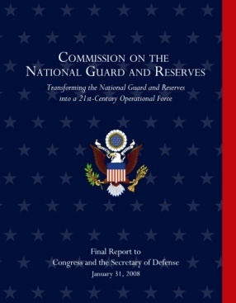
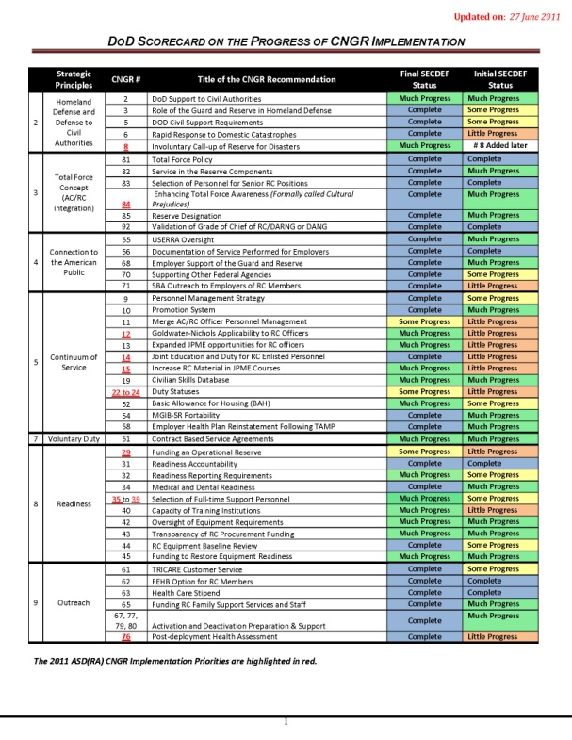
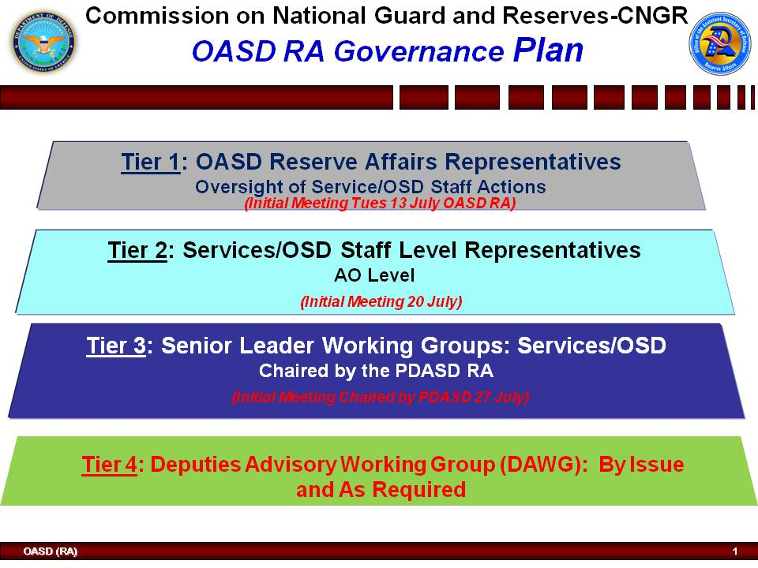
Commission on the
National Guard and Reserves
Implementation & Governance
Notes:
Slide owner: Strategic Integration (Lt Col Lawrence Colby)
**Recommendations needing ongoing action are asterisked.(**)
OASD RA Governance Plan Composition:
The Office of the Assistant Secretary of Defense for Reserve Affairs was designated as lead office for providing oversight to the implementation plans. An effective 4-Tiered governance process was established. Tier 1 and/or 2 level working group was comprised of Reserve Affairs personnel and Action Officers of the Services and representatives from the National Guard Bureau, Joint Staff and other DOD offices.
The Tier 3 Senior Leader working group was comprised of representatives at the Senior Executive and General/Flag levels from the Services, the Joint Staff, the Combatant Commands and designated offices of the Fourth Estate. The goal was to resolve issues at the lowest level possible and therefore Tier 4 was not required to this point.
DOD made a self-assessment of the status of implementation on each of the 54 recommendations and held regular governance meetings to track progress. A “Scorecard” was used to track regular progress. Recommendations whose status is designated as complete, have been deemed to require no further implementation actions, or have already been incorporated into the normal business practices of the targeted Service/Agency. Those recommendations identified as “on-going” are valid initiatives that would benefit from continued oversight from another governance body that is better positioned to achieve the directed results.
Significant progress has been made since the final report was published by the CNGR Commission. Implementation plans continue to be worked in the Department of Defense, as needed.
Completed by COL Susan Kolb, Strategic Initiatives and Integration, OASD(RA)
5

Slide 25
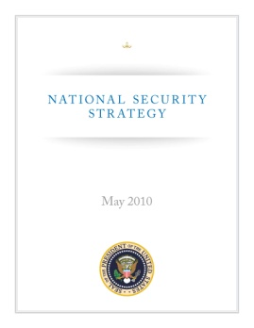

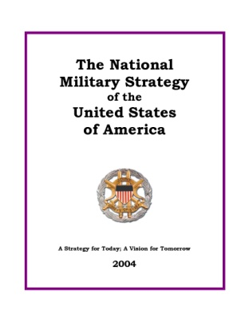
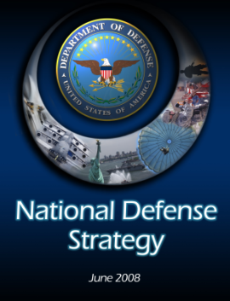
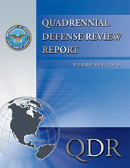
21ST Century Reserve Force
Ready, relevant, integrated
An operational force that is the “force of first choice” for well suited missions and a strategic reserve that can surge required capability increases at a time of national crisis
National Security
National Security Strategy
Commission on the National
Guard and Reserves
National Defense
National Defense Strategy
National Military Strategy
Quadrennial Defense Review
Joint Operating Environment
GDF/GEF/DPPG
Reserve Affairs
QDR Comprehensive RC Review
RC 2020
Integrated Training Environment
Comprehensive Review of the Future Role of the Reserve Component
Strategic alignment in direct support of U.S. National Security and Military Mission
Notes:
Slide owner: RT&M (CAPT Baxter)

Slide 26
Comprehensive Review
of the Future Role
of the Reserve Component
BACKGROUND
The 2010 Quadrennial Defense Review directed the analysis, which was co-sponsored by the VCJCS and ASD(RA) and drew participation from 24 organizations.
The review focused on costs, uses, roles, standards, rebalancing, and law and policy changes that will impact the Reserve Component’s role in the Total Force for the next generation and beyond.
RESULTS & WAY AHEAD
The report proposes options to enhance Total Force capabilities, mitigate stress on the Total Force, efficiently use DoD resources, and utilize the RC in roles for which they are well suited.
Each Service is addressing these rebalancing options as they evolve to meet the ever-changing operational environment.
Key recommendation topics include Continuum of Service, Access, Civilian Skills, Pay & Status, Rebalancing, Sourcing, and Training & Readiness.
These findings and recommendations will elicit key changes to law, policy and doctrine that will help preserve the Total Force, engender efficiency, increase capacity, and expand capabilities.
The report’s recommendations are being implemented throughout the Department utilizing existing processes and via coordinated effort among key stakeholders.
“This report offers compelling analysis regarding the future role of the RC.”
--Secretary Gates
Notes:
Slide owner: RT&M (CAPT Dwayne Baxter)
5

Slide 27


Youth Programs
ASD/RA designated responsibility for exercising the authority of the SecDef to manage the DoD STARBASE Program and National Guard Youth Challenge Program
National Guard Youth Challenge Program
Purpose: To raise the interest and improve knowledge and skills of students in kindergarten through twelfth grade in science, technology, engineering and mathematics (STEM). The program targets "at risk" (minority and low socio-economic) students and utilizes instruction modules specifically designed to meet specific STEM objectives.
Military commanders through the Secretaries of the Military Departments are responsible to the ASD/RA for administering and conducting the program.
STARBASE currently operates on predominantly Reserve and Guard installations at 76 locations in 40 states (to include Native American Reservations), D.C, and one territory. Approximately 75,000 students participate in the program from over 1200 public schools and 385 public school districts.
The elementary school program is currently designed to provide 20-25 hours of hands-on instruction and to reach students at the fifth grade level. In partnership with local public school districts, the middle school and high school program is an afterschool STEM mentoring program.
Purpose: To improve the life skills and employment potential of participants by providing military-based training and supervised work experience, together with the core program components of assisting participants in attaining a high school diploma or its equivalent, leadership development, promoting fellowship and community service, developing life coping skills as well as job skills, and improving physical fitness, health and hygiene.
Chief, National Guard Bureau is responsible to the ASD/RA for administering the program through cooperative agreements with the states.
NGYCP currently operates in 27 states, the District of Columbia and Puerto Rico with about 9,000 graduates annually. The 17 month program consists of two phases(residential and post-residential and is for 16-18 year old high school dropouts, who are unemployed, drug free, and not involved with the criminal justice system.
Notes:
Slide owner: Resources (Mr. Ernie Gonzales)
5

Slide 28

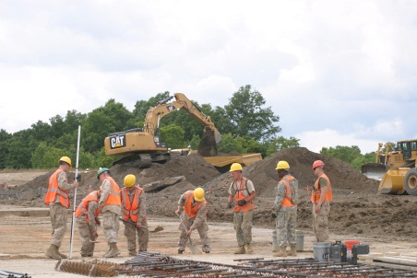
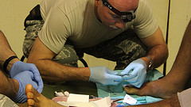



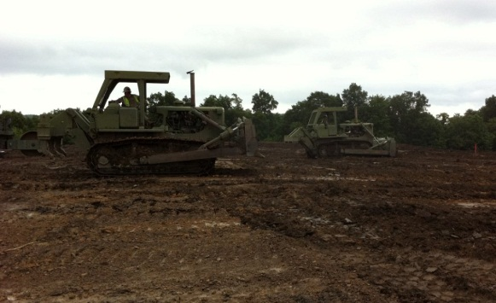
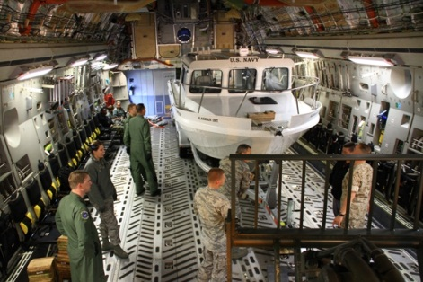
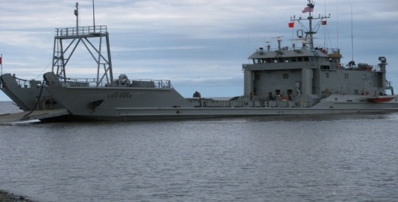
Innovative Readiness Training
The Innovative Readiness Training Program (IRT) is authorized under 10 U.S.C. 2012 and operates in the US, its territories and possessions, and the Commonwealth of Puerto Rico.
Provides for a civilian-military partnership where Military Combat Support and Combat Service Support Units & Personnel with Specific Training Requirements (mission essential task list/pre-deployment training) assist with meeting the needs of an underserved civilian community.
This is a volunteer program for the Services; OASD/RA has no tasking authority.
FY13 IRT Program
  Major training events:
    Engineering: Mertarvik (AK), Boy Scouts (WV)
    Medical: Arctic Care (AK), Mississippi (MS)
FY13 IRT Program
  Communities and services have submitted applications
  Anticipating $20M budget
Notes:
Slide owner: RT&M (CAPT Trueblood)
5

Slide 29
Employment Initiative Program
Hero2Hired
Mission: Promote career readiness in order to enhance civilian employment across the seven Reserve Components.
End State: An infusion of currently serving Reserve Component service members into the public and private workforce in careers that reflect and reward their talent and dedication, and their commitment to the United States and its best values.
High Tech with High Touch Network: Hero2Hired is a powerful, comprehensive career readiness program. Includes H2H.jobs website, résumé builder, military skills translator, job search and career exploration, mobile apps and social networking.
- Placement of 56 contracted Employment Transition Coordinators (ETC) in all 50 States, Territories and the District of Columbia to provide Service member employment assistance, case management and program administrative level support.
www.H2H.jobs
29
Notes:
Slide owner: FEPP (Mr. Ted Fessel)
New Yellow Ribbon Reintegration Program (YRRP) and Employer Support of the Guard and Reserve (ESGR) mission. This new mission is articulated in ESGR’s Strategic Plan FY11-15.
The Program is resourced by YRRP and supported by ESGR.
Purpose to support activities and engage with Strategic Partners to seek ways to find and create civilian employment opportunities for RC Service Members and their families. Also to leverage ESGR’s network of over 4,700 volunteers to engage at the state and local levels.
Key Strategic Partners include: DOL-VETs; VA; OPM and SBA
Also working with some appropriate Non-Federal Entities: Best example the Society for Human Resource Management (SHRM)
- Key tool is the Hero2Hired (H2H) website where employers and service members may post available jobs and resumes. Tangible resource and mechanism to find employment the link is: http://www.H2H.jobs
5

Slide 30
Transparency and Accountability
of Reserve Equipment Procurement
Unlike all other areas of the Defense budget, there is no Reserve appropriation for equipment that mirrors the Active force. The Reserve Components rely on the Active procurement account and the Congressional addition called National Guard and Reserve Equipment Appropriation.
The key is to know how much of the Active procurement appropriation is intended for the Reserve components and follow the money. We refer to this process as the Equipment Transparency continuum.
CNGR 42/43 Equipment Transparency Report
DoDD 1225.6
Funding Request
Appropriation
Projected Deliveries
Actual
Deliveries
Equipment Withdrawn or Diverted from RC
RC resources tracked and
protected by ETR
RC resources tracked and protected by DoDD 1225.6
Notes:
Slide owner: M&F (Mr. Matt Dubois)
5

Slide 31

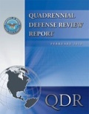
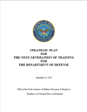
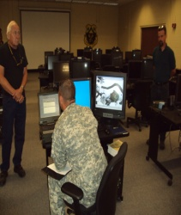
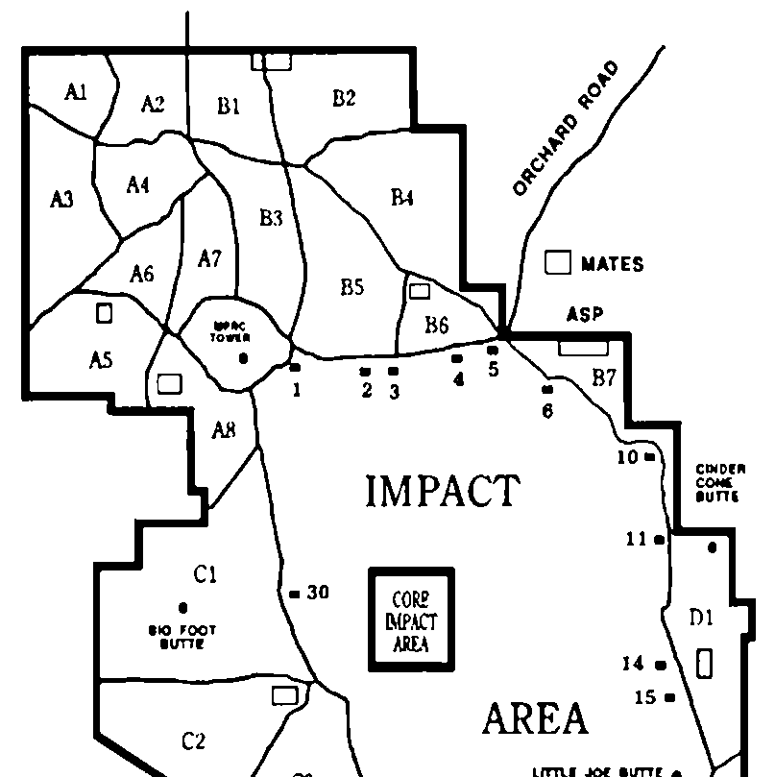
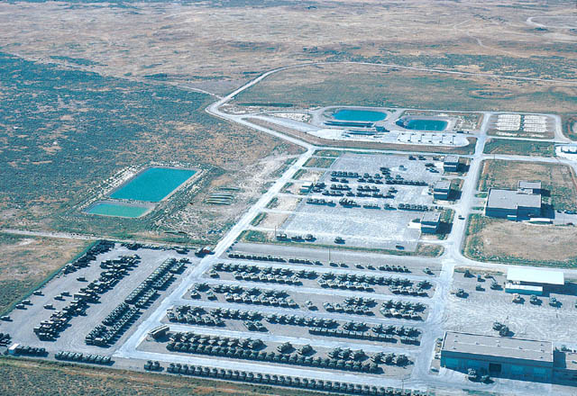
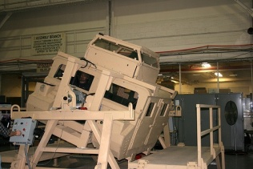
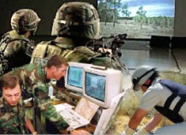
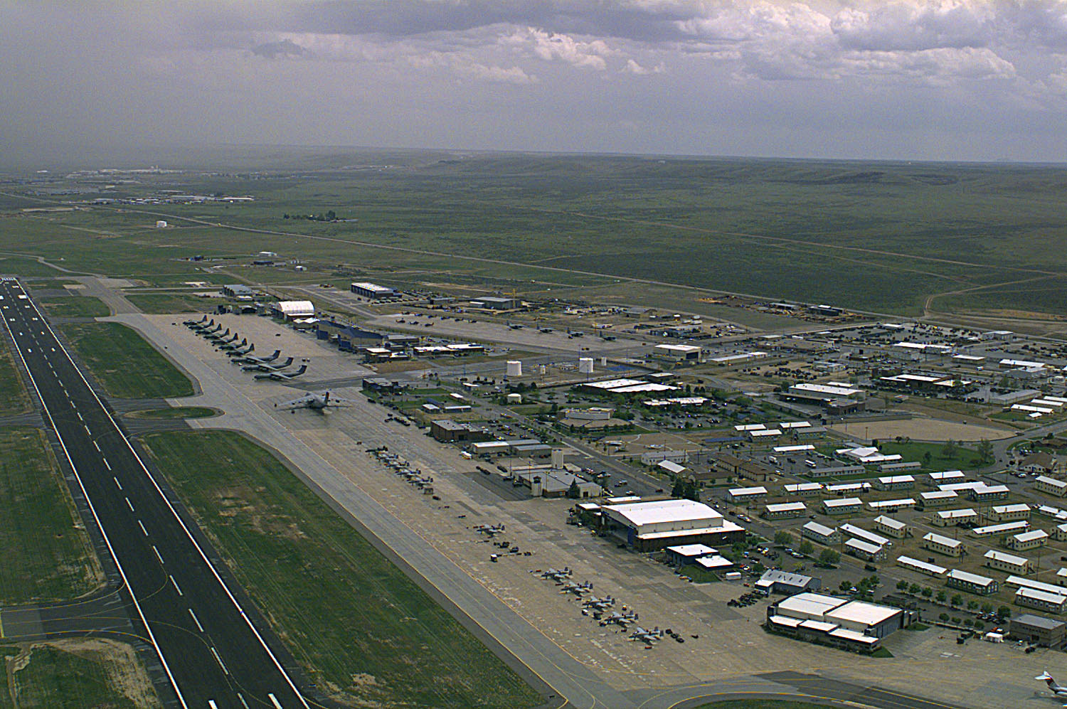
Regional Integrated Training Environment
(RITE)
“… ensure the right mix and availability of equipment, provide more efficient and effective use of defense assets, and contribute to the sustainability of both the AC and RC.”
QDR, 2010
“Unity of effort is essential to responding to ever tightening fiscal environments; increasing competition for air, land and maritime training resources…”
Strategic Plan for the Next Generation of Training for DoD, 2010
Service Training Strategies (Rotational Readiness Models)
Sustains readiness of the pre-trained Total Force and Nation’s investment in RC
Company
Battalion
Leverages complementary training and surge capacity
DoD-wide Visibility System
Battalion
Squadron
Total Force Regional Training Centers
Maximizes efficient use of existing training capabilities based on regional requirements
Optimizes the use of DoD training resources
Classrooms
Ranges
Shared Equipment Pools
Networked Training Site
Sims / Trainers
Live Virtual Constructive
Airfields
Networked Training Site
RITE: network of regional installations designed to support Total Force training requirements and sustains readiness through optimized use of training resources
Notes:
Slide owner: M&F (COL Adrian Nagel)
RITE sustains the pre-trained Force in an impending era of constrained resources
RITE links Services’ regional training requirements with regional training capabilities and capacity while facilitating /optimizing shared training resource usage
What it Does:
Links Services’ force generation training requirements to a consortium of regional / home station networks of facilities’ training resources
Supports the Nation’s investment in pre-trained RC (Train-Mobilize-Deploy construct)
Expands Services’ innovative, cost-effective training strategies (up to ‘Battalion level’)
Fully leverages simulation, pooled, shared equipment, joint live, virtual, constructive (JLVC) federation, and training aides to support training demand
DoD-wide system provides visibility and scheduling coordination of training resources
Supports and Complements the Army’s Regional Collective Training Capability and DASD (R) TRS Defense Training Environment
What it Does Not Do:
Relinquish Services’ control of training resources
Prescribe training regimens
Create separate Component training infrastructure
Enablers
DoD-wide accessible Training Visibility System
Shared Pools of Equipment
Simulation / Live Virtual Constructive
Installations networked to meet regional training requirements/demand
Benefits
Fully supports SECDEF’s efficiency initiative
Optimizes DoD training resources supporting Strategic Plan for the Next Generation of Training for DoD 2010
Leverages complementary training and surge capacity
Maximizes efficient use of existing training capabilities based on regional requirements
Links Services’ regional training requirements with regional training capabilities and capacity while permitting shared training resource usage
Supports the Comprehensive Review of the RC recommendation 11C

Slide 32
Budget Cycle
FY 2014-FY 2018 Program/Budget Submission/Review Schedule*
  FY 2014 Strategic Portfolio Review FEB - MAR
  Defense Planning Guidance Issued MAR
  Fiscal Guidance Issued APR 3
  FY 2014 - FY 2018 Integrated Program and Budget Guidance Issued JUN
  Strategic Portfolio Review Results MAY – AUG
  Component Program/Budget Submissions Due
  (databases lock, required Select and Native Programming (SNaP) exhibits) AUG 3
  Component Program/Budget Briefs to 3-Star/Defense Advisory Working Group (DAWG)JUL 30-AUG 10
  Select and Native Programming (SNaP) Exhibits Due AUG 20
  Draft Future Years Defense Program (FYDP) Data Available AUG 20
  Issue Nominations Due AUG 31
  Budget Justification Material Due to OSD/Office of Management and Budget (OMB) SEP 4
  Principal Staff Assistants/Combatant Commanders Issue Briefs to Deputy Secretary SEP 4-14
  Issue Nomination Disposition SEP 14
  Strategic Portfolio Re-engagement SEP - OCT
  Program/Budget Review and Issue Team Analysis SEP - NOV
  Manpower Management System Memoranda of Agreement cut-off date OCT 19
  Budget Lock DEC 21
  President's Budget Released FEB 4
* This schedule will be amended as required.
Notes:
Resources (LTC Beller)
5

Slide 33

2012 Legislative Evolving Calendar
JAN 12
FEB 12
MAR 12
APR 12
MAY 12
JUN 12
JUL 12
AUG 12
SEP 12
OCT 12
NOV 12
DEC 12
FY12 Execution
FY13 or CR Execution
FY-12
Congressional Budget Hearings/Testimony
HAC / HASC Consideration / Mark-Up
QFRs
Appeals
Appeals
SAC / SASC
Consideration / Mark-Up
PB-13
2013 PB Submit
PB-13 Appropriation Bills Signed or CR
QFRs
Floor Consideration of NDAA and Appropriation Conference Bills
Call for Legislative Proposals for FY 2014
Deadline for submission of proposals
Deadline for completion of internal coordination
OMB will not accept any DoD proposals after this point
FY 2014
FY15A ULB proposals due
FY14 Legislative Review Panel
Notes:
Mr. Carson
BES: Budget Estimate Submission
COCOM: Combatant Command
CPA: Chairman’s Program Assessment
CPR: Chairman’s Program Recommendations
CR: Continuing Resolution
DPG: Defense Planning Guidance
DSLC: Defense Senior Leadership Conference; One of the principal integrated civilian-military governance bodies of DoD. Meets at least semi-annually to address broad, crosscutting issues affecting the Office of the Secretary of Defense (OSD), the military departments, the combatant commands (COCOM), and interagency efforts. The DSLC shall provide advice and assistance to the Secretary of Defense (SECDEF) on the strategic direction of the department.
GEF: Guidance for the Employment of the Force
HAC: House Appropriations Committee
HASC: House Armed Services Committee
JCIDS: The Joint Capabilities Integration and Development System is the formal United States Department of Defense (DoD) procedure which defines acquisition requirements and evaluation criteria for future defense programs.
JROC: Joint Requirements Oversight Council
PB: President’s Budget
PBR: President’s Budget Review
POM: Program Objective Memorandum
RMD: Resource Management Decisions
SAC: Senate Appropriations Committee
SASC: Senate Armed Services Committee

Slide 34
BACK UP
Notes:
5

Slide 35
Resources
Strategic Goals
Assess and advise on formulation and execution of National Guard and Reserve POMs and budgets in accordance with DoD policy.
Propose and continually refine a Total Force blended costing methodology.
Assess Reserve component Future Year Defense Programs (FYDP) against established DoD strategic guidance.
Coordinate development and submission of OSD National Guard and Reserve legislative products supporting the President’s Agenda.
Participate in Department Strategic Portfolio Reviews (SPR) and Strategic Choices Group (SCG) activities.
Notes:
Slide owner: Resources (Mr. Trey Carson)
5

Slide 36
Resources
Human Resources and Enterprise Support Directorate
(HR&ES)
Provides human resources and enterprise support to RA, to include RFPB, ESGR, and YRRP.
Key HR activities include:
  Strength Management
  Manpower Management
  Personnel in- and out-processing
  GS and SES Performance Management
  Civilian hiring, separations, retirements, promotions, payroll processing
  Military awards, evaluations, and general personnel support
  Personnel Security
  SOCO/Ethics Coordinator
Key ES activities include:
  Information Security
  Communications Security
  Facilities Management & Physical Security
  Tasker Control and Coordination (SACCP)
  Execution of Travel (DTS), Training, and Supplies Budgets
  Official Representation Funds (ORF) Management
  Information Management Control Officer
Notes:
Slide owner: Resources (CDR Phil Reed)
5

Slide 37
Resources
Systems Directorate
Responsible for administrative and technical support of RA’s information technology systems.
Represents RA in OSD enterprise information technology governance organizations.
Administers RA’s information assurance program and provides representatives to the enterprise information assurance board.
RA’s representative to the OSD enterprise configuration control board.
Administers RA’s Operations Security (OPSEC) program.
Manages RA’s world wide web and social media sites and provides graphical interface development for mission systems and marketing efforts.
Notes:
Slide owner: Resources (Lt Col Bucher)
5

Slide 38



Employer Support of the
Guard and Reserve
Organization
Headquarters – Arlington, Virginia
  National Chair (Volunteer)
  Executive Director (SES)
  National Staff Size 58 (27 Mil/31 Civ)
ESGR State Committees (54)
  Located in all States, D.C. and U.S.
  Territories
  4,900+ volunteers
  2-3 full-time staff per State Committee
  Volunteer organization supported by full-time staff
38
Notes:
Slide owner: FEPP (Mr. Ted Fessel)
- This slide shows the Employer Support of the Guard and Reserve (ESGR) overall structure.
ESGR has a presence in all 50 states, D.C., Puerto Rico, The Virgin Islands and Guam; 54 committees in total.
- ESGR is a volunteer organization supported by full time staff.

Slide 39

Employer Support of the
Guard and Reserve
Metrics
Major Missions: Employer Outreach, Military Outreach and Ombudsman. Outcomes for the past three Fiscal Years are reflected below:
ESGR by the numbers:
39
Notes:
Slide owner: FEPP (Mr. Ted Fessel)
This slide is a cut-n-paste from ESGR’s FY 10 Annual Report.
It shows key mission area metrics.
You may wish to highlight some of the positive trends indicating ongoing support from Civilian Employers: Number of Statements of Support signed, Patriot Awards and Freedom Award Nominations. NOTE: for FY 11 not shown, the number of Freedom Award Nominations are up, the total 4,049.
- Also, worth highlighting is the success of the Ombudsman Mission and resolving USERRA Cases. In particular: 84.4% success rate within 10.27 Calendar Days.

Slide 40





Yellow Ribbon Reintegration Program
What Yellow Ribbon Does
Family member / designated representative
Service Members and families / designated representative
Providing resources and information to support Service members and their families during all phases of the deployment cycle.
Service members and families / designated representative at 30,60 & 90th days
Service members
Notes:
Slide owner: FEPP (Mr. Ted Fessel)
Provide curriculum examples
Pre-Deployment activities:
a. Medical, dental, and mental health benefits (i.e. TRICARE, stress control, suicide prevention, etc.)
b. Administrative information (DEERS, Civilian Employment Information – CEI, key web sites, etc.)
c. Financial & employment information (counseling services for ESGR, DOL, mortgage, savings, etc.)
d. Legal Information (POA, wills, legal guardianship, housing & rental issues, child custody, etc.)
e. Community and outreach (VA, RC, community & youth programs, government & NGOs, etc.)
f. Special or spiritual programs (chaplain programs, local faith-based organizations, VA centers, etc.)
Deployment activities:
a. Special or spiritual programs
b. Medical, dental, and mental health benefits
c. Community and outreach
d. Financial & employment information
e. VA Vet centers
Demobilization activities: (30 – 60 – 90 – day events)
a. Medical, dental, and mental health benefits (PDHA/PDHRA, TAA, etc.)
b. Special or spiritual programs
c. Community and outreach
d. Financial & employment information (Reinforce obligation and information regarding employment & finances, etc.)
e. Administrative information
f. Legal issues
g. Safety information (reacquaint SMs with local laws governing driving in communities)
For the most part, Service members and their families attend events together. While the Service members are deployed, the Yellow Ribbon Program works collaboratively with family readiness groups to bring the families together.
5

Slide 41
Yellow Ribbon Reintegration Program
YRRP Vision: A ready and resilient National Guard and Reserve Force successfully navigating the challenges of deployments.
YRRP Mission: To promote the well-being of National Guard and Reserve members, their families and communities, by connecting them with resources throughout the deployment cycle.
OUSD(P&R) Strategic Goal 2: Strengthen individual and mission readiness and family support, and promote well-being.
41
Notes:
Slide owner: FEPP (Mr. Ted Fessel)
YRRP’s mission is to promote the well-being of NG and Reserve members, their families and communities, by connecting them with resources throughout the deployment cycle.
the YRRP is linked to the OUSD (P&R) strategy as reflected in “Goal 2.”
Prior to 2008, no consolidated reintegration program existed.
The Yellow Ribbon Reintegration Program was established under the authority of Public Law 110-181, Section 582: (January 20, 2010)
ESTABLISHMENT OF PROGRAM – “Secretary of Defense shall establish a national combat veteran reintegration program to provide National Guard and Reserve members and their families…known as the Yellow Ribbon Reintegration Program.”
b) PURPOSE OF PROGRAM; DEPLOYMENT CYCLE – “…shall consist of informational events and activities…though the 4 phases of the deployment cycle.”
(c) EXECUTIVE AGENT – “The Secretary shall designate the Under Secretary of Defense for Personnel and Readiness as the DoD executive agent for the Yellow Ribbon Reintegration Program.”
(d) OFFICE FOR REINTEGRATION PROGRAMS —
(1) ESTABLISHMENT— “The Under Secretary of Defense for Personnel and Readiness shall establish the Office for Reintegration Programs within the Office of the Secretary of Defense. The office shall administer all reintegration programs in coordination with State National Guard organizations. The office shall be responsible for coordination with existing National Guard and Reserve family and support programs.”

Slide 42

Yellow Ribbon Reintegration Program
Center for Excellence
Collect Event After Action Reports
Review Best Practices
Gather Service Member & Family Post-Event Survey
Provide Training, Vetted Presentations & Training Materials
Analyze Data, Provide Feedback to Services
Develop Attendance Accountability
Enhance Clearinghouse for Military Family Readiness (CMFR)
The Center for Excellence is one of the cornerstones to success for the Yellow Ribbon Reintegration Program.
42
Notes:
Slide owner: FEPP (Mr. Ted Fessel)
- Community Support: Program Specialists (26 and possible expansion) located in communities alongside Guard and Reserve.
2011: Continue to enhance relationships at local level. Leverage the YRRP Cadre of Speakers and increase information sharing across the spectrum of event planners, program managers and community members.
- CFE: New NDAA-11 enhancement calls on YRRP to “develop and implement a process for evaluating the effectiveness of the Yellow Ribbon program in supporting the health and well-being of the members of the Armed Forces and their families throughout the deployment cycle.” This new language also aligns with Administration emphasis on health and well-being as well as a focused commitment on “associated metrics.”
- Employment: Again, NDAA-11 requires that we “provide information on employment opportunities” during the reintegration phase. Strong working relationship with ESGR, and Department of Labor along with the USAR Employer Partnership of the Armed Forces.
- NDAA 2011 requirement for resiliency training to promote comprehensive programs for members of the Armed Forces to build mental and emotional resiliency for successfully meeting the demands of the deployment cycle.

Slide 43
Individual & Family Support Policy
Individual and Family Support Policy
Expand Military-Community cooperation in support of Military families
Engage & Advise Family Support partners to ensure:
  Essential family support resources/benefits are established and available
  Mechanisms are in place to improve awareness of & access to benefits (i.e., VA, childcare, MWR, commissary, Military OneSource)
  Continuum of service issues are addressed (i.e., transition, education, employment)
  Availability and access to health and behavioral health providers
  Achieve IFSP Vision and Mission through liaison with organizations that advocate for Military members and their families such as: Reserve & National Guard Family Support Program offices, Assistant Secretariat Offices for Manpower and Reserve Affairs, DoD Military Community & Family Policy, DoD Wounded Warrior Care & Transition Policy, Veterans Affairs, Department of Labor, Small Business Administration, Department of Education, National Military Family Association, National Fatherhood Initiative.
43
Notes:
Slide owner: FEPP (Mr. Ted Fessel)
5

Slide 44
Regional Integrated Training
Environment
(RITE)
BLUF: Sustain pre-trained, total force (operational
force) readiness while optimizing training resources using RITE.
  Synergizes Components’ Training Strategies (Rotational Readiness Models)
  Leverages Simulation, Shared Pools of Equipment, JLVC, Training Aides, etc.
  Lynch Pin: DoD-wide system enabling stakeholder visibility and scheduling capability of training
  resources
Goal: Sustain a cost effective and fully integrated total force that when called is accessible (RC), trained, ready and surge capable as determined by Readiness Rotational Models across the full spectrum of operations; including Home Land Defense, Consequence Management and Crisis Response.
What it Does:
Links Services’ force generation training requirements to a consortium of regional / home station networks of facilities’ training resources
Supports the Nation’s investment in pre-trained RC (Train-Mobilize-Deploy construct)
Expands Services’ innovative, cost-effective training strategies (up to ‘Battalion level’)
Fully leverages simulation, pooled, shared equipment, joint live, virtual, constructive (JLVC) federation, and training aides to support training demand
DoD-wide system provides visibility and scheduling coordination of training resources
What it Does Not Do:
Relinquish Services’ control of training resources
Prescribe training regimens
44
Notes:
Slide owner: M&F (COL Adrian Nagel)

Slide 45
Reserve Component Support
of Civil Authorities
RC Role in Homeland Defense and Defense Support of Civil Authorities / Consequence Management and Crisis Response
Chemical, Biological, Radiological, Nuclear (CBRN) Consequence Management ( CM) Enterprise
  Weapons of Mass Destruction-Civil Support Teams (WMD-CST)
  Chemical, Biological, Radiological, Nuclear and High-Yield Explosives (CBRNE) Enhanced Response Force (CERFP)
  Homeland Response Force (HRF)
  Defense Consequence Management Response Force (DCRF)
  Command and Control CBRN Response Element (C2CRE)
Crisis Management and Disaster Response Situational Awareness
  Southwest Border Support, Deep Water Horizon, Hurricanes, National Security Special Events
Council of Governors
  Unity of Effort
  T10/T32 Command Authority (Unity of Effort/Command)
  Dual-Status Commander
Counterproliferation Review Committee (CPRC)
DoDD 5105.ac “Joint Force Headquarters-State (JFHQ-State)”
Counterdrug State Plans
Continuity of Operations (COOP) for Reserves Affairs
Emergency Preparedness Liaison Officer
Commission on National Guard And Reserves Recommendations Re: HLD and DSCA
Notes:
Slide owner: RT&M (CAPT Dwayne Baxter)
5

Slide 46
Reserve Benefits
Professional Development/PME/JPME
Reserve Transition Programs
Retirement
Simultaneous Membership Program (concurrent employment)
Special & Incentives Pays
Student Loan Repayment Program (up to $50K)
Tax Credit Thrift Savings USERRA (accountability)
Voluntary Education (little cost to the civilian force)
Accession/Retention Policy (Mission oriented)
Bonuses/Incentives (Service specific)
Compensation Education Assistance Programs (State Programs)
Insurance Programs (TRICARE)
Notes:
Slide owner: M&P (Mr. Tom Liuzzo)
5

Slide 47
THE DIFFERENCE BETWEEN THE
NATIONAL GUARD & RESERVES
CINC = Governor
CINC = POTUS
CINC = POTUS
State Active Duty - State $
Title 32 Federal $
Title 10 Federal $
Always Title 10 Federal $
Law Enforcement
State Missions
Man-Made Disasters
Hurricanes
Tornados
Floods
Blizzards
Federal Service
Federal Service
CONUS
Federal Disaster Declared by POTUS
OCONUS
Enforce the Law
Repel Invaders
Dual Hat Commander
47
Notes:
Slide owner: Resources (Mr. Warren Grant)

Slide 48
Reserve Component Funding
(PB13 Request)
Notes:
Resources (LTC Beller)

Slide 49
Base Realignment and Closure (BRAC) /
Small Base Closure
Materiel and Facilities (M&F)
Issue: USD(P&R) and ASD(RA) participation as Secretary of Defense-approved senior group members in future BRAC rounds / Small Base Closures. Note: The USD(P&R) and the ASD(RA) were not selected to participate in BRAC 2005, making it virtually impossible to have any significant input or influence over BRAC decisions being made by the Department regarding the Reserve components (RCs).
Background: As a result of DoD’s new defense strategy and funding priorities, a legislative proposal requesting congressional authorization for two more rounds of BRAC in FY 2013 and FY 2015 was included in the FY 2013 President’s Budget. Although the HASC and SASC have denied DoD’s request, DUSD(I&E) BRAC testimony indicates that DoD is prepared to use its existing Title 10 authority in Section 2687 to begin the closure and realignment process. If used, this authority will also have an immediate impact on Reserve centers and RC installations having less than 300 civilian personnel.
Intent: To ensure ASD(RA) is designated as a senior group member, which will also allow the Reserve Affairs organization to fully participate in any new BRAC or small base closure process; to provide OSD leadership sage counsel and timely advice on future RC BRAC recommendations; and to ensure the military value final selection criteria used makes a better distinction between Active and Reserve component facilities and installations.
Focus Area this initiative will support: Engage in and Improve Existing Processes
Measurement metric: Secretary of Defense/Deputy Secretary of Defense approval
Estimated time of completion: Unknown
DASD: Mr. Wightman OPR (AO): Mr. Jameson
Notes:
Mr. Jameson

Slide 50
RC Equipment Transparency
Materiel and Facilities (M&F)
Issue: Unlike all other areas of the Defense budget, there is no Reserve appropriation for equipment procurement that mirrors the Active force. The Reserve Components (RC) rely on the Active procurement account and the Congressional addition called National Guard and Reserve Equipment Appropriation. Transparency is the process DoD developed to determine and track how much of the Active procurement appropriation is intended for the RC and follow the money from purchase to an RC unit delivery.
Background: The Equipment Transparency Report (ETR), originally referred to as the Equipment Delivery Report, was created as a result of the findings of the Commission on the National Guard and Reserve (CNGR). The CNGR found that Guard & Reserve equipment transparency and accountability was lacking. As a result DEPSECDEF directed the ETR’s reporting requirements to the Services. In support of the ETR, the Services are required to develop accurate projected equipment funding and item quantities in the P-1R, and track the actual deliveries to RC units for that projected funding. This includes documenting accurate expenditures for previous fiscal years captured in the P-1R as well as inclusion of ALL equipment planned for or procured for the RC.
Intent: To achieve full transparency of RC equipment from appropriation through acquisition to delivery to an RC unit. This effort will require significant effort to overcome OSD/Service resistance.
Focus Area this initiative will support: Support National Security Home and Abroad
Measurement metric: Automated, fully transparent report providing OSD and Congressional leadership the tools they need to make informed decisions concerning RC equipment procurement.
Estimated time of completion: Unknown
DASD: Mr. Wightman OPR (AO): CAPT Graham
Notes:
CAPT Graham

