Slide 1
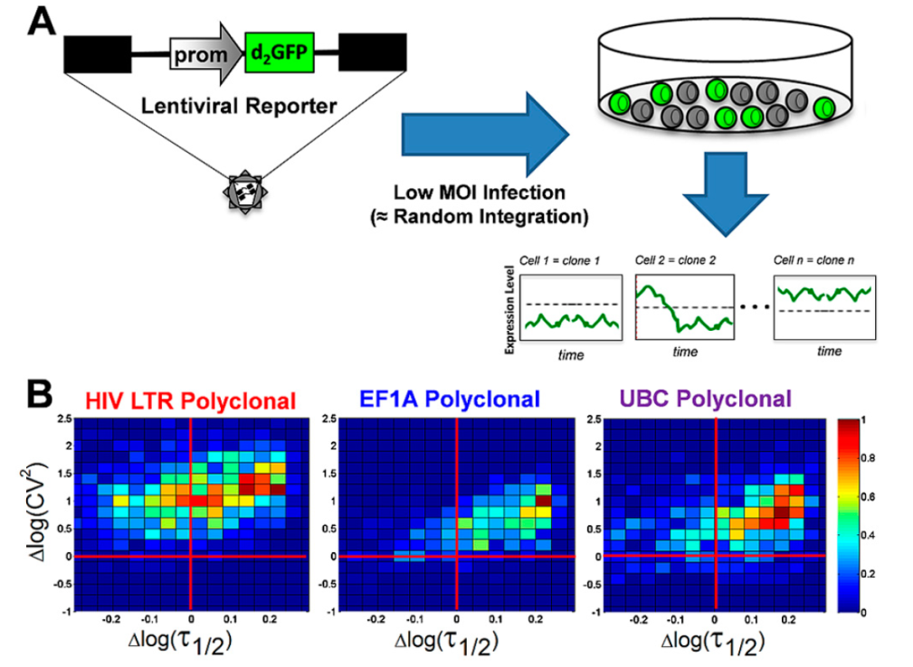






CNMS Staff Science Highlight
Noisy Gene Expression Allows Many Genes to Share Few Resources in Cells
Scientific Achievement
A new technique – “Noise Mapping” – was developed and used to image how resources are shared in complex systems of interacting nanoscale components. The model systems studied were biological cells (human immune cells), and Noise Mapping was applied across the human genome to show that as a rule the sharing of resources is episodic and “noisy,” rather than continuous and “quiet.”
Significance
These findings suggest lessons for the construction of manmade complex systems of intreacting nanoscale components. Cells have evolved to make use of this “bursty” noise to create function, and indeed such noise can be key to achieving more function in less space – a central challenge for nanoscience.
Research Details
CNMS Capability: Noise Mapping technique developed at CNMS allows the characterization of interactions between nanoscale elements that cannot be directly imaged. Here it was used to “see” the noisy and episodic nature of gene expression across a genome.
Working with collaborators at the Gladstone Institute, Noise Mapping was extended to look at more than 8,000 distinct genomic loci with three different promoters integrated throughout the genome.
These results were related back to a two-state model of gene expression that describes how the resources of gene expression are shared across so many different interacting components and how this sharing distributes noise across these elements.
Episodic-bursty expression dominates across the human genome. (A) To create the polyclonal population, cells are infected with a lentiviral vector expressing d2GFP so that each cell represents a unique clone harboring a single semirandom integration of reporter. (B) Resultant noise maps for over 8,000 individual cell trajectories for the HIV-1 LTR promoter, EF1A promoter, and UBC promoter. The shift of these points away from the origin and to the upper right quadrant is indicative of the episodic (bursty) nature of the expression of the genes.
R. D. Dar, B. S. Razooky, A. Singh, T. V. Trimeloni, J. M. McCollum, C. D. Cox, M. L. Simpson, L. S. Weinberger. Proc. Nat. Acad. Sci. DOI. 10.1073/pnas.1213530109.
Notes:
Highlight Narrative Text
(~175 words)
High functional density -- lots of functions in little space – presents a unique environment about which little is known. In this work we looked at how many genes can share few resources in cells. We found that sharing is enabled by episodic behavior where genes experience burst of activity (high access to resources) and periods of inactivity (no use of resources). For the first time we looked at this behavior across the genome using the noise mapping technique developed at CNMS. These first noise maps of the human genome showed that episodic bursty behavior is the rule for expression of human genes. These findings suggest lessons for the construction of manmade complex systems of nanoscale components. First, at extremes of functional density, bursty behavior may be required, but at the cost of high noise as burstiness increases noise magnitude and correlation. However, cells have evolved to make use of this noise to create function, and indeed such noise can be key to achieving more function in less space (Simpson and Cummings (2011) ACS Nano 5(4)).
Reference:
“Transcriptional Burst Frequency and Burst Size Are Equally Modulated Across the Human Genome”
R. D. Dar,^{1,2,3} B. S. Razooky,^{1,4,5} A. Singh,⁴ T. V. Trimeloni,⁶ J. M. McCollum,⁶ C. D. Cox,^{7,8} M. L. Simpson,^{2,9} L. S. Weinberger.^{1,4,10}
¹Gladstone Institutes, San Francisco; ²Center for Nanophase Materials Sciences, Oak Ridge National Laboratory;
³Department of Physics and Astronomy, University of Tennessee; ⁴Department of Chemistry and Biochemistry, University of California at San Diego; ⁵Biophysics Graduate Group, University of California, San Francisco; ⁶Department of Electrical and Computer Engineering, Virginia Commonwealth University; ⁷Center for Environmental Biotechnology, University of Tennessee; ⁸Department of Civil and Environmental Engineering, University of Tennessee; ⁹Department of Materials Science and Engineering, University of Tennessee; ¹⁰Department of Biochemistry and Biophysics, University of California, San Francisco.
Proc. Nat. Acad. Sci. DOI. 10.1073/pnas.1213530109.
Acknowledgment of Support:
B.S.R. was supported by National Science Foundation Graduate Research Fellowship Grant 1144247 and by National Institutes of Health (NIH) Molecular Biophysics Training Grant GM08326. L.S.W. acknowledges support from the Pew Scholars Program in the Biomedical Sciences and the Alfred P. Sloan Research Fellowship Program. This work as supported by the NIH Director’s New Innovator Award (OD006677) (to L.S.W.), the in-house research program at the Center for Nanophase Materials Sciences at Oak Ridge National Laboratory (sponsored by the Office of Basic Energy Sciences, US Department of Energy) (to R.D.D. and M.L.S.), and by the National Institute of General Medical Sciences National Systems Biology Centers at University of California at San Diego (P50 GM085764) and University of California, San Francisco (P50 GM081879).

