Slide 1
The Auditor: How to Build a Criminal Case
Stephen P. Learned
Investigative Counsel
Federal Housing Finance Agency OIG

Slide 2
QUESTION: HOW CAN THE METHODOLOGY OF OIG AUDITORS BE IMPROVED SO THAT FRAUD CASES (CIVIL AND CRIMINAL) CAN BE MORE READILY PROVED? ANSWER: BY FORCING THE BAD GUY TO LIE TO THE AUDITOR ABOUT AN IMPORTANT MATTER

Slide 3
UNITED STATES V. DUTTA CONSULTING PAYMENTS TO A FOREIGN COMPANY IS THERE ANY WORK PRODUCT TO JUSTIFY THE PAYMENTS?

Slide 4
18 U.S.C. §1516 “WHOEVER, WITH INTENT TO DECEIVE OR DEFRAUD THE UNITED STATES, ENDEAVORS TO INFLUENCE, OBSTRUCT, OR IMPEDE A FEDERAL AUDITOR IN THE PERFORMANCE OF HIS OFFICIAL DUTIES ....” SHALL BE GUILTY OF AN OFFENSE

Slide 5
UNITED STATES V. BAUM, SANZ, AND ROMSTEDT VACATION HOMES EXPENSED AS BUSINESS OFFICES ON COST PLUS DOD CONTRACT DOCUMENT THE RESPONSE WITH EMAIL, IF NECESSARY 18 U.S.C.§371 (CONSPIRACY TO DEFRAUD THE U.S.)

Slide 6
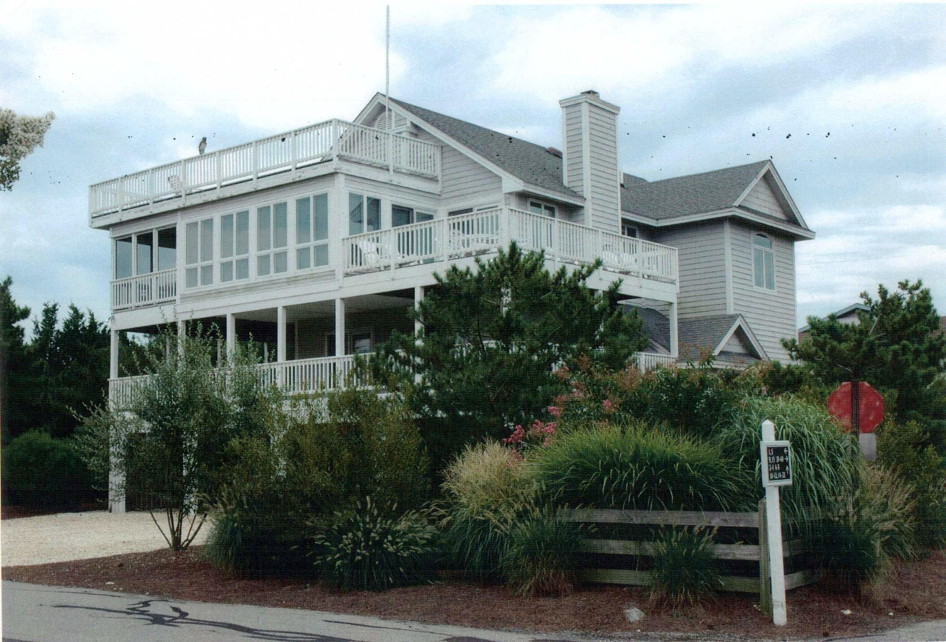

Slide 7
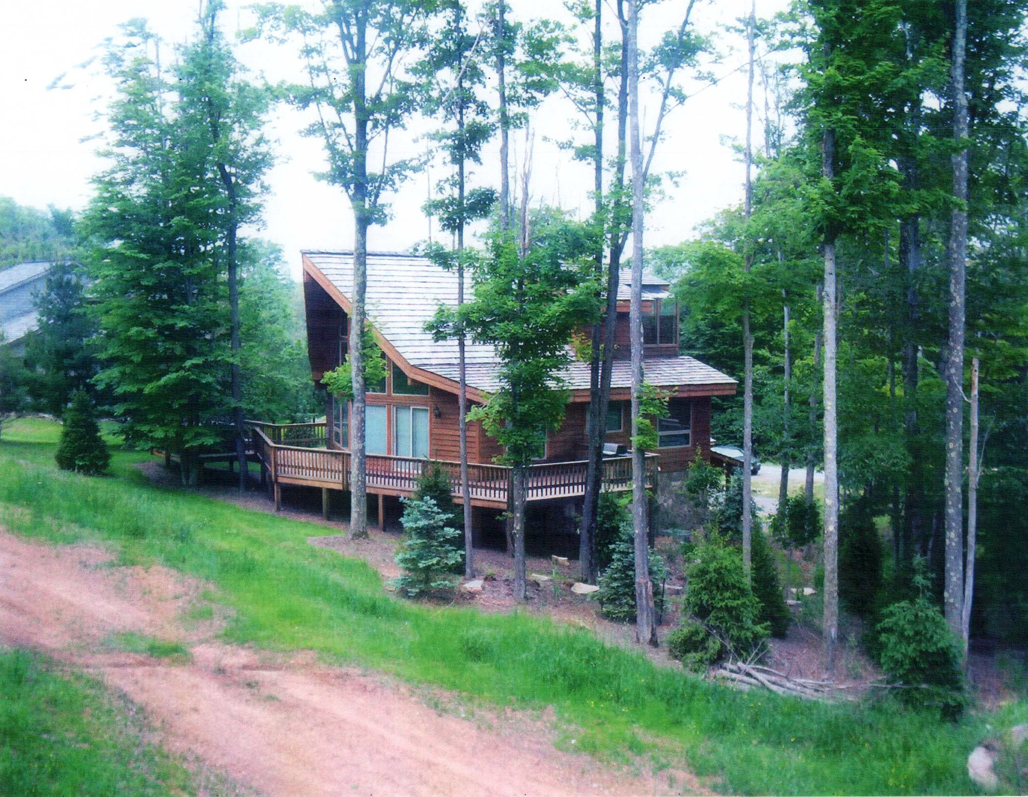

Slide 8
SARBANNES OXLEY: SINCE 2002 THE CEO OF A PUBLIC COMPANY HAS TO PERSONALLY CERTIFY TO THE OUTSIDE AUDITOR THAT THE COMPANY HAS SUFFICIENT INTERNAL CONTROLS TO DEAL WITH FRAUD AND INSIDER ABUSE SAS 99: OUTSIDE AUDITORS HAVE TO “BRAINSTORM” ON THE POSSIBILITY OF FRAUD COMMITTED BY SENIOR OFFICERS. THEY HAVE TO RAISE THE ISSUE OF FRAUD WITH THE CEO DIRECTLY AND DOCUMENT THE CEO’S RESPONSE.

Slide 9
IN SUCCESSFUL PROSECUTIONS, IT WAS OFTEN A DILIGENT AUDITOR WHO INSISTED ON GETTING ANSWERS TO HIS OR HER QUESTIONS FROM THE HIGHEST LEVEL IN THE COMPANY HOW CAN OIG AUDIT METHODOLOGY BE IMPROVED TO MAKE THIS HAPPEN MORE FREQUENTLY?

Slide 10
BANK EXAMINERS AND INSURANCE REGULATORS FORCE COMPANIES TO ANSWER SEVERAL RED FLAG QUESTIONS IT IS INSUFFICIENT TO HAVE A COMPANY ANSWER A QUESTIONNAIRE BY SIMPLY CERTIFYING THAT ITS REPORTS AND COST SUBMISSIONS COMPLY WITH THE FAR.

Slide 11
DCAA INCURRED COST SUBMISSIONS REQUIRE ONLY THE FOLLOWING: A CERTIFICATION BY A VP OR CFO THAT “ALL COSTS INCLUDED IN THE PROPOSAL TO ESTABLISH FINAL INDIRECT COST RATES...ARE ALLOWABLE IN ACCORDANCE WITH THE COST PRINCIPLES OF THE FAR.... [AND] THIS PROPOSAL DOES NOT INCLUDE ANY COSTS WHICH ARE EXPRESSLY UNALLOWABLE UNDER APPLICABLE COST PRINCIPLES OF THE FAR....”

Slide 12
THE IG AUDITOR NEEDS TO SUBMIT AN INTRUSIVE QUESTIONNAIRE TO THE CONTRACTOR THAT ADDRESSES SPECIFIC PROBLEM AREAS THE MOST CONSPICUOUS RED FLAG QUESTION ADDRESSES THE ISSUE OF AFFILIATED PARTIES

Slide 13
THE DCAA DOES THIS WITH RESPECT TO A CONTRACTOR’S FACILITIES COSTS. IN PART A OF DCAA’S INTERNAL CONTROL QUESTIONNAIRE: PLANT AND FACILITIES ___ OWNED _____ LEASED _____ OTHER IF LEASED, IS THERE A RELATIONSHIP BETWEEN THE LESSEE AND LEASOR? IF YES, EXPLAIN THE RELATIONSHIP

Slide 14
IT IS NOT ENOUGH TO HAVE INTRUSIVE QUESTIONS. YOU NEED TO GO TO THE TOP LEVEL OF MANAGEMENT TO GET YOUR ANSWERS CERTIFIED AS ACCURATE REMEMBER SAS 99 INSIST THAT THE COO OR CEO SIGN THE RESPONSE TO ANY QUESTIONNAIRE YOU SUBMIT

Slide 15
SOME SUGGESTIONS FOR A QUESTIONNAIRE FOR GOVERNMENT CONTRACT AUDITORS TO USE, ON THE EVE OF AN AUDIT, TO BE ANSWERED BY THE CONTRACTOR AND CERTIFIED AS ACCURATE

Slide 16
QUESTION #1: (RELATED PARTIES) IDENTIFY ALL a) AFFILIATED FIRMS and b) IMMEDIATE FAMILY MEMBERS OF SENIOR MANAGEMENT OR A PRINCIPAL SHAREHOLDER WITH WHOM THE FIRM IN THE PAST 12 MONTHS HAS ENTERED INTO CONTRACTS OR HAS DONE AT LEAST $10,000 IN BUSINESS, WHICH COSTS WERE ALLOCATED TO A GOVERNMENT CONTRACT.

Slide 17
QUESTION #2: (RELATED PARTIES) LIST ALL PARTIES DOING BUSINESS WITH THE FIRM, WHOSE COSTS WERE ALLOCATED TO A GOVERNMENT CONTRACT, AND WHO ARE OR HAVE BEEN RECIPIENTS OF LOANS EXTENDED BY ANY OF THE FIRMS’S PRINCIPAL SHAREHOLDERS OR SENIOR MANAGEMENT.

Slide 18
QUESTION #3:(RECIPROCAL TRANSACTIONS) IDENTIFY ANY EXPENSE OF THE FIRM, WHICH WAS ALLOCATED TO A GOVERNMENT CONTRACT, AND WHICH WAS INCURRED IN WHOLE OR IN PART AS AN ACCOMMODATION TO ANY PARTY IN RETURN FOR, OR AS AN INDUCEMENT FOR, ANY OTHER BUSINESS WITH ANY OTHER PARTY, INCLUDING THE FIRM AND ANY OF THE FIRM’S AFFILIATES.

Slide 19
QUESTION #4: (Irregular Transactions) LIST ANY INCOME OR EXPENSE ACCOUNT ITEM OF THE FIRM CARRIED ELSEWHERE THAN ON THE GENERAL LEDGER INCOME OR EXPENSE RECORDS.

Slide 20
QUESTION #5: (The Employee Who Is Never Absent From Work) LIST THE NAMES OF ANY OFFICERS AND EMPLOYEES, WORKING ON A DAY TO DAY BASIS IN THE AREA OF ACCOUNTING WHO, DURING THE LAST 24 MONTHS, DID NOT REMAIN ABSENT FROM THEIR DUTIES FOR A MINIMUM OF FIVE CONTINUOUS WORKING DAYS DURING ANY PERIOD OF OFFICIAL BUSINESS.

Slide 21
QUESTION #6 (OUTSIDE AUDITS): SINCE THE PERIOD OF THE LAST GOVERNMENT AUDIT, HAS AN EXTERNAL CPA’S MANAGEMENT LETTER NOTED: a) ANY INTERNAL CONTROL DEFICIENCIES or b) ANY IRREGULARITIES REGARDING COSTS INCURRED THAT WERE ALLOCATED TO A GOVERNMENT CONTRACT?

Slide 22
QUESTION #7 (CONSULTANTS) HAS THE FIRM INCURRED COSTS OR FEES ALLOCABLE TO A GOVERNMENT CONTRACT FOR CONSULTING OR PROFESSIONAL SERVICES? IF SO, IS THE FIRM CURRENTLY IN POSSESSION OF WRITTEN WORK PRODUCT PAID FOR WITH SUCH FEES?

Slide 23
QUESTION #8: (Identification of Lawsuits) IF THE FIRM IS A DEFENDANT IN ANY SUITS IN LAW OR EQUITY IN THE PAST 12 MONTHS, GIVE THE NAMES OF THE PLAINTIFFS, AMOUNTS SUED FOR, AND NATURE OR BASIS FOR LITIGATION.

Slide 24
QUESTION #9: (Identification of Criminally Charged Employees) GIVE THE NAME OF ANY DIRECTOR, OFFICER OR EMPLOYEE OF THE FIRM, WHO HAS IN THE PAST 24 MONTHS BEEN CONVICTED OF, OR WHO IS PRESENTLY UNDER INDICTMENT FOR, ANY CRIMINAL OFFENSE INVOLVING DISHONESTY OR A BREACH OF TRUST.

Slide 25
QUESTION #10: Anti Kickback Violations (Gratuities Received) IDENTIFY ANY PERSONAL BENEFIT IN EXCESS OF $50 (PER YEAR) TO ANY EMPLOYEE OF THE FIRM, GIVEN BY ANY COMPANY, OR EMPLOYEE OF ANY COMPANY, DOING BUSINESS WITH THE FIRM.

Slide 26
QUESTION #11: Anti Kickback Violations (Gratuities Given) IDENTIFY ANY PERSONAL BENEFIT IN EXCESS OF $50 (PER YEAR) GIVEN BY THE FIRM OR BY ANY EMPLOYEE OF THE FIRM TO ANY EMPLOYEE OF A COMPANY DOING BUSINESS WITH THE FIRM.

Slide 27
QUESTION #12 (Illegal Gratuities To Government Officials) IDENTIFY ANY PERSONAL BENEFIT IN EXCESS OF $25 (PER YEAR) GIVEN BY THE FIRM (OR ONE OF ITS AFFILIATES) OR BY ANY EMPLOYEE OF THE FIRM (OR ONE OF ITS AFFILIATES) TO ANY EMPLOYEE OF A GOVERNMENT AGENCY SUBSTANTIALLY INVOLVED WITH ANY BUSINESS OF THE FIRM.

Slide 28
THE FLOORCHECK QUESTIONNAIRE IDENTIFY ALL IMMEDIATE FAMILY MEMBERS OF SENIOR MANAGEMENT OR OF A PRINCIPAL SHAREHOLDER EMPLOYED WITH THE FIRM AND DESCRIBE THEIR JOB RESPONSIBILITIES AND LOCATION.

Slide 29
GETTING ANSWERS IDENTIFY THE FIRM’S DOMINANT CONTROLLING PERSON GET THE CEO’S EMAIL ADDRESS: FORCE A RESPONSE GO AS FAR TO THE TOP AS POSSIBLE TO GET THE ANSWER DO NOT TELEGRAPH WHAT YOU ALREADY KNOW

Slide 30
MATERIALITY YOU ARE NOT AN ACCOUNTANT REVIEWING THE FINANCIAL STATEMENTS OF A PUBLIC COMPANY LOOK FOR IRREGULARITIES THAT GIVE RISE TO A CRIMINAL REFERRAL LITTLE CASES GIVE RISE TO BIG CASES

Slide 31
IF THE TRANSACTION IS SUSPICIOUS, DOCUMENT THE EXPLANATION YOU SUCCEED BY DOCUMENTING A FALSE STATEMENT EVEN IF YOU CANNOT PROVE AT THE TIME THAT YOU HAVE BEEN LIED TO.

