Slide 1
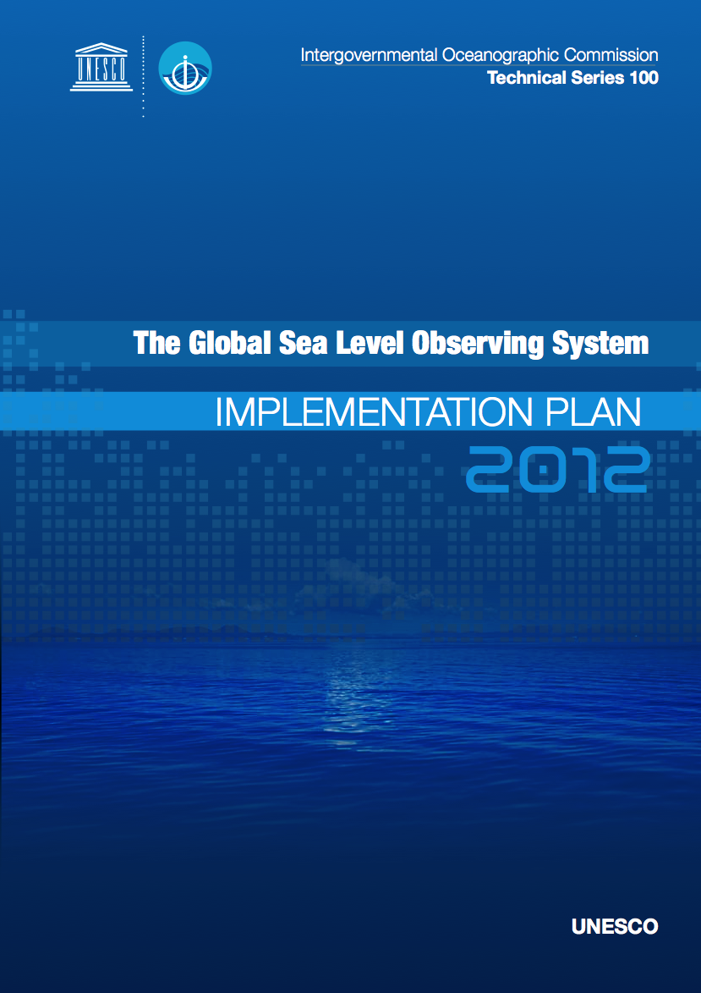
The Global Sea Level Observing System (GLOSS) 2012
Mark Merrifield
University of Hawaii
Requirements
Status
Strategies
Partnerships
Emerging technologies
5-yr vision
Ocean Climate Observations Workshop
June 2012

Slide 2
The GLOSS Program
Established by the IOC/UNESCO in 1985 to provide oversight and coordination for global and regional sea level networks in support of scientific research
First GLOSS Implementation Plan (GIP) in 1990
  established GLOSS Core Network (GCN) of ~300 stations
  set measurements standards
Ocean Climate Observations Workshop
June 2012

Slide 3
The GLOSS Program
Second GIP in 1997 formed sub-networks
  long-term trends (GLOSS-LTT)
  calibration network for altimetry (GLOSS-ALT)
  monitoring aspects of ocean circulation (GLOSS-OC),
Ocean Climate Observations Workshop
June 2012

Slide 4
Sea-level monitoring requirements
2006 WCRP workshop “Understanding Sea Level Rise and Variability”
  Complete GCN of ~300 gauges with real-time data availability
  GNSS positioning at appropriate stations
  Pursue data archaeology
Second Report on the Adequacy of the Global Observing Systems for Climate
  Enhance and extend global and regional sea-level networks for climate change detection and assessment of impacts
  GLOSS sites may also provide a platform to measure additional common variables
Ocean Climate Observations Workshop
June 2012

Slide 5
Sea-level monitoring requirements
Integrated, Strategic Design Plan for the Coastal Ocean Observations Module of the Global Ocean Observing System
  GLOSS system contributes to the global coastal module of GOOS.
International GNSS Service (IGS) and the Tide Gauge Benchmark Monitoring Pilot Project (TIGA)
  TIGA seeks to establish a global network of continuously operating GNSS stations at or near tide gauges
  Promotes GNSS processing centers tied to GLOSS data centers
Ocean Climate Observations Workshop
June 2012

Slide 6
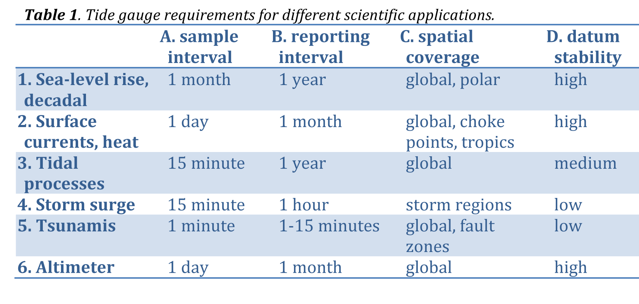
Requirements
Ocean Climate Observations Workshop
June 2012

Slide 7
Global sea level reconstructions from tide gauges
Ocean Climate Observations Workshop
June 2012

Slide 8
Multi-decadal sea level variability in the western tropical Pacific
Ocean Climate Observations Workshop
June 2012
Merrifield et al. (2012)

Slide 9
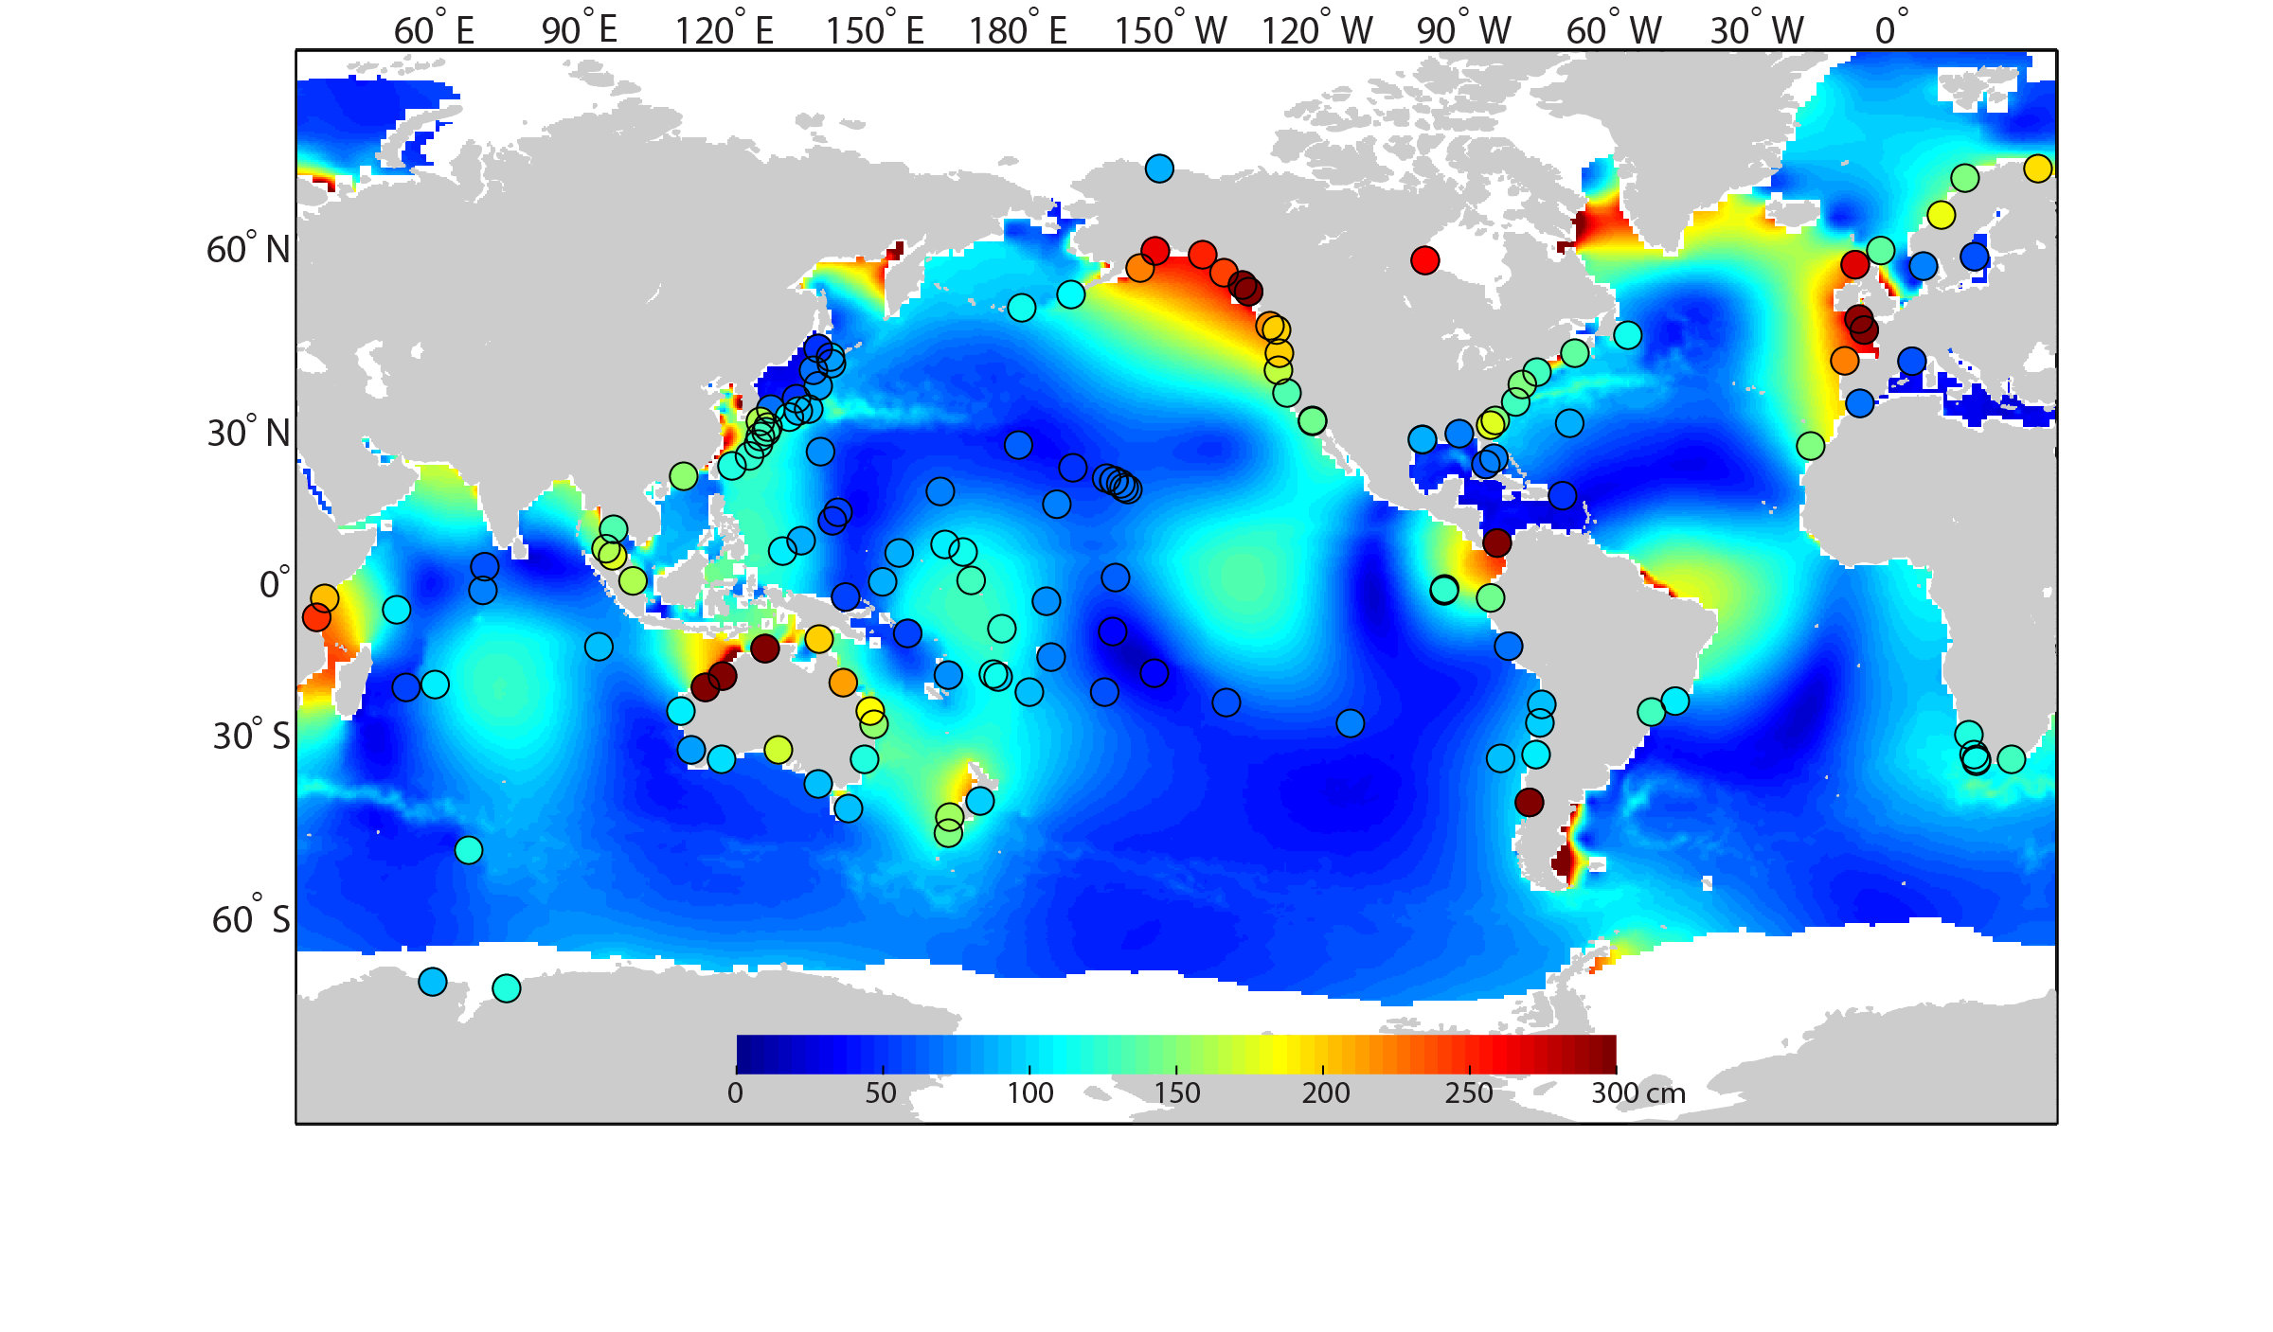
Global map of sea level annual extremes
Ocean Climate Observations Workshop
June 2012
Genz et al. in prep.

Slide 10
Island coastal inundation – waves and water level
Ocean Climate Observations Workshop
June 2012

Slide 11
GIP 2012 Recommendations
100% operational GLOSS Core Network (GCN)
All GCN stations report in near-real time
Ground motion monitoring at all GCN stations
Continuation of GLOSS-LTT, GLOSS-OC, and GCOS Climate datasets
GCN will serve as GLOSS-ALT
Formation of GLOSS-HF, database of high frequency observations
Ocean Climate Observations Workshop
June 2012

Slide 12
GIP 2012 Recommendations
Delayed Mode Data – PSMSL/BODC
Fast Delivery Data – UHSLC
GNSS/DORIS Data – ULR
High Frequency Data – BODC/UHSLC
Sea Level Monitoring Facility – VLIZ
Ocean Climate Observations Workshop
June 2012

Slide 13
Status – GCN 290 stations
Ocean Climate Observations Workshop
June 2012
Regions of improvement: Caribbean, India, Central America
85% operational tide gauge, 69% NRT or fast reporting, 65% w/ GPS/DORIS
Notes:
69% NRT or FD
85% operating
65% w/ GNSS

Slide 14
Status – GCOS 170 stations
Ocean Climate Observations Workshop
June 2012
92% operational tide gauge, 75% NRT or fast reporting, 74% w/ GPS/DORIS
Notes:
75% NRT or FD
92% in operation
74% w/ GNSS

Slide 15
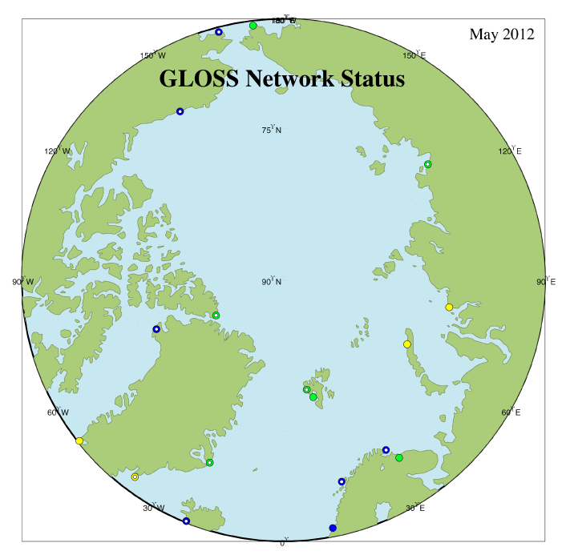
Arctic Ocean stations

Slide 16
General Strategy
National tide gauge networks are the main contributor to GLOSS and GCOS
International, interconnected data centers
International assistance for developing countries
Regional networks – shared sea level technicians and resources
Coordination with tsunami/hazards and GPS communities
Ocean Climate Observations Workshop
June 2012

Slide 17
Partnerships
GLOSS provides international coordination – US support for IOC
IGS - international initiatives needed to complete the GNSS network
Coastal inundation and wind wave observing systems
Major network expansions (Indian Ocean, SE Asia, Caribbean) possible due to tsunami funding – sustainability issues
Ocean Climate Observations Workshop
June 2012

Slide 18
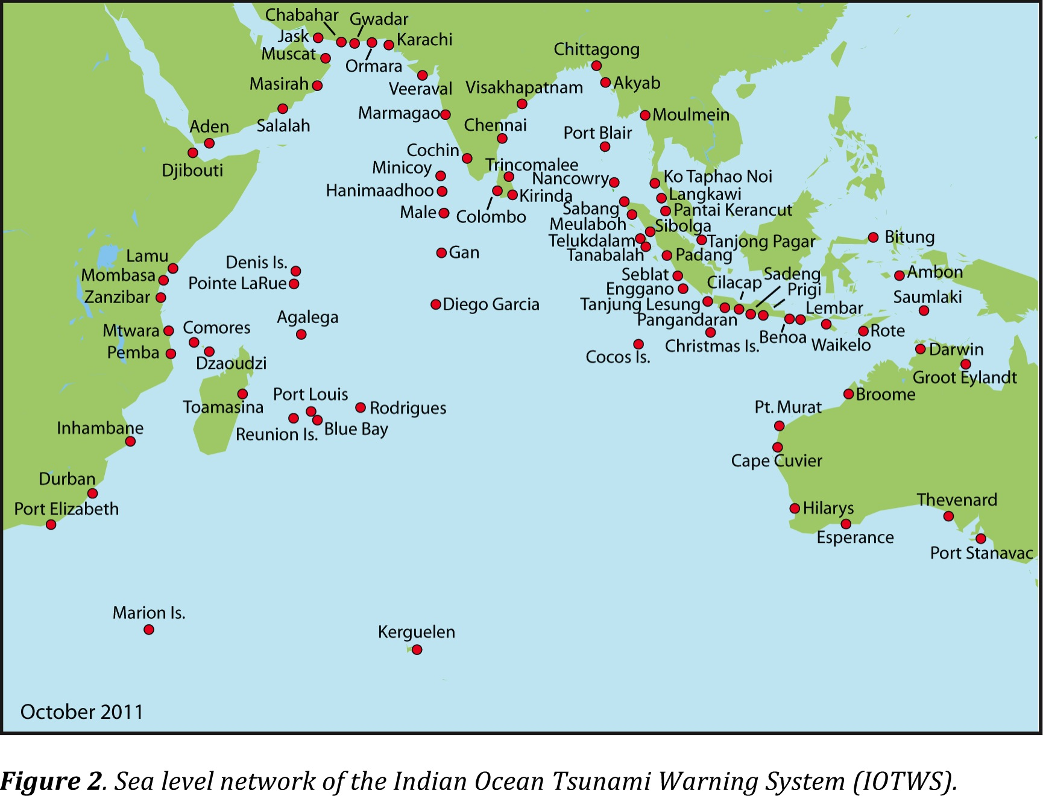
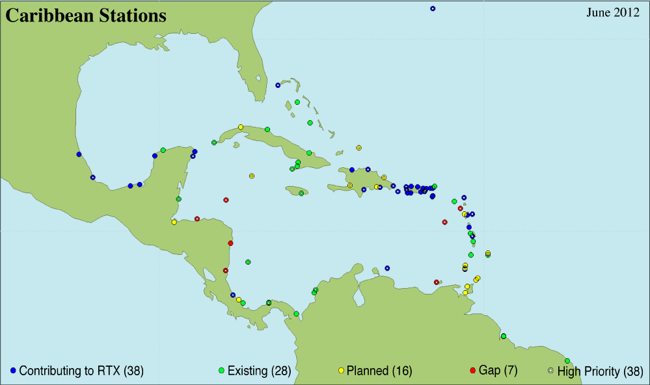
Maintain build-up accomplished through tsunami programs
Indian Ocean Tsunami Warning System
CARIBE Early Warning System
Ocean Climate Observations Workshop
June 2012

Slide 19
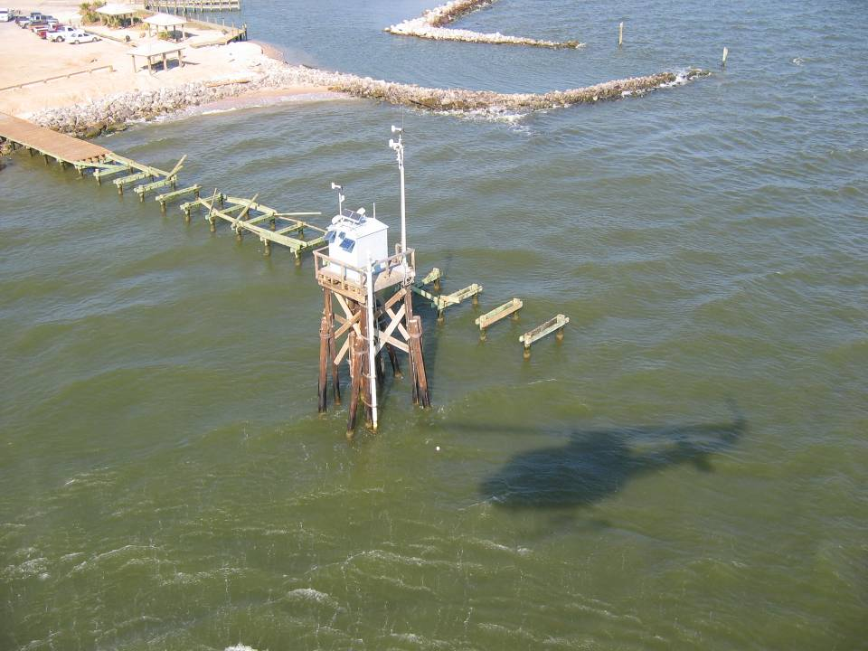
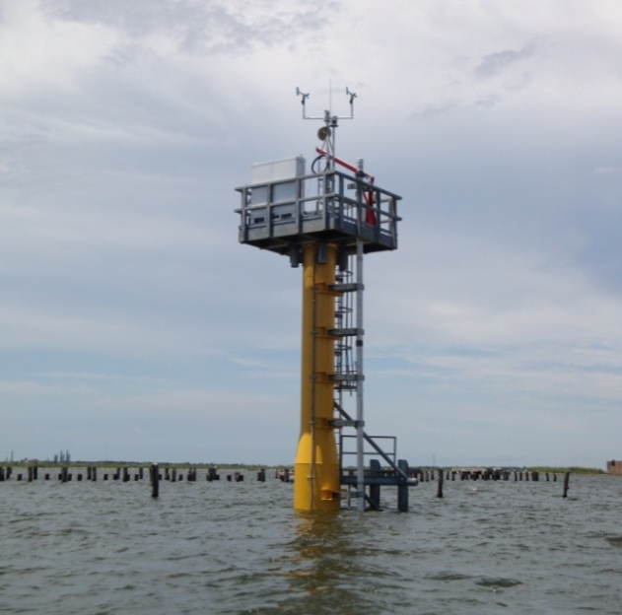
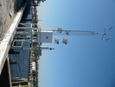
Emerging Technologies
Hardened stations and single pile platform design have been installed by NOAA CO-OPS in areas of high coastal storm vulnerability (e.g., Gulf of Mexico).
Mobile, AL Tide Station
Dauphin Island, AL Tide Station
After Hurricane Katrina
New Canal, LA Tide Station refurbished
After Hurricane Katrina
Lake Borgne, LA Tide Station installed prior to
After Hurricane Gustav
R. Edwing

Slide 20
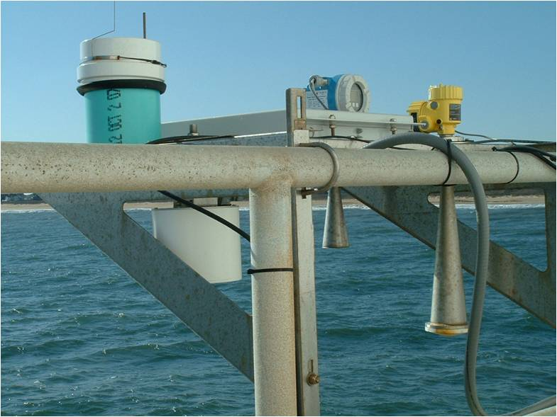
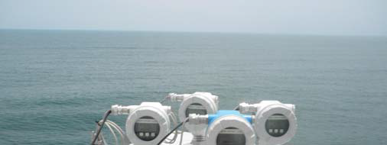
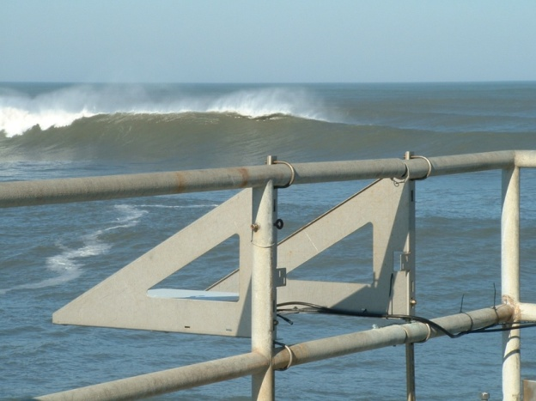
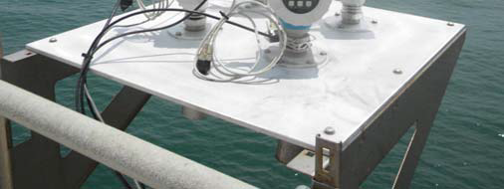
Emerging Technologies
NOAA CO-OPS has made progress testing and evaluating microwave water level sensors.
Evaluation of multiple sensors
Ensemble evaluation of
single sensor type
Evaluation in high wave
environments
R. Edwing
AIR GAP RESULTS: http://tidesandcurrents.noaa.gov/publications/tecrpt42.pdf

Slide 21
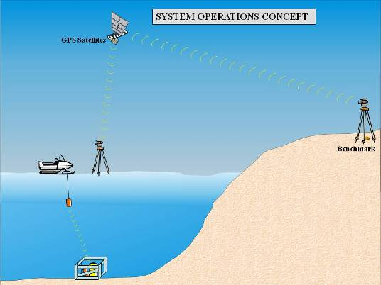
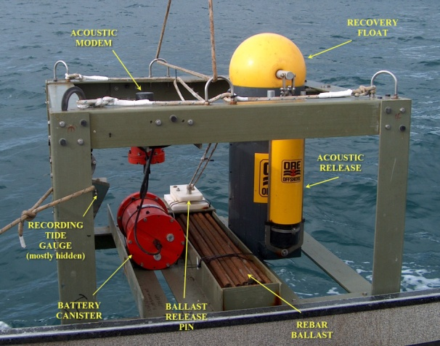
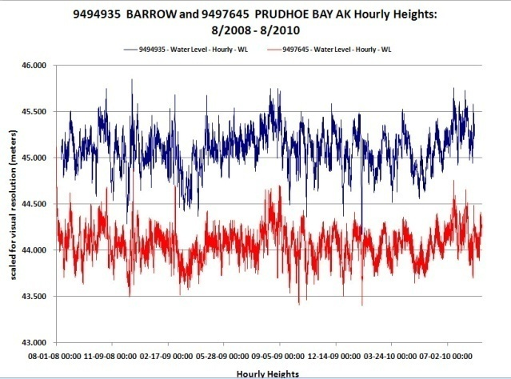
Emerging Technologies
NOAA has developed a methodology to obtain long-term measurements in the Arctic Ocean.
Schematic of the bottom-mounted, under
ice pressure Gauge configuration
Operating offshore of Barrow, AK
Photo of bottom-mounted, under
ice pressure gauge system
Collection of two-years of continuous data at Barrow for comparison with Prudhoe Bay, AK
R. Edwing

Slide 22
5 year vision
GNSS installations – increase to 80% GCN, 90% GCOS
Near real-time transmissions – 80% GCN, 90% GCOS
Coastal inundation – waves + water level
Increase number of Arctic Ocean stations
Establish regional technical support
Ocean Climate Observations Workshop
June 2012

