Slide 1
Victor Levesque U.S. Geological Survey Florida Water Science Center Tampa, Florida
Documenting
Regression Analysis for Index Velocity Ratings
Notes:
Hello and welcome to another installment in the OSW Hydroacoustic Webinar Series.
As a courtesy to everyone, make sure that your phones are muted, to reduce background noise, and allow everyone to hear the presentation.
Hydroacoustic reviews have shown the need to provide guidance for documenting stage-area and index velocity ratings. A common finding is the workbooks and worksheets are not understandable by a reviewer and sometimes the original hydrographer doesn’t remember what they did to arrive at the final ratings. This webinar will provide guidance on what documentation needs to be included with the stage-area and index velocity ratings

Slide 2
Overview
Data required for the rating (Stage-area and Index velocity)
What to collect and what to keep
Assembling and Documenting the data
Examples
Rating documentation (Stage-area and Index velocity)
Assembling and Documenting the data
What information is needed
Examples
Notes:
This webinar will provide guidance about what data needs to be included in a rating, how the data and information should put together and organized and examples of poor and suggested rating data, documentation, and analysis.
As you will see, documentation and additional information are key to providing a map that can be followed by anyone to retrace the steps taken and the logic involved in developing stage-area and index velocity ratings.

Slide 3
Two Ratings
Stage-to-area
Index-to-mean velocity
Q = VA
Notes:
The index-velocity rating requires two separate ratings, but both ratings are used to develop the final index-to-mean velocity rating and to compute discharge.
The stage-area rating is relatively straightforward, and requires only cross-section shape and water level data.
The index velocity rating requires the stage-area rating, water level, discharge measurements, and index velocity data.

Slide 4
Stage-to-Area Rating
Collect cross-section survey and water level data
Assemble data
Document data and results
Create and document a stage-area rating
Notes:
Carefully survey the standard cross-section shape.
Assemble all the survey and water level data together in a file (Spreadsheet is a useful and commonly used tool).
Provide information (document) about how and what data were collected.
Provide information (document) about how the stage area rating was developed, and why the stage-area rating was chosen.
Provide sufficient information (documentation) that will allow a reviewer to easily reproduce your results and to follow your logic in the rating determination.

Slide 5
Data Collection
Standard cross-section
Clearly mark cross-section in the field and document in the rating
Include a site sketch
Include distances
Document survey method
Identify water level data and datum
Index Sensor
Flow direction
20 feet upstream
150 feet
Oak tree on left bank. Orange X on trunk.
Large rock with orange X
Standard cross-section
Notes:
Clearly mark and accurately reference the location of the standard cross-section in the field and in the stage-area rating analysis.
A site sketch with reference marks identified and dimensions should be included in the stage-area rating documentation.
Also measure and document the physical location and orientation of the index velocity sensor.
The information should also be in the station description, so that all subsequent cross-section surveys are performed in the same location year after year.
Include what methods were used to survey the cross-section.
Identify water level and datum used for the water surface at the time of the survey.

Slide 6
Data Collection
Important items to remember
Cross section must be referenced to stage
Survey past the maximum expected stage
You should routinely check for channel changes Every year for first three years
If there is a departure in the index velocity rating
After a high flow event
Use the same cross-section for resurvey
Notes:
1. Location of standard cross-section and the survey and water level data both need to be documented.
2. Measure higher than maximum expected stage (if possible). Some locations may not allow this to be feasible (large forested flood plain or swamp), and the stage at which flow occurs into this area needs to be documented, so discharge is either not computed or marked as estimated. It is important to determine the elevation where this flow will occur.
3. If the first three years of cross-section survey do not show any substantial change (may be as small as 2 to 3 percent, but may be closer to 5 percent as the measurement error must be considered), then cross-section surveys could be performed once every three years.
Always resurvey the standard cross-section after high flow events, or if a consistent deviation in the index-to-mean velocity rating is detected.
4. Always measure the same cross-section (This is where the documentation can help produce more accurate data).

Slide 7
Assemble the Data
Data can be input to a spreadsheet
Describe how and where data were collected
Label all columns
Include times and time datum
Include water level data measured during the time of the survey
Include a site sketch
Notes:
In the spreadsheet or worksheet, include information about the data. How was it collected, what has been done to the data (any interpolation or averaging?).
Clearly label all columns and include units and Time zones.
Include water level data slightly prior to, during, and slightly after the survey to provide information on gage height rate-of-change.
If you want to use short abbreviations for data variables, create a list with definitions describing what each column of data represent.
Include a site sketch (with distances and locations) that shows the standard cross-section location so that it can be measured again in the same place.

Slide 8
NWIS
Management
Station Information
Historical WY
Current WY
\\FloridaFL-S\Projects
GW
SW
WY2008
WY2007
WY2010
WY2009
25xx
30xx
252115080293701
DCP Programs
GW
SW
25xx
30xx
0220
0237
25xx
30xx
25xx
30xx
0220
0237
02370000
02370000
EDL
Inspections
Levels
Measurements
Levels Summary
Pictures
SIMS
DCP Programs
Levels Summary
Pictures
SIMS
Ratings
Station Analysis
Station Description
SWReview
Velocity
Water Quality
252115080293701
EDL
Inspections
Levels
Station Analysis
Station Description
Water Quality
Go2 Plots
Swami Scripts
Notes:
This is an example of a WSC file archival system.
It is recommended that all files associated with the stage-area rating (rawdata, cross-section plots, etc) are stored in a Ratings Folder under the Station Number (or however your WSC electronic data archive is specified).

Slide 9
Stage-Area Rating - Poor Example
Notes:
Many times, this is all the documentation available for a stage-area rating.
This is not an adequate stage-area rating. It leaves too many questions unanswered, and does not allow for checking the results.
The only data is the final stage area rating and a single plot.
More information is needed.
How was the rating determined?
How was the cross-section data collected?
Where is the original cross-section data?
Another hydrographer would have to redo the entire rating in order to be sure that this is the correct stage-area rating for the site.

Slide 10
Limited Documentation
Notes:
This is the only other information for the inadequate stage-area rating example.
No new information is provided about the rating on the plot worksheet.

Slide 11
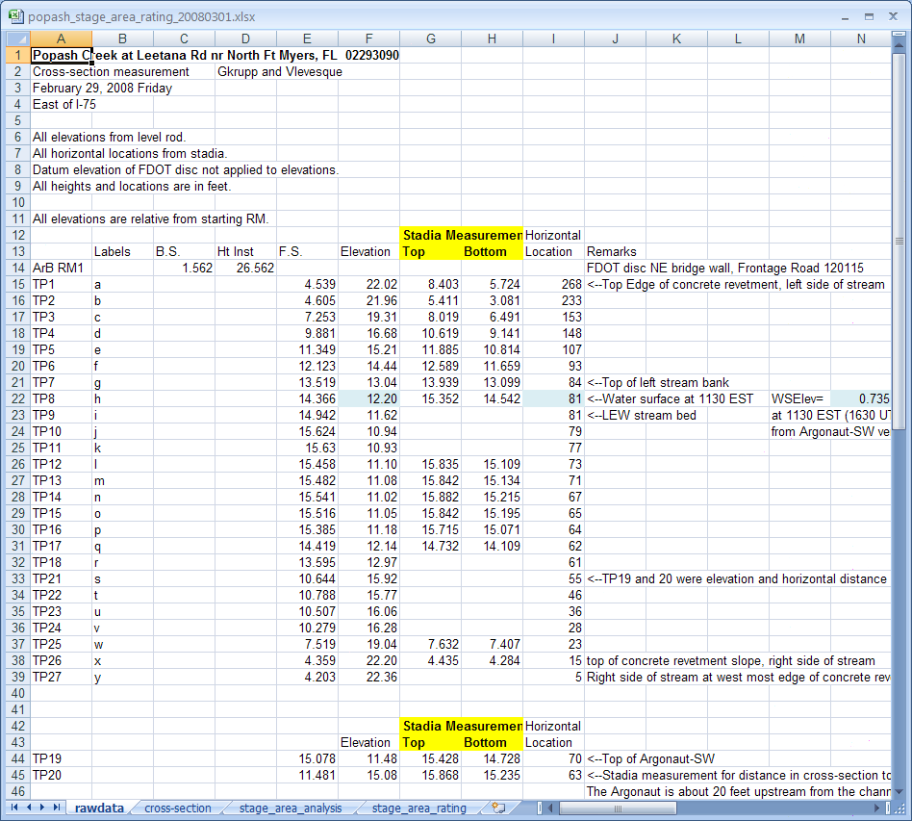
Stage-Area Workbook
Notes:
A better example of a stage-area rating.
This is the cross-section survey data.
Excel spreadsheets/workbooks are a convenient way to organize and document your data.
Notice the tabs (worksheets) at the bottom of the Excel workbook. Each tab should be labeled to identify the data on each worksheet (tab).
Many times the tabs are left with default names (like Sheet 1, 2, 3, etc). Labeling the tabs provides an organization overview for any one checking the rating.
Notice that the worksheets (tabs at the bottom) in the Workbook are organized in order from raw data on the left to the final stage-area rating on the right. It is suggested that all rating Workbook’s be organized in a logical order of progression from the basic to the most specific.

Slide 12
Where, when, who
How data were collected and what are the data
Details
Notes:
Worksheet 1 (rawdata tab) – rawdata and computations for cross-section with notes describing the data.
This example is a simple cross-section survey using only a level and level rod.
Information should be included that would allow another person to use the data to understand what all the data are and what was done with the data.

Slide 13
Plot the Cross-Section
Notes:
It is suggested that after the cross-section survey data has been assembled it is a good idea to plot the cross-section. This plot is to check the computations from Worksheet 1 (rawdata). Plot should make sense.
Plotting the assembled data will easily allow the hydrographer to see if there are problems with the data.

Slide 14
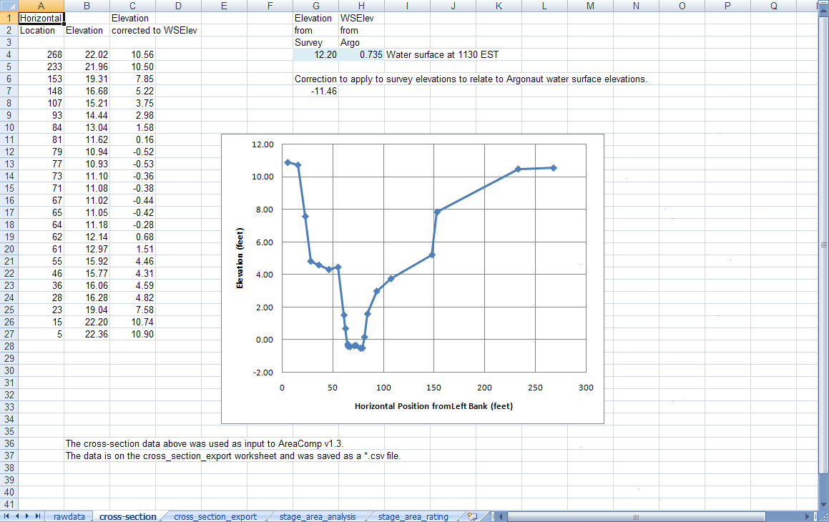
Cross-section corrected to WS elevation
Notes:
This worksheet (cross-section tab) has the cross-section survey data after correcting the arbitrary level elevations to the WS elevation (SW Gage Height) at the time of the survey.
These data and plot are on the cross-section worksheet (tab) spreadsheet workbook (popash_stage_area_rating20).
These data will be imported into software that will compute cross-sectional areas for a range of stage.
AreaComp is easy to use software created just for this purpose.

Slide 15
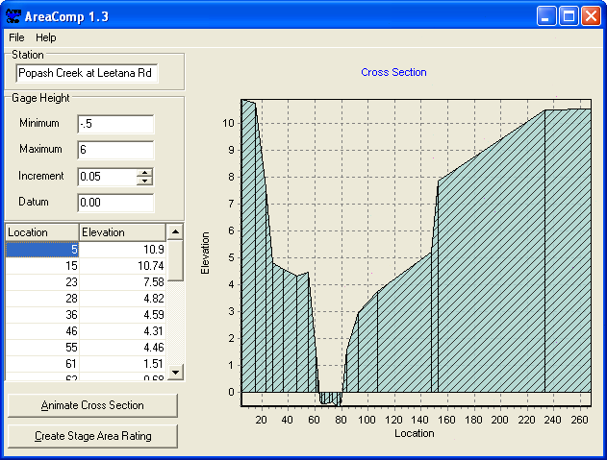
Input Data to AreaComp
AreaComp
USGS program for the purpose of attaining cross sectional area
Can use data tables or WinRiver ASCII files
Provides output for stage and area
http://hydroacoustics.usgs.gov/indexvelocity/software.shtml
Notes:
Load (or input) cross-section data into AreaComp (station and elevation).
Cross-section survey to the top of the bridge embankments on either side of the stream. The stream has gone into the overbank area (water level around 4 feet) on at least one occasion.
Make sure to save the cross-section shape as documentation.
When surveying using an ADCP and level and stadia methods, make sure the ADCP measurement and the appropriate ASCII file used for the cross-section survey is copied into the Stage_Area_Rating Folder.
All data used in the survey must be easily available for a reviewer to check the work.
Make sure the final cross-section data used in AreaComp are included in the Stage_area_Rating Folder.

Slide 16
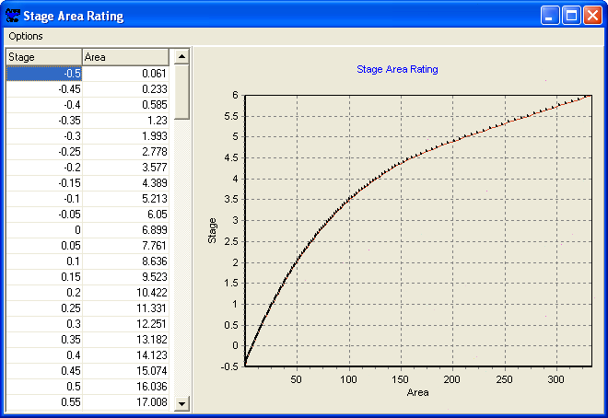
Generate a Stage-Area Rating
Save all output from AreaComp
Include data in Rating Workbook
Notes:
This is the first step to creating the stage-area rating. This is the AreaComp computed stage-area rating based on the user input.
Output these stage-area data using the Options selection at the top left of the plot.
This data should be included in the stage-area workbook.
Make sure also to save the cross-section and stage-area rating outputs from AreaComp into the Stage_Area_Rating folder.

Slide 17
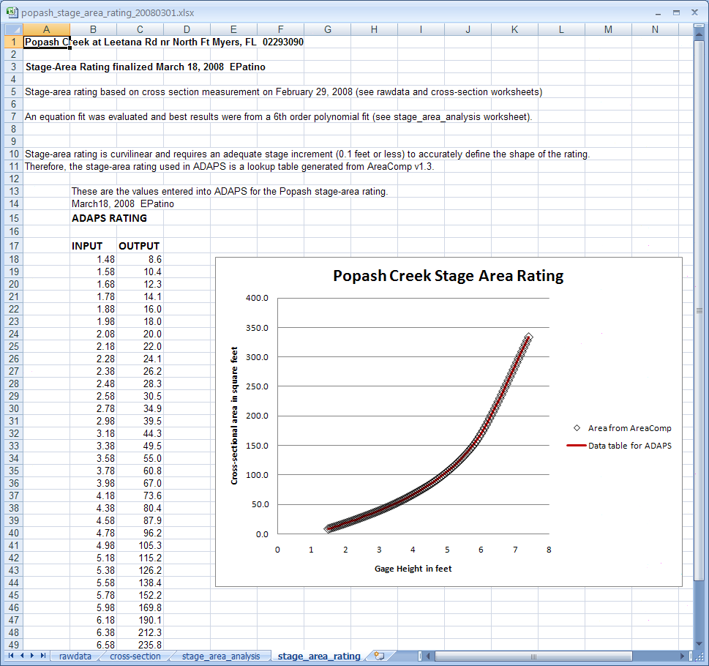
Stage-Area Rating final worksheet
Notes:
Here is the final stage-area rating based on the AreaComp output.
It was determined that a table-lookup rating would be the easiest to implement in ADAPS and can be used for the area computations for the index velocity rating
(the index-velocity look-up table will require 0.01 foot increments).
Plotting the AreaComp output (black diamonds) and comparing the look-up table data (solid line) can help make the determination for an adequate stage increment. The straight line segments between each stage increment should follow the higher resolution (smaller increment) stage-area data from AreaComp.
An adequate stage increment (here 0.1 and 0.2 feet increments) were selected to adequately describe the stage-area curve.
The final rating is clear as to what data were used in ADAPS and why this rating was chosen.

Slide 18
Documenting the Stage-Area Rating
How were data collected and transformed?
What data were used to create the rating?
Documentation to describe how the rating was developed
Leave no doubt as to how, what, and why the rating was developed
Notes:
Make sure the documentation provided answers all questions about the rating.
How were data collected and transformed (corrected)?
What data were used to create the rating?
Why was this rating was chosen?
Make sure sufficient documentation is provided that fully explains the rating development process and can be understood by another person.
Now the stage-area rating has been developed, with documentation that explains the rating development process, we will use the stage-area rating in developing the index-to-mean velocity rating.

Slide 19
Index Velocity Rating
Collect calibration data
Discharge
Stage
Index Velocity (RangeAvg X,Y, Z, Multi-Cell X,Y,Z)
Assemble data
Document data
Perform Regression Analysis
Identify and Document Selected Rating
Notes:
The index-velocity rating development process is similar to developing the stage-area rating, it just requires more data, more plots, and linear regression analysis. With more data, more documentation is required.
Documenting the data means including information on every worksheet or file that describes the organization and what is the data.

Slide 20
Collect Calibration Data
Synchronize all data sensor times
Configure index velocity and stage sensor data collection interval
Save and document all data
Notes:
It is extremely important to synchronize the data logger and the internal clock of the index velocity sensor.
It is recommended that index velocity and stage data be measured at a sample interval of 60 seconds with 60 second averaging.
The one-minute data will be used to synchronize and synthesize an index velocity value for the duration of each discharge measurement. The stage data should also average for 60 seconds and record for 60 seconds. Many times, after verifying that the stage does not change significantly over the course of the discharge measurements, it may be possible to use interpolation to adequately determine the stage value at the mid-time of the discharge measurement.

Slide 21
Assemble the Calibration Data
Discharge measurements
Dates, start and end times, and total discharge
Stage
Dates, times and stage
Index Velocity
Dates and times
RangeAvg X,Y,Z, Multi-Cell X,Y,Z, depth
Index Velocity Configuration
Notes:
Each of these categories (discharge, stage, and index velocity) can be in separate Workbooks, just make sure however you decide to assemble the data, that you include information that anyone can understand and follow to recreate all the steps you use in the rating development process. All data used for the rating process should be readily accessible and assembled to allow for easy review and checking.

Slide 22
Rating Analysis Documentation
Label all data columns
Include information about the data
Rearrange the data columns as necessary
Synchronize and Synthesize Data
Create an organized data table
Perform regression analysis
Select appropriate rating
Notes:
When using Spreadsheets;
Always label all columns to leave no doubt as to what are the data.
Vr or Vrated are not as clear as Computed Mean Velocity. You should include a variable name list at the top of the data tables, or in a file if you use other means than an Excel Workbook to synchronize, synthesize, and assemble the data.
Do not leave anything to a guess. Be explicit with any descriptions about what is on the worksheet and anything that will help clarify what is being done on the worksheet or with the data.
Could also have a separate workbook for discharge summary, stage data, and one-minute index velocity data.

Slide 23
Discharge Data Worksheet
Notes:
This an example index velocity rating Excel Workbook with multiple worksheets (tabs at the bottom).
This is the chronological discharge summary worksheet. The data was copied from the WinRiver II discharge summary (F12) and pasted into the worksheet. Data columns were added and moved to get the necessary information adjacent to each other (Date, Start Time, End Time, and Total Q).
It might be convenient to keep all the raw data (discharge, stage, and index velocity) in one workbook, and then copy the needed rawdata into a worksheet in the rating Workbook.
Select one way and make it standard practice in your WSC.

Slide 24
Stage Data Worksheet
Free Excel Interpolation Add-In available:
http://www.xlxtrfun.com/XlXtrFun/XlXtrFun.htm
Notes:
This is raw stage data during the time of the calibration measurements. Notice that the columns are all labeled and time datums are listed. For this site, index velocity data and discharge data are collected in UTC to prevent confusion about when Daylight Saving Time begins or ends.
For this particular site, the 15-minute stage data will be used with interpolation to compute the gage height at the mid-time of the discharge measurement. The interpolated data from the 15-minute pressure-sensor stage data and the one-minute calibration acoustic water level data were previously compared and it was determined that interpolation of the 15-minute data were sufficiently accurate for the computation of stage for the calibration measurements. That data was documented in a separate Workbook, and is saved in the Ratings folder.
There is handy free add-in that provides an easy way to perform interpolation in Excel that can be downloaded and added to the built-in Excel functions. The web address for getting the add-in is shown on the slide.

Slide 25
Index Velocity Data Worksheet
Notes:
This is index velocity data from the SonTek Argonaut and was output using ViewArgonaut to export *.dat and *.vel files. English units were selected in ViewArgonaut.
Notice that signal to noise ratio data and many other columns that are normally output from ViewArgonaut. Only the data that is necessary for analysis is retained.
Information notes are included at the top of the data table identifying how the data are from and what are the data.
Notice the Range-averaged Y velocity and the Mutlti-cell X and Y data. The columns for Multi-cell Speed and direction will be removed in the next step (Spd and Dir).
Cell begin and end are retained to verify that the values have not changed for any calibration measurements.
Currently only two days of calibration data are listed. As more calibration data are added to this worksheet, the date range will be updated.
These are the minimum amount of data that should be included for the index velocity rating analysis.

Slide 26
Synchronize and Synthesize Data
Notes:
This data table is slightly different from the previous worksheet.
Information at the top of the data worksheet explain what are these data what was done to the data table.
Columns not directly used in the regression analysis are not included on this worksheet. However, the extra data is still available in the previous worksheet.
This information is essential to understanding and following the rating analysis.
Synthesizing data means creating new values of index velocity and stage that are synchronized with the discharge measurement data. It is important to understand what time is represented by each time stamp (start of measurement, end of measurement, mid-time of measurement, etc). For most index velocity sensors, the time stamp is the start of the measurement.

Slide 27
Synchronize and Synthesize Data
Notes:
This is the same worksheet as the previous one, only focused on the synthesis and synchronization of the index velocity data with the discharge data (moved to the right).
Discharge start and end times, mid-time, and total Q are between the one-minute velocity data on the left and the synchronized and synthesized (averaged) index velocity data on the right.
Care must be used to ensure all data have the same time datum (EST, UTS, CST, etc).
It is important to include these data in the rating Workbook, as it allows the hydrographer and any reviewers to easily check the computations, and makes it easier to go back and change something if a problem is discovered.

Slide 28
Synchronization and Synthesis
Notes:
This is the same worksheet of the Workbook that shows how the index velocity data are synchronized and synthesized.
You must be aware of how the all the data is time stamped. For the SonTek Argonauts, the time in the data file represents the start time of the measurement. You must know what the index velocity averaging time is from the configuration information included with the data.
For the TRDI ADCPs discharge measurements the start and end times are relatively easy to understand. The discharge measurement mid-times are used to compute a stage for each discharge measurement in this rating example.
Notice that all the times include seconds, this level of accuracy is necessary in conditions with rapidly changing flow (tidal, small-basin flashy streams, etc). Always include dates and times (to the second) for all data.
The start and end times of the discharge measurement are used to determine what index velocity data will be averaged together for each discharge.
Describe the procedure and bring attention to the formula in the highlighted cell.
One method of synchronizing and synthesizing index velocity data is described here. There are other methods that can be used, just make sure that the method used is described in the rating Workbook.
Using 60 second index velocity data, if the start time of the discharge measurement is less than or equal to 30 seconds from the start time of the index velocity measurement, then that will be the first index velocity value used in the duration average. If the start time of the discharge measurement is greater than 30 seconds from the start time of the index velocity data, then the next value of index velocity is the first index velocity value in the duration average.
Similarly, if the end time of the discharge measurement is less than or equal to 30 seconds from the index velocity start time, the previous index velocity value is the last value used in the duration average. If the discharge measurement end-time is greater than 30 seconds from the index velocity end-time, then that value of index velocity is the last value in the duration average.

Slide 29
Create an Organized Data Table
Notes:
After synchronizing and synthesizing the index velocity data, we need to “clean up” the data table so we can use the data in regression analysis. The data on this page were copied (and special pasted with numbers and formats only) from the previous worksheet and all the rows between each averaged index velocity have been deleted. This can be tedious, but it is important to be careful and not make any mistakes. We almost have all the data required for the index velocity rating analysis.
Notice the information provided at the top of the worksheet that describes the data, and identifies where the data came from.
Still missing columns for stage, cross-sectional area, and mean velocity.

Slide 30
Add Variables
Notes:
This table is slightly different than the previous data table as it includes stage (in this case additional water level (Gage Height) ), cross-sectional area from the stage-area rating, measured mean velocity. These data will be used in the regression analysis for the index velocity rating.
In this case the Punta Blanca Pressure data (water level data) were interpolated to the mid-time of the discharge measurements. Care must be used to ensure all data have the same time datum (EST, UTS, CST, etc).

Slide 31
Exploratory Data Analysis
Plot with Measured-Mean Velocity (y-axis)
Index velocity (X, Y, Z, multi-cell X,Y,Z)
Stage
Notes:
Include plots of the data as the initial part of the regression/rating analysis.
Exploratory analysis gives an overall view of how the independent variables relate to measured mean velocity and possibly with each other. This is valuable information as it can indicate which variables might be related to mean velocity.

Slide 32
Index Velocity
Notes:
Here are two exploratory plots. Include these types of plots in the rating Workbook with documentation that describes the observations by the rating hydrographer. The plots of independent variables (index velocity, gage height, cross-stream velocity, etc) can help identify how all possible variables interact with the measured mean channel velocity, and also provide clues to the hydrographer as to the flow characteristics at the site.
Include notes about the plots that make hydraulic sense.
RA X velocity is the range–averaged along-stream velocity.
RA Y velocity is the rang-averaged cross-stream velocity.
In this example;
The plot of the RA X velocity with measured-mean velocity shows pretty good agreement with the mean velocity, although there appears to be some curvature in the relation on the high end of the positive range. This indicates that a simple linear relation would not be the best fit for the data.
The plot of cross-stream velocity (RA Y velocity) with measured-mean velocity indicates that the flow orientation changes depending on whether the flow is upstream (negative mean velocity) or downstream (positive mean velocity). This is a clue that indicates that the cross-stream velocity might be considered as an independent variable in the regression analysis.

Slide 33
Stage
Notes:
This is a plot of the stage data with measured-mean velocity.
Data shows some linearity in the negative mean velocity region.
The positive data may be linear above a certain range in velocity, but generally looks to be curvilinear.
The plot indicates distinct regions where the stage does not linearly relate with the measured-mean velocity (~5.2 – 5.3 feet), and another region where the stage appears to be linearly related, but has a V shape (mean velocity less than -1.5 and greater than zero and 4.9 – 5.3 stage range and mean velocity greater than -1.5 fps and a stage range of 5.1 to 5.3 feet).
This information (the plot) should be included in the rating Workbook.

Slide 34
This is NOT Regression Analysis
Notes:
This is an example of an inadequate regression analysis. The data was divided into two regions, and a trend line was added for each region. This can be a quick look at a possible rating, but by itself, the plot only provides one part of a regression analysis. More information is needed to completely assess the regression analysis.

Slide 35
Inadequate Documentation
Notes:
This is an example of a rating that is confusing for someone not familiar with the data and the site.
There is no regression analysis.
It is unclear which rating was chosen, as it shows two ratings, and equation rating at the top (Rating #2) and a lookup table at the bottom (Rating #2).
Times are missing.
Not sure how mean velocity were computed (no area or reference to the stage-area rating).
No Multi-cell data.
Only shows X velocity data.

Slide 36
Index-to-Mean Velocity Regression All Data
Notes:
This is an example of an Excel regression output for range-averaged X velocity and the measured-mean velocity.
This is one part of the information that needs to be included in the rating analysis.
Make sure all variables used in the regression are labeled properly, so any one can realize what data has been analyzed.
The yellow highlighted boxes and the plots are used to assess the regression fit.
Comments about the regression output can be added here or in the final summary of the rating analysis.

Slide 37
Regression Analysis continued
Notes:
This is an example of the a rating that divided the velocity data into three regions.
Given the limited amount of calibration data over only two days of measurements, the rating was divided into three sections based on the apparent slope changes and residual plots. A regression output should be performed for each range.
The lower velocity range regression output is shown in this figure.
A plot of the divided rating was used to visualize the divisions.

Slide 38
Select Appropriate Rating
Notes:
The three section rating can be represented with a table-lookup rating in ADAPS.
Intercept points were computed and the resulting Rating table is shown in the lower left corner of the worksheet.

Slide 39
Check the Rating
Notes:
It makes it easier to review a rating if plots of the discharge residuals are provided in the rating analysis workbook.
You should also plot the discharge residuals (y-axis) over time (x-axis) to check for any possible systematic patterns.
Residuals are just computed discharge minus measured discharge, plotted versus measured discharge.

Slide 40
Regression Analysis
Notes:
Summarize the results of the regression analysis that was performed on this worksheet. The data table used in the regression analysis is below the summary notes.

Slide 41
Rating Summary
Notes:
There should be a rating summary page. This example Workbook’s worksheets are arranged such that the final worksheet “rating_summary” is the left most worksheet in the workbook. The raw data starts in the right most worksheet, and as the data is processed subsequent worksheets are to the left. You can use a left to right progression, the idea is for the worksheets to follow the logical procession used to determine the rating.
You may also want to have separate workbooks for the discharge data, stage data, and the index velocity data to reduce the number of worksheets (tabs) in the rating analysis workbook. Just be sure to identify where the data in the rating workbook came from. Information that lists the other workbook filenames and other information about the data used in the rating analysis should be provided and easily understood.

Slide 42
Summary
Collect and document data
Carefully assemble and identify data
Maintain good notes
Perform thorough analysis
Clearly identify the final rating and provide information for the selection
Leave no doubt as to how, what, and why the rating was developed
Notes:
Collect and document data – make sure data is collected to the best standards and quality assured when assembling the data. Make sure times are all correct. This can be substantial source of error in ratings.
Assemble and identify the data – be sure to include all possible data, not just the X-velocity. Make sure all the data used to synthesize and synchronize the data are available for review (discharge, stage, cross-section shape, and index velocity).
Plot variables first to begin the rating analysis.
After deciding which variables are the best to use, perform the appropriate regression analysis and document the steps so a reviewer could easily follow your procedure and understand your logic that were used to arrive at the final rating.
Clearly identify the final rating choice- Include similar information from the regression analysis to document the choice of the final rating.
Continue adding data to the rating, and redo the regression analysis. If a substantial change is required, then the older ratings must be maintained to provide the history of the station. It would be appropriate to start a new rating workbook if the rating has to be changed. In this case, the original rating workbook should be preserved (archived), but information regarding the rating history must always be carried forward into the new rating workbook.
If a new rating has to be created, then a well documented rating summary could be used as the rating history in a new rating workbook.

Slide 43
Questions?
Notes:
Popash Creek high-flow condition looking towards right bank of creek. Argonaut-SW is located slightly to the right of the gage shelter (with hydrographer), almost in the middle of the creek. Flow is out of the bank on the left side of the creek (where grasses start in the foreground).

