Slide 1
Addressing NCEP Director’ Concerns About the NAM Upgrade:
Read-Ahead Material Prepared by EMC 09/16/11
Updated with relevant feedback slides from original 9/12/2011 decision briefing
Enhanced with recent reruns and feedback from
SPC & AWC on those reruns

Slide 2
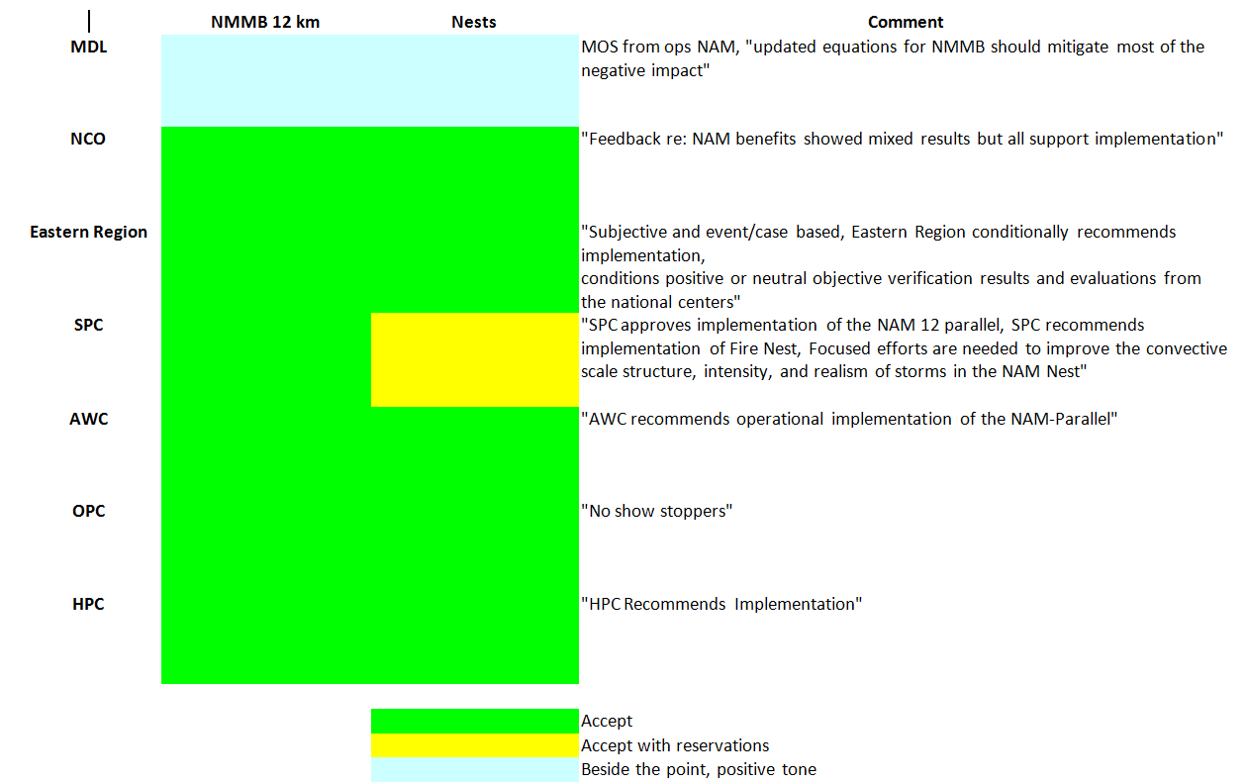
Summary of Reviewers’ Recommendations
National Interagency Fire Center (NIFC) recommended implementation.

Slide 3
SPC NAM Nest Evaluation
  Major Findings
    4 km CONUS Nest
      The NAM CONUS Nest typically generated storms that exhibited broader, weaker, and less useful reflectivity signatures, and much weaker storm intensity characteristics as revealed by updraft speed and updraft helicity products
        Updraft speed and updraft helicity were typically 2-5 times smaller compared to other high-resolution models
      On many outbreak days, the NAM Nest failed to generate storms indicative of high severe weather potential
      It is not uncommon for convective storms in the NAM Nest to have effective resolution considerably coarser than the 4 km grid would suggest
      Overall, the NAM Nest does not provide the same level of guidance as other high-resolution models, and its current performance is not useful for SPC and NWS severe weather forecasting
      Recommendation: Focused efforts are needed to improve the convective scale structure, intensity, and realism of storms in the NAM Nest

Slide 4
EMC Response to SPC’s Concerns About the NAM Nests (1 of 2)
Discussions were held between EMC and SPC in April. The following were discussed and, at the time, SPC said they understood our position and strategy (see next slide) and would not block implementation of the NAM upgrade. They do support implementation with acknowledgement that EMC will continue to improve the 4km nest performance for severe weather applications
The NAM upgrade is not replacing an existing useful tool for SPC with an inferior one
NAM nests are brand new and their implementation will not degrade the quality of SPC guidance in any way

Slide 5
EMC Response to SPC’s Concerns About the NAM Nests (2 of 2)
SPC already benefits from NCEP running WRF-ARW and WRF-NMM in the HiResWindow in operations multiple times per day and continued running of WRF-NMM (older version preferred by SPC) in Matt Pyle’s special twice daily runs.
Among the various sources of severe weather guidance used by SPC, the new NAM nests just won’t be one of them in its initial form.
EMC will seek ways to bring out structure and strength of convection while preserving the utility of nest guidance for the other users

Slide 6
Non Severe Weather Applications of the NAM 4km Nest
The NAM nests were not designed or tuned to provide the severe weather guidance needed by SPC
The NAM nests were designed to provide NWS WFOs and other users with basic weather guidance, e.g. QPF
The nest resolutions were selected to match the NDFD grids on which WFOs produce their gridded forecasts
Currently, the NAM-DNG WFOs use to initialize their GFE, is downscaled from NAM’s 12 km to local NDFD resolutions [5.9-2.5 km] by the not-so-accurately-named “smartinit” processing
Having NAM nests will mean very little (if any) downscaling will be needed to produce NAM-DNG.

Slide 7
Dissemination of NAM Nests
NAM-DNG is already distributed to WFOs via AWIPS-SBN and thus available to private sector users via NOAAPORT. This is the primary distribution mechanism for NAM nest fields including QPF and simulated reflectivity.
New double resolution NAM-DNG grids will be made for CONUS and Alaska which anticipate the future move of NDFD to those resolutions and recognize & support the fact that a majority of WFOs are already doing their forecast prep at those double resolutions.
NWS/HQ, the OSIP/TOC/SBN enterprise, NCO & EMC have geared up to distribute the new NAM-DNG grids.

Slide 8
FROM HPC/DAVE NOVAK Day 1 Warm-Season QPF
May 9 – June 10, 2011
4 km CONUS nest best among guidance evaluated
4 km CONUS nest substantially better than operational NAM
12 km parallel NAM worst among guidance evaluated
12 km parallel NAM worse than operational NAM
Best
Worst

Slide 9
Analysis of the NAM 12km Parent QPF
The HPC results (HMT Day-1 warm season QPF) were limited to 23 days spanning 5 weeks (9 May - 10 June) in Spring 2011 (small sample)
The QPF stats produced during the NAM development cycle span a full year and are broken down by season (see next two slides)
Overall, Eq. Threat Scores are comparable to current 12km NAM and are significantly better in Summer (June-August) 2011 for large amounts
When they are somewhat worse (Spring, March-May), the higher quality of the 4km nest’s QPF more than compensates
Comparable ETS despite lower bias [especially during Spring] implies more hits without false alarms

Slide 10
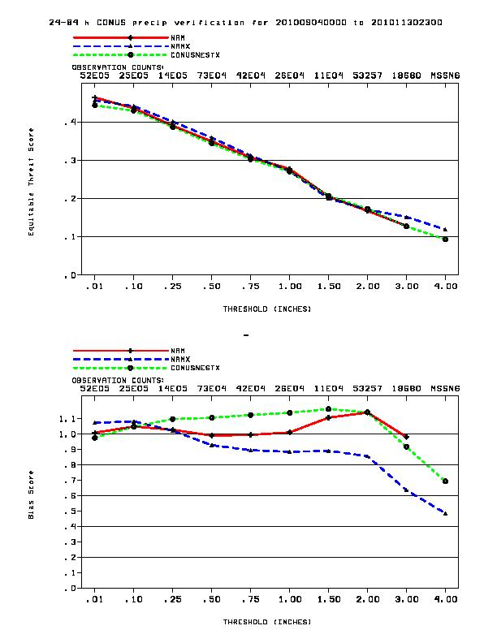
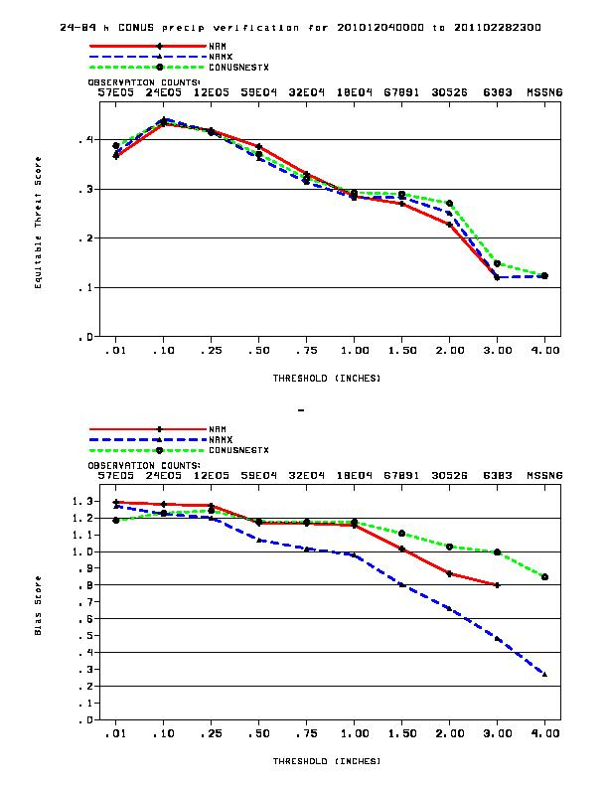
September - November 2010 QPF scores
December 2010 – February 2011 QPF scores
ETS
ETS
ETS
Bias
Bias
Bias
These results show comparable skill between current and new NAM.

Slide 11
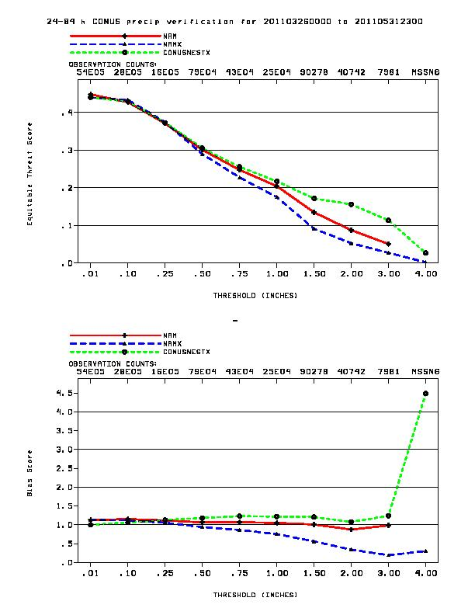
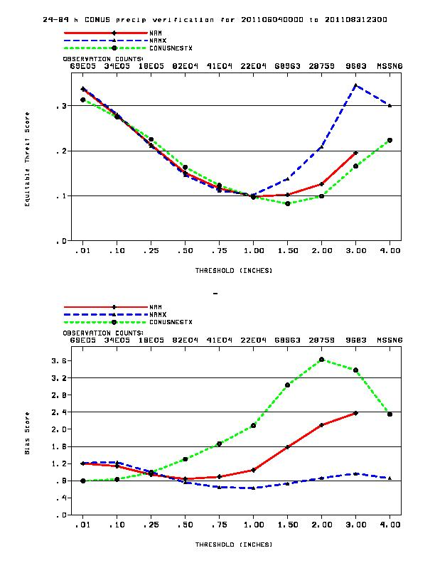
March – May 2011 QPF scores
June - August 2011 QPF scores
Nest much improved
over current NAM
12 km parent significantly
better than current NAM
ETS
ETS
Bias
Bias
12km parent Dry Bias
Bias

Slide 12
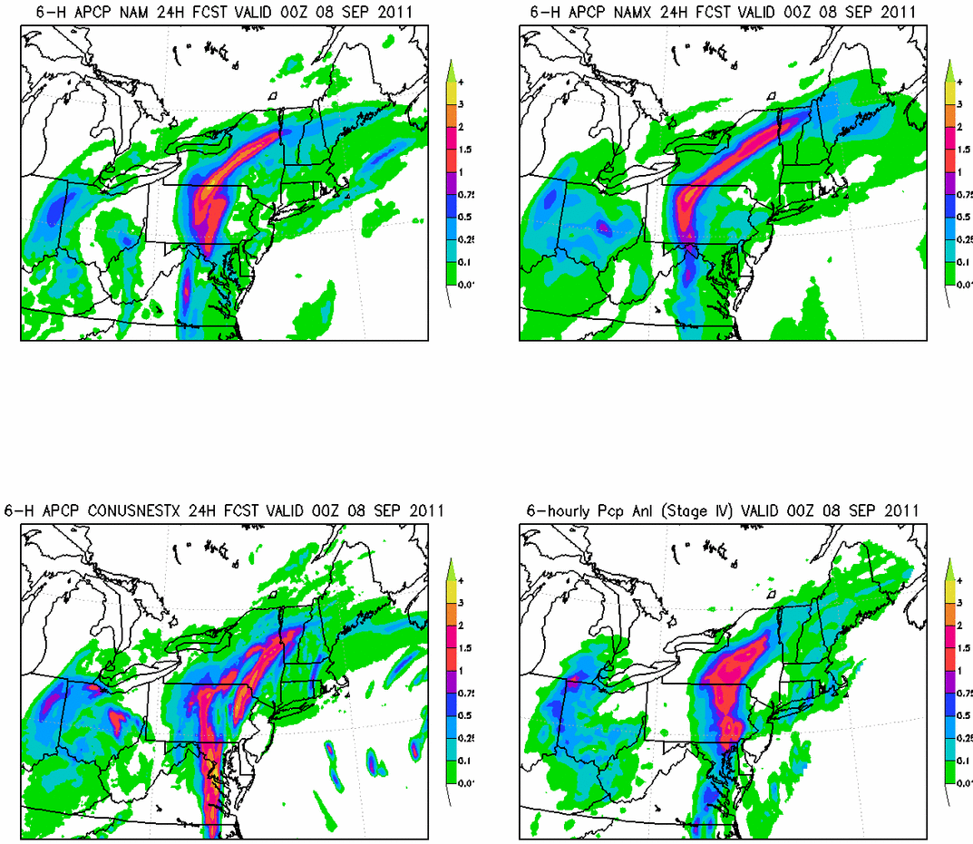
NAM 4km nest captured Lee’s locally heavy precip at 24hr range

Slide 13
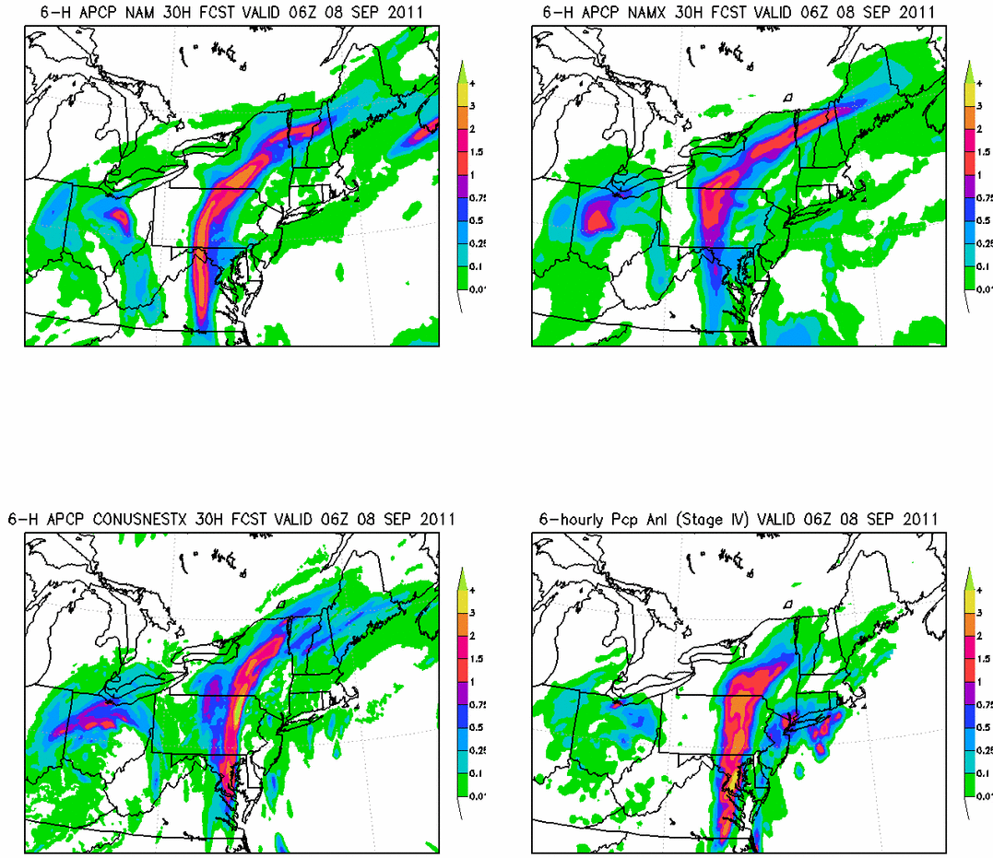
NAM 4km nest captured Lee’s locally heavy precip at 30hr range

Slide 14
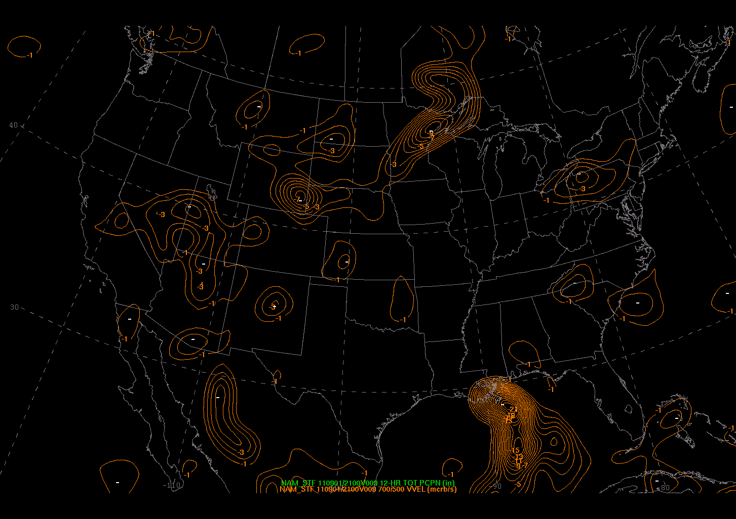
NAM 700-500 Omega<-1 valid 20110902_21V009
Thanks to Steve Silberberg AWC
Nascent TS Lee

Slide 15
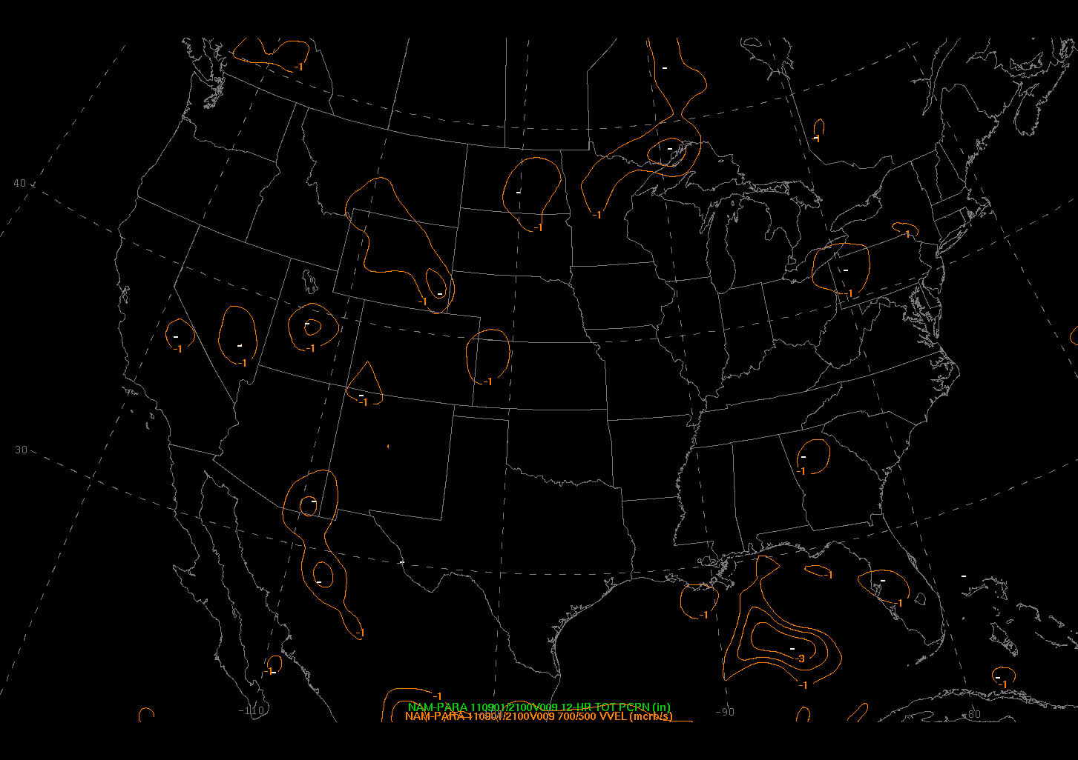
NAM-Parallel 700-500 Omega<-1 valid 20110902_21V009
Thanks to Steve Silberberg AWC
Nascent TS Lee

Slide 16
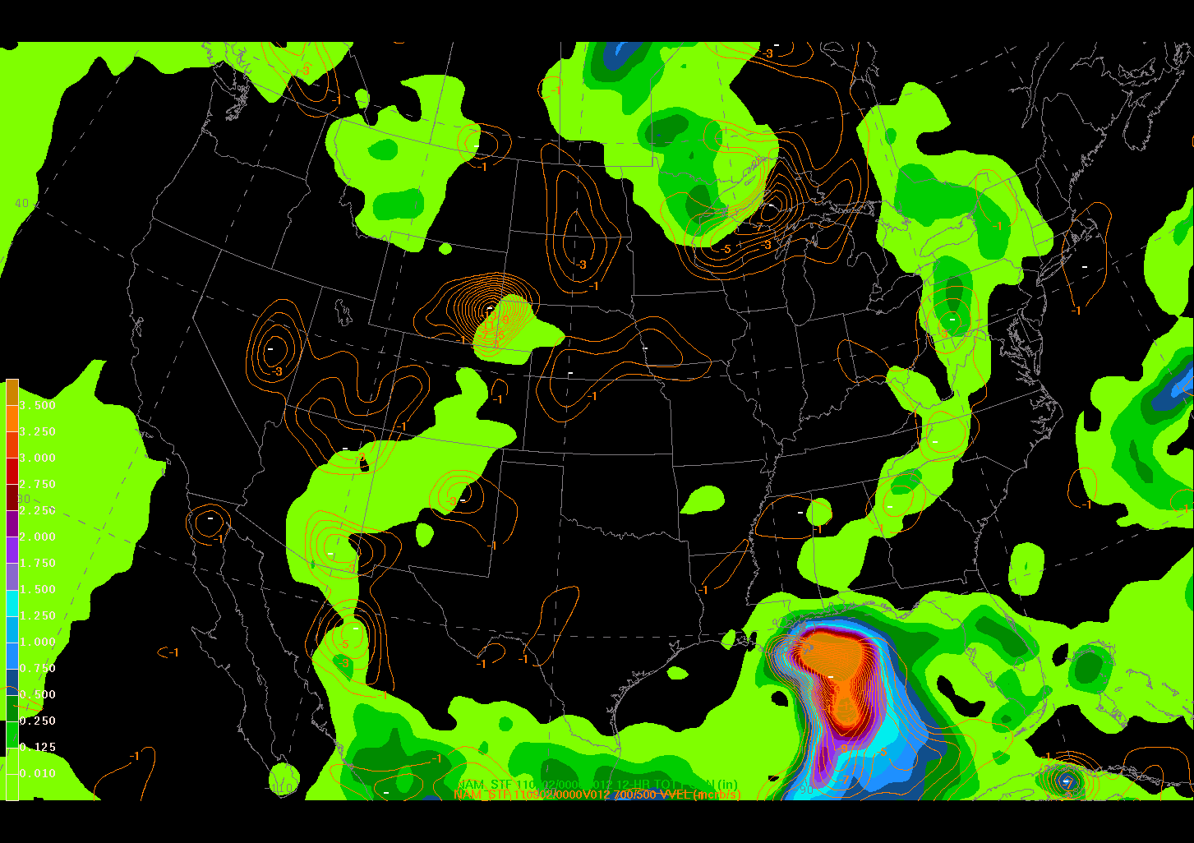
NAM 700-500 Omega<-1 & QPF12 valid 20110902_00V012
Thanks to Steve Silberberg AWC
Nascent TS Lee

Slide 17
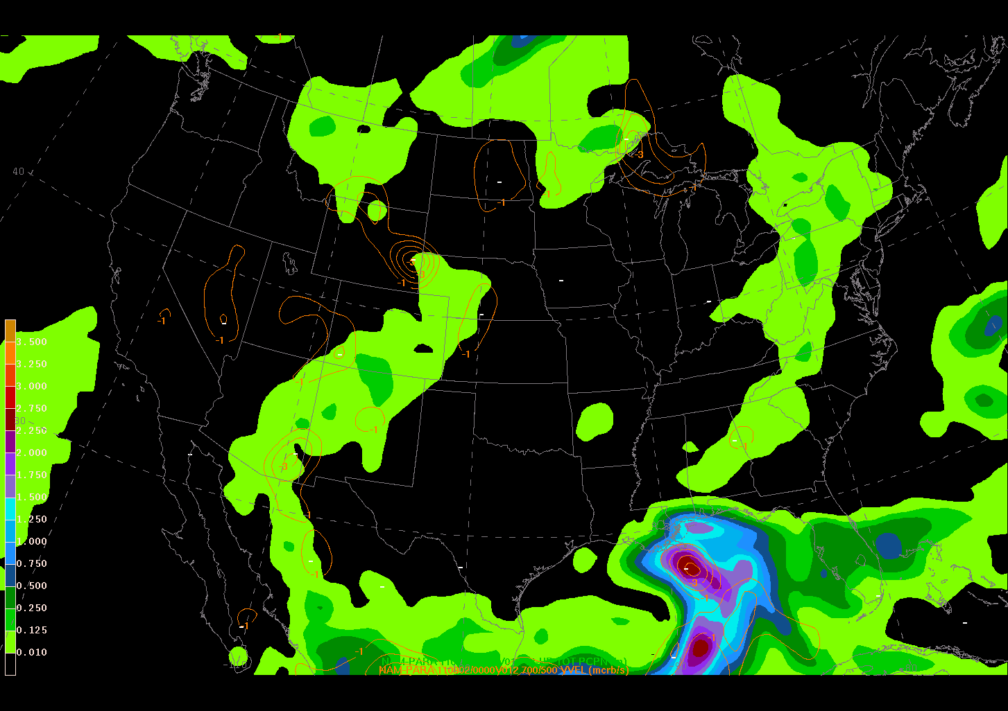
NAM-Parallel 700-500 Omega<-1 & QPF12 valid 20110902_00V012
Thanks to Steve Silberberg AWC
Nascent TS Lee

Slide 18
Issue of Vertical Velocity Being too Weak (1 of 3)
There is nothing wrong in the model
We have many examples of indirect evidence indicating the above
All the verification statistics which show new NMMB is comparable or better than current NMM, e.g. the fits to RAOBs and QPF Equitable Threat Scores

Slide 19
Issue of Vertical Velocity Being too Weak (2 of 3)
Investigation has indicated a discrepancy in the model output of the vertical velocity between the operational NAM and the NMMB
The difference: In the NMMB the Barotropic component of vertical velocity (due to external mode) is removed from the total vertical velocity for the purpose of computing nonhydrostatic vertical acceleration
Therefore, from the NMMB we are currently outputting and viewing a quantity less than the total vertical velocity—hence it’s smaller then it should be
Recommendation: The Barotropic component should be added back in the total before outputting vertical velocity. See next slide for impact of this fix to the model output.

Slide 20
Issue of Vertical Velocity Being too Weak (3 of 3)
NOTE: Due to logistical reasons in the NEMS-NMMB code, the 00-h vertical velocity in the parallel NAM does not have the barotropic component added back to it
Reason: 00-h omega is the field in the NDAS first guess model restart file, which is passed through the 00-h analysis unchanged. (This also applies to all fields not changed by the analysis (T, V, q, p*), or derived from analyzed fields)
Vertical velocity field passed through the assimilation in the full model restart file is the field with the barotropic part removed, used to compute the nonhydrostatic vertical accelerations.
Barotropic component added back once the model starts integrating.

Slide 21
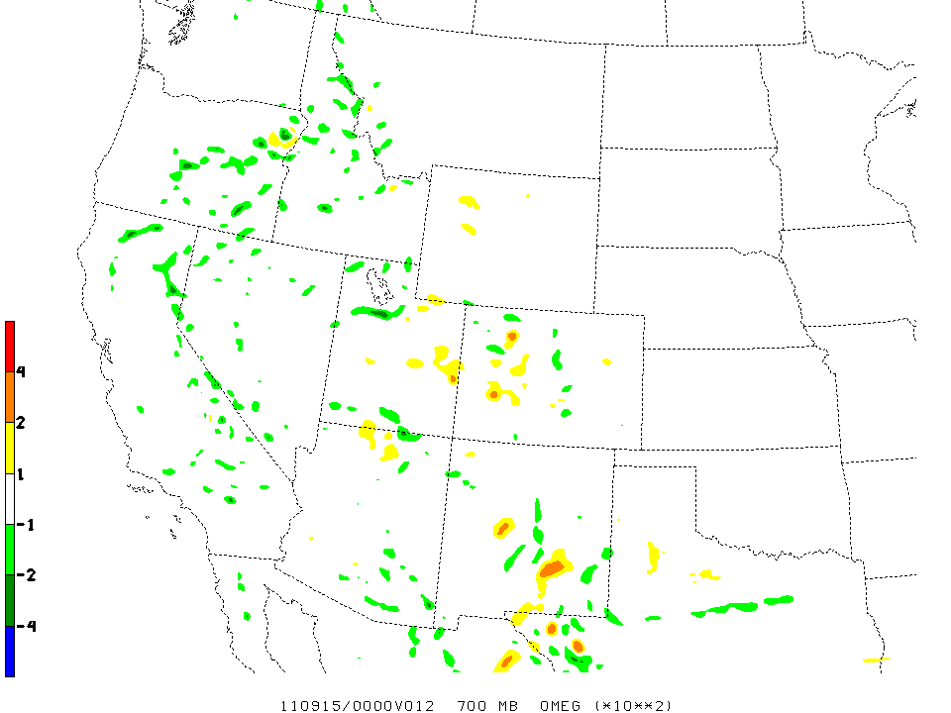
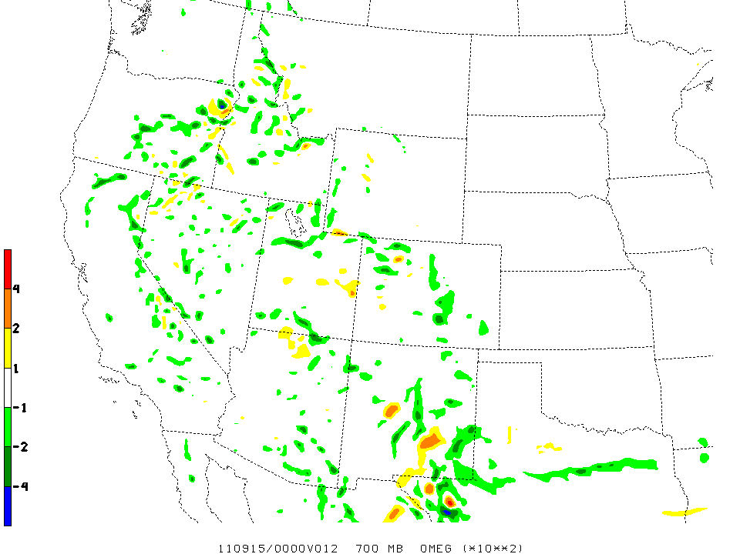
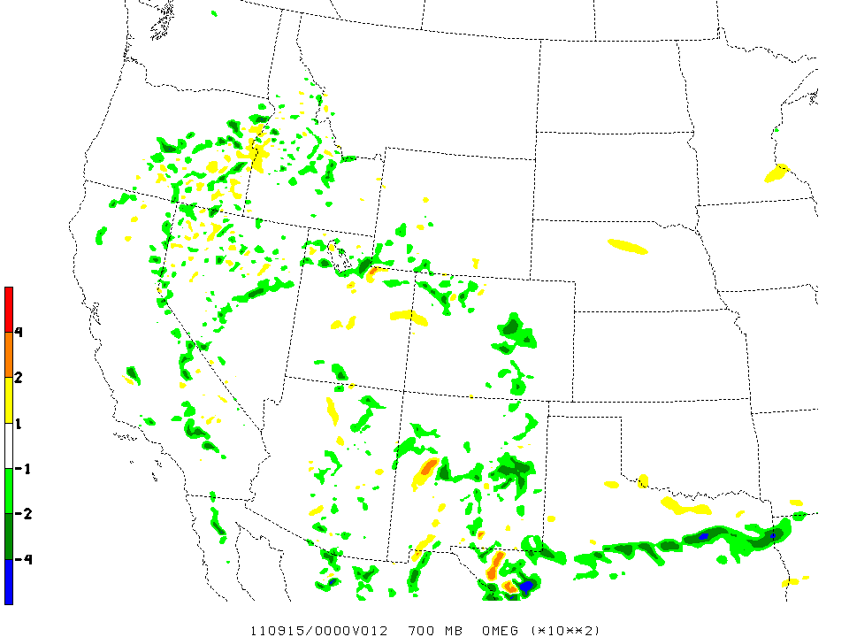
700mb Omega
Before & After Fix
w/o fix
Virtually all other forecast fields were bit identical including QPF.
with fix
ops NAM

Slide 22
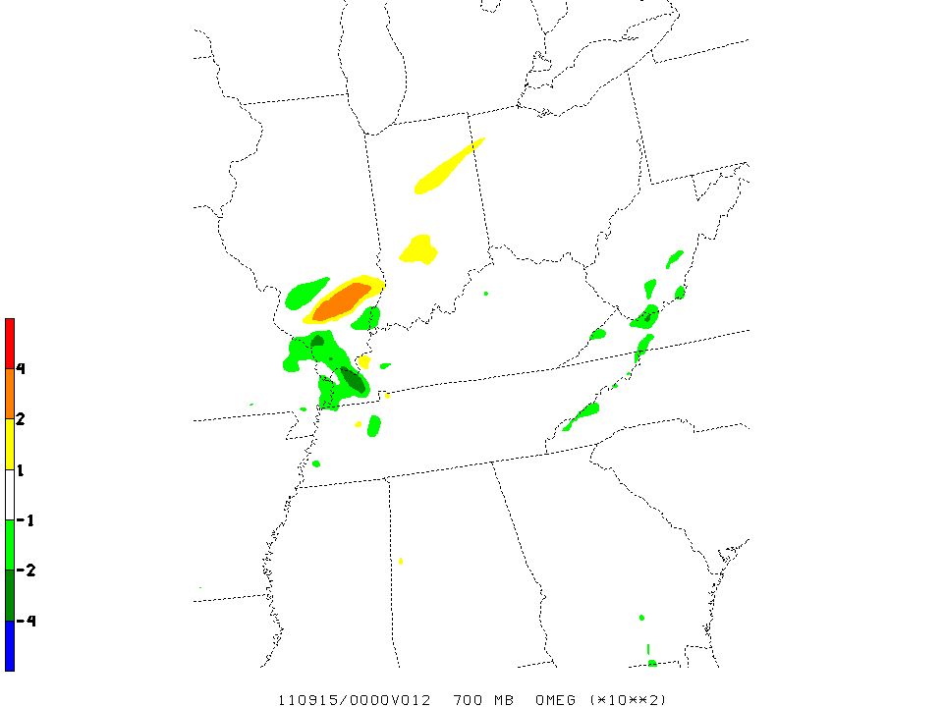
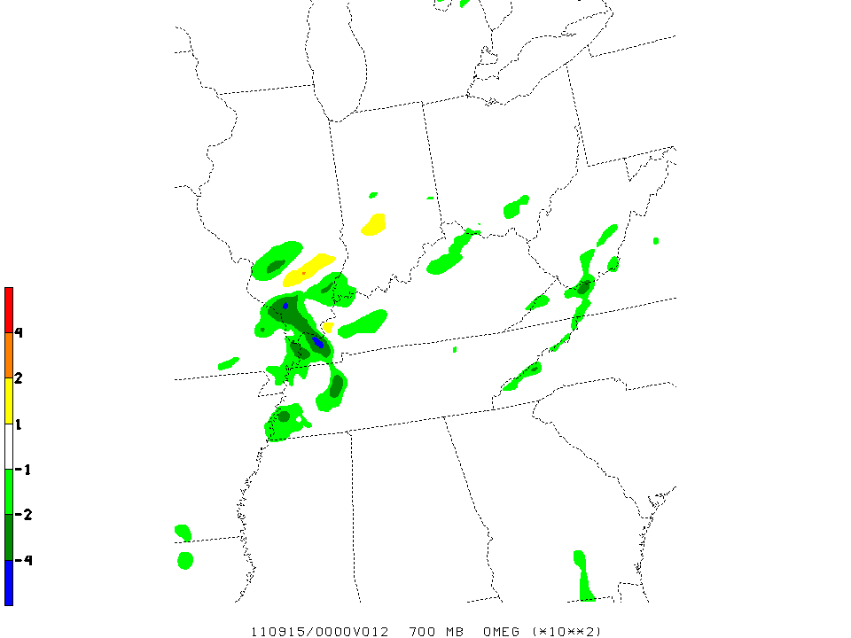
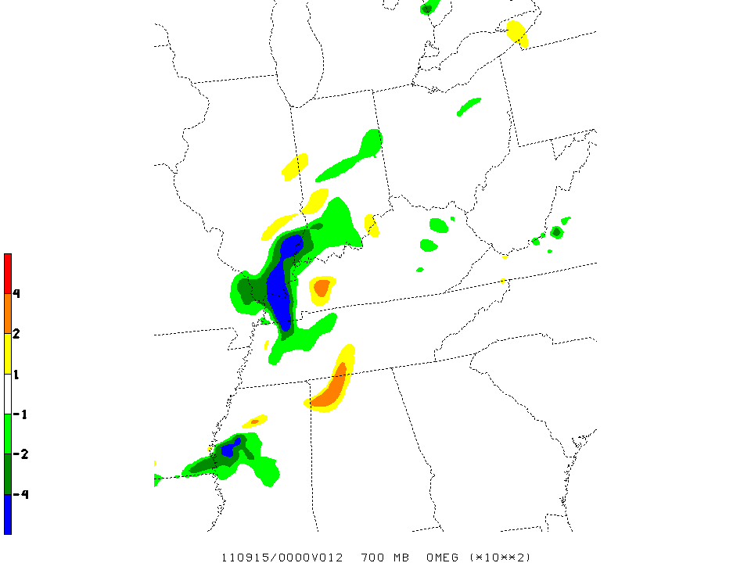
700mb Omega
Before & After Fix
w/o fix
Virtually all other forecast fields were bit identical including QPF.
with fix
ops NAM

Slide 23
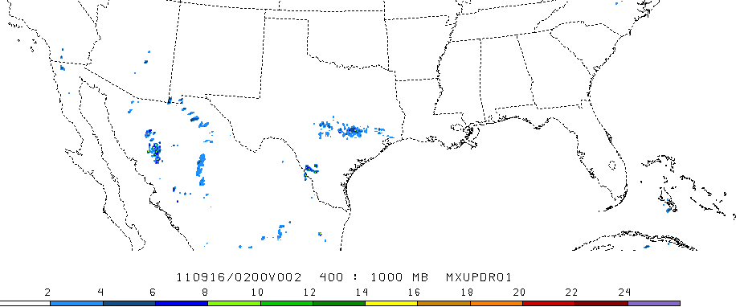
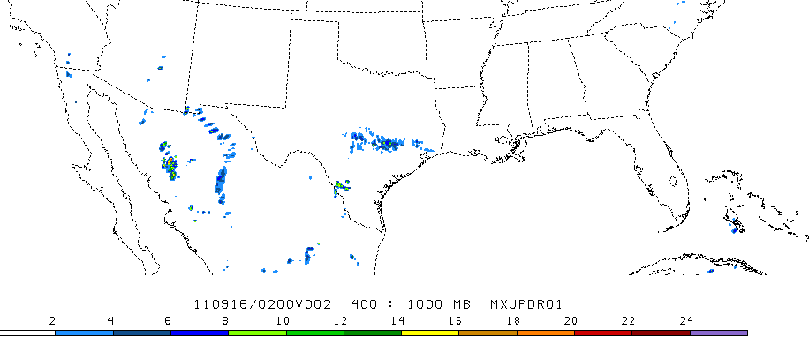
f02
Max 14.4 m/s
Hourly maximum updraft velocity (no w fix)
Max 24.4 m/s
Hourly maximum updraft velocity (bonus w fix – using full w in diagnostics)

Slide 24
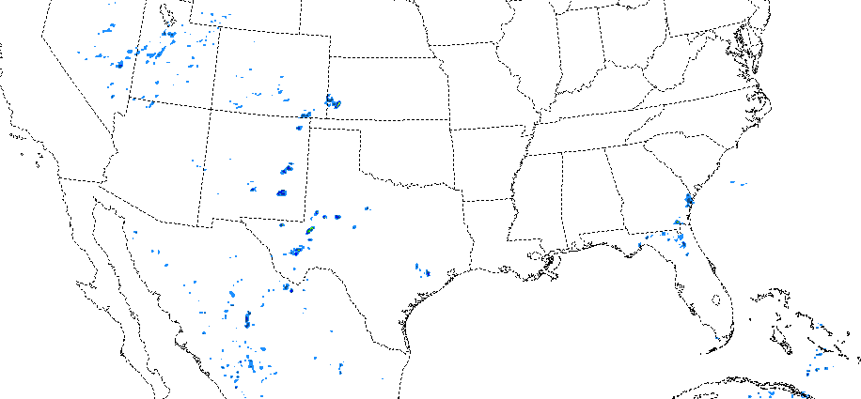
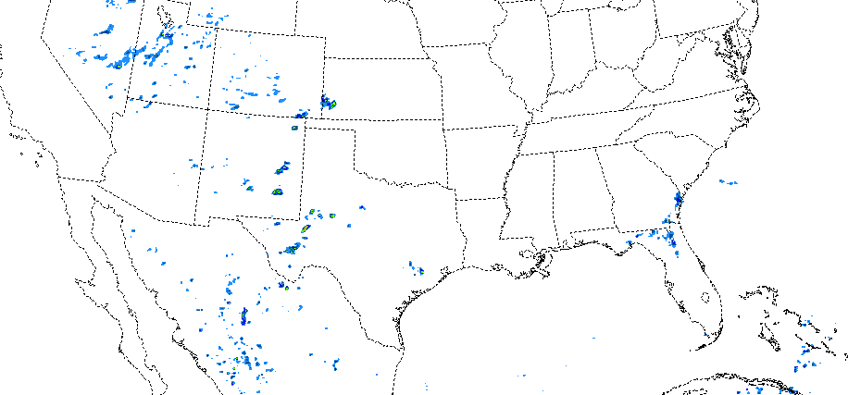
f02
Max 12.9 m/s
Hourly maximum updraft velocity (no w fix)
Max 20.2 m/s
Hourly maximum updraft velocity (bonus w fix – using full w in diagnostics)

Slide 25
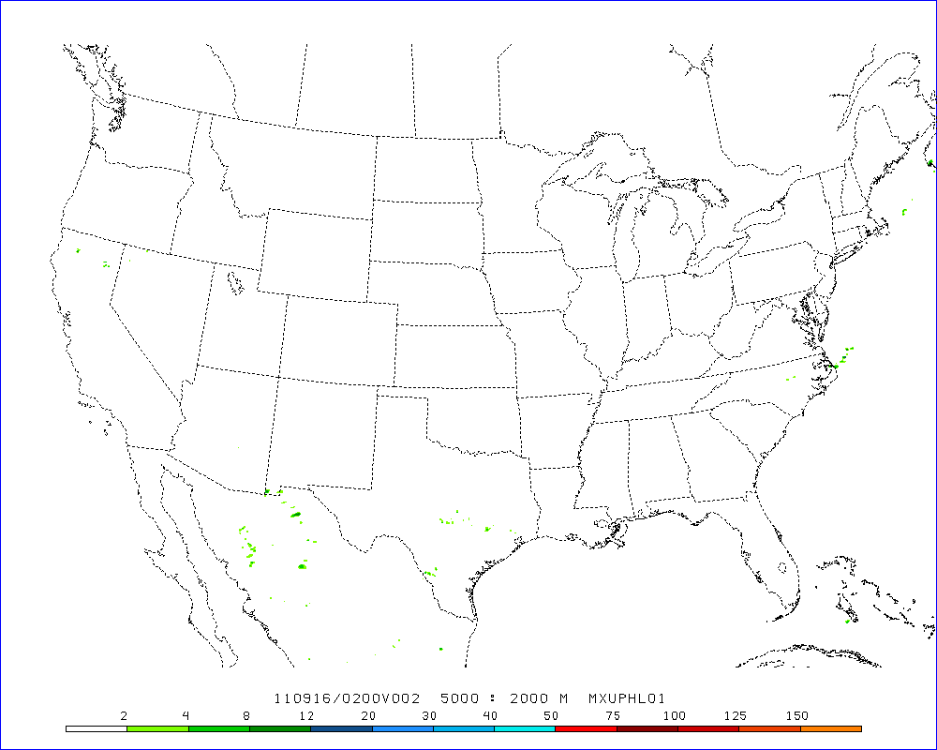
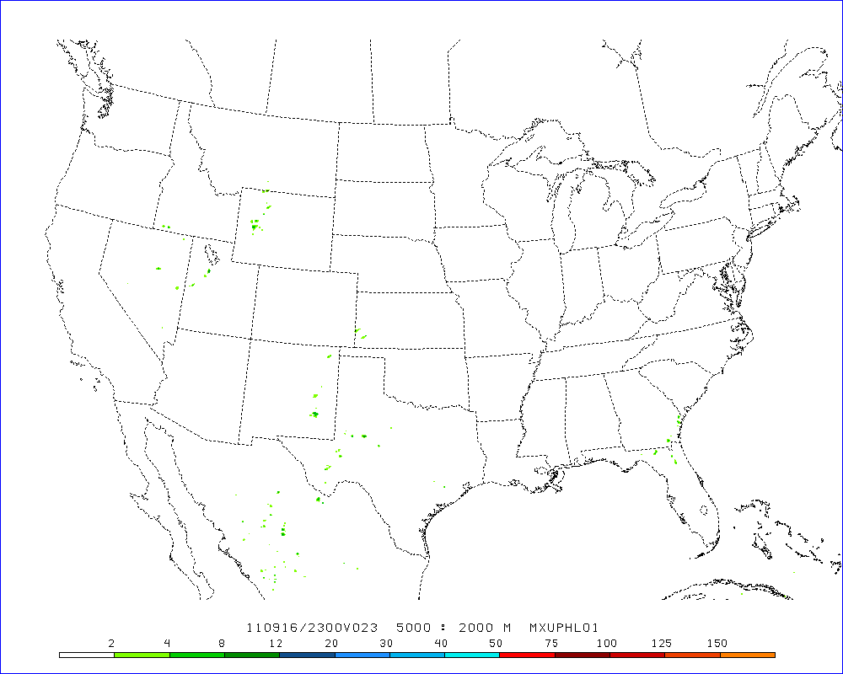
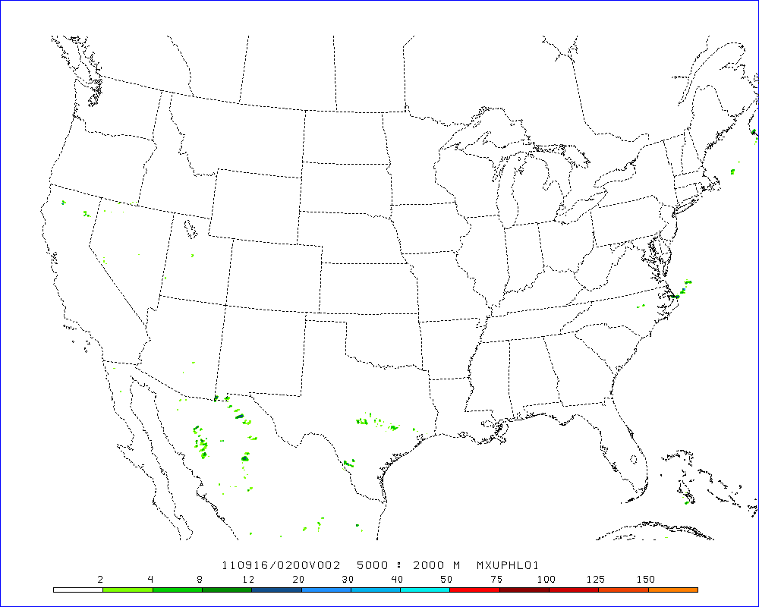
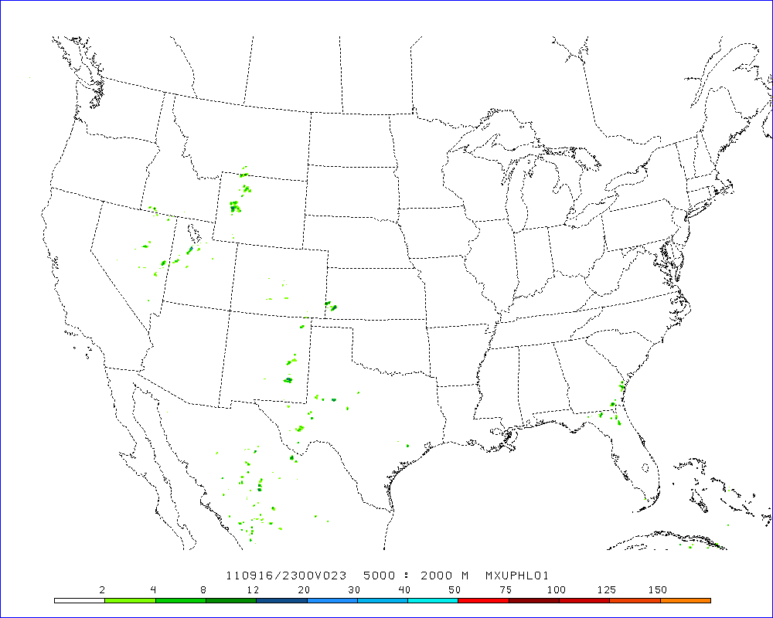
f23
f23
Hourly maximum updraft helicity (no w fix)
Hourly maximum updraft helicity (no w fix)
Grid maximum 21.3 m^2/s^2
Grid maximum 15.4 m^2/s^2
Hourly maximum updraft helicity
(bonus w fix – using full w in diagnostics)
Hourly maximum updraft helicity
(bonus w fix – using full w in diagnostics)
Grid maximum 40.2 m^2/s^2
Grid maximum 29.5 m^2/s^2

Slide 26
NAM Nest reflectivity similar to HRW ARW, but lower than NMM and NSSL ARW
Fix will not effect reflectivity.

Slide 27
NAM Nest updraft speed substantially lower than from other high-resolution models
Fix should ~double updraft speeds, ~up to values of other guidance.

Slide 28
NAM Nest UH substantially lower than from other high-res models
Fix should ~double updraft helicity, ~up to values of other guidance.

Slide 29
NAM Nest predicts reflectivity >40 dBZ over smaller areas
Fix will not effect reflectivity.

Slide 30
NAM Nest predicts moderate updraft speeds at relatively few grid points (comparatively few strong storms produced)
Fix should ~double updraft speeds, number of grid points will be increased.

Slide 31
NAM Nest predicts minimal or greater strength rotating updrafts (supercells) much less frequently
Fix should ~double updraft helicity, number of grid points will be increased.

Slide 32
EMC’s Action Items
Get nesting and total vertical velocity fixes to NCO
After fixing the model to output properly the total vertical velocity:
  Rerun the AWC case Sept 1, 2011
  Rerun the SPC case 27 April, 2011
  Rerun other case(s) for SPC
Implementation, however, is not contingent on these results

Slide 33
Matt Pyle’s Rerun added 9/22/2011
AWC 0901/21Z omega example
Slides 2 and 3 simply redisplay the ops NAM and parallel NAM from the AWC example (noting the caveat of the 3rd bullet below)
The key comparison here is between slides 4 and 5, showing a clean test of the NAM code modification made over a slightly smaller 12 km grid spacing domain:
  Slide 4 shows the forecast using the original parallel NAM code
  Slide 5 shows the forecast using the updated parallel NAM code
Note that all examples here went through slightly different processing than the real-time production/parallel files shown in the original AWC example:
  Everything started on the 12 km grid 218, which was horizontally interpolated to 90 km grid 104.
  A 9-point horizontal smoother was used in plots to mimic the smoothing applied in the operational generation of grid 104 (but not applied in my interpolation).

Slide 34
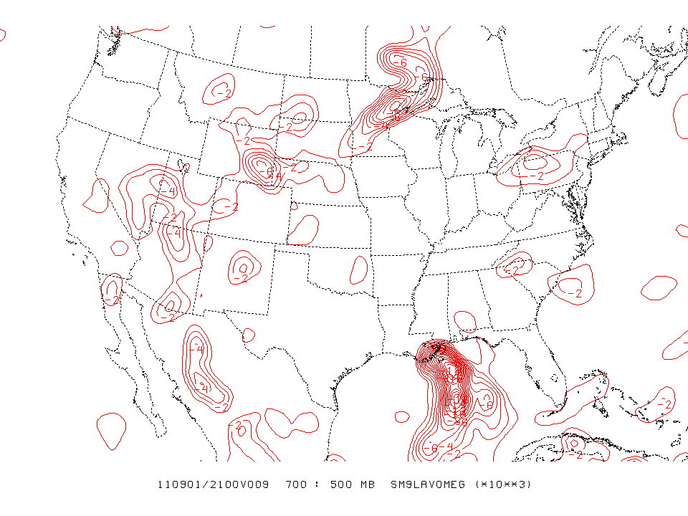
Ops NAM

Slide 35
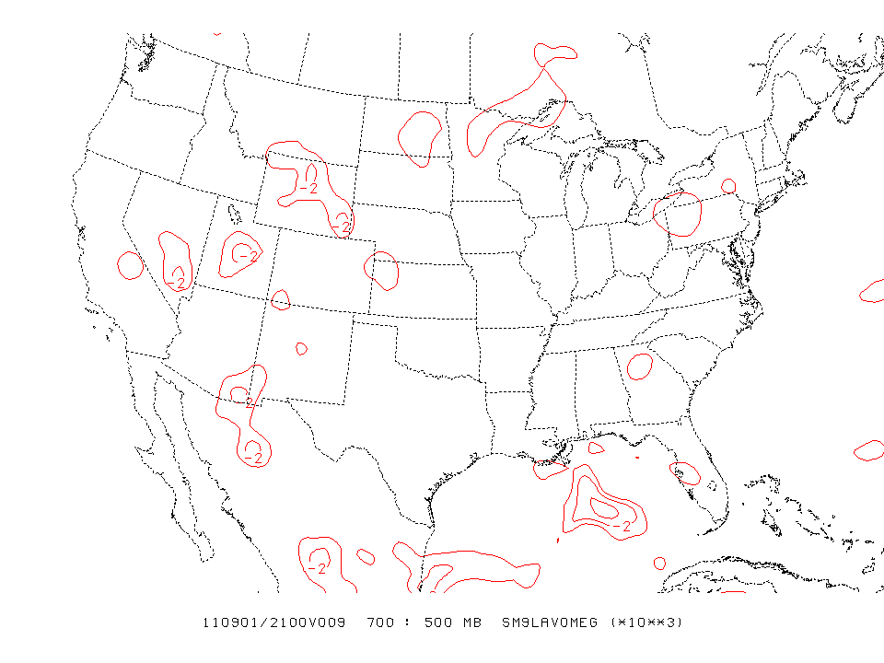
Para NAM

Slide 36
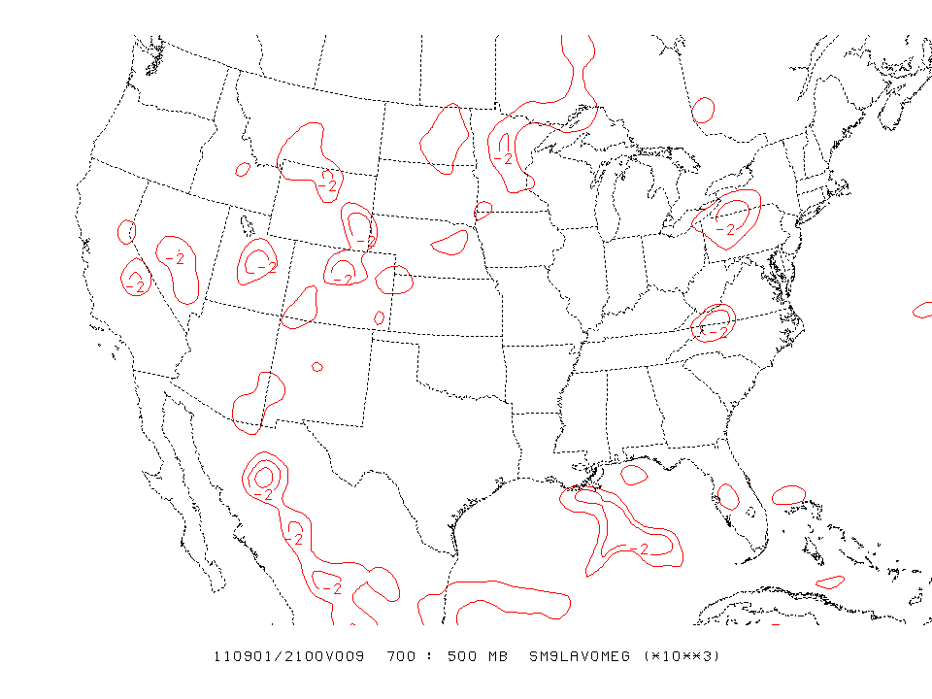
Test NMMB rerun
w/o fix

Slide 37
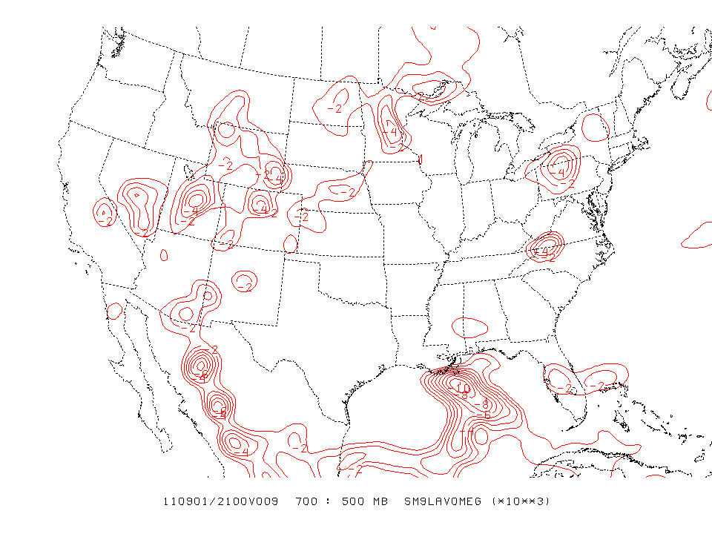
Test NMMB rerun
with fix

Slide 38
AWC’s Steve Silberberg’s Response
Hi Matt,
I appreciate you and your colleagues taking the time to address the mystery of the missing omega in the AWC example. Your examples clearly show that the latest NAM code addresses the case of missing omega.
We consider the case of the missing omega closed and look forward to implementation of the latest NAM code when supercomputer conditions permit.
Great work!
Regards,
Steverino

Slide 39
Eric Rogers’ 1st Rerun with vertical velocity fix for 00z 4/27/2011 case
NAM 4 km CONUS Nest

Slide 40
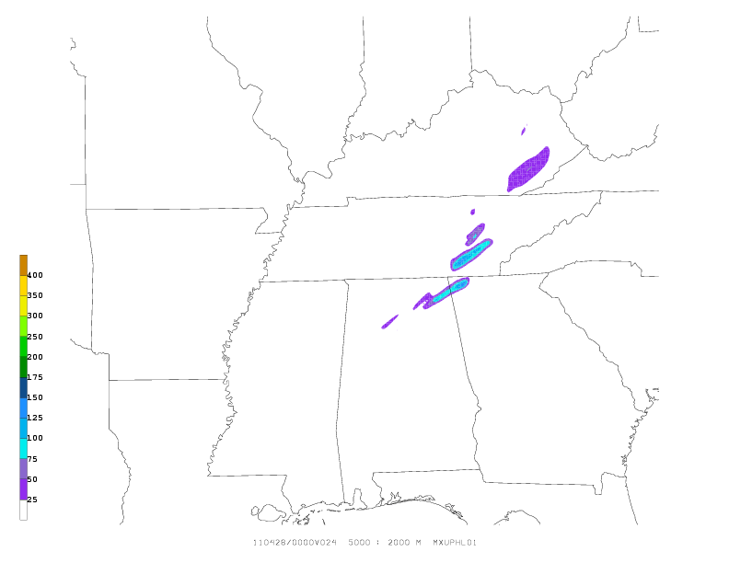
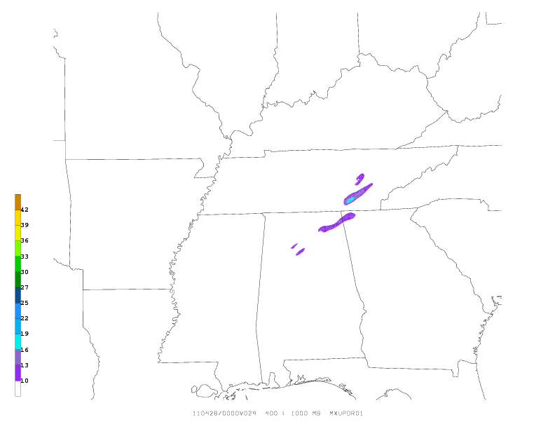
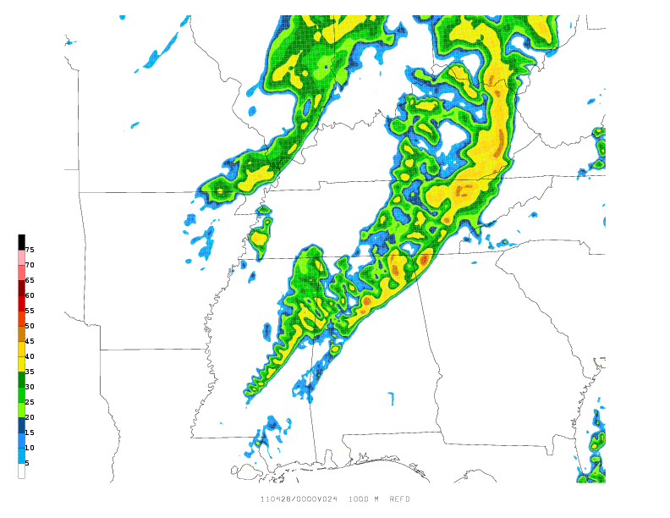
24-h Forecast Hourly Max Updraft Helicity valid 00z 4/28
24-h Forecast Hourly Max Updraft Speed valid 00z 4/28
24-h Forecast 1 km AGL Simulated Reflectivity valid 00z 4/28
Israel Jirak’s Response
Eric,
Thanks for re-running this case and creating comparison images. The vertical velocity fix appears to have resulted in significantly improved output of hourly max updraft speed/helicity for this case with magnitudes now at least comparable to the other high-resolution models. It is nice to see multiple UH swaths with values >100 m2/s2 for this historic tornadic outbreak. I believe Steve has been in contact with Brad regarding cases that SPC would like to see re-run.
Thanks again for your efforts,
Israel

Slide 41
Is weaker vertical velocity the reason there is a dry bias in QPF in the parent domain?
Weaker vertical velocity and reduced precipitation are closely interrelated and feed back on each other: weaker vertical velocities mean less precipitation, and less precipitation means weaker vertical velocities. There is no clear cause and consequence relationship.
There is another big piece effecting precipitation amounts in NMMB.
NMMB uses the new more accurate and more conservative scheme for advecting passive variables like water vapor and condensate (cloud + hydrometeors), whereas the current NAM uses the old scheme which introduces spurious moisture sources.
We know the new scheme results in less precipitation and cloud amounts as we saw when it was turned on in the WRF-NMM in the HiResWindow.
This also contributes to weaker vertical circulations.

Slide 42
If nothing is wrong in the model, then why is the vertical velocity still weaker after the output fix?
Zavisa says, in addition to the output issue & passive advection effect, there are likely two more reasons:
  There is more horizontal diffusion in new NMMB than in current NMM
  There is more divergence damping in new NMMB than in current NMM
Matt Pyle (see below) has done a couple of sensitivity tests with smaller amounts of diffusion and divergence damping in NMMB both individually and together. Indeed, the magnitude of the vertical velocities (still without the barotropic component) increases when either or both are decreased.

Slide 43
Why is there more diffusion and divergence damping in NMMB than in NMM?
These are the result of a myriad of pre-implementation case studies & parallel testing.
After many tests, Brad found that increased diffusion had a big effect on improving the location and intensity of NMMB QPF predictions of the May 2010 Tennessee floods. Further tests showed that almost all of the improvement could be gained by targeting the increased diffusion only to the moisture variables.
Our QPF statistics & case studies had indicated a tendency for the current NAM to overdo heavy precip (high bias especially in summer and fall) and these increased amounts of diffusion and divergence damping were seen as helping that situation.

Slide 44
Can we improve the low QPF bias of the parent?
Recall, this was not a problem throughout the year.
For the warm season, Zavisa has recommended a change to the BMJ convection following the adjusted version used in the new nests (so called BMJ_DEV).
Eric Rogers has been testing this in a parallel (see next slide).
QPF performance for a limited period (2 weeks of testing) was significantly improved, but we see some mixed results with some of the fcst-vs-raob performance statistics.
Brad can also tune the cloud & precipitation microphysics once decisions have been made about whether to change diffusion & divergence damping and put in BMJ_DEV or not.

Slide 45
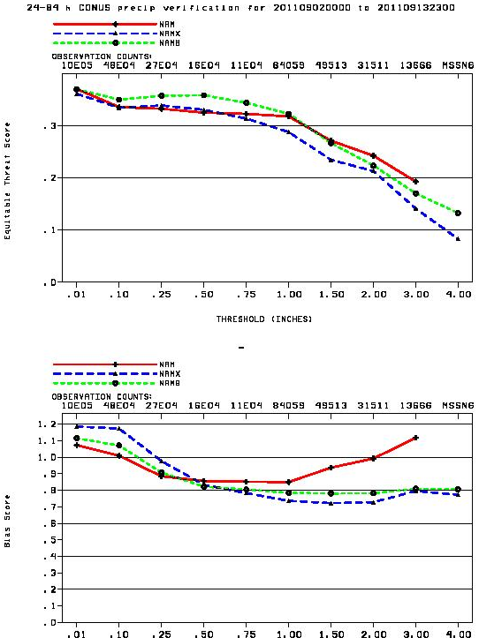
Red = NAM
Blue = NMMB
Green = Eric’s test of fres=.75
Much better scores for all thresholds
Higher bias at high end

Slide 46
Quick diffusion/div damp test
Performed before the barotropic component was added back in to the total vertical velocity
12 km/60 level, 524x397 domain centered @ 40N, 100W. GFS IC/LBC.
Ran a CTL configuration and three tests:
  CTL: codamp=9.0, smag2=0.4 (12 km NAMB levels)
  TEST1: codamp=3.0, smag2=0.4 (just less div damping)
  TEST2: codamp=9.0, smag2=0.1 (just less hor diff)
  TEST3: codamp=3.0, smag2=0.1 (lowers both div damp, hor diff)
Lowering divergence damping, particularly when combined with lower diffusion significantly increased vertical velocities.
Much less impact on precipitation.

Slide 47
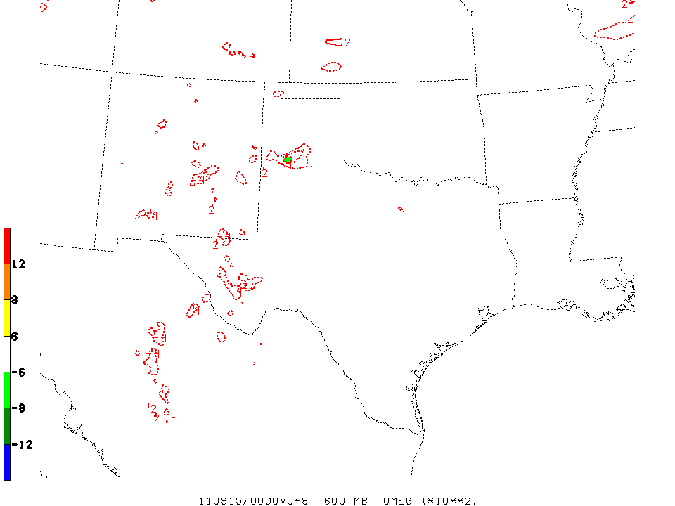
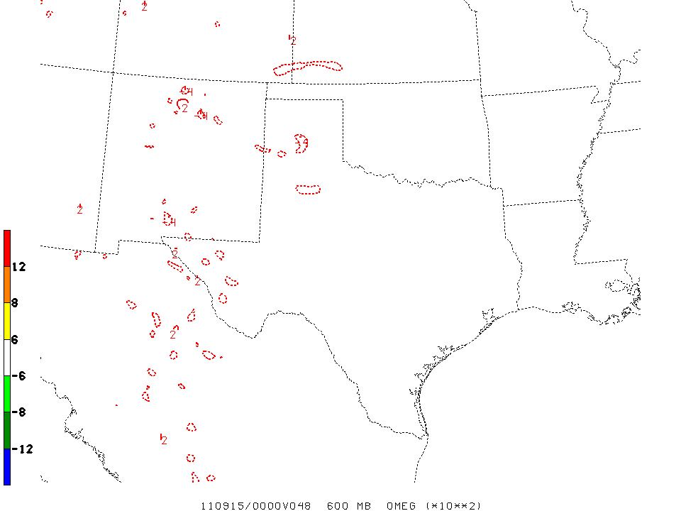
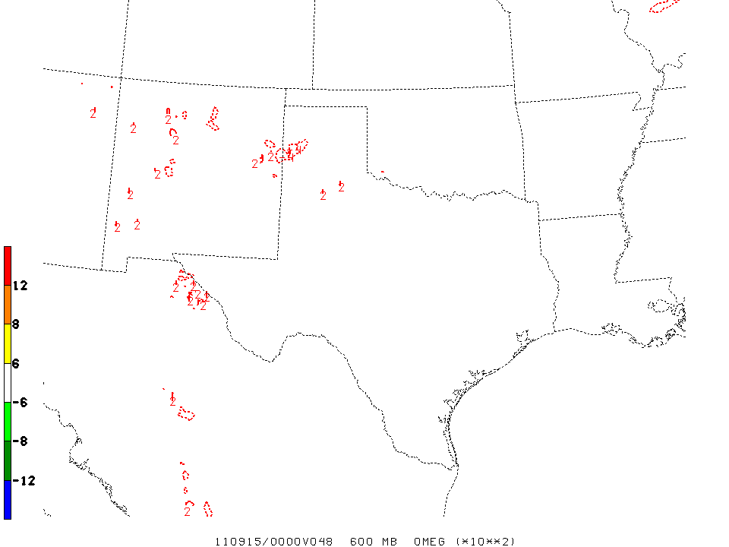
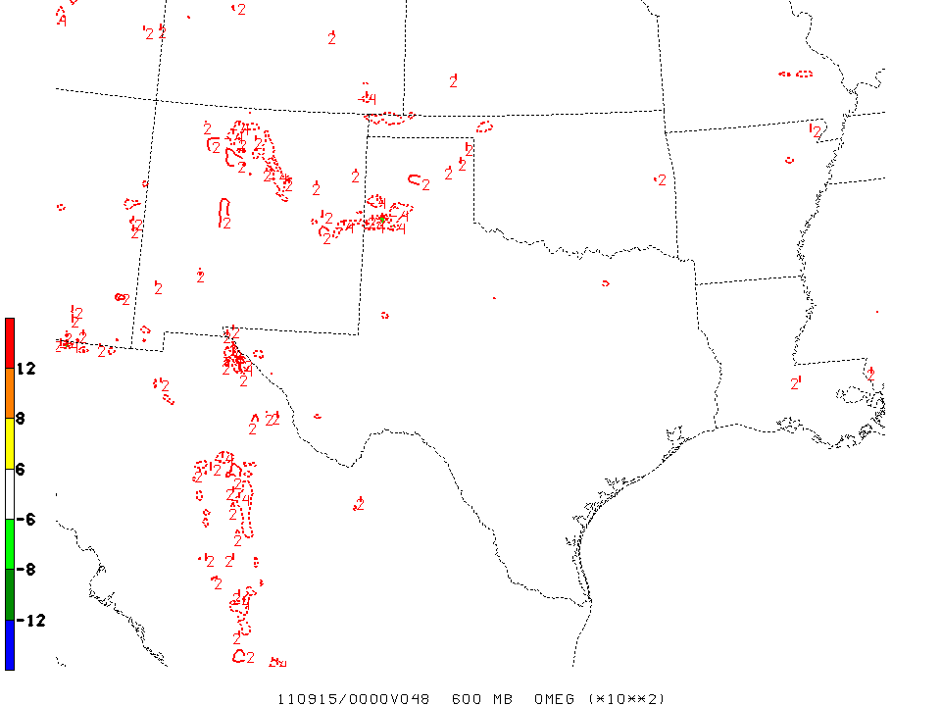
600 hPa omega, f48
TEST1
(just less
div. damping)
Ops NAM
TEST1
TEST2
Just diffusion
TEST3
Both

Slide 48
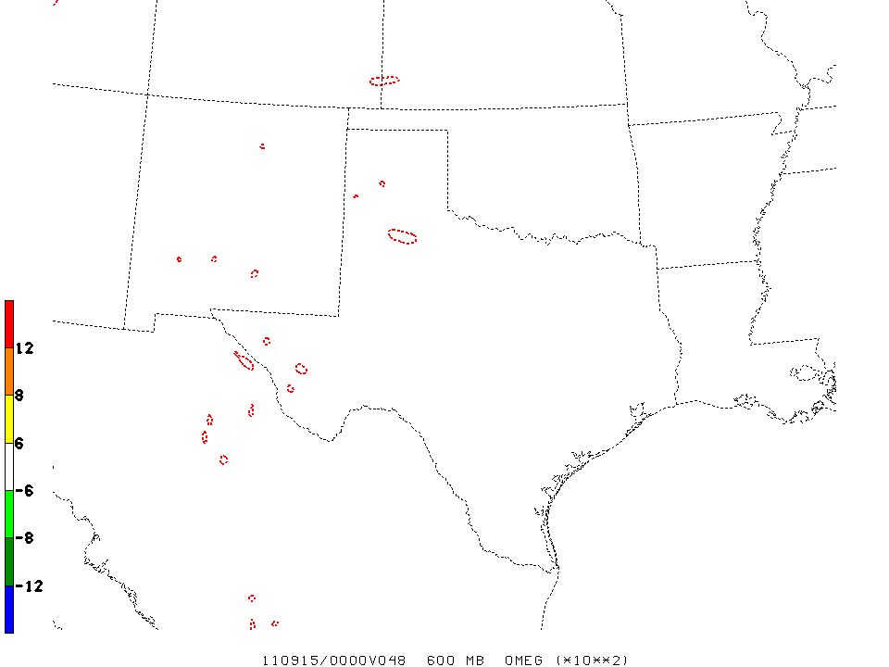
600 hPa omega, f48
TEST1
(just less div. damping)
CTL
TEST2
Just diffusion
TEST3
Both

Slide 49
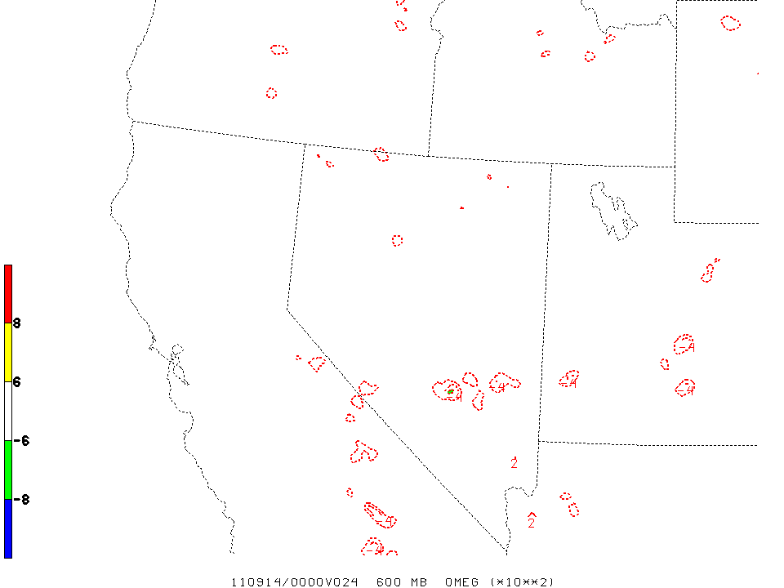
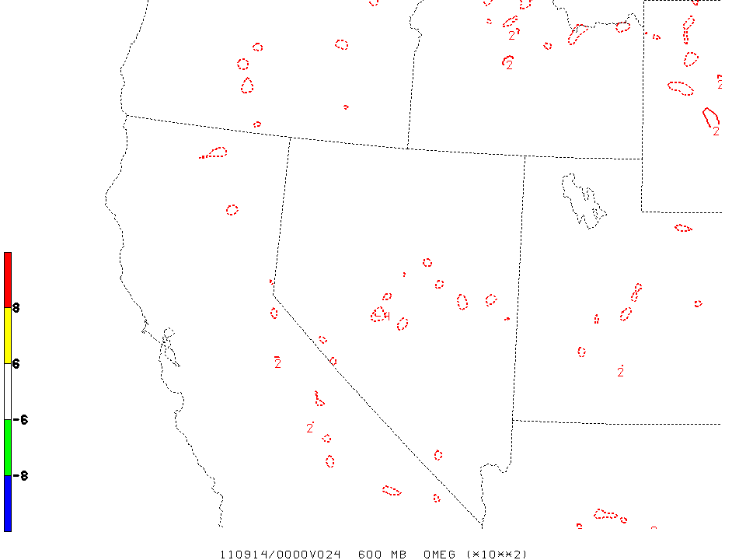
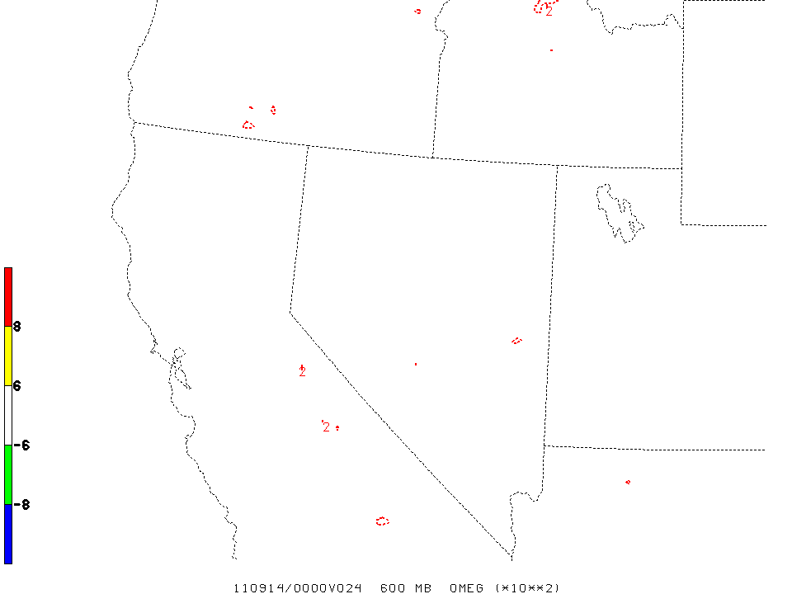
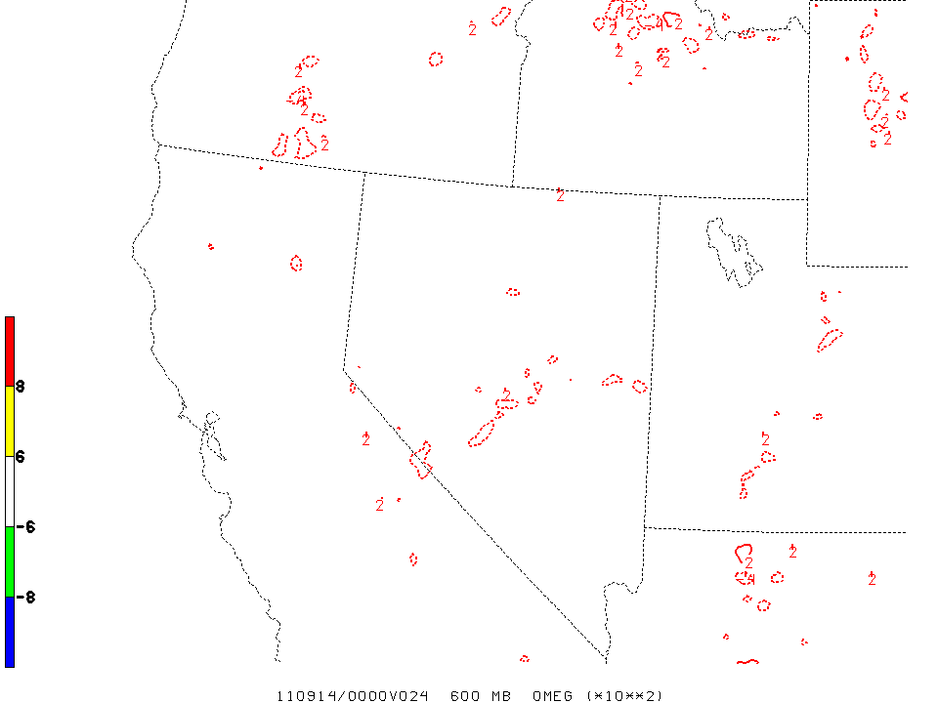
600 hPa omega, f24
TEST1
(just less div. damping)
Ops NAM
TEST2
Just diffusion
TEST3
Both

Slide 50
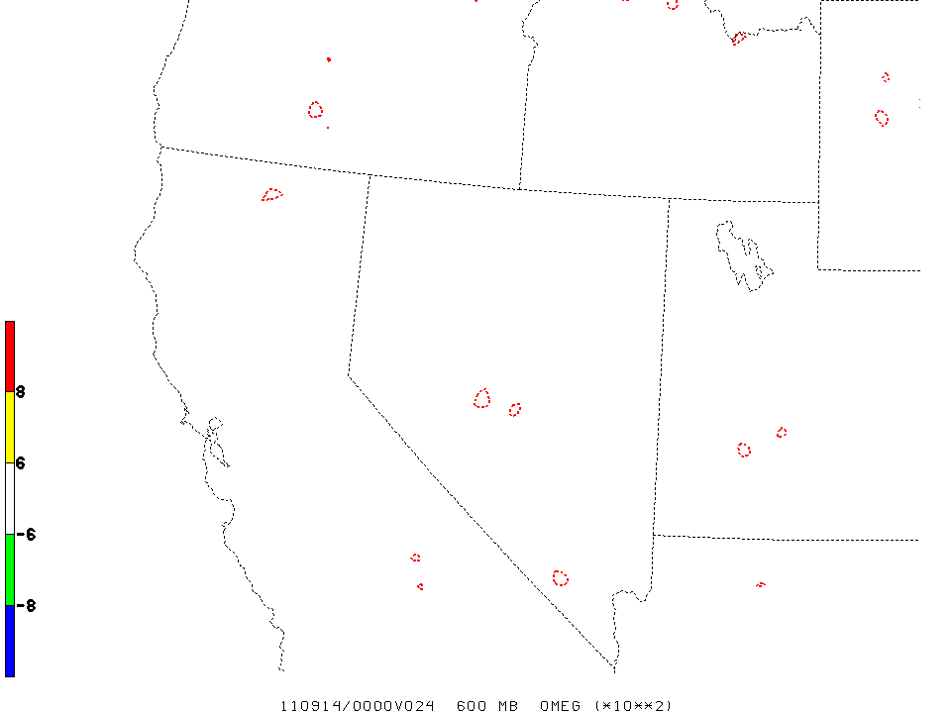
600 hPa omega, f24
TEST1
(just less div. damping)
CTL
TEST2
Just diffusion
TEST3
Both

Slide 51
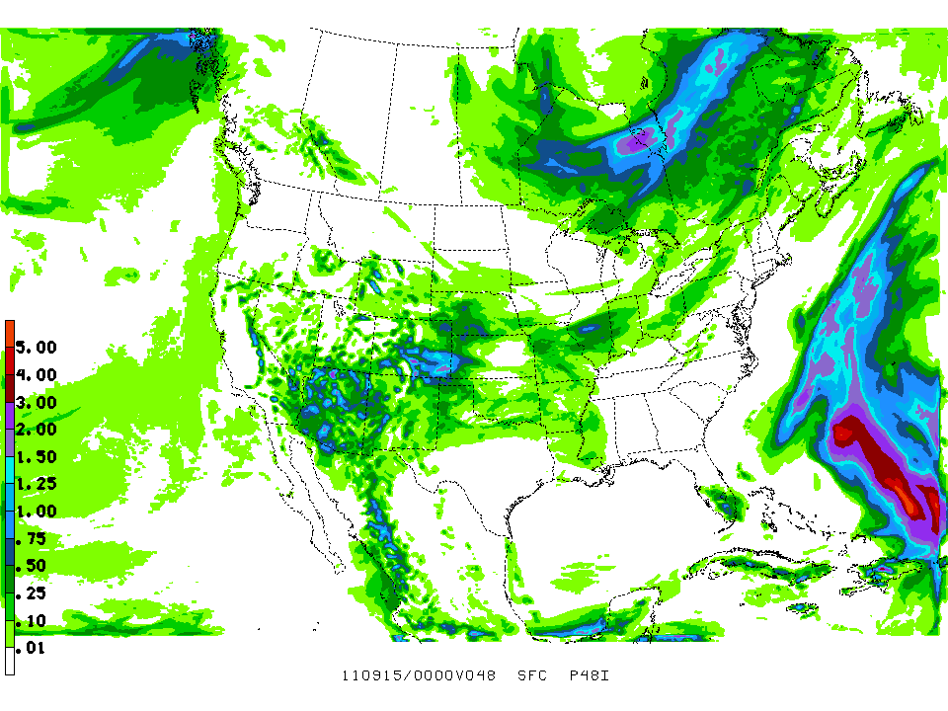
CTL

Slide 52

TEST1 – less div damp

Slide 53
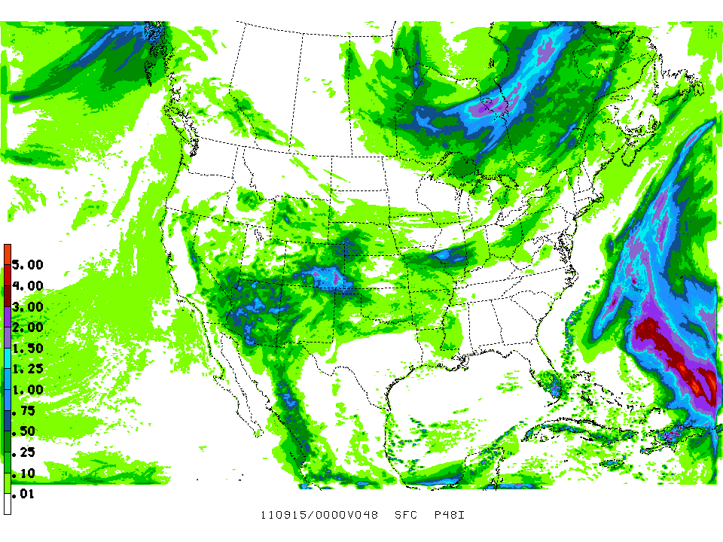
TEST2 – less diffusion

Slide 54
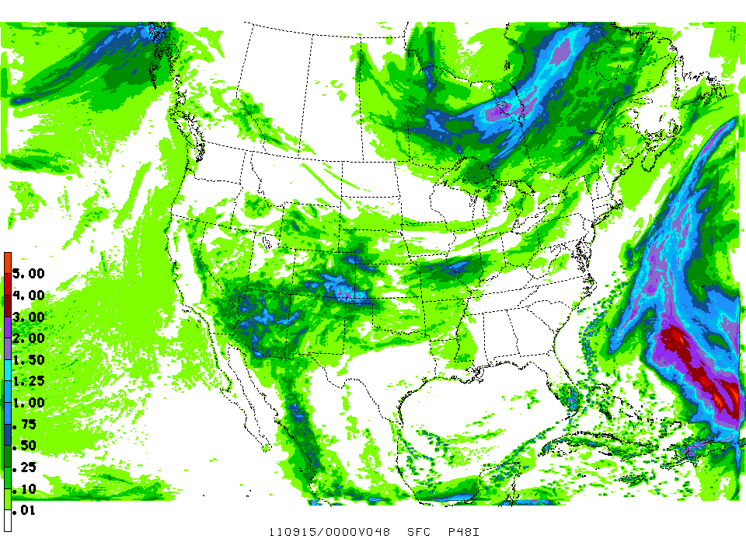
TEST3 – less of both

Slide 55
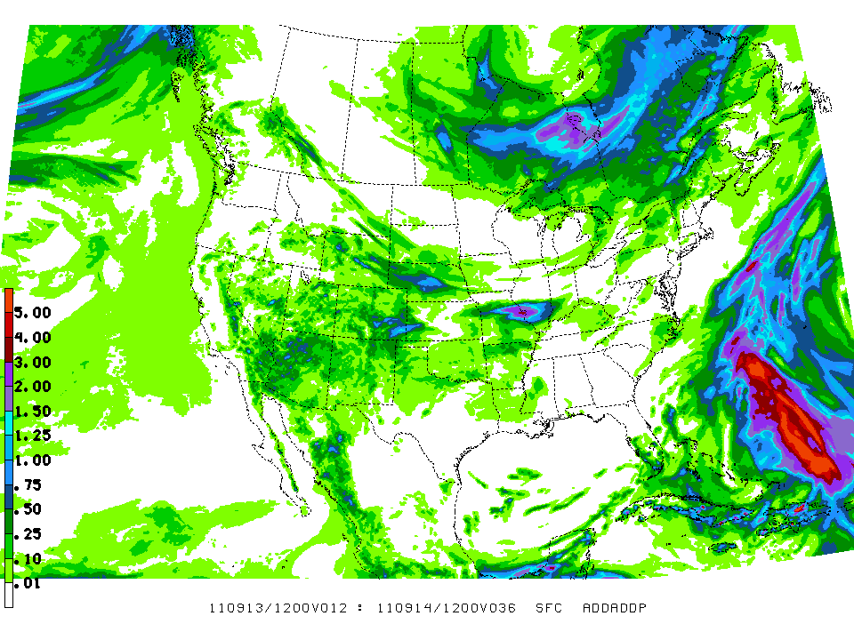
Ops NAM

Slide 56
Quicker diffusion/div damp test
12 km/60 level, 584x497 domain centered @ 40N, 100W. GFS IC/LBC. 20110914/12Z cycle
Ran a CTL configuration and one test:
  CTL: codamp=9.0, smag2=0.4 (12 km NAMB levels)
  TEST3: codamp=3.0, smag2=0.1 (lowers both div damp, hor diff)

Slide 57
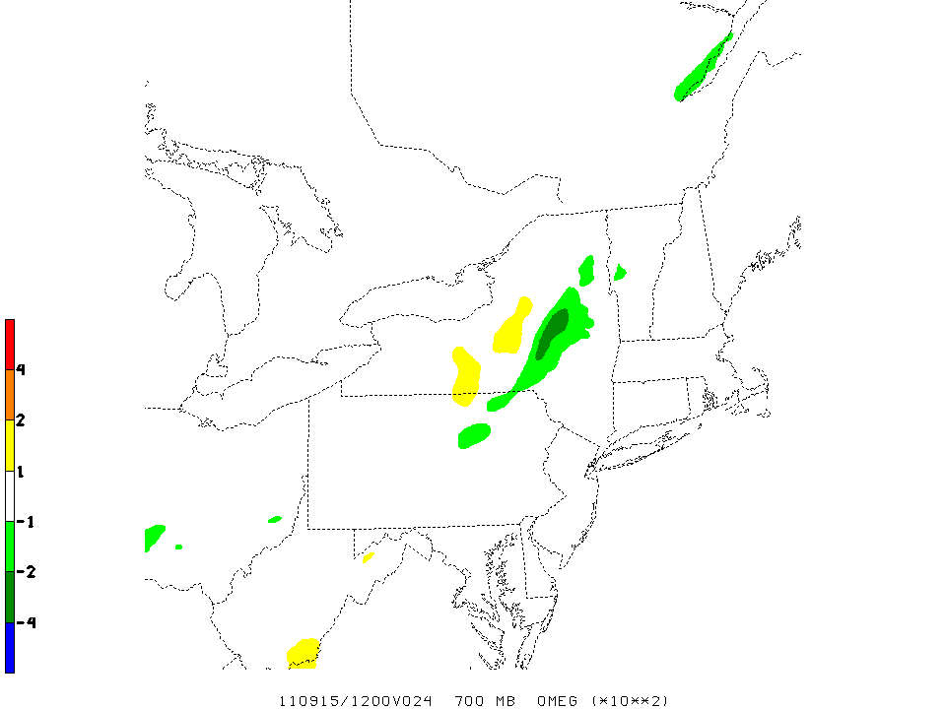
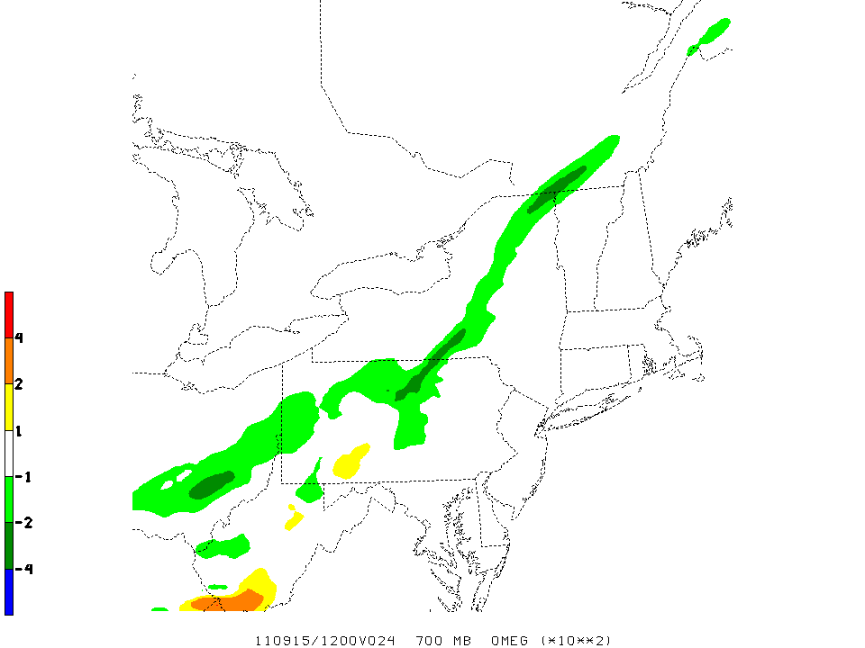
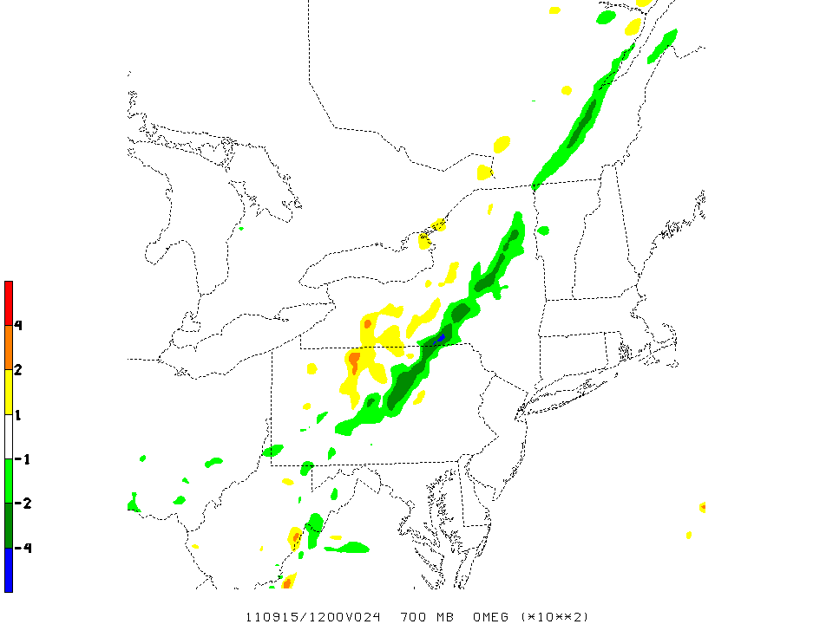
700 hPa omega, f24, VT 0915/12Z
CTL NMMB
Ops NAM
TEST3 NMMB

Slide 58



700 hPa omega, f45, VT 0916/09Z
CTL NMMB
Ops NAM
TEST3 NMMB

Slide 59
Can we fix the low convection intensity problem in the nests for SPC?
Fixing vertical velocity output to reflect the total vertical velocity will improve two out of three statistics – reflectivity is unchanged with that fix.
Yes, eventually, but we need more time to test all the ramifications on the accuracy & usefulness of the other guidance parameters. This will be a tough balancing act.
We can increase the intensity of vertical circulations by reducing the diffusion or divergence damping or both. This can be done selectively for the nests but not the parent.
We can also increase the texture/structure of both precip and reflectivity by decreasing the diffusion (see Pyle result above).
BMJ_DEV convection activates fairly infrequently in the nests so the only option is probably to turn it off altogether.
Brad can also tune the cloud & precipitation microphysics once decisions have been made about whether to change diffusion and/or divergence damping and to run with BMJ_DEV or not.
This retuning exercise will be greatly hampered by lack of sufficient computing, and the result will most likely benefit only SPC.
But, we are not giving up on this challenge.

Slide 60
Additional considerations
[original]
Much improved computational efficiency and increased throughput.
Runtime for NAM w/ nests –
Current opnl code: > 4 hours
New code: 70 minutes
2.5 minute delay is only on cirrus
Fix to nesting known already for the Fire Weather failure.

Slide 61
Additional considerations
(enhanced)
New NAM is doing 11 times more work than the current NAM.
To finish in same amount of time, the new NAM is using only 7.7 times more compute resources!
IBM estimates the NMMB will scale well up to at least ~24,000 cores.
NAM completion 2.5 minute late is only on cirrus, it finishes 1 minute early on stratus.

Slide 62
CONUS Nest reruns of selected severe wx events for SPC
(by Eric Rogers, added 3 Oct)

Slide 63


00z 4/4/11 cycle; 21-hr forecasts: Hourly maximum updraft helicity
Original 4km CONUS nest run
Maximum value = 12.45 m2/s2
Rerun with vertical velocity fix
Maximum value = 41.20 m2/s2

Slide 64


00z 4/4/11 cycle; 21-hr forecasts: Hourly maximum updraft speed
Original 4km CONUS nest run
Maximum value = 7.47 m/s
Rerun with vertical velocity fix
Maximum value = 14.38 m/s

Slide 65


00z 4/4/11 cycle; 21-hr forecasts: 1 km AGL reflectivity
Original 4km CONUS nest run
Rerun with vertical velocity fix

Slide 66


00z 4/16/11 cycle; 21-hr forecasts: Hourly maximum updraft helicity
Original 4km CONUS nest run
Maximum value = 13.83 m2/s2
Rerun with vertical velocity fix
Maximum value = 30.07 m2/s2

Slide 67


00z 4/16/11 cycle; 21-hr forecasts: Hourly maximum updraft speed
Original 4km CONUS nest run
Maximum value = 6.75 m/s
Rerun with vertical velocity fix
Maximum value = 9.09 m/2

Slide 68


00z 4/16/11 cycle; 21-hr forecasts: 1 km AGL reflectivity
Original 4km CONUS nest run
Rerun with vertical velocity fix

Slide 69


00z 5/22/11 cycle; 23-hr forecasts: Hourly maximum updraft helicity
Original 4km CONUS nest run
Maximum value = 115.95 m2/s2
Rerun with vertical velocity fix
Maximum value = 355.59 m2/s2

Slide 70


00z 5/22/11 cycle; 23-hr forecasts: Hourly maximum updraft speed
Original 4km CONUS nest run
Maximum value = 15.71 m/s
Rerun with vertical velocity fix
Maximum value = 33.39 m/2

Slide 71


00z 5/22/11 cycle; 23-hr forecasts: 1 km AGL reflectivity
Original 4km CONUS nest run
Rerun with vertical velocity fix

Slide 72
Steve Weiss’ Response 1 of 3
Eric,
Thanks very much for sharing the case reruns. At all three case times, the NAM fix generates larger values of updraft speed and UH compared to the original version. On two of the three outbreak days (April 4 and May 22), the NAM fix provides updraft speed and UH values that are more similar in magnitude compared to output from the existing convection-allowing models (CAMs). In fact, for 22 May the NAM fix now generates much larger values than most CAMs. Conversely, for the April 16 North Carolina outbreak case, the NAM fix values remain considerably lower than those from other CAMs.
Here is a comparison table for the hourly max field updraft speed and updraft helicity (UH). The NAM Nest fix values come form the max field value you provided, whereas the values for the other CAMs are estimates based on visual inspection of the color bar threshold.

Slide 73
Steve Weiss’ Response 2 of 3
 | Nest (Fix) | CONUS NMM | HRW NMM | HRW ARW | NSSL ARW | Nest (Fix) | CONUS NMM | HRW NMM | HRW ARW | NSSL ARW
 | Updraft | Updraft | Updraft | Updraft | Updraft | UH | UH | UH | UH | UH
4 Apr 21z | 14 | 18 | 18 | 23 | 30 | 41 | NA | NA | NA | NA
16 Apr 21z | 9 | 15 | 18 | 20 | 25 | 30 | 125 | 125 | 100 | 175
22 May 23z | 33 | 18 | 18 | 25 | 33 | 356 | 125 | 25 | 50 | 150

Slide 74
Steve Weiss’ Response 3 of 3
Overall, the new results are clearly improved over the original NAM Nest parameter magnitudes (not shown in table). Since we are only looking at a single snapshot forecast time, it is also possible that values could be higher/lower at adjacent hours. These times were chosen to roughly correspond to when observed severe storms were well developed and ongoing. Also, we have looked at several of the real-time parallel runs this week and there has been a noticeable increase in the updraft speeds in the Nest fix. Thus, our early impressions are that the fix is generally improving the forecast results for convective storm intensity. We'll keep looking into next week.
Lastly, if this trend continues, we have more confidence in the ability of the NAM 4 km Nest to provide some useful information about severe storm potential (although the simulated reflectivity values remain lower compared to the NSSL ARW and CONUS NMM). In our SSEO development, we had limited the NAM Nest membership to the most recent 12z or 00z run. The newer results suggest that adding to the SSEO a time-lagged NAM Nest member from 12-hrs earlier may be useful in increasing spread, but this would require extending hourly output to 48 hrs from the current 36 hrs. Is it feasible to consider creating selected NAM nest hourly GEMPAK grids to 48 hrs? (We would not be surprised if this might have to wait for the next NAM bundle!)
Thanks again for your work on this. It is much appreciated.
Steve W

