Slide 1
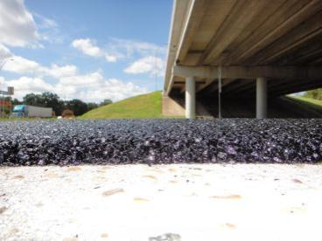
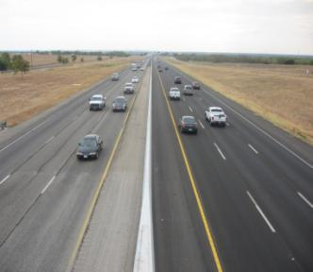

Use Of Fine Graded Mixes
Research Project 0-6615
August 2012
Texas Transportation Institute
Texas Department of Transportation
TxDOT Project Director: Dale Rand
TTI Researchers: Tom Scullion, Cindy Estakhri, Bryan Wilson
Notes:
TxDOT has to explore new ways to maintain low volume roads besides just doing chip seals. Chip seals are a good way to keep roads sealed but when this treatment is used close to populated areas it can create some problems with road noise. The state of New Mexico has significantly improved the performance of their low volume pavements in the past 10 years. Many people have noticed the good performance of a specific type of Open Graded Friction Course (OGFC) that is currently used on many low volume roads in New Mexico. The OGFC is finer and placed significantly thinner than TxDOT’s PFC mixes. The typical OGFC in New Mexico is placed at a thickness between 1/2” and 3/4”. This mix is used as an alternate to seal coat or microsurfacing. The mix is much quieter and smoother than a typical seal coat or microsurfacing. Such a mix could give TxDOT more or better options regarding surfacing low volume roadways.
Other states are using fine grained dense mixes to execute thin overlays on aged pavements that do not require strengthening. These types of overlays last longer than chip seals and are more appealing especially for urban environments.
This project ends Aug 2012, the main deliverable is a new spec which is already being implemented into TxDOT’s new HMA specs under review in Summer of 2012

Slide 2

Class Overview
Types of very thin overlays (1 inch or less)
Review of proposed specifications for thin overlays
Implementation/evaluation within districts
Development of mix designs for a typical district
Laboratory measurements of surface noise absorption and skid
Performance problems already encountered with thin overlays
Notes:
These are the 6 areas which will be described. In 2 the key areas of the currently proposed spec will be covered, Section 3 shows the test and full scale projects already placed. Section 4 is an example of the work done by TTI to assist a District coming up with each of the three new mixes for the first time. This case is from testing conducted for the Dallas District. Most of the existing projects are doing well but Section 6 covers problems areas

Slide 3
Section 1.0
What is a Fine Graded Mix?
Notes:
In this section we will discuss what we are talking about with a fine graded mix? What is the definition of a thin overlay?

Slide 4
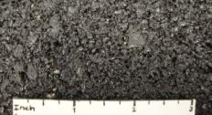
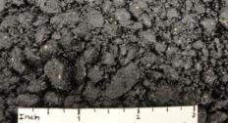
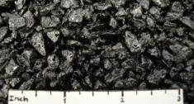



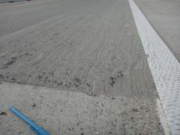
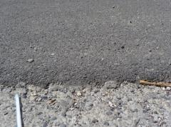
Thin HMA Layers (1.0 in. and thinner)
Micro-Overlays (slurry products)
  Crack Attenuating Mix Fine Stone Matrix Asphalt Fine Permeable Friction Course
  (CAM) (Fine SMA) (Fine PFC)
  ~50% coarse + 50% scrn. ~75% coarse + 25% scrn. 100% coarse
  E-Krete Microsurfacing/
  MicroTekk
...Etc.
Notes:
There are two general types of fine graded mixes we will discuss: Thin HMA layers (less than 1 inch thick) and micro overlays (or slurry-type products that are ultra thin, usually less than ½ inch);
The types of thin overlay covered by the proposed spec are shown at the top of the slide. Several of the micro overlays are proprietary and not widely used.

Slide 5
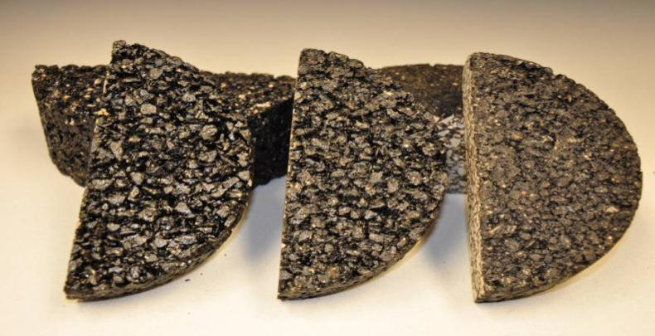
HMA Mixture Types
Fine PFC Fine SMA Fine DGM
OPEN GRADED (24% AV) GAP DENSE
30% Cost savings over traditional mixes - lifts of 1 inch or less
Pass Rutting (HWTT) and Cracking (OT) performance tests
Mandate PG 76-22 SAC A Grade 5 Rock
Under evaluation in several Districts
Options being added to Construction Divisions new Specs
Notes:
For the new surface mix the dense graded mix (DGM) has been suggested to replace the CAM mix, the big difference is the design approach where as will be described the target density has been reduced lowering the binder content. The 5 points at the bottom of the figure are very important. The SS to be described has been used in both the Bryan and Brownwood Districts

Slide 6
Section 2.0
Specifications
SS 3328 (Used in the Bryan District)
SS 3243 (Used by the Brownwood District)

Slide 7
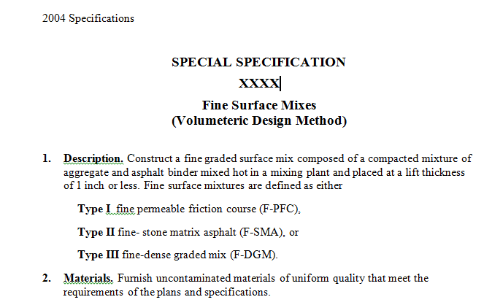
One Time Use Special Spec 3328
Notes:
This is the cover page for the new spec it will need to be proposed as a special one time use special specification. Note the three different Types of mix are all included in this one spec

Slide 8
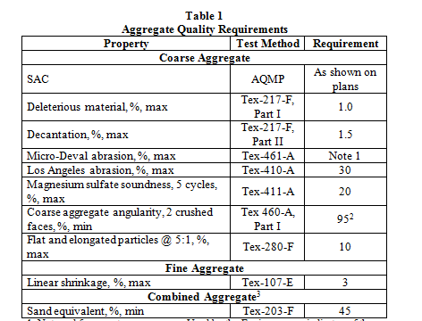
.
3. RAP. Do not use RAP in Fine Graded Surface Mixes.
Notes:
Aggregate quality requirements are identical to other performance mixes. For the PFC type mixes the flat and elongated requirement is very important . Also this version of the spec does not allow any RAP or RAS, the new TxDOT specs will incorporate these fine mix gradations but it will allow small amounts of RAP/RAS

Slide 9

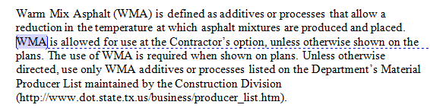
Notes:
PG 76-22 is mandated. An SMA mix placed on I 20 in the Atlanta district had severe bleeding and rutting problems when the contractor was allowed to switch from a PG 76-22 to PG 70-22 (even though it passed Hamburg) That problem was tied to the very hot summer of 2011.
Warm mix is allowed and, in theory, these types of mixes would benefit from the use of WMA since the thin lifts cool so fast. Austin specifies WMA when the plant is more than 30 miles from the job.

Slide 10
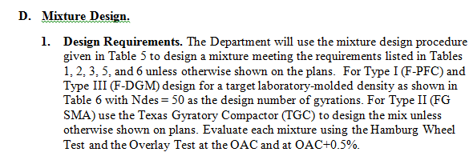

Notes:
Read this very carefully. 1) The PFC and DGM are designed using the Superpave, 2) the SMA uses the Texas Gyratory and 3) for all mixes the designer has to make and test 2 sets of samples at different AC contents. The TxDOT supervisor has the final say on which to use. If all cases the asphalt is paid for as a separate bid item. The SMA’s are very tough mixes and often you cannot get the required density with the SGC, this toughness can be an issue in the field especially when it comes to compaction.

Slide 11
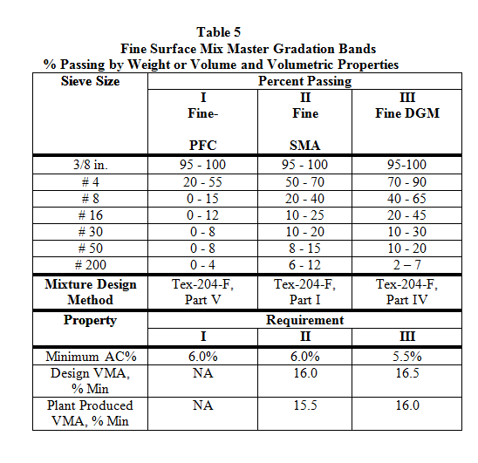
Notes:
Important slide showing gradation and min AC content

Slide 12
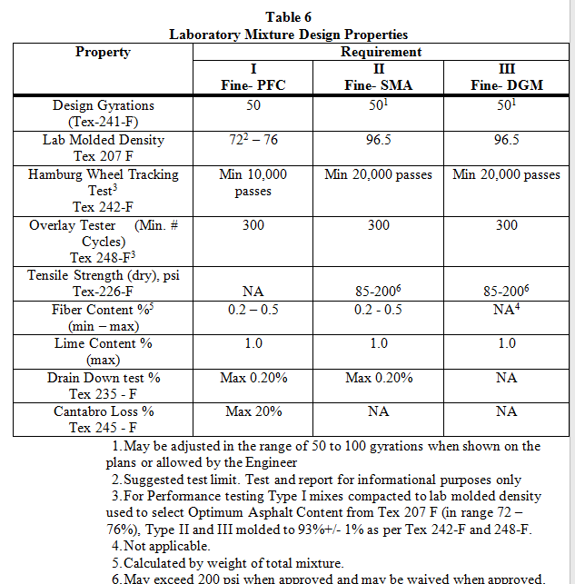
Notes:
How to select the optimal asphalt content. Recall SMA is a Texas Gyratory Compactor (TGC) design while the others use Superpave. HWTT requirement is based on the fact that a PG 76-22 is mandated for these thin surfacings. Lime content is max – it can be 0%.
All 3 mixture types have both a Hamburg and Overlay Test requirement.

Slide 13
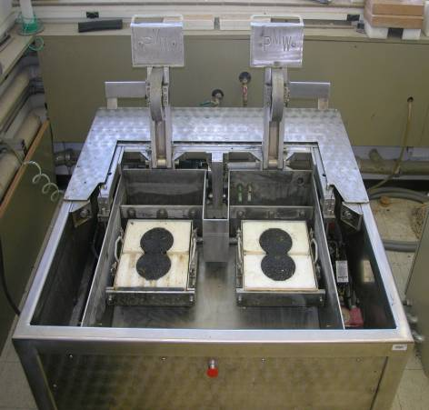
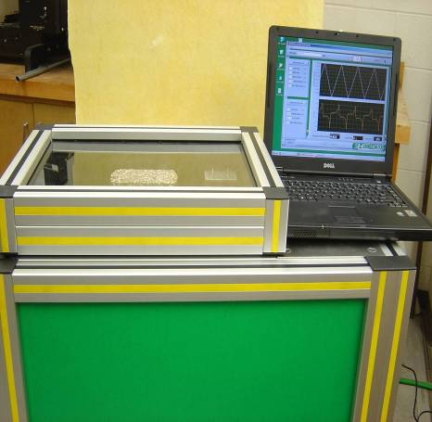
Designing Thin Overlays
Hamburg Wheel Tracking Device
Overlay Tester
Notes:
These are the two main tests use to assess the performance of these thin overlays

Slide 14

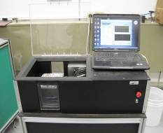
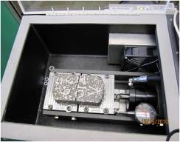
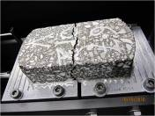
The Overlay Tester (OT)
Overlay Tester (OT)
Room temp 25 C 0.025 inch (0.635 mm)
10 s/cycle
In Texas OT ≥ 300, 750, @ 93% density
Measures load, number of cycles, time, etc.
click here to see Video of Old OT
Notes:
The OT is a standard test for assessing the cracking resistance of mixes in Texas. The equipment is available at TTI, in Cedar park and in the Houston and Childress Districts. The equipment is currently being manufactured by Troxler Inc of North Carolina

Slide 15
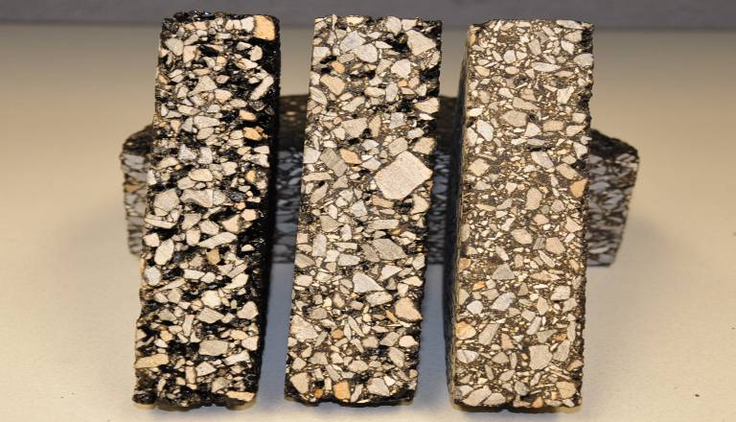
PFC SMA DGM
Hamburg 10 K 20 K 20 K
Overlay 300 300 300
Air Voids Very high Low Low
Skid Very Good Good Ok (high speed/wet??)
Noise Low Low Low
Notes:
This shows a summary of the required results from performance tests in the lab. The one concern is the performance of the dense graded fine mix in high speed conditions especuially under wet weather

Slide 16
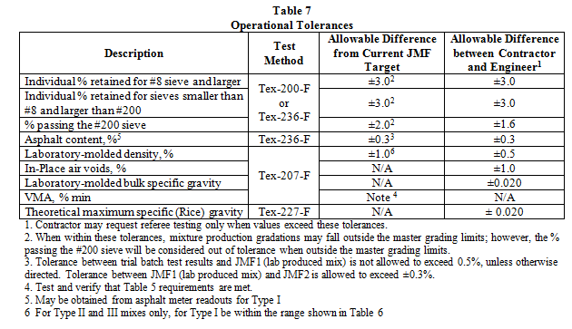
Notes:
The operational tolerances on the fine mixes are similar to those on other performance mixes in Texas

Slide 17
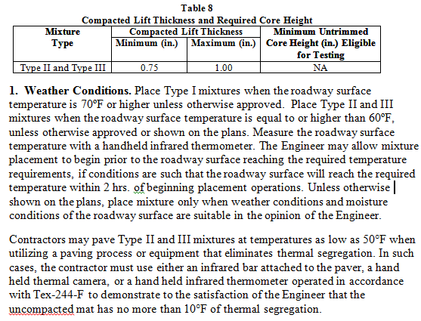
Notes:
The intent here is to place these mixes in hot weather conditions because their very thin nature will mean that they are susceptible to rapid cooling which could be a problem

Slide 18
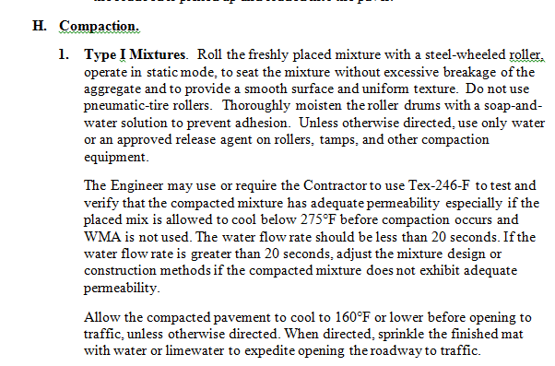
Notes:
As with a conventional PFC, the rolling patterns should be established using the water flow test. Normally one or two passes of the steel wheel is all that is needed to seat these materials.

Slide 19
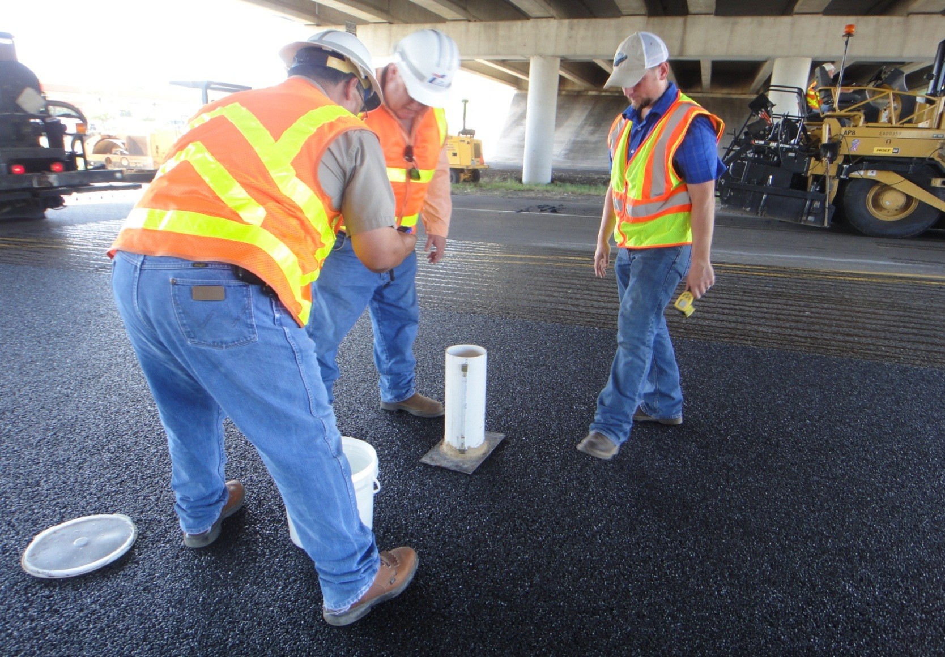
Water Flow Test – 6 seconds
6-in diameter by 10-in high
cylinder. Plumber’s putty used
to seal the edges of the pipe to
pavement surface so water flows
through the PFC.
Notes:
This shows the fine PFC placed in the Lufkin District/ the contractor has modified the equipment with a base plate on the bottom to let him stand on the system to enhance contact with the surface. In this case the water flow was around 6 seconds which is very good. Conventional PFCs are normally around 20 seconds.

Slide 20
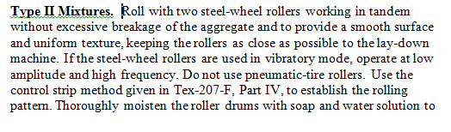

Notes:
The SMA’s are very difficult to compact. This spec calls for the use of dual steel wheel rollers working in tandem, keeping them as close as possible to the paver. No pnuematics are allowed as they tend to pick up these rich mixes when they stop.
Controlling the level of compaction with normal density measurements is still under review, more work is underway in this area. As a minimum the water flow is recommended to make sure this mix is NOT permeable. We have seen examples of high air void problems with the TOM mix in Austin which is very similar to the fine SMA.

Slide 21
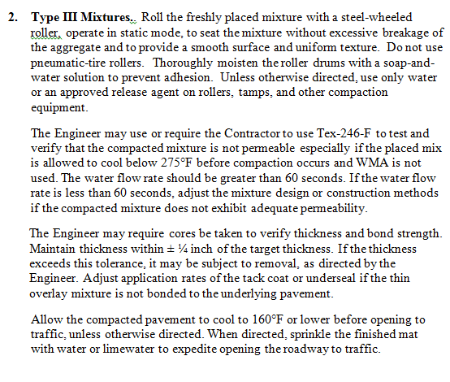
Notes:
Controlling the level of compaction with normal density measurements is still under review, more work is underway in this area. This mix should be impermeable so a water flow of over 60 seconds is recommended

Slide 22

TxDOT’s new PFC draft spec
Notes:
The fine PFC spec discussed earlier has in part been incorporated into the new TxDOT statewide ITEM 342 spec. This is under final review in the summer of 2012 and it is expected to be released for widespread use in the Fall. The one difference here is that this spec permits the use of RAP and RAS in all the PFC’s

Slide 23
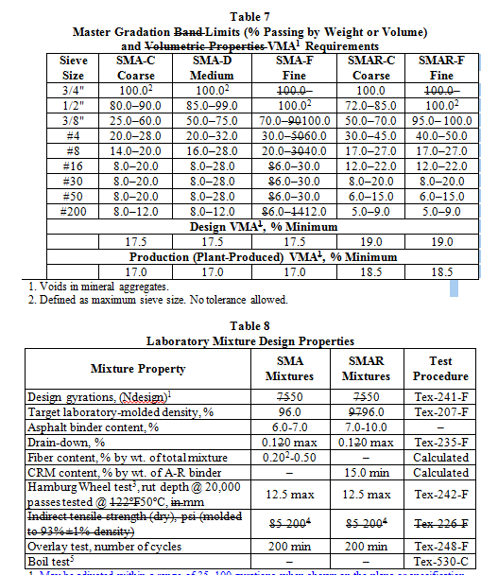
Notes:
TXDOT’s newly proposed SMA spec, this incorporates for the first time the SMA-F developed as part of this research study

Slide 24
Thin (<1 inch) Fine Surface Mixes
Type 1 Fine PFC
Safety/drainage/noise
Type 2 Fine SMA
Rut/crack resistance/skid
Type 3 Fine DGM
Rut/crack/low speed
All with Quality aggregates and PG 76-22 binders
Notes:
One key aspect is finding where is the best application for each of these thin overlays. The fine PFC can be used to cover bleeding chip seals, where wet weather accidents are known to have occurred, or where noise is a concern. The fine SMA and DGM are good mixes to use where the existing surface is cracked, with the SMA being particularly good for high speed applications. The DGM is proposed to be placed to restore texture and friction and could be an alternative to microsurfacing applications. The goal is to attempt to place this mix at around 0.5 inches thick.

Slide 25

Anyone for Seal Coats?
Notes:
Districts continue to have issues with badly constructed seal coats. Seal coats are still the primary pavement preservation surface used by TxDOT and, yet, they are noisy and when constructed poorly they deteriorate quickly from either flushing or rock loss. Probably every district has been forced to deal with public complaints from a seal coat gone bad. Cost-effective alternatives are needed for those locations where a seal coat may not be the best choice. All three fine overlays are intended for use over existing deteriorated seals and as an alternative to a seal coat.

Slide 26
Section 3.0
TxDOT’s Field Evaluation of
Thin Overlays
Notes:
In Section 3.0, we will cover the field implementation and evaluation of the thin HMA overlays previously described.

Slide 27
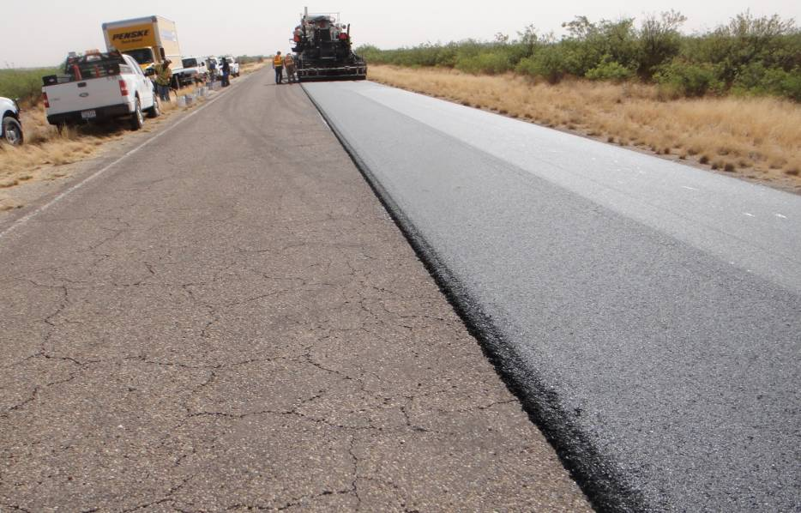
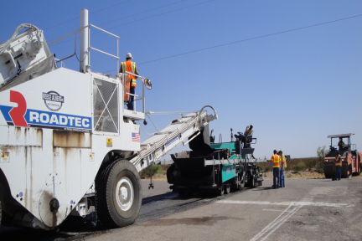
Thin Lift Construction at
Pecos Test Track
All layers 1 inch thick
Fine mixes typically 95 to 100% passing 3/8 sieve
All mixes pass Hamburg and Overlay Tester requirements
2 fine Porous Friction Course designs
2 fine Stone Matrix Asphalt designs
2 Crack Attenuating Mixes designs
Notes:
This is the location where the first series of thin overlays were placed in Texas. A total of six different mixes were placed as test sections, with two different aggregates (a Capital Aggregates Hoban Rhyolite design and a Vulcan Eastland limestone for each mixture type). The Hoban aggregate is a SAC A aggregate while the Eastland aggregate is a SAC B although it is considered a relatively high quality SAC B source.

Slide 28
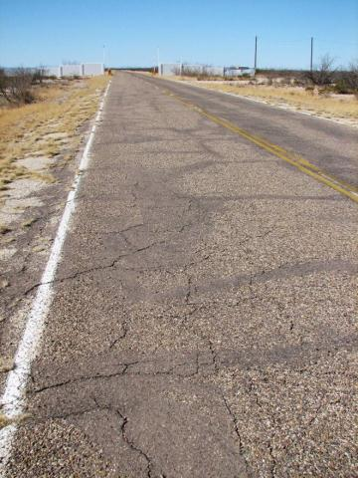
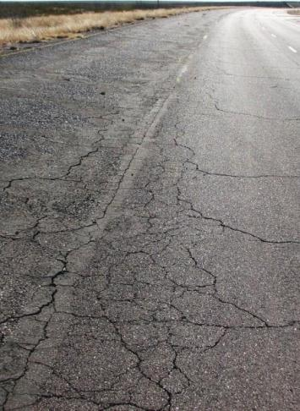
Existing Conditions
Entry Road Test Track
Notes:
We’ll see how these do to resisting reflection cracking. Cracking here is quite severe.

Slide 29
Mix Designs
Mix Name | Binder (PG 76-22) | Aggregate |  | Other
 |  | Composition | (Quarry)
Hoban Fine PFC | 6.5% (76-22) | 100% Gr 5 | (Hoban) | 0.3% fibers
Eastland Fine PFC | 6.5% (76-22) | 100% Gr 5 | (Eastland) | 0.3% fibers
Hoban Fine SMA | 7.0% (76-22) | 60% Gr 5 | (Hoban) | 0.3% fibers
 |  | 40% Screenings | (Turner)
Eastland Fine SMA | 7.2% (76-22) | 60% Gr 5 | (Eastland) | 0.3% fibers
 |  | 40% Man. Sand
Hoban CAM | 8.8% (76-22) | 65% Gr 6 | (Hoban) | -
 |  | 35% Screenings | (Turner)
Eastland CAM | 8.1% (76-22) | 30% Gr 5 | (Eastland) | -
 |  | 70% Man. sand
Notes:
These are the mixes used at Pecos. The sections were constructed in early 2011 and Reece Albert Construction from Midland did an excellent job of placing these. Typically, we would have performed the mix designs using lime but the plants in this area do not typically have that capability, so for these mixes, no lime was used.

Slide 30
Mix Designs (cont.)
Mix Name | Design Density (%) | Design Gyrations | HWTT |  | Overlay
 |  |  | Rut Depth (mm) | # Cycles | # Cycles
Hoban Fine PFC | - | 50 | 8.1 | 10,000 | 635
Eastland Fine PFC | 77.8 | 50 | 6.3 | 10,000 | 640
Hoban Fine SMA* | 98.8 | - | 2.6 | 20,000 | 300
Eastland Fine SMA* | 98.0 | - | 6.0 | 20,000 | 300**
Hoban CAM | 96.5 | 50 | 9.0 | 20,000 | >1,000
Eastland CAM | 96.5 | 50 | 10.5 | 20,000 | 950
*Texas Gyratory Compactor and Balanced Mix Design
**Predicted
Notes:
The results of the performance test are shown here

Slide 31

CAM 2
Eastland
SMA 1 Hoban
Notes:
Each of these mixes were placed on the entrance road and on the test track at Pecos. Each test sections was about 1000 ft. in length.

Slide 32



Field Testing Complete
Skid Resistance
Noise from Tires
Infra-Red
Notes:
All of the thin overlays are performing very well to date. In addition to visual assessments we also collected both noise and skid measurements on these sections

Slide 33
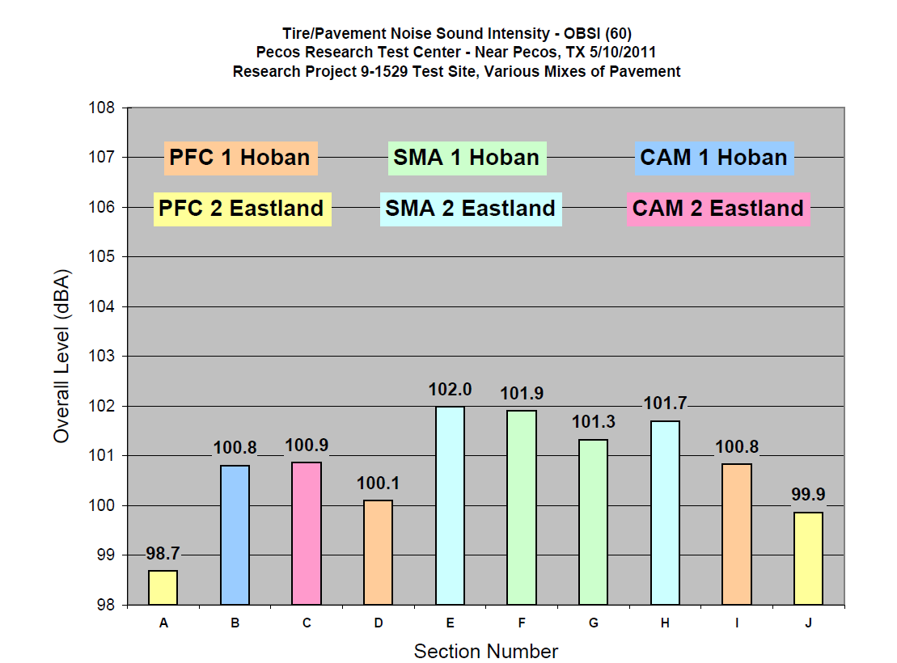
Notes:
These values are as expected. All sections are very quiet, with the PFC’s being best at around 100 dBA. All of these mixes are substantially quieter than most of the large stone mixes (Dense, PFC and SMA) normally placed as wearing surfaces in texas

Slide 34
Task 5 – Noise Testing
_________________________________________________________________________________________________________
Notes:
Here are the tire/pavement noise measurements collected by TxDOT on different seal coats around the state on research project 0-6496. Even Grade 5 seal coats were noisier than any of the surfaces placed at the Pecos Test Track.

Slide 35
Skid Numbers at PECOS
Notes:
No problems either with the skid measurements. These were collected 2 weeks after placement, it is expected that these values may now be a little higher once the asphalt has worn off the surface rocks

Slide 36
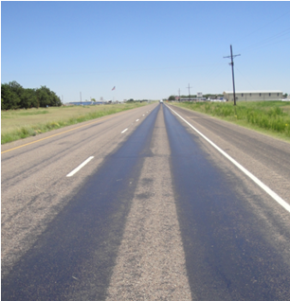
Applications for the Fine PFC
Notes:
The following slides show where the thin overlays have been placed. One very popular application is the use of the fine FFC on sections such as the one shown where the condition is good but the wheel paths are badly flushed. The excess asphalt present in bleeding seal coats tend to migrate through any type of mix placed over it. The advantage of using the fine PFC is that the air void content is roughly 24% which potentially can accommodate that excess binder.

Slide 37
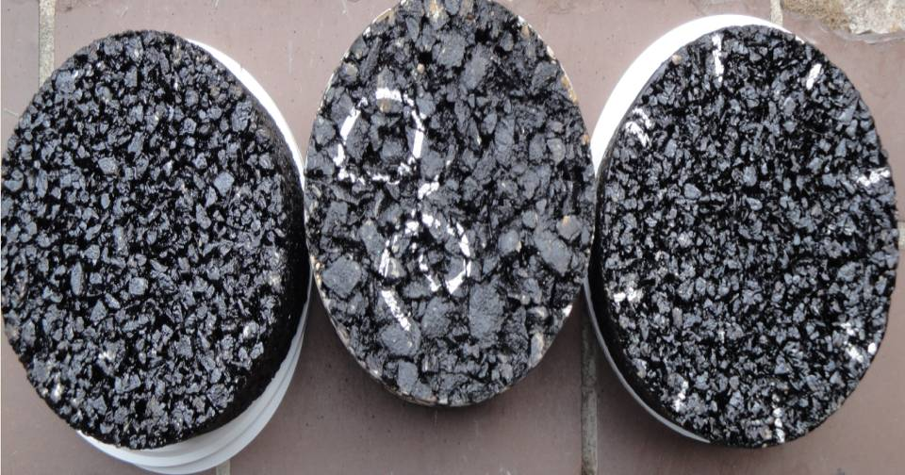
New Rice Crispy PFC
New Fine PFC Current Item 342
Notes:
In the lab the finer PFC’s drain substantially better than the more coarse Item 342. Air voids may be smaller in size but there are more of them (24% versus about 20% for conventional PFC).

Slide 38
Proposed Criteria for Fine PFC
Property | Fine PFC Specification Requirement
Design Gyrations | 50
Lab Molded Density | 74 – 78%
Hamburg Wheel Tracking | Min 10,000 Passes to ½ inch rut
Overlay Test, Minimum # of Cycles | 300
Cantabro Loss | 20 %
Fiber content | 0.2 – 0.5%
Lime Content, max | 1%
Drain Down Test, max | 0.20%
Notes:
The new items here are a) lower lab molded density requirement b) use of the Hamburg and OT performance tests

Slide 39
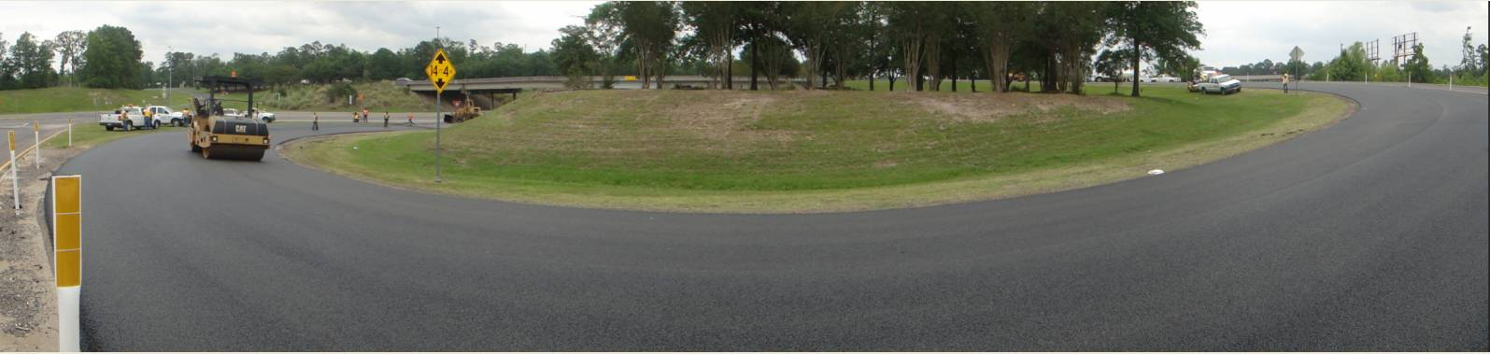
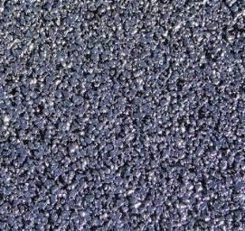
Field Test – Lufkin District –
May 2011
Notes:
The first test site for the Fine PFC, the Cloverleaf from US 59, onto the loop around Lufkin. All trucks going south on US 59 take this exit to loop around downtown Lufkin. The district reported that ever time it rained, they were pulling cars out of the ditch. They also reported that no surfacing they had tried held up to the heavy trucks applying brakes and turning. It was the worst or possibly “best” site to try this PFC. The existing surface was a somewhat “bleeding” seal coat.

Slide 40
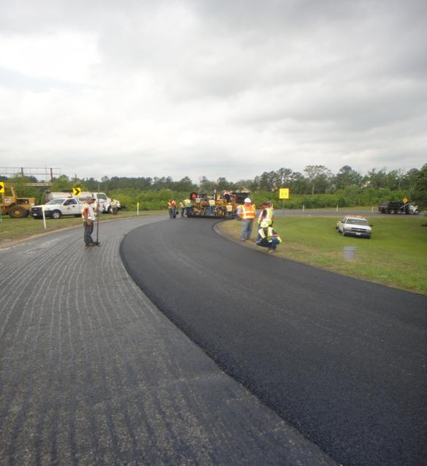
Construction of Fine PFC
Notes:
This was placed by a local contractor who was placing a normal PFC close by. A field change was made to his contract. The mix itself was purchased thru the research project, made and delivered to the project by East Texas Asphalt. During construction, the PFC was placed directly over an existing seal. A much heavier tack would be required over regular HMA

Slide 41
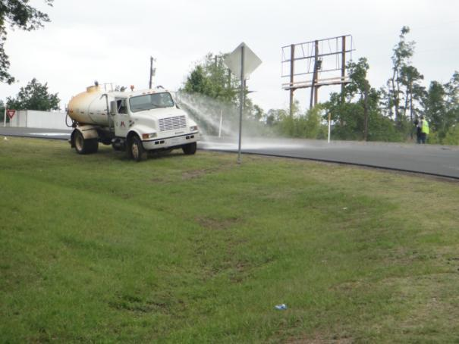
Water Used to Cool Prior to Traffic
Notes:
It is the District policy to wet the PFC down after rolling so traffic can be placed on it ASAP. In this case, there was also particular concern with making sure the PFC had sufficiently cooled prior to allowing heavy trucks braking and turning on the fresh surface.

Slide 42
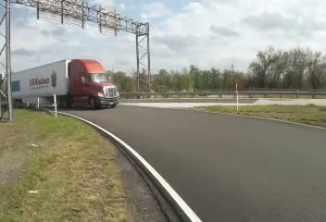
Video showing typically traffic
Notes:
This video clip shows the intensity of the truck loading on this section. The PFC withstood the extremely hot summer of 2011 (100 days of 100°F+ temps) and it is still performing well. The District went ahead and built a second section and they are considering placing this mix on US 59

Slide 43
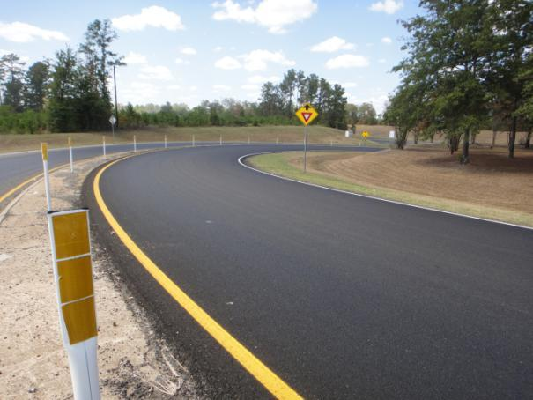
After 12 months
Notes:
The project is as of Aug 2012 almost 16 months old - still holding up very well, the District contact is Paul Montgomery

Slide 44


Second Section in Lufkin
Placed by TxDOT’s Maintenance Crew
Notes:
Funds were made available to build a second section near a truck stop in Lufkin. This time the crew placing the mix was a TxDOT maintenance crew. The same mix design was used and East Texas Asphalt produced the mix.

Slide 45

After 3 months
Conventional Dense Graded
Fine PFC
Notes:
Excellent at removing standing water

Slide 46
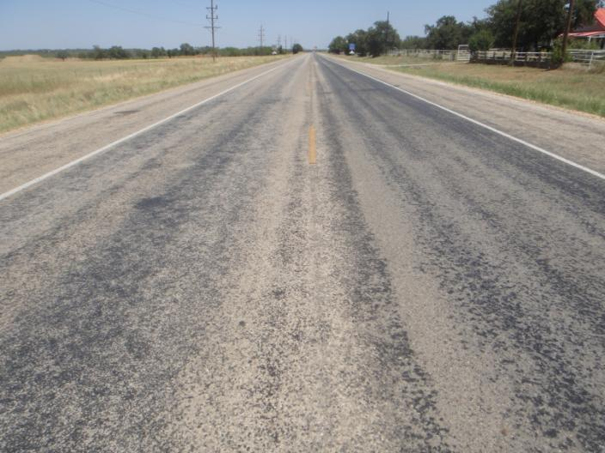
July 2012 Full Scale Project Brownwood
Full scale project US 183, Brownwood, to correct bleeding surface trt.
8.75 miles, 5000 tons, $97/ton (Zack Burkett), CSJ 6231-69-001
Notes:
This is the first full scale, fine PFC project recently placed in Brownwood to cover up a bleeding/peeling surface treatment. The surface treatment had been constructed using a winter grade emulsion which began to bleed with the approach of hot weather. It had been in place for a little over one year at the time of this overlay. Several large LRA patches were placed over the problem areas. LRA tends to have very high air voids so an extra heavy tack was placed over the LRA. Tack rates for the seal coat were 0.07 gsy and tack on top of the LRA patches were 0.14 gsy. The mix was designed using limestone from Zack Burkett’s Lindsey pit and from Vulcan’s Eastland quarry.

Slide 47
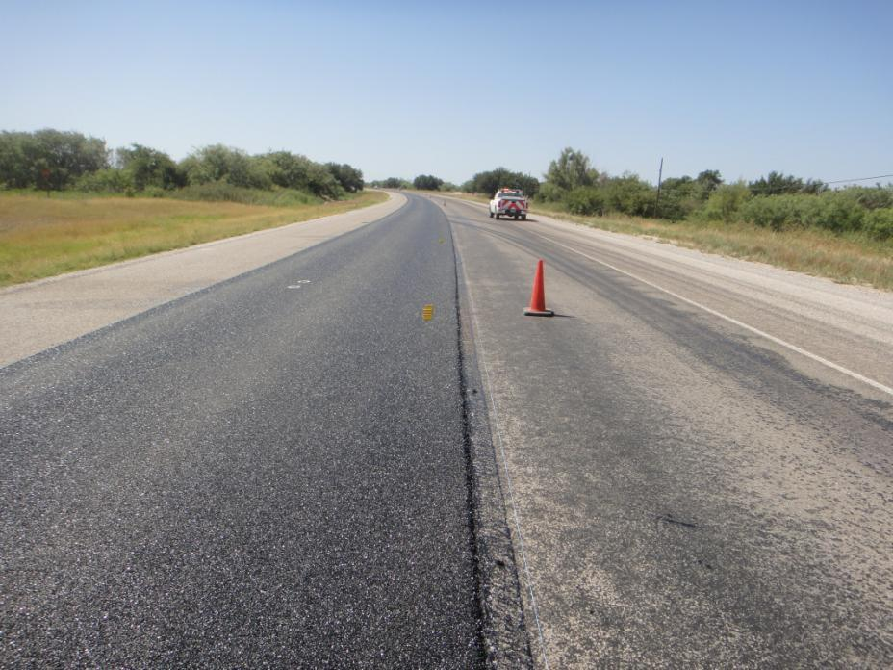
Notes:
The main lanes only were paved. This project is on US 183 just south of Breckenridge

Slide 48
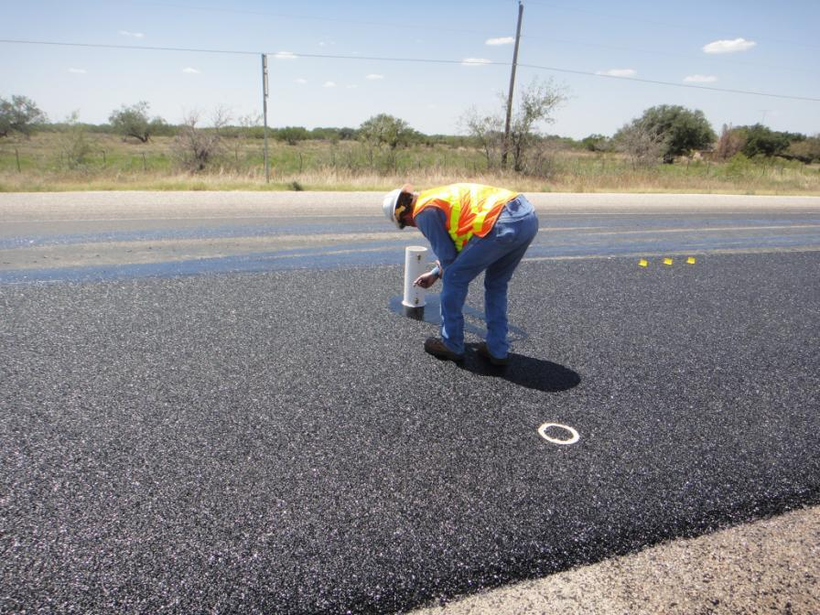
Notes:
Waterflows were run to adjust the rolling patterns. In this case the contractor backed off the amount of rolling to ensure he was getting a water flow value of around 20 seconds

Slide 49
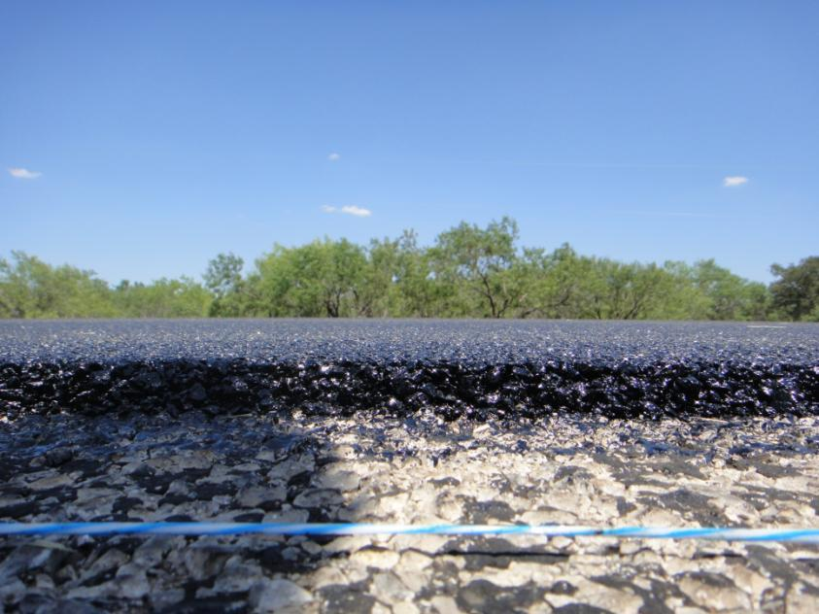
Notes:
The thickness at placement was around ¾ inch after rolling . Yield on the project was 63 lbs/sy.

Slide 50

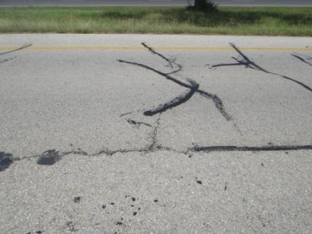
Aug 2012, FG SMA on
SH 6 FR Bryan District
Notes:
The first fine SMA was placed in the Bryan District on the frontage roads of SH 6. The existing pavement was old brittle HMA with multiple crack seals. The Bryan District has made widespread use of the CAM mix but they wanted to try this mix for its superior surface texture and potentially better high speed skid

Slide 51
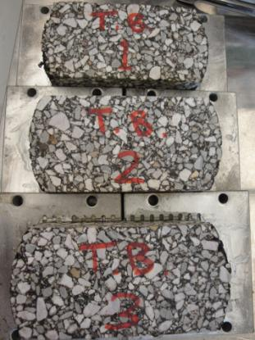
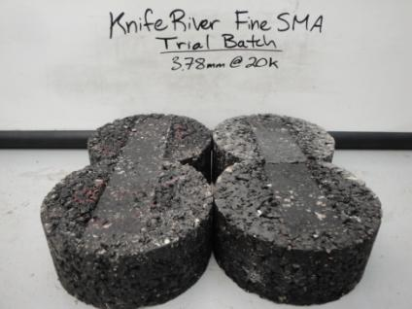
Bryan FG SMA Trial Batch
Hamburg Results
Overlay Results
3.8 mm @ 20,000 cycles
508 Cycles
Notes:
TTI worked with the local contractor Knife River to come up with an acceptable mix design and optimum asphalt content.

Slide 52

Notes:
Setting the optimum rolling patterns was a challenge. The initial sequence of two passes each side of the mat was not sufficient as the initial void contents were measure with the nuke gauge to be above 11%. A short section of tandem rolling was tried and triple passes appears to be optimum. The data collected on this section is still being analysed

Slide 53
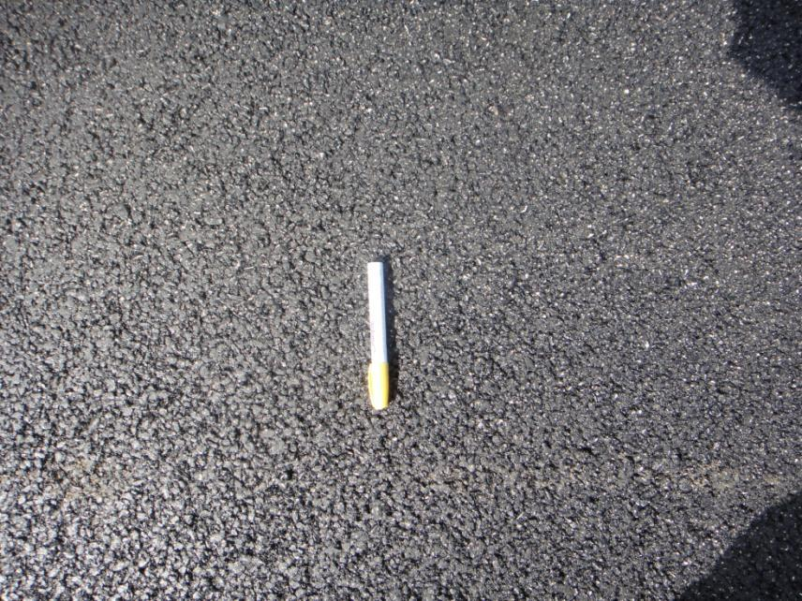
Notes:
The final surface has the required superior texture

Slide 54

Notes:
In many locations especially on the inside lane the mat was less than the 1 inch specified, in some cases it was around 0.75 inches

Slide 55

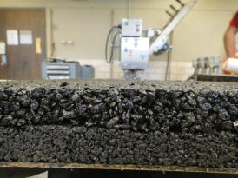
Houston’s US 59
Plans under development for 1” CAM + 1” Thin Surfacing
Based on early success with performance mixes on SH 6
Notes:
TTI is also working with the Houston District to design a thin overlay option for this mega project in Houston. The final surface will be either a fine SMA or a TOM mix from Austin. The bottom 1 inch will be a CAM type mix. All lanes will be overlaid

Slide 56
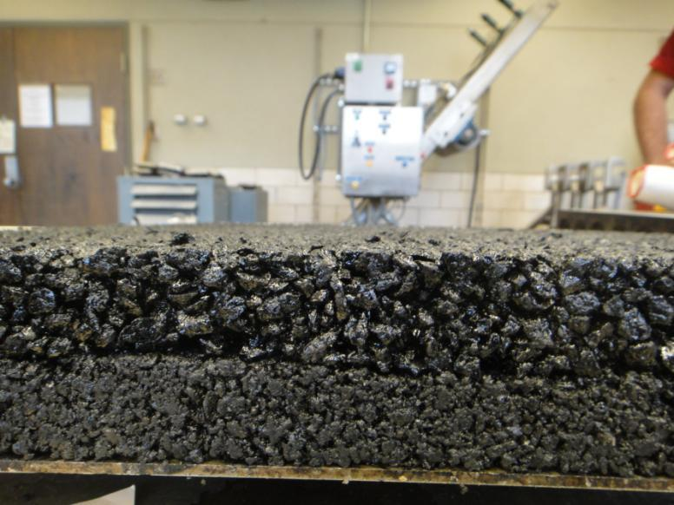
Fine PFC
CAM
Slabs made at TTI for performance testing
Notes:
This is a very popular combination which could potentially be used in many locations statewide, especially in Urban areas as an overlay for concrete. The total thickness will be two inches. The bottom lift is to seal the concrete and minimize reflection cracks and provide a impermeable layer under the PFC. At TTI slabs have been made for both noise and skid testing. These slabs are 22 in by 22 in and these are tested under the TTI polisher

Slide 57
Statewide Summary
Specs for fine mixes developed
TTI assisting with initial implementation
MNT has funds available for demo sections
No RAP or RAS in mixes
Placement by both
  Contractor (tied to on-going job)
  District Maintenance Crews
Trials completed under intense loading successful
Districts moving to full-scale implementation (Austin/Brownwood/Bryan)
Lots of interest statewide
Notes:
Read each one of these and discuss. Most of this was covered in the earlier slides

Slide 58
Test Sections?
Fine PFC (0.75 to 1 inch) (full sun section)
  Noise reduction on PCC
  Severely Bleeding chip seal
  Wet weather accident locations
Fine SMA (0.75 to 1 inch)
  Cracked section
  Cost effective replacement for Item 341
  High speed traffic need to improve skid
Fine DGM (as thin as possible)
  Instead of micro-surfacing
  On top of a worn out seal
Notes:
If this is to be presented to a District it is now worth letting them discuss if there are sections where they could try this. All mixes are possible. The DGM could be placed over a worn out seal with multiple patches, bad transverse variations in texture. The goal is to eventually get to place this very thin at a reasonable cost, so to have a sequance – chip seal – thin overlay chip seal. Placing seals over problem seals rarely works well.

Slide 59
Section 4.0
Mix Designs for Typical District
Example: Designs for Fort Worth/Paris/Dallas Districts.
Notes:
This type of work has been done in several Districts. TTI polls the TxDOT lab folks and the local contractors to obtain a source of locally available quality fine aggregates. These are typically grade 5 seal coat rock. SAC materials is preferred and strongly recommended. For the PFC these must be cubical, strictly enforcing the F&E spec. Both clean and dirty screenings are identified preferable from the same source rock so that the SMA and DGM. This example covers work done for the Metroplex

Slide 60

Fine Graded PFC
Mill Creek Aggregate (1/4-in chips)
used by APAC at Dallas HMA Plants
Notes:
This material was supplied by David Morton in the Dallas area, originally from Oklahoma, but widely available in the Dallas and FW Districts

Slide 61


Fine PFC
Best Lab Performance Test Results Seen to Date
Mix Design | Percent Passing
3/8 in. | 99.5
# 4 | 47.0
# 8 | 7.0
# 16 | 3.0
# 30 | 2.0
# 50 | 1.5
# 200 | 1.1
1% Lime 6.5% PG 76-22 | 76.4% Density
Hamburg | Overlay Test | Permeability, Elapsed time | Cantabro Loss
7.1 mm @ 20000 cycles | 1000 cycles | 2.6 seconds Conventional PFC: 10.4 s | 6.0% AC ,30.9% 6.5% AC, 16.2%
Notes:
This presents the design results for the fine PFC this design was done using the recommended spec discussed earlier where the performance test were run at two different asphalt contents. The OAC was 6.5%. The only concern with this mix was the high Cantabro test results, all other results were excellent. All performance tests past at 6.5% binder

Slide 62


Fine Graded SMA
65% Mill Creek ¼ in chips
35% Mill Creek Dirty Screenings
Notes:
In order to get the high -200 content in the fine SMA it is necessary to use dirt screenings, these are unwashed materials from the same source

Slide 63

Fine SMA
Mix Design | Percent Passing
3/8 in. | 99.7
# 4 | 65.3
# 8 | 32.1
# 16 | 20.9
# 30 | 14.3
# 50 | 10.4
# 200 | 6.6
1% Lime 0.3% Fibers 6.6% PG 76-22 | 96.5 % Density
Hamburg | Overlay Test
2.66 mm @ 20,000 cycles | 352 cycles
Notes:
The results for the fine SMA are shown here. As specified in the spec this is a Texas Gyratory design which specifies that we need to use 6.6% binder. Testing was performed at both 6.1 and 6.6% asphalt, the 6.1% failed the OT. From a quick review here it looks like this mix could possibly use a little more binder. The use of WMA as a compaction aid probably would not hurt

Slide 64



Fine Dense-Graded Mix
50% Mill Creek
¼ in Chips
25% Mill Creek Dirty Screenings
25% Mill Creek Clean Screenings
Notes:
To get the continuous gradation needed for the dense graded mix it is necessary to blend both the dirty and clean screenings as shown in this slide. From experience it is very difficult to consistently arrive at a passing SMA design with the Superpave compactor, but the concern is can the TGC mixes be adequately compacted in the field

Slide 65

Fine DGM
Mix Design | Percent Passing
3/8 in. | 99.8
# 4 | 73.2
# 8 | 43.6
# 16 | 28.3
# 30 | 17.9
# 50 | 10.8
# 200 | 5.4
1% Lime 7.2% PG 76-22 | 96.5 % Density
Hamburg | Overlay Test
5.4 mm at 20 K | 1000+
Notes:
Based on design criteria 7.2% binder was proposed for this mix. This mix did extremely well in both the HWTT and OT

Slide 66
Section 5
Laboratory Testing of HMA Surface Properties
Texture and Skid Resistance
& Noise Absorption
Notes:
This short section will cover some of the advanced no standard laboratory test recommendations proposed by TTI. All of this equipment is available at TTI

Slide 67



Test Set-Up
Texture and skid resistance
Wet polishing to 100K cycles
Notes:
Two important aspects of performance that are under evaluation in the TTI lab are the ability to test for both skid and surface noise. To make this TTI has a compactor that molds samples 22 by 22 by 2 inches thick. These samples are placed in the polishing equipment shown this is a wet polisher where typically 100000 wheel passed are made under 100 lbs load, the texture noise and skid are measured using the equipment shown in the following slides

Slide 68




Slab Before and After
Notes:
For dense graded mixes the system does a good job at polishing the surface- limestone mixes can become very slick under these loading wheels

Slide 69




Test Set-up
Texture and skid resistance
Circle-Texture Meter
Dynamic Friction Tester
Notes:
This shows the two pieces of equipment especially designed to test the polished surface. The change in Texture and skid can be measured throughout the 100k polishing cycles. No firm guidelines or specs exist at the moment but this looks like useful equipment to look at these critical performance issues in the lab

Slide 70


Results
Texture & Skid Resistance
Texture vs Polishing
Skid Resistance vs Polishing
*Results for fine SMA slabs
Notes:
Typical results for the equipment shown in the last slide The Eastland is a SAC B limestone which was reported to have polishing problems by the Abilene District. It does worst in both of these tests

Slide 71



Test Set-up
Noise Absorption
Acoustic Impedance Tube
Custom-made plate:
More accurate results
More equipment stability
Notes:
This is the new impedance tube which measure the sound absorption by the surface layer. A sound pulse is sent down the tube and what is reflected is picked up by microphones in the tube. The frequency components of the reflected sound are calculated, so it is possible to see what sounds have been absorbed by the PFC layer

Slide 72

Results
Noise Absorption
Notes:
As expected the PFC does a good job at absorbing noise over a range of frequencies from 400 to 1300 Hz which is the audible range. HOWEVER absorption is only one source of tire pavement noise, others are related to the surface texture which can overpower the absorption factor, this is why coarse graded PFC can still be very noisy

Slide 73
Section 6.0
Field Performance Evaluations

Slide 74

Performance Evaluations on
Existing TxDOT Projects
5 CAMs
3 Fine CMHB/SMA Mixes
1 Fine PFC
E-Krete
MicroTekk/Microsurfacing
Data Collected
Mix Design & Construction Info.
Visual Condition
Subsurface Condition (GPR)
Skid Resistance
Tire-Pavement Noise
Notes:
These mixes are relatively new. Very few “existing” projects. This section will describe some of the issues found to date with very thin surface layers

Slide 75
Summary of Findings
Several CAMs had shoving/flushing problems.
  Lowering target density to 96.5% of mandating PG 76 would help.
Don’t put seal coat on soft CAM.
All mixes studied, except one CAM, MicroTekk, and E-Krete, had good cracking resistance.
Notes:
Most CAMs are performing well but in some instances under stop and go traffic some pushing and shoving has been observed. The CAM design have been modified in this project. The newly proposed DGM will have all of the aggregate and grading characteristics of a CAM but significantly less asphalt (between 0.7 and 1% less). The cracking requirement for the DGM has been reduced to 300 cycles in the OT (from 750 for the CAM)
The seal coat problems were observed during the extremely hot summer of 2011

Slide 76
Summary of Findings (cont.)
Good skid resistance (in most cases)
Thin overlays are quiet (98–101 dB) vs.
new dense-graded HMA (104 dB) vs.
seal coat (107 dB).
Notes:
The skid and noise data for the fine mixes especially those with the SAC A aggregates has been excellent and these mixes are all very quiet

Slide 77


Performance Issues with CAM
Slight shoving at intersections
Blistering
  (trapped moisture)
Reduce Target Density to 96.5%
Mandate PG 76
Notes:
Problem with CAMs have been at stop and go areas or heavy cornering in a urban area, also the use of lower PG binders is not recommended
The blistering problem occurred in Laredo and Amarillo. This can occur if the mix is placed over and open surface layer shortly after rain. Any moisture in the surface will be trapped beneath the CAM which is highly impermeable

Slide 78



Perf. Issues with CAM (cont.)
Possible skid problems at high speed/wet weather.
Flushing
Even using SAC A Granite!
Design with new polisher
Don’t put seal coat on soft CAM
Reduce Target Density to 96.5%
Mandate PG 76
Notes:
This just shows other issues - the reduction in binder content for the DGM will help this situation

Slide 79




Perf. Issues with Fine SMAs
Too early to tell
Severe Flushing
PG 70 WMA
Stripping?
Layer de-bonding
Notes:
This failure happened in the hot summer of 2011, with 10 days in a row where the air temp was over 110. The District modified the design based on a contractor request, the mix with the PG 70 passed the HWTT at 20k passes. Bleeding occurred. Also the use of WMA resulted in localized very low air voids less than 3% which could be used to explain some of the mix pushing. The bleeding is blamed mostly on the use of a PG 70 as a short section which used PG 76 did not have this level of bleeding

Slide 80

Perf. Issues with Fine SMAs (cont.)
Compactability
Rapid Cooling
242 F
210 F
Passes 1 and 2
Passes 3 and 4
190 F
Notes:
One major concern about these thin overlay is shown here. The mix cools very fast. This is data from an instrumented roller, this shows the mix temp on the first pass of the roller. Two passes were made down the right side of the mat and two down the left, temp drops of up to 50F were found. This emphasizes the need for possible dual brake-down rollers and the use of WMA

Slide 81

Perf. Issues with Fine SMAs (cont.)
CMHB F
15% Voids
FINE PFC
20% Air Voids
Notes:
In the cool areas the CMHB (TOM mix) looks more like a PFC, in this case the air voids were close to 15%

Slide 82


Perf. Issues with Fine PFC’s
Too early to tell
Closing up, but still looks great
New Mexico OGFC in Lubbock, SS 3411 typically < 1 inch
Notes:
No real performance data yet on the fine PFC. This is a 4 year old PFC from Lubbock with a slightly coarse gradation than the one proposed. This one has closed up but it still looks great on a busy road

Slide 83


Perf. Issues w/ MicroTekk
Cracking
Developing transverse crack
Notes:
These didn’t do as well as other thin overlays in evaluation…but maybe it does better than conventional microsurfacing.
This project doesn’t really show this well.

Slide 84


Perf. Issues with E-Krete
Cracking
Fine cracking pattern
Notes:
The E krete test sections monitored have mot performed well. The issue has been the brittle nature of this mix leading to excessive cracking

Slide 85



Performance Tests
Material Property | Test
Abrasion Resistance | Wet-Track Abrasion, NCAT Polisher
Bond Strength | ASTM Pull-Off Test (Modified)
Notes:
This last slide shows the new test equipment under development at TTI to measure layer bonding. This equipment will be run on upcoming thin overlay project. The Wet track abrasion and NCAT polisher are being run on current and future variations of microsurfacing

Slide 86
Summary
Thin overlays an important role in pavement preservation.
Specifications have been developed for 3 HMA mixture types.
Districts have implemented these specifications and field sections are under evaluation.
Test sections show excellent performance along with skid and noise benefits. A few performance issues have been noted.
TTI has developed mix designs for multiple districts and can work with any district who would like some assistance to assess with a trial sections.

