Slide 1
TXDOT RESEARCH PROJECT 0-6640
STATE OF THE PRACTICE FOR WORKERS IN VERY SHORT DURATION WORK ZONE OPERATIONS
THE CENTER FOR TRANSPORTATION RESEARCH
THE UNIVERSITY OF TEXAS AT AUSTIN
Educational Module
July 17th 2012, 10am-3pm

Slide 2
Agenda
Time | Topic
10:00 am – 10:30 am | Pre-workshop Assessment
10:30 am – 11:00 am | PART I: What should be considered as VSDOs?
11:00 am – Noon | PART II: Why is risk assessment important for VSDOs?
Noon – 1:00 pm | Lunch Break
1:00 pm – 2:30 pm | PART III: How to make better judgments in VSDOs?
2: 30 pm – 3:00 pm | Recap & Post-workshop Assessment

Slide 3
Objectives of the Educational Module
After finishing this module, you will know
WHAT should be considered as Very Short Duration Operations (VSDOs)
WHY is risk assessment important for VSDOs
HOW to properly assess risk and make better judgments in VSDOs

Slide 4
Content
PART I: What should be considered as VSDOs?
PART II: Why is risk assessment important for VSDOs?
PART III: How to make better judgments in VSDOs?
RECAP

Slide 5
PART I
What should be considered as VSDOs?

Slide 6
Current Common Classifications of Work Zone Operations
Guidance provided by MUTCD and TxDOT policies:
Long-Term Stationary – Work that occupies a location more than 3 days.
Intermediate-Term Stationary – Work that occupies a location from overnight to 3 days.
Short-Term Stationary – Daytime work that occupies a location for 1 to 12 hours.
Short Duration –Work that occupies a location up to 1 hour.
Mobile – Work that moves intermittently or continuously.

Slide 7
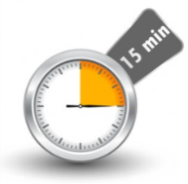
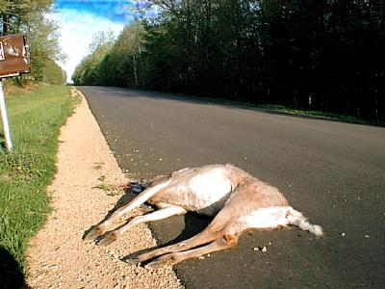

Definition of Very Short Duration Operations
A planned or urgent activity, to be executed in 15 minutes or less by a crew of, one man and one truck or more, and the hazard of not executing the work as a very short duration operation is greater than executing it.
Currently very little guidance is provided.
15 minutes or less
Not executing is more dangerous than executing
Usually one man and one truck

Slide 8
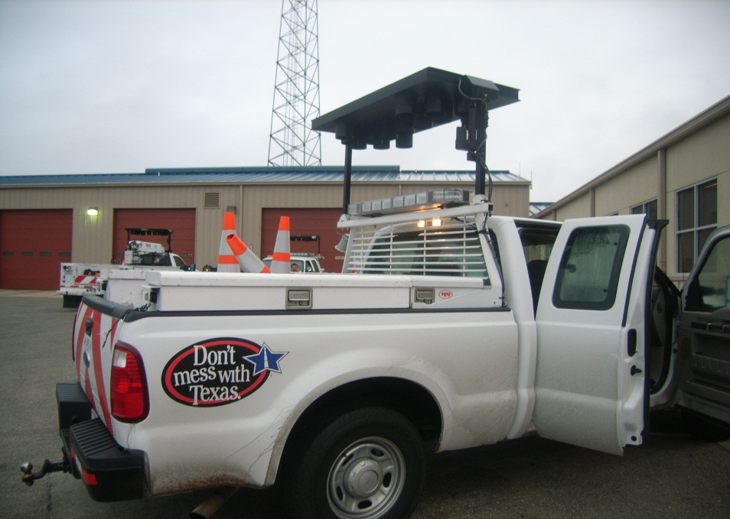
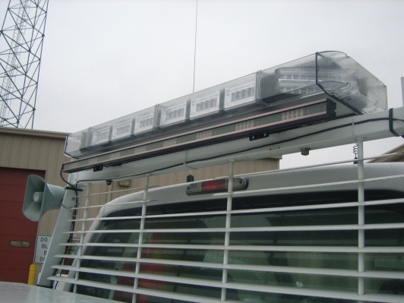
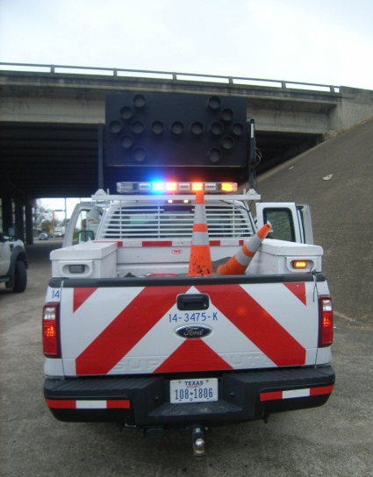
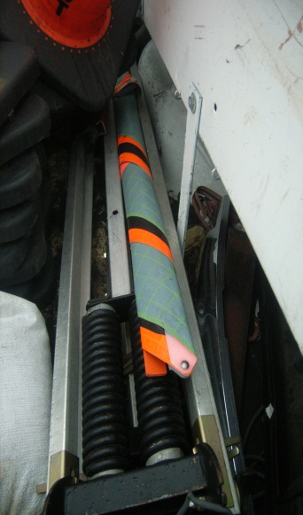
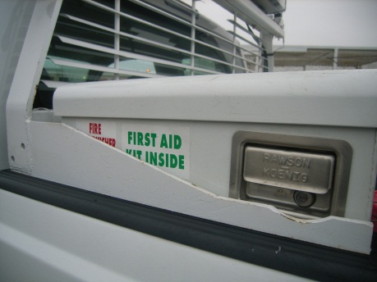
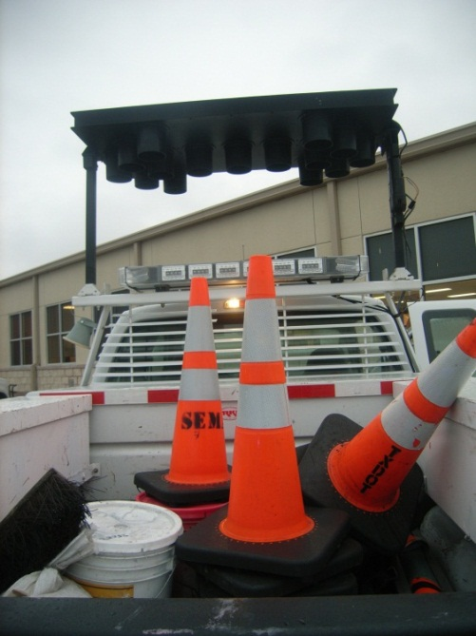
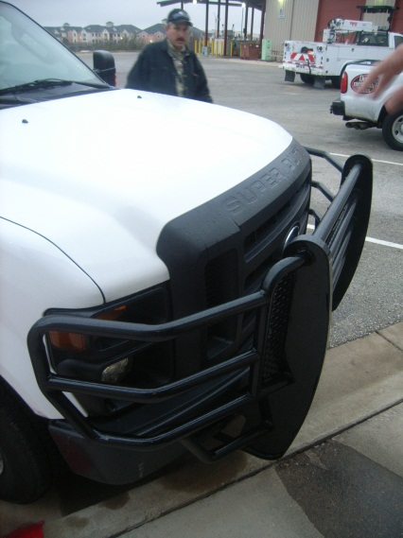
Maintenance Pick-up Truck
Signal Lights
Bumper
Fire Extinguisher & First Aid Kit
Cones and other tools
Portable Message Sign

Slide 9
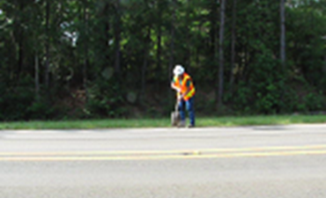
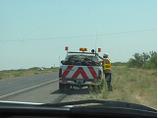
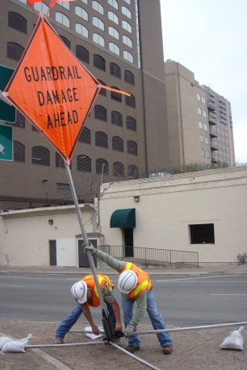
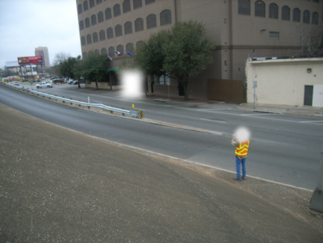
Typical VSDOs
  Temporary pothole patching
  Debris removal
  Signal light replacement in rural areas
  Edge patching – edge of travel lane at short length
  Delineator maintenance on the side of the road
  Warning sign placement
  Supervisor markings for future work
  Taking photographs
  Setting up traffic counters
  Data collection/surveys

Slide 10
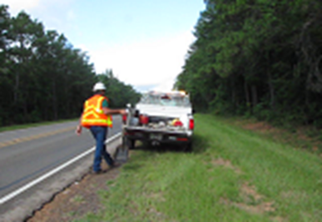
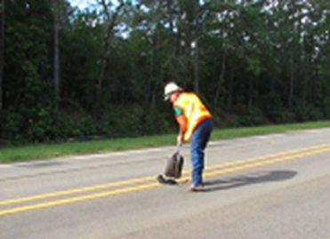
  Temporary pothole patching

Slide 11
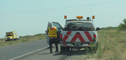
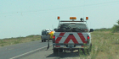
Removing Tire Scraps from the Shoulder

Slide 12
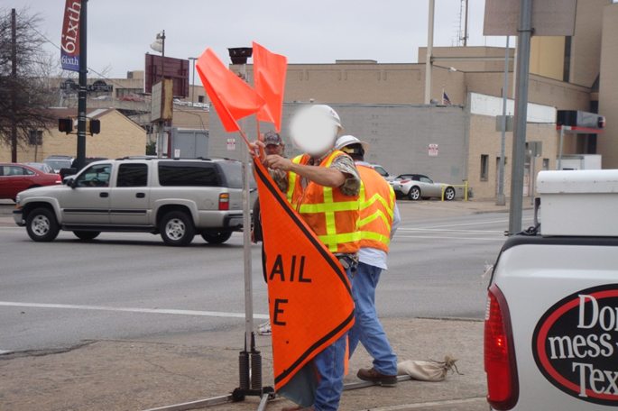
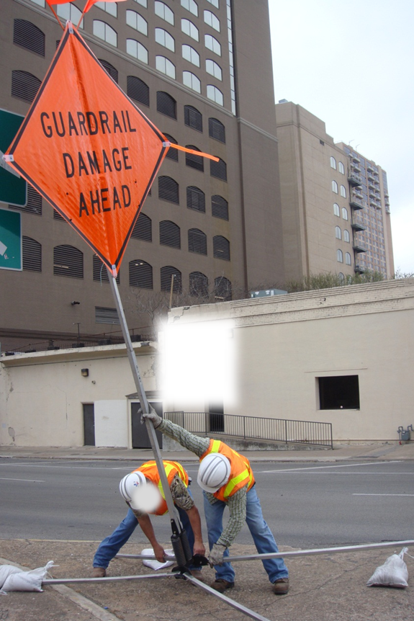
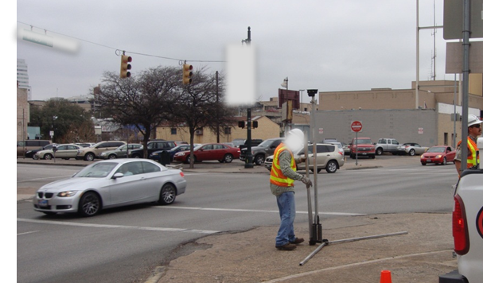
  Warning sign placement

Slide 13
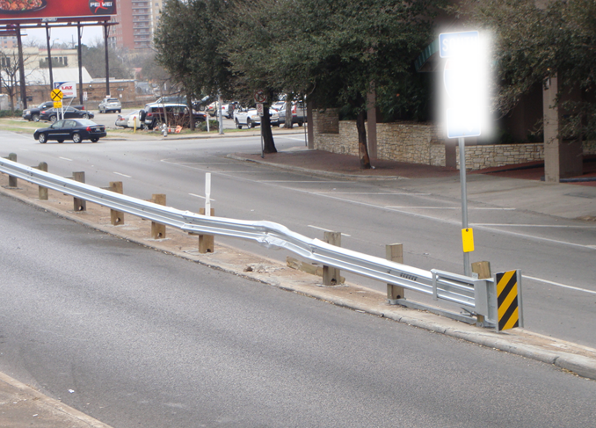
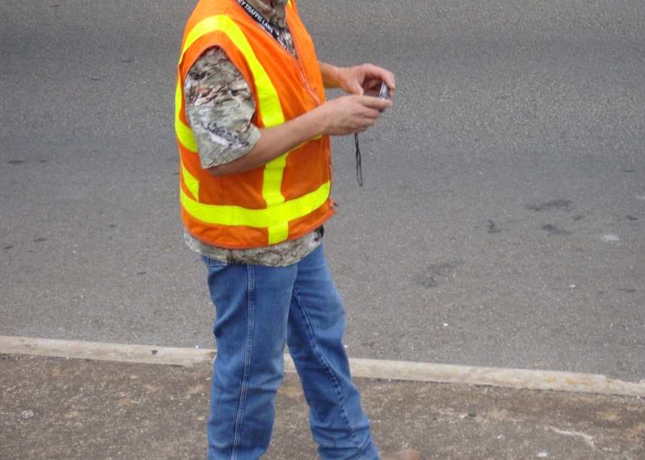
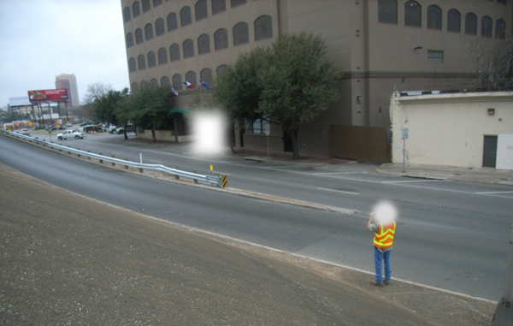
  Taking photographs

Slide 14
Activities NOT considered as VSDOs
Short duration and mobile maintenance operations such as
crack sealing
herbicide application
mowing/brush cutting
raised pavement marker replacement
snow and ice control
striping
sweeping
guardrail work
lighting maintenance
paving operations
signal work
sign repair and installation

Slide 15
PART I
Evaluation
What should be considered as VSDOs?
Q: Should the following activities be considered as VSDOs? Why?
Scenario A: Removing a dead cow from a shoulder
Yes or No
Scenario B: Repairing a damaged guardrail during rush hour
Yes or No
  Scenario C: Picking up multiple objects on freeway exit ramp
Yes or No

Slide 16
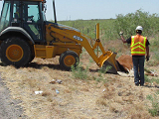
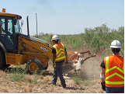
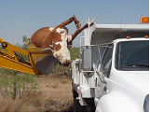
PART I
Evaluation
What should be considered as VSDOs?
Answer:
Scenario A: Removing a dead cow from a shoulder
Answer: Yes/No depending on
    The size of the cow
    Available equipment and workers
    Hazard to the traffic

Slide 17
PART I
Evaluation
What should be considered as VSDOs?
Answer:
Scenario B: Repairing a damaged guardrail during rush hours
Answer: No. Usually repairing a damaged guardrail
    Takes more than 15 minutes
    Requires special maintenance workers and equipment (contracted out)
    The hazard of executing the work is greater than not executing
* Taking pictures of the damaged guardrail or setting up a warning sign can be considered as a VSDO.

Slide 18
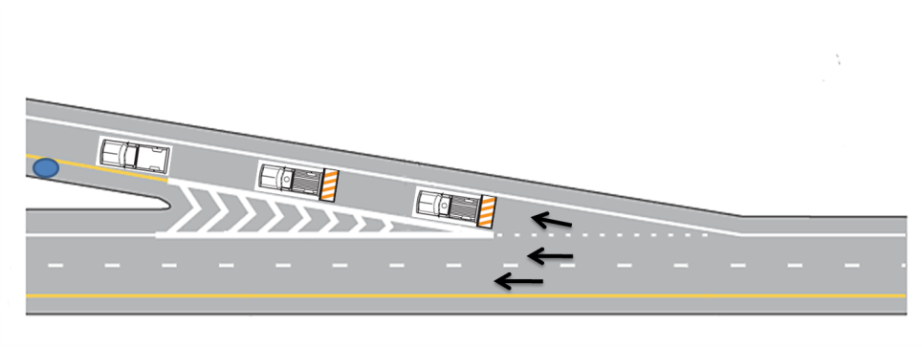
PART I
Evaluation
What should be considered as VSDOs?
Answer:
  Scenario C: Picking up multiple objects on freeway exit ramp
  Answer: No. Usually picking up multiple objects on freeway exit ramp
    Requires temporary traffic control devices (e.g. truck-mounted attenuators)

Slide 19
PART II
Why is risk assessment important for VSDOs?

Slide 20
Some Safety Pitfalls:
“Nothing will happen in 2 minutes.”
  Visibility distance?
  Traffic speed? Traffic volume?
“The drivers will notice my vehicle.”
  Visibility distance of the driver?
  Stopping distance?
“I will be able to escape before the vehicle approaches.”
  Place of refuge?
  Available time?

Slide 21
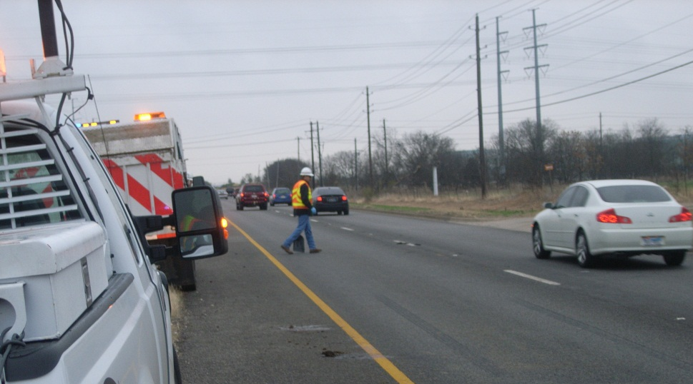
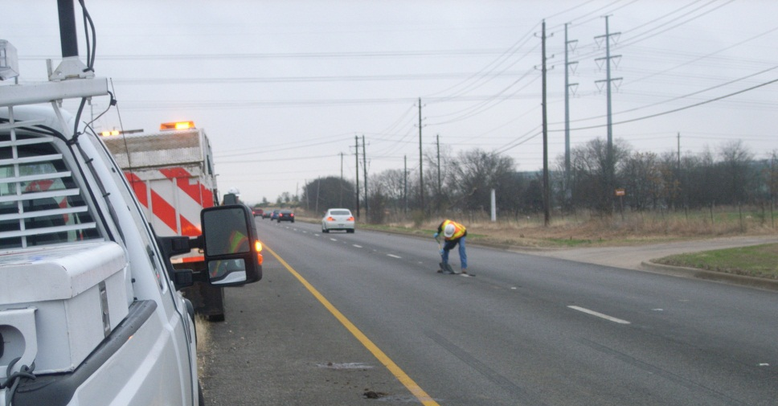

Slide 22
Examples of risky behavior (based on real events):
An eye-witness account describes a maintenance worker patching some pavement failures on an urban roadway. The worker is alleged to have parked on the shoulder and when there was no oncoming traffic would dart out into a travel lane with a shovel, dump patching material, and dash back to the shoulder.

Slide 23
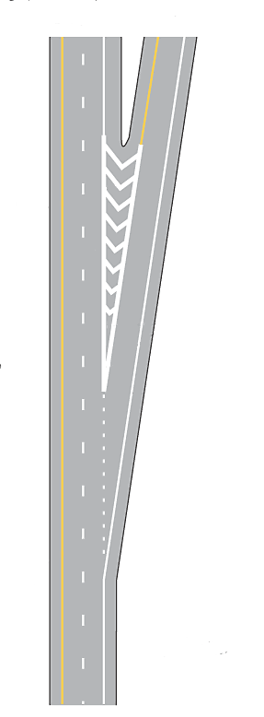
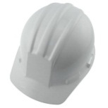




Examples of risky behavior (based on real events):
A maintenance worker was killed while trying to remove a dead dog on a freeway ramp. Despite the worker having a spotter to watch for oncoming traffic, the worker ran in the same direction as the vehicle when the spotter yelled at the worker.
Whose fault? The worker? The driver?
-- Maintenance worker
-- Object to be removed

Slide 24
Performing VSDOs can be very risky due to
Limited time for decision making
Negligence of the maintenance workers
Limited traffic control devices
Ambiguous scope of the work zone
Unpredictable conditions (e.g. traffic speed/volume, tasks and weather)
Largely depends on workers’ judgments !
Accidents are likely to occur in case of poor judgments.

Slide 25
Causes that might lead to accident occurrence in a VSDO
String of bad judgments
The worker relies on the driver
The driver relies on the worker

Slide 26
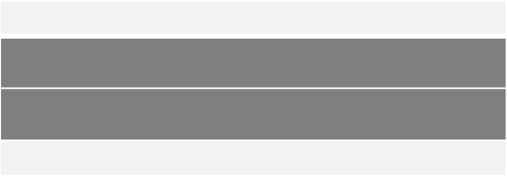

Example： Removing Tire Scraps from the Roadway
Duration: Less than a minute
Roadway geometry | Two lane rural road, level and straight
Location of work | On the travel-way
Where do they locate their vehicle? | On the shoulder
Traffic control devices | Truck-mounted Flashing light bars
Traffic control procedures | A maintenance worker walked out of the truck and removed tire scraps from a road way
Safety precautions | N/A

Slide 27
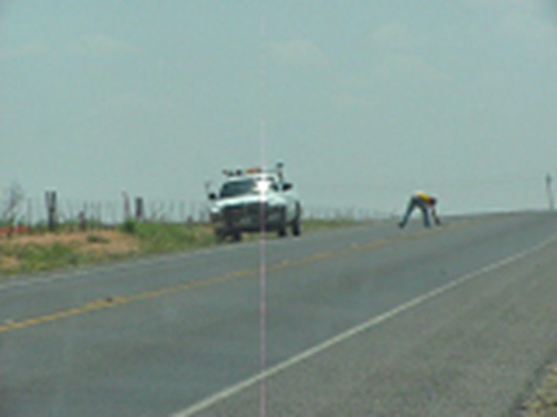

Example： Removing Tire Scraps from the Roadway
- From the worker’s viewpoint -
It’s ok. There will be no car coming.
What are the possible reasons that might lead to bad judgments?

Slide 28
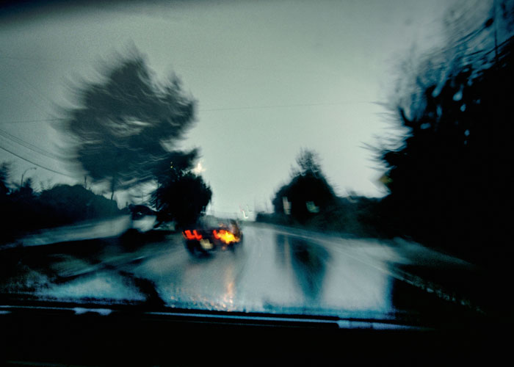
Example： Removing Tire Scraps from the Roadway
- From the driver’s viewpoint -
In what conditions would the drivers fail to control their vehicles?

Slide 29

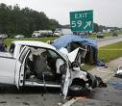
Example： Removing Tire Scraps from the Roadway
- Accident-

Slide 30
It is important to have a streamlined risk assessment process to ensure efficient and better judgment.
Depends on Workers’ Judgments

Slide 31
Depends on Workers’ Judgments
Based on workers’ experience
If you have not done this before, the risk is higher!
Do not proceed with work as a VSDO, if the answer is “no” or “not sure”!

Slide 32
Depends on Workers’ Judgments
Is this work have to be done right now?
How dangerous it is to you if you perform the work?
How dangerous it is to the public if you do not perform the work?
If it is dangerous to you, do not proceed with work as a VSDO!
If it is dangerous to the public, ask for assistance!

Slide 33
Depends on Workers’ Judgments
Do you need a spotter? Do you have one?
Minimum Safety Requirements:
One truck, one worker
  Truck should have a high intensity light bar
Do you need additional equipment to perform the work?
If you do not have everything you need, do not proceed with work as a VSDO! Ask for assistance!

Slide 34
It is important to have a streamlined risk assessment process to ensure efficient and better judgment.
Depends on Workers’ Judgments

Slide 35
PART II
Evaluation
Why is risk assessment important for VSDOs?
Q: What are the potential causes for poor judgment in the following accident? What would you do differently?
Accident in Fall 2009 - Less than 15 minutes, 1 lane on an exit ramp, up-hill, no curves, clear, dry, sunny, strobes on and mounted sign that said "Use Caution To Pass" speed limit = 65, ADT = 6900, employee was going to back up and pull off the road to patch a pot hole, would have been in the open lane with another employee to flag, employee was going slow and vehicle got inside his mirrors, employee started to back up and hit the vehicle.

Slide 36
PART II
Evaluation
Why is risk assessment important for VSDOs?
Q: What are the potential causes for poor judgment in the following accident? What would you do differently?
Accident in Fall 2009 - less than 15 minutes, 2 lane roadway, some curves and hills, dry, cloudy, strobes on and sign on truck that said "Use Caution To Pass" speed limit = 55, ADT = 2100, employee would have been in open lane with other employee to flag, employee was going slow and vehicle got behind him inside of his mirrors, employee started to back and hit the vehicle. employee should have turned around and pulled off the road to patch the pot hole.

Slide 37
PART III
How to make better judgments in VSDOs?

Slide 38
Influencing Factors
Factors that will increase the probability of accidents during Very Short Duration Operations (VSDOs)
  Limited visibility (e.g. foggy/rainy weather, night and curves)
  Icy pavement
  Medium/low traffic volume and high traffic speed

Slide 39
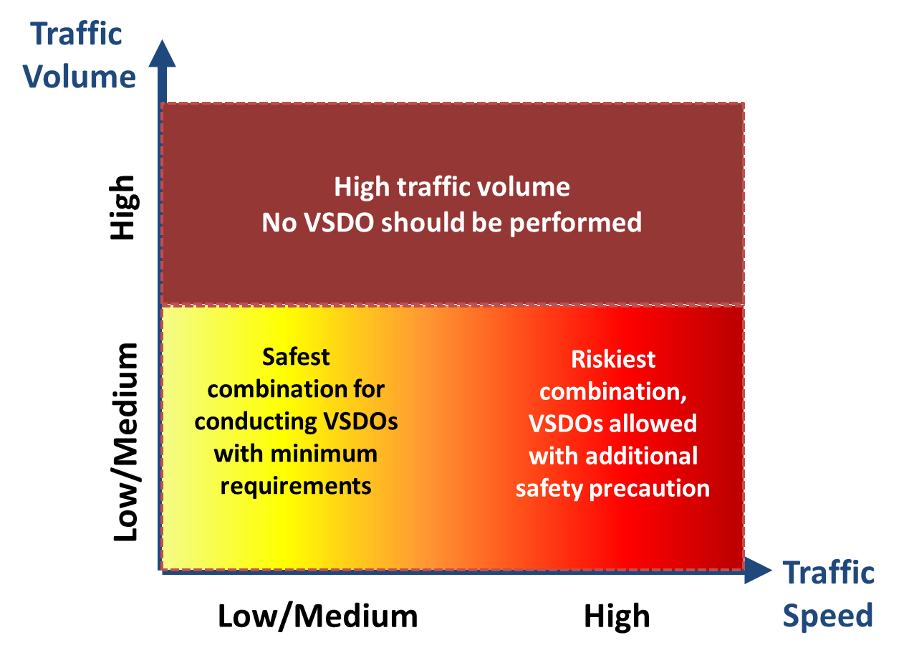
Risk Judgment Matrix
Risk level
Low
High

Slide 40
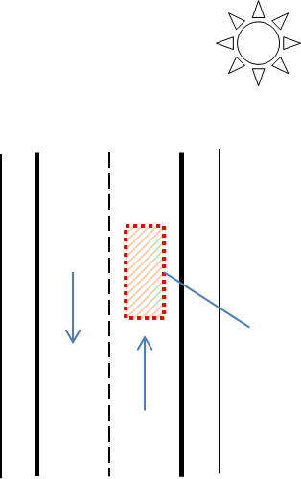
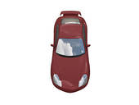
Most Common Scenarios in VSDOs
  Scenario I – Typical VSDOs on a travel-lane
Minimum requirements:
  One truck, one worker
  Truck should have a high intensity light bar
Where to park the maintenance vehicle?
  On the shoulder
Weather condition: Clear
Pavement condition: Dry
Traffic volume: Low
Traffic speed: Medium
Location of work: Within a travel lane
Availability of refuge: Shoulder

Slide 41
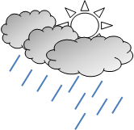
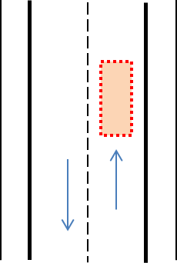
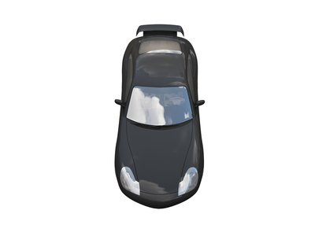
Most Common Scenarios in VSDOs
  Scenario I – Typical VSDOs on a travel-lane
What if?
Traffic volume: Medium
Traffic speed: High
Weather condition: Rainy
Pavement condition: Wet
Location of work: Within a travel lane
Availability of refuge: Shoulder

Slide 42
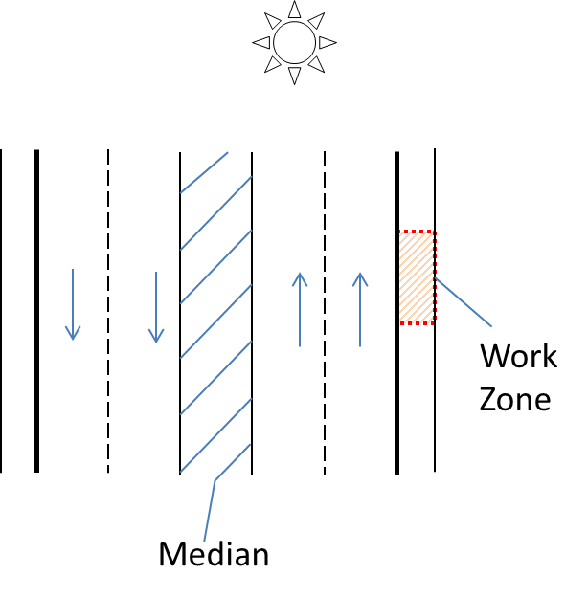
Most Common Scenarios in VSDOs
  Scenario II - Typical VSDOs on a shoulder
Weather condition: Clear
Pavement condition: Dry
Traffic volume: Low
Traffic speed: Medium
Minimum requirements:
  One truck, one worker
  Truck should have a high intensity light bar
Where to park the maintenance vehicle?
  Parking location can be either on a shoulder or a median
Availability of refuge: Shoulder

Slide 43
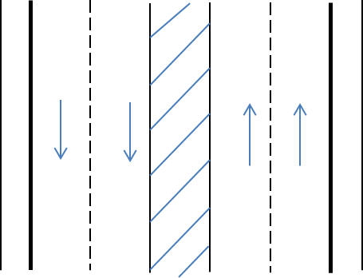
Most Common Scenarios in VSDOs
  Scenario II - Typical VSDOs on a shoulder
What if?
Traffic volume: Low
Traffic speed: High
Weather condition: Rainy
Pavement condition: Wet
Work Zone
Availability of refuge: Shoulder
Median

Slide 44
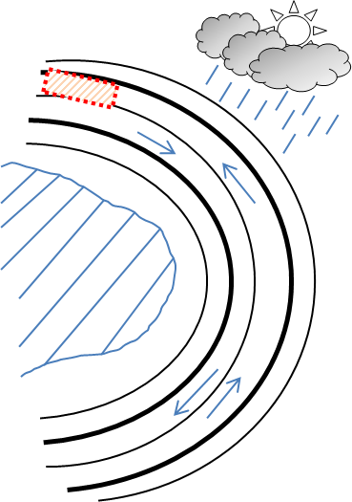
PART III
Evaluation
How to make better judgment in VSDOs?
Scenario A
Q: Please identify the risk factors that need be considered during the decision making process

Slide 45
PART III
Evaluation
How to make better judgment in VSDOs?
Answer: Scenario A – VSDOs with vision blocking geometry
2) Weather Condition: Rain/ fog
3) Pavement condition: wet
4) Limited visibility
1) Location of work: Within a travel lane and after a curve
5) Traffic volume: Medium/low
6) Traffic speed: High
7) Availability of refuge: Shoulder

Slide 46
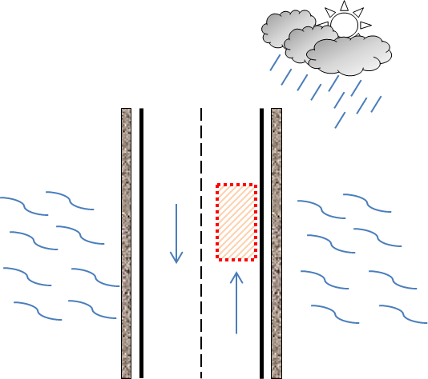
PART III
Evaluation
How to make better judgment in VSDOs?
Scenario B
Q: Please identify the risk factors that need be considered during the decision making process

Slide 47
PART III
Evaluation
How to make better judgment in VSDOs?
Answer: Scenario B – VSDOs without places of refuge
Weather Condition: Rain/ fog
Pavement condition: wet
Limited visibility
Traffic volume: Medium/low
Traffic speed: High
Availability of refuge: None, a bridge without a shoulder
Location of work: Within a travel lane and on a bridge

Slide 48
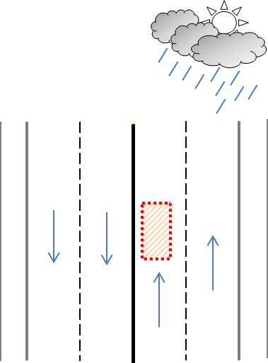
PART III
Evaluation
How to make better judgment in VSDOs?
Scenario C
Q: Please identify the risk factors that need be considered during the decision making process

Slide 49
PART III
Evaluation
How to make better judgment in VSDOs?
Answer: Scenario C – VSDOs on multilane roadway without a median
Weather Condition: Rain/ fog
Pavement condition: wet
Limited visibility
Traffic volume: Medium/low
Traffic speed: High
Availability of refuge: None, Multilane roadway without a median
Location of work: Within a travel lane

Slide 50
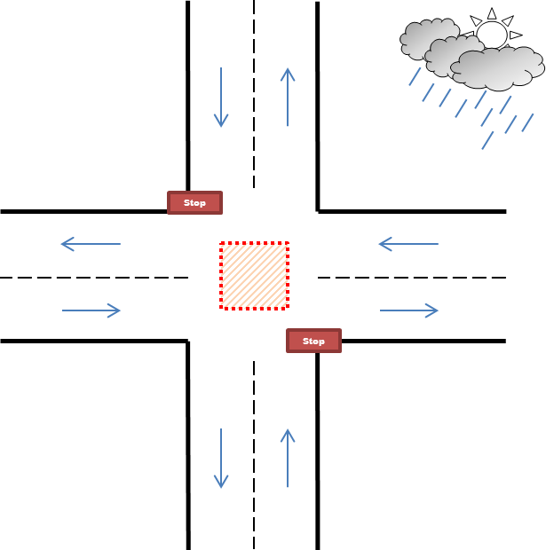
PART III
Evaluation
How to make better judgment in VSDOs?
Scenario D
Q: Please identify the risk factors that need be considered during the decision making process

Slide 51
PART III
Evaluation
How to make better judgment in VSDOs?
Answer: Scenario D – VSDOs at intersection with two-way roads
Traffic volume: Medium/low
Traffic speed: High
Weather Condition: Rain/ fog
Pavement condition: wet
Limited visibility
    Location of work: Within an intersection
    Availability of refuge: none

Slide 52
recap

Slide 53
THINK before you work!
Whether you should proceed with work as a VSDO?
  15 minutes
  One maintenance worker and one truck
  Not executing the work is more dangerous than executing
Accidents are usually caused by a string of bad judgments
Factors that will increase the probability of accidents during Very Short Duration Operations (VSDOs)
  Limited visibility (e.g. foggy/rainy weather, night and curves)
  Icy pavement
  Medium/low traffic volume and high traffic speed

Slide 54
Acknowledgments
Joe Graff
Paul Montgomery
Wade Odell
Terry Paholek
Carlos Ibarra
Herbert Bickley
Ted Moore
Quincy Allen
Bob Blackwell
J.C. Wood
Quinton Alberto
Brian Taylor
Eddy Rentas
Gary Tarter
Jimmy Busby
Joe Villarreal
Michael Lee
Michele Regis
Rodney Chesser
Maintenance workers from the Austin, Lufkin and Odessa districts
Texas Department of Transportation

Slide 55
Think safe! Work safe!

