Slide 1
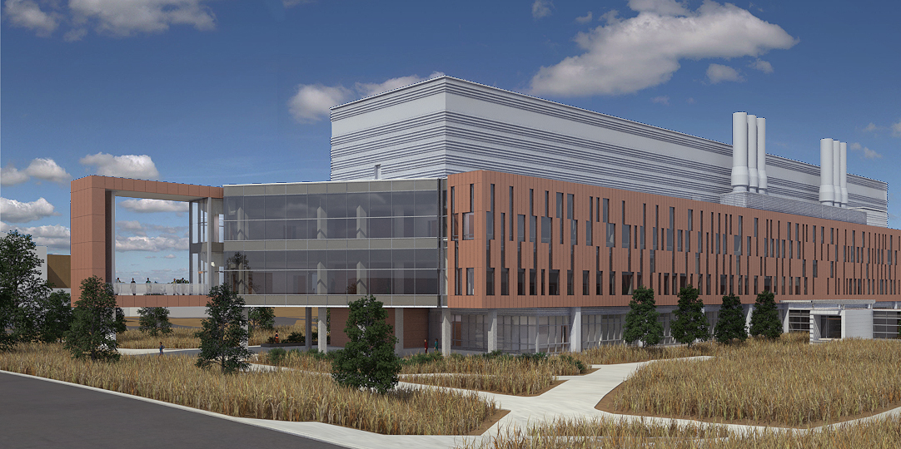
Design Features Energy Sciences Building

Slide 2
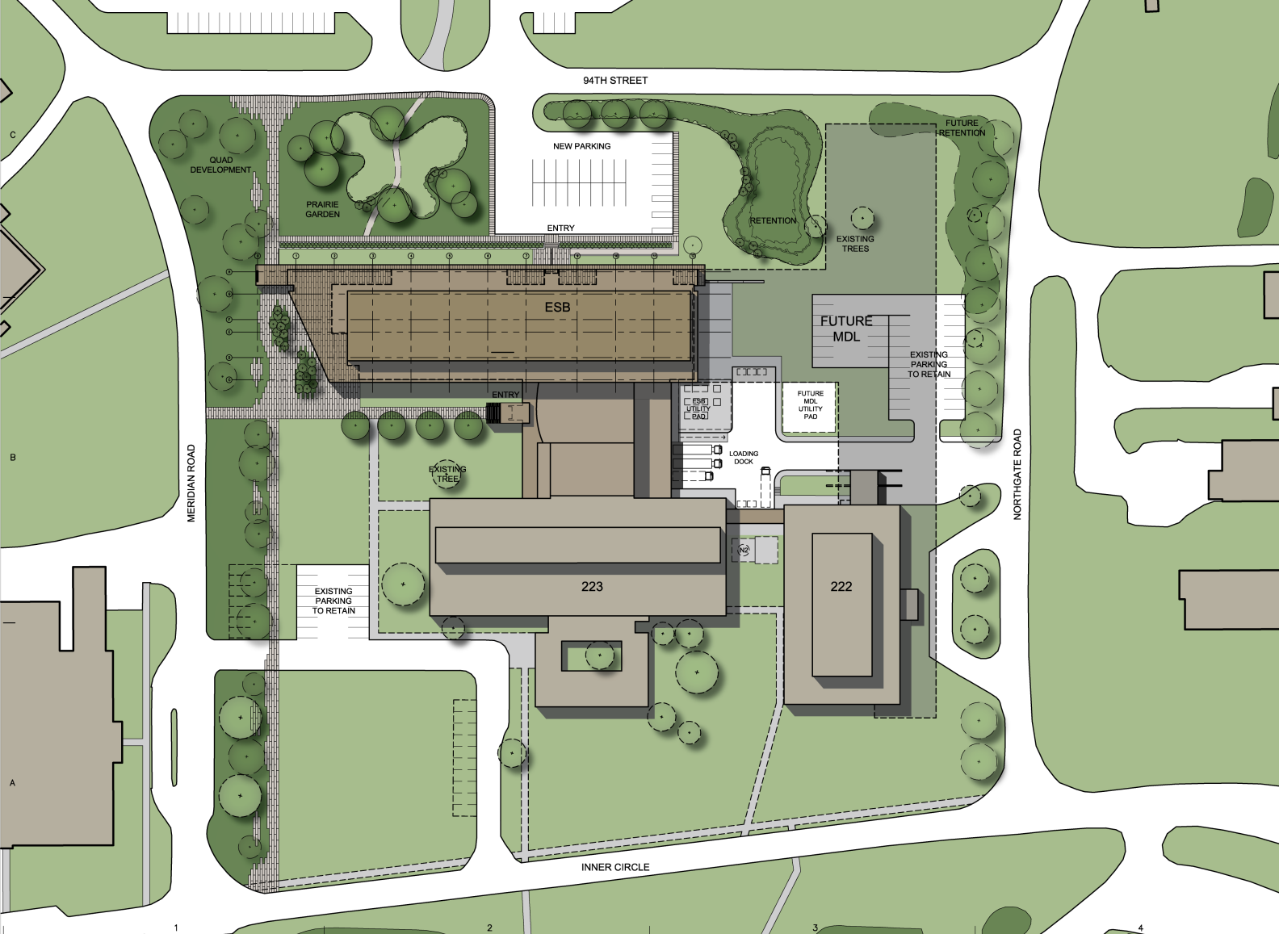
Unified Energy Quad

Slide 3
Centralized Service Court
ESB
MDL
223
222

Slide 4
Planning by Research Type
First floor
Third floor
Wet Chemistry
Second floor
Instrumentation
Ground floor
Synthesis
Characterization
Laser/Microscopy

Slide 5
Program Summary
Laboratory Area
46,000 sf
Laboratory 64%
Net Area
79,000 sf
Total Area
145,000 sf

Slide 6
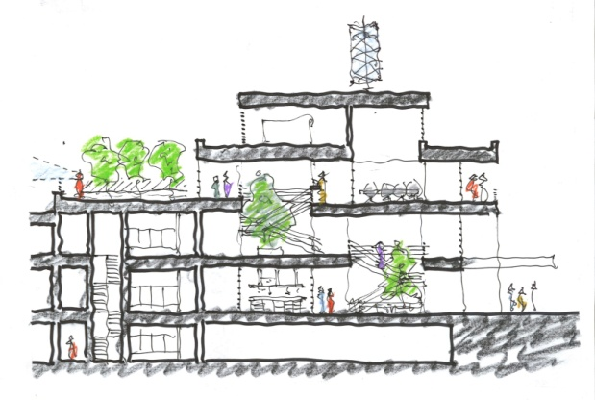
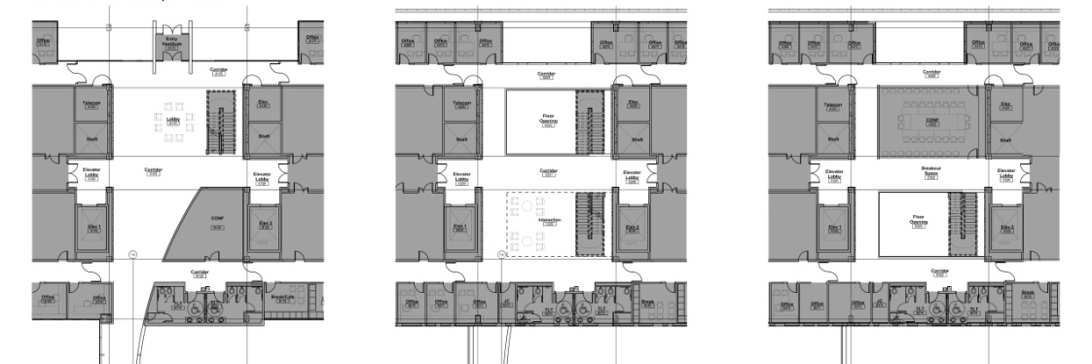
Daylight, Floor Connectivity, Interaction
Skylight
Toilets
Seminar/breakout
Lounge
Conf. Room
Main Lobby
Notes:
6

Slide 7
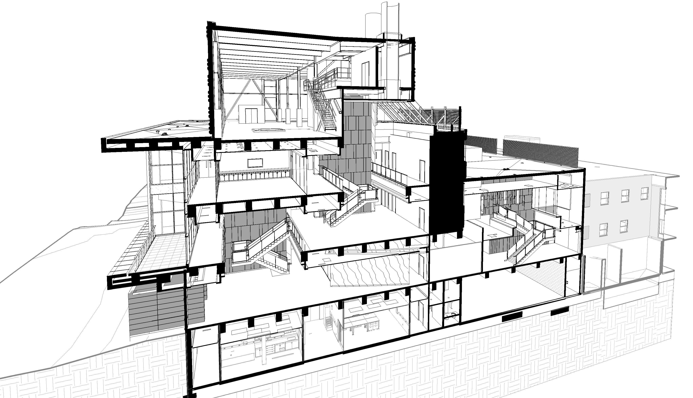
Section – Open Atrium
SKY LIGHT
CONF.
INTERACT
BALCONY
LOBBY
ENTRY

Slide 8
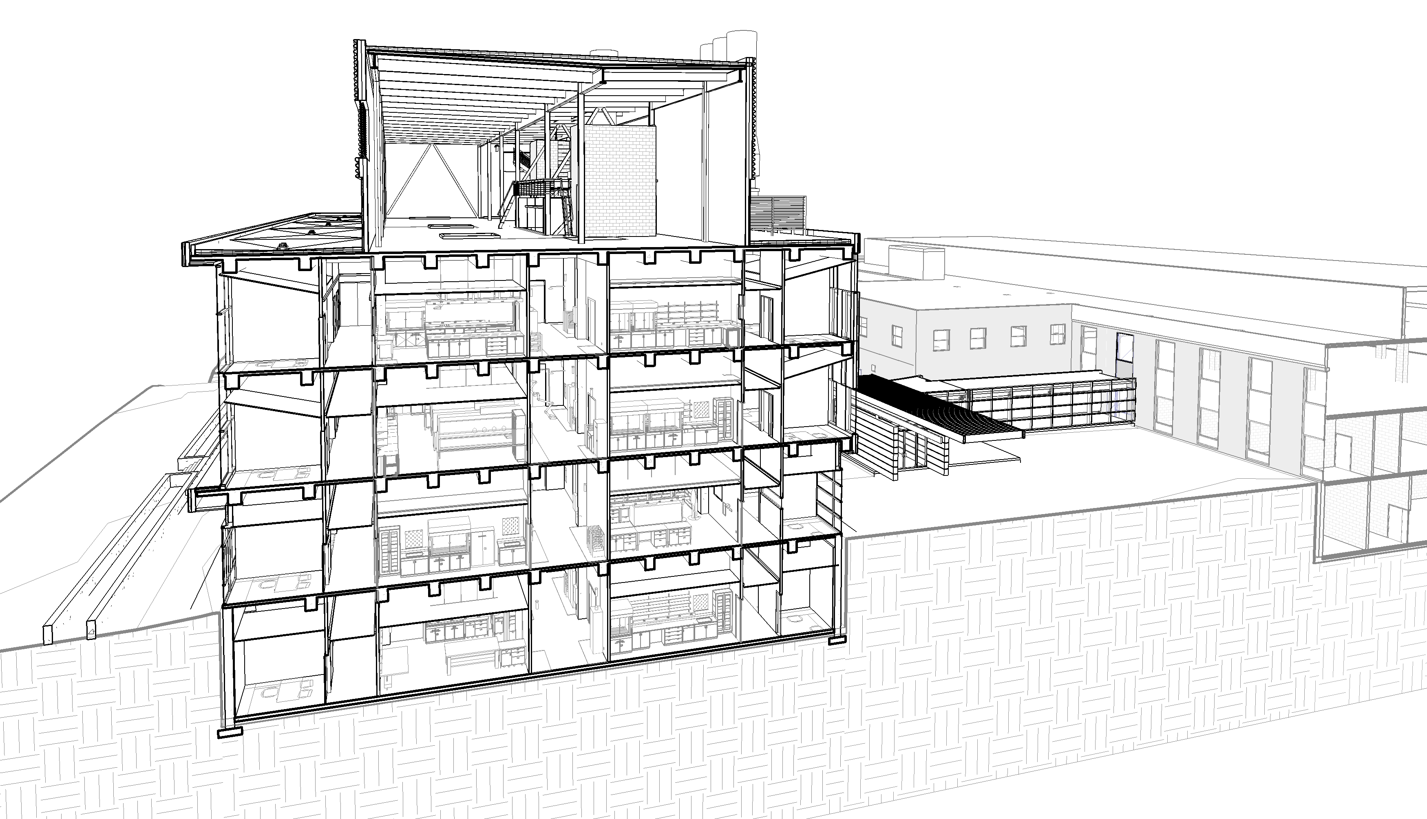
Section - Typical Bay
Mechanical Penthouse
LAB
OFF.
OFF.
LAB
LAB
OFF.
OFF.
LAB
LAB
OFF.
OFF.
LAB
LAB
OFF.
OFF.
LAB

Slide 9
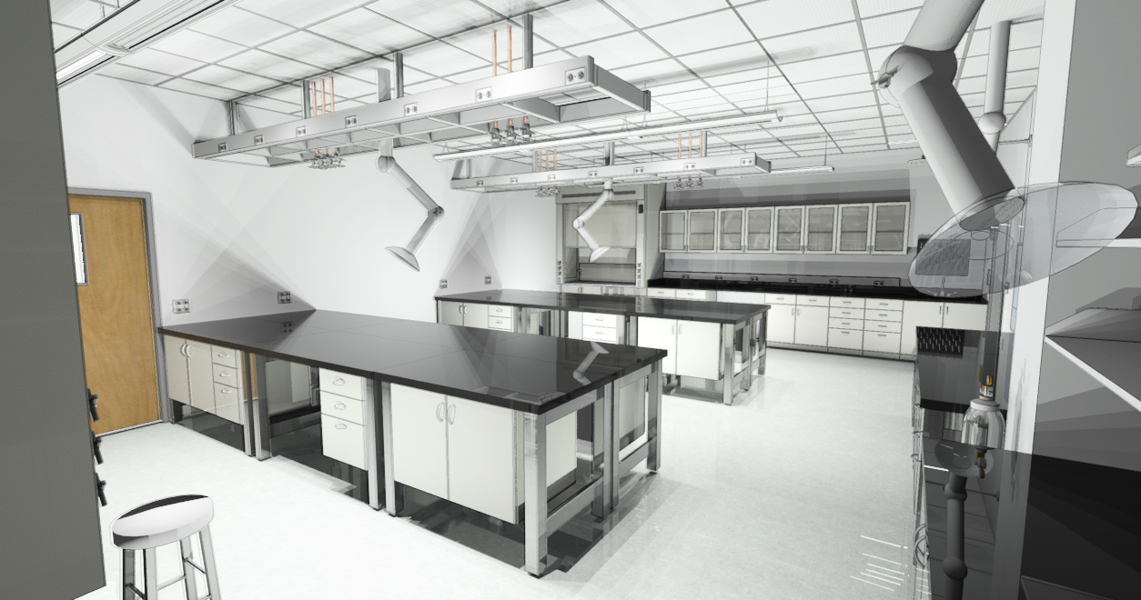
Flexible and Reconfigurable Labs

Slide 10
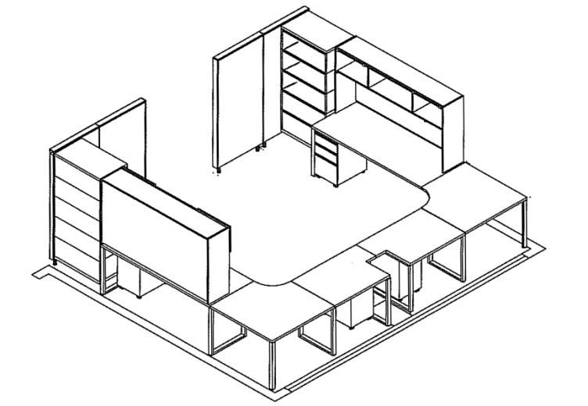
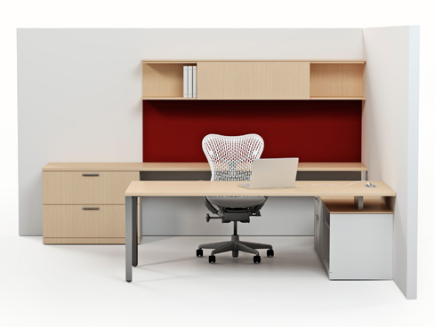
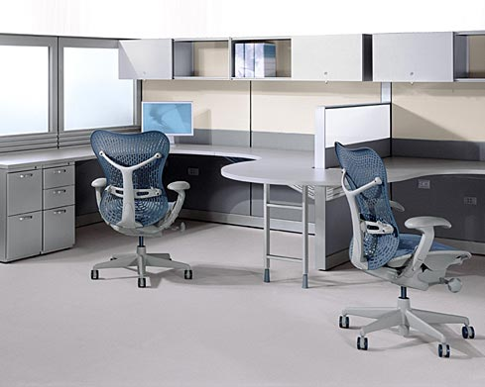
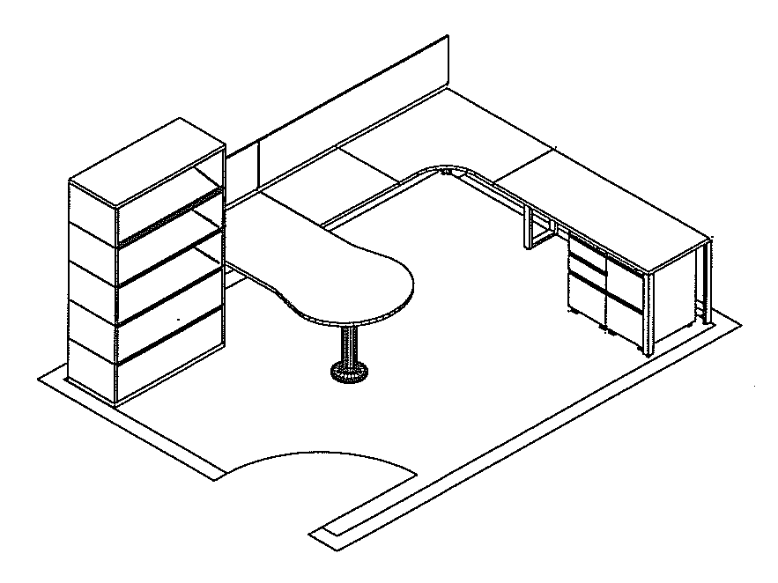
Workstation Flexibility

Slide 11
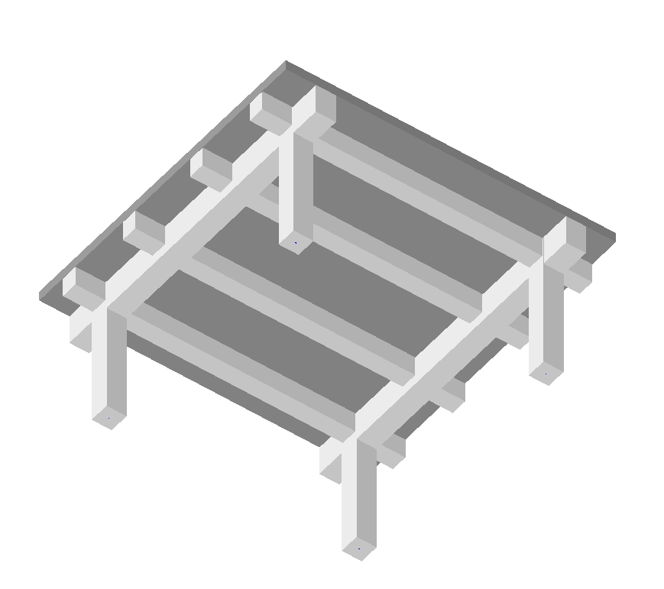
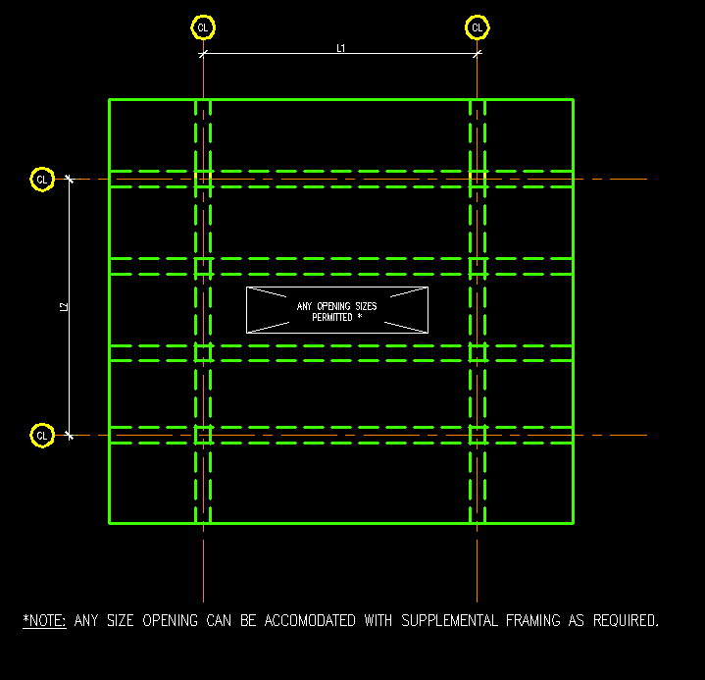
Optimized Structural Frame

Slide 12
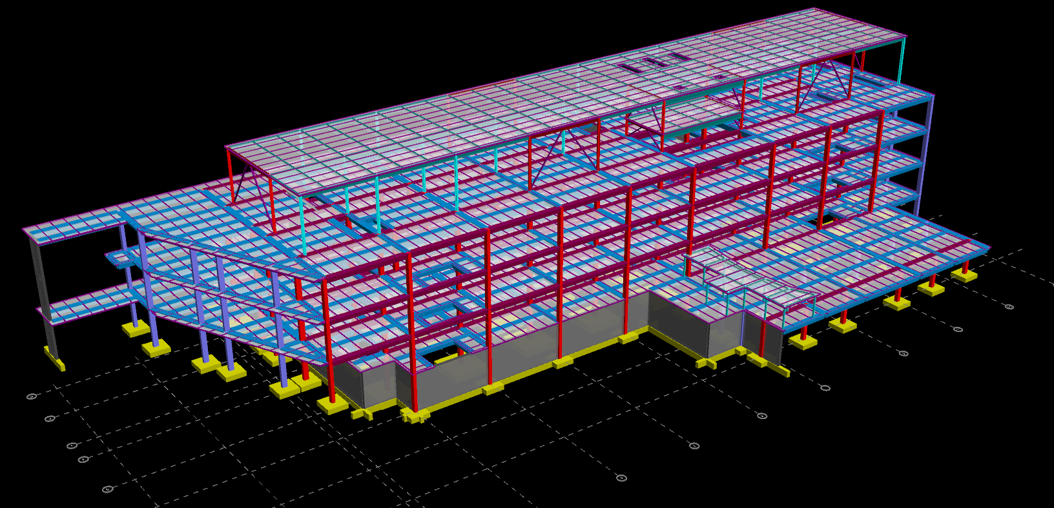
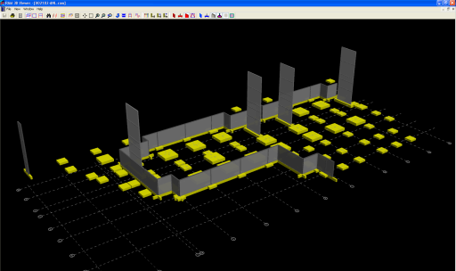
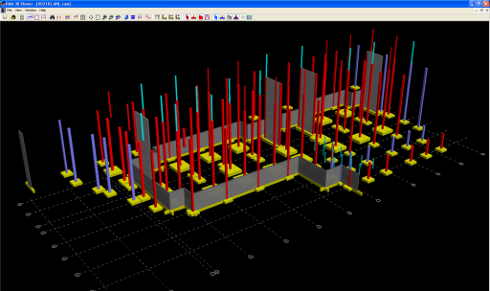
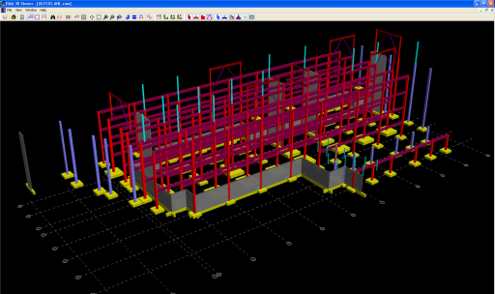
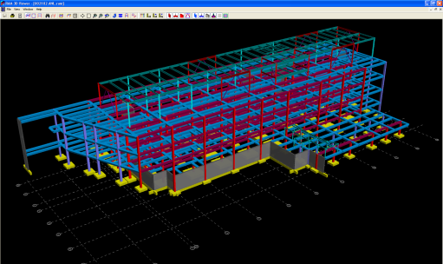
State of the Art Structural Analysis and Design

Slide 13
Electrical System Modularity
Switches
Transformers
Switch Gear

Slide 14
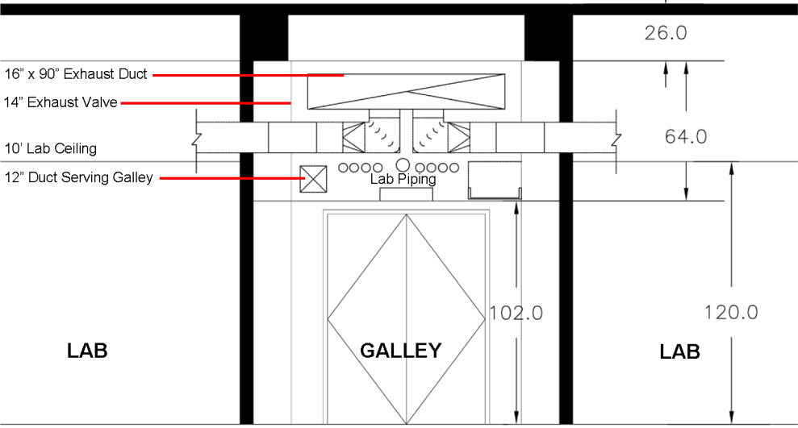
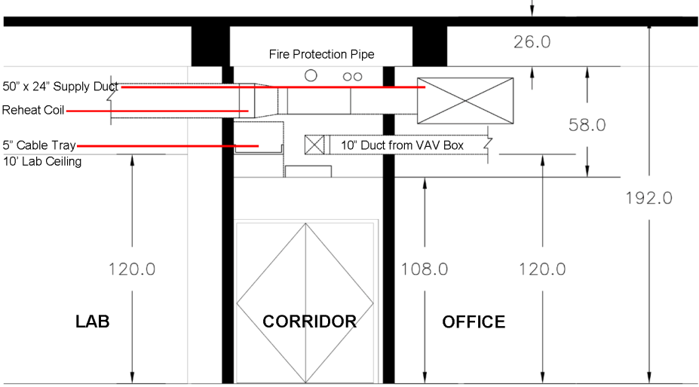
Pressurization of Mechanical Systems
Exhaust Valve
Pressurization Flow
Pressurization Flow
Pressurization Flow
Section at Lab Corridor
Section at Public Corridor
Pressurization Flow
Pressurization Flow
* System designed to improve safety by separating people and noxious fumes
Section at Typical Lab Bay

Slide 15
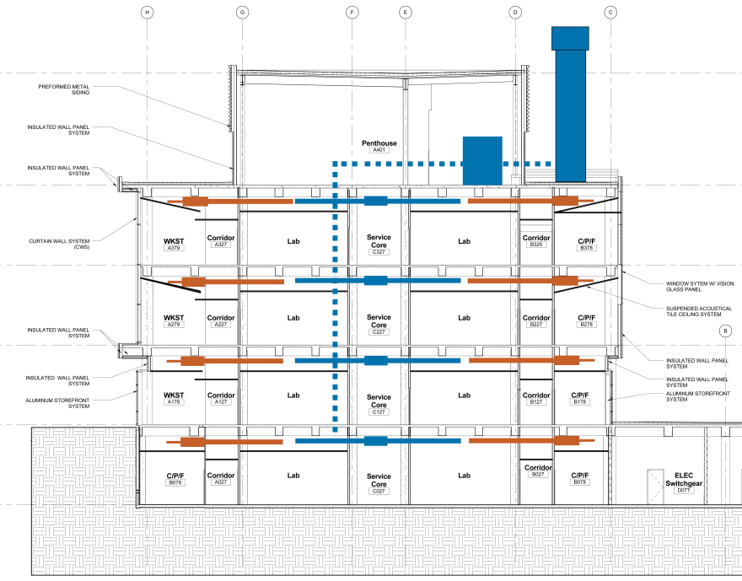
Efficient HVAC Distribution
Lab Office
Lab Exhaust / Heat Recovery

Slide 16
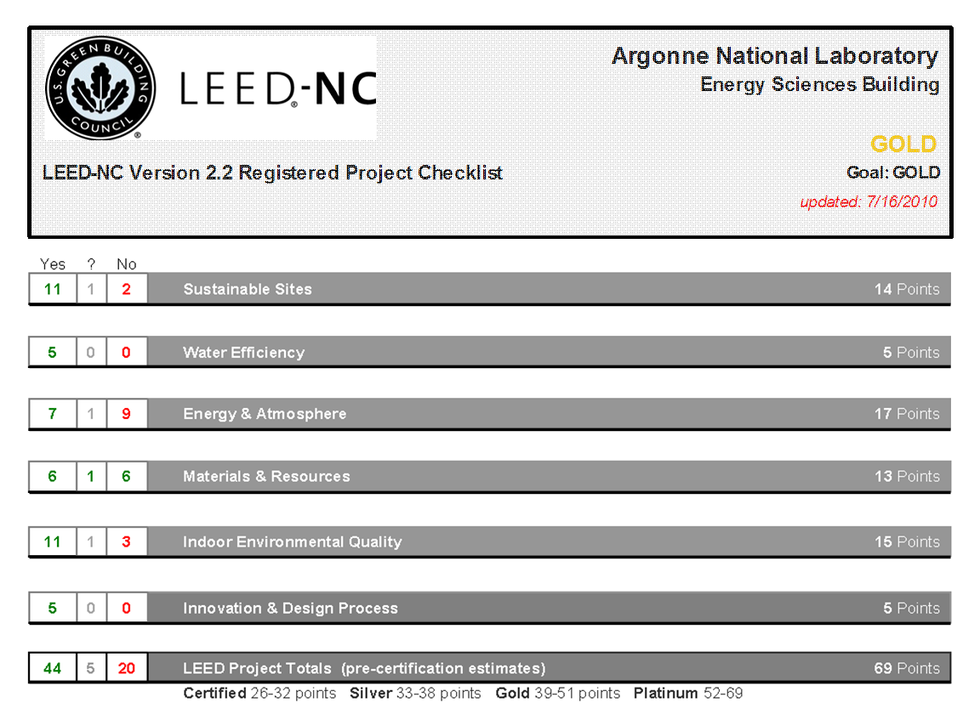
LEED Gold Analysis

Slide 17
Energy Efficiency

Slide 18
Smart Building Monitoring Systems

Slide 19
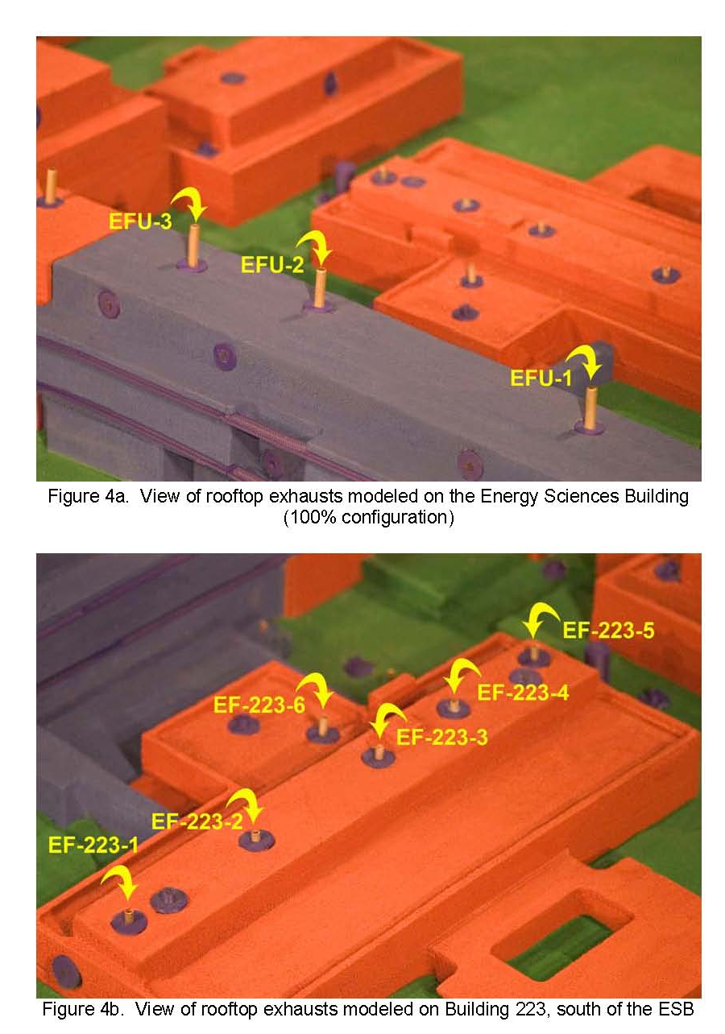
Exhaust Dispersion Analysis

Slide 20
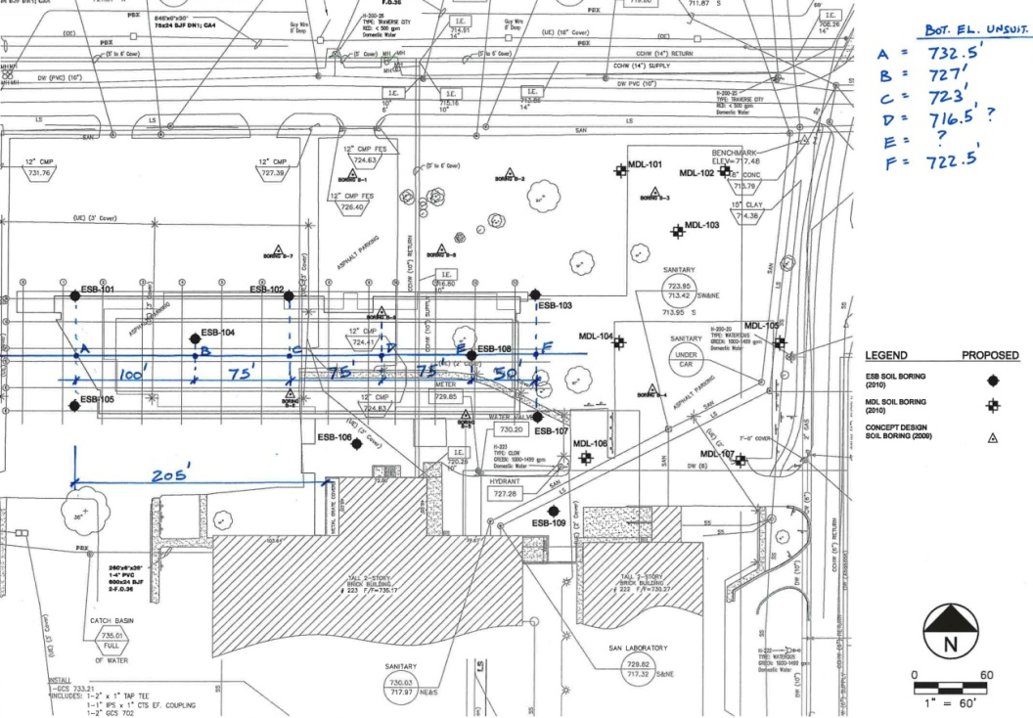
Subsurface Investigation and Foundation Analysis
Existing Grade
Unsuitable Soil
Suitable Soil

Slide 21
Vibration Analysis

Slide 22
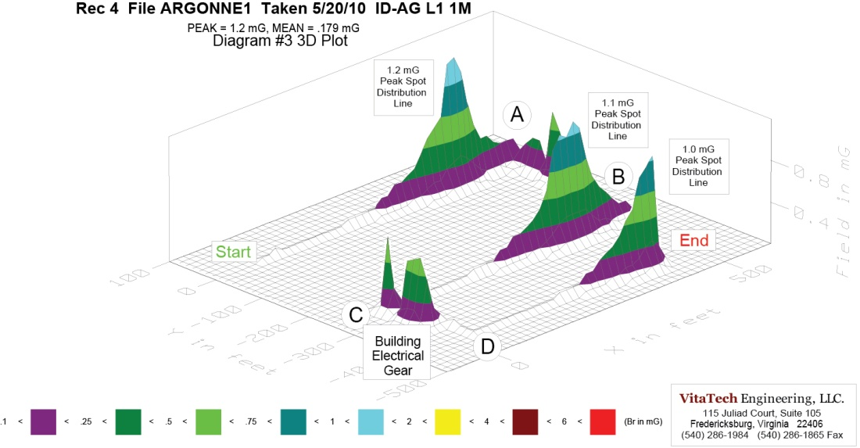
Electro Magnetic Analysis

Slide 23
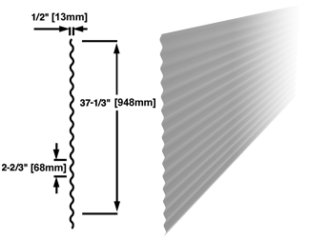
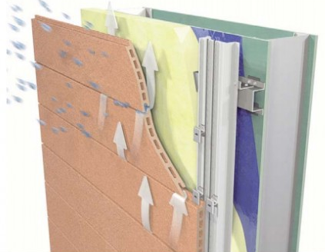
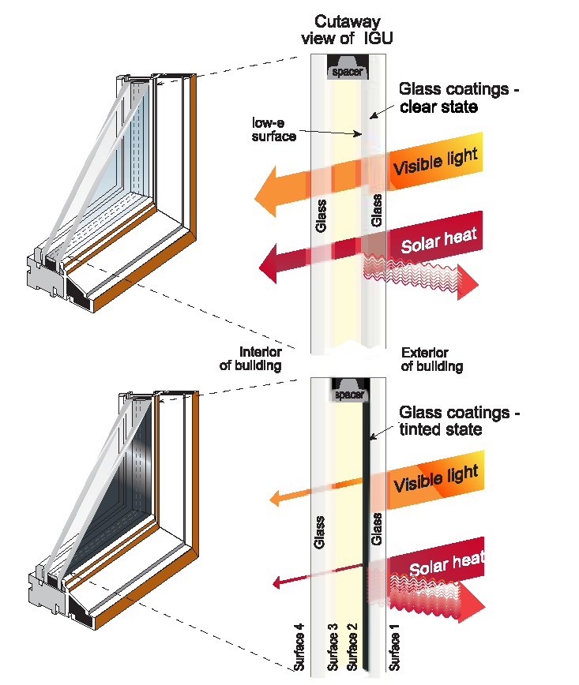
Exterior Façade
3” Insulated Envelope
Rain Screen Facade
High Performance Glazing
Copper Anodized Aluminum Panels

Slide 24
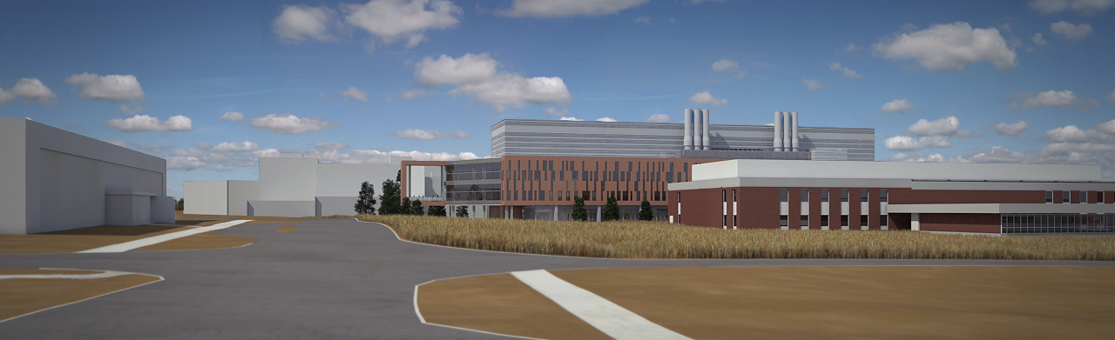
North Façade
South Façade
A modern building geometry and material selection invigorates the energy quad while acknowledging the campus history

Slide 25
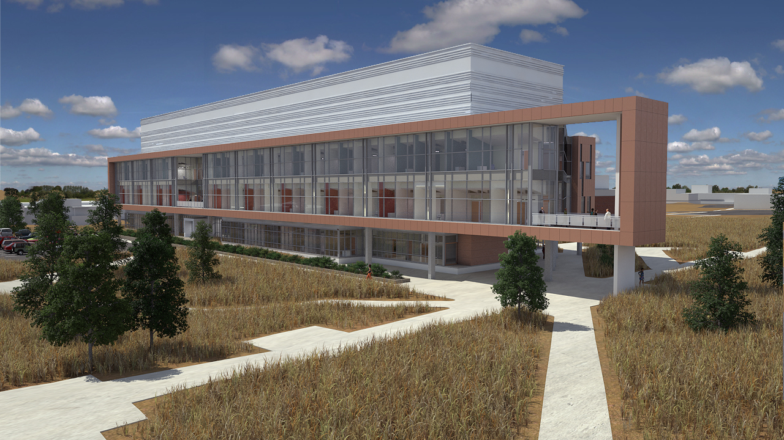
Northwest Perspective
Extruded balcony frames the pedestrian mall
North facing office block provides ample day lighting without glare and heat load into an active working space

Slide 26
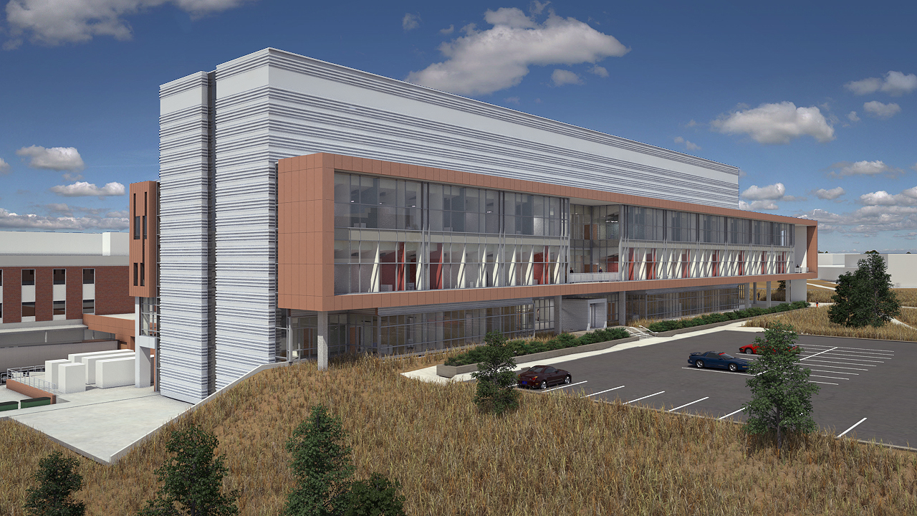
Northeast Perspective
East façade geometry and material selection reflect the buildings program while acknowledging plans for future expansion

Slide 27
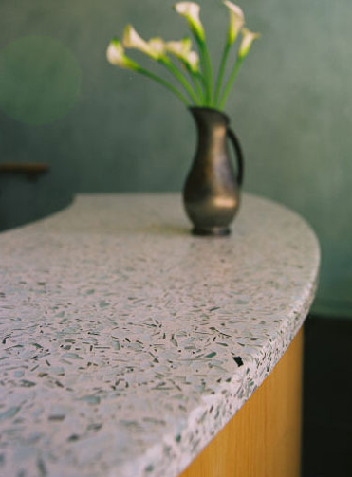
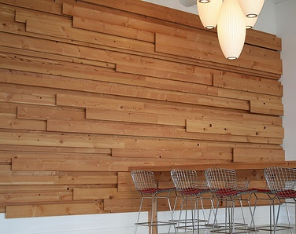
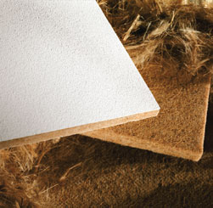
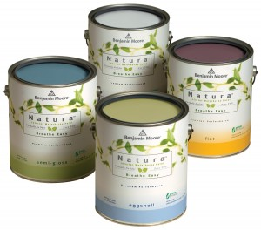
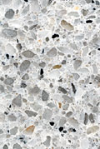
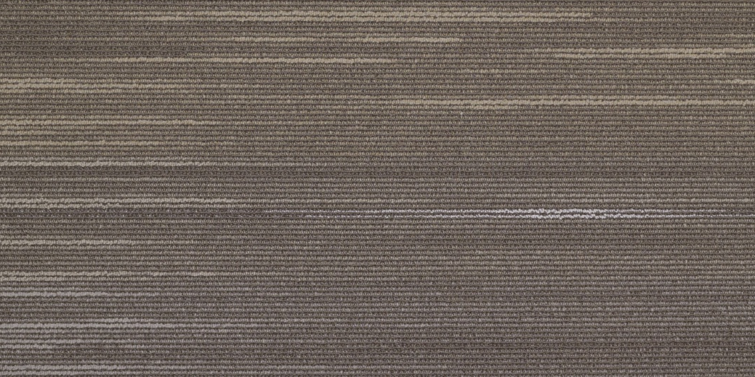
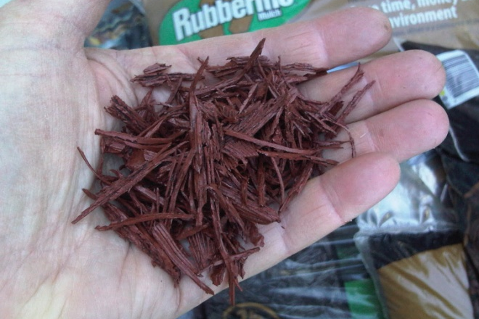
Sustainable Materials
Reclaimed Wood Paneling
Recycled
Ceiling Tile
Recycled Glass Countertops
No Voc Paint
Recycled Tile
Recycled Glass Terrazzo Flooring
Rapidly Renewable Rubber Flooring
Concrete
LED Lighting
Recycled Carpet Tile

Slide 28
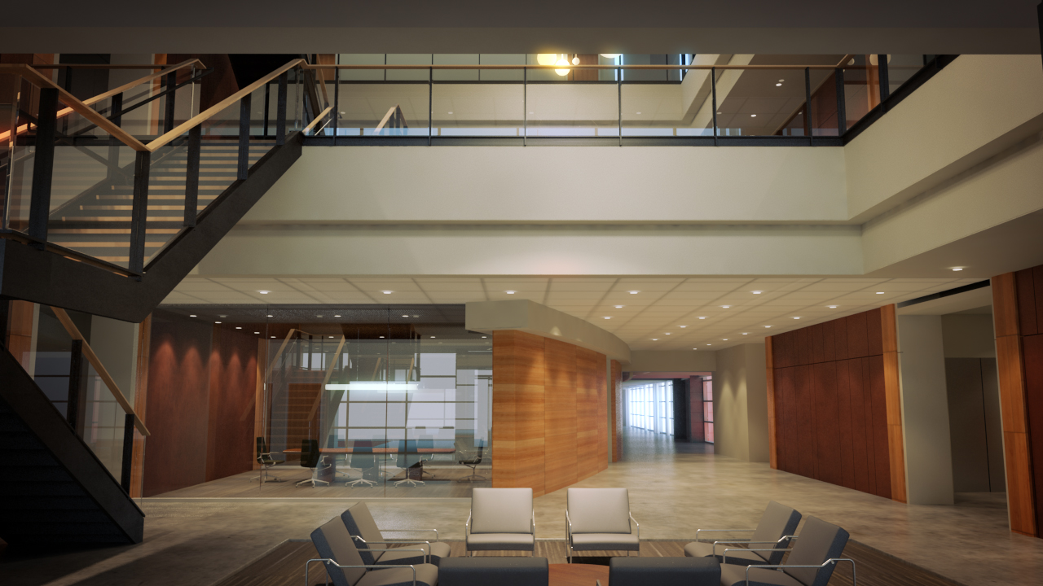
Entry Perspective
A wide variety of sustainable materials will engage the user at all levels

Slide 29
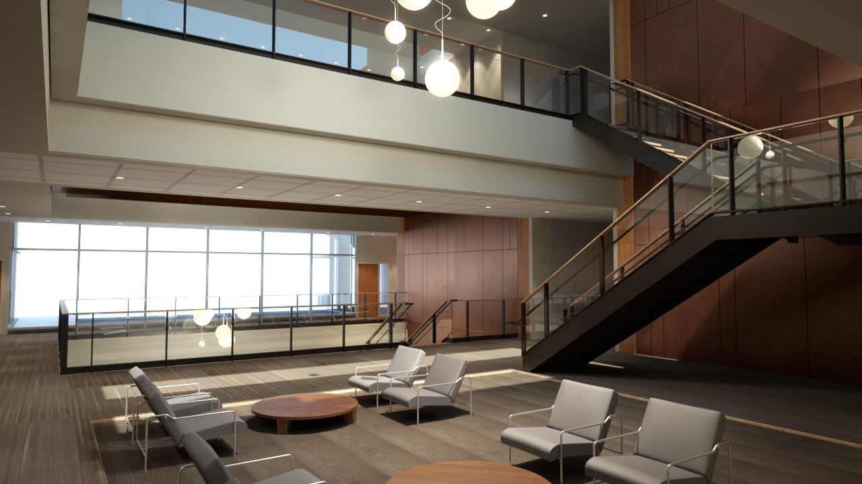
Atrium Perspective
Atrium skylight will naturally illuminate three levels of interaction space

