Slide 1
Office of the Assistant Secretary of Defense/ Reserve Affairs
(Materiel and Facilities)
COL Adrian Nagel
OASD/RA(M&F)
(703) 693-8110 DSN 223-8110
Adrian.Nagel@osd.mil
Notes:
Introduction: LTC Adrian Nagel, I work for OASD/RA, I’m AGR and belong to the NGB G4

Slide 2
Joint Service Reserve Component Facility Board (JSRCFB)
Notes:
Next I’ll cover the Joint Service Reserve Component Facility Board

Slide 3
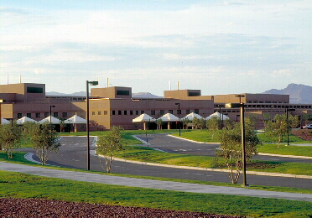
Joint Service Reserve Component Facility Board (JSRCFB)
Mission:
To maximize usage of Reserve Component Land, Facilities, and Installations by promulgating Joint Use and Construction by two or more Reserve Components.
MISSION:
Notes:
This is the mission of the JSRCFB

Slide 4
Joint Service Reserve Component Facility Board (JSRCFB)
Overview:
The JSRCFB is required in each state to annually assess Reserve component Military Construction (MILCON) projects for potential as joint construction projects
The JSRCFB is comprised of appointed members from each Reserve component that has at least one unit in that state or territory
Purpose:
Review and Validate All States Military Construction (MILCON) Requirements / Identify “Potential” Joint Projects
Establish and Maintain Communication Between Reserve Components / Encourage Pursuit of Best Opportunities for Joint Construction and Joint Use of DOD Facilities
Leverage Scarce MILCON Resources
Notes:
Overview:
For those of you who are not familiar with the JSRCFB, the board is an annual requirement in each state
The board consists of representatives of all the Reserve components present in the state or territory
Purpose:
The objective of the board is to review all potential MILCON projects and identify possible joint projects involving two or more Reserve components
Establishes communication between the Reserve Components in a state
Leverage scarce MILCON funds by increasing the number of joint projects
Joint projects save funds over building unilateral facilities normally save funds on site preparation, supporting facilities and shared areas within the building

Slide 5
Joint Service Reserve Component Facility Board (JSRCFB)
Authority:
TITLE 10 U.S.C. Chapter 1803-Facilities for Reserve Components
  § 18231. Purpose and
  §18234. Location and Use
§ 18231. Purpose
(2) the joint use of those facilities by units of two or more of those reserve components, to the greatest practicable extend for efficiency and economy;
§ 18234. Location and Use
No expenditures or contribution may be made for a facility under section 18233 of this title, unless the Secretary of Defense determines that—
(2) the plan under which the facility is to be provided makes provision for the greatest practicable use of the facility jointly by units of two or more of those components.
Notes:
STATUTORY: TITLE 10 U.S.C. Chapter 1803 § 18231 and §18234
§18234: No expenditures or contribution may be made for a facility under section 18233 of this title, unless the Secretary of Defense determines that— (2) the plan under which the facility is to be provided makes provision for the greatest practicable use of the facility jointly by units of two or more of those components.

Slide 6
Joint Service Reserve Component Facility Board (JSRCFB)
Authority:
Title 10 § 2815. “Joint use military construction projects: annual evaluation” requires:
  (b) Annual Evaluation.— In the case of the budget submitted under section 1105 of title 31 for any fiscal year, the Secretary of Defense shall include in the budget justification materials submitted to Congress in support of the budget a certification by each Secretary concerned that, in evaluating military construction projects for inclusion in the budget for that fiscal year, the Secretary concerned evaluated the feasibility of carrying out the projects as joint use military construction projects.
DoD Financial Management Regulation Volume 2B, Chapter 6 provides implementing guidance
  The DD Form 1391 submitted in the budget estimate submission to OSD must include a statement certifying that the project was considered for joint construction
Failure to include the statement can lead to the elimination of a project from the program by OUSD (Comptroller)
Notes:
The requirement for annual evaluation is set out in T10 and implemented in a DoD FMR.

Slide 7
Joint Service Reserve Component Facility Board (JSRCFB)
Authority:
DoD Financial Management Regulation, Volume 2B, Chapter 6
DoD Directive, 1225.07 Reserve Component Facilities Programs and Unit Stationing
DoD Instruction, 1225.8 Reserve Component Facilities Programs and Unit Stationing
Notes:
The DoDD and DoDI are documents which contain guidance for the joint boards. The DoDI contains more detailed information on the board. Both the DoDD and DoDI are maintained by OASD/RA. We will be rewriting the DoDD and DoDI.

Slide 8
Joint Service Reserve Component Facility Board (JSRCFB)
Joint Construction Project:
Military Construction (MILCON) project that combines the space and functional requirements of two or more Service components into one facility, thereby eliminating the need to build separate (or unilateral) facilities.
  Each Component occupies the facility, and has some exclusive use space; however, the facility also has shared or common use areas that effectively reduce the overall required square footage (resulting in reduced construction costs).
  Cost savings occur due to the design and construction of one facility instead of two (or more) separate facilities.
  Cost savings also occur in contract administration, supervision, inspection, and overhead (one contract versus two or more).
  Cost savings continue after construction by eliminating duplication of the following requirements: Antiterrorism/Force Protection; facility maintenance and repair (i.e., Sustainment); and future Restoration and Modernization costs.
Notes:
The annual certification addresses joint use facilities. A subset of joint use is joint construction. OASD/RA focus is on identifying and coordinating joint construction projects.
Joint construction projects are defined as a project that combines the space and functional requirements of two or more service components into one facility, thereby eliminating the need to build separate facilities.
The Joint Construction project saves on common us areas, supporting facilities and accrues construction efficiencies. After construction the joint facility should have lower SRM costs due to a smaller footprint.

Slide 9
Joint Service Reserve Component Facility Board (JSRCFB)
Procedures:
Annual
State JSRCFB Meeting
JSRCFB recommended joint projects
The ARNG member is the board records custodian
Reserve
Component
HQ Engineer Sections
OASD(RA)
M&F
Policy & Compliance
Board Minutes Review/Analysis
Coordination with other Reserve component HQs
Establish Lead component, MOA, and Joint 1391
Board Minutes Review/Analysis
Joint Construction Working Group (JCWG) Review
Notes:
The board meeting is held annually and the minutes forwarded to the reserve components engineers and OASD/RA.
The minutes contain a list of recommended joint projects.
The ARNG member is the records custodian for the board, this is per DoDD 1225.07.
The HQ engineer sections and OASD/RA review and analyze the minutes with the intent of finding promising projects for joint construction. Working together the engineer sections and OASD/RA work to place joint projects in the FYDP. For the process to work quality project list are required from the state boards.
OASD/RA is working with the OSD lean six sigma office to improve the efficiency and effectiveness of the process at the HQ and OSD levels.

Slide 10
Joint Service Reserve Component Facility Board (JSRCFB)
Board Minutes:
Inputs
Outputs
Quorum (member from each RC in State)
Proposed RC construction projects
Studies, surveys, reports, agreements, lessons learned
List of RC HQ Engineer sections contact info (OASD/RA/M&F)
Last year’s minutes (ARNG Record keeper)
State JSRCFB historical file (ARNG Record keeper)
Recommended joint projects
Rationale for unilateral use
Date of the Next Meeting
Other recommendations
Members’ signed approvals
Updated member contact info
Annual
State JSRCFB Meeting
Due by 1 Sept of each year
Notes:
The inputs for the meeting are:
Quorum of the RC members in the state
A list of proposed construction projects from each RC
The board should consider all available economic analyses, manpower potential reviews, and environmental documentation in making their recommendation.
HQ Engineers contact information.
The last years records and historical board records.
The outputs from the board are:
Recommended joint projects
If a project is recommended for unilateral use then a rational is required.
The date of the next meeting

Slide 11
Recent Changes to the JSRCFB Process
All state board minutes are due by 1 September of each year
Revised data fields to facilitate digital manipulation and analysis, see file under separate posting on website
Project data submitted in MS Excel format
Upload minutes and project data to http://ra.defense.dodlive.mil/wp-login.php
OASD/RA is in the rewrite process to update and reflect changes
  DoDD 1225.07, Jun 2001 (certified current as of April 23, 2007)
  DoDI 1225.8, Sep 2001
Notes:
We recently relooked the JSRCFB process looking for ways to make it more efficient and effective. The changes we identified are:
State board minutes are due by 1 Sept of each year. The reason is that most services look at the FYDP development in the Fall. By making the minutes due by 1 Sept the data is available at the right time to influence the FYDPs. This creates a problem in that many of the RCs don’t have many people working the joint boards. For this reason try to schedule the boards earlier so as to not overwhelm the MC Reserve and Navy reserve.
We also revised the data fields. The intent was to gather the right data in a usable format. The old format had combined fields that were hard to use in a spreadsheet. Also information was missing such as the project number of the proposed joint projected.
The project data should also be sent in Excel format. This way the data can be easily accessed and manipulated.
Another change is sending minutes and project data to a dedicated e-mail address. Since we want Excel format for the project list the has to be e-mailed.
We will be rewriting the DoDD and DoDI in the upcoming year to reflect these changes and make other required updates.

Slide 12
Project Listing Data Description
Data Fields | Explanation
Component | Use the following acronyms: ARNG, USAR, USNR, USMCR, ANG, USAFR
Installation | If applicable list the name of the post, base, airfield, camp, training site, etc.
City | List the name of the nearest city
State | Postal code
Zip Code | Zip code of the proposed project site
Project Name | Should match the project title on DD Forms 1390/91
Approximate Cost $M | Project cost for the single service listed, show the cost for the joint service on a separate line
Component Project Number | Unique project number assigned by component
Recommended Joint | Yes or No recommended for joint construction with more than one appropriation
Joint Component | Name of the joint component
Corresponding Service Project Number | Unique project number assigned by partner service for the proposed joint project
Additional Joint Component | Name additional joint component or components
Corresponding Service Project Number | Unique project number assigned by component for second joint project
Year Funded in FYDP | List year if the project is currently funded in the service FYDP
Date Recommend | Most recent board meeting date (is this required)
Date First Recommended for Joint | Date originally recommended as a joint project
Reason Approved for Unilateral Use | If the project is not a candidate to be joint, what is the reason
Remarks | Any information useful to help explain the project
Notes:
These are the new data fields. The intent is to provide the data necessary to make a preliminary identification of promising joint projects. At the same time we tried to minimize the number of fields. The template is on the RA website. Please use the data fields as defined and organized so the data can be rolled up with other states.

Slide 13
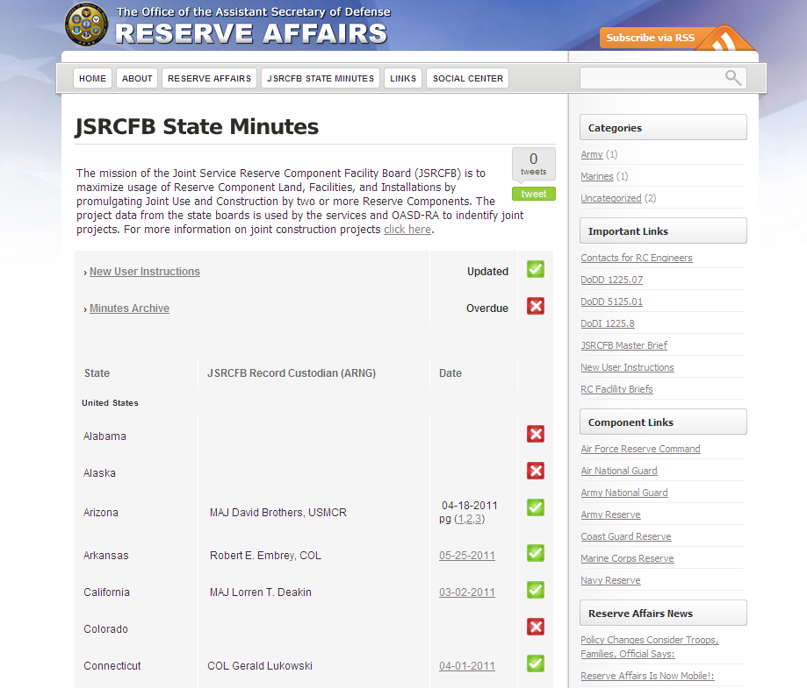
Reference Links
JSRCFB Information Brief
JSRCFB Minutes Log
JSRCFB Minute Submission Guidance
Latest JSRCFB State Minutes
Example Documents
Engineer Chiefs of the Reserve Components
Joint Construction Definition
Notes:
RA has a website that has contains much of the information you will require. The link is on the slide, if you Google OSD/RA you will be able to follow the menu to the screen shown here.
Reference Links, link to the key references
JSRCFB Information Brief, Contains a brief that provides information on the Joint Board
JSRCFB Minutes Log, Contains a list of the board minutes by state and when they were submitted
JSRCFB Minute Submission Guidance, contains the engineers addresses and a sample memo for submitting minutes
Latest JSRCFB State Minutes, contains the last minutes received by RA
Example Documents, contains sample documents to include the project listing excel template
Engineer Chiefs of the Reserve Components, listing of all the RC engineer chiefs
Joint Construction Definition, is a definition of joint construction

Slide 14
Joint Service Reserve Component Facility Board (JSRCFB)
OASD/RA (M&F) staff is currently re-examining the process of identifying, programming, and executing joint construction projects
The effort is focusing on the Reserve component engineer, Service and OSD levels

Slide 15
Joint Service Reserve Component Facility Board (JSRCFB)
For Assistance Contact:
COL Adrian Nagel
(703) 693-8110 DSN 223-8110
Adrian.Nagel@osd.mil
Mr. Steve Jameson
(703) 693-7486 DSN 223-7486
Steve.Jameson@osd.mil

