Slide 1
What Does Charting Impact Provide that the Numbers Don’t
Presented by
Ken Berger, Pres. & CEO of Charity Navigator

Slide 2
OUR DEFINITIONS OF ACCOUNTABILITY & TRANSPARENCY (per Prof. Brackman Reiser)
ACCOUNTABILITY - is an obligation or willingness by a charity to explain its actions to its stakeholders.
FINANCIAL - to safeguard and manage the charities financial resources.
ORGANIZATIONAL – to consistently follow rules of governance and operational process.
MISSION – to set goals and then measure and manage performance to assure the charity is achieving meaningful results.
TRANSPARENCY - an obligation or willingness by a
charity to publish and make available critical accountability data about the organization.

Slide 3
QUALITIES OF AN ACCOUNTABLE & HIGH IMPACT ORG.
Organizational Accountability: Governance
Capable Leadership
Passion
High Performance
Data management discipline
Experience
Persistence
Relate efforts to outcomes
Learn and adjust approach
Impact
Outcome focused intent
Creativity
Constituent feedback
Strategy/Theory of Change
Ability to get other s to follow
Continuous improvement
Mission Accountability: Results
Positive, sustainable change
Independently evaluated
HIGHER RISK INVESTMENT
LOWER RISK INVESTMENT
Financial Accountability: Financial Health
Financial Health
* Inspired by the Alliance for Effective Social Investing

Slide 4
USING MEANINGFUL INFORMATION
(The Nonprofit Marketplace Hewlett Foundation, 2008)

Slide 5
2011: CN 2.0 – ORGANIZATIONAL ACCOUNTABILITY

Slide 6
MISSION ACCOUNTABILITY - OVERLAP BETWEEN US
1. What is your organization aiming to accomplish? YES
2. What are your strategies for making this happen? YES
3. What are your organization’s capabilities for doing this? YES - FOR CN IN ALL MULTIPLE ACCOUNTABILITY DIMENSIONS
4. How will your organization know if you are making progress? YES
5. What have and haven’t you accomplished so far? YES

Slide 7
CN 3.0 – MISSION ACCOUNTABILITY
Alignment of Mission and Resources
Results Logic and Measures – CHARTING IMPACT WILL HELP HERE
Constituent Voice – CHARTING IMPACT MAY HELP HERE
Participation with Credentializers –
CHARTING IMPACT MAY HELP HERE
*Prototype for purpose of illustration only. Final product is likely to be different and/or vary by cause area.

Slide 8
Your Questions & Our Web Addresses
Website: www.charitynavigator.org
Blogs:
www.kenscommentary.org
blog.charitynavigator.org
Twitter- kenscommentary
Email – kberger@charitynavigator.org

Slide 9
Notes:
Atlas Corps, started in 2006, is a nonprofit organization based in Washington, DC, that engages individuals and organizations throughout the world. We believe that talent exists throughout the world yet opportunity does not. This epiphany occurred when our Founder and CEO, Scott Beale, after working alongside local democracy rights activists in Bosnia and human trafficking experts and constantly saw the work of these knowledgeable locals overshadowed by the arrival of their international counterparts. Therefore, we created a model to enable individuals and organizations to share ideas and abilities across borders (regardless of cultural, political, or geographic differences) to address some of our world’s most challenging social issues through active collaboration.

Slide 10
Our Mission Statement
To address critical social issues,
Atlas Corps develops leaders, strengthens
organizations and promotes innovation through
an overseas fellowship of skilled professionals.
Notes:
Our Fellows are a diverse crew in the professional and personal sense. All have at least a Bachelors Degree, with 65% having advanced education, English proficiency. They represent every major religion and 5 continents. The average Fellow is a 29 year old woman with a Masters degree and 5 years of experience. Of course, their personal stories provide the most comprehensive description of who they are…

Slide 11
Our Long-Term Vision
A fluid global nonprofit sector—connected by skill, interest, and issue and not divided by political and cultural barriers—that effectively addresses the world’s most critical issues.
Our 10-Year Vision
To engage 1,500 Fellows/year from 50 countries in in organizations in 8 countries.
The Result
A global nonprofit sector ready to address critical social issues that is led by trained and networked leaders, informed by those with first-hand experience of the issues, and enhanced by the personal perspective only gained through such a long-term service opportunity.
Notes:
Atlas Corps boosts a diverse financial model, which includes being 75% sustainable based on Host Organization cost share. On average, an organization will contribute $27,000 – 30,000/year to engage a Fellow for 12 months. Atlas Corps uses these funds to provide the support for this Fellow.
Other financial support comes from our broad individual donor base and other funders including the American Express Foundation, U.S. Embassies, the Motorola Mobility Foundation, and more.
This financial model ensures the sustainability of the Atlas Corps model while also making economic sense for our Host Organizations.

Slide 12
Our Strategic Partners & Host Organizations
Notes:
Our Host Organizations are also a diverse crew and include some of the most well-known names in the world. These are just a few. The Atlas Corps model is such that we play an intermediary role - we recruit talented individuals AND dynamic organizations and we match them based on need and skill set. So, an organization like the Peace Corps will tell us that they are looking for a Spanish-speaking professional with experience in training and civic engagement. We provide them with 3 to 5 candidates. They review, interview, and select the best candidate – Katya Garcia (Mexico, Class 5, Peace Corps). We then offer the position to the individual. Once accepted, we provide all the support to achieve the visa, roundtrip travel, orientation in the United States, a living stipend, health insurance, and ongoing professional development through the Atlas Corps Nonprofit Management Series, and ongoing support.

Slide 13
Our Strategies
Fellowship (original model)
Host Organizations contribute 75% of our revenue through a cost share (approximately $30,000/year).
Our Measures of Progress
Economic: Sustainability, Cost Share Increase, Candidates, Extending Fellows
Programmatic: Skills, Host Org Satisfaction, Alumni
Notes:
Atlas Corps boosts a diverse financial model, which includes being 75% sustainable based on Host Organization cost share. On average, an organization will contribute $27,000 – 30,000/year to engage a Fellow for 12 months. Atlas Corps uses these funds to provide the support for this Fellow.
Other financial support comes from our broad individual donor base and other funders including the American Express Foundation, U.S. Embassies, the Motorola Mobility Foundation, and more.
This financial model ensures the sustainability of the Atlas Corps model while also making economic sense for our Host Organizations.

Slide 14
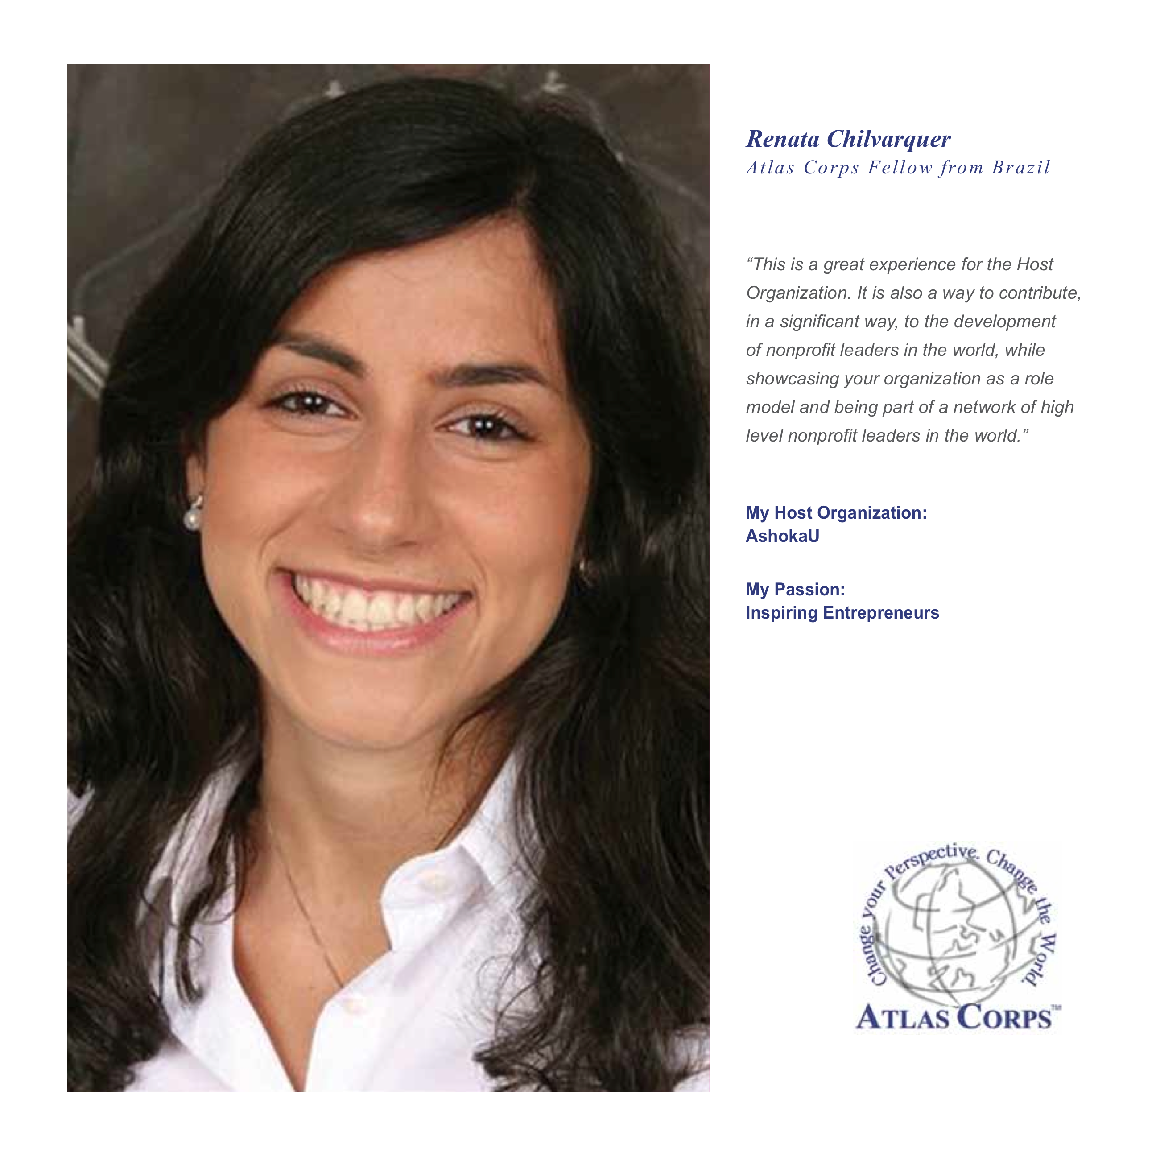
Notes:
Meet Renata (Brazil, Class 7, AshokaU) who is an advocate for social entrepreneurship. She has seen her own native land of Brazil benefit from this innovative spirit as rapid economic growth has propelled Brazil to the economic forefront on the world scene. She has also witnessed the social challenges that evolve with such rapid growth. Her focus is on combining economic growth with social benefit. She brings this perspective to her role at AshokaU where she is helping to train this upcoming generation of leaders around the world.

Slide 15
Atlas Corps
Abby Flottemesch, abby@atlascorps.org
www.atlascorps.org
“The Atlas Corps model of two-way, professional exchange
is one of the most innovative exchange programs with which I’ve have worked.”
–Ambassador Maura Harty, Former Assistant Secretary of State for Consular Affairs
Notes:
Any questions?

Slide 16
BBB Wise Giving Alliance
Bennett Weiner
Chief Operating Officer
Charting Impact: A Collaboration Story
October 1, 2012

Slide 17
BBB Wise Giving Alliance
Educating donors
Standard-setting organization
No charge to charities for evaluation
Free public access to reports
Accredited Charity = Meets 20 BBB Standards
Due process – charity receives draft report
Charity Seal optional for accredited charities
1,300 national charity reports
10,000 local charity reports

Slide 18
Standards for Charity Accountability Standard 7: Measuring Effectiveness
Submit for governing board approval
Written report outlining results of performance and effectiveness assessment
And recommendations for future action

Slide 19
Charity Effectiveness Project
Help make charity effectiveness info publicly accessible
Growing charity sector interest
Educate not rate effectiveness issue
Supplement not replace accountability

Slide 20
Charting Impact: A Collaboration Story

Slide 21
Charting Impact
2-years to develop
Common reporting framework on plans, progress and achievements.
Nearly 200 nonprofit and foundation leaders helped test
Charities answer 5 questions using platform at: www.chartingimpact.org

Slide 22
What is your organization aiming to accomplish?
What are your strategies for making this happen?
What are your organization’s capabilities for doing this?
How will your organization know if you are making progress?
What have and haven’t you accomplished so far?
A framework for advancing strategic thinking.
A standardized method for sharing concise information with key stakeholders and the public.
#chartingimpact
Notes:
Charting Impact is a set of five deceptively simple questions. These questions require reflection, encourage learning, and promote communication about what really matters – results. They offer a clear, concise way for organizations of all sizes, types, and missions to share their impact with donors, grantees, volunteers, members, and other stakeholders.
We started a process three years ago to develop a standard framework for impact. We had three goals at the start:
Organizations are more intentional about planning for and assessing their impact, leading to greater effectiveness toward their missions.
Organizations adopt a common vehicle for sharing that information, thus reducing duplication in the sector and providing a standard set of information about impact.
Based on both of these outcomes, we aim to change the dynamics of the information and funding marketplace in ways that would direct resources to effective organizations, encourage alignment and collaboration around shared goals, help us understand what’s really working, and demonstrate the real impact of our sector.
These questions are both (1) a framework for strategic thinking, as a complement or introduction to strategic planning, and (2) a common vehicle for sharing concise information with key stakeholders and the public. So we want people to use them to be more effective in their planning and assessment, but also communicate their results in order to strengthen the field.

Slide 24
How will Charting Impact be used in BBB Wise Giving Alliance Reports?

Slide 25
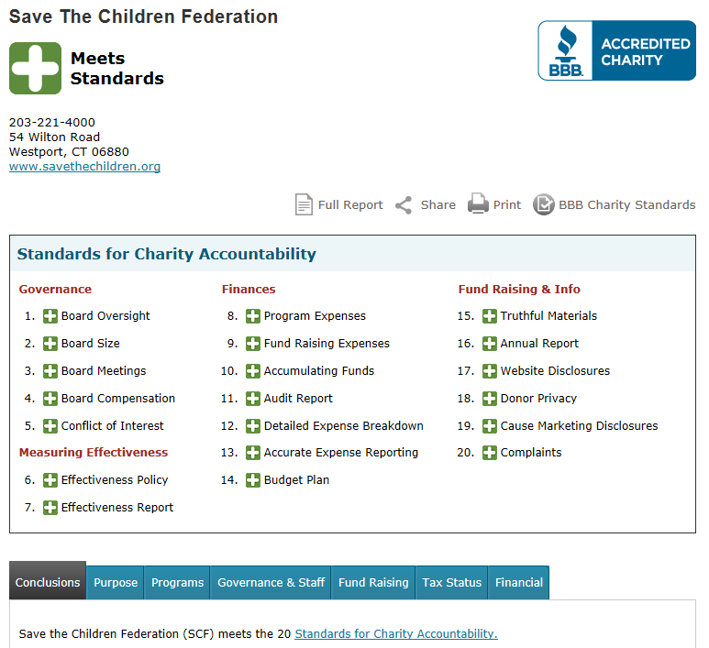

Slide 26
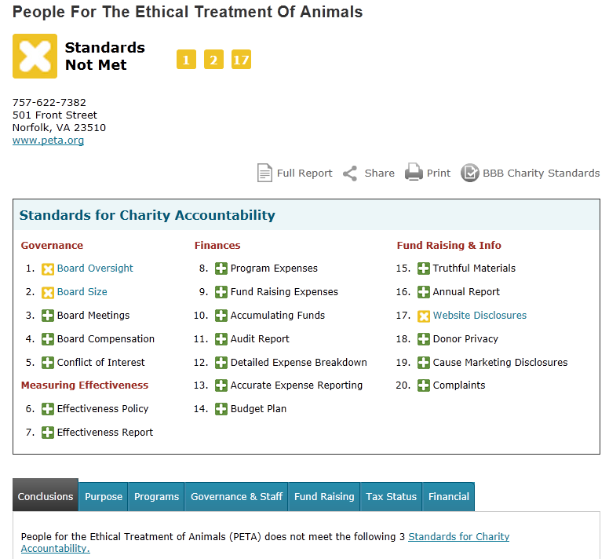

Slide 27
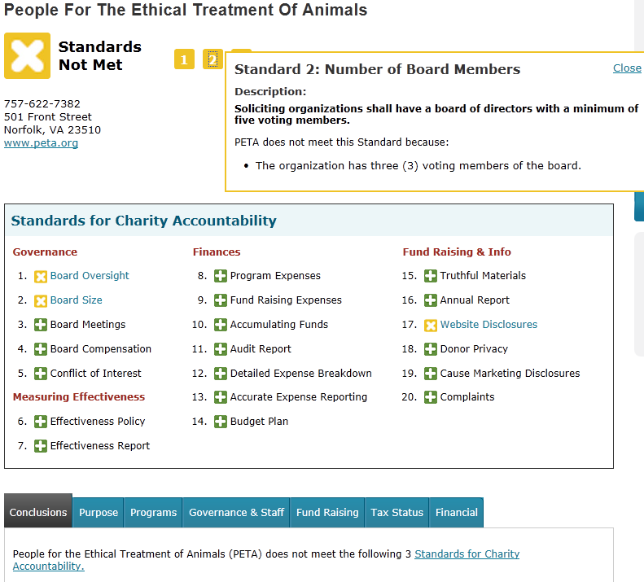

Slide 28
BBB Wise Giving Alliance
Educating donors about:
Charity accountability
Effectiveness / impact
Wise giving decisions
www.give.org

