Slide 1
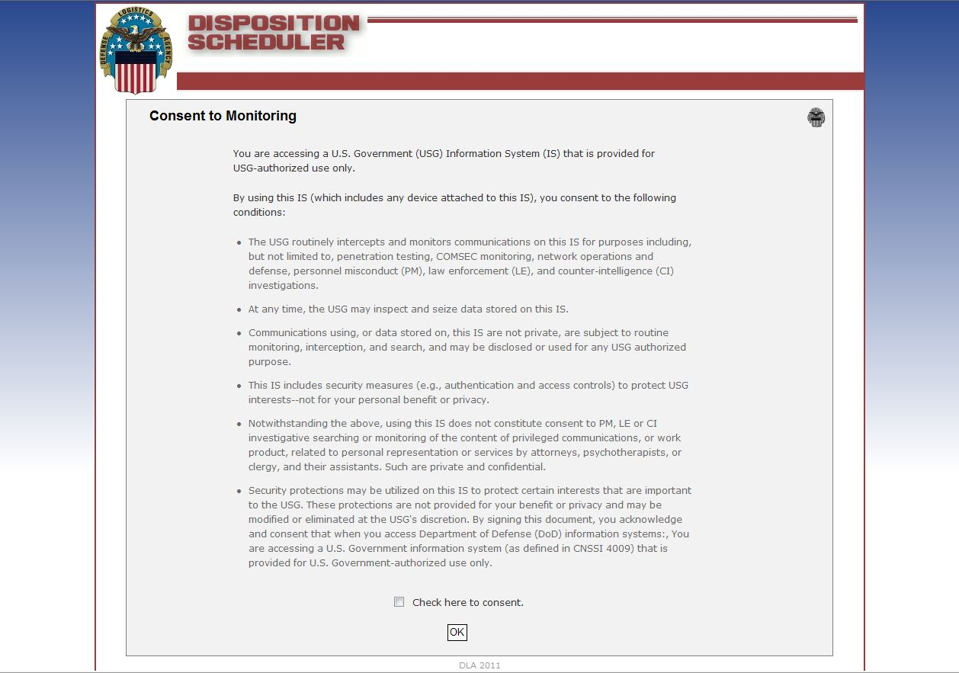
New Scheduler for Non-local /
DLA Disposition Services J411 Scheduled Shipments

Slide 2
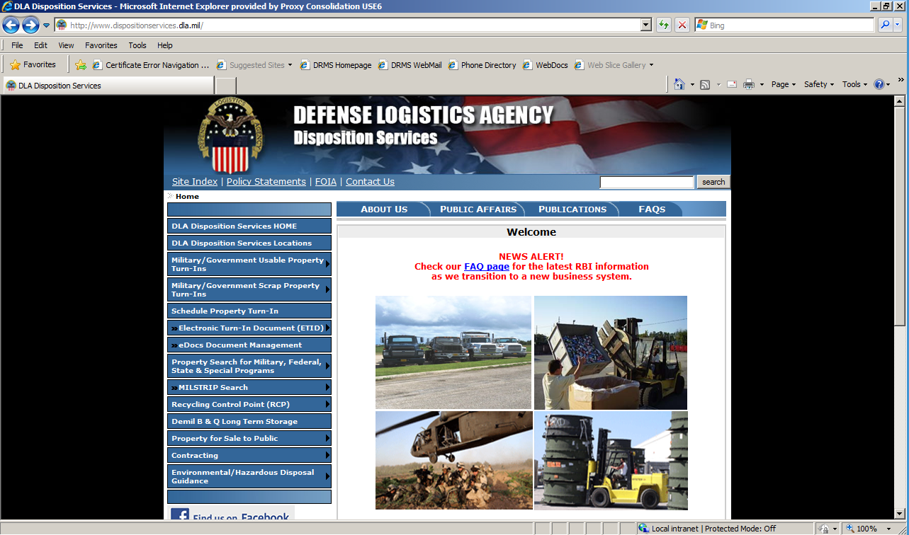
Non- Local Customer DLA Disposition Service
Scheduler Turn-in Procedures
Go to:
http://www.dispositionservices.dla.mil
Click Here

Slide 3
Consent to monitoring page
Click Here

Slide 4
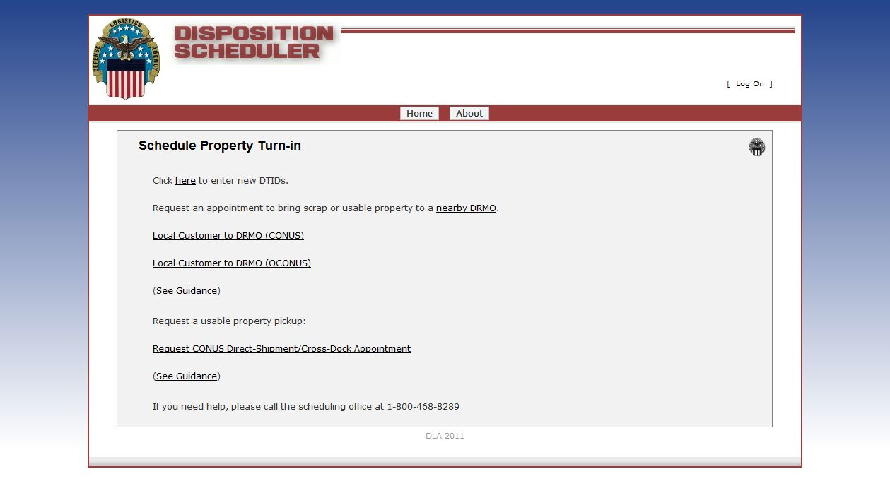
Type of turn in page
Click Here

Slide 5
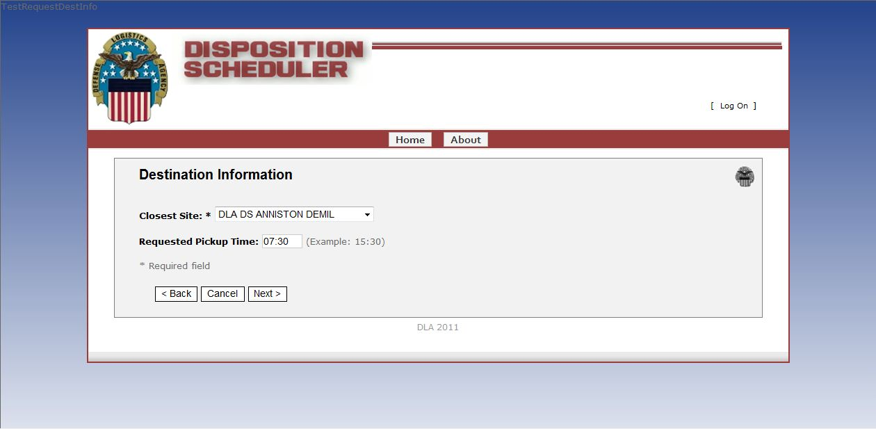
Destination Information
Chose your closest site from the drop menu
Select a requested pickup time
Click Next

Slide 6
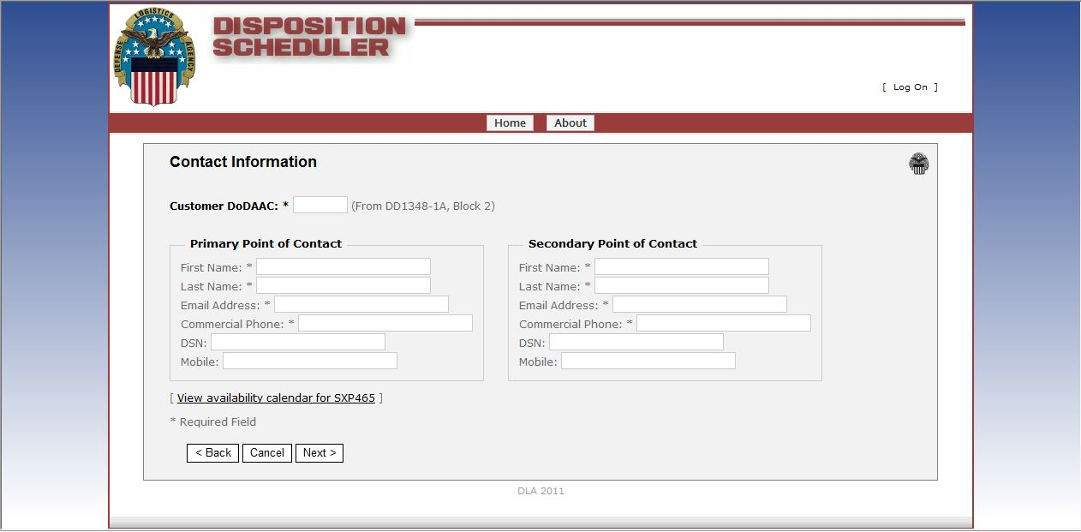
Contact information
A secondary POC is MANDATORY for all non-local shipments
The Drop off location calendar is visible

Slide 7
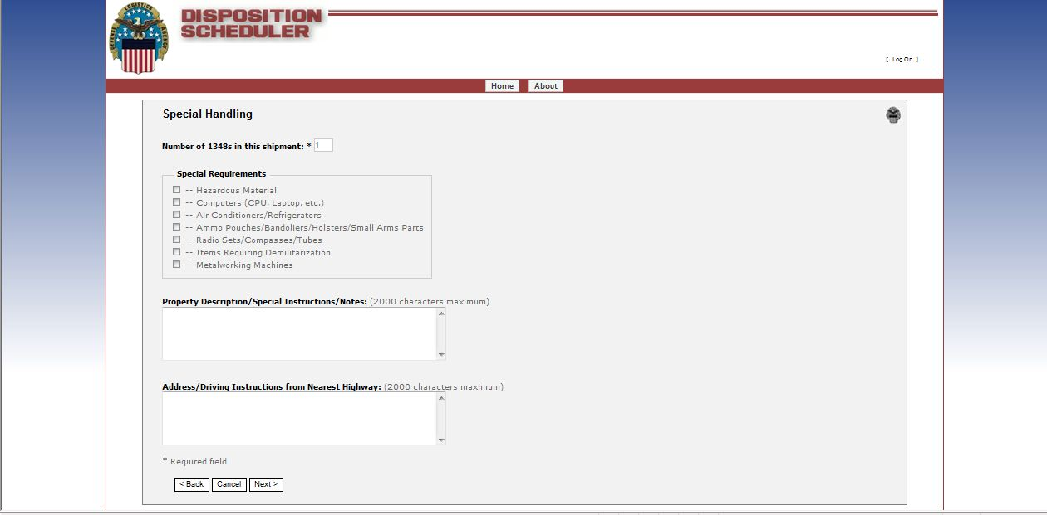
Special Handling
Include request pickup dates
Enter number of 1348’s for the shipment
If a check box is checked guidance to the requirements for turn in is provided
Property description and notes
Provide any driving directions to pick up location

Slide 8
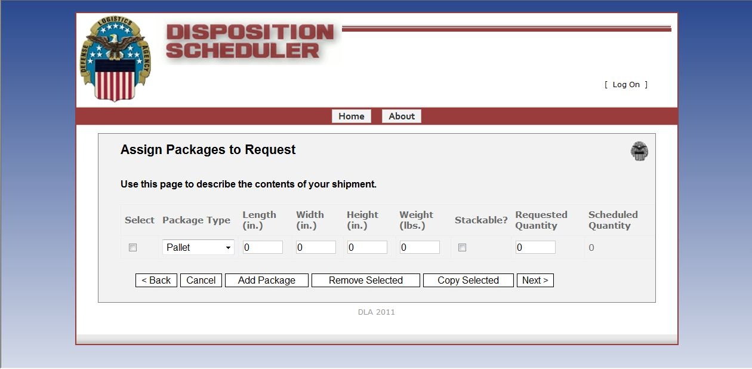
Assign Packages to Request
Select the Package Type from the dropdown menu. Available types are:
  Pallets, Tri-walls, Rolling Stock, and Other
Enter Length, Width and Height in inches, the weight in Lbs. Select if it’s Stackable and enter the Requested Quantity.
Select Add Package to Enter more lines, click the Select box and click Remove Selected to remove, or click Copy Selected to duplicate a line.
Click next to continue to the select DTID page.

Slide 9
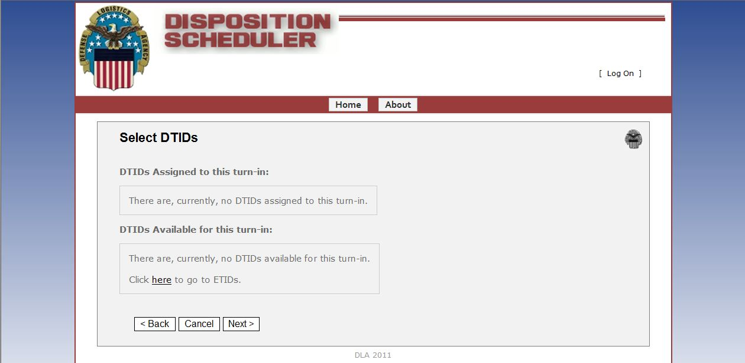
Select DTIDs
Available DTIDs will show in the bottom box. As you select the DTIDS they will move to the assigned Section. If DTIDs are not available you can select to go out to DTIDs to create new DTIDS

Slide 10
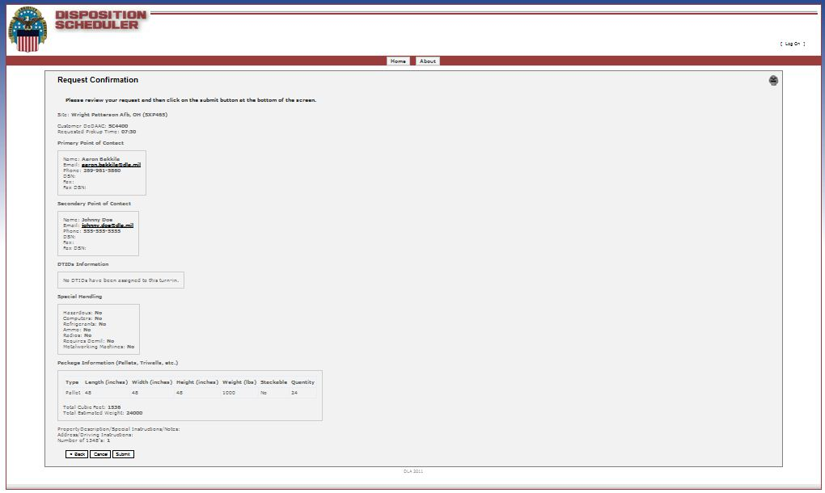
Request confirmation
Please review your request and then click on the submit button at the bottom of the screen.
Review for accuracy and click on Submit to send the request to the local scheduler.

Slide 11
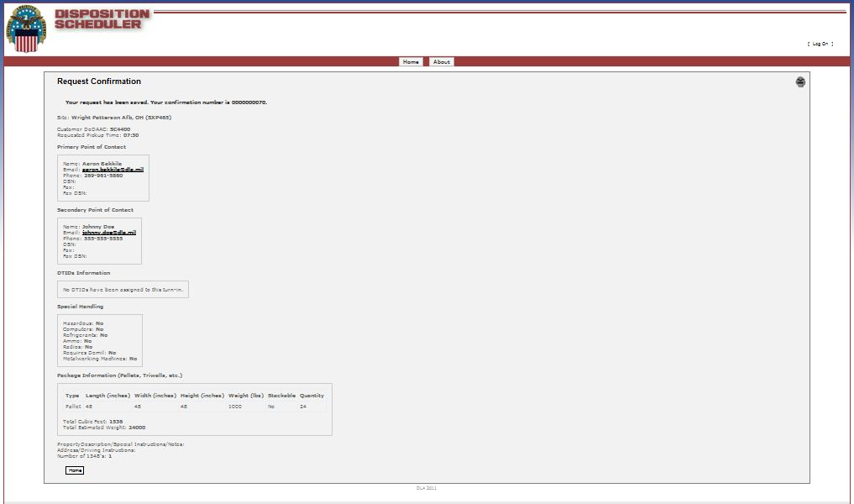
Request Confirmation Continued
Your request has been submitted. You conformation number is 0000000078
Request shown with confirmation number. An e-mail will also be sent to Primary and secondary contacts on the request form.

Slide 12
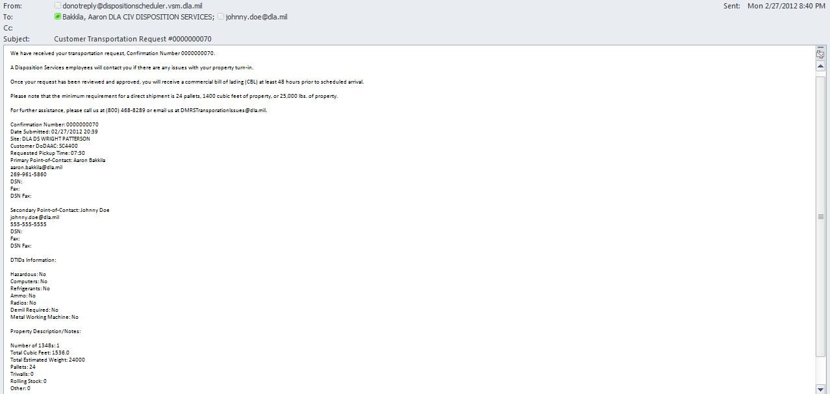
Automatic Confirmation E-mail
A Disposition Services employees will contact you if there are any issues with your property turn-in.
Once your request has been reviewed and approved, you will receive a commercial bill of lading (CBL) at least 48 hours prior to scheduled arrival.
Please note that the minimum requirement for a direct shipment is 24 pallets, 1400 cubic feet of property, or 25,000 lbs. of property.
For further assistance, please call us at (800) 468-8289 or email us at DMRSTransporationIssues@dla.mil.

