Slide 1
Crushing Burden of Debt (U.S. Debt Held By Public as a Share of Economy)
Figure 1

Slide 2
What Drives Our Debt? (Government Spending as a Share of Economy)
Figure 12
Source: CBO

Slide 3
The Cost of Waiting – The Fiscal Gap (Unfunded Promises in Trillions of Dollars)
Figure 3
Source: Government Accountability Office

Slide 4
Health Care Costs are the Primary Driver of the Debt (Government Spending as a Share of Economy)
Figure 4

Slide 5
Who Benefits From Tax Loopholes Average per Person Benefit By Category of Earners
Chart 8
Figure 6

Slide 9
Notes:
Note:
U.S. Debt Held By Public: 67% (2011, CBO)
TPs:
Europe is paying the consequences for decades of empty promises
Europe’s unsustainable social welfare state has reached a point of terminal decline.
European politicians spent decades making promises – to retirees, to government workers, to their citizens – that they had no plan to pay for and therefore no intention of keeping.
After the recent financial crisis exposed just how indebted these countries were, investors demanded higher rates to lend to them and their borrowing costs rose dramatically – compounding their debt woes.
With confidence shaken, countries are losing the ability to kick the can down the road.
We are at the moment of reckoning: Greece will default – it is a matter of when, not if – and there is a real concern that Italy, Ireland, Portugal and Spain will follow.
The crisis is affecting the United States
We just experienced a painful crisis – the result of too many houses purchased without the ability to finance them. We’ve seen a similar pattern with governments: too many government benefits have been promised without a clue how they’d be financed.
Poor decisions were papered over with debt.
In 2008, toxic mortgage debt spread through the banking system and caused a financial crisis. In Europe today, toxic government debt has spread throughout their banking system, and we’re at the doorstep of another financial crisis.
This could create two problems for the U.S. economy:
If the banking crisis in Europe drags down the European economy, then U.S. companies that export goods and services to Europe will suffer. A slowdown in demand from Europe couldn’t come at a worse time for American manufacturers, since exports are one of the few bright spots in our economy today.
Financial institutions in the United States could also experience disruptions if the crisis grows large enough.
If we fail to learn from Europe’s mistakes, we’ll be next
The bigger point is that we need to learn from Europe’s mistakes, instead of emulating them.
If we keep making empty promises, we will share Europe’s fate.
Right now, European countries such as Greece are experiencing painful fiscal austerity – sharp cuts for current beneficiaries and painful tax hikes that slow down their economy. They waited until it was too late to act, and now find themselves with no good options: simply a menu of pain.
We must put an end to empty promises, and offer reforms that ensure real security and renewed prosperity. The missing ingredient in these budget debates is economic growth.
We can avoid Europe’s fate by putting aside the failed policies of the past and replacing them with real reforms that get the debt under control and give investors and businesses the certainty they need to create jobs.

Slide 10
Who Owns Our Debt? (Debt Held by Public, 1970 -2011)
Figure 10

Slide 11
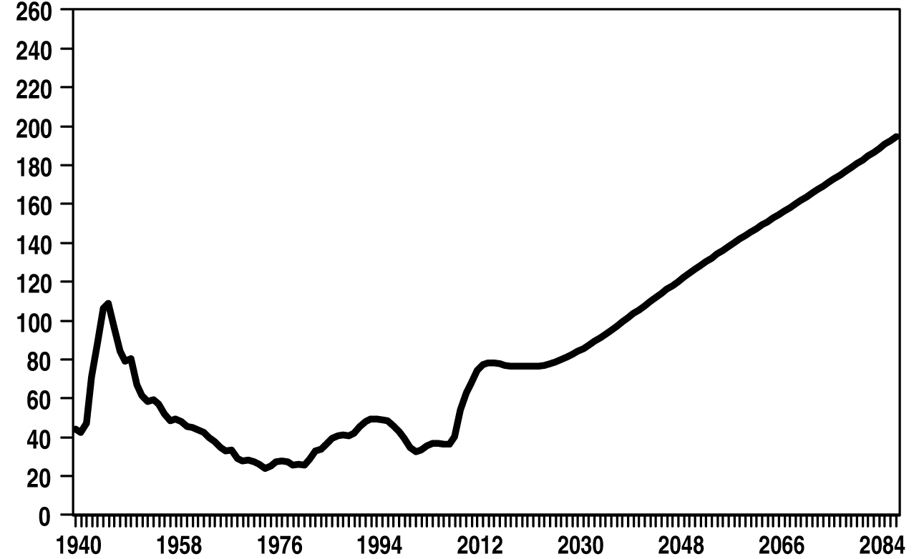
Debt Held by Public (as a Share of Economy) Chart 5-1 in President’s FY2013 Budget
Figure 11
Source: OMB

Slide 12
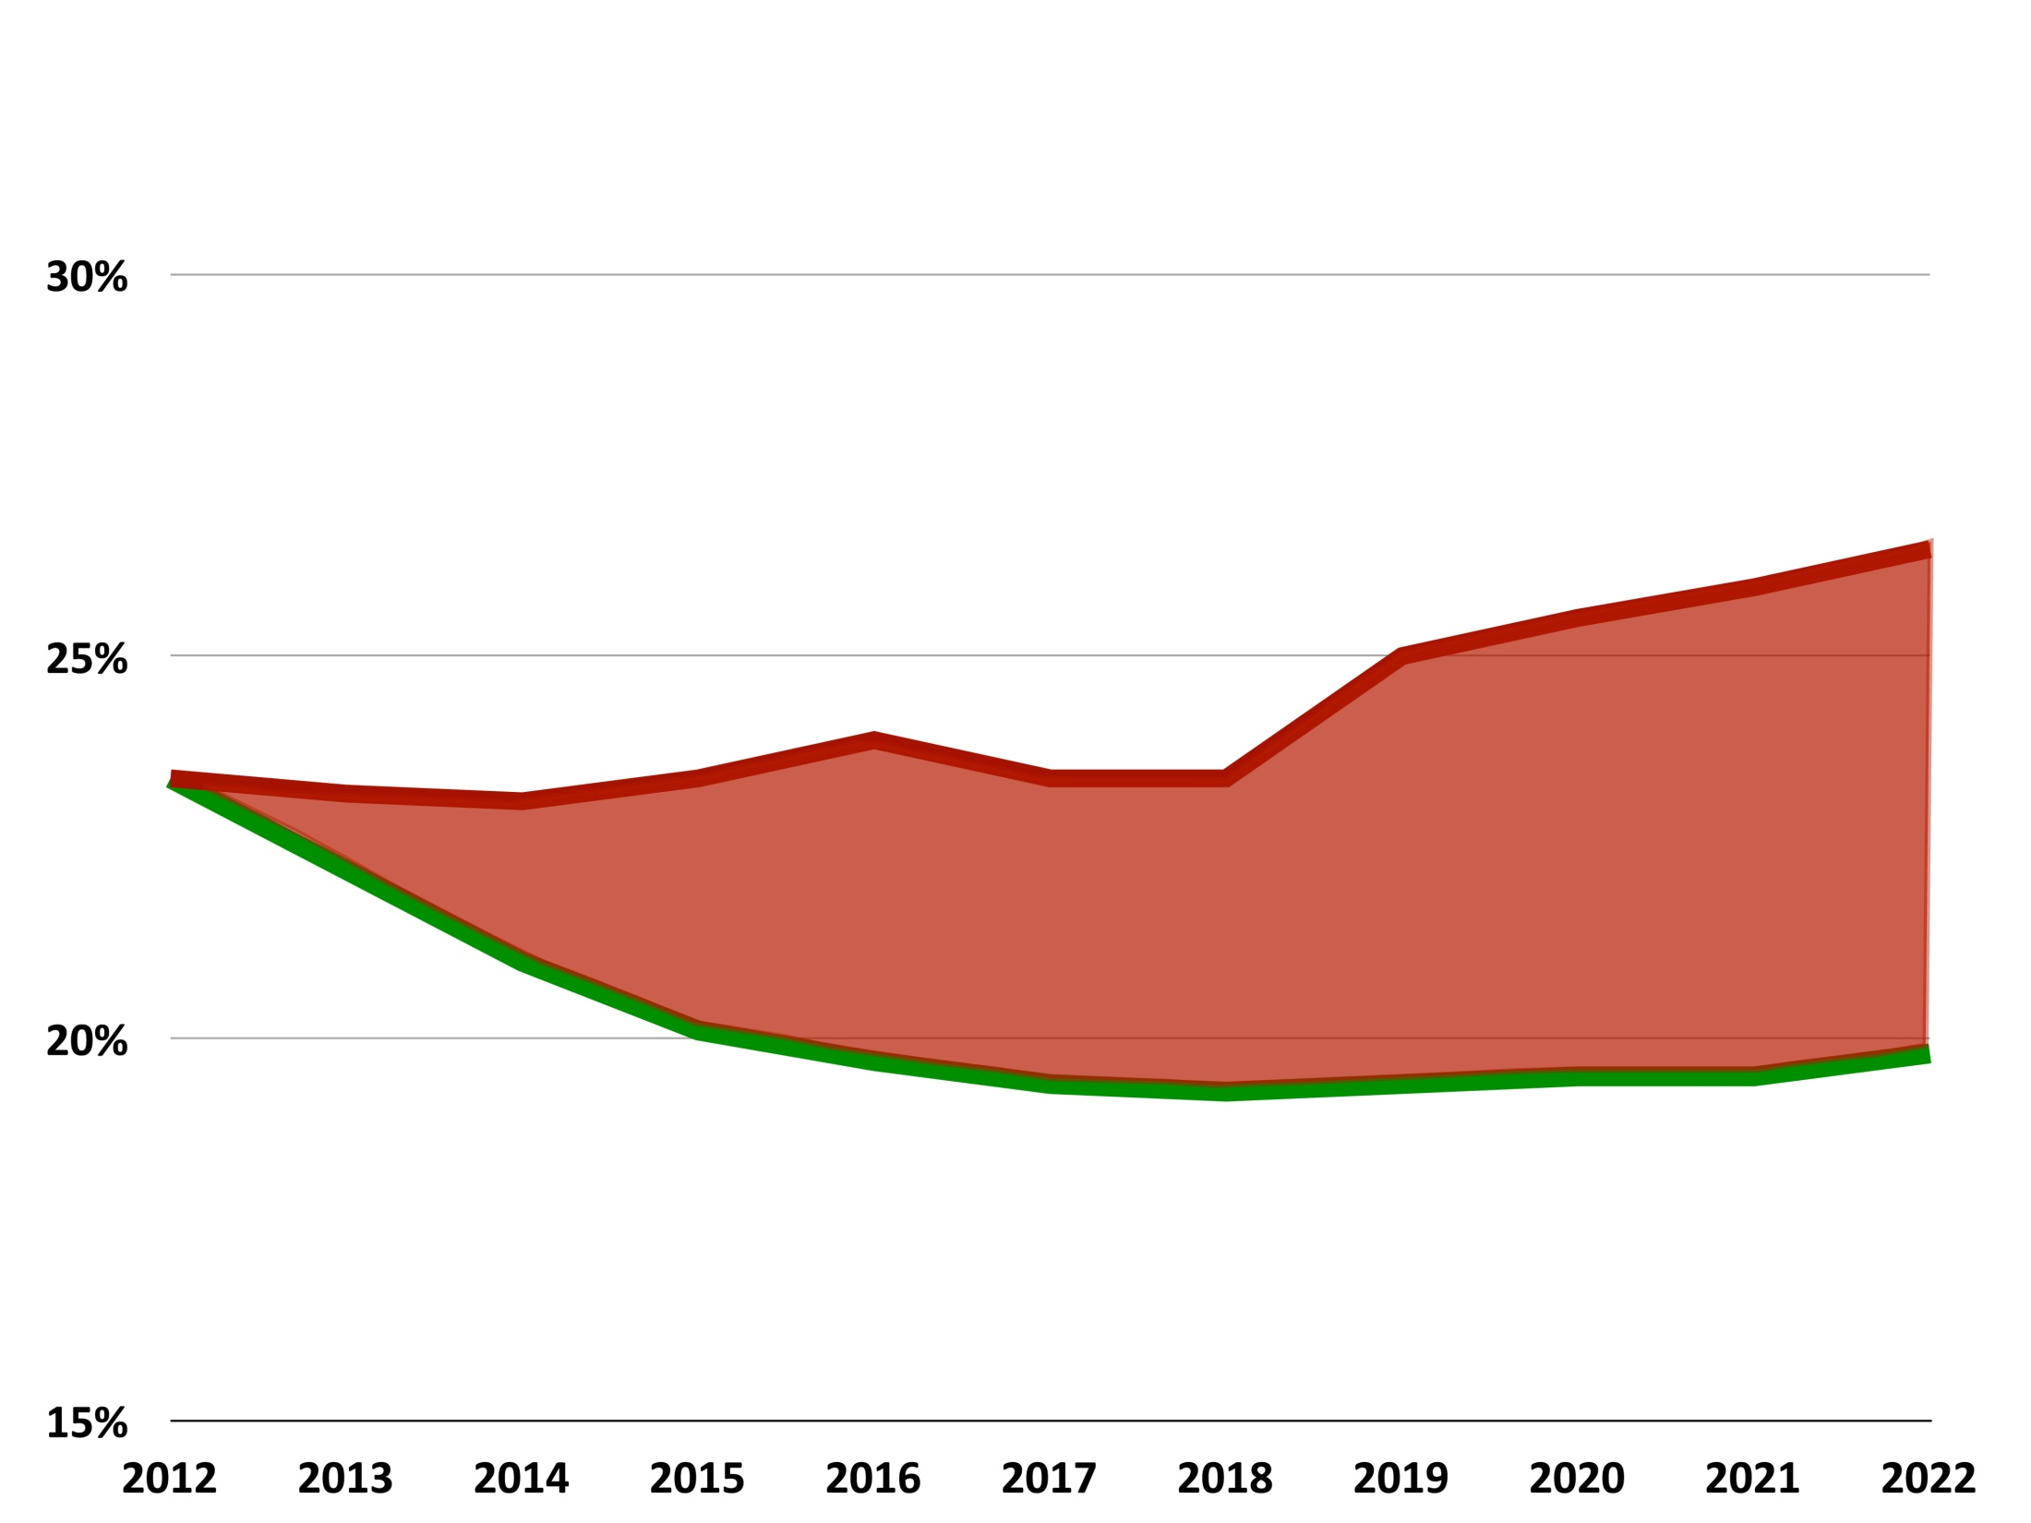
Government Spending (as a Share of Economy)
Figure 12
President’s Budget
$5.3 Trillion
Path to Prosperity
Source: CBO/HBC

Slide 13
Federal Deficit or Surplus (as a Share of Economy)
Figure 13

Slide 14
A Choice of Two Futures (Debt as a Share of Economy)
Figure 14

Slide 15
Total Government Spending (as a Share of Economy)
Figure 15

