Slide 1
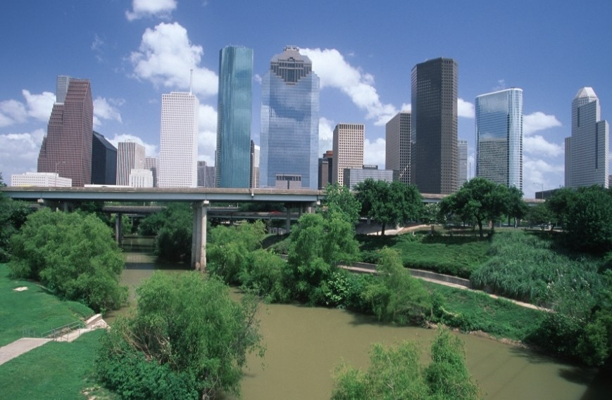
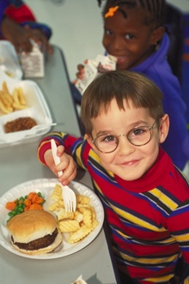
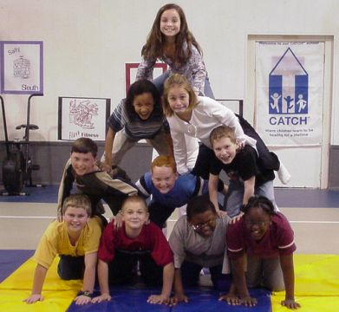
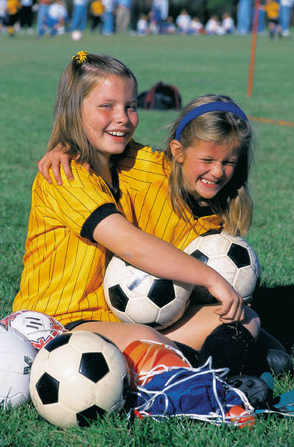
Childhood Obesity in Texas: A ‘Massive’ Public Health Issue (and what we can do to help)
Shreela Sharma, PhD, RD, LD
Assistant Professor,
The University of Texas School of Public Health
Michael & Susan Dell Center for Healthy Living

Slide 2
Michael & Susan Dell Center for Healthy Living
Mission: Healthy Children in a Healthy World
Established in 2006 at the University of Texas School of Public Health with funding from MSDF.
Director: Dr. Deanna Hoelscher; Co-director: Dr. Steve Kelder
19 faculty members located in Austin, Houston and Brownsville
One of our goals: prevention and control of childhood obesity through healthy eating and physical activity, promotion of healthy living behaviors in youth, policy and environmental change
http://www.sph.uth.tmc.edu/research/centers/dell/
Source: Brownell, 1994
Notes:
Product Scan Data
For total market
1994: 3886 new food products
2004: 4538
Total ~43,845 products over 10 years
For C &Y
1994: 54 new food products targeted
2004: 513 new products in 2003 (slight decline to 473 in 2004)
Steep increase [total ~4,000 new products x 10 years]
Similar pattern observed for new beverage products.

Slide 3
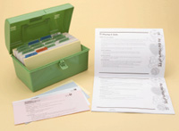
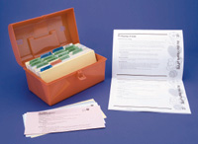
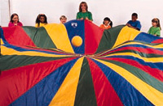
Coordinated Approach to Child Health (CATCH)
Classroom Curriculum
Physical Education
School Food Service
Family
A Good Place to Start

Slide 4
Research Phases of CATCH
Pilot 1987-91 8 schools
Trial 1991-94 96 schools
Tracking 1994-97 51 schools
Maintenance 1998-99 88 schools
Dissemination 1998-2006 1900 + schools
Catch Kids Club 1999-2001 16 schools
Homocysteine 2000-2001 25 schools

Slide 5
Research Phases of CATCH
EXPORT 2003-2007 LRGV
Pass & CATCH 2004-2007 8 schools
RWJ Policy 2005-2008 150 schools
Harris County 2005-2007 430 schools
CDC SIP 11,12,18 2005-2008 32 schools
Dell CATCH 2006-2010 97 schools
CATCH UP 2008-2011 16 Head Start centers
CATCH is a TEA approved program
Proven to increase healthy eating behaviors and physical activity in children.

Slide 6
But….does CATCH have any effect on childhood obesity?

Slide 7
El Paso CATCH replication.
The Michael & Susan Dell Center for Healthy Living’s SPAN study found a significant decrease in the obesity rates for children in the El Paso region from 2000-2002 to 2004-2005, from 25.8% to 18.8%. CATCH initiative was ongoing in schools for 8 years.
Hoelscher et al., Obesity 2009.

Slide 8
Steps to a Healthier Houston/Harris County Consortium: Dissemination of CATCH in Harris County Public Elementary Schools (2007-2008)
22 Harris County Districts Invited
19 Districts
488 schools
2,119 school staff trained in CATCH
39 Trainings Conducted
March ‘06- Nov. ‘07
20 Districts Agreed to Participate
Potential reach of >335,000 students

Slide 9
Evaluation Results (n=39 schools)
No increases in prevalence of obesity over study period.
Increased physical activity (total minutes, number of PE classes, outdoor time)
Improvements in dietary habits

Slide 10
Travis County Dell CATCH community program
8.3% decrease in obesity prevalence from spring 2007 to spring 2008, compared to a 1.3% decrease in elementary school students enrolled in the CATCH BasicPlus program.
Hoelscher DM et al., Obesity 2010. 18 suppl 1, S36-44.

Slide 11
CATCH Early Childhood for preschoolers
CATCH UP – CATCH in Underserved Populations
Nutrition and garden-based classroom curriculum
Age and developmentally appropriate physical activities
Family component
Implemented in Harris County Department of Education Head Start centers (1200+ children enrolled)
Predominantly low-income Hispanic and AA families with >35% of the children overweight or obese; <5% of time at preschool spent in MVPA; low intake of vegetables and high prevalence of sedentary behaviors.
Pilot evaluation of CEC showed:
Significant increases in vegetable intake (p=0.002)
Increase in mean minutes of physical activity and MVPA (p<0.05)
Sharma et al., American Journal of Health Education, 2011

Slide 12
Dissemination of CATCH in Texas
Other
Adopters:
Dept of Def
Florida
California
Illinois
New York
New Mexico
Maine
Delaware
Kansas
Nat’l Parks & Rec
>2,500 Texas elementary schools
Thousands nation and worldwide
950,800 children; 33% of Texas students

Slide 13
Why CATCH?
Evidence-based
Proved track record of success
Cost-effective
Teacher-led
Available for purchase through Flaghouse Inc. across U.S. and Canada (www.catchinfo.org)

Slide 14
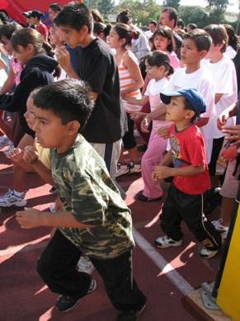
Promoting physical activity through social reinforcement and goal setting: the effects of Marathon Kids® on low-income elementary school students in Texas
Nonprofit organization established in 1996 in Austin, Texas.
Austin, Dallas, Houston, Harlingen, Los Angeles, Baltimore, & Chicago:~150,000
Goals:
To engage children (and families) in running/walking 26.2 miles over six month period.
To promote children’s consumption of 5 fruit &
vegetables a day/26 days per month.

Slide 15
Evaluation Results
383 intervention vs. 128 controls (primarily low-income, minority)
Significant increases in:
Running time (p=0.007)
Fruit (p=0.01) and vegetable (p=0.03) intake
Athletic identity, physical activity self-efficacy and outcome expectations (p<0.001)
Springer et al., Journal of Physical Activity and Health, in press

Slide 16
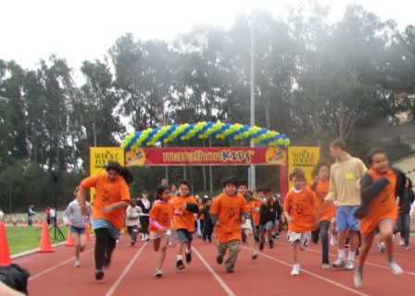
Promising Practices
Simple model (Low-cost, high volunteer factor, easy to implement at school)
Structured time for run/walk during school day
Social reinforcement: parents, teachers, public role models, public events, rewards
Next Steps: How do we refine the model for greater impact?
Notes:
Tracking logs could enhance curriculum
Narrative: “several promising strategies and approaches can be seen from the MK model, including X, X and X. [read list]”. Our study suggests that a community-school partnership can enhance PA levels of children. That said, we recognize that the effect sizes of this study were generally low, which suggests that enhancements can be made to

Slide 17
Sprouting Healthy Communities
Sprouting Healthy Communities (SHC) is a comprehensive community-based project, developed by the Sustainable Food Center (SFC), a non-profit organization based in Austin, Texas.
SHC targets community members of low-income communities through multiple interventions including a school-based program, community cooking classes, community gardens, and local farmers’ markets.
Currently they are measuring the impact of the middle school program and the farmers’ markets on fruit and vegetable intake of program participants.
Evans A, Jennings R, Smiley A, Medina J, Sharma S, Rutledge R, Stigler M, Hoelscher D. Placement of farm stands in low-income communities increases fruit and vegetable consumption among community residents. Under review.

Slide 18
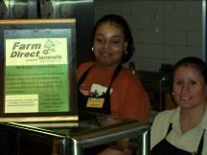
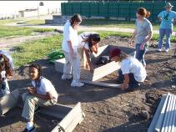
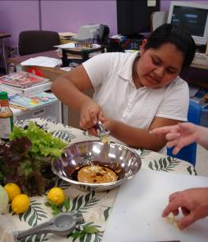
SFC projects
Sprouting Healthy Kids
farm-to-school and food systems education project
Local foods in the school cafeteria
In-class lessons in core curriculum classes
After-school program, including gardening and cooking activities and field trips

Slide 19
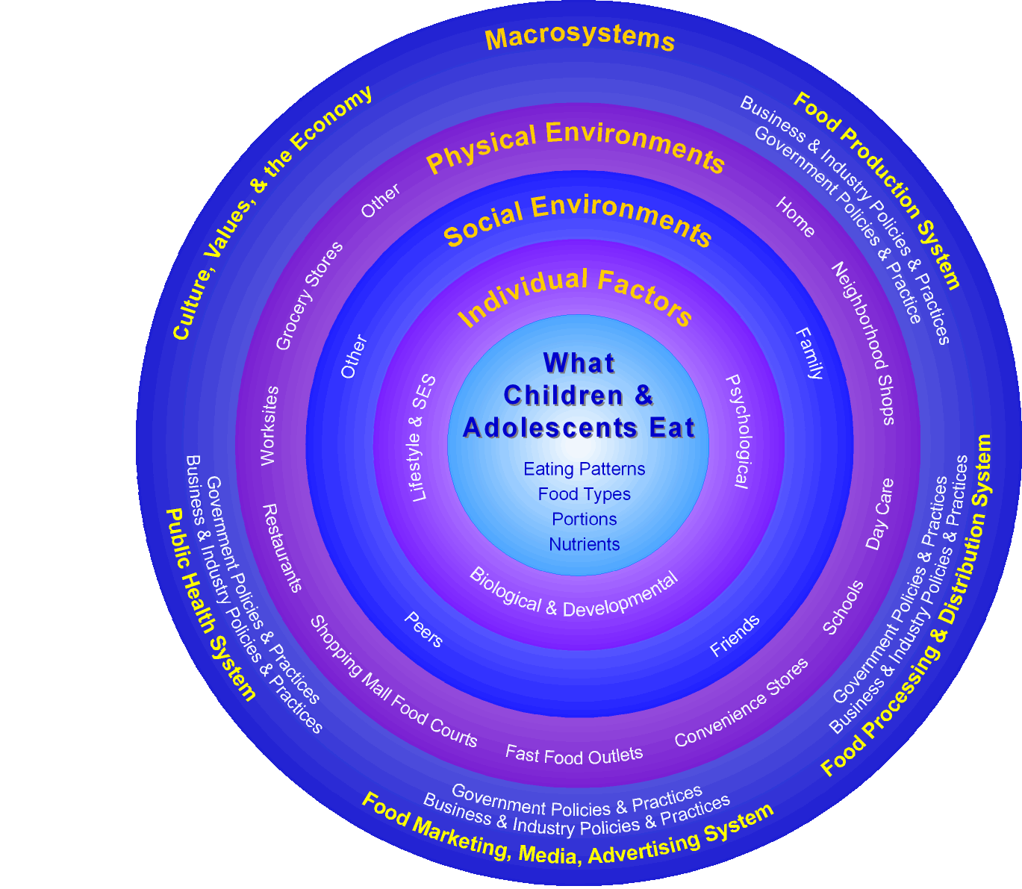
An Ecological Model Depicting the Multiple Influences on What Children & Adolescents Eat
Source: Kolbe, L & Story M. Preventing childhood obesity. National Academies Press; 2005. p.84

Slide 20
What Can We Do?
Strengthen work on evidence-based Coordinated School Health Programs (SB 19, 42, 530, 283, 892)
Increase accountability
Provide resources (personnel, funding) and structure (e.g., require community members to serve on school committees)
Require healthy eating and physical activity courses in high schools
Support evidence-based community strategies
Increase and improve availability of healthy foods in public places
Create safe communities that support physical activity

Slide 21
What Can We Do?
Provide opportunities for increased access to PA and healthful eating
Increase allocation of funds for Safe Routes to School
Provide guidelines for early childhood nutrition and physical activity (SB 395)
Support expansion of farm to school programs and WIC/SNAP into farmers’ markets
Support recess in schools
Monitor BMI & nutrition/activity trends
SPAN and Fitnessgram

