Slide 1
Health Impact Assessment: A Collaborative Approach to Good Policy Solutions Kara Vonasek, M.P.H. Project Manager Health Impact Project www.healthimpactproject.org

Slide 2
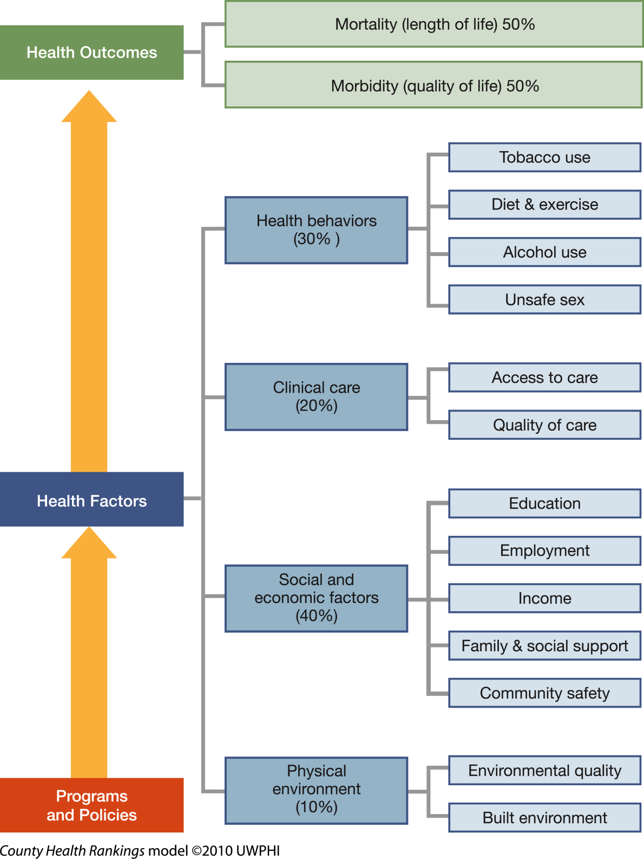
County Health Rankings
RWJF and University of Wisconsin Madison: www.countyhealthrankings.org/about-project/background
Notes:
First I’d like to start out by giving a little context for HIA. This model used by the County Health Rankings is but one way to break down the broad range of social, economic, and environmental factors that drive health and health disparities
Here it shows that access to healthcare and quality of care only makes up 20% of the factors that contribute an individual’s health. The real drivers of health are your environment, social and economic factors and health behaviors.

Slide 3
The Problem
So many daily policy decisions made outside of the health sector have significant health implications that go unrecognized because health is just not on the radar screens of decision makers.
Notes:
The problem is that so many daily policy decisions are made outside of the health sector but have significant health implications that go un recognized because health is just not on the radar screens of decision makers.

Slide 4
Decisions Have Unintended Health Benefits Too
1996 Olympic Games, Atlanta
24 hour public transportation
Addition of public buses
Reduction of auto travel and congestion
Public announcements
Was shown to decrease acute childhood asthma events
Introduction of EZ Pass, Northeastern U.S.
Reduced traffic congestion
Reduced motor vehicle emissions
Reduce disparities
Resulted in reduction of low birth-weight infants in surrounding neighborhoods
Slide courtesy of Human Impact Partners
Notes:
Decisions made outside the health sector have positive benefits too. . .
. . . And these very circumstances, the unintended benefits and consequences of our daily decisions is what the tool of HIA is meant to address.

Slide 5
What is HIA?
A framework or process that predicts anticipated health outcomes of a decision/project
Translates that information into recommendations for well-informed policies
Helps folks outside the heath field understand the direct health impacts of their work
HIA’s purpose is to improve health, track unintended consequences and mitigate risk
Notes:
That’s where HIA comes in. HIA is . . .

Slide 6
HIA Addresses Determinants of Health
How might the proposed
project, plan, policy
affect
Housing
Air quality
Noise
Safety
Social networks
Nutrition
Parks and natural space
Private goods and services
Public services
Transportation
Livelihood
Water quality
Education
Inequities
And potentially lead to predicted health outcomes?
Notes:
Another way to look at it is how might a proposed project, plan or policy affect these determinants and lead to predicted health outcomes?

Slide 7
The HIA Process
Screening: Is HIA feasible and likely to add value?
Scoping: What are the important health effects? Who are the affected populations? What is available evidence?
Assessment: What are the baseline conditions and likely health impacts?
Recommendations: Develop health-based recommendations and a feasible plan for implementing them
Reporting: Disseminate the report to the public, stakeholders
Monitoring and Evaluation: Monitors results of HIA, monitors health outcomes; evaluates the HIA process
Notes:
There are six steps to the HIA process . . . I won’t go into too many details.
Screening—establishes the need for and value of conducting an HIA. Is it feasible? Can you do an HIA within the timeframe of the decision? These are many factors to consider when determining whether to conduct an HIA
Scoping—helps you identify the affected populations and narrows the scope of health effects that you will evaluate to those of greatest potential importance. During this stage you also develop you list of research questions and identify the data and methods that will help you answer those questions.
Assessment—describes the baseline health conditions of the affected populations and characterizes the expected health effects of the proposal, as well as alternatives under consideration. This is the stage where the data and indicators from the risk assessment field come into play. HIA helps translates that data into information that can be used by decision makers to inform healthier polices.
Recommendations—is where you propose alternatives that mitigate any anticipated negative consequences and maximize the benefits. It is important to ensure that your recommendations are practical and match the political realities of the situation.
Reporting—is the actual formal HIA report and your plan for communicating findings to the decision maker and the public.
Monitoring and evaluation—Monitoring tracks the results of the HIA (whether or not the recommendations were adopted) as well as monitors for predicted health outcomes. Evaluation looks at the process of the HIA.

Slide 8
What HIA is not . . . What HIA is
It’s not used to make the case for why a policy, program or project should be proposed.
It’s not an assessment to understand the impacts of a program or policy once it has been implemented.
The Sweet Spot – It’s proactive! It’s meant to inform a proposed policy, program or project currently under active consideration by a decision-making body.
It’s not a community assessment tool (i.e., MAPP & CHA), but those are used during assessment stage of HIA.
HIA is the framework that translates that data into well-informed policies.
Notes:
What HIA is Not . . . What HIA is
Sometimes there is confusion over what HIA really is and at what stage of the decision making process it is applied. The way that I typically describe is that. . .
HIA is not used to make the case for why a policy, program or project should be proposed
And it is not an assessment that is done to understand the impacts of a program or policy once it has been implemented
The sweet spot of HIA is meant to inform a proposed policy, program or project that is currently under active consideration by a decision-making body and predict potential health outcomes of that proposed policy or project.
People also ask how it relates to the many kinds of community assessments that are out there, such as MAPP, CHIP and CHA.
HIA is very different from these kinds of community assessments meant to gather a baseline data for existing conditions in a community.
HIA is the framework that translates that data into information and uses it to inform the decision making process.
These community assessments are tools that could be used during the assessment stage of HIA.

Slide 9
HIA Ex: Jack London Gateway Development
Authors: Human Impact Partners & SFDPH
Decision: Plan for 61 new senior housing units close to 2 freeways & Port of Oakland
Impacts: Air quality; noise; safety; retail access
Recommendations: Noise-insulating windows; pedestrian protection medians; traffic calming measures; air quality monitoring; installation of ventilation systems; and many others
Outcomes:
Many recommendations adopted
Additional HIA projects were funded
Healthy Development Checklist adopted by the development committee
Notes:
In San Francisco, they did an HIA of a proposed senior housing facility located next to two busy freeways and looked at a variety of impacts . . . air quality noise, safety, retail access.
They ended up making several actionable recommendations such as noise-insulating windows, moving the building entrance to the non-freeway side to cut down on pedestrian injuries, etc.
But one of the key findings here is that even though the building’s air-filtration system met all permitting requirements, the air-intake vent the way it was written into the plans would have pulled exhaust from the freeway and pumped it into the building, leading to harmful indoor air quality for residents who are already at high-risk for respiratory illness
A relatively easy fix—that actually was implemented—involved relocating the intake vent to the other side of the building and upgrading the building’s air-filtration system.
This is a good example of why it is still useful to do HIAs even though air quality regulations are already in effect. Those regulations don’t always take into account the potentially harmful effects that surrounding air quality can have on people.

Slide 10
Texas Examples of HIA
Transit Oriented Development – Houston (Texas Southern University)
In-progress HIA of possible development patterns that could occur in neighborhoods near planned light-rail expansion
Will examine potential outcomes such as access to public transportation and services, mixed-use land development and affordable housing
Habitat Conservation Plan – San Antonio (Health Department)
In-progress HIA to examine the health impacts of the Southern Edwards Plateau Habitat Conservation Plan, as part of local implementation efforts of the federal Endangered Species Act
Will examine issues such as air quality, park space and conservation of endangered species

Slide 11
Texas Examples of HIA (Continued)
Public Housing Redevelopment – Galveston (GA Health Policy Center & University of Texas Medical Branch)
In-progress HIA of the Galveston Housing Authority Board’s decision on the location and upgrading of public housing units destroyed in Hurricane Ike
Will examine potential outcomes such as injury and asthma rates, exposure to toxins and air pollution, access to green space, goods and services, health care facilities
School Siting Policies – Austin (University of Texas)
In-progress HIA that will address the health implications of choices regarding where to site and build schools

Slide 12
The Benefits of HIA
Involves a broad-range of impacted people
Community capacity building/empowerment
It’s an effective tool for meaningful cross-sector collaboration
Relationships/trust is built among partners through HIA process
Increases likelihood of routine consideration of health
There is a strong business case for HIA
Corporate social responsibility – address community concerns early in the planning process
Lower business costs – can actually help speed approval of a project/decision
Know your “Health ROI” – HIA as a form of risk management
Notes:
There are many benefits of HIA
It involves a broad range of impacted people and can be used as a tool for community capacity building. It gives communities a structured way to engage with decisions makers where their voice hasn’t previously been at the table.
It’s an effective tool for meaningful cross-sector collaboration. The relationships and the trust that is built through the process increases the likelihood of routine consideration of health.
There is a strong business case for HIA -- business and industry have actually been early adopters . . .
The World Bank and IFC have made HIA a part of their standards for evaluating loan requests for large development projects.
And, large multinational companies like Shell and Chevron are increasingly implementing their own standards for HIA in planning new projects.
From industry’s perspective, it helps them be more socially responsible corporate citizens by proactively addressing community concerns when something can still be done about it without exorbitant cost
It can actually help speed approval and lower business costs – we’ve even seen examples of HIA helping to avoid litigation.
And it helps them know their health return on investment used as a form of risk management.

Slide 13
Who Does HIA?
Non-profit organizations
Community groups affected by a decision
Local and State government agencies
Public Health, Environmental Health, Planning Departments, Transportation Departments
Universities & research institutions
Industry/business community
Notes:
There is a diversity of entities that do HIA . . .
Often times HIA arises from community concerns and is conducted by non profit organizations. HIA is also carried out by local and state government agencies, companies, or universities.

Slide 14
Notes:
And while there is diversity in the types of practitioners, there is also diversity in the topics and sectors to which HIA is applied.

Slide 15
Completed HIAs 2007
(N = 27)
MN 1
MA 2
NJ 1
CO 1
CA 15
GA 3
FL 1
AK 3
Map Courtesy of A. Dannenberg, A. Wendel, CDC NCEH
Notes:
There also is increasing geographic diversity over the past several years . . . In 2007, there were 27 known completed HIAs in 8 states across the US

Slide 16
Completed HIAs 2009 (N = 54)
Health Impact Project Founded
WA 4
MT 1
MN 5
OR 2
MI 1
PA 1
MA 2
OH 1
NJ 1
CO 2
CA 25
MD 1
GA 4
FL 1
AK 3
Notes:
In 2009, 54 completed in nearly twice as many states.

Slide 17
Completed HIAs 2012 (N = 91)
WA 3
MT 1
MN 7
ME 1
OR 9
WI 2
NY 1
PA 1
MA 3
OH 2
NJ 1
CO 3
CA 33
MO 1
MD 3
KY 1
TN 2
DC 1
AZ 1
NM 2
GA 5
AK 7
Federal HIAs: 3
Notes:
In 2012, that number jumps to 91

Slide 18
Completed HIA and In Progress HIAs
2012 (N = 173)
WA 6
ME 1
MT 2
MN 13
OR 20
WI 7
NH 1
NY 2
MI 1
PA 1
MA 5
NE 1
OH 4
IL 3
NJ 1
CA 53
CO 4
KS 1
MO 2
VA 1
MD 3
KY 2
TN 2
DC 1
AZ 2
NM 2
SC 1
GA 7
TX 4
AK 15
HI 1
Notes:
And when you add the in-progress HIAs, we practically have an epidemic on our hands.

Slide 19
Key Points About HIA
The best way to learn HIA is just to do one!
Legacy of HIA:
Relationships/trust is built among partners
Increased stakeholder understanding of value of HIA
Increases likelihood of doing another HIA in future or routine consideration of health in decision making
Most HIAs aren’t all that expensive—primarily staff time
Takes a champion willing to spearhead effort
Notes:
We have found that the best way to learn HIA is just to do one – the relationships and trust that are built and the shared understanding gained from doing an HIA builds strong bridges with other disciplines and naturally leads to health-informed decision-making.
HIAs do not have to be expensive. A survey of the comprehensive HIAs that we are aware of typically ranged from as little as a few thousand dollars to $150,000. The primary expense in HIA is staff time.
That’s why, it requires a champion on the ground who is committed to the cause and supportive leadership who is willing to give them the leeway to explore the opportunity for HIA.

Slide 20
How Does HIA Typically Come About?
A decision/policy/program/plan is on the table and potentially impacted populations are concerned about it
HIA identified as a tool for effective engagement and informing the decision-making process
Folks see the value of HIA and want to develop capacity to carry it out
First Step: need to identify an appropriate HIA decision target
How? – Meet with folks outside health sectors to learn about upcoming decisions that may be important to health
Screening step is KEY! – screening worksheet available
Notes:
Important to note that plenty of people have taken up HIA without official training.
HIA is a common sense approach that can be picked up by researching, reading and learning from the ample resources that are out there.
It’s really just about sitting down w sister agencies (planning & transp) and structuring PH input in a way that is relevant for decision makers in other agencies.

Slide 21
Once You Have An Appropriate HIA Decision Target . . .
Apply for grant opportunities
3rd CFP from Health Impact Project released today
Grants up to $75,000 for 18 months, tailored 2-day HIA training, ongoing mentoring and technical assistance
Association of State and Territorial Health Officials (ASTHO) released RFP today, up to 15,000 for 9 months
Or, seek out wealth of resources online
Plenty of people have taken up HIA without official training
HIA is a common sense approach
It’s really about structuring public health input in a way that is relevant for decision makers in other sectors
Notes:
Important to note that plenty of people have taken up HIA without official training.
HIA is a common sense approach that can be picked up by researching, reading and learning from the ample resources that are out there.
It’s really just about sitting down w sister agencies (planning & transp) and structuring PH input in a way that is relevant for decision makers in other agencies.

Slide 22
Helpful HIA Websites & Resources
Health Impact Project: Interactive Map of HIA in U.S.
www.healthimpactproject.org
National Network of Public Health Institutes: Training Materials
http://nnphi.org/CMSuploads/PHI_HIATrainingMaterials_NNPHIWebsite.pdf
Human Impact Partners: HIA Training Materials & Worksheets
www.humanimpact.org
UCLA’s HIA-CLIC: HIA Clearing House for Practitioners
www.hiaguide.org
American Planning Association: Online HIA Training
http://professional.captus.com/Planning/hia/default.aspx
CDC’s “phConnect”: Online HIA Community
www.phconnect.org

Slide 23
Discussion
Kara Vonasek
kvonasek@pewtrusts.org
Phone: 202.540.6379
www.healthimpactproject.org

