Slide 1
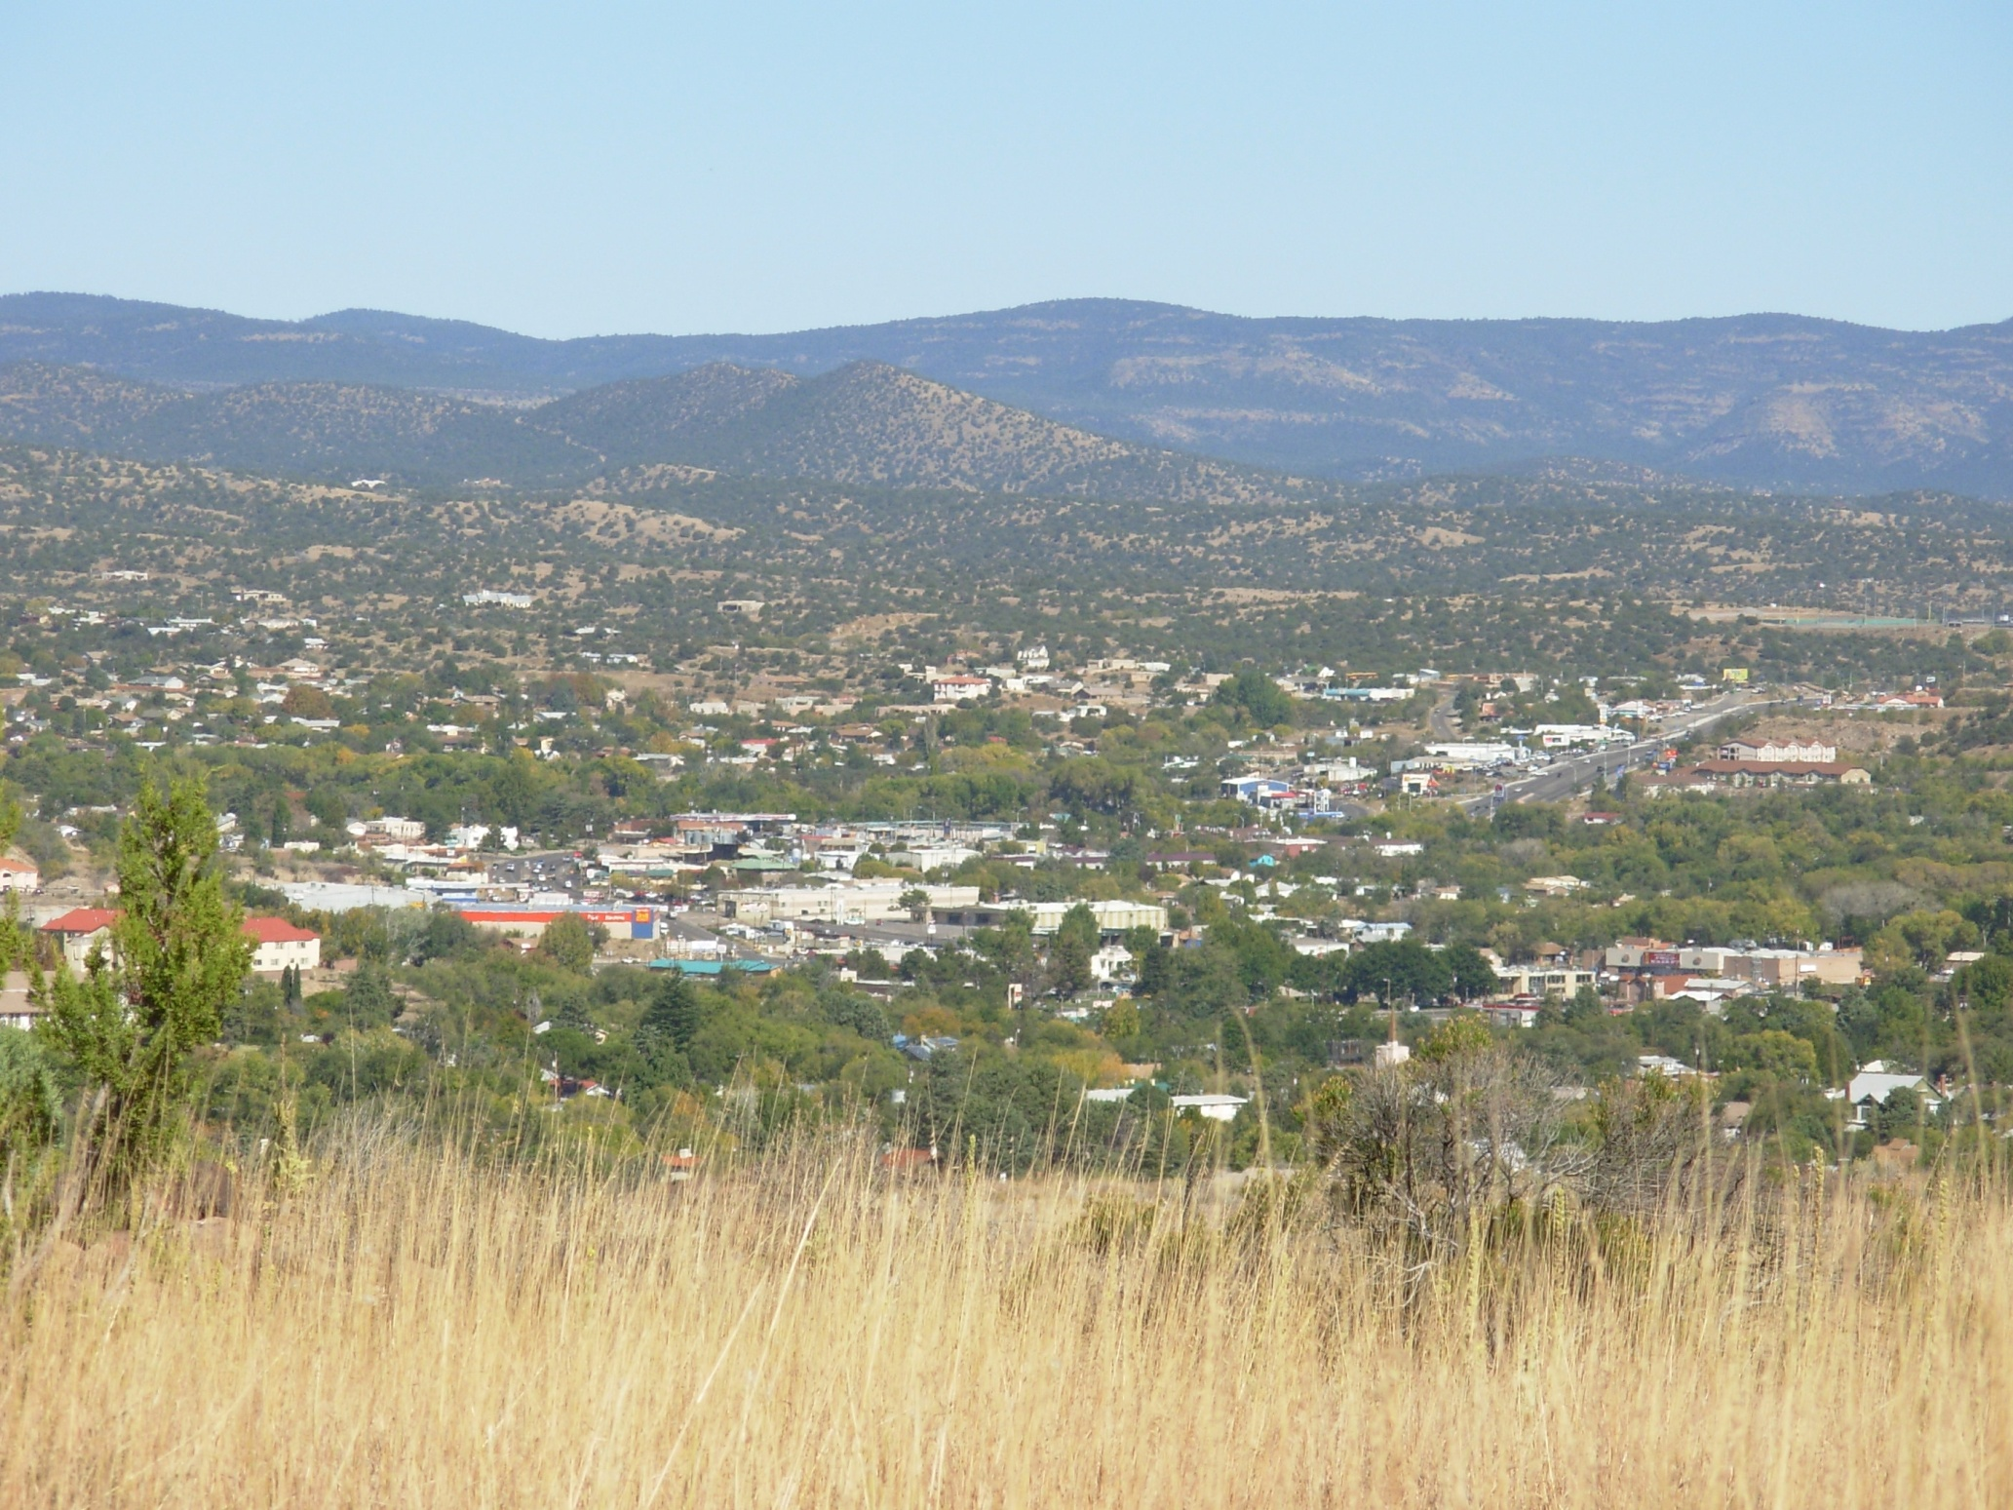

Andrea Sauer, Project Coordinator www.GrantCountyHKHC.com
Healthy Kids, Healthy Communities
Grant County, New Mexico

Slide 2
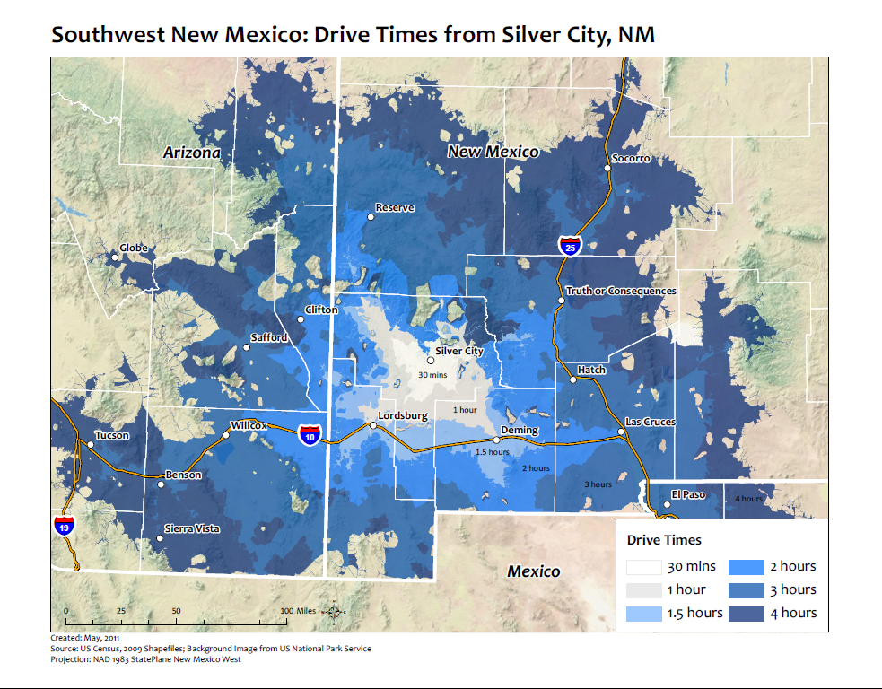
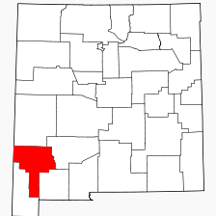
Notes:
Demographics
Obesity statistics

Slide 3



















Who We Are
Walkability accessibility advocacy group and bicycle advocacy group
Village of Santa Clara
Notes:
HKHC partners: non-profits, quasi-governmental agencies (COG, Extension), state and local government agencies, medical providers, educational institutions (Cobre, Silver, WNMU) and funders RWJF and facilitators Grant County Health Council and Active Living by Design.

Slide 4
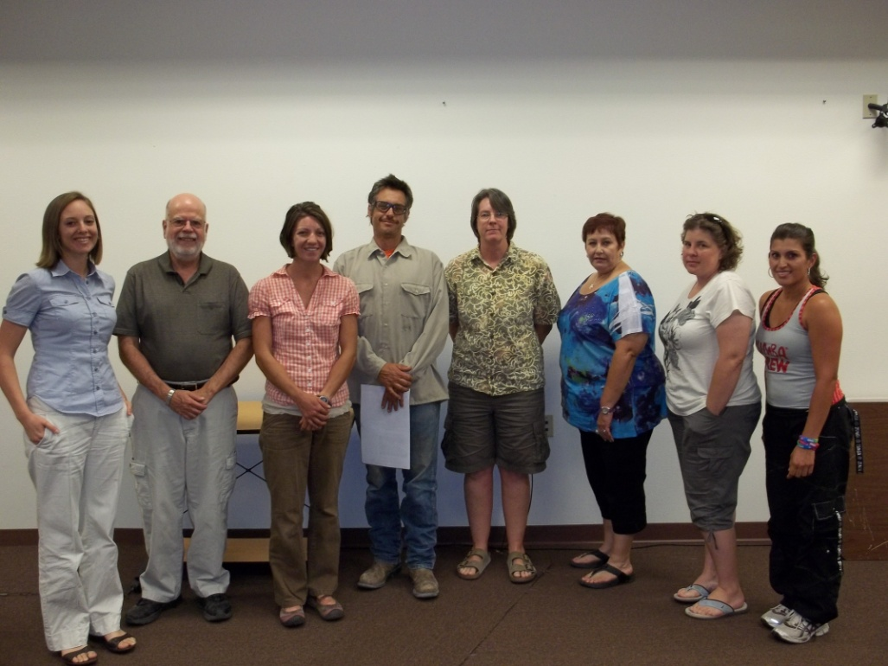
Grant County Food Policy Council
13-member County advisory board
Government and non-government representatives
Focus on key policies and projects
Notes:
HKHC was instrumental in forming the Grant County FPC in 2010. Council accomplishments include enabling all farmers’ markets to accept EBT, facilitating the sale of local food to our senior centers, and advocating for food policy bills in the NM legislature.

Slide 5
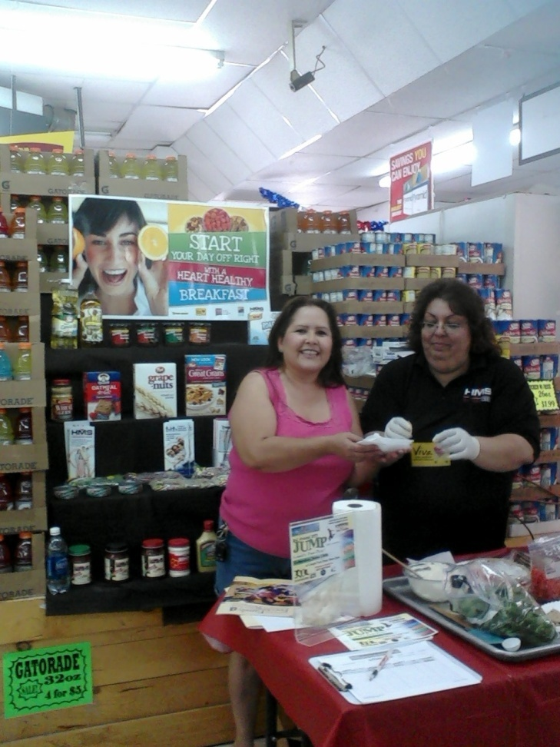
Grocery Store Initiative
Hidalgo Medical Services-FQHCC
Summer 2011
Healthy displays
Shopping guide
Free cooking demonstrations and giveaways
Notes:
Grocery store initiative: Initiated by the family support division at HMS- a federally qualified health care center, in partnership with the co-owners of our local grocery store chain (Food Basket) in Summer 2011. Key components included a “guide to heart healthy items” in each aisle of the grocery store- free to customers, displays and end caps of heart healthy items that rotate each month, and free cooking demonstrations featuring local, culturally appropriate ingredients.

Slide 6
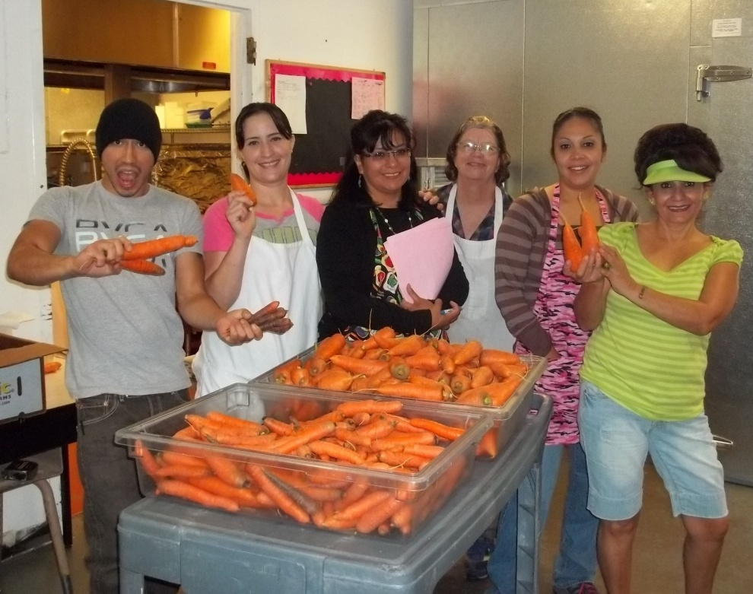
Farm to School Pilot Project
DoD Fresh Fruit and Vegetable program funds
Sept. 19-23
1,800 kids @ 6 Elementary schools
More in 2012?
Notes:
Farm to School pilot program: HKHC facilitated a partnership between two school districts in Grant County, local farmers, and our local food cooperative to pilot a Farm to School project the week of Sept. 19. The schools used funding from the Department of Defense Fresh Fruit and Vegetable program to purchase local produce for over 1,800 kid’s snacks at 6 different Elementary Schools. If successful, the schools have expressed interest in making this a permanent component of their meal program, particularly during the Summer lunch program. It’s through projects like this that we hope to increase local agriculture supply and demand to strengthen our local economy, provide healthier food for kids, and address policy and infrastructure barriers that prohibit this vision from becoming a reality. We would like to be a model for rural Farm to School pilot programs across New Mexico and the country.

Slide 7
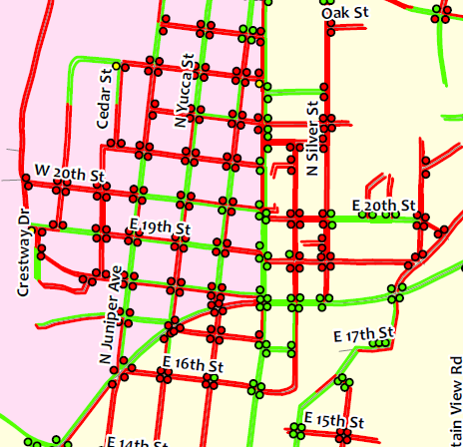
Silver City Land Use & Zoning Code
Language adopted to enhance/protect
  Complete streets
  Trails
  Community gardens
  Farmers’ markets
Notes:
Silver City Land Use and Zoning Code: HKHC successfully advocated for changes to the Silver City Land Use and Zoning Code, which now includes provisions for complete streets, trails, farmers’ markets and community gardens. For example, community gardens are now an allowed use in any zone and developers can dedicate land for parks or community gardens when building subdivisions (which we don’t have a lot of, but it’s nice to have as an option anyway!). After the Town Council adopted this language, the Town hired a new planner who is currently developing a Pedestrian and Bicycle Plan to guide the implementation of their new complete streets policy. [EXPLAIN PICTURE]

Slide 8
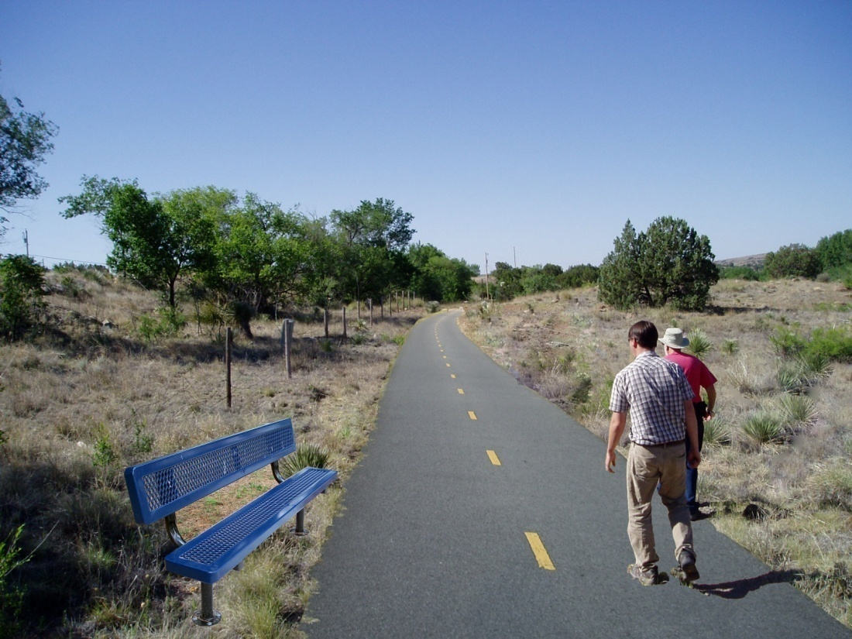
Multi-use Trail Planning
10+ miles of paved, off-road trail for pedestrians and bicyclists
Connects 3 towns
$50,000 CDBG
Notes:
Multi-use trail planning: Assessment results showed that lack of connectivity and road safety was a major issue for low-income communities in the County. So HKHC developed a plan for an off-road multi-use trail system that would provide over 10 miles of paths for recreational and daily transportation use. Three local governments endorsed the plan, and the largest of the three was awarded $50,000 in community development block grant funding to update their comprehensive plan and conduct a trail feasibility study. [EXPLAIN PICTURE]

Slide 9
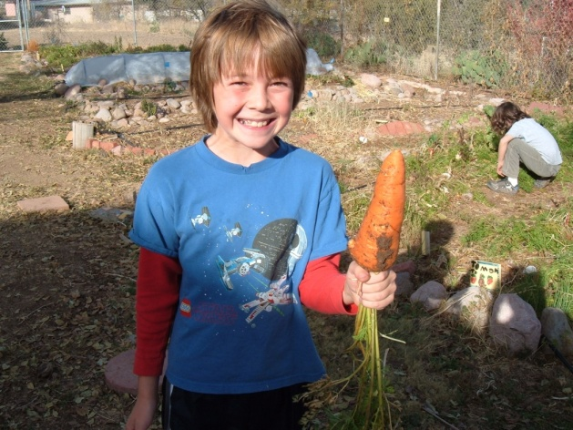
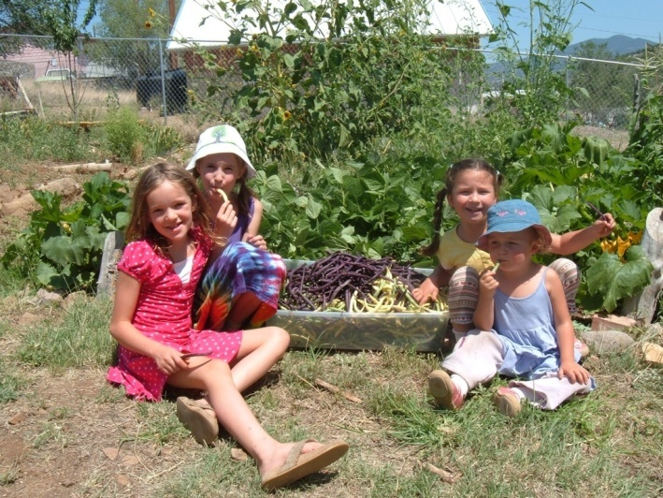
Challenges
Lack of senior leadership
Partnership diversity
Resources
Shift in cultural paradigm

Slide 10
Plans for the future…
Goals for healthy eating:
  Family-friendly check out lanes and more produce options at convenience stores
  Farm to School project; school gardens
  Food Policy Council
Goals for active living:
  Pedestrian and bicycle plan
  Multi-use trail feasibility study
  After school activities and joint use agreements
Goals for partnership:
  Diversify!
  Capacity building through HKHC leadership program
Notes:
Goals for healthy eating:
Expand grocery store initiative to include family-friendly check out lanes and more produce options at small vendors (convenience stores)
Farm to school project in Summer 2012 and develop school gardens
Address key policy areas with the FPC, including incorporating protections for farmland and encouraging economic development through County planning and policies
Goals for active living:
Finish TOSC ped-bike plan to implement complete streets policy
Conduct multi-use trail feasibility study for Bayard-Hurley-Santa Clara
After school activities and joint use agreements for increased physical activity opportunities
Goals for partnership:
Expand partnership, particularly with parents
Build capacity and skill sets through HKHC leadership and advocacy program

Slide 11
Thank you!
---
Andrea Sauer
HKHC Project Coordinator asauer@grmc.org
(575) 388-1198 x 14

