Slide 1
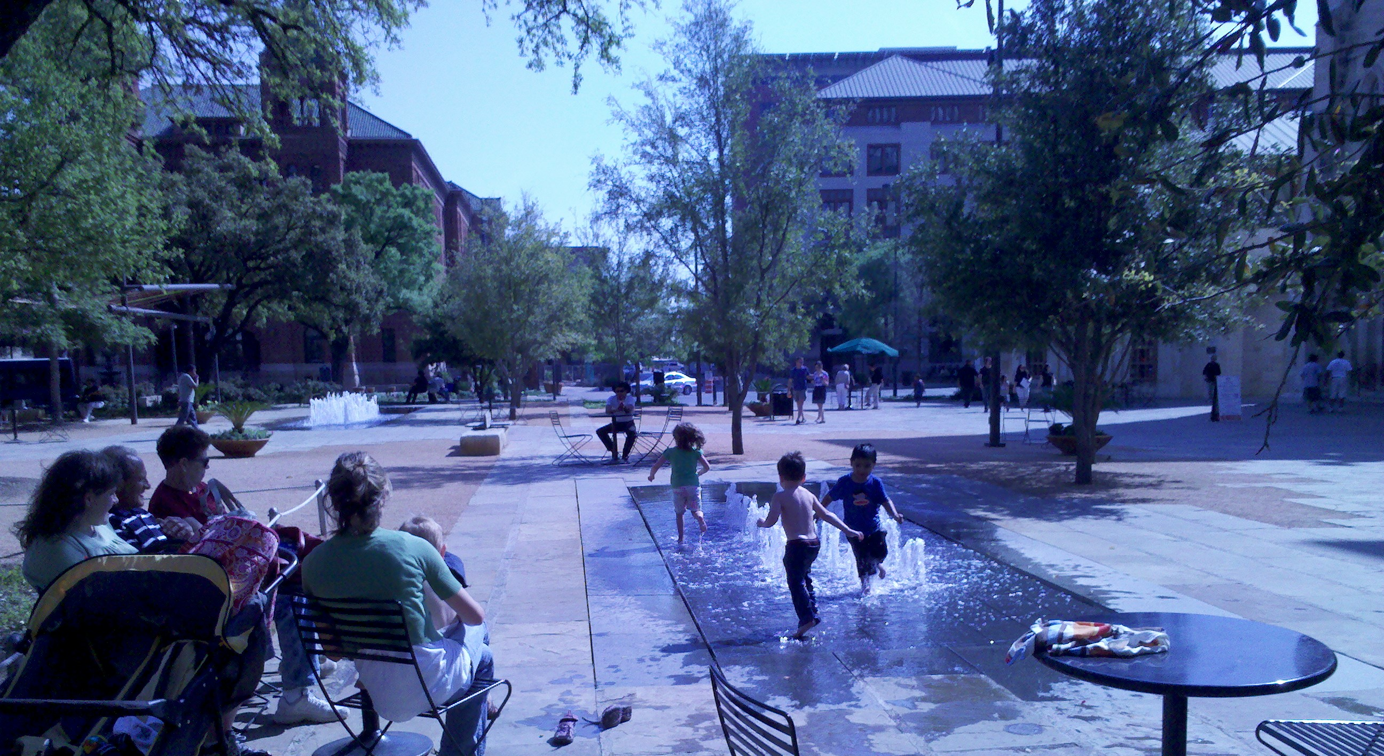


Healthy Communities in Westside San Antonio
Healthy Communities Conference . September 28, 2011
David Clear
Healthy Kids, Healthy Communities Coordinator
San Antonio Metropolitan Health District

Slide 2
A Healthy Kids Snapshot
4 Year, $360,000 grant to reverse childhood obesity
Target area is Westside, San Antonio
Healthy Kids has a strong partnership structure
Focused on policy & environmental changes
Focused on both physical activity & nutrition-related initiatives
Notes:
Hispanic (76%) and African American (72%) residents in Bexar County are disproportionately overweight or obese compared to Whites (61%)
Hispanics are fastest growing segment of U.S. and Bexar County Population
Correlations exist between poverty, poor educational performance and obesity

Slide 3
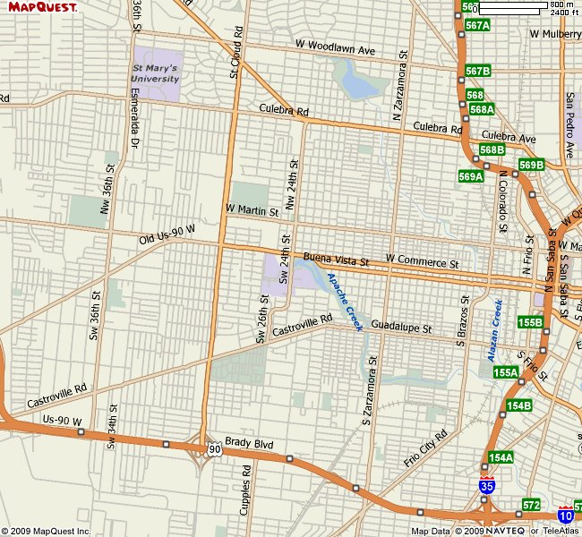
HEALTHY KIDS, HEALTHY COMMUNITIES:
Target Area: Westside, San Antonio
106,000 people
95% Hispanic
58% without high school diploma
33% living below poverty in 2000
23% of WIC kids overweight/obese (across S.A.)
Notes:
BOUNDARIES OF WESTSIDE DEVELOPMENT CORPORATION:
WEST=Acme/36th St., NORTH=Cincinnati, EAST=San Saba, SOUTH=Hwy 90
ABOUT TARGET POPULATION:
106,000 residents
Two school districts, the San Antonio Independent School District (SAISD) and Edgewood Independent School District (EISD)
Racial/ethnic composition: 63% White, 2% African American, 35% other or multiple races, 95% are identified as Hispanic
Young population with 69% under the age of 45
As of 2000, 35% of the population had less than a ninth grade education and 58% did not have a high school diploma
Estimated per capita income of $9,925 and a median household income of $25,160
33% of the population was living below the poverty line as of 2000
The projected unemployment rate in 2007 was nearly 13%, with most of those employed working in blue-collar jobs
ABOUT OBESITY IN BEXAR COUNTY:
2/3 of adult population is overweight or obese
Of 47,844 WIC clients across San Antonio in 2007, 11.3% of children were at risk for being overweight and 11.3% were overweight
In 2007, BMI measured among 19,045 SAISD students, 29% had a BMI greater than the 95th-percentile
2007 YRBSS survey administered at 8 SAISD high schools (1,317 students) found 19.1% of students were overweight and 20.2% were obese

Slide 4


Where is Metro Health Now ?
Healthy Kids Healthy Communities
  Childhood Obesity Prevention targeting the West Side
Mayor’s Fitness Council
Communities Putting Prevention to Work (CPPW)
  Find Your Balance (SABalance.org)
Community Diabetes Project
Notes:
Funding awarded to implement evidence-based policy, environmental and system change to increase active living and healthy eating
HKHC
Expanding shared use of schools and other public facilities in the target area for after-hours use for physical activity
Implementing a Complete Streets policy for new development and redevelopment projects
Increasing number of Por Vida! Healthy Restaurants in target area, and promoting healthy choices in corner stores
Healthy Corners Stores
Community Garden Pilot initiative
MFC - 12 month $85,000 grant ending on August 31,2011
Funded by TDSHS with a mission to transform San Antonio into a healthier and more active community
Launch San Antonio Mayor’s Fitness Council, mission and logo
Implement two Healthy Schools Summits
Plan and organize Mayor’s Fitness Challenge
Support Fitness in the Parks Initiative
Collaborate with the San Antonio Worksite Wellness Task Force
Develop an interactive health and wellness web portal
Establish four community gardens in collaboration with SAHA
Host a Sustainability Summit to develop a sustainability plan addressing current obesity prevention programs
CPPW -
CDC’s CPPW program awarded 44 grants for a total of $372.8 million to address:
Grant award of $15.6 million
Two year project period March 19, 2009 - March 18, 2012
Funded by HHS and CDC with ARRA stimulus funds to reduce obesity in San Antonio/Bexar County

Slide 5


San Antonio
Healthy Restaurants Coalition

Slide 6
Healthy Restaurants Coalition
City of San Antonio Metropolitan Health District (Metro Health)
San Antonio Restaurant Association
San Antonio Dietetic Association
Restaurateurs, Local Food Writer, Public Health Professionals, Food Distributors

Slide 7
Notes:
Show fantastic menu design.
Point out little pequin logo.

Slide 8

Por Vida Nutrition Criteria
Entrée + 2 Sides
  ≤ 700 Calories
  ≤ 23g Total Fat
  ≤ 8g Saturated Fat
  ≤ 0.5g Trans-Fat
  ≤ 750mg Sodium
Entrée
  ≤ 300 Calories
  ≤ 10g Total Fat
  ≤ 3.5g Saturated Fat
  ≤ 0.5g Trans-Fat
  ≤ 325mg Sodium
Side Item
  ≤ 200 Calories
  ≤ 7g Total Fat
  ≤ 2g Saturated Fat
  ≤ 0.5g Trans-Fat
  ≤ 215mg Sodium

Slide 9
Children’s Menu Criteria
Category | Options | Recommendations
Fruits | Serve one or more serving of fruit | ● Fresh Fruit ● Canned Fruit: must be in natural juice or light syrup ● Examples: Fruit Cup, Applesauce, Strawberries, Mandarin Oranges
Vegetables | Serve one or more serving of vegetable | ● non-fried vegetables ● vegetables can be served as side dish or prepared in meal ● Examples: Side Salad, Green Beans, Carrots, Broccoli, grilled vegetable medley
Non fried foods | Serve a variety of non fried entrée items | ● Offer a variety of baked, grilled, or sautéed entrée items
No Sugar Sweetened Beverages | Offer a variety of No Sugar Sweetened Beverages | ● 100% Real Fruit Juice ● Low Fat Milk ● Water
Portion size | Offer children’s portion size of entrées and side items to be ≤ 75% of adult portion size | ● see Children’s Portion Control plate for more details
Notes:
"The children's menu should follow all of the categories highlighted in yellow. Por Vida also encourages to follow the category highlighted in blue, but it is not required."

Slide 10







Por Vida Restaurants

Slide 11







Por Vida Restaurants

Slide 12
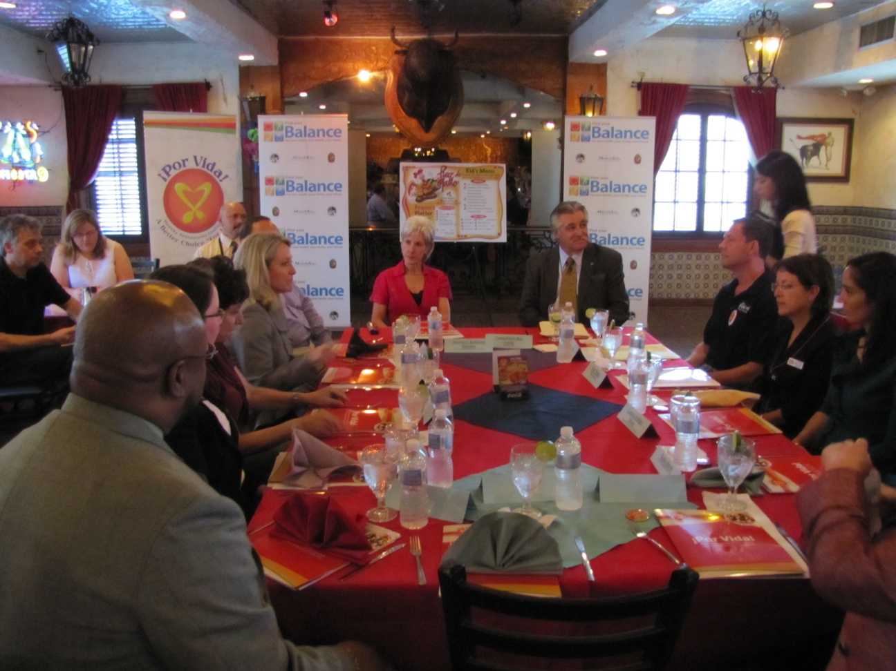
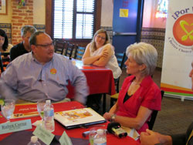

Slide 13

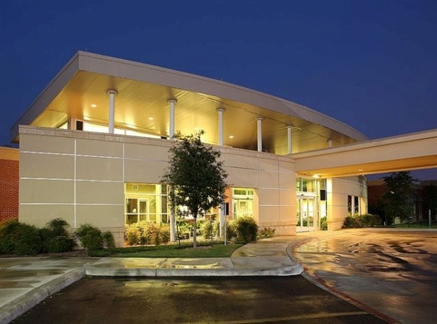
Por Vida expands its reach
LifeCare Hospitals of San Antonio is proud to be the first hospital in San Antonio to offer healthy menu options as a part of the ¡Por Vida!
LifeCare Hospital is an acute care facility that treats medically complex patients who require intensive hospital care for an extended period of time

Slide 14




Summer Camp
Sample Menu 2010/2011
The COSA Parks & Recreation Department’s Summer Camp program supplies hot lunches and an afternoon snack to 7,000-10,000 children each weekday from
June 13 – August 5, 2011
The nutritional value of this menu was enhanced with additional whole grains, reduced saturated fat, and lower sodium content.
Additional criteria were utilized to ensure vitamin A sources are present at least twice a week, vitamin C sources are in the menu daily, and fruit juice is served no more than once a day.
Before | After
Meal: Chopped BBQ Beef (3 oz.) on Whole Wheat Bun Pinto beans (1/2 cup) Mixed vegetables (1/2 cup) 1% milk (8 oz.) Snack: Granola bar, plain (50 gm) Seasonal fresh fruit 100% apple juice (6 oz.) | Meal: Grilled pork (3 oz.) Low sodium stuffing (1/2 cup) Mixed California Blend Vegetables (1/2 cup) Warm spiced fruit (1/2 cup) 1% milk (8 oz.) Snack: Whole Grain Banana Bran Muffin (2 oz.) Seasonal fresh fruit 100% apple juice (6 oz.)
Children’s calorie & nutrient needs vary drastically by age, therefore this menu incorporates healthy choices and balanced meals.
Notes:
This menu cycle meets the USDA’s Summer Food Service Program (SFSP) Meal Pattern requirements.

Slide 15



Funding for Por Vida
Healthy Kids Healthy Communities: Robert Wood Johnson Foundation (RWJF)
2009 American Recovery & Reinvestment Act (ARRA)
DSHS Obesity Prevention Project

Slide 16

www.sanantonio.gov/health/porvida

Slide 17
HEALTHY KIDS, HEALTHY COMMUNITIES:
Robert Wood Johnson Foundation (RWJF) Funded Grant
Existing Projects:
  Built Environment initiatives:
    Shared Use Agreements in place in Westside locations
    Complete Streets policy developed community wide
New Projects:
  Greenspace Projects
    Photovoice & 2012 BOND Election
    Hike & Bike Trail
    Community Garden with Expansion Potential
  Healthy Hubs
    Streamline Policy (Farmers Market, Community Gardens, etc.)
    Develop a Plan for 2 Westside ‘Healthy Hubs’
    Economic Development Impact of Greenspace & Mixed Use Development)
Notes:
I would like to take a few minutes to explain the connection between the RWJF and the Healthy Kids Healthy Communities program. As well as introduce you to the Evaluation consultants and the other sites across the country.
17

Slide 18
HKHC: Greenspace
Parks Measured in Acres of Parkland per 1,000 Residents
Nationwide Average = 16 acres per 1,000 residents
How Areas of San Antonio Measure Up:
  Far West - 67.63 (includes Government Canyon)
  East - 57.97 (includes Calaveras Lake & Braunig Lake)
  Northwest - 30.09 (includes many natural areas)
  South - 16.12 (includes SA missions)
  Central - 14.63
  North - 13.79
  Northeast - 9.43
  Far North - 7.91
  Southwest - 5.1
  West - 3.03
Red Text Indicates Below National Average for Parkland

Slide 19
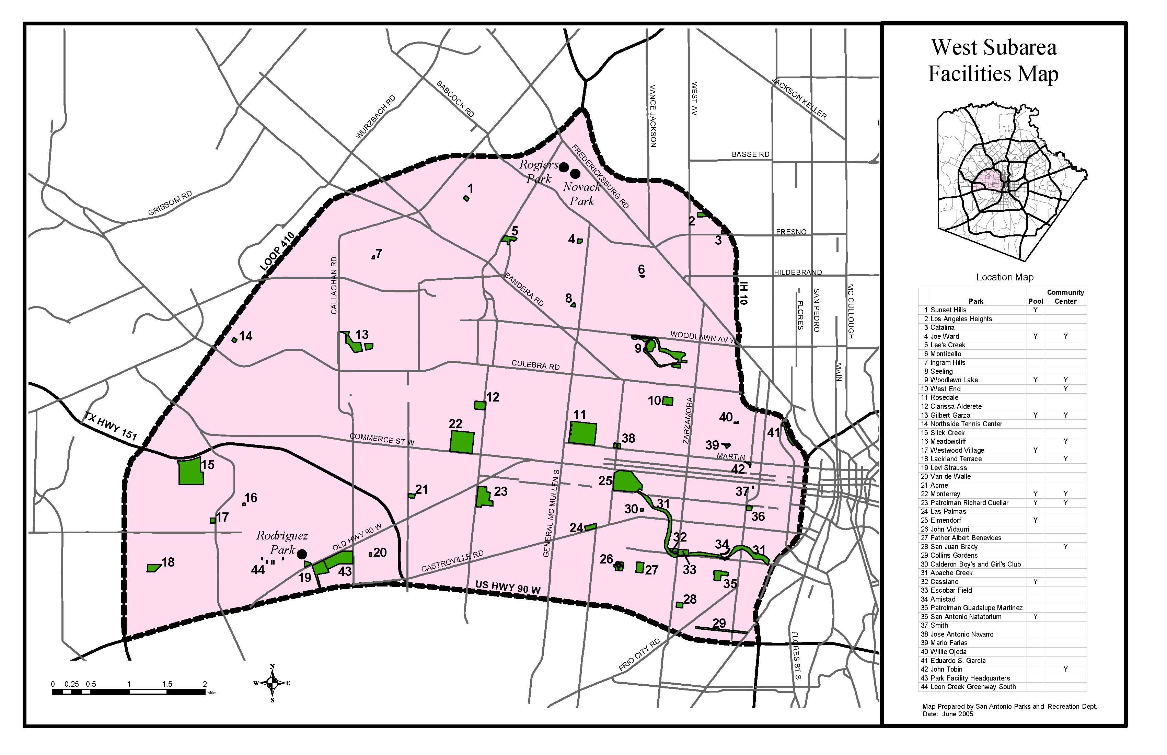
HKHC: Greenspace
How Does That Look In the Community?
Park Desert
Park Desert

Slide 20
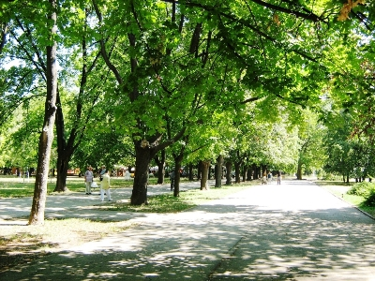
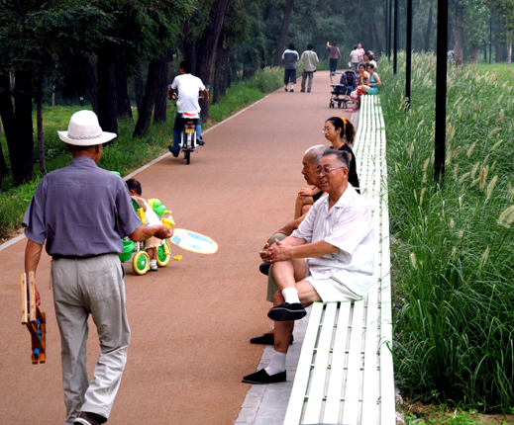
HKHC: Greenspace
Park Access is As Important as Park Acreage
Even a ½ mile (10 minute) walk may not be reasonable if
  There is a Lack of Trees/Shade
  There is a Lack of Sidewalks & Lighting/Safety

Slide 21
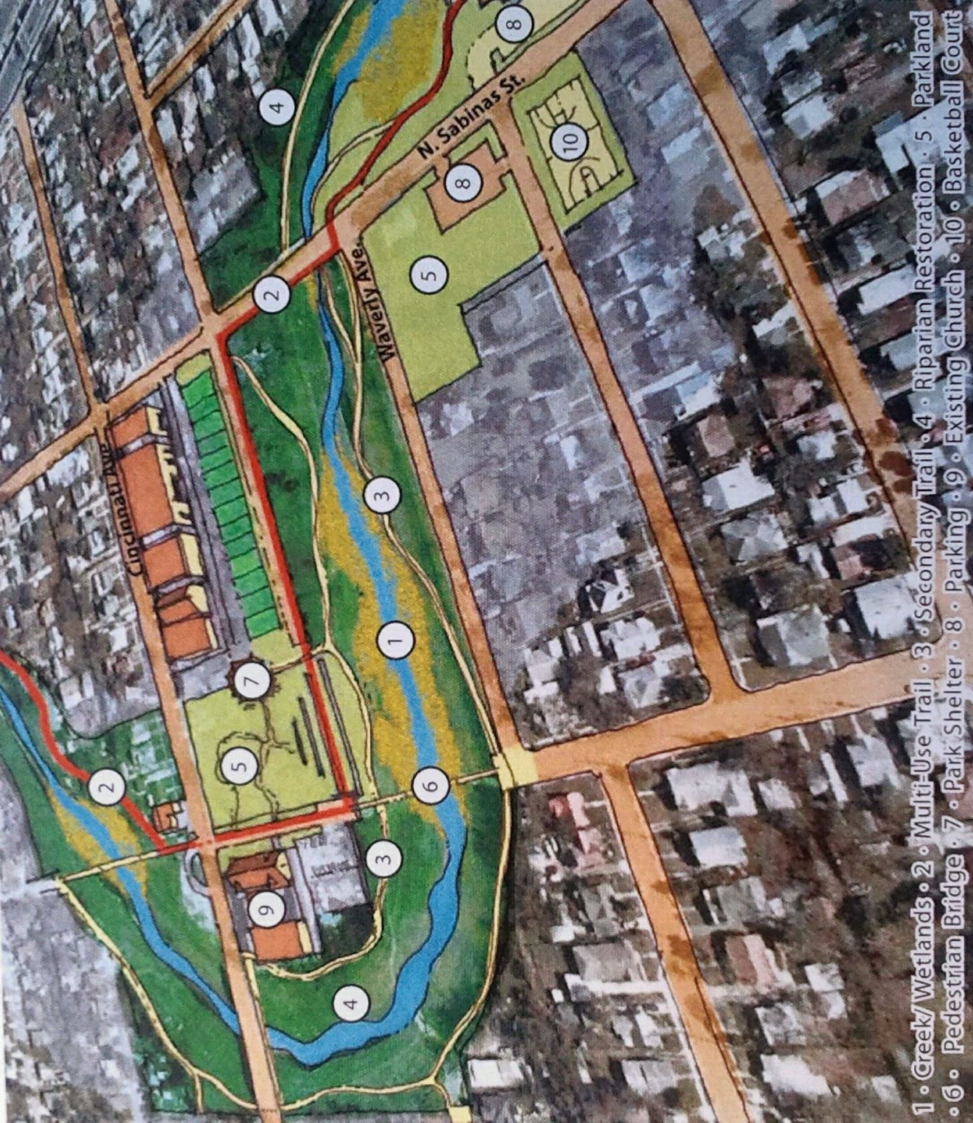
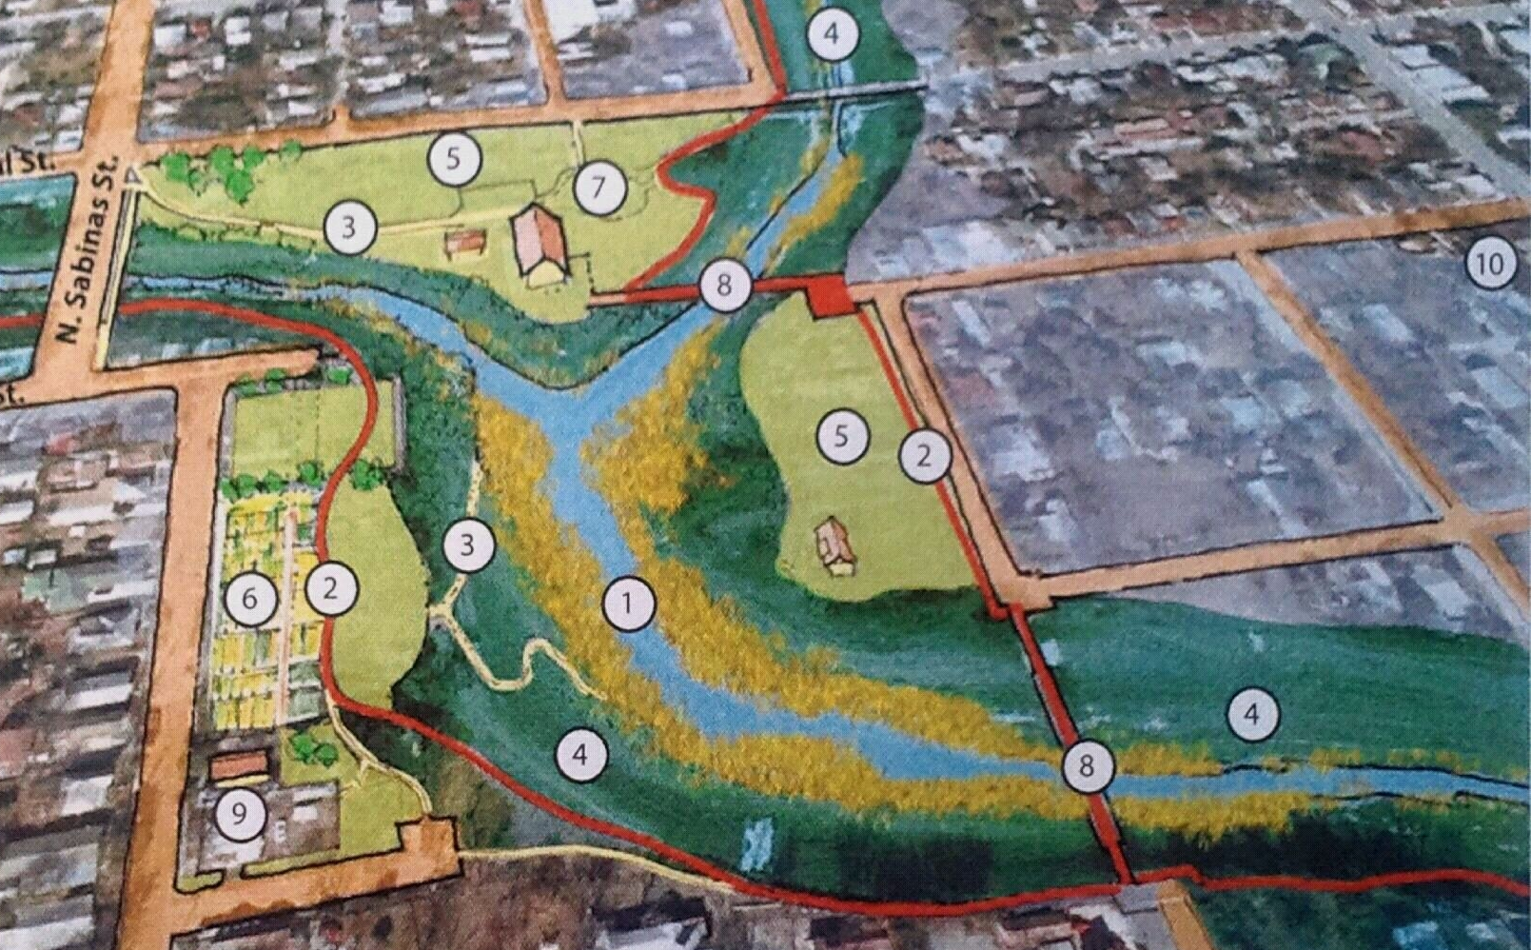
HKHC: Greenspace
New HKHC Partner: San Antonio River Authority (SARA)
New HKHC Partner: San Antonio River Authority (SARA)
Westside Creekway Restoration Concept Plan
  Hike & Bike Trails (Cleaner Air than Streets; Connected to
  Neighborhoods
  New Parkland/Greenspace Areas
  Catalyst Sites
    Community Gardens
    Farmers Markets, Sports Fields & Other Resources

Slide 22
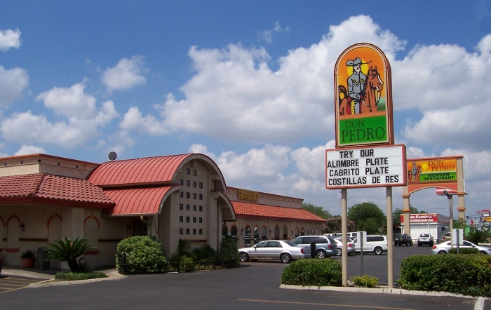
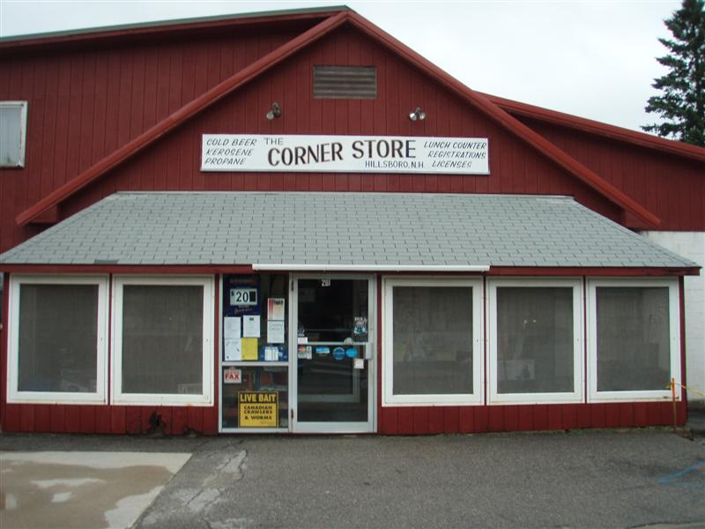
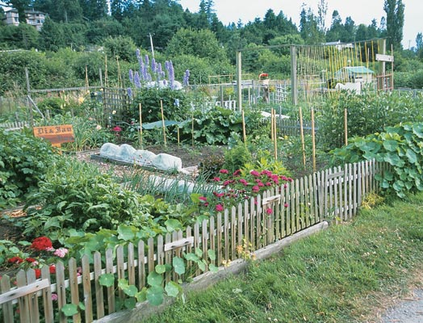
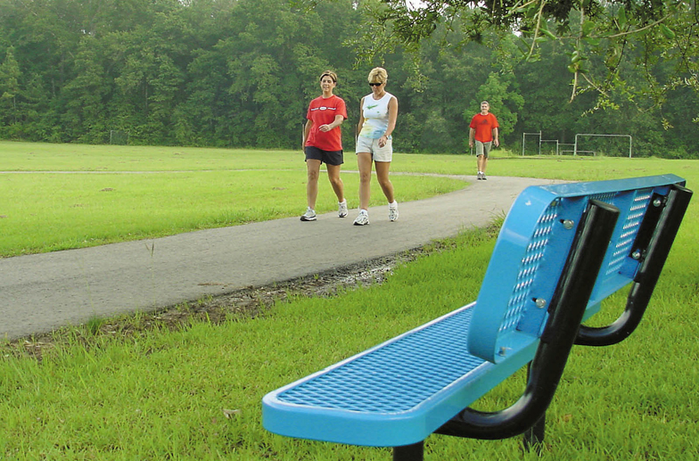
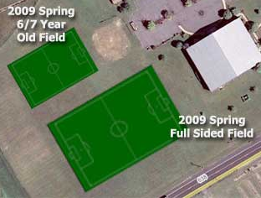
HKHC: Healthy Hub
Nutrition Element:
2. Physical Activity Element:
Restaurants Corner Stores Community Gardens
Fitness Trails/Stations Small Sided Soccer Community Gardens

Slide 23
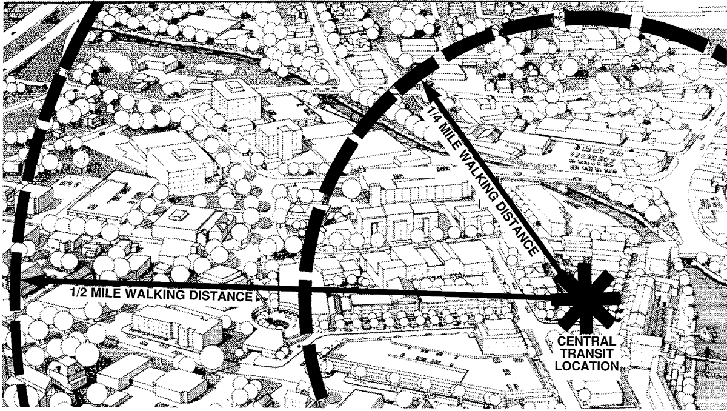
HKHC: Healthy Hub
Walkable:
4. Mixed Use Potential:

Slide 24

Metro Health Project Contacts
David Clear, Senior Management Analyst
332 W. Commerce, SA, TX, 78205
Phone: 207-2002
E-mail: david.clear@sanantonio.gov
Notes:
24
And in case you forget or lose our contact information, it’s included here.
That concludes the formal part of our presentation for today.

