Slide 1
Project RED: The ReEngineered Discharge
Care Transitions: Navigating the Health Care System
AHRQ 2011 Annual Scientific Meeting
Bethesda, Maryland
September 19, 2011
Brian Jack MD
Professor and Vice Chair
Department of Family Medicine /
Boston University School of Medicine

Slide 2
Agenda for Today
Opportunities for improved transitions
Policy implications
RED checklist
Evidence for RED
Dissemination
New AHRQ Toolkit
Challenges to Implementation

Slide 3
“Perfect Storm" of Patient Safety
“Perfect Storm" of Patient Safety
39.5 million hospital discharges per year
Costs totaling $329.2 billion!
Hospital discharge is not-standardized
Loose Ends
Communication
Poor Information
Poor Preparation
Great Variability
Fragmentation
19% of patients have a post-discharge AE
20% of Medicare patients readmitted within 30 days
Notes:
N summary – there is great room for improvement in the hospital discharge.

Slide 4

A Real Discharge Instruction Sheet
Notes:
4

Slide 5
Patient Safety Has Collided with Policy
MedPAC (March ’09)
  Recommends reducing payments to hospitals with high readmission rates
  "Hospitals with high rates of readmission will be paid less if patients are readmitted to the hospital within the same 30-day period saving $26 billion over 10 years“
Patient Protection and Affordable Care Act (2010
  Accountable Care Organizations → begin 1/1/2012
  Expanding Authority to Bundle Payments and Value-Based Purchasing
    www.hospitalcompare.hhs.gov
    MI, CHF, PNA → “Starter Set”
  Payments changes for discharges beginning October 1, 2012.

Slide 6
National Programmatic Activity in Transitions
CMS
  QIOs
    9th Scope of Work -focused demonstrations in Safe Transitions
    Impressive results implementing transitional care interventions
    Now expanded to 50 states
  Partnership for Patients Program
    100 Hospital Engagement Contractors funded to implement 10 evidence based solutions to decrease AEs
  Community Based Care Transitions Program (CCTP or 3026)
    New payment policies to encourage improved transitions
    Hospitals, Providers, Community-based organizations
Office of the National Coordinator for Health IT
  Beacon Communities
  Focus on HIT in bringing transitional care interventions to scale
Public Sector
  Many BIG and small fish – most HIT
  “Transitions” morphing into “care of complex patients”

Slide 7
Principles of the RED:
Creating the Toolkit
Patient
Readmitted
Within
3 Months
Readmission Within
6 Months
Hospital
Discharge
Probabilistic
Risk
Assessment
Process
Mapping
Failure Mode
and Effects
Analysis
Qualitative
Analysis
Root Cause
Analysis
Notes:
7
7

Slide 8
RED Checklist
Eleven mutually reinforcing components:
❶ Medication reconciliation
❷ Reconcile dc plan with National Guidelines
❸ Follow-up appointments
Outstanding tests
❺ Post-discharge services
❻ Written discharge plan
❼ What to do if problem arises
❽ Patient education
❾ Assess patient understanding
❿ Dc summary to PCP
> Telephone Reinforcement
Adopted by
National Quality Forum
as one of 30
"Safe Practices" (SP-11)

Slide 9
Methods- Randomized Controlled Trial
RED Intervention
N=375
30-day
Outcome Data
Telephone Call
EMR Review
Enrollment
N=750
Randomization
Usual Care
N=375
Enrollment Criteria:
English speaking
Have telephone
Able to independently consent
Not admitted from institutionalized setting
Adult medical patients admitted to Boston Medical Center (urban academic safety-net hospital)
Notes:
Usual care at BMC
No policy to make PCP appt for patients
Provided with dc summary, typed out sheet with dc info written
Little instruction, few minutes with nurse/doctor

Slide 10
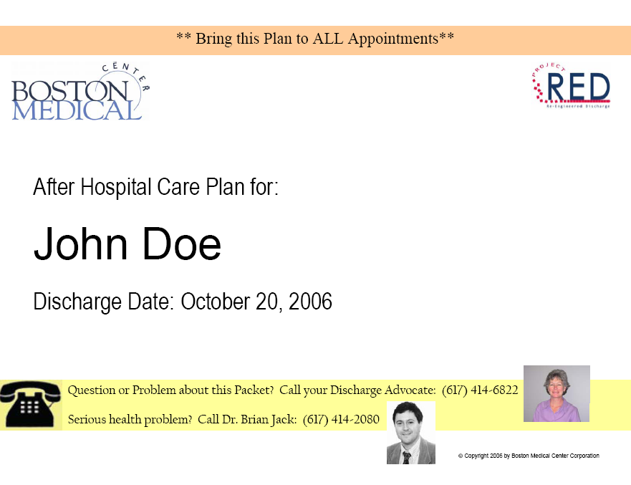
Personalized cover page

Slide 11
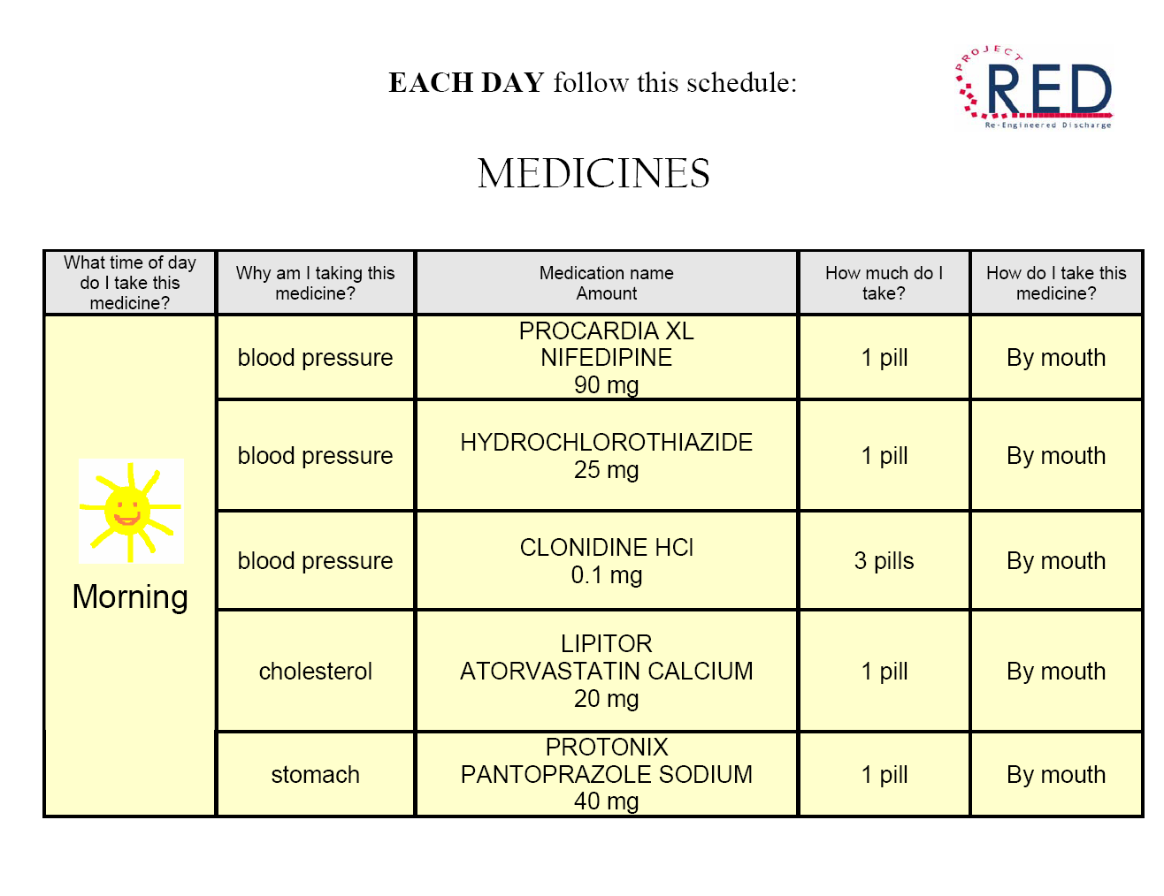
Updated list of all medicines

Slide 12
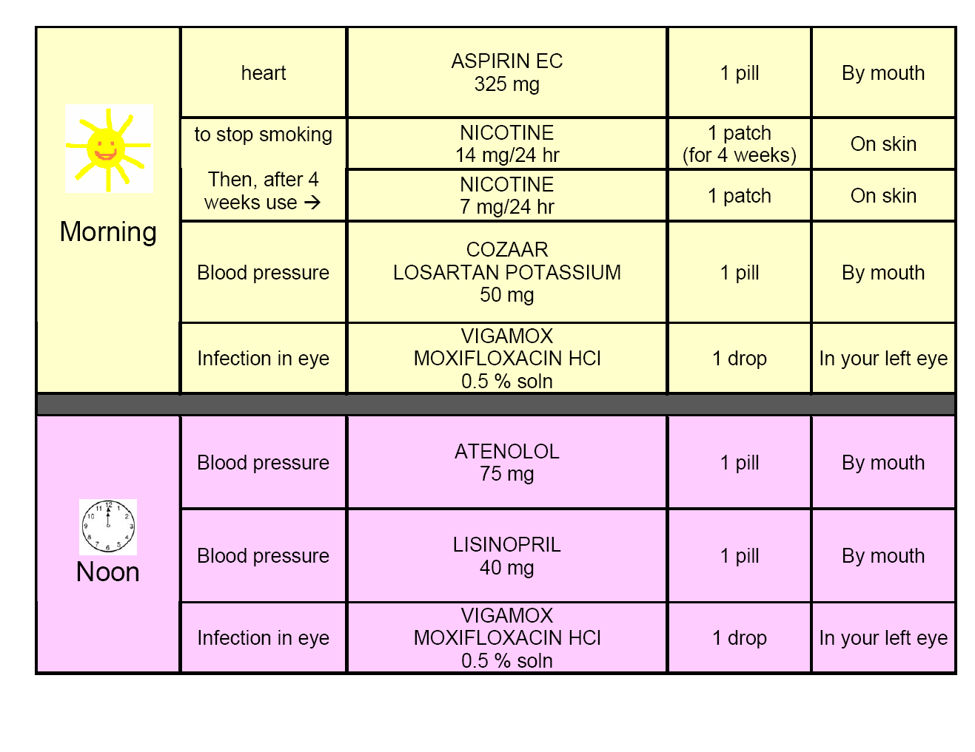
MEDICATION PAGE (2 of 3)

Slide 13
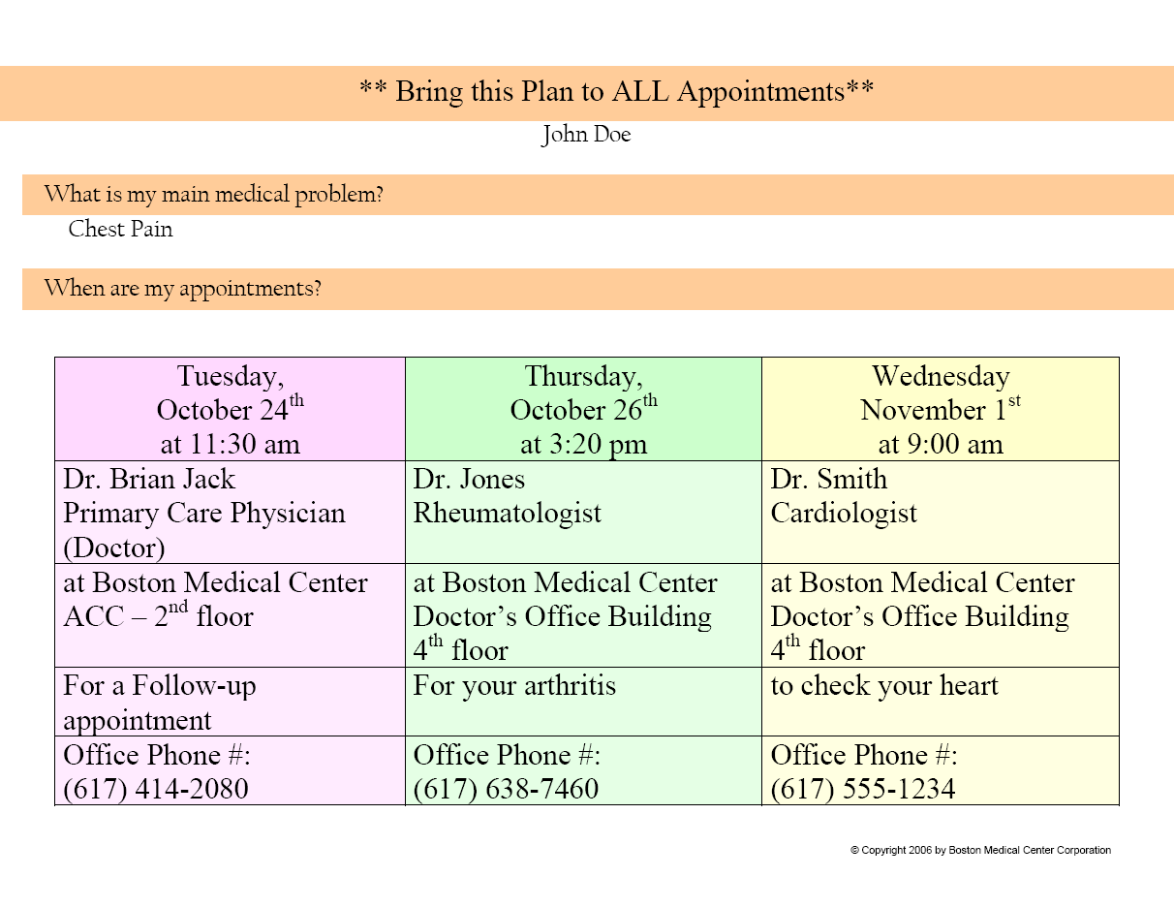
APPOINTMENTS PAGE

Slide 14
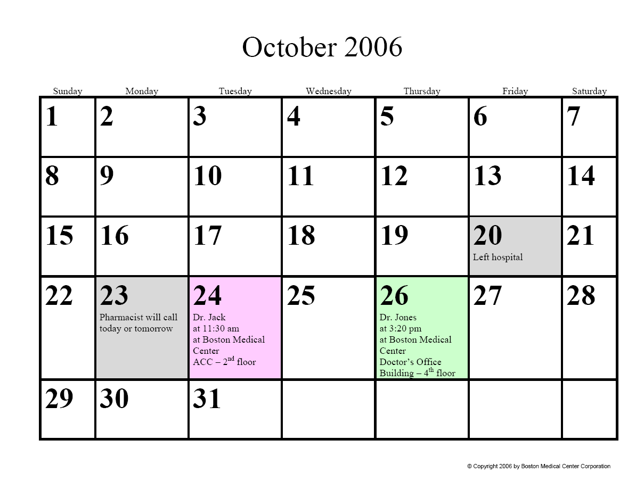
APPOINTMENT CALENDAR

Slide 15
PRIMARY DIAGNOSIS PAGE

Slide 16
Primary Outcome:
Hospital Utilization within 30d after dc
 | Usual Care (n=368) | Intervention (n=370) | P-value
Hospital Utilizations * Total # of visits Rate (visits/patient/month) | 166 0.451 | 116 0.314 | 0.009
ED Visits Total # of visits Rate (visits/patient/month) | 90 0.245 | 61 0.165 | 0.014
Readmissions Total # of visits Rate (visits/patient/month) | 76 0.207 | 55 0.149 | 0.090
* Hospital utilization refers to ED + Readmissions

Slide 17
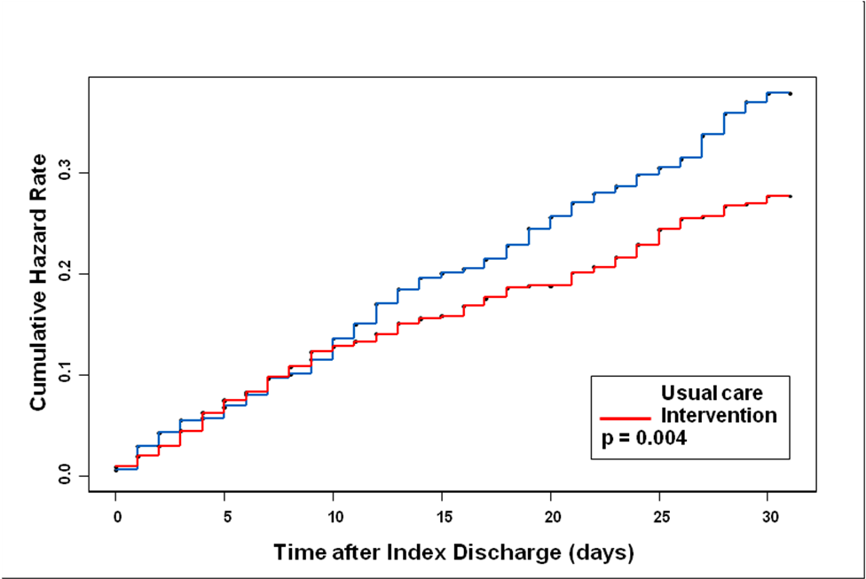
Cumulative Hazard Rate of Patients Experiencing Hospital Utilization
30 days After Index Discharge

Slide 18
Outcome Cost Analysis
Cost (dollars) | Usual Care (n=368) | Intervention (n=370) | Difference
Hospital visits | 412,544 | 268,942 | +143,602
ED visits | 21,389 | 11,285 | +10,104
PCP visits | 8,906 | 12,617 | -3,711
Total cost/group | 442,839 | 292,844 | +149,995
Total cost/subject | 1,203 | 791 | +412
We saved $412 in outcome costs for each patient given RED

Slide 19
Consultations to Implementers
NQF
Joint Commission
AMA
VA
State Hospital Associations
AHA - H2H
IHI / Commonwealth Fund - STARS
Society Hospital Medicine – BOOST
NAPH
Many Health Plans
Private Companies

Slide 20
Dissemination
AHRQ webinar in 2009 - 2,200 hospitals
Website diagnostics – 28,530 hits in last 12 months
Direct Hospital “Reverse Detailing” of Best Practices
Contract to JCR to implement at 50 Hospitals, renewed for 250 more

Slide 21
AHRQ Contract to Study Dissemination
  Toolkit
    Overview of the Toolkit. Why is this Important?
    How to Begin Implementation at Your Hospital
    How to Deliver RED
    How to Conduct a Post-discharge Follow-up Phone Call
    How To Benchmark Your Improvement Process
    How to Deliver RED to Diverse Populations
  10 hospital beta sites across country
    Does RED work in the real world?
    What works? What doesn’t? What are the barriers?
    How to Adapt RED for diverse populations

Slide 22
Barriers to High Quality Transitions
Lack of resources
“Heads on Beds”
Delayed discharge
Discharge receives low priority
Last minute test / consultations
Communication with PCP is low priority
Language and health literacy issues
Substance abuse/depression

Slide 23
Barriers to RED
Who serves as the Discharge Educator?
Who does the 2 day phone call?
How is the AHCP produced?
Can dc summaries be done in 1-2 days?
Who does med rec?
Can appointments be made?

Slide 24
Role of Senior Leadership
Align with organization’s strategies & priorities
Set the vision and the goal
Communicate Commitment
  Newsletter, grand rounds, M+M, RCA, emails
Provide resources & staff
Create implementation team
Set policies to integrate across organizational boundaries
Get IT on board
Hold people accountable
Recognize and reward success
24
Notes:
24

Slide 25
Role of Implementation Team
Recruit a collaborative, interdisciplinary team
Identify process owners and change champions
Staff Engagement
  Energize staff
  Get buy-in
Build skills to support and sustain improvement
Trouble shoot as RED is rolled out
Monitor progress to provide feedback
Monitor sustainability
25
Notes:
25

Slide 26
Changing the Culture of Hospitals is Hard
“Culture Eats Strategy for Lunch”

Slide 27

Thank you!
brian.jack@bmc.org
http://www.bu.edu/fammed/projectred/

Slide 28
How to Get Started
Step 1: Make a clear and decisive statement and get buy in
Step 2: Appoint team leader
Step 3: Constitute implementation team
Step 4: Analyze current discharge process and rehospitalization rate
Notes:
28
28

Slide 29
How to Get Started - 2
Step 5: Establish goals. What is the target rehospitalization rate?
Step 6: Establish timeline
Step 7: Identify the target patient population
Step 8: Decide how to fulfill the role of discharge educator
Step 9: Identify approach for follow up phone calls
Notes:
29
29

Slide 30
How to Get Started - 3
Step 10: Determine how to train DE & phone call staff
Step 11: Decide how to generate ‘AHCP’
Step 12: Adapt transitions of care for low health literacy and LEP patients
Step 13: Decide How and What to Measure
Step 14: Monitor and Feedback Process and Outcome Measures

Slide 31
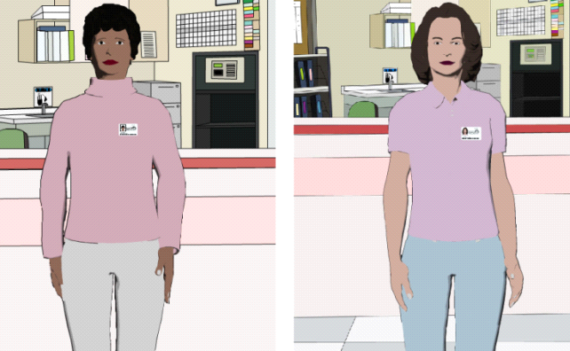
Using Health IT to Overcome Challenge of RN Time
Embodied Conversational Agents
  Emulate face-to-face communication
  Develop therapeutic alliance using empathy, gaze, posture, gesture
  Teach RED
  Determine Competency
  Can drill down
  Maps of CHCs
  High Risk Meds
  Lovenox
  Insulin
  Prednisone taper
Characters: Louise (L) and Elizabeth (R)

Slide 32

Patient Interacting with Louise

Slide 33
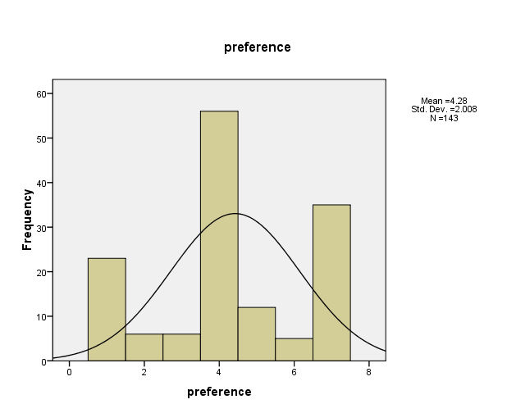
Who Would You Rather Receive Discharge Instructions From?
36% prefer agent
48% neutral
16% prefer doc or nurse
“I prefer Louise, she’s better than a doctor, she explains more, and doctors are always in a hurry.”
“It was just like a nurse, actually better, because sometimes a nurse just gives you the paper and says ‘Here you go.’ Elizabeth explains everything.”
1=definitely prefer doc, 4=neutral, 7=definitely prefer agent
Notes:
33

Slide 34


Slide 35
PATIENT ACTIVATION PAGE

Slide 36
The Importance of
Organizational Context
Support of senior leader
Implementation team that engages frontline staff
Redesign work processes
Monitored Progress
36
Notes:
36

