Slide 1



Slide 2
The National Health Service Corps (NHSC)
builds healthy communities by supporting qualified health care providers dedicated to working in areas of the United States with limited access to care.

Slide 3

A network of close to 10,000 primary health care professionals and 14,000 sites*
*As of July 2012

Slide 4
The NHSC provides financial support to providers in exchange for working at NHSC-approved sites.
Students to service
Loan
Repayment
Loan
Repayment
Scholarship
Program
Program
Program

Slide 5
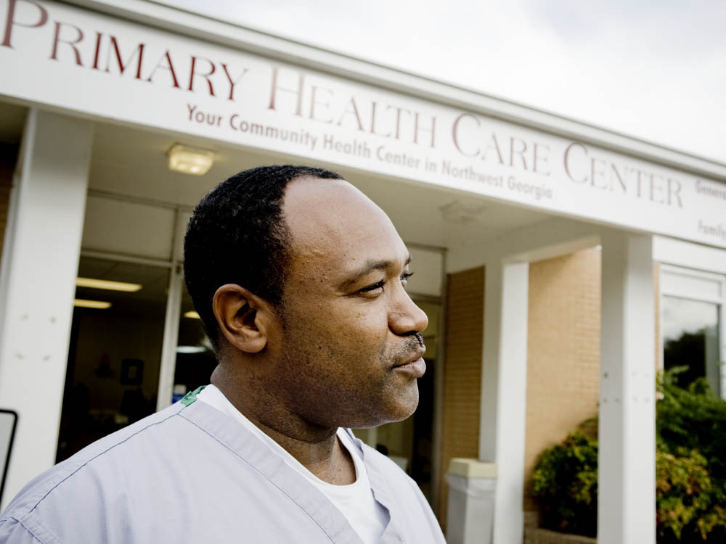
NHSC sites
Apply to join the NHSC network of approved sites
Are located in communities that have limited access to health care
Allow NHSC providers to fulfill their service commitments

Slide 6
Bureau of clinician recruitment and service
The NHSC falls within HRSA’s Bureau of Clinician Recruitment and Service (BCRS)
BCRS coordinates the recruitment and retention
of health professionals to
work in medically
underserved communities
Department of Health
and Human Services (HHS)
Health Resources and Services Administration (HRSA)
Bureau of Clinician Recruitment and Service (BCRS)

Slide 7
Native Hawaiian Health Scholarship Program
NHHSP
National Health
Service Corps
Scholarship
Program
Nursing Scholarship Program
NHSC
sP
NSP
Nursing Education
Loan Repayment Program
BCRS
National Health
Service Corps
Loan repayment
Program
NHSC
lrP
NELRP
National Health
Service Corps
Students to service loan repayment program (pilot)
Faculty Loan Repayment Program
NHSC
S2S
FLRP
NHSC
SLRP
State Loan Repayment Program

Slide 8

History of the Corps

Slide 9
The NHSC was created in response to the health care crisis that emerged in the United States in the 1950s and 1960s when retiring physicians left many areas of the country without medical services.

Slide 10
1970s
1980s
1990s
2000s
NHSC created
First scholarships
Grew from 181 providers to
over 1,800
Budget 10 times larger by end of decade
Loan Repayment Program (LRP) launched
Predicted physician surplus—budget reduced
Field strength at 1,500 by 1989
Early 1990s —
Only 1,000 providers serve
Mental health disciplines
added to LRP
Over 2,500 providers in service by end
of decade
Recovery Act and Health Care Reform —increased funding
Unprecedented growth in field strength
A network of close to 10,000 providers*
*As of July 2012

Slide 11

NHSC Today

Slide 12
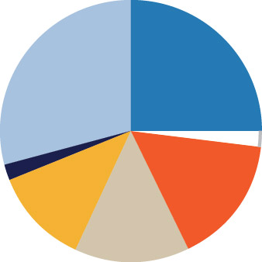
NHSC Field Strength*
29%
25%
Mental Health Providers
Physicians
Nurse Midwives • 2%
Nurse Practitioners
2% • Dental Hygienists
Dentists
14%
12%
16%
Physician Assistants
*As of Sept. 30, 2011
Close to 10,000 NHSC primary care providers are working in communities with limited access to health care nationwide.

Slide 13
Fast facts
NHSC members are currently providing care to more than 9.5 million people in the United States
Networking and other educational resources are available to support NHSC providers during their service
The number of in service providers has more than doubled since 2008

Slide 14

Loan Repayment
Program
(LRP)

Slide 15

An opportunity to pay off student loans while providing care to communities in need

Slide 16
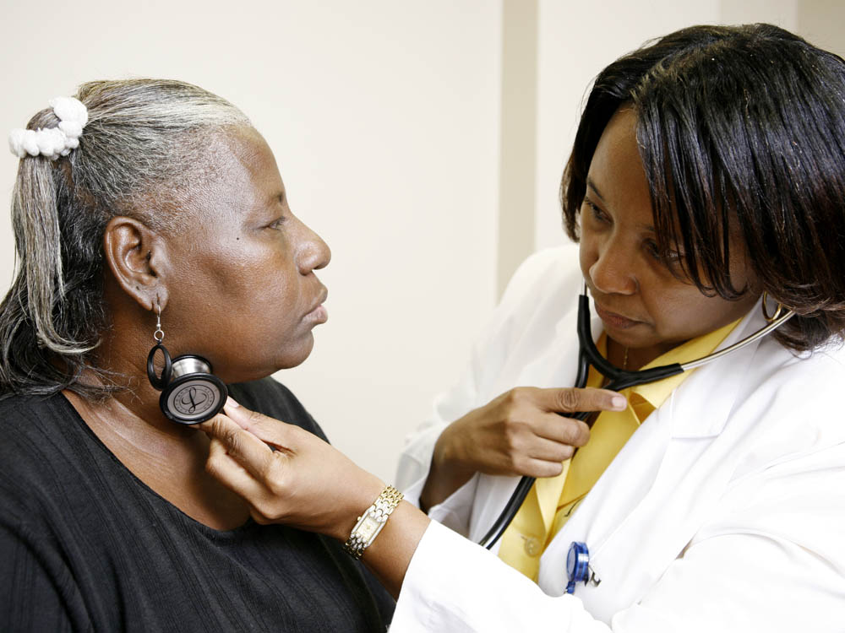
Offers both full-time
and part-time options

Slide 17

“At the end of the
day when I leave the office, I get a sense of satisfaction that
I have made a difference in the
lives of my patients.”
~ Patrick Antoine, NHSC member

Slide 18
Up to
Up to
$60,000
$170,000
2 yearS
5 yearS
The full-time program offers up to $60,000 in tax-free loan repayment for 2 years of service, and up to $170,000 for a 5-year service commitment.
With continued service beyond 5 years, health care providers may be able to pay off all their student loans.

Slide 19
Providers receive loan repayment in addition to a competitive salary from their employers: NHSC-approved sites
1
2
Providers find a job at an NHSC-approved site
Apply to the
NHSC for loan repayment
Then

Slide 20
NHSC Jobs center
Job seekers search for NHSC sites with and without current job openings
Sites showcase photos of their site and community images
Google based mapping makes it easy for job seekers to find schools, places of worship and other community amenities near a site
Details about each site are listed such as languages spoken by patients, specialties offered, size of practice, and more

Slide 21
Loan Repayment Award
The NHSC Loan Repayment Program offers two levels of funding, based upon the need of the community in which a provider works,
as defined by Health Professional Shortage Area (HPSA) score
Initial Award Amounts
 | 2 Years Full-time | 4 Years Half-time | 2 Years Half-time
Sites with HPSA Score of 14+ | Up to $60,000 | Up to $60,000 | Up to $30,000
Sites with HPSA Score of 0-13 | Up to $40,000 | Up to $40,000 | Up to $20,000
With continued service, NHSC providers may be able to pay off all of their student loans.

Slide 22
Additional Benefits
  A portion of service obligation can be fulfilled by teaching
  Face-to-face and virtual networking opportunities provide support from other providers and community resources
  Educational support including access to free CEU courses
  Rewarding patient relationships

Slide 23

An opportunity to be part of something bigger than yourself

Slide 24
Eligibility
U.S. citizen or national
Currently work, or applying to work, at an NHSC-approved site
Have unpaid government or commercial loans for school tuition, reasonable educational expenses, and reasonable living expenses, segregated from all other debts
Licensed to practice in state where employer site is located

Slide 25

Eligible
Must be licensed in
one of the following
disciplines

Slide 26

Physician (MD or DO)
Nurse practitioner (primary care)
Certified nurse-midwife
Physician assistant

Slide 27

Dentist
(general or pediatric)
Dental hygienist

Slide 28

Psychiatrist
Psychologist
(health service)
Licensed clinical
social worker
Psychiatric nurse specialist
Marriage and
family therapist
Licensed professional counselor

Slide 29
How to apply?
1
2
3
Review the Application and Program Guidance
Find a job at an NHSC-approved
site or find out if your current job is at an NHSC-approved site
Apply online at NHSC.hrsa.gov/
loanrepayment
nhscjobs.hrsa.gov

Slide 30

Learn more at
NHSC.hrsa.gov/loanrepayment

Slide 31

Scholarship
Program
(SP)

Slide 32
Students pursuing careers in primary care can receive a scholarship now and serve later.
The scholarship* includes:
  Payment of tuition and required fees (tax-free)
  Some other tax-free educational costs
  (books, etc.)
  A monthly living stipend (taxable)
*available for up to 4 years

Slide 33

“We bring health care to people who otherwise wouldn’t have access. That’s what inspired me. It’s filling a void. It’s filling a need that is very much there.”
~ Kristen Frank, NHSC Scholar

Slide 34
YEARS OF
=
YEARS OF
SUPPORT
SERVICE
Scholars commit to serve in the Corps upon completion of their training — one year for each year of support (at least 2 years).

Slide 35

Scholars choose where they will serve from a list of close to 14,000 NHSC-approved sites
in high-need rural, urban, and frontier areas.

Slide 36
Additional Benefits
  A portion of service obligation can be fulfilled by teaching
  Face-to-face and virtual networking opportunities provide support from other providers and community resources
  Educational support including access to free CEU courses once in service
  Rewarding patient relationships

Slide 37
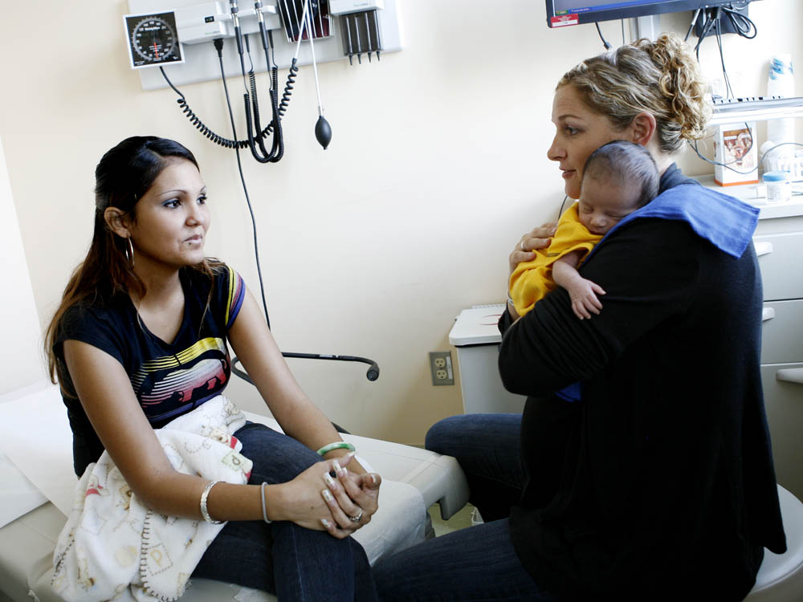
An opportunity to be part of something bigger than yourself

Slide 38
Eligibility
U.S. citizen or national
Full-time student at an accredited school, pursuing a degree in:
    Medicine (DO or MD)
    Dentistry (DMD or DDS)
    Nurse practitioner
    Certified nurse-midwife
    Physician assistant (primary care)

Slide 39
How to apply
1
2
Review the Application and Program Guidance
Apply online at NHSC.hrsa.gov

Slide 40
Learn more at
NHSC.hrsa.gov/scholarships

Slide 41
Students to Service Loan Repayment Program
(S2S LRP)

Slide 42
Up to
Up to
$120,000
$120,000
3 yearS
Full-Time Service
6 yearS
Part-time service
The NHSC offers up to $120,000 in tax-free loan repayment for 3 years of full-time or 6 years of half-time service.
With continued service, eligible providers may be able to pay off all their student loans.

Slide 43
Eligibility
U.S. citizen or national
Full-time student in the last year at an accredited school, pursuing a degree in Medicine (MD or DO)
Planning to complete an accredited primary medical care residency in an NHSC-approved specialty (Internal Medicine, Family Practice, Pediatrics, OB/GYN, and Geriatrics)
Have unpaid government or commercial loans for school tuition, reasonable educational expenses, and reasonable living expenses, segregated from all other debts

Slide 44
awards
100 awards planned
The NHSC will give funding preference to applicants who:
  Come from a disadvantaged background
  Display characteristics that indicate a higher likelihood of continuing to serve in an underserved area once their service commitment is complete

Slide 45
How to apply
1
2
Review the Application and Program Guidance
Apply online at NHSC.hrsa.gov/loanrepayment/studentstoservice.htm

Slide 46
Learn more at
NHSC.hrsa.gov/loanrepayment/studentstoservice.htm

Slide 47

NHSC
Sites

Slide 48

Health care practice sites apply to the NHSC to participate in the NHSC loan repayment and scholarship programs.

Slide 49
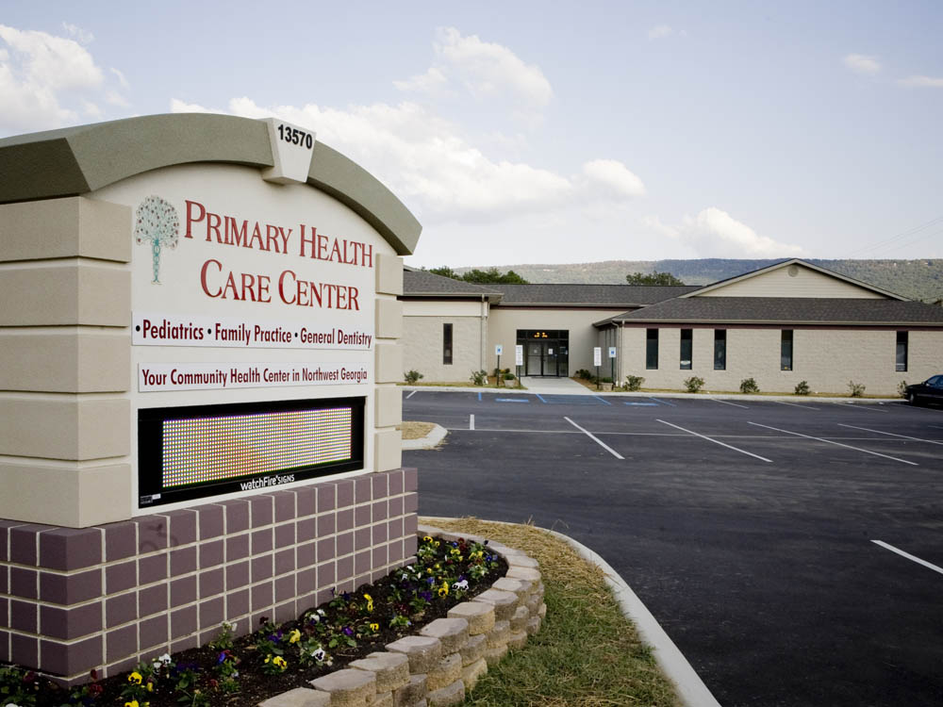
NHSC-approved sites enable NHSC providers to fulfill their service obligations.

Slide 50

“The NHSC clinicians working here are some of the most committed, dedicated, mission-driven people I have ever worked with in my life.”
~ Larry Gottlieb, NHSC-approved Site Administrator

Slide 51
Benefits
Recruit
providers and residents dedicated to working where they are needed most
Post clinical vacancies on the NHSC online national recruitment database
Network with other NHSC-approved sites
Establish
an integrated system of care that includes the uninsured and underinsured
Receive community and site development assistance
Develop linkages with academic institutions and other organizations

Slide 52

Eligible Types of Sites
Federally qualified health center (FQHC)
Federally qualified health center look-alike
Certified rural health clinic
Hospital-affiliated primary care out-patient clinic
Indian Health Service, Tribal Clinic, and Urban Indian Health Clinic (ITU)
State or Federal Correctional Facility
Private Practice (Solo/Group)
Other Health Facility

Slide 53
Eligibility
Site must be
    Located in a federally designated Health Professional Shortage Area (HPSA)
        A geographic area, population group,
        or health care facility that has been designated by HRSA as having a
        shortage of health professionals
    See all patients regardless of ability to pay
    Provide services on a discount fee schedule

Slide 54
Eligibility
Site must
    Accept patients covered by Medicare, Medicaid, and the Children’s Health Insurance Program
    Not discriminate in the provision of services
    Document sound fiscal management
    Have capacity to maintain a competitive salary, benefits, and malpractice coverage package for providers

Slide 55
How to apply
1
2
3
Contact the appropriate State Primary Care Office
Complete and submit the Site Application
Complete and submit the Site Profile Form

Slide 56
Learn more at
NHSC.hrsa.gov/communities

Slide 57

State Loan Repayment Program
(SLRP)

Slide 58

BCRS provides matching funds to more than 30 states to operate their own loan repayment programs for primary care providers.

Slide 59
  SLRP and NHSC LRP complement each other in reaching the goal of improving access to health care in underserved communities
  SLRP varies state to state and also as compared to the NHSC in:
    Approved disciplines
    Length of service commitment
    Amount of contract offered
    Ability to utilize alternative funding sources

Slide 60
Learn more at
NHSC.hrsa.gov/loanrepayment/stateloanrepaymentprogram.index.html

Slide 61

Nursing Education Loan Repayment Program
(NELRP)

Slide 62

Loan repayment assistance is available to registered nurses and advanced practice registered nurses, such as nurse practitioners, working in a Critical Shortage Facility OR nursing faculty employed by an accredited school of nursing.
NELRP program participants receive 60 percent of their total outstanding qualifying educational loan balance incurred while pursuing an education in nursing for a two-year service commitment.
Qualifying NELRP participants may receive an additional 25 percent of their original loan balance for a third year of service.

Slide 63
Eligibility
  Be a U.S. citizen, U.S. national or lawful permanent resident;
  Be a registered nurse, advanced practice registered nurse, such as a nurse practitioner, or nurse faculty with a diploma, associate’s, bachelor’s, master’s, or doctoral degree in nursing;
  Be employed full-time (at least 32 hours per week) at a public or private, non-profit Critical Shortage Facility OR be employed full-time at an accredited, public or private, non-profit school of nursing;
  Have completed the program for which the loan applies.

Slide 64


Service Commitment
2+1
32 hours per week,
for at least 45 weeks
per year as an RN or an advanced practice nurse employed at a Critical Shortage Facility
2-year minimum with an optional 3rd year
Full-time nurse faculty may work at an accredited public or private nonprofit school of nursing

Slide 65
Critical Shortage Facilities
NELRP Loan Recipients serve at Critical Shortage Facilities (CSF). These are health care facilities with a critical shortage of nurses located in underserved communities. Approved NELRP sites have a primary medical care or mental health Health Professional Shortage score.
HPSA: A geographic area, population group, or health care facility that has been designed by HRSA as having a shortage of health professionals.

Slide 66
For more information on
The nelrp and how to apply, visit:
www.hrsa.gov/loanscholarships/
repayment/nursing/overview.html

Slide 67

Nursing
Scholarship
Program
(NSP)

Slide 68

Nursing students are eligible to receive funding for their education and training in exchange for working at a health care facility with a shortage of nurses, known as a Critical Shortage Facility (CSF).

Slide 69
Eligibility
  Accepted or enrolled in an eligible, registered nursing or accelerated nursing degree program at an accredited school in the United States
    Associate Degree School of Nursing (ADN)
    Collegiate School of Nursing
    (BSN, graduate degree)
Notes:
Notes for Presenter:
50% of NSP funds will be made available for NPs due to increasing demand for NPs
Applicants with an Expected Family Contribution (EFC) of between $0 and $5,550 will be considered as having the greatest financial need and will be given funding preference

Slide 70
Service Commitment
One-year service commitment for each year of scholarship support (with a minimum 2-year service commitment). Maximum of up to 4 years of support.
Serve in a Critical Shortage Facility (CSF)
  Critical Access Hospital
  Disproportionate Share Hospital
  Public Hospital
  FQHC or FQHC Look-Alike
  Indian Health Service Health Center
  Native Hawaiian Health Care System
  Rural Health Clinic
  Skilled Nursing Facility
  State of Local Public Health or Human Service Department

Slide 71
Full-time status part-time status
vs.
  Minimum of 32 hours per week, for at least 45 weeks per year
  Minimum of 26 hours providing clinical services
  to patients
  From 16 to 31 hours per week, for at least 45 weeks
  per year
  At least 80 percent of practice hours each week spent providing clinical services to patients

Slide 72
Critical shortage facility
NSP Scholars complete their service commitment at a Critical Shortage Facilities (CSF). These are health care facilities with a critical shortage of nurses located in underserved communities. Approved NELRP sites have a primary medical care or mental health Health Professional Shortage score.
HPSA: A geographic area, population group, or health care facility that has been designed by HRSA as having a shortage of health professionals.

Slide 73
For more information on
The NSP and how to apply, visit:
www.hrsa.gov/loanscholarships/
Scholarships/nursing

Slide 74
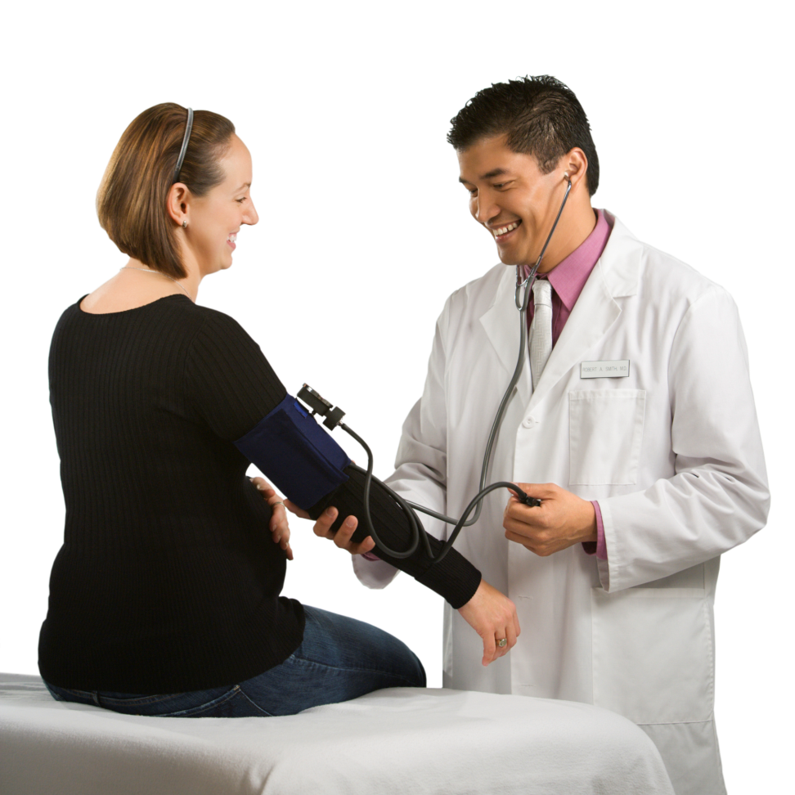

Native Hawaiian
Health Scholarship Program
(NHHSP)

Slide 75

Native Hawaiian students entering health care professions are eligible to receive funding for their education and clinical training in exchange for working with Native Hawaiian populations in Hawaii upon graduation and licensure.
The program provides tuition, fees, reasonable educational costs, and a monthly living stipend for a maximum of 4 years.

Slide 76
Eligibility
    Verifiable Native Hawaiian ancestry
    Full-time student enrolled at a fully
    accredited college or university
    Pursuing training in an eligible discipline
    Willingness to relocate anywhere within
    the State of Hawaii

Slide 77
Eligible
disciplines
    Medicine (MD/DO)
      Family medicine
      General internal medicine
      Geriatrics
      Obstetrics/gynecology
      General pediatrics
      General psychiatry
    Mid-Level Providers
      Primary care nurse practitioner
      Physician assistant
      Certified nurse-midwife

Slide 78
Eligible
disciplines
    Nursing
      Registered nurse
      (ADN, BSN, MSN)
    Oral Health
      Dentistry (DDS, DMD)
      Dental hygienist
    Public Health
    Pharmacy
    Behavioral and Mental Health
      Clinical psychologist
      Social worker
      Professional counselor
      Marriage and
      family therapist

Slide 79
Service Commitment
At least 32 hours a week for a minimum of 45 weeks per year at an approved Native Hawaiian practice site.

Slide 80
For more information on
The nhhsp and how to apply, visit:
www.nhhsp.org

Slide 81

Faculty Loan Repayment
Program
(FLRP)

Slide 82

Faculty members from disadvantaged backgrounds with a professional health care degree or certificate may receive loan repayment assistance in exchange for teaching at an accredited health professions school.

Slide 83
Eligibility
    Must be from a disadvantaged background based on environmental and/or economic factors
    Have a professional health care
    degree or certificate
    Full-time or part-time faculty position for a minimum of 2 years (at an eligible health professions school)

Slide 84
Eligible disciplines
    Medicine (MD/OD)
    Dentistry (DDS/DMD)
    Pharmacy
    Podiatric Medicine
    Optometry
    Nursing (registered nursing or higher)
    Public Health (graduate level only)
    Physician Assistant
    Behavioral & Mental Health (graduate level only)
      Clinical psychologist
      Marriage and family therapist
      Professional counselor
      Clinical Social worker

Slide 85
Eligible disciplines
    Allied Health
      Audiology
      Dental hygiene
      Medical laboratory technology
      Occupational therapy
      Physical therapy
      Radiologic technology
      Registered dietitians
      Speech pathology
    Veterinary Medicine

Slide 86
Service Commitment
Two years of service for up to $40,000. Participants may apply for sequential contracts.

Slide 87
For more information on
The flrp and how to apply, visit:
www.hrsa.gov/loanscholarships/
repayment/faculty

Slide 88

Life in the Corps

Slide 89
NHSC Providers
Support network
Community
Primary Care Office • Primary Care Association • Area Health Education Centers • State Offices of Rural Health • Ambassadors
Resources
Customer Service Portal •
Call Center • NHSC Web site • PrimaryCareForAll.hrsa.gov
BCRS Staff
Headquarters staff •
Regional office staff

Slide 90
Staff Support
Dedicated staff located in the Washington, DC, area support the needs of Corps members
Ten regional offices provide dedicated contacts that know your area of the country

Slide 91
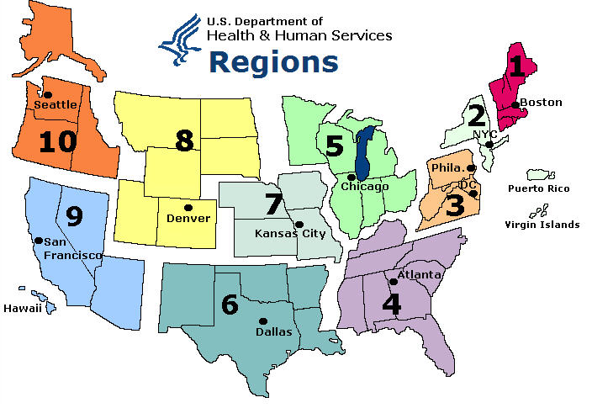

Slide 92
Resources
Customer Service Portal
  Allows NHSC members to access their information and complete transactions online, at any time
  Corps members can:
    View payment information
    View tax information
    Update contact information
    Ask BCRS a question
    Request to defer start date

Slide 93
Resources
www.primarycareforall.hrsa.gov
  NHSC has developed an online
  portal uniquely adapted to NHSC providers
  The portal includes:
    Online training, resources, and networking opportunities (Chat rooms, forums, and file sharing to create a virtual community for providers serving the underserved)
    Best practice examples
    Tools and templates

Slide 94
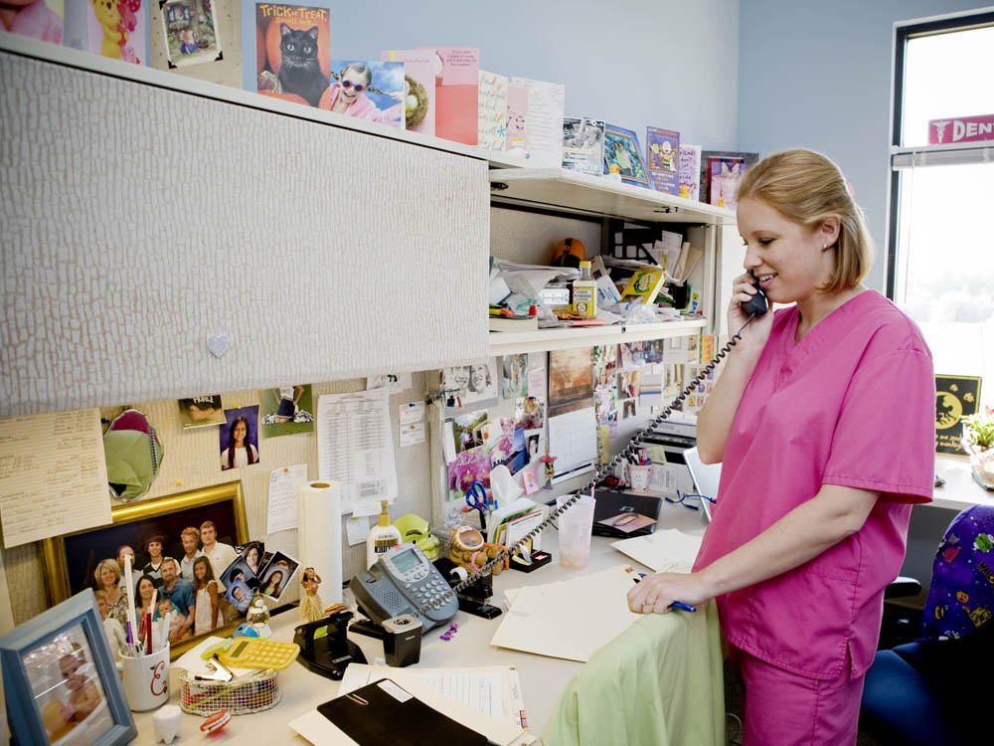
Customer Care Center
Access member resources and information by:
  Phone: 1-800-221-9393
  Email: GetHelp@hrsa.gov
  Web: NHSC.hrsa.gov

Slide 95

Community support
NHSC Ambassadors
  Ambassadors help:
    Increase awareness of NHSC loan repayment and scholarship programs
    Increase pool of applicants for the NHSC programs
    Provide opportunities for peer-to-peer interactions for potential Corps members
  Learn more at NHSC.hrsa.gov/ambassadors

Slide 96
Community support
Primary Care Offices (PCOs)
  State level offices that facilitate and participate
  in activities to improve access to health care
  services for residents of their state
  PCOs:
    Know the needs and barriers to primary care in each state
    Know providers and sites in their state—including NHSC-approved sites
    Help members identify available jobs
    at NHSC-approved sites
    Assist sites with the NHSC application process

Slide 97
Community support
Primary Care Associations (PCAs)
  Non-profit organizations located in states that provide
  training and technical assistance to community, migrant
  health, homeless, and other safety net providers
  PCAs:
    Assist in planning for growth of health centers in their states
    Help develop strategies to recruit and retain health center staff
    Help members identify available jobs at NHSC-approved sites
    Assist sites with the NHSC application process

Slide 98
Community support
Area Health Education Centers (AHECs)
  AHEC programs help recruit, train, and retain a health professions workforce committed to underserved populations
  AHECs:
    Understand where the need for health care professionals
    in the state and communities exists
    Link to community and academic educational partnerships
    Connect NHSC members to educational opportunities, continuing education, and rotations for residents

Slide 99
Community support
State Offices of Rural Health (SORHs)
  SORHs work to improve access to health care in rural and underserved areas to reduce health disparities
  SORHs:
    Provide access to tools and resources for those serving
    in rural areas
    Know about job opportunities at rural NHSC-approved sites
    Offer networking opportunities with other rural providers

Slide 100

Other Resources
  www.facebook.com/nationalhealthservicecorps
  Twitter.com/NHSCorps
  www.youtube.com/
  HRSAtube

Slide 101

Contact
Information
Name:
Email address:
Phone number:

