Slide 1
DoD Natural Resources Policy Update
L. PETER BOICE
DEPUTY DIRECTOR, NATURAL RESOURCES

Slide 2
Overview
Policy
Program Oversight
Tools and Training
Partnerships
Program Awareness
Advocacy
Notes:
I’ve organized this year’s Policy Overview in terms of the Natural Resources program’s top priorities.
These priorities are currently in draft form, subject to further refinement. They represent the framework upon which the new DoD Natural Resources Strategic Plan is being built.

Slide 3
Policy
Notes:
Policy is our #1 NR priority.

Slide 4
Natural Resources Conservation Instruction, DoDI 4715.03
14 February 2011
Purpose
Improve the integration of mission and stewardship needs and the long-term health of installation ecosystems
Integrate a conservation ethic throughout DoD
Facilitate military readiness and cost-effective policies through sustained use of natural resources
Identify opportunities for improved cooperation, information sharing, technology demonstration and transfer, and public communications
http://www.dtic.mil/whs/directives/corres/pdf/471503p.pdf
Notes:
Signed by USD(AT&L) Ashton Carter – is now official DoD policy.
Available on DoDNaturalResources.net, DENIX, and the DoD Issuances page.
Incorporates legislative and policy changes
Gives increased consideration to species at risk (SARs) – funding essential to maintain current compliance
Adds new requirements to consider climate change and provide for sustainable ecosystem services
Formalizes new NR Metrics

Slide 5
DoD Component Responsibilities
Integrate the DoD Natural Resources Program with mission activities
Comply with all applicable Federal statutory requirements, including Executive Orders and DoD policies
Plan, program, and budget necessary resources
Ensure scientifically sound, innovative, and effective stewardship
Ensure that installations prepare, maintain, and implement INRMPs
Conduct internal self-assessments and external INRMP reviews
Notes:
The new DoDI defines responsibilities of the DoD Components.
These are some of the key ones.
The Military Departments may supplement/add to DoD policy – they may not diminish or reduce DoD policies.

Slide 6
INRMP Implementation Manual
General INRMP provisions
Coordination, review and public comment
Implementation and special management
INRMP contents
Ecosystem-based management
New issues
DoD Forestry Reserve Account Criteria
Valuing and Managing Ecosystem Services
Planning for Climate Change
Evaluating Informal Comments
Notes:
The INRMP Implementation Manual is in final informal coordination.
Please send us any additional comments by April 30.
We expect formal coordination to being by mid/late summer.

Slide 7
Coordination with USFWS Draft Sikes Guidance
Key Issues
Consistency of definitions
Nature and timing of reviews for operation and effect
Unnecessary inclusion of environmental contaminants
USFWS input to annual metrics
Notes:
The USFWS issued updated draft Sikes guidance in September 2010.
We have identified some key DoD concerns with this guidance. USFWS needs to work with DoD to resolve these concerns before their guidance is finalized.

Slide 8
Proposed Sikes Amendments
Better Coverage of Military Installations
Would add 47 ARNG installations
Meet statutory definition of “military installation”
Align management of these state-owned lands with Army policy, streamlining funding
Sikes Hearing – May 25, 2010
Expanded Consideration of Invasive Species
Added by then HASC Subcommittee Chair Bordallo
Casualty of Continuing Resolution
Expected Reintroduction for FY 2012
Notes:
We expect the proposed Sikes amendments to be reintroduced as part of the FY 12 DoD Authorization bill.

Slide 9
Pending Policy Memos
White-nose Syndrome
Birds and Powerlines
Access for Disabled Sportsmen
Feral Animals
Wetlands
Landscape Conservation Cooperatives
Notes:
We expect to issue policy guidance on each of these topics within the next six months.

Slide 10
Oversight
Notes:
Oversight is the 2nd NR Priority.

Slide 11
OSD Program Oversight
Providing flexibility for mission activities while protecting natural and cultural resources
 | FY 2009 | FY 2010 | FY 2011
REQUEST | $330M | $323M | $320M
APPROP | $344M | $322M
ACTUAL | $350M
Notes:
We are looking more closely at the DoD Components’ overall Conservation budgets. – what they budgeted, what they received, what they actually spent.

Slide 12
Overarching Accomplishments
FY 2010 Accomplishments
Promulgated and evaluated new DoD Natural Resources Conservation Program Metrics
Convened DoD-focused workshops - Invasive Species Management; Plant Conservation; Pollinators; Biodiversity Management
Completed and posted/distributed an Invasive Species Outreach Toolkit
Developed first contingency operations cultural resource guidance for CENTCOM
FY 2011 Initiatives
Issue revised Natural Resources Instruction and develop and issue new INRMP Manual
Provide new Advanced Sikes Act Training and Endangered Species Act for DoD Managers Training courses and Climate Change Tools for DoD workshop
Cosponsor Sustaining Military Readiness Conference 2011
Develop guidance on appropriate rehabilitation practices for historic
FY 2012 Initiatives
Complete new Natural Resources Strategic Plan
Complete DoD Partners in Amphibians and Reptiles Strategic Plan
Develop a DoD archaeological curation policy instruction
Notes:
We’re also asking what specifically they accomplished with these funds.

Slide 13
Critical Habitat Designation Avoidance
Notes:
We’ve asked the Components to report on CHD avoidance for the past 6 years.
For FY 10, the focus was on fish species in the Pacific Northwest.

Slide 14
Natural Resources Metrics
Evaluate effectiveness of natural resources support to the military mission
Assess overall health and trends of each installation's natural resources program
Identify and correct potential funding and other resource shortfalls
Notes:
We established new NR program metrics in FY 09 to accomplish these goals.

Slide 15
Focus Areas
INRMP Implementation
Partnership Cooperation/Effectiveness
Team Adequacy
Impact on Military Mission
Listed Species Status
Ecosystem Integrity
Fish and Wildlife Management
Notes:
We established these 7 focus areas.
We expect each installation with an INRMP to develop scores for each of the 7 focus areas (as appropriate), in collaboration with the USFWS and State fish and wildlife agency.
Currently analyzing results from the second year's reporting.

Slide 16
Metrics Next Steps
Improved consistency in program health metrics
Standardized project evaluations using legal and mission drivers
Quantify mission project benefits
Facilitate partnerships between the environmental community (owners) and the readiness community (operators)
Base budget analyses and allocations on both legal and mission priorities
Provide a more comprehensive basis for justifying future budget requests
Notes:
We plan to continue to fine tune and update the current metrics.

Slide 17
Tools and Training
Notes:
Tools and Training is the 3rd NR Priority.

Slide 18
Courses
Sikes Act 101
Sikes Implementation
Endangered Species Act for DoD
Beta Test at NAVFAC SW
NMFWA!
SMR 2011 – July 25th
Notes:
We’ve developed three new training courses.

Slide 19
Informational Workshops
Recent
Pollinators
Plant Conservation
Invasive Weeds
Climate Change Tools
Current
White-nose Syndrome
PARC Strategic Plan Implementation
Pacific NW Conservation Tools
Notes:
We continue to provide workshops on “hot” NR conservation topics.

Slide 20
Crosscutting Plenary Sessions (3 mornings)
Subject-specific Concurrent Sessions
~18 Workshops, including
ESA for DoD course
PARC Strategic Plan workshop
Ecological Forestry
NEPA
Exhibits and posters
Service breakouts
Notes:
SMR 2011 will be held in Nashville, July 25-29.
NR sessions currently under development.
Opportunities for poster presentations.
Register at http://www.smrconference.com

Slide 21
NEW! DoD Biodiversity NRinform
Internet discussion group for DoD natural resources managers and others
Access NRinform and register for an account at http://dodbiodiversity.org/nrinform/
Moderated discussion
Goal : an interactive discussion site to share success stories, lessons learned, BMPs and other information that will be useful across military lands.
Potential discussion topics -- invasive species management, protection of endangered species, managing lands for multiple uses, etc.
Notes:
Here’s the latest biodiversity tool – an Internet discussion group!

Slide 22
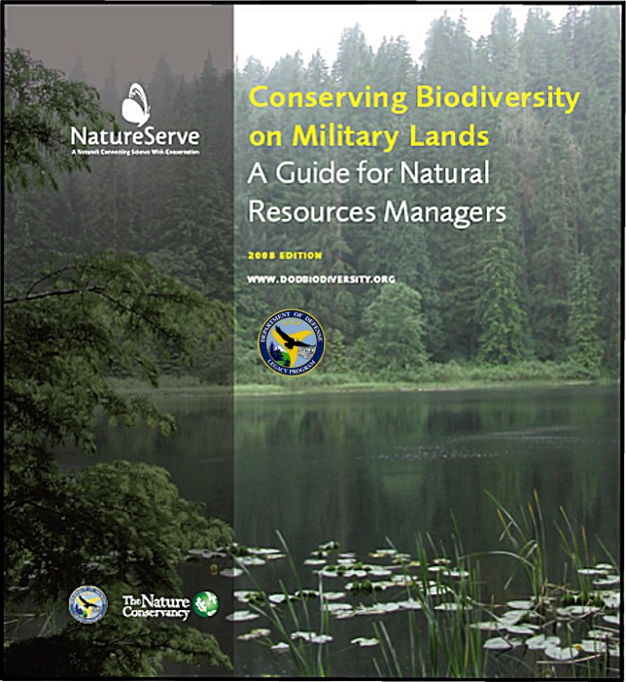
Biodiversity Tools
Revised Handbook with Case Studies
Biodiversity Outreach Toolkit (2 DVD-set)
Biodiversity Conservation Toolbox
Notes:
A reminder of the Biodiversity tools that we completed last year

Slide 23
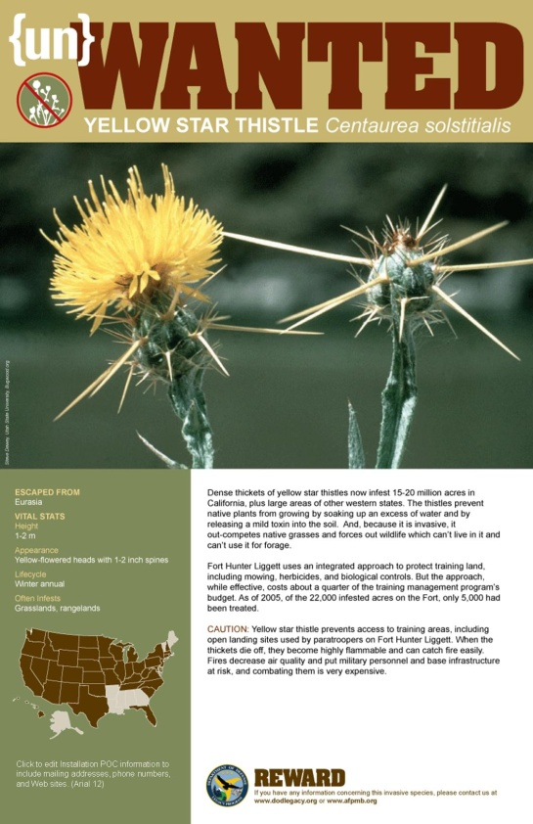
Invasive Species Outreach Toolkit
http://www.dodinvasives.org/
Invasive Species Resources
Commander’s Guide
Template of PPT presentations
Radio PSAs
Online Resources
Notes:
And the Invasive Species outreach toolkit that we also completed last year.

Slide 24
Climate Change Vulnerability
Scanning the Conservation Horizon: A Guide to Climate Change Vulnerability Assessment
Overview of general principles of climate change vulnerability related to species and ecosystems
Description of various assessment approaches
Examples of currently used assessments
www.nwf.org/vulernabiltyguide
Notes:
We partnered with National Wildlife Federation, USFWS and others to fund this ne climate change vulnerability assessment guide.

Slide 25
Partnerships
Notes:
Partnership development is the 4th NR Priority.

Slide 26
DoD PIF Strategic Plan
Identifies actions that support and enhance the military mission while minimizing impacts to bird species and habitats
Sets goals and priorities for eight key areas:
Stewardship
Partnerships/Cooperation
Communications
Habitat and Species Management
Bird/Animal Aircraft Strike Hazard (BASH)
Monitoring
Research
Information and Education
Establishes a system to objectively evaluate performance in meeting stated goals
Notes:
We are working with the AF Safety Center to finalize coordination on the draft PIF Strategic plan.

Slide 27
DoD PARC Strategic Plan
Develop a herpetofauna strategy that
Protects and sustains the military mission
Reduces and mitigates the threats to amphibians and reptiles on DoD lands
Raises public awareness
Helps support habitat management
Promotes the protection of ESA-listed and common species
Promotes proactive efforts to help preclude the need to list species that may impact mission activities
Highlights the ecological benefits from military natural resources programs
Notes:
We expect the draft DoD PARC Strategic Plan to be ready for formal coordination in late spring.

Slide 28
Program Awareness
Notes:
Awareness is the 5th NR Priority.

Slide 29
Websites
DoDNaturalResources.net
New NR program fact sheets
Links to info on Invasives, Pollinators, Workshops, DoD PIF, DoD PARC
DENIX.osd.mil/NaturalResources
Reorganization underway
DoDLegacy.org
Final project fact sheets and products
Current projects
FY 2012 RFP – mid-April
Notes:
We’re working to distribute NR program info through as many different venues and formats as possible.

Slide 30
NR Program Fact Sheets
Natural Resources Program
T&E Species on DoD Lands
Species at-risk
Invasive Species and DoD
State fact sheets
Pollinators
Notes:
These program fact sheets are available on http://www.DoDNaturalResources.net

Slide 31
Natural Selections
Coming soon – 1st Quarterly Issue
Invasive Species
Complemented by Natural Resources and Legacy “Blasts”
Seeking your feedback and contributions
Notes:
We’re restructuring how and when we communicate different typos of information.
We’ll use both email blasts and a newly revised quarterly newsletter.

Slide 32
Program Advocacy
Notes:
Advocacy is the 6th NR Priority.

Slide 33
Current Initiatives
Natural Resources Strategic Plan
POM Issue Paper
Compilation of Success Stories
Endangered Species Bulletin
Interviews
Social Media
DoD Facebook page
DoD Blog
Twitter
Notes:
We hope you’ll be seeing more soon for each of these current initiatives.

Slide 34
Questions?
Peter.Boice@osd.mil
Notes:
Please feel free to contact me if you have any questions.

