Slide 1
Welcome To Wage Record Systems 101
United States Department of Labor (DOL)
Employment and Training Administration (ETA)
July 26, 2012

Slide 2
Table of Contents
Wage Record Interchange System (WRIS)
WRIS 2
Federal Employment Data Exchange System (FEDES)
Common Reporting Information System (CRIS)

Slide 3
WRIS

Slide 4
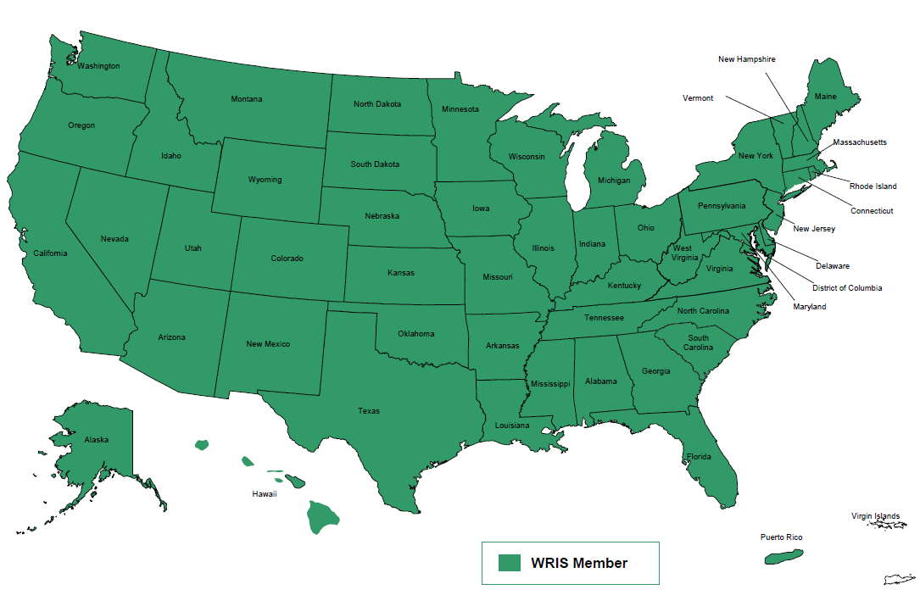
WRIS Participants
Currently all 50 states, the District of Columbia and Puerto Rico have signed the Wage Record Interchange System (WRIS) Data Sharing Agreement (DSA).

Slide 5
Purpose
WRIS allows states to share wage data for performance reporting purposes.

Slide 6
Three Approved Uses
1. Assessment of individual training providers and training programs,
2. Support states in preparing and submitting reports to the USDOL; and,
3. Support research and evaluation efforts specifically authorized under the terms of the DSA.

Slide 7
Legal Authority
Both WRIS and WRIS 2’s legal authority to establish these agreements are derived from Section 136(f)(2) of WIA (Public Law No. 105-220).
Section 303(a)(1) of the Social Security Act (SSA) and Section 3304(a)(9)(B) of the Federal Unemployment Tax Act (FUTA).
WRIS Agreement Section II. Legal Authority
...The participating SUIAs use of the Distributed Data Base Index (DDBI) for purposes of determining Federal-State Unemployment Compensation (UC) program eligibility is governed by Section 303(a)(1) of the Social Security Act (SSA), requiring, as a condition of a state’s administrative grants, that it follow methods of administration “reasonably calculated to insure full payment of unemployment compensation when due,” and Section 3304(a)(9)(B) of the Federal Unemployment Tax Act (FUTA), which requires each State, as a condition of participation in the UC program, to participate in any arrangement specified by the Secretary of Labor for payment of UC “on the basis of combining an individual’s wages and employment” in two or more states.

Slide 8
Parties to the Agreement
State Unemployment Insurance Agency or Agency that holds state wage data (SUIA)
Performance Accountability and Customer Information Agency
(PACIA)
Employment and Training Administration (ETA)

Slide 9
WRIS Governance
A WRIS Advisory Group is comprised of three parties:
  Each state may have two representatives,
  ETA may have one officer and up to five support staff; and,
  The operations contractor(s) participate but are not considered Advisory Group members.

Slide 10
SUIA Responsibilities
Ensure paperwork is completed for employee authorization.
Transmit social security numbers (SSNs) to the operations contractor by the date established for the Distributed Data Base Index (DDBI).
Respond to queries in a timely manner.
Ensure solid internal security measures are in place.
Ensure all employees comply with WRIS guidelines.
Participate in confidentiality compliance reviews.

Slide 11
PACIA Responsibilities
Provide ETA with proper employee authorization forms.
Only submit requests for Wage Data allowable under the terms of the DSA.
Ensure employees work within the WRIS guidelines.
Prepare aggregate statistical data and reports.
Participate in confidentiality compliance reviews.

Slide 12
ETA Responsibilities
Communicate with states, other federal agencies, the Congress, and other interested public and private parties regarding the operation and value of the WRIS.
Facilitate the confidentiality of Wage Data.
Continuously improve the WRIS in collaboration with the operations contractor and the participating WRIS states.

Slide 13
Confidentiality
All parties to this Agreement recognize that confidentiality of Wage Data is of paramount importance and must be observed except where disclosure is allowed by this Agreement or by court order.
All data exchange activity by the SUIA and/or PACIA through the WRIS will be conducted in a manner consistent with applicable state law.

Slide 14
2012 DDBI Schedule
Quarter | Original Due Date | Original Online Availability Date | New Due Date | New Online Availability Date
4th Quarter 2011 | April 2, 2012 | April 9, 2012 | April 9, 2012 | April 16, 2012
1st Quarter 2012 | July 2, 2012 | July 9, 2012 | July 9, 2012 | July 16, 2012
2nd Quarter 2012 | October 1, 2012 | October 8, 2012 | October 8, 2012 | October 15, 2012

Slide 15
WRIS 2

Slide 16
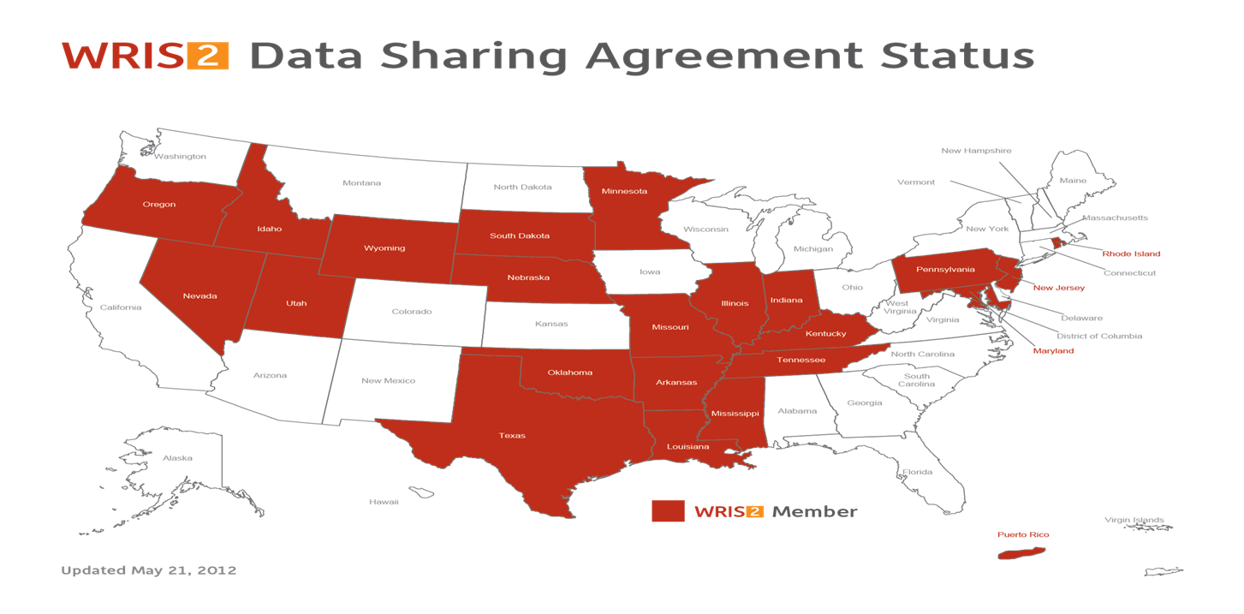
WRIS 2 Participants
As of July 13, 2012, there are 22 states and one territory currently participating in WRIS 2.

Slide 17
WRIS 2
WRIS 2 extends the WRIS data sharing model, with specific requirements outlined in the WRIS 2 DSA, to educational partners.
WRIS 2 is not only for Department of Labor programs, but also eligible training providers.
Very specific guidelines on participants and data usage are located in the DSA.

Slide 18
The Differences in WRIS & WRIS 2
WRIS is limited to the sharing of records for state and Federal reporting and performance purposes for DOL funded programs.
WRIS 2 allows data to be shared with Third Party Entities (TPE).
TPE – any public body, agency, or private career school required by law to meet state and/or Federal performance measures. A PACIA, or its agent or consultant, cannot be designated as a TPE.

Slide 19
WRIS 2
WRIS 2 functions in the same manner as WRIS; however, there are a couple of important differences.
    There is a separate platform for WRIS 2 to help eliminate any potential confusion.
    Only states who have signed the WRIS 2 DSA can participate in the sharing of records via the WRIS 2 portal.
    In order to be a member of WRIS 2, a state must also be a party to WRIS.

Slide 20
WRIS 2 Aggregate Statistical Reports
WRIS 2 Aggregate Statistical Reports may be provided to TPEs, provided that the PACIA has voluntarily entered into an agreement with a TPE which sets forth terms and conditions for such data sharing that are otherwise consistent with the terms of the WRIS 2 Agreement and with 20 CFR part 603, or directly with ETA.

Slide 21
Research and Evaluation Limitations
a) The research and evaluation must relate to one or more programs or an activity set forth in subparagraph 1 of paragraph C on page 8 of the WRIS 2 DSA;
b) There are no conditions under which use of wage data is approved for research and evaluation without the express, voluntary consent of the participating state whose data are to be used for such purpose;
c) A state that has elected to participate in research proposals shall share only its own data, and not data obtained through the WRIS2, for such purpose;
d) All data for approved research purposes shall be transmitted between participating PACIAs; no other entity conducting research may have direct access to the WRIS2 for this purpose.

Slide 22
Confidentiality
Confidentiality and restrictions on the use of information are detailed in a comprehensive manner in both the WRIS and WRIS 2 DSAs.
Any breaches of personally identifiable information, either WRIS or WRIS 2 related, are to be reported to ETA immediately (within one hour).

Slide 23
Practical Applications – State of Utah
Utah – Rick Little, Director
Workforce Research and Analysis
Utah Department of Workforce Services
John Brandt, Grant Manager
Utah Data Alliance
Utah State Office of Education
Leslie Shortt, Business Analyst
Workforce Research and Analysis
Utah Department of Workforce Services

Slide 24
Utah Data Alliance (UDA)
Utah's Statewide Longitudinal Data System (SLDS) Partnership
Partnership between Utah State Office of Education, Utah State Office of Higher Education, Department of Workforce Services, Utah College of Applied Technology, Utah Education Network, Utah Education Policy Center
Created to provide better data regarding educational outcomes for policy makers
Partnership governance structure created
One anticipated use of data is for Perkins reporting of employment outcomes

Slide 25
UDA – SLDS, continued
Partnership applied for and awarded SLDS grant
Created and have in place explicit and restrictive Memorandums of Understanding and Data Sharing Agreements for sharing and storing at a neutral partner site (Utah Education Network) confidential data from UDA partners for educational research and how results are to be published
UDA in final stages of initial data warehouse build

Slide 26
Utah WRIS2 Initial Match Request
Educational Research request generated by a Student Longitudinal Tracking System (SLDS) partner - Utah System of Higher Education (USHE)
Research Question: Do levels of post-secondary degree/certificate and degree/certificate type return different levels of wages - do they change over time
WRIS2 data allowed for a more complete data set from out of state employment (see chart showing data requested and returned)
WRIS2 only provided to USHE aggregate data on employment and wage by degree/certificate/type

Slide 27
Utah WRIS2 Initial Match Request, continued
USHE only can receive information from wage data in aggregate of (10) or greater cell size
Data led to an in-depth discussion with our economists regarding how to properly use wage data in research
Current Result - because of the discussion on how to properly utilize wage data in research USHE is completely re-structuring their research question

Slide 28
Utah DWS Summary of WRIS2 Match for Utah Data Alliance
6/15/2012
Total Ids submitted by UDA |  |  |  | 24906
Invalid or Duplicate IDs |  |  |  | 1209
Unique IDs submitted to WRIS2 |  |  |  | 23697
Unique IDs matched by WRIS2 |  |  |  | 685

Slide 29
Utah
ELEVEL | 12 | SUBMITTED | MATCHED | % MATCHED
Associates | Liberal Arts | 4721 | 4 | 0.085%
Bachelors | STEM | 3617 | 362 | 10.008%
Bachelors | Business | 2700 | 1 | 0.037%
Associates | STEM | 1997 | 104 | 5.208%
Bachelors | Services | 1775 | 2 | 0.113%
Bachelors | Liberal Arts | 1617 | 1 | 0.062%
Bachelors | Social Sciences | 1337 | 5 | 0.374%
Masters | STEM | 840 | 93 | 11.071%
Certificate | STEM | 775 | 48 | 6.194%
Bachelors | Other | 753 | 1 | 0.133%
Masters | Business | 642 | 2 | 0.312%
Associates | Business | 641 | 0 | 0.000%
Masters | Services | 546 | 0 | 0.000%
Associates | Services | 498 | 0 | 0.000%
Doctorate or Professional | STEM | 482 | 94 | 19.502%
Certificate | Services | 414 | 0 | 0.000%
Masters | Social Sciences | 249 | 0 | 0.000%
Certificate | Social Sciences | 157 | 2 | 1.274%
Masters | Liberal Arts | 138 | 0 | 0.000%
Doctorate or Professional | Professional | 136 | 0 | 0.000%
Certificate | Business | 113 | 0 | 0.000%
Certificate | Liberal Arts | 86 | 2 | 2.326%
Associates | Social Sciences | 69 | 0 | 0.000%
Doctorate or Professional | Services | 65 | 0 | 0.000%
Masters | Other | 63 | 0 | 0.000%
Associates | Professional | 47 | 0 | 0.000%
Bachelors | Professional | 36 | 0 | 0.000%
Associates | Other | 35 | 0 | 0.000%
Doctorate or Professional | Social Sciences | 20 | 0 | 0.000%
Doctorate or Professional | Liberal Arts | 17 | 0 | 0.000%
Doctorate or Professional | Business | 16 | 0 | 0.000%
Certificate | Other | 9 | 0 | 0.000%
Certificate | Professional | 7 | 0 | 0
 |  | 24618 | 721 | 2.929%

Slide 30
FEDES

Slide 31
FEDES
The Department of Labor has awarded funds to the State of Maryland, Department of Labor, Licensing, and Regulation for the purpose of developing a consolidated Federal employment data exchange.
FEDES provides Federal and state agencies with an effective way to include Federal employment information in support of performance and evaluation reports required by Federal and state regulation.

Slide 32
Parties to the Agreement
United States Office of Personnel Management (OPM)
United States Department of Defense (DOD), the Defense Manpower Data Center (DMDC)
United States Postal Service (USPS)

Slide 33
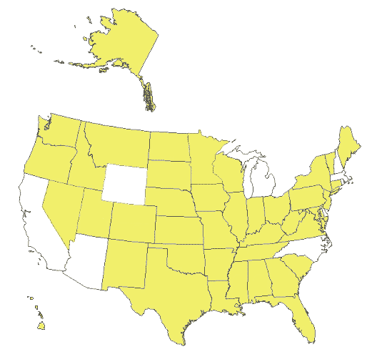
Member States
There are currently 43 states participating in FEDES.

Slide 34
Approved Usage for OPM and USPS
Satisfying, or contributing to, Federal performance measurement and consumer report activities required by the United States Office of Management and Budget (OMB) or Federal law or regulation;
Satisfying, or contributing to, State performance measurement and reporting requirements authorized under state law or regulation; and
Satisfying, or contributing to, other federal and state performance measurement or evaluation research requirements that must be specified in advance and approved by both Parties.

Slide 35
Approved Usage for DMDC
Satisfying, or contributing to, Federal performance measurement and consumer report activities required by the United States Office of Management and Budget or Federal law or regulation; and
Satisfying, or contributing to, other federal or state performance measurement or evaluation research requirements that must be specified in advance and approved by both Parties.

Slide 36
Confidentiality & Data Retention
Agreements
Retention of data

Slide 37
CRIS

Slide 38
CRIS Overview
CRIS is an arrangement between the Kansas Department of Commerce and ETA.
CRIS allows ETA’s national program grantees to access both WRIS and FEDES to calculate common measures.
The MOU is specific in which programs may obtain data:
  Indian and Native American Program (INAP);
  Senior Community Service Employment Program (SCSEP);
  Registered Apprenticeship (RA);
  National Farmworker Jobs Program (NFJP);
  High Growth Job Training Initiative (HGJTI);
  Community-Based Job Training Grants Initiative (CBJTG); and,
  Job Corps.

Slide 39
CRIS Program Information
National program grantees submit program exiter information into DOL’s Enterprise Business Support System (EBSS). NFJP grantees submit their information to Social Policy Research Associates (SPRA).
ETA sends exiter information via secure File Transfer Protocol (sFTP) to Kansas. SPRA sends NFJP data directly to Kansas via sFTP.
Kansas submits SSNs to the WRIS and FEDES operators.
The WRIS and FEDES operators return matched SSNs to Kansas.
Kansas compiles the information and calculates aggregate, program specific common measures reports.

Slide 40
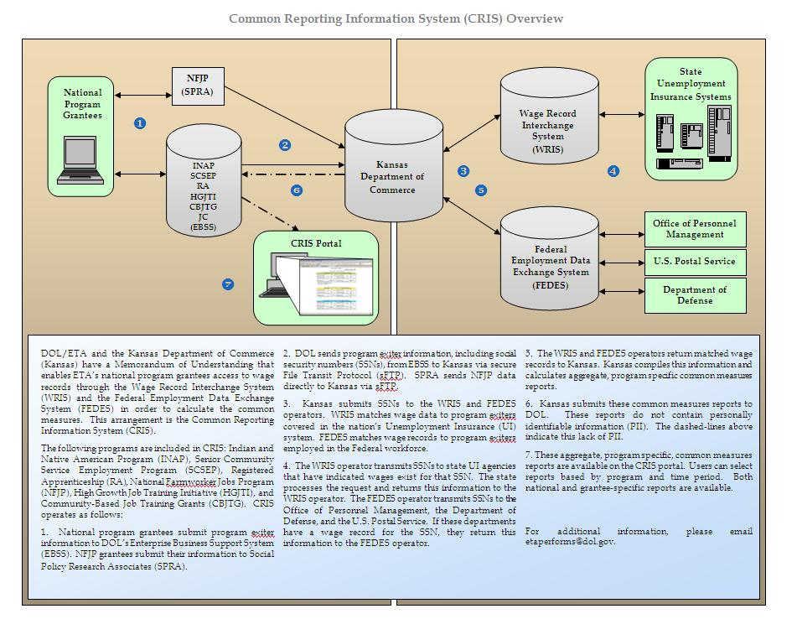

CRIS Operations

Slide 41
Visit Us on the Web!
WRIS - http://www.doleta.gov/performance/WRIS.cfm
WRIS 2 - http://www.doleta.gov/performance/wris_2.cfm
FEDES - http://www2.ubalt.edu/jfi/fedes/index.cfm
CRIS - http://www.doleta.gov/performance/CRIS.cfm

Slide 42
National Office Contacts
Kate Louton Heather Parker
Workforce Analyst Workforce Analyst
Office of Policy Development and Research Office of Policy Development and Research
Employment and Training Administration Employment and Training Administration
U.S. Department of Labor U.S. Department of Labor
200 Constitution Avenue NW 200 Constitution Avenue NW
Washington, D.C. 20210 Washington, D.C. 20210
202-693-2745 202-693-2633
Louton.kathryn@dol.gov parker.heather@dol.gov
Stan Blazek Karen Staha
Supervisory Workforce Analyst Division Chief
Office of Policy Development and Research Office of Policy Development and Research
Employment and Training Administration Employment and Training Administration
U.S. Department of Labor U.S. Department of Labor
200 Constitution Avenue NW 200 Constitution Avenue NW
Washington, D.C. 20210 Washington, D.C. 20210
202-693-3784 202-693-2917
Blazek.stan@dol.gov staha.karen@dol.gov

