Slide 1
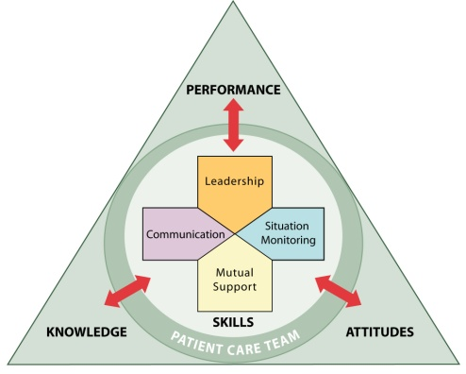

Enhancing Safety for Patients With
Limited English Proficiency
Train-the-Trainer Instructor Guide
TM

Slide 2


Introduction
SAY:
In recent years, the Agency for Healthcare Research and Quality and the Department of Defense have worked together to enhance patient safety through the TeamSTEPPS system. The TeamSTEPPS system is a powerful set of teachable and trainable skills, behaviors, and tools that has been shown to reduce medical errors. In this module, we show how the TeamSTEPPS system can be used to enhance the safety of patients with limited English proficiency (LEP).
Before we start the module, I’d like you to complete some baseline surveys. The surveys are anonymous and will help us track our progress as a team. Everyone in this session should complete the Learning Outcomes Survey. In addition, everyone in the group except for interpreters should complete the baseline Pretraining Behavior Survey. You will have 10 minutes to complete these surveys.
(Collect baseline surveys and thank participants.)
MODULE TIME:
60 minutes + evaluation time (30 minutes)
PRE- TRAINING EVALUATION TIME:
15 minutes
MATERIALS:
INSTRUCTOR NOTE:
This module may be customized based on the group’s knowledge and experience with LEP and culturally diverse patients and TeamSTEPPS. For example, if the group is aware of medically significant miscommunication incidents that have occurred with LEP patients in their hospital, it may be useful to replace one of the presentation’s case examples with the example that participants know. Groups familiar with TeamSTEPPS may not need as many slides about TeamSTEPPS, whereas some hospital teams may want to add more slides about TeamSTEPPS as part of a comprehensive implementation effort. Additional TeamSTEPPS resources are available at http://teamstepps.ahrq.gov/.
  Flash drive or CD with training materials
  Pens
  Staff training handouts

Slide 3
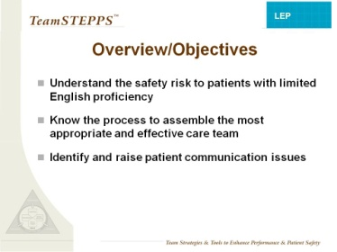
Overview/Objectives
SLIDE TIME:
1 minute
SAY:
This module will help you to:
Understand the safety risk to patients with limited English proficiency.
Know the process to assemble the most appropriate and effective care team for LEP and culturally diverse patients.
Identify and raise patient communication issues.
Notes:
Read objectives
2

Slide 4
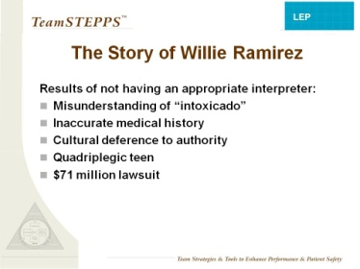
The Story of Willie Ramirez
SAY:
To illustrate why LEP patients are at risk of patient safety events, I would like to share the story of Willie Ramirez. This case is one of the most well-known examples in which limited English proficiency and cultural misunderstandings led to a tragic medical error.
In 1980, 18-year-old athlete Willie Ramirez was taken to the ER by ambulance in a coma, accompanied by his Mom, his sister, his girlfriend, and his girlfriend’s Mom. The ER physician, who did not speak Spanish, assumed Willie had a drug overdose because he had pinpoint pupils and because the girlfriend’s Mom said, in broken English, “He is intoxicado.” In Cuban Spanish, “intoxicado” means “poisoned.” The family thought he had eaten a bad hamburger at a new fast food restaurant that day.
When the ER doctor told the family he would treat Willie for drug overdose, they said to one another, in Spanish, “That’s impossible, he would never take drugs.” Willie was an all-star baseball player and was opposed to drugs and drinking. However, the doctor did not understand what the family was saying. Willie’s brain hemorrhage kept bleeding for more than 2 days before a neurologic consult was scheduled. By then, Willie was quadriplegic. The family sued the hospital, resulting in a $71 million settlement.
Although the ER doctor didn’t understand what was said at the time, in a later interview, the ER doctor said, “If I had a Mom who said, ‘My son would NEVER use drugs,’ I may have thought differently.” However, the family member who was interpreting did not share this information with the doctor, because cultural differences complicated the language issue. In some cultures, people never contradict an authority figure, such as a doctor.
Neither the doctor nor the family asked for a professional medical interpreter because they thought they were communicating well. A professional interpreter could have facilitated mutual understanding by interpreting the doctor’s and family’s words to one another, asking questions to make sure they understood correctly, and speaking up when the family expressed doubts about the doctor’s diagnosis.
SLIDE TIME:
5 minutes
INSTRUCTOR NOTE:
You may read the full story here:
http://healthaffairs.org/blog/2008/11/19/language-culture-and-medical-tragedy-the-case-of-willie-ramirez/
3
Notes:
3

Slide 5
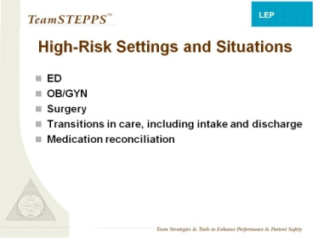
High-Risk Settings and Scenarios
SAY:
Research shows that patient safety events that affect LEP patients tend to be more severe and more frequently due to communication errors compared to English-speaking patients.
LEP patients may be particularly vulnerable in interactions with staff in ED, OB/GYN, or surgical settings. When care is time sensitive and communication with the patient or family is important, such as intake, transitions in care, discharge, and medication reconciliation, LEP patients may need additional support to maintain safety.
SLIDE TIME:
1 minute
INSTRUCTOR NOTE:
The points made above are supported by preliminary research conducted to develop this training module and by these references:
Divi C, Koss RG, Schmaltz SP, et al. Language proficiency and adverse events in U.S. hospitals: a pilot study. Intl J Qual Health Care 2007;19(2):60-67. Epub 2007 Feb 2.
Flores G, Laws MB, Mayo SJ, et al. Errors in medical interpretation and their potential clinical consequences in pediatric encounters. Pediatrics 2003;111(1):6-14.
Notes:
4

Slide 6
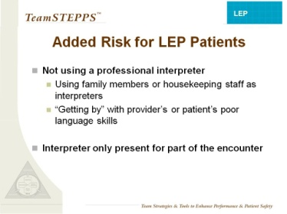
Added Risk for LEP Patients
SAY:
Research also indicates that without a professional interpreter, medical interpretation errors are more common and significantly more likely to have potential clinical consequences. LEP patients also have higher lengths of stay and readmission rates.
When the care team asks family members or housekeeping staff to interpret, or when they rely on their own limited foreign language skills or the patient’s limited English, they place LEP patients at risk for physical harm.
In addition, they place the ad hoc interpreter at risk for psychological harm. Imagine how you would feel if you made an error in interpretation that caused your family member to become quadriplegic.
Another risky situation is when the interpreter arrives after the encounter has already begun or is called away before the encounter ends. Ideally, the interpreter should be present for the whole encounter. If this is not possible, the interpreter should be briefed when he or she arrives and a backup plan should be in place in case the interpreter has to leave.
As of this writing, there is no evidence that in-person interpreters are any safer than phone or video interpreters. The key is to use a professional medical interpreter.
SLIDE TIME:
2 minutes
INSTRUCTOR NOTE:
The points made above are supported by preliminary research conducted to develop this training module, and by the references in the Evidence Summary handout.
MATERIALS:
  Evidence summary sheet

Slide 7
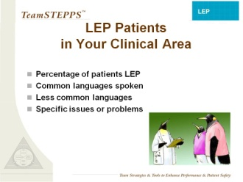
LEP Patients in Your Clinical Area
INSTRUCTOR NOTE:
The bullet points in this slide should be replaced with information about LEP patients in the clinical area where you conduct the training.
About the penguins: Graphic design used throughout TeamSTEPPS, including the cartoon penguins, is inspired by the 2006 book by John Kotter, Our Iceberg Is Melting: Changing and Succeeding Under Adverse Conditions. The book illustrates Kotter’s Eight Stages of Change, a proposed set of steps to initiate and sustain change in an organization, through the story of a penguin colony faced with a melting iceberg.
Reference:
Kotter J, Rathgeber H, Mueller P. Our iceberg is melting: changing and succeeding under adverse conditions. New York, NY: St Martin’s Press; 2006.
SLIDE TIME:
1 minute
CUSTOMIZABLE CONTENT
Notes:
6

Slide 8
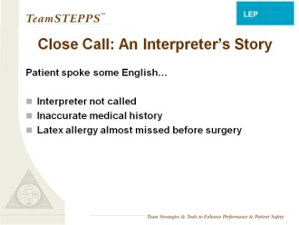
Close Call: An Interpreter’s Story
SAY:
Here is an example of a close call that we experienced here. This story comes from (specify source, such as interpreter services, nursing, or patient safety).
“The patient came to the surgery, and it was assumed that the patient spoke English. After the whole assessment was done, the patient answered inappropriately, and that made the nurse doubt. She called interpreters, and I arrived. And the nurse said, ‘You said you’re not allergic to medicine….drug or latex.’ And when I interpreted, [the patient] said, ‘I am allergic to latex’. …And the nurse kept saying, ‘Are you sure?’ and she said, ‘Yeah…’ ‘And what happens to you?’ ‘Well, they put the latex band…it was itchy, it was red, and it was swollen.’ So she had to stop, run, call the OR, put on the latex sensitivity. They had to move everything from the OR.”
SLIDE TIME:
2 minutes
INSTRUCTOR NOTE:
Replace this story with a local story from one of your clinical settings, in which an LEP patient was at risk or was harmed due to problems with cultural differences or missed communication. You will likely discover stories of close calls or risky situations if you speak to frontline staff members or leaders in nursing, interpreter services, or patient safety.
If you do not have a local story to share, you may use the example above and say:
“As part of the preliminary research that was done for this training module, 18 people were interviewed in 3 hospitals among frontline staff and leaders in interpreter services, nursing, and patient safety. All 18 reported situations where an interpreter was needed but was not present. In several cases, this led to ‘close calls’ like the one described on this slide.”
7
Notes:
7

Slide 9
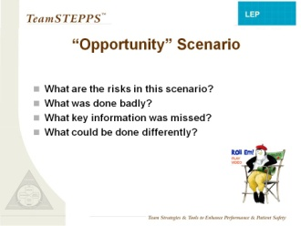

Scenario
SAY:
This video gives us an example situation in which a patient with limited English proficiency is at risk.
DO: Show the “Opportunity” video.
Play the video by clicking the penguin director icon on the slide.
You must be in slide show mode for the video to play.
SLIDE TIME:
7 minutes
Ask participants: What are the risks in this situation? What was handled well? What was handled poorly? What important information was missed? What could be done differently? Allow them the opportunity to discuss and respond. If they do not respond, prompt them with suggestions:
What might the triage nurse have known about words that sound familiar in foreign languages?
  Words that sound the same can mean different things.
At what point should a professional interpreter have been called ?
  The triage nurse, Rachel Lansky, could have identified the need and called the interpreter sooner.
At what other points were there missed opportunities to call an interpreter?
  At the front desk (before the triage nurse), and earlier in the conversation with Dr. Desai .
What else could the care team have done to better communicate with the patient and his wife?
  We’ll review some of the things the care team could have done in the rest of the training.
VIDEO TIME:
4:34 minutes
Notes:
8

Slide 10
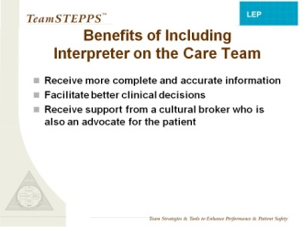
Benefits of Including Interpreter on the Care Team
SAY:
Including a professional interpreter as a member of the care team has significant benefits to the patient.
The presence of a professional interpreter also has significant benefits to the care team, ensuring that both the patient and the care team have more accurate and complete information, which facilitates decisionmaking.
The interpreter achieves this primarily by interpreting the spoken words or written documents.
In addition, the interpreter can serve as an advocate, speaking up when he or she thinks the patient or provider may have missed important information.
Finally, the interpreter can serve as a cultural broker, helping health care providers understand the cultural perceptions and expectations of the patient as well as helping the patient understand the expectations and culture of health care.
SLIDE TIME:
3 minutes
INSTRUCTOR NOTE:
It can also be beneficial to use bilingual staff who are certified to provide care in non-English languages or volunteers who are trained and certified to act as interpreters.
Some health care settings advocate a “Black Box” model, where interpreters limit themselves to interpreting and translating words. However, patient safety can be enhanced when the interpreter is also allowed to share important cultural information and raise patient safety concerns.
In many other health care settings, medical interpreters are trained to serve as cultural brokers and patient advocates, but clinical staff do not always welcome their intervention in this role. It may be useful to assess the culture of interpretation at your own hospital to help you set your goals.
9
Notes:
9

Slide 11
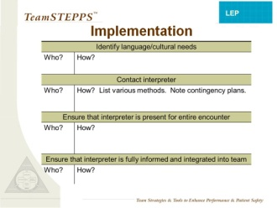

Implementation
SAY:
  What is the process for obtaining an interpreter in your clinical area?
  The basic steps include (1) identifying the need for language or cultural support, (2) contacting the interpreter, (3) ensuring that the interpreter remains present during the entire patient encounter, and (4) ensuring that the interpreter is fully informed and integrated into the patient care team.
  There are often barriers that make it difficult for people to fully implement the process. For example, an interpreter is not always available right away, or the interpreter may arrive late or need to leave early. Since these problems put LEP patients at risk, it is important that you or your team leader raise these issues with your patient safety and interpreter services leaders. This module has an accompanying guide to help hospital leaders address the challenges.
  In the meantime, your process should include a way of implementing contingency plans, such as calling a phone interpreter if no face-to-face interpreter is available, briefing interpreters when they arrive, and switching to a new interpreter or telephone interpretation if the face-to-face interpreter needs to leave before the encounter is complete.
  EXERCISE:
  Instruct participants to take out their blank copy of the patient language process map and to take 5 minutes to complete it, adding any steps necessary at their site and noting who, when, and how. If there is a team from one unit or area, they can work together to complete the worksheet, or they may use a flipchart for easy viewing by the whole group. Once they have completed the sheet, ask the groups to share their detailed maps with the full group, closely monitoring time (5 minutes).
  Participants may find it useful to flag problems that hinder them from following the outlined process and to develop a contingency plan and a plan to raise these issues with their organization’s leaders.
SLIDE TIME:
7 minutes
MATERIALS:
  Patient Language Process Map
  Optional: Flipcharts and markers
Notes:
10

Slide 12
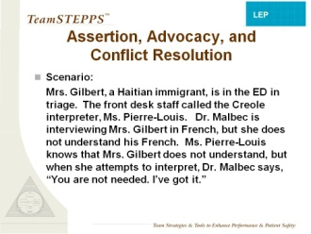
Assertion, Advocacy, and Conflict Resolution
DO:
Read the scenario.
DISCUSSION:
What are the risks to the patient in this scenario?
What could go wrong?
What needs to happen to avoid problems? If you were Ms. Pierre-Louis, what could you do?
(Allow time for group to answer questions and discuss. If no one speaks up, call on a few people by name to encourage responses to these questions.)
SAY:
Specific skills needed in this scenario include assertion, advocacy, and conflict resolution. We will learn some structured methods of assertion that might help in situations like this.
SLIDE TIME:
3 minutes
INSTRUCTOR NOTE:
Two main languages are spoken in Haiti, Haitian Creole (sometimes referred to as just “Creole”) and French. Speaking French signals a higher social status. Thus, some patients may be reluctant to admit they don’t understand it well.
Most countries have more than one language and several dialects. It is safest and only takes a few seconds to ask patients what language they speak best or in what language they would like to receive care.
11
Notes:
11

Slide 13
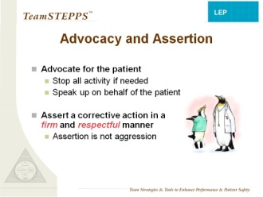
Advocacy and Assertion
SAY:
Advocacy and assertion are useful for any team member who does not agree with a decisionmaker or who notices a patient safety problem. In advocating for the patient and asserting a corrective action, the team member has an opportunity to correct or avoid errors. Failure to use advocacy and assertion has been frequently identified as a primary contributor to the clinical errors found in malpractice cases and sentinel events.
DISCUSSION:
When might you use advocacy and assertion for LEP patients?
To make sure that patient language needs are assessed.
To make sure that an interpreter is called when needed.
To raise communication issues.
SAY:
When advocating, assert your viewpoint in a firm and respectful manner. You should also be persistent and persuasive, providing evidence or data for your concerns. Appropriate assertion is a way to advocate for the patient. In the interest of safety, you may need to speak up to stop all patient care activity until a risk can be resolved or until the patient understands what is happening. In this session, we will show you structured language and gestures that can make it easier to be appropriately assertive.
It’s helpful to note that assertion is not aggression. Assertive statements respect and support authority.
SLIDE TIME:
3 minutes
DISCUSSION:
Why might it be difficult to speak up on behalf of the patient? (Allow the group to respond.) Some possible reasons include the traditional hierarchy of health care, strong personalities of some health care providers, and previous negative experiences with speaking up. If you have tried it once and been “shot down,” you tend to be very hesitant to speak up again even in a different setting with different people. Cultural differences are also a factor in the difficulty with assertion, because deference to authority is an important value in many cultures.
Notes:
12

Slide 14
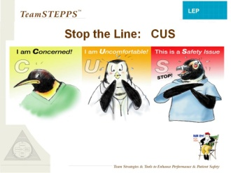
Stop the Line: CUS
SAY:
Structured language can make it easier to speak up and be assertive when it’s needed. Using a “script” of set phrases that the team has agreed upon in advance can make interactions more predictable and less “personal.”
In TeamSTEPPS, when we need to “stop the line” to ensure safety, we “CUS.” The team understands that when any member of the team says, “I’m concerned…I’m uncomfortable…This is a safety issue…” it means that we need to pause and make sure no safety risks are happening and that the entire team understands the situation.
The phrases function as a signal, similar to calling a code. Hand signals or gestures are also useful as “code” language for interpreters (or others) to indicate a need to stop and listen. Raising the hands in front of yourself, palms out, can be an agreed-upon gesture to “stop the line” for interpreters. Here’s an example.
SLIDE TIME:
5 minutes
DO: Show “CUS” video clip.
VIDEO TIME:
:47 seconds
Play the video by clicking the penguin director icon on the slide.
DISCUSSION:
Was the use of CUS effective? Why?
SAY:
You can also use these signal phrases to escalate a concern. First state that you are concerned; then, if there is no response, you can go on to say you are uncomfortable or that this is a safety problem. It’s important to give as much information as you can regarding why you are concerned and what you are seeing or hearing that is making you uncomfortable.
13
Notes:
13

Slide 15
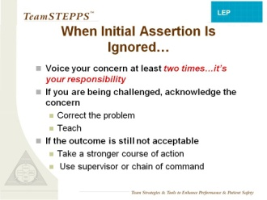
When Initial Assertion Is Ignored…
SAY:
It is important to voice your concern by advocating and asserting your statement at least twice if the initial assertion is ignored (sometimes it is called the “Two-Challenge rule”). These two attempts may come from the same person or two different team members.
The first challenge should be in the form of a question or initial concern. The second challenge should provide some support for your concern. Remember, assertion is about advocating for the patient.
This “two-challenge" tactic ensures that an expressed concern has been heard, understood, and acknowledged. If, after two attempts to clearly assert your concern, there is no resolution of the problem, you may then seek assistance from an additional resource, such as a charge nurse or other physician.
SLIDE TIME:
1 minute
Notes:
14

Slide 16
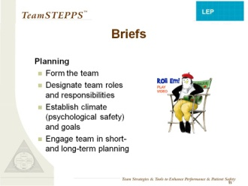
Briefs
SAY:
Once the full team is present and engaged, it’s necessary to ensure that all are informed. This includes the interpreter. Briefs are a communication and team tool for planning purposes.
The team leader is responsible for organizing a short briefing to discuss essential team information and to establish an environment in which the team, including the interpreter and the patient, are comfortable speaking up and participating. The following information should be discussed in a brief:
  Team membership and roles—who is on the team (including the interpreter) and who is the designated team leader.
  Encouragement to speak up and share any relevant information or concerns, including relevant information about the patient’s culture that might affect care.
  Team goals, plans, and risks—what is to be accomplished, who will do it, and what the potential risks are.
SLIDE TIME:
3 minutes
DO: Show “Optional Briefs” video.
Play the video by clicking the director icon on the slide.
VIDEO TIME:
:36 seconds
  DISCUSSION:
  Who is the team leader?
  How did the leader establish psychological safety for the team?
  Did the team have a plan for the patient?
  Did everyone understand the plan?
15
Notes:
15

Slide 17
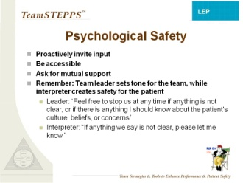
Psychological Safety
SAY:
The team leader establishes psychological safety for the group; the INTERPRETER establishes this for the patient. This is the way we create an environment in which it is safe to speak up.
Traditional hierarchy, status differences, and cultural differences can create real barriers to effective team communication. It is up to the leaders of a team to overcome these barriers through these strategies.
Leaders invite comments by calling on team members by name and by role: “Gerardo, as the interpreter, do you see anything here that we’ve missed or that Mr. Ruiz may not understand?” or “Jane, as Mrs. Ruiz’s nurse, do you have anything to add?”
Leaders also are perceived as more accessible and approachable if they validate the comments of the team. “Mr. Ruiz, it sounds like you are concerned about this.” Leaders also recognize that all humans can make mistakes and they ask for mutual support to avoid error. You can do this in your own words; for example: “If you see anything that seems risky or that you don’t understand, please let me know,” or “Feel free to stop us at any time if anything is not clear, or if there is anything I should know about the patient's culture, beliefs, or concerns.”
SLIDE TIME:
3 minutes
VIDEO TIME:
:40 seconds
DO: Show the “Psychological Safety” video.
Play the video by clicking the penguin director icon on the slide.
Notes:
16

Slide 18
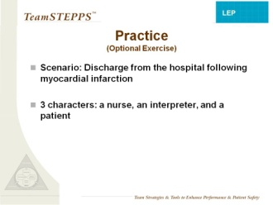
Optional Practice Exercise
INSTRUCTOR NOTE:
This exercise is optional. It may be useful if you have more than an hour to teach the module, or if you are teaching the module in segments over several days’ time.
SAY:
We’re going to practice briefing, including creating psychological safety, by having you read through a scenario where a patient is being discharged from the hospital after a myocardial infarction. I need someone to play the nurse, someone to play the interpreter, and someone to play the patient.
DO: Hand out the briefing exercise. Ask for volunteers to be the nurse, interpreter, and patient. Have them read the scenario. It is o.k. for them to deviate from the script and do more of a role play.
OPTIONAL EXERCISE TIME:
5 minutes
MATERIALS:
  Briefing exercise handout
17
Notes:
17

Slide 19
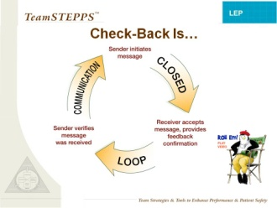
Check-Back Is…
SAY:
A check-back is a closed-loop communication strategy used to verify and validate information exchanged. The strategy involves the sender initiating a message, the receiver accepting the message and confirming what was communicated, and the sender verifying that the message was received.
A simple example of this is in the coffee shop when you order a tall nonfat soy latte, and the cashier says aloud, “Tall nonfat soy latte” and the person behind the counter repeats back, “Tall nonfat soy latte,” and you verify, “That’s correct.”
A clinical example would be an information call-out such as, “BP is falling, 80/48 down from 90/60.” The sender expects the information to be verified (repeated aloud) and validated and to receive a follow-on order that must be acknowledged with a check-back.
In the video, you will see a provider using check-back to confirm her understanding of what the patient was saying.
  DO: Play the “Check-Back” video clip.
  Play the video by clicking the penguin director icon on the slide.
SLIDE TIME:
3 minutes
VIDEO TIME:
:57 seconds
Notes:
18

Slide 20
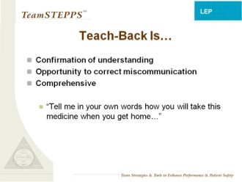
Teach-Back Is…
SAY:
While check-back simply verifies accuracy of a simple communication, teach-back is a method to confirm understanding of larger concepts or processes. In a teach-back, you ask people to tell you in their own words what they have learned or understood.
This technique can be most useful for interpreters, who can use the teach-back to correct any misinformation or missed communication.
Examples include asking patients to tell how they will take their medication when they get home or how they will explain their illness to their family.
SLIDE TIME:
1 minute
19

Slide 21
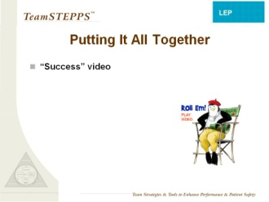
Putting It All Together
  DO: Play the “Success” video.
  Play the video by clicking the penguin director icon on the slide.
DISCUSSION:
What tools were used in this version that were not used in the first version of this scenario?
How did the use of those tools change the outcome?
What challenges might you have using these tools in your work?
How might you overcome these challenges?
Tell us about a time when these tools would have come in handy.
SLIDE TIME:
8 minutes
VIDEO TIME:
6:08 minutes
20
Notes:
20

Slide 22
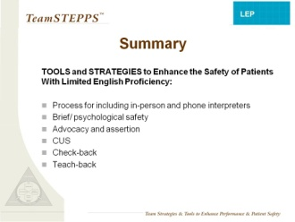
Summary
SAY:
In summary, here are tools and strategies that can enhance the safety of your patients with LEP:
Process for including in-person and /or phone interpreters
Brief/psychological safety
Advocacy and assertion
CUS
Check-back
Teach-back
SLIDE TIME:
1 minute
21

Slide 23
Training Evaluation
SAY:
Thank you very much for your participation today. Please take a few minutes to complete the training evaluations that are in your training packets. Then we will discuss this module. Everyone should complete two forms: the Training Participant Satisfaction Survey and the Learning Outcomes Survey. We anticipate this will take you no more than 15 minutes.
As a reminder, you do not have to put your names on any of the survey questionnaires. We are just using this information to get some feedback on how we did as trainers and to improve future trainings.
No Slide
POST-TRAINING EVALUATIONTIME:
15 minutes
MATERIALS:
  Training Participant Satisfaction Survey
  Learning Outcomes Survey
  Pens

