Slide 1

MedlinePlus Connect
Boost Box
October 9, 2012
Notes:
Hello everyone and thank-you for joining us today. A special thank-you to Diane Hauser, from the institute for family health in new york city who will be providing a demo of M+C from within a patient portal as well as discussing the usability studies conducted at the institute for family health. Before I turn it over to Diane, I just want to spend a few minutes bringing everyone up to speed on M+C and how it may be used to satisfy one of the core objectives for achievement of meaningful use.
I also want to give credit to Stephanie Dennis from the National Library of Medicine. Stephanie is involved in the development of M+C and much of the information on these slides has been taken or adapted from a March update that Stephanie provided for the regional medical libraries.

Slide 2
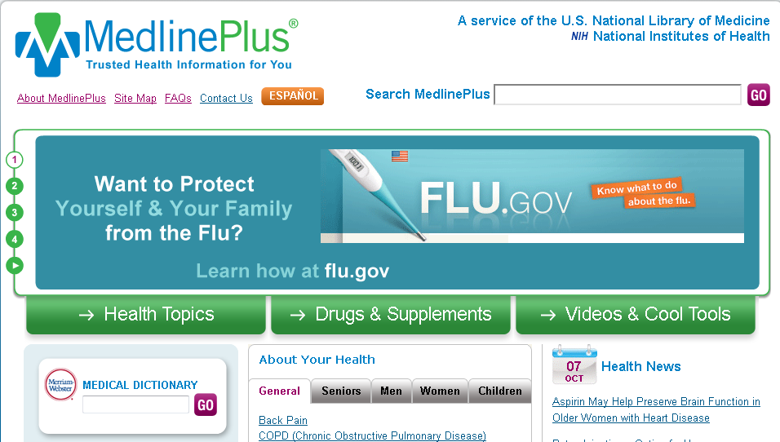
MedlinePlus Connect → MedlinePlus
Notes:
MedlinePlus Connect works by linking health IT systems, patient portals and electronic health record (EHR) systems to relevant, authoritative patient health information from MedlinePlus.gov.
As you know Medlineplus.gov contains:
Easy-to-Read materials on over 900 health topics - reviewed twice a year with new links added daily
The A.D.A.M. Medical Encyclopedia - updated quarterly
Interactive Tutorials and Anatomy and surgery Videos – updated annually

Slide 3

MedlinePlus Connect → returns related MedlinePlus information
  Problem codes (diagnosis): ICD-9-CM and SNOMED CT®
  Medications: RXCUI (RxNorm Concept Unique ID) and NDC
  Lab tests: LOINC®
  HL7 Context-Aware Knowledge Retrieval (Infobutton) standard
Notes:
MedlinePlus Connect accepts requests for information on diagnoses (problem codes), medications, and lab tests, and returns related MedlinePlus information.
It is available as a Web application or a Web service.
For problem code requests, MedlinePlus Connect supports:
ICD-9-CM (International Classification of Diseases, 9th edition, Clinical Modification)
SNOMED CT® (Systematized Nomenclature of Medicine, Clinical Terms). Note: MedlinePlus Connect coverage of SNOMED CT focuses on CORE Problem List Subset codes (Clinical Observations Recording and Encoding) and their descendants.
MedlinePlus Connect will support ICD-10-CM when it becomes the U.S. standard.
For medication information, MedlinePlus Connect supports:
RXCUI (RxNorm Concept Unique Identifier)
NDC (National Drug Code)
The drug info in medline plus comes from the AHFS­ Consumer Medication Information and is licensed for use on MedlinePlus from the American Society of Health-System Pharmacists, ASHP, Inc.
AHFS™ was first published in 1959 as an adaptation from the Hospital Formulary of Selected Drugs
For lab tests, MedlinePlus Connect MedlinePlus Connect supports:
LOINC® (Logical Observation Identifiers Names and Codes)
And returns applicable information from the licensed A.D.A.M. encyclopedia, which is in MedlinePlus.
MedlinePlus Connect supports the HL7 Context-Aware Knowledge Retrieval (Infobutton) standard.
EXTRA INFO:
information on diagnoses and lab tests in English or Spanish
drug information in English only.
M+C is available as a web service or web application

Slide 4


MedlinePlus Connect
Problem, medication, or lab
code-based request
EHR/Health IT System
MedlinePlus Connect
Consumer health information targeted response
Patient portal
Clinical system
Notes:
Schematic compliments of NLM’s MedlinePlus connect team

Slide 5
EHR Certification Criteria: ONC Rule
Aug 23, 2012: Final rule from the Office of the National Coordinator for Health Information Technology (ONC)
  RxNorm, SNOMED CT®, LOINC®
  HL7 Context-Aware Knowledge Retrieval (Infobutton) standard
Certified EHR technologies need to include to support meaningful use under CMS EHR incentive programs
Notes:
Now, these standards: RxNorm, SNOMED CT, LOINC , and the infobutton standard that I just listed on the previous slide as being supported in MedlinePlus Connect have also been recently released, on Aug 23, in the final rule from the Office of the National Coordinator as designated standards and implementation specifications that certified EHR technologies need to include in order to support the achievement of meaningful use under the Centers for Medicare Medicaid Services (CMS) EHR incentive programs.

Slide 6
Meaningful Use: CMS Rule
Aug 23, 2012: Centers for Medicare and Medicaid Services (CMS) published a final rule that specifies stage 2 criteria:
  To participate in EHR Incentive Programs
  To avoid ‘payment adjustments’
Criteria take effect 2014
Notes:
Additionally, On August 23, the centers for medicare and medicaid services (CMS) published a final rule that specifies the Stage 2 criteria that eligible professionals (EPs), eligible hospitals, and critical access hospitals (CAHs) must meet in order to continue to participate in the Medicare and Medicaid Electronic Health Record (EHR) Incentive Programs.
It also specifies Medicare “payment adjustments” for Eligible Professionals (EPs) & hospitals that fail to demonstrate Meaningful Use of certified EHR technology.
The earliest that the Stage 2 criteria will be effective is in fiscal year 2014 for eligible hospitals and CAHs or calendar year 2014 for EPs.
(MY NOTES: In the Stage 1 meaningful use regulations, CMS had established a timeline that required providers to progress to Stage 2 criteria after two program years under the Stage 1 criteria. This original timeline would have required Medicare providers who first demonstrated meaningful use in 2011 to meet the Stage 2 criteria in 2013.
However, we have delayed the onset of Stage 2 criteria. )
Stage 2 overview tipsheet:
http://www.cms.gov/Regulations-and-Guidance/Legislation/EHRIncentivePrograms/Downloads/Stage2Overview_Tipsheet.pdf

Slide 7
Meaningful Use: CMS Rule
EPs must meet 17 core objectives and 3 menu objectives = 20 total core objectives
Eligible hospitals and CAHs must meet 16 core objectives and 3 menu objectives = 19 total core objectives
Core Objective: Use certified EHR technology to identify patient-specific education resources
Notes:
To demonstrate meaningful use under Stage 2 criteria—
Eligible Professionals (Eps) must meet 17 core objectives and 3 menu objectives that they select from a total list of 6, or a total of 20 core objectives.
Eligible hospitals and CAHs must meet 16 core objectives and 3 menu objectives that they select from a total list of 6, or a total of 19 core objectives.
The “Use of certified EHR technology to identify patient-specific education resources” is a core objective
Stage 2 overview tipsheet:
http://www.cms.gov/Regulations-and-Guidance/Legislation/EHRIncentivePrograms/Downloads/Stage2Overview_Tipsheet.pdf

Slide 8
Patient-Specific Education Resources
“Use clinically relevant information from Certified EHR Technology to identify patient-specific education resources and provide those resources to the patient.”
Notes:
The core objective for patient-specific education resources states, ““Use clinically relevant information from Certified EHR Technology to identify patient-specific education resources and provide those resources to the patient.”

Slide 9
Patient-Specific Education Resources
“…these resources or materials do not have to be stored within or generated by the Certified EHR Technology. We are aware that there are many electronic resources available for patient education materials, such as through the National Library of Medicine, that can be queried via Certified EHR Technology (that is, specific patient characteristics are linked to specific consumer health content).”
Notes:
National Library of Medicine resources are specifically mentioned:
“…these resources or materials do not have to be stored within or generated by the Certified EHR Technology. We are aware that there are many electronic resources available for patient education materials, such as through the National Library of Medicine, that can be queried via Certified EHR Technology (that is, specific patient characteristics are linked to specific consumer health content).”

Slide 10
Method of Providing Patient-Specific Education Resources
“…The EP or hospital can then provide these educational resources to patients in a useful format for the patient (such as, electronic copy, printed copy, electronic link to source materials, through a patient portal or PHR).”
Notes:
The core objective for patient-specific education resources further states that Electronic links to materials are considered an acceptable method of providing patient-specific education resources

Slide 11
Measures for Providing Patient-Specific Education Resources
EPs: Provide educational resources to patients for >10% of all office visits.
Hospitals: Provide educational resources to >10% of all unique patients admitted to inpatient or emergency departments
Notes:
And finally, the measures for providing patient- specific education resources indicate this must be done
>10% of the time for all eligible professional (EP) office visits
And
>10% of the time for all unique patients admitted to inpatient or emergency departments

Slide 12
National Outreach Initiative
  HIT workforce/HIT schools
  Medical librarians
  RECs
  FQHCs
Notes:
MedlinePlus Connect has been identified by the 8 regional medical libraries and the national network office as a national outreach initiative.
This means the 8 regional medical libraries are working together on a task force to educate and promote M+C.
The task force was just formed in early 2012. So far, we have identified 4 audiences to target for outreach:
HIT workforce/HIT schools
Medical Librarians
RECs (regional extension centers)
FQHCs (federally qualified health centers)
Currently the task force is proceeding with interviewing representatives from each of these populations in order to learn about each and help determine effective strategies for outreach.

Slide 13



Engaging Patients through
MedlinePlus Connect
Diane Hauser
The Institute for Family Health
dhauser@institute2000.org
This project has been funded in whole or in part with Federal funds from the National Library of Medicine, National Institutes of Health,
Department of Health and Human Services, under Contract No. HHS-N-276-2011-00003-C with the University of Pittsburgh-Health Sciences Library System.

Slide 14
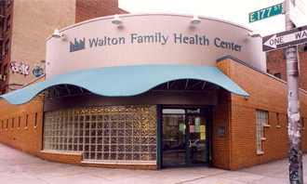
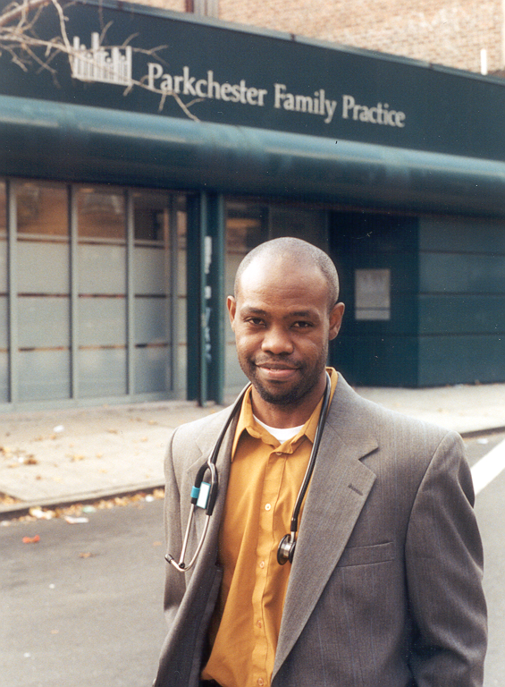
The Institute for Family Health
18 full-time Federally Qualified Health Centers (FQHC)
2 School based health programs
4 Dental centers
2 Mental health centers
2 Free clinics
8 Homeless healthcare sites
3 Family Medicine Residency Programs
>400,000 patient visits
90,000 unique patients
14% uninsured, 44% publicly insured

Slide 15
Implemented Epic in September 2002

Slide 16

Focus Group Findings
Excited about MyChart’s convenience
Concerns about self-efficacy
Don’t want MyChart to be a communication barrier
Less than expected concerns about privacy and confidentiality
Concern if test results released w/o discussion
Current Internet users for health information - but:
  -Overwhelmed by amount available
  -Want information approved by
  their doctor

Slide 17
Patient Survey –
Readiness for Health Information Technology (HIT)
466 survey respondents, English and Spanish
74% use the Internet
Main reason for those who do not: No computer
40% very likely to use Internet to look up health issues
71% have an email address
72% do not have need for computer training
20% very likely to participate in computer training
30% very likely to use a computer at health center
Caveats: Mostly English speaking patients, Mid-Hudson Valley majority

Slide 18
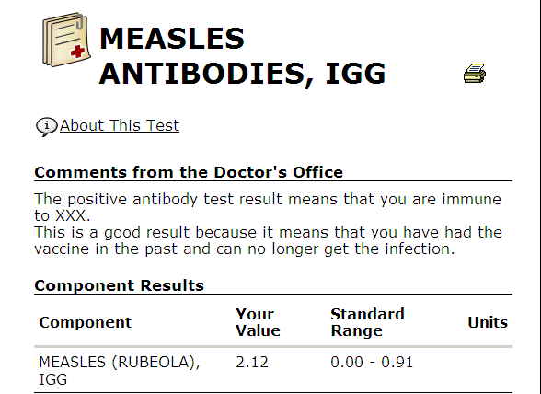
Usability Testing
Patients are confused by test results
Do I have Measles?

Slide 19
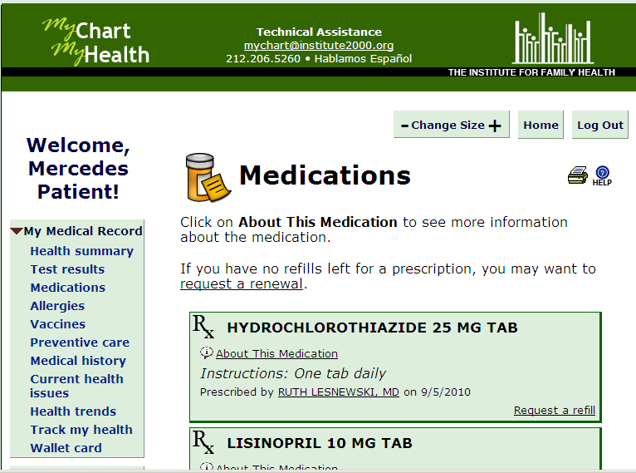
Patients want to understand
Why am I taking this medication?

Slide 20
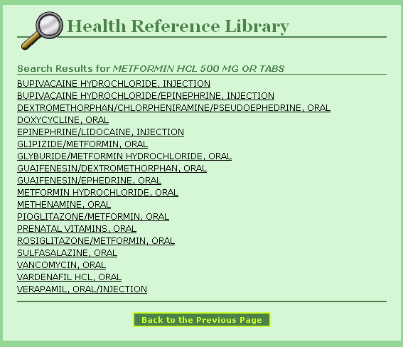
Original link for Metformin

Slide 21
Why MedlinePlus?
Commercial electronic health education libraries
-too expensive
-limited language options for diverse population
National Library of Medicine (NLM) continuously updates information and links
-over 800 diseases and conditions
-prescription and non-prescription drugs
-written at 5th – 8th grade level
-available in Spanish and up to 33 other languages
-easy-to-understand tutorials

Slide 22
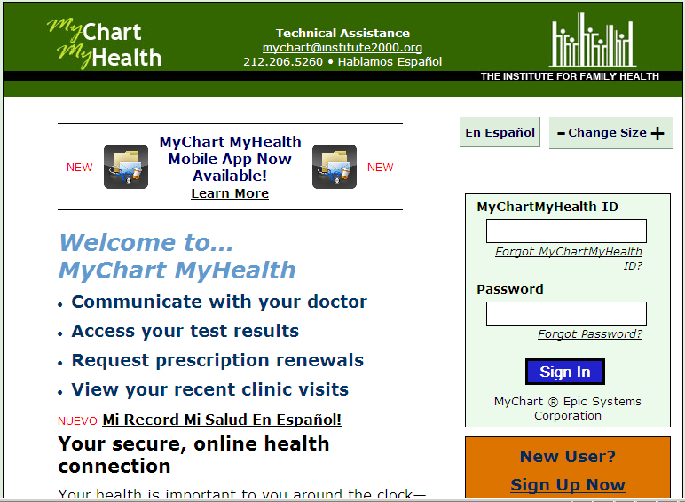

Slide 23
Frequent MedlinePlus Connect Searches

Slide 24
Demographics of Portal and
MedlinePlus Connect Users
Characteristic | MedlinePlus Connect Users | No MedlinePlus Connect Use | MyChart Users | No MyChart Use
N | 4,788 | 8,327 | 13,115 | 51,027
Mean age | 39.2 | 40.5 | 40.1 | 43.2
Women, n (%) | 69% | 67% | 67% | 61%
Race, n (%) white black unknown all other races | 39% 22% 12% 27% | 47% 18% 12% 23% | 44% 20% 12% 25% | 41% 23% 12% 24%
Ethnicity, n (%) Hispanic/Latino not Hispanic/Latino unknown | 26% 59% 16% | 22% 59% 19% | 24% 59% 18% | 23% 60% 16%
Preferred language, n (%) English Spanish missing all other languages | 91% 3% 6% 0 | 88% 3% 9% 0 | 89% 3% 8% 0 | 82% 8% 9% 1%

Slide 25
Insurance Status
Characteristic | MedlinePlus Connect Users | No MedlinePlus Connect Use | MyChart Users | No MyChart Use
N | 4,788 | 8,327 | 13,115 | 51,027
Insurance status, n (%) Uninsured + self-pay Private Medicaid Dual-eligible Medicare All others Unknown | 10% 45% 29% 0 8% 4% 4% | 10% 48% 25% 0 10% 4% 3% | 10% 47% 26% 0 9% 4% 4% | 16% 29% 31% 0.5% 15% 3% 5%)

Slide 26
Health Conditions
Characteristic | MedlinePlus Connect Users | No MedlinePlus Connect Use | MyChart Users | No MyChart Use
Number of clinical encounters, mean | 3.1 |  | 3.1
Number of chronic conditions, mean | 0.96 | 0.86 | 0.89 | 0.85
Individual chronic conditions, n (%)
hyperlipidemia | 17% | 17% | 17% | 15%
hypertension | 17% | 17% | 17% | 19%
depression | 20% | 16.5% | 18% | 15%
asthma | 13% | 11% | 12% | 10%
diabetes | 9% | 8% | 8.5% | 10%
HIV | 2.3% | 2.1% | 2% | 2%
chronic hepatitis | 2.6% | 1.9% | 2% | 2.7%
alcoholism | 2.2% | 2.0% | 2% | 2.5%
drug dependency | 2.8% | 2.5% | 3% | 4%

Slide 27

Patient Portal Classes
Patients excited when they saw MedlinePlus, started looking up health information on their own instead of following class

Slide 28
Thank you!
Questions??
Diane Hauser
dhauser@institute2000.org

