Slide 1
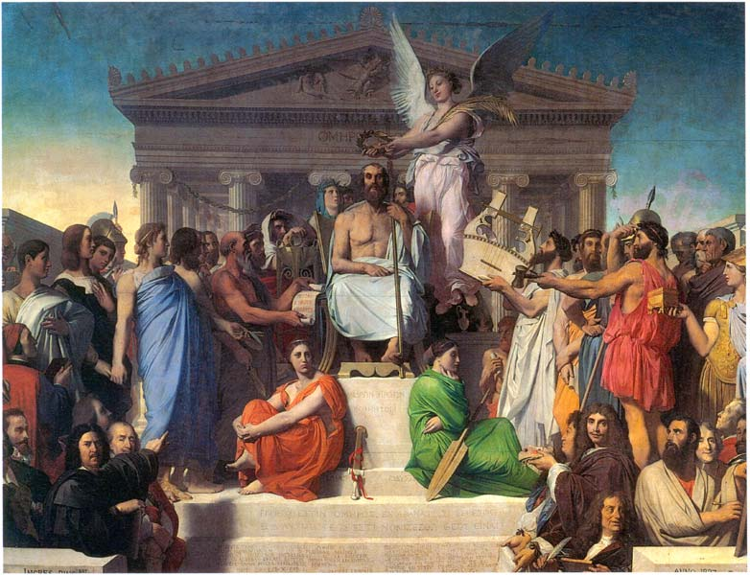
Achievements of the Tevatron Fixed-Target Program
Heidi Schellman
Northwestern University
Notes:
I am not here to sing the lay of the 43 Tevatron experiments as the begats alone take 3 days to recite.

Slide 2
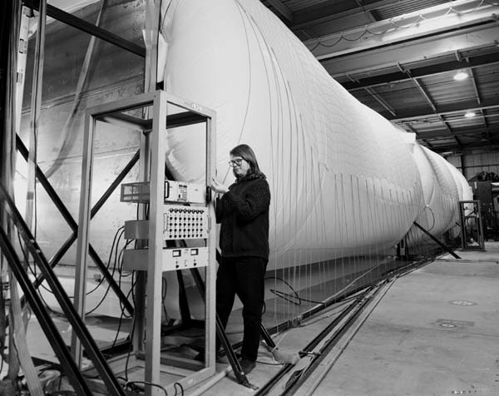
Tevatron II (1983-2000)
43 experiments in many different beamlines
> 400 doctorates from >100 Universities in 18 countries
More than 300 publications
Typical postdoc
http://conferences.fnal.gov/tevft/ has it all
Notes:
Many of the “usual” suspects were trained on Tevatron II . For example, I once taught a young student how to strip a detector of any valuable components. Here she is reassembling them.

Slide 3
Achievements
Charm Physics and new technologies
CP violation and rare kaon decays
Nucleon spin and structure – anti-quarks and gluons
QCD tests at many scales
Hyperons galore
Precision measurements of standard model parameters (V_{us}, V_{dc}, α_{S}, θ_{W} ...)
Creation and detection of ν_{τ}
Notes:
I’m not going to show all of these in a 20 minute talk

Slide 4
TeV II
Every minute
ramp from 0-800 GeV
Deliver up to 3x10¹³ protons/cycle
> 10 dipoles gave their lives for TeV II
Notes:
Every minute the Tevatron would ramp from 0-800 GeV and deliver a 23 second spill of up to 3 x10¹³ protons to switchyard.
The beam was split onto many different primary and secondary targets.

Slide 5
Why fixed target?
Collider
Tevatron I
Fixed Target
Tevatron II
~1960 GeV
~40 GeV
Notes:
Heck - why bother

Slide 6
Advantages
  Higher Luminosity
    10¹³ p/min instead of 10¹³ p/day
    10³⁶/cm²/sec vs 10³²/cm²/sec
  Longer, more flexible detector designs
  Hot and cold running exotic particle beams
  Smaller groups

Slide 7
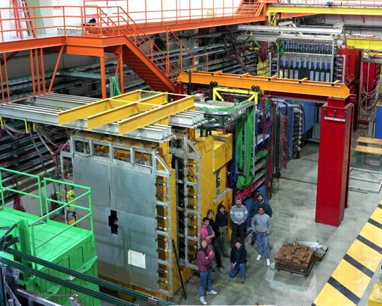
Generic detector (E687)
Target
Silicon microstrips
Scint. Counters
Tracking chambers
Particle ID
EM calorimeter
Hadron calorimeter
Muon detector
Notes:
The generic detector consists of a high precision silicon strip detector followed by magnets, tracking systems, Cerenkov detectors for particle identification, Electromagnetic and hadronic calorimeters, and finally, a muon filter and detector.
Robert Wilson pioneered the idea of painting these colors other than hospital green

Slide 8
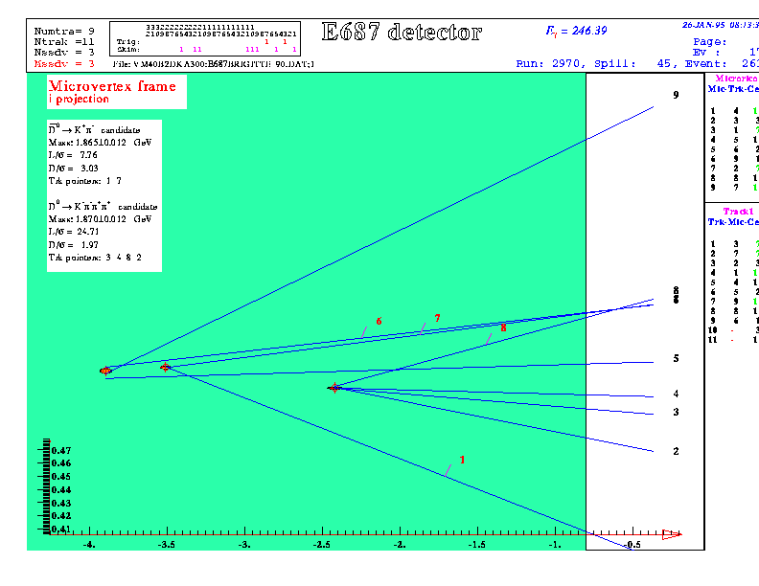
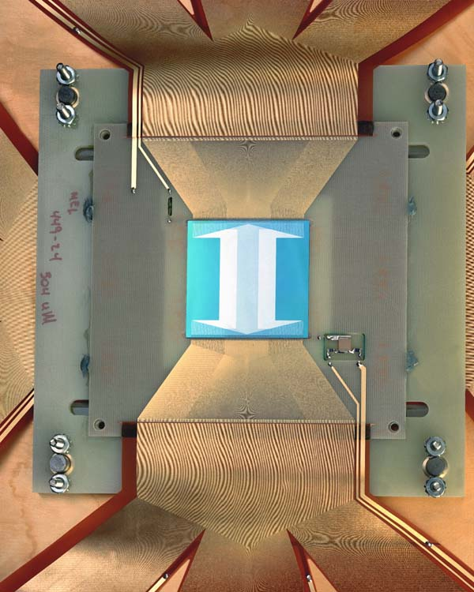
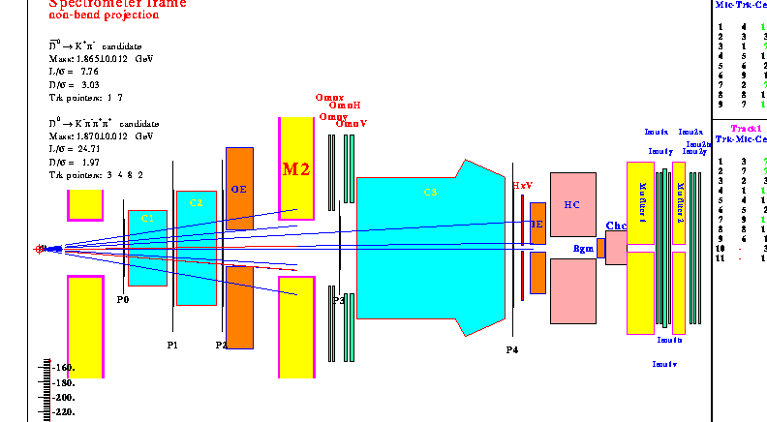
Photon
High statistics Charm physics
Use silicon strip detectors to identify charm in humungous background
E687 – photon beam
Notes:
An E687 event showing a photon beam producing a fully reconstructed D Dbar pair in the silicon detector. This was not easy.

Slide 9
Charm rates at E791
Pion beam at 2 MHz
The target consisted of 5 foils:
  A 0.5 mm Pt target and
  Four 1.6 mm C (diamond) targets
Interaction rate of 40 kHz – 10 kHz written to tape
Only 1/1000 of the events were charm
A total of 2 x 10¹⁰ events were recorded.
D_{s}
D⁺
Slides from M. Purohit
Notes:
Another example was E791 which went for even higher luminosity with a pion beam. Interaction rate was 40 kHz and they wrote 10kHz to tape. 1/1000 were charm

Slide 10
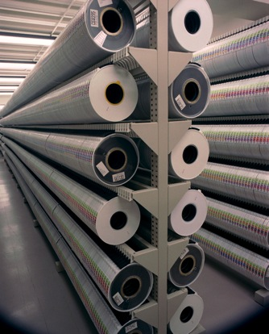
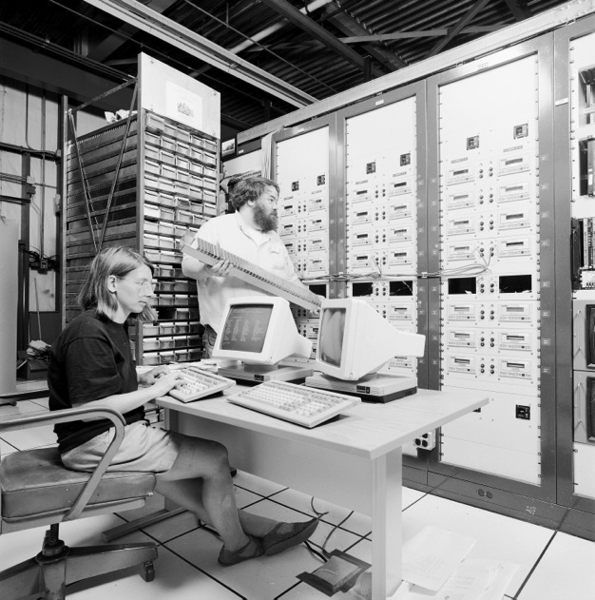
E791
charm
Before
E791

Slide 11
Data Volume per experiment (in Gbyte)
CMS
E791
KTeV
LEP
E691

Slide 12
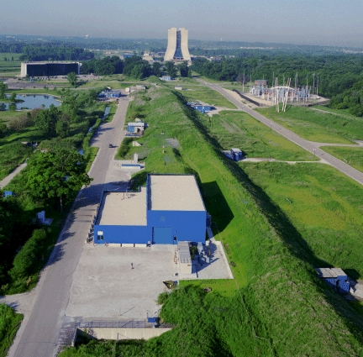
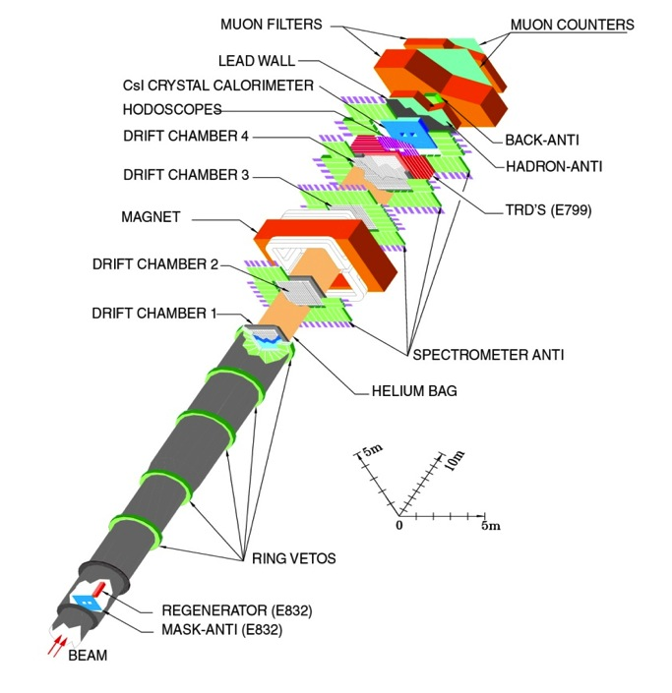
KTeV: high intensity kaon beams
Notes:
Now on to a very rare decay experiment KTeV
The detector consists of a very long decay pipe, followed by tracking and calorimetery

Slide 13
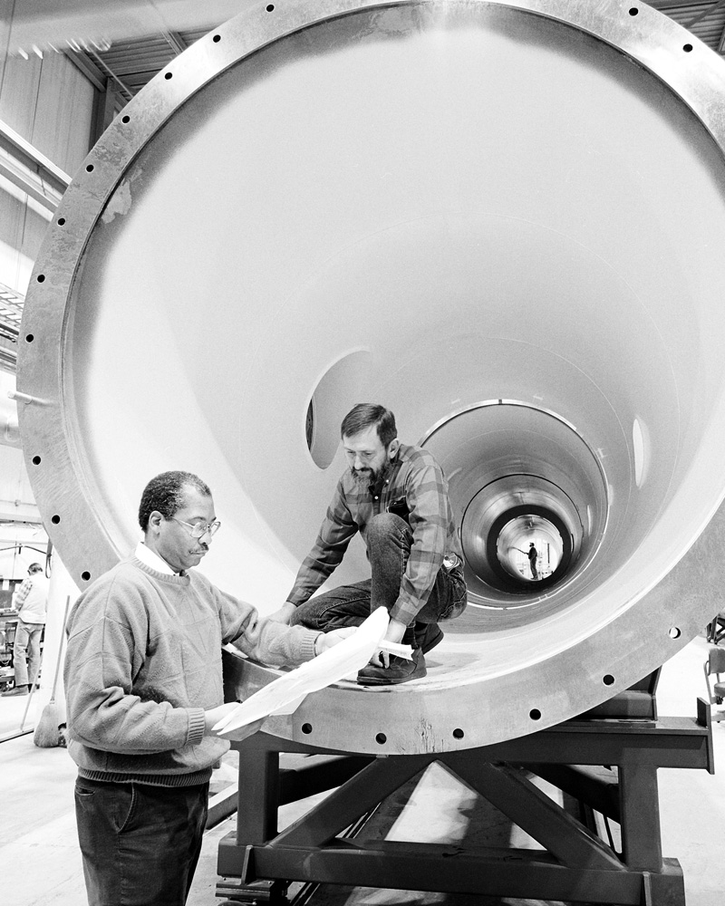

Slide 14
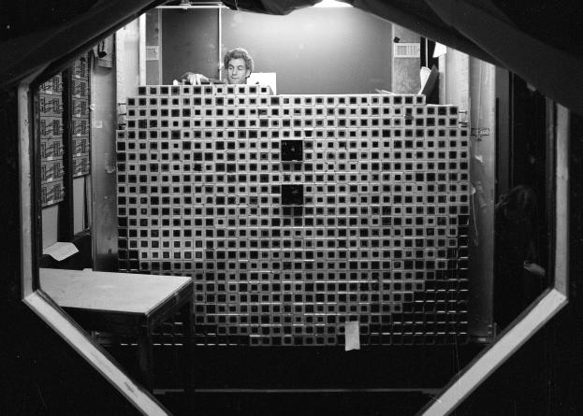
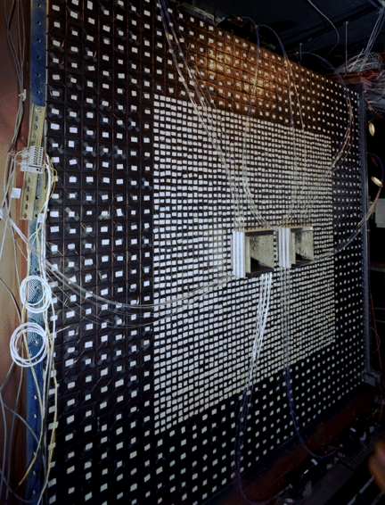
KTeV Pure CsI Calorimeter
3100 crystals, 1.9mx1.9m
27 X₀ deep (50cm)
0.6% energy resolution
E731 lead glass
KTeV CsI
K_{L}gπ⁺π⁻e⁺e⁻
Notes:
This shows the Cesium Iodide calorimeter – with the predecessor lead glass calorimeter. The “typical” event is a rare decay that was discovered at KTeV – with 5000 events.

Slide 15
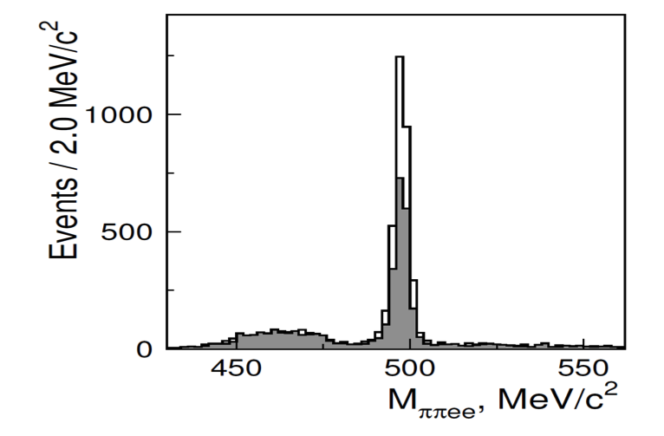
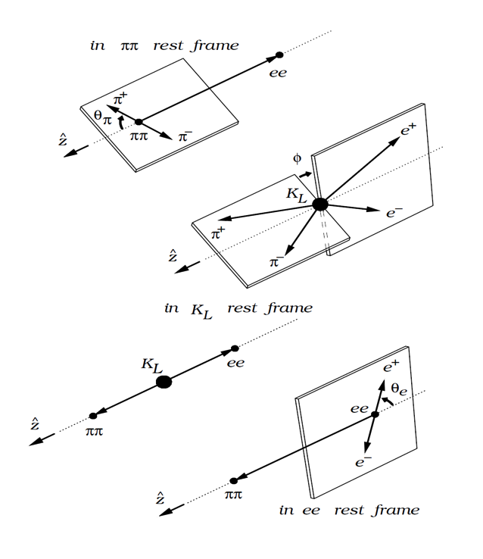
Example of Intensity
Discovery of K_{L}gπ⁺π⁻e⁺e⁻
Branching fraction of 4x10⁻⁷
Phys. Rev. Lett. 96, 101801 (2006).
KTeV
sinφcosφ is T-odd
Gray: sinφcosφ<0; Clear: sinφcosφ>0
5000 events observed, sensitivity < 10⁻¹⁰.
Large T-odd, CP asymmetry observed.
Notes:
This slide shows the KL mass peak in the rare channel KL -> pipi e e. If one forms a plane from the pions and one from the electrons you can define a T odd variable. The plot shows the number of events for sin phi cos phi posiitve and negative. The T violation is the difference between the grey and white curves. Yikes.
They saw 5000, could have seen it if it was 1000 times as rare!

Slide 16
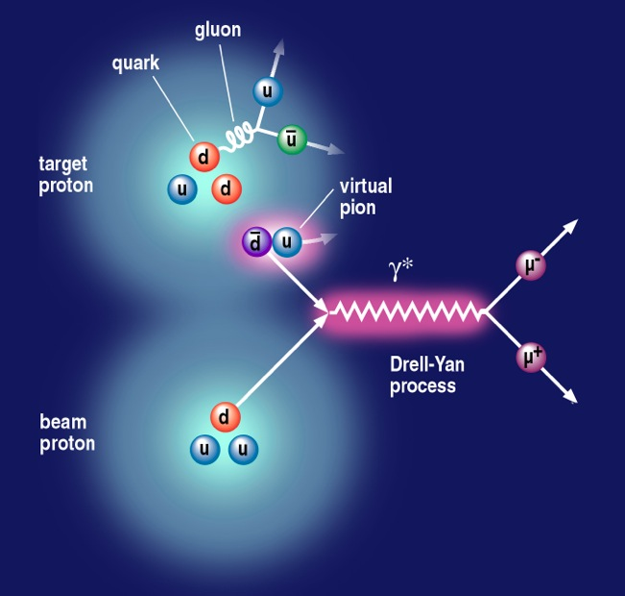
NUSEA – proton on protons
Proton Structure
Naïve expectation
anti-u = anti-d = anti-s
Collide protons on protons
Annihilate quarks and anti-quarks
Notes:
Now let’s use a lot of beam to look at proton structure.
Protons are made of 3 valence quarks but they also contain gluons and a “sea” of virtual quark anti quark pairs. Our first expectation would be that these “sea” quarks would be isospin symmetric. We can look at the antiquarks by annihilating them on the quarks from a proton beam to produce lepton pairs

Slide 17
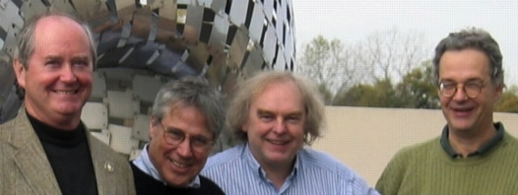
Momentum fractions
If you can pick out a type of quark, you can measure its momentum fraction
Vital input to almost all collider physics
Notes:
Can we patent this like

Slide 18
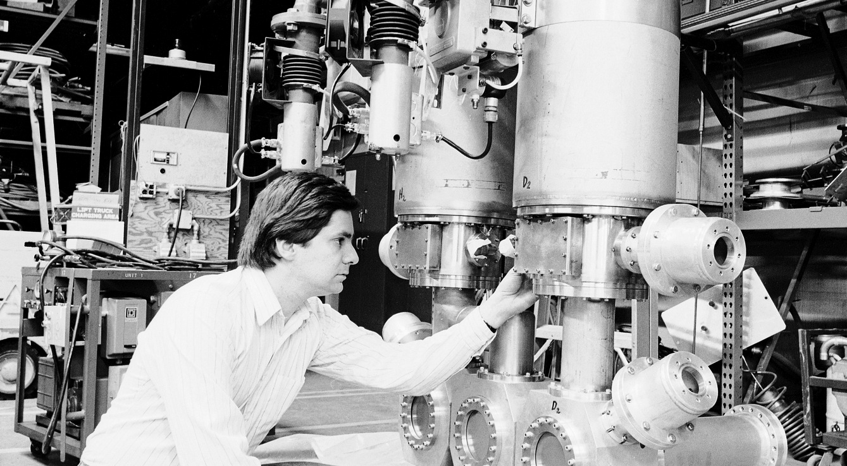
Hydrogen and deuterium targets
Content
50% u
50% d
Content
67% u
33% d
Notes:
By comparing deuterium to hydrogen and assuming isopsin and charge symmetry they could tell anti-d quarks from anti-u quarks.

Slide 19
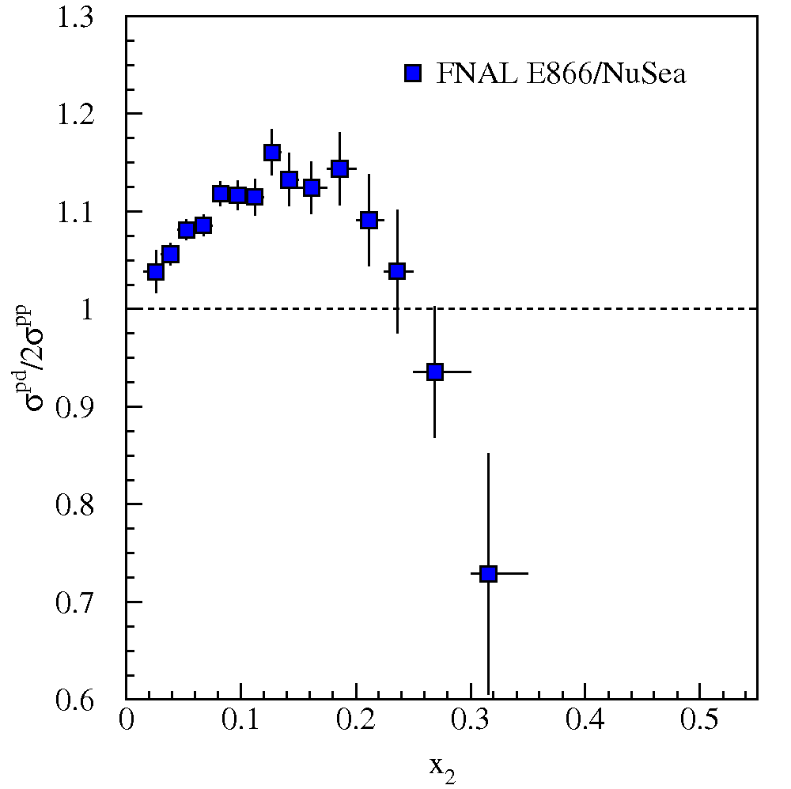
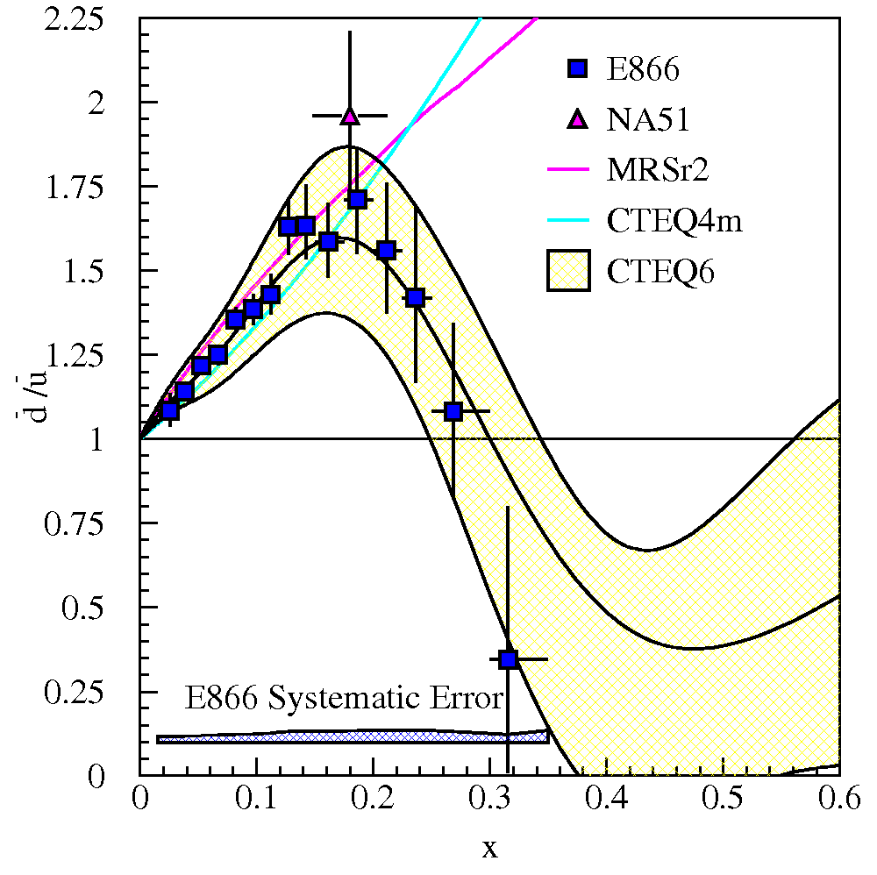

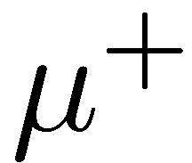
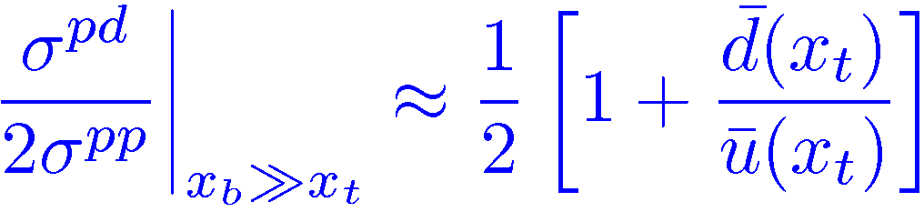

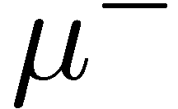
Drell-Yan Cross Section Ratio and dbar/u-bar
Yikes
Notes:
Big surprise – the d and u anti-quarks act differently as a function of their momenta! Everyone had to rewrite their parton code for CDF, D0 and the LHC.

Slide 20
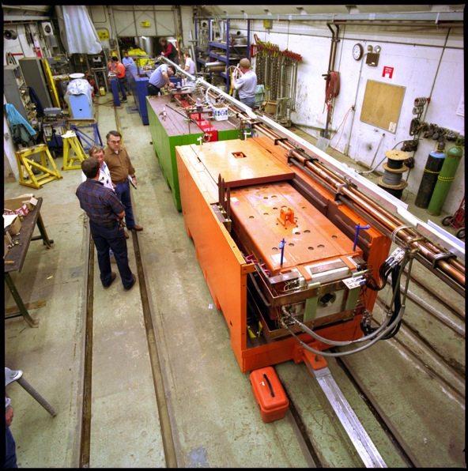
Use neutrinos to see strange quarks
NuTeV Sign Selected beam
< 0.1% anti-ν in ν
< 0.3% ν in anti-ν
Notes:
Now let’s use a neutrino beam to study quarks some more.
To tell quarks from anti-quarks it helps to have both a neutrino and anti-neutrino beam and be able to tell them apart. The NuTeV sign selected beam had almost no cross-contamination.

Slide 21
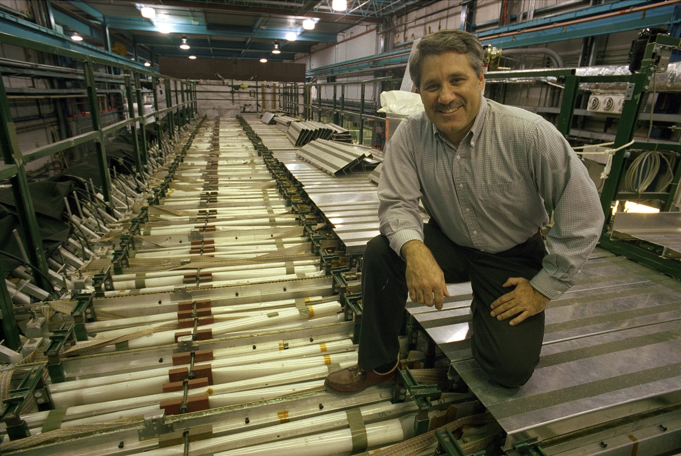
Mike Shaevitz on top of the 690 Ton target
NUTeV luminosity was ~3000 fb⁻¹

Slide 22
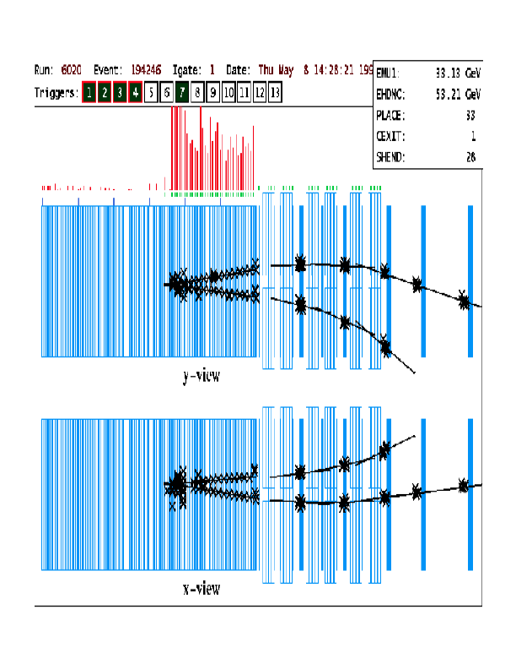
Strangeness
Neutrinos scattering can pick out strange quarks through the process
ν+s→μ⁻+c
c decays to μ⁺
Dimuons at NuTeV measure
Strange content s(x)
s/anti-s difference
V_{sc}/V_{dc}

Slide 23
NuTeV Weinberg Angle
Ratio of neutral to charged current interactions
Need the sign selected beam
Notes:
NuTeV measurement is several sigma larger than theoretical expectation – inspired measurement at the Tevatron and search for possible charge symmetry violation in nucleons.

Slide 24
Discovery of the tau neutrino (DONUT)
Make a ν_{τ} beam
Detect a τ decay
Notes:
Finally the most exotic beam of all.
The D(S) meson decays to tau lepton + tau neutrino about 5% of the time. So all you need to do is make D_s, let it decay before it interacts – put something in the way of all the other stuff to filter out junk and collect the tau neutrinos coming out the back end.

Slide 25
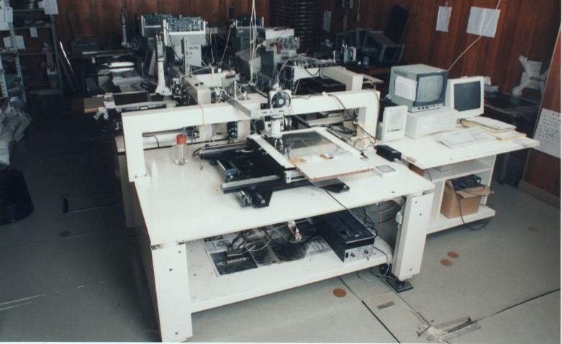
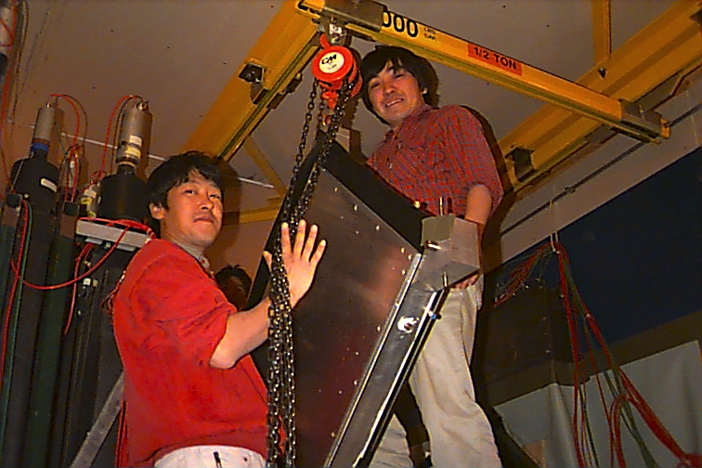
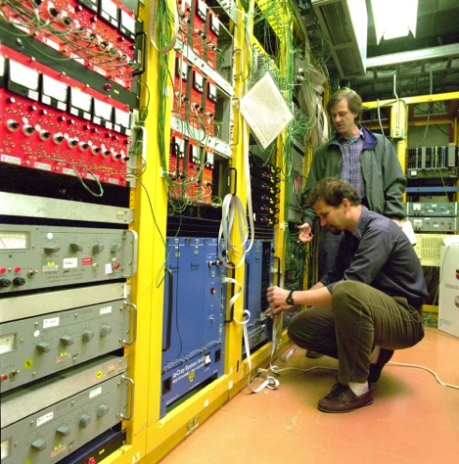
Emulsion modules and drift chambers
Emulsion plates interleaved with 1mm steel plates: total target mass 260 kg (not kt !)
Recycled drift chamber electronics
Notes:
Use 260 kG of emulsion, which must be taken to Japan and run through an automatic scanning machine
Note, drift chambers recycled from E665 – built by Schellman/Baller and lab 6.

Slide 26
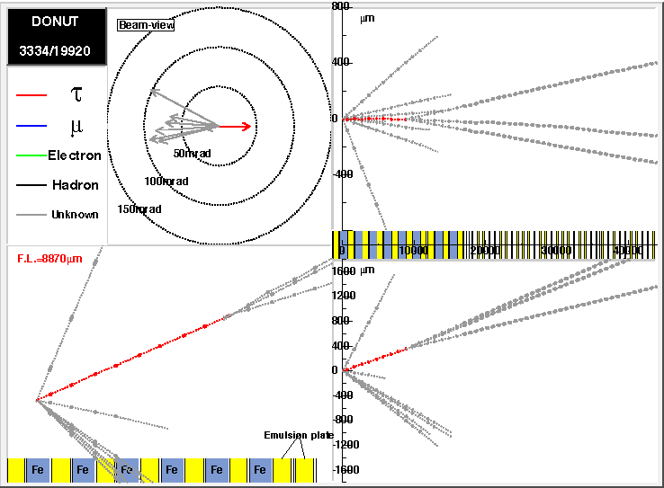
        Saw 9 candidates 7.52 v→τ + 1.48 background
τ → 3h± + ντ
~80 GeV τ : τ probability 0.99+
~9mm decay length
digitized emulsion information shown
Notes:
They saw 9 candidates and expected 1.5 background. Here is an example where the tau decays hadronically.
OPERA has now seen at least one of these from CERN

Slide 27
Conclusions
Tevatron II legacy
  Led to Detectors and computing used in all modern experiments
  High intensity and highest energy ever in fixed target
    Charm physics
    Kaon physics to 10⁻¹⁰
    Proton Structure
    Precision Standard Model Parameters
    Discovery of ν_{τ}

Slide 28
Not over yet
Fermilab fixed target lives at 8 and 120 GeV
Neutrino physics at 8 and 120 GeV
  Cross sections (MINERvA)
  Oscillations (MINOS, NOvA, MiniBooNE, MicroBooNE, LBNE …..)
  ???
Kaon Physics with ORKA
Proton Physics
  SEAQUEST – son of NUSEA
Your idea here

Slide 29
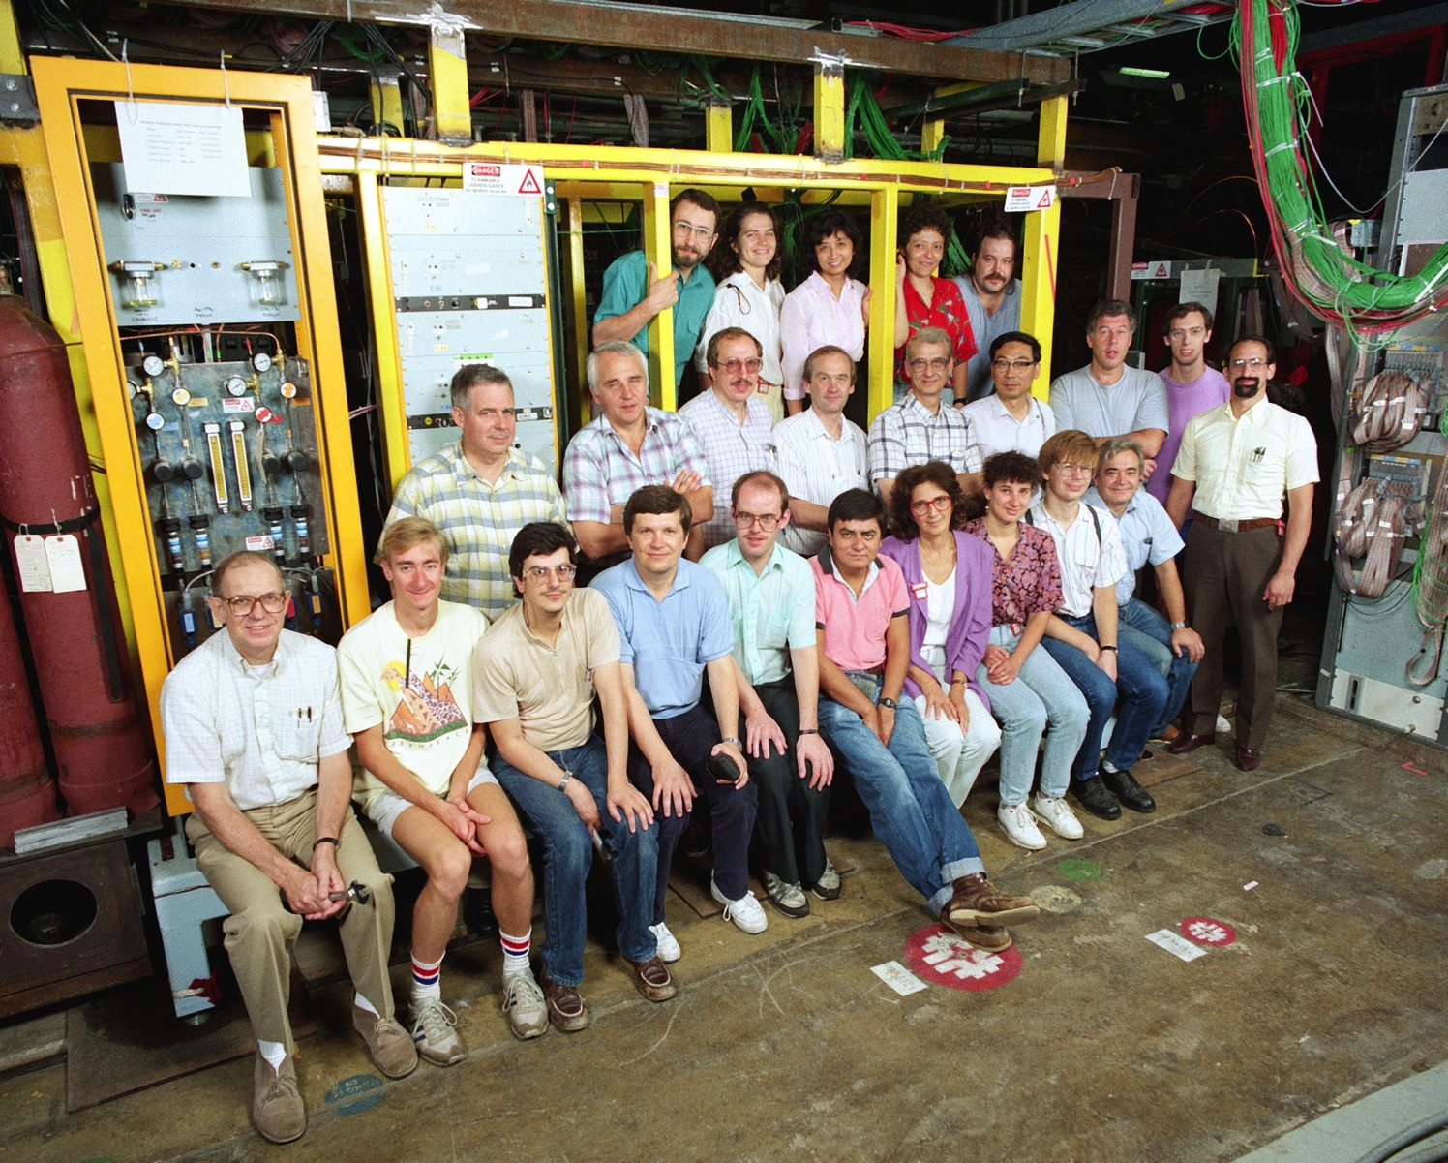

Slide 30
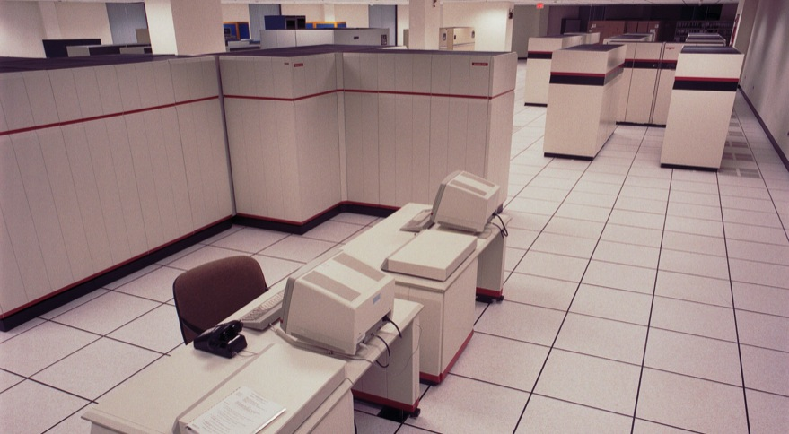
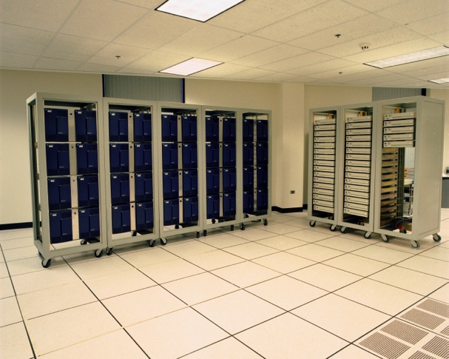
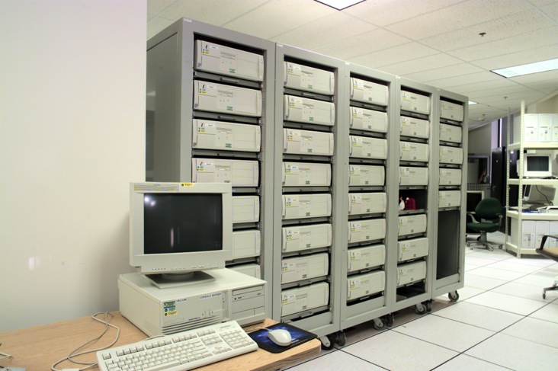
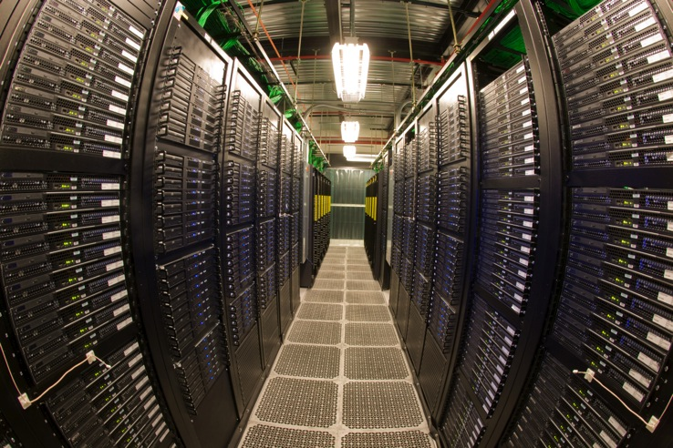
1990
1992
1999
2008
Notes:
This shows the Amdahl computer ~ 1990, the first silicon graphics and IBM farms in 1992, Linux farms in 1999 and part of the farms in 2008.
Circa 2000 someone thought that we would never need a big computer room again

Slide 31
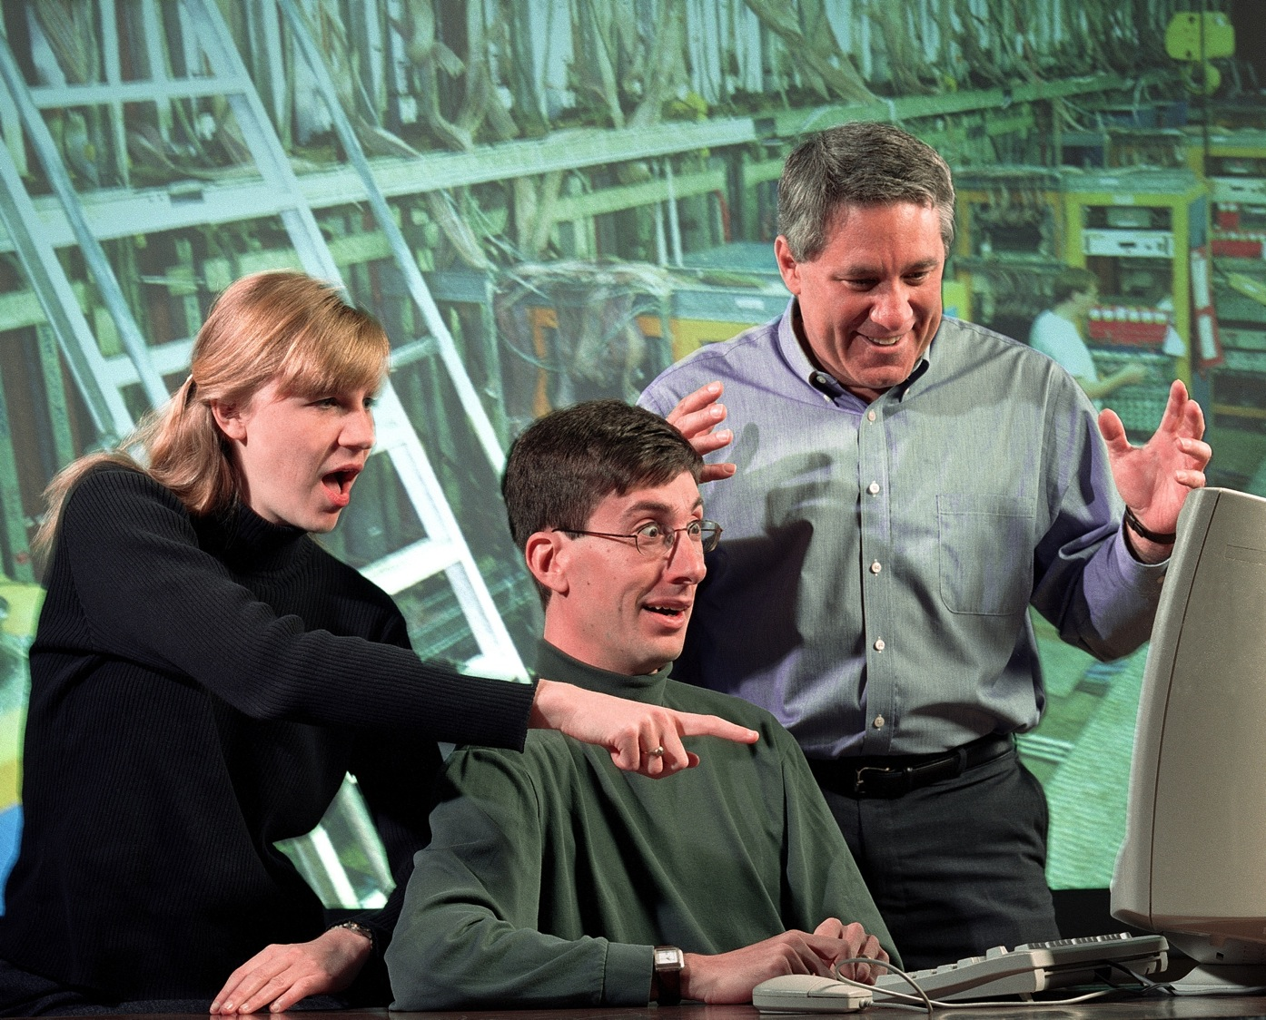

Slide 32
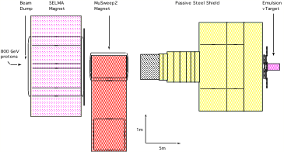
ν Beam and Shielding
μ⁺
ν
μ⁻
Muon rate ~10⁸ per 10¹³ protons
Muon rate ~ 2×10⁴ per 10¹³ protons in emulsion area
~5% of neutrinos are ν_{τ}
Notes:
Not so easy – there is a lot of stuff coming out the back, including products from charm production in the target. Use magnets to sweep the remaining muons out of the way before your detector.

Slide 33
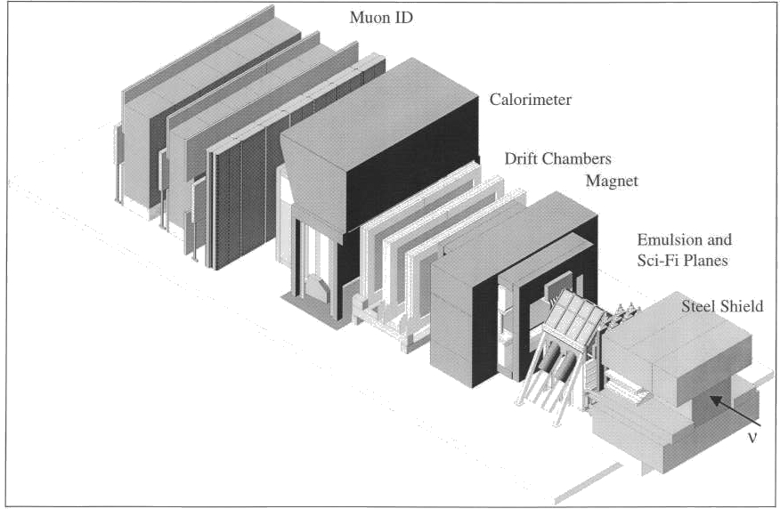
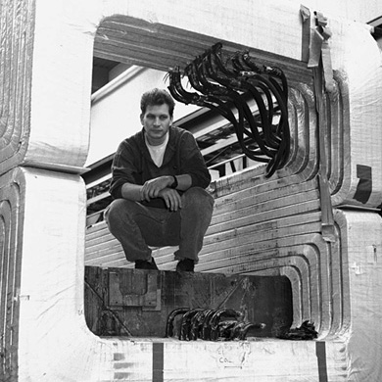
Another typical (small) spectrometer
Notes:
Build a small spectrometer.

Slide 34
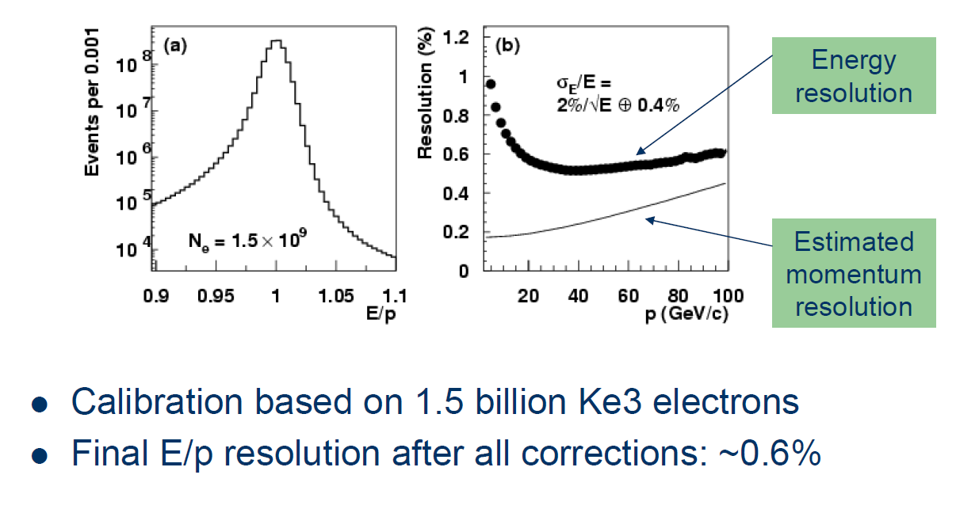
better than 1% resolution in EM calorimeter

Slide 35
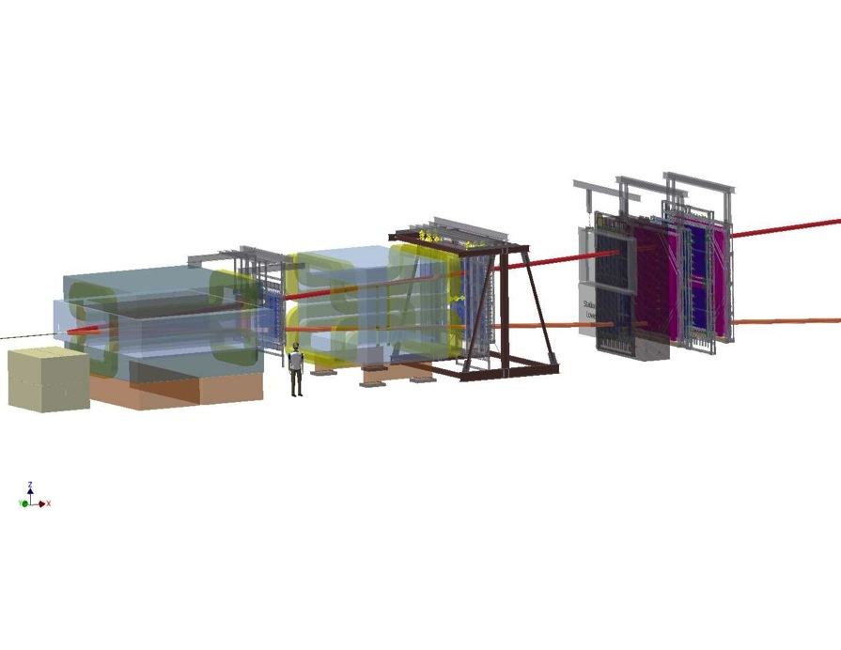
E866/NUSea
2x10¹² p/min
Muon momenta tell you the approximate quark momentum fraction x
Notes:
NUSEA took a lot of protons and aimed them at deuterium and hydrogen targets. The experiment is, as usual, generic, except that they put were really only interested in the muon pairs from annihilation. A very small fraction of the total interactions which occurred in the detector.

Slide 36
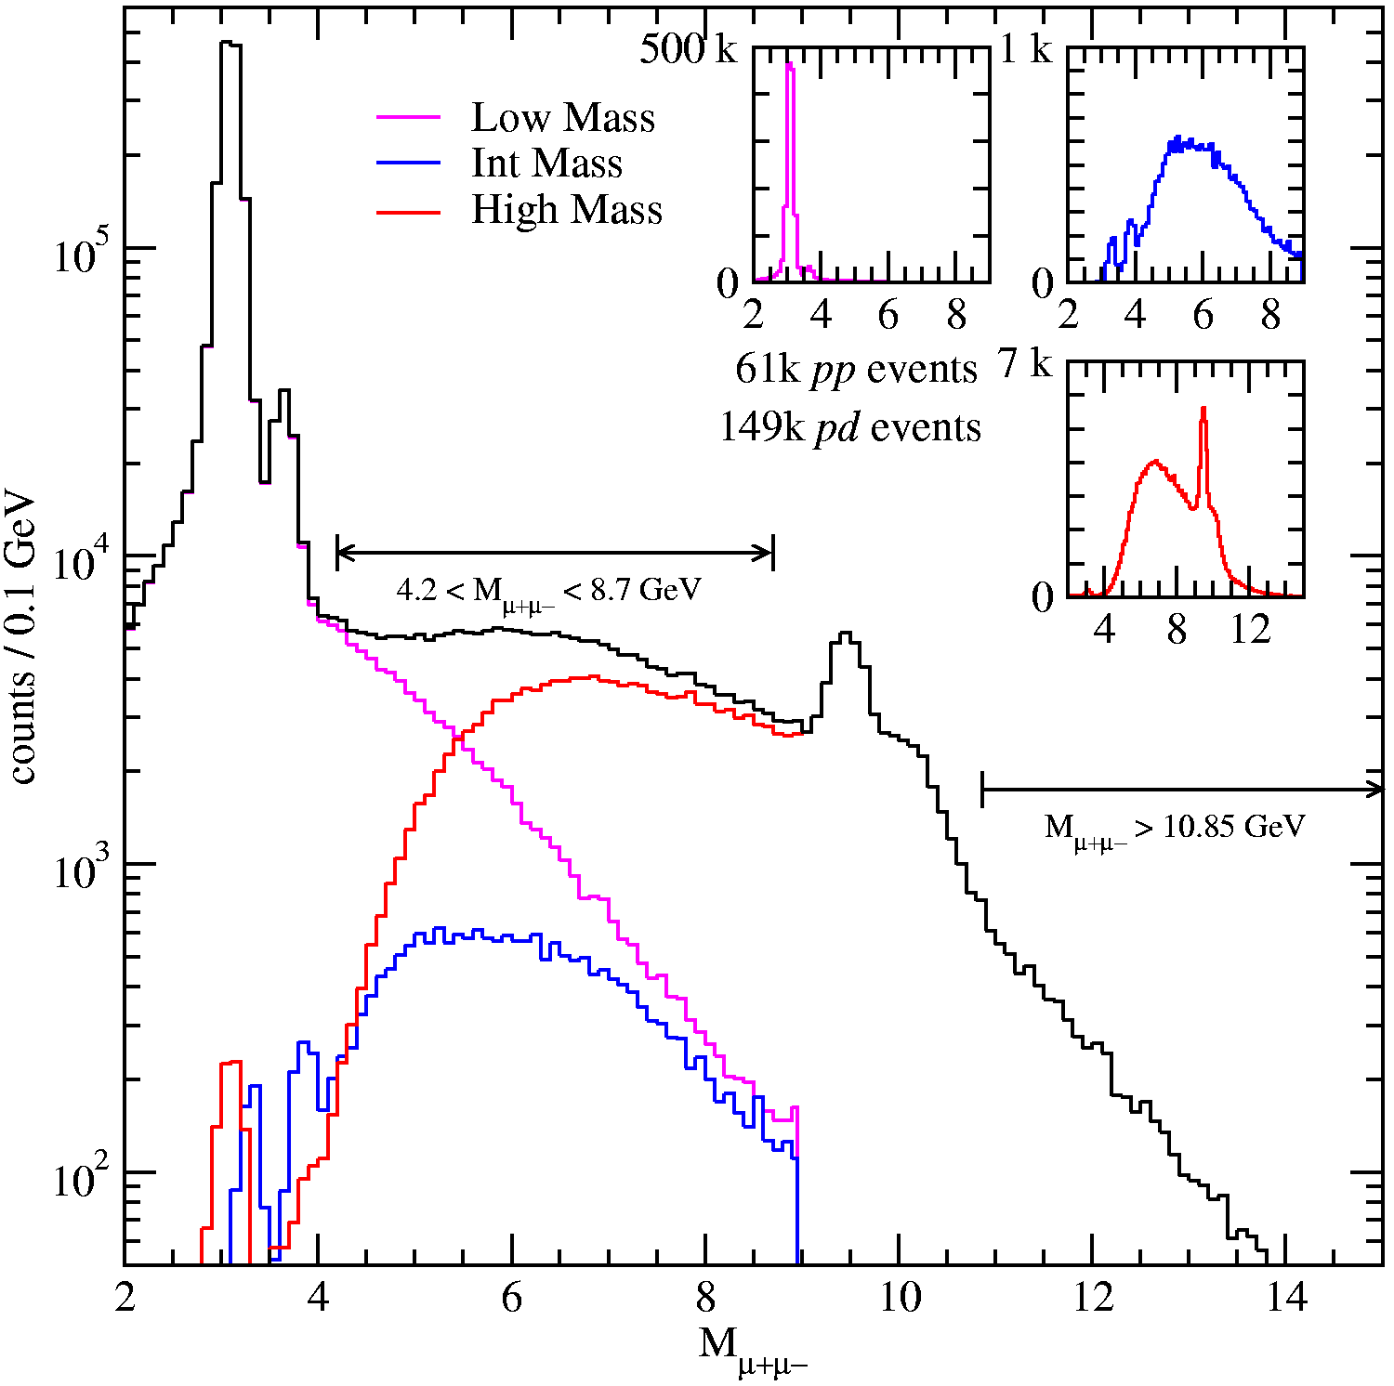

Slide 37
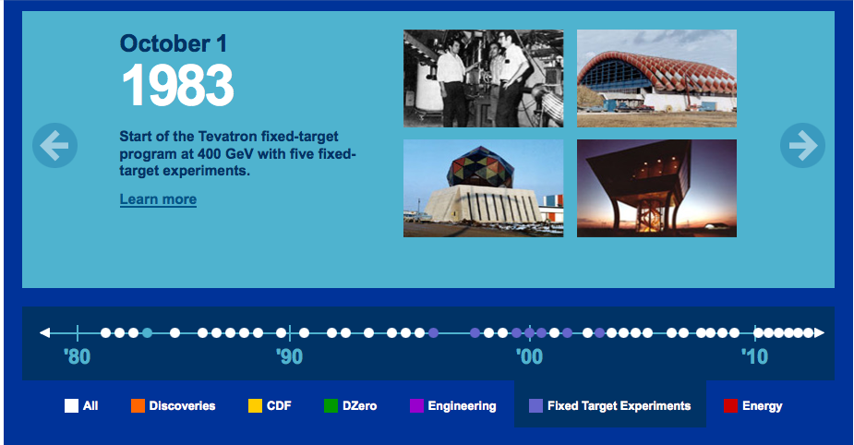
The beginning

