Slide 1
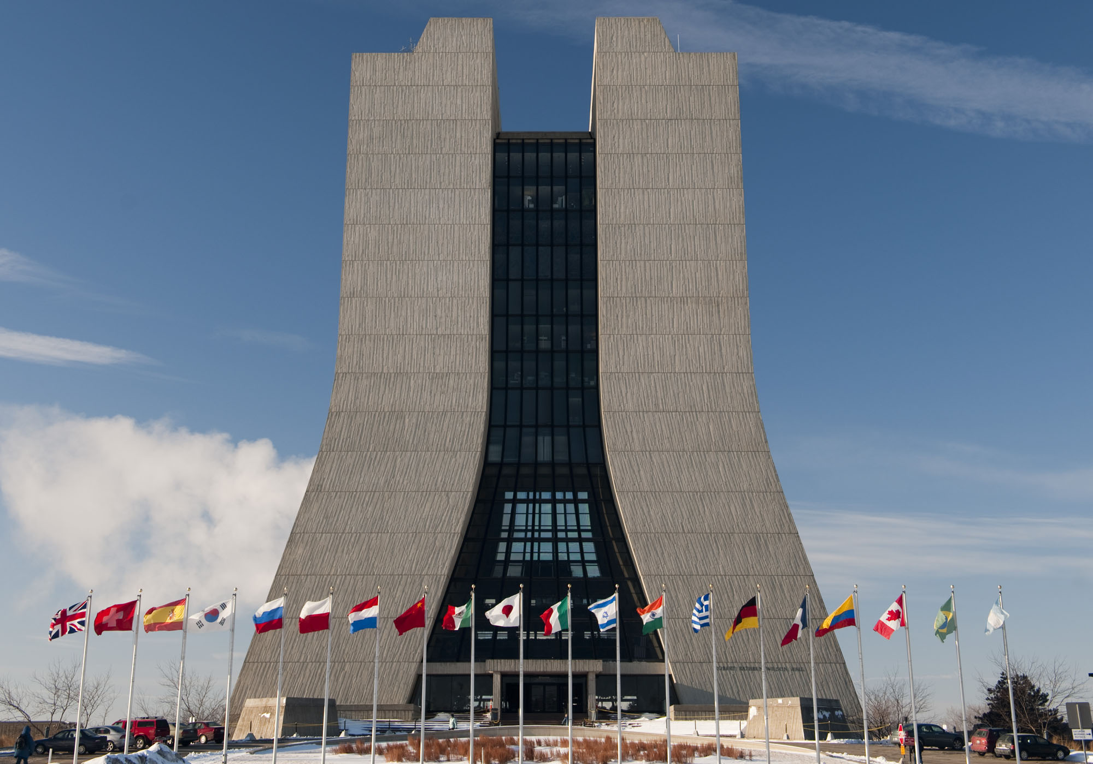
The future of
Fermilab
P. Oddone
Tevatron Symposium
June 11, 2012

Slide 2
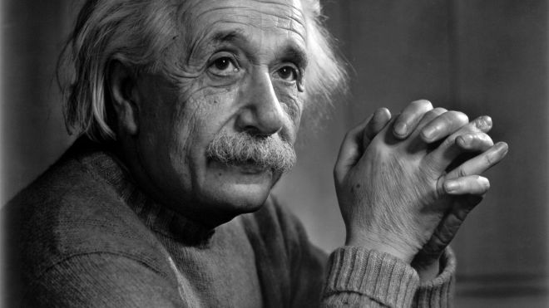
It is the best of times!
“The most beautiful experience we can have is the mysterious. It is the fundamental emotion which stands at the cradle of true art and true science”
The sense mystery has never been greater!

Slide 3
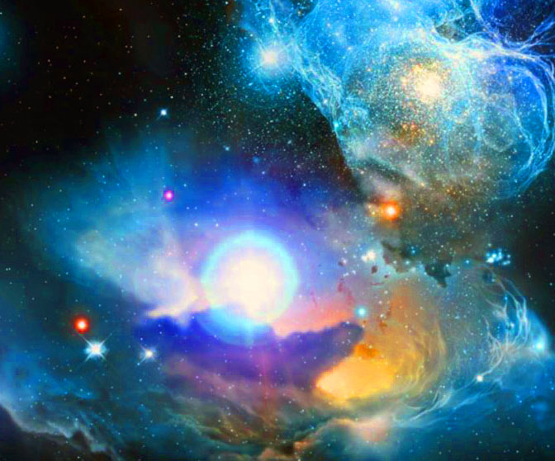
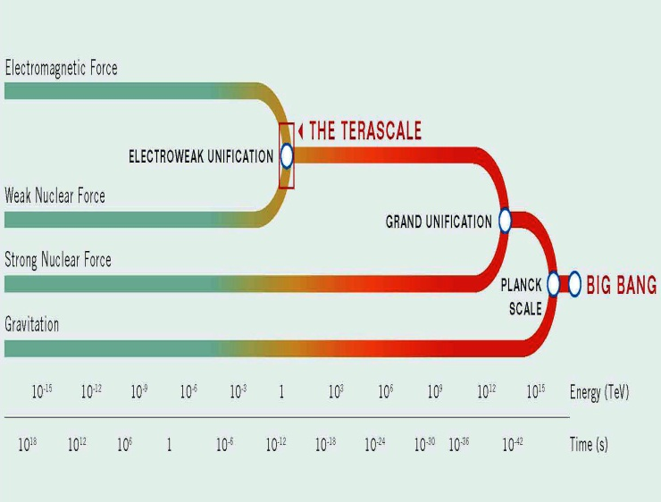
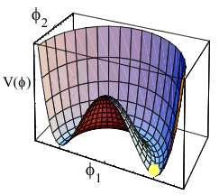
The sense of mystery….
Why are we not a soup of red photons?
Do all forces unify?
How do elementary particles get their mass?

Slide 4
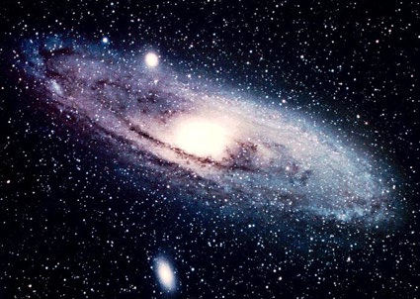
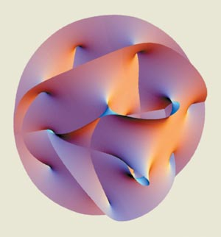
The sense of mystery….
ν
M
See-saw
Why are neutrinos so light?
What is dark matter?
Are there extra dimensions of space?

Slide 5
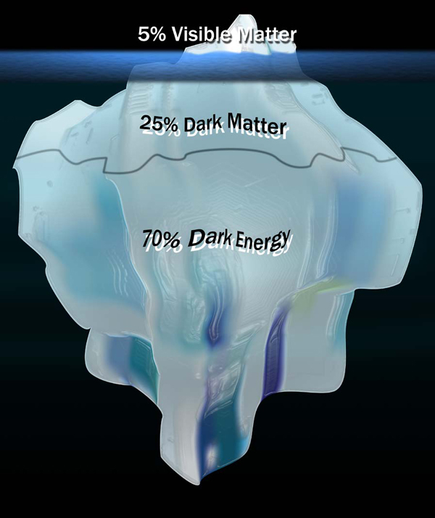
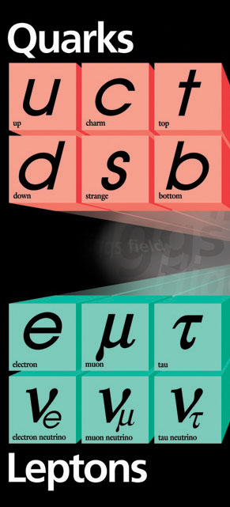
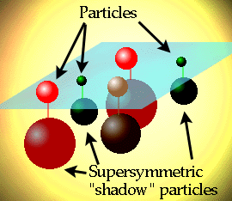
The sense of mystery….
Why three families of quarks and leptong?
What is dark energy?
Is there supersymmetry? Where?

Slide 6

Why are we so puzzled?
The present theory is a remarkable intellectual construction
Every particle experiment ever done fits in the framework
It allows us to define what is incomplete in our understanding, and there is much we are missing

Slide 7

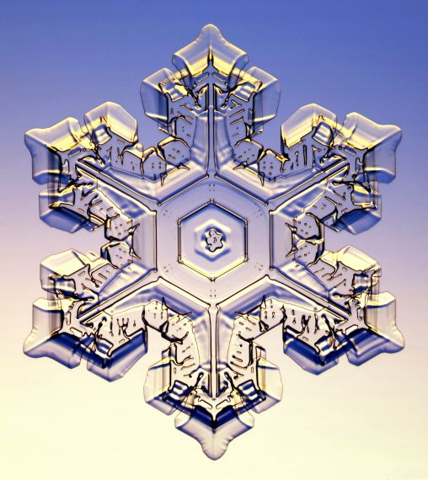



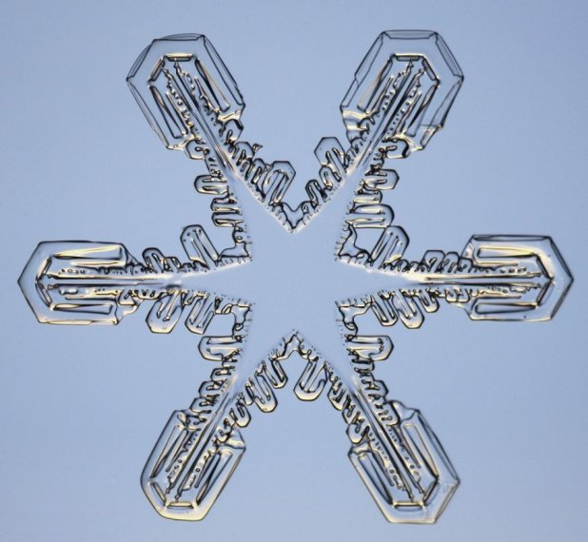
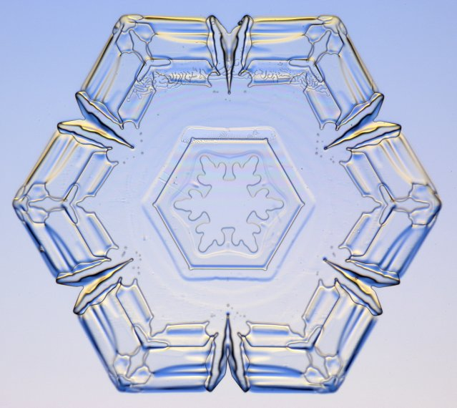
The quest to put it all together!
Is there an underlying simplicity?

Slide 8

The world has now a remarkable set of tools to try to answer these questions, and more in construction and in the planning stages. A global vision articulated by ICFA in Beacons of Discovery
Fermilab is an integral part of this global vision, with a unique set of tools and contributions to the world’s program

Slide 9
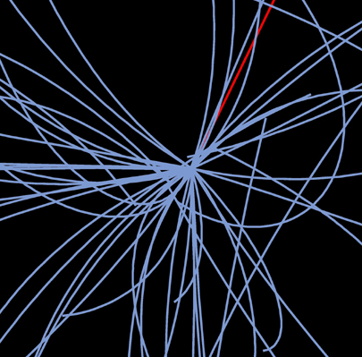
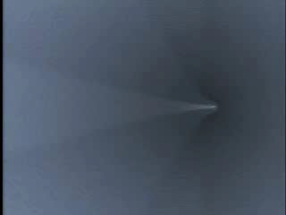
Energy Frontier
anti particle
E
particle
E = Mc²
Limit: a few TeV

Slide 10
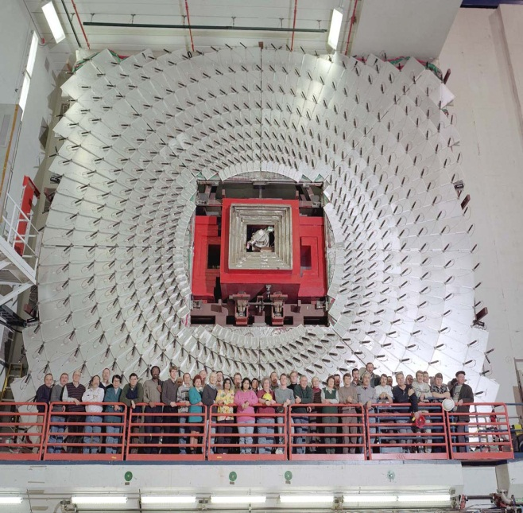
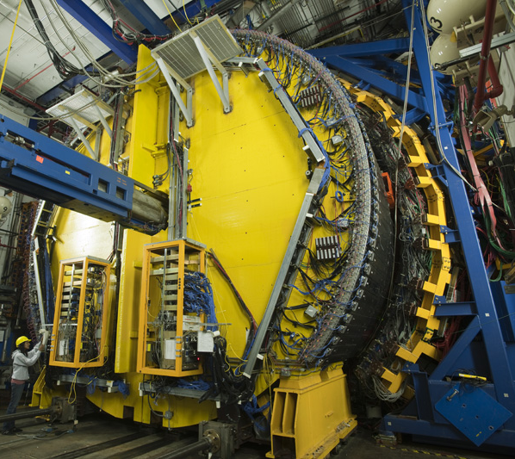
At the energy frontier….. now
DZero
CMS physics and LHC and CMS upgrades
CDF

Slide 11
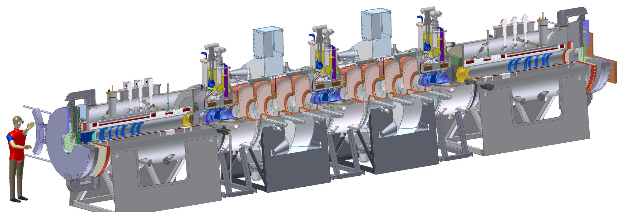
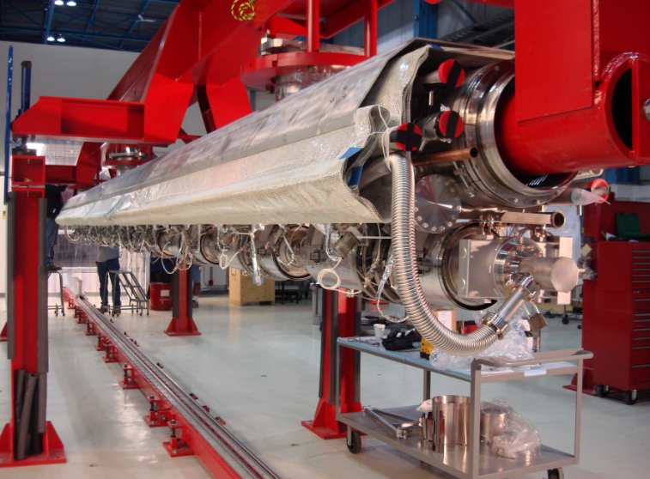
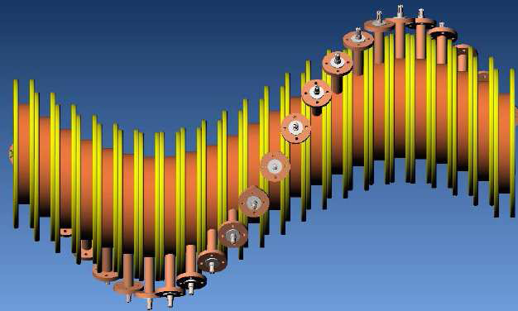
At the energy frontier….. future
Muon cooling and muon collider
ILC

Slide 12
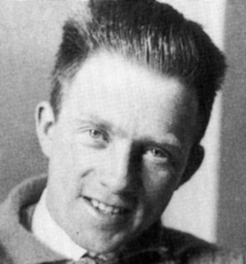
At the Intensity Frontier
Discover the nature of massive known & NEW particles
indirectly by intense beams of charged leptons and quarks
Quantum Fluctuation
Top
W, Z
….
NEW
High-intensity
particle beam
Rate for rare transition
E = Mc²
Limit ~10⁴ TeV
Uncertainty Principle

Slide 13
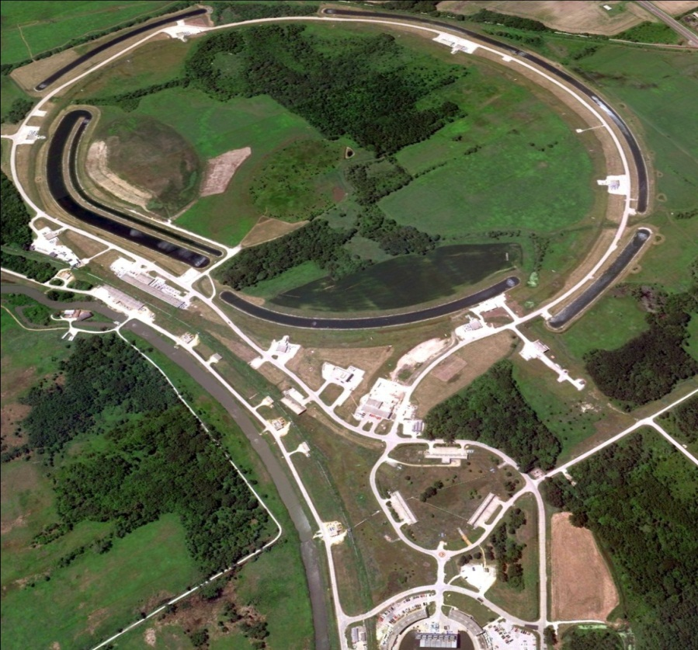
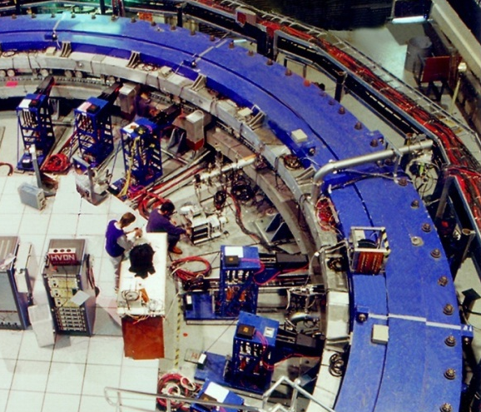


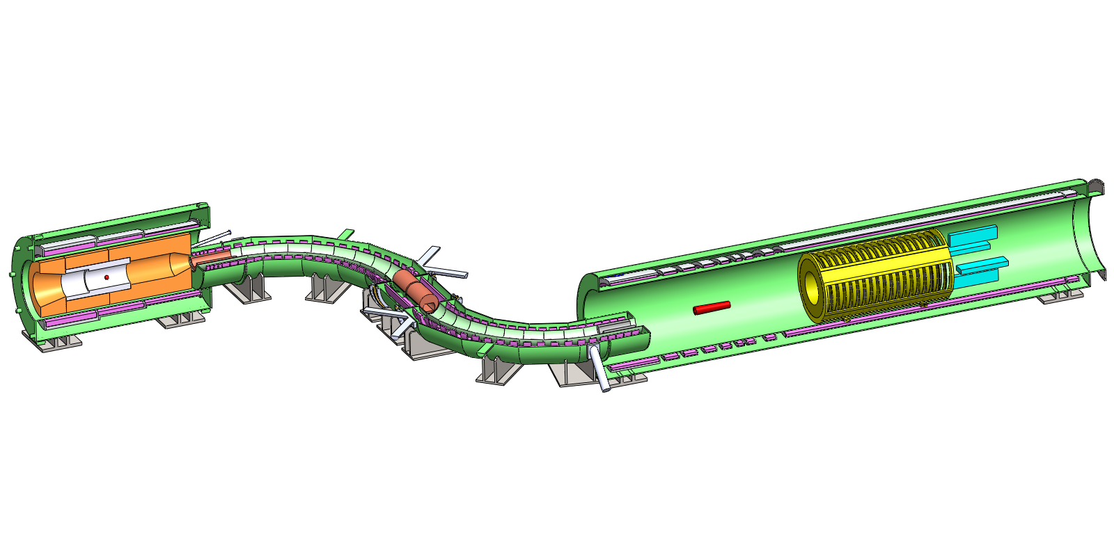
Intensity Frontier at Fermilab: Muon Campus
Proton delivery
Beam Transfer
Muon Campus
Muon g-2
Production Solenoid
Detector Solenoid
Transport Solenoid
Proton Beam
to Target
Tracker
Calorimeter
Mu2e

Slide 14
Intensity Frontier
Probe even more massive NEW particles and dark sector particles by intense neutrino beams
ν
high intensity
neutrino beam
M
Seesaw
E = Mc²
Probing~10¹² TeV
m_{ν} x m_{N} ~ (m_{quark})²

Slide 15
Why multiple neutrino experiments?
Different aspects of neutrino physics drive different experiments; each limited by having to operate at one distance and one energy. Beams not used up!!
  Long baseline:
    MINOS (disapearance; broad energy spectrum, on-axis; high rate)
    NOVA (electron appearance, off-axis, narrow energy spectrum; low rate)
    LBNE (appearance and disappearance; on-axis high rate, best positioned to add second oscillation maximum)
  Short baseline
    MINERvA: cross sections different nuclei
    MiniBOONE and MicroBOONE: anomalies

Slide 16
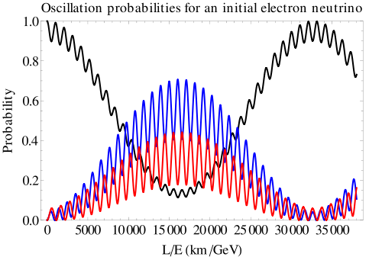
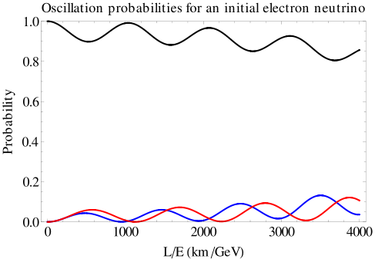
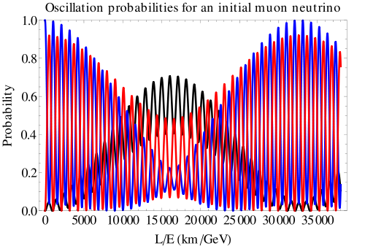
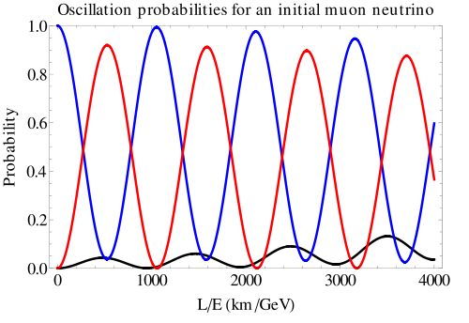
Neutrino oscillations

Slide 17
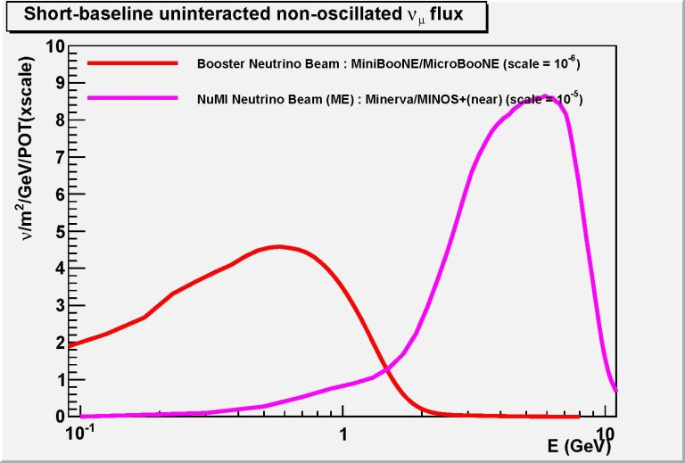
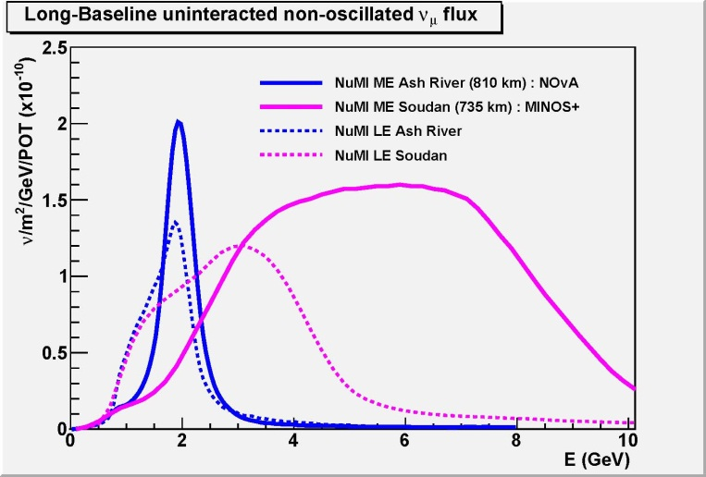
Neutrino beams
Diverse and intense beams: Unmatched in the world

Slide 18

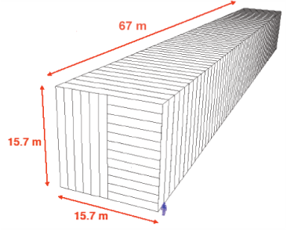
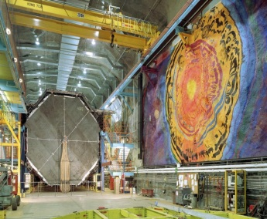
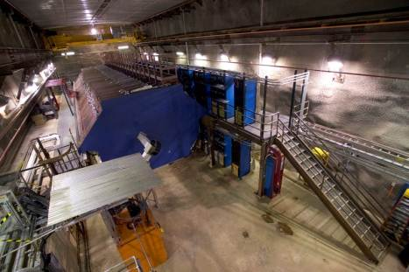
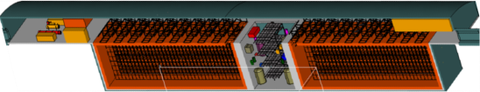
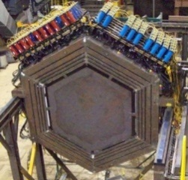

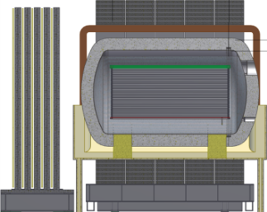
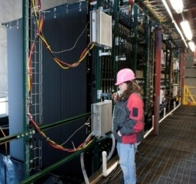
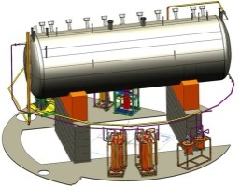
Neutrino program
Under construction
Online 2013
(700 kW)
NOvA (far)
MINOS (far)
Operating
since 2005
(350 kW)
MINOS (near)
735 km
810 km
MINERvA
LBNE under development
1300 km
Far detector
(34 kton LAr TPC)
MiniBooNE
NOvA
(near)
Near detector
MicroBooNE
Under construction
(LAr TPC)

Slide 19
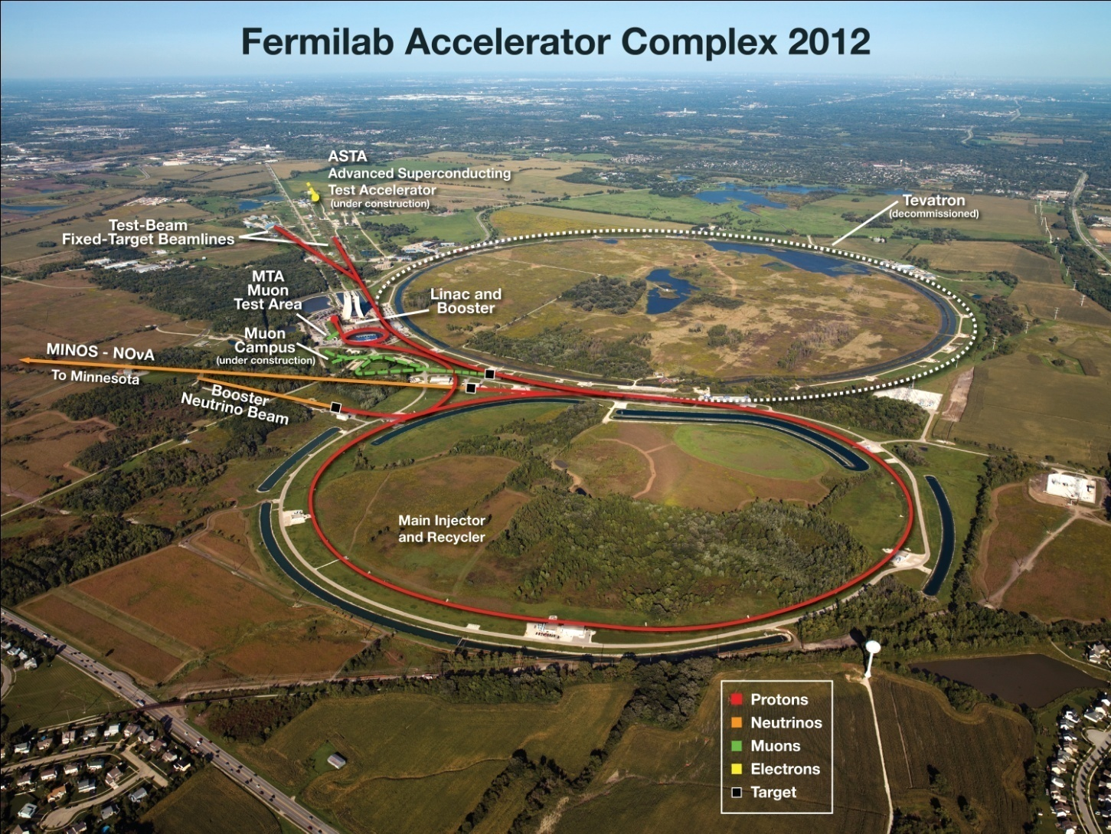
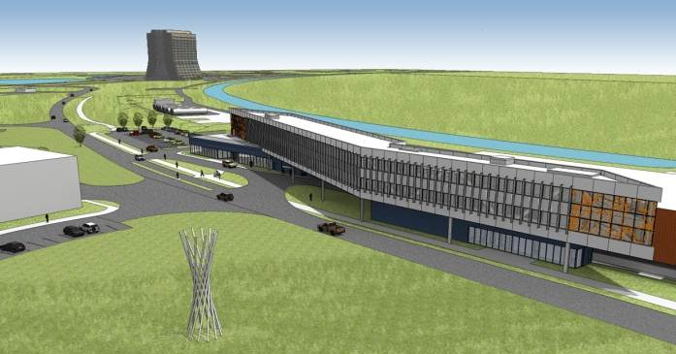
Illinois Accelerator Research
Center (IARC)
CDF

Slide 20
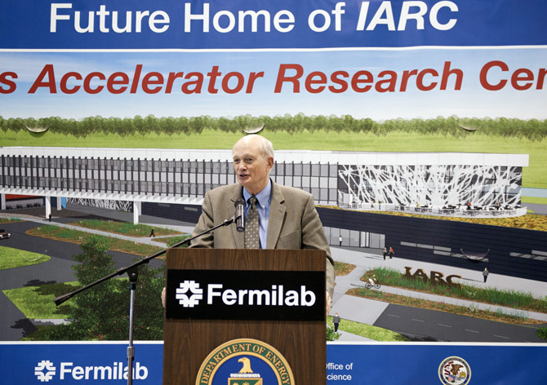
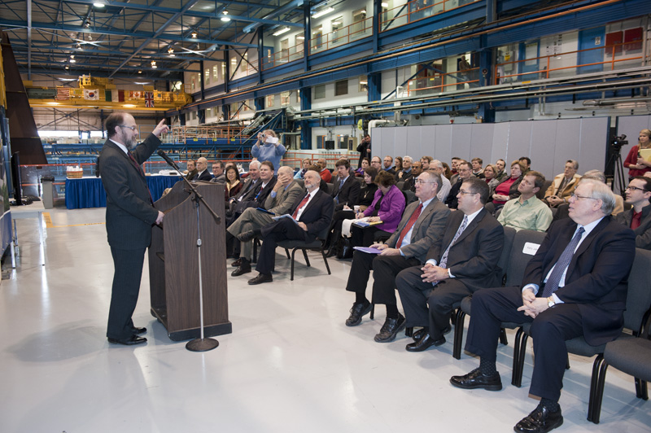
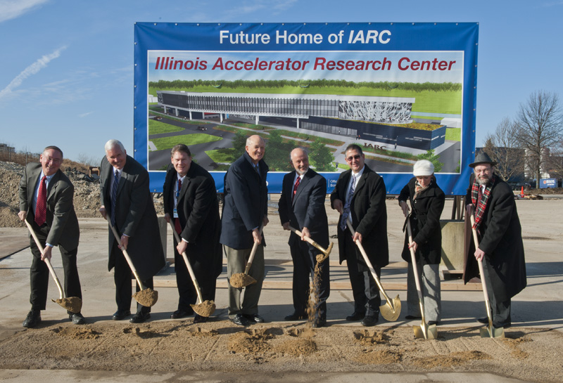
Accelerator stewardship: IARC
Funding from the State of Illinois for new building; reconditioning of CDF assembly hall and provision of utilities thanks to DOE. IARC to act as a) portal to Fermilab accelerator facilities b) collaborative space for universities and industries c) training ground for accelerator technologists

Slide 21
The strategy and experimental reach
Proton Decays
Intensity
Frontier
Neutrinos
Indirectly
Directly
Charged Leptons
Quarks
Connection
Energy
Frontier
LHC
Tevatron
1 3 5 Log (Energy [GeV]) 13 15 17
Time since the Big Bang
We need all these tools and the cosmic frontier tools
to reach a more complete and elegant theory
10⁻¹¹ s = 0.01 ns

Slide 22
Cosmic Frontier at Fermilab
Pioneering role starting three decades ago in establishing the connection between cosmology and particle physics: David Schramm, Rocky Kolb, Michael Turner…
Leader of the Sloan Digital Sky Survey: established large surveys as cosmological tools (progenitor of DES, LSST, BigBOSS….)
Pioneering work in dark-matter searches and the study of ultra-high-energy cosmic rays

Slide 23
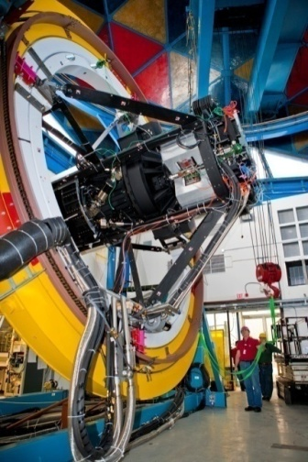
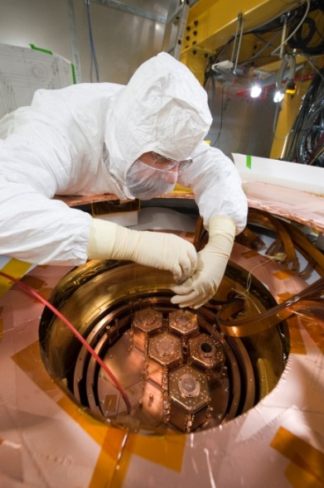
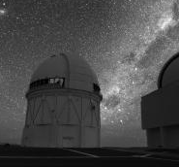
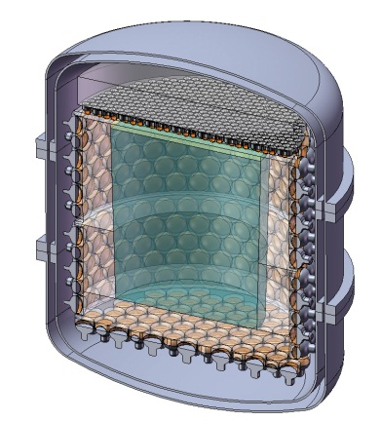
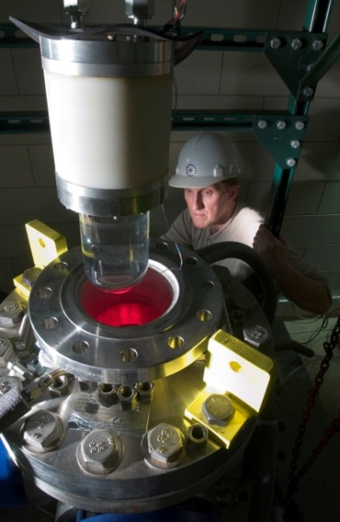
Cosmic Frontier at Fermilab
Dark Matter Detector
Dark Energy Camera
DES
Dark Matter Particle
Detector
CDMS
DarkSide
COUPP
570-Megapixel
digital camera
nuclear recoil
Fermilab
Detectors in underground facilities
Blanco Telescope, Chile

Slide 24
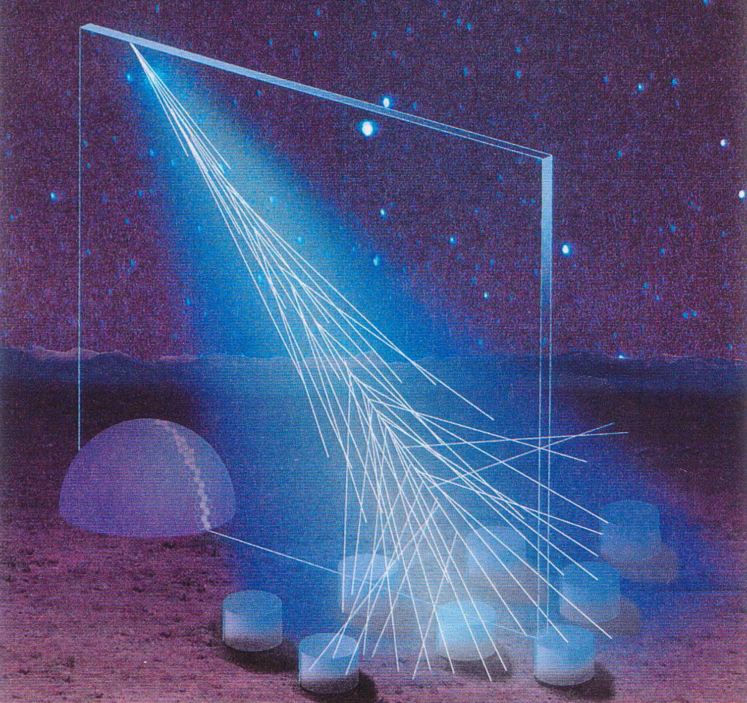
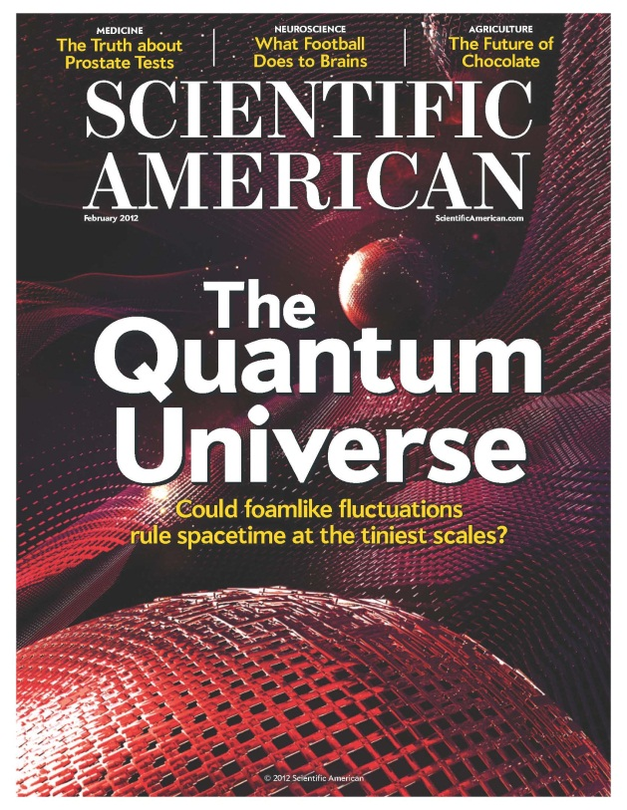
Cosmic Frontier at Fermilab
Exploring
Highest-Energy Cosmic-Ray Particles
(Auger)
Exploring
Quantum Space-time
(Fermilab Holometer)

Slide 25

Recent results and Fermilab’s strategy
Recent results on θ₁₃ and the LHC further validate our strategy:
The gate for great neutrino physics is now wide open
No low-energy structures at LHC (other than possibly the Higgs) → makes indirect intensity frontier methods more urgent
If there are new structures they are likely to be at higher energies → a boost to muon collider R&D
The cosmic frontier always critical: the right mathematical equations “remember” the history of the Universe

Slide 26
Program next decade
LBNE: will have completed Phase 1 of the project and we would be running a 700kW beam to Homestake (or alternative). Assuming a detector on the surface, the second phase of LBNE would be to add mass underground to enlarge the program to proton decay and SN collapse in addition to better neutrino measurements
Project X: a broad program with megawatts of continuous beam, ideal to lead at the Intensity Frontier
  Neutrino, long/short base-lines, more than 2 MW to LBNE
  Kaons where the Standard Model backgrounds are minimal and we are sensitive to many models
  Rare muon decay with sensitivity to masses 10000 TeV
  Symmetry violations through electric dipole moments in nuclei
  Applications to transmutation, spallation targets, ADS

Slide 27

      as;lkjfda;lskdjf;salkjfd
Argonne National Laboratory • Brookhaven National Laboratory • Fermi National Accelerator Laboratory • Lawrence Berkeley National Laboratory
Pacific Northwest National Laboratory • Oak Ridge National Laboratory / SNS • SLAC National Accelerator Laboratory • Thomas Jefferson National Accelerator Facility
Bhaba Atomic Research Center • Raja Ramanna Center of Advanced Technology • Variable Energy Cyclotron Center • Inter University Accelerator Center

Slide 28

Project X Siting

Slide 29
Project X
Unique facility with a 3 MW at 3 GeV continuous-wave (CW) linac. Multiplies low-energy flux of protons at Fermilab by 100 with flexible timing patterns, ideal for rare decays
Solves “proton economics”. Experiments run simultaneously at 3 GeV, 8 Gev and 60-120 GeV at high power
Delivers 2+ MW to LBNE
To be developed consistently to serve as front end of neutrino factory or muon collider
Very strong partnership with India in the development of Project X and Intensity Frontier Program

Slide 30
Phased approach to Project X
Project X can be broken into three phases, each for about a third of the cost
  Phase 1: Up to 1 GeV. Retires old linac, increases flux of neutrinos x1.7, enhances existing Mu2e by x10, starts EDM, nuclear-physics and nuclear-material studies
  Phase 2: Up to 3 GeV. Starts powerful Intensity Frontier experiments with kaons and short baseline neutrino programs
  Phase 3: Up to 8 GeV; Multiplies power to LBNE by factor of 3; power at 8 GeV by several fold for short-baseline neutrino experiments
Decision on when these phases should start can wait to much later in the decade

Slide 31



We value our many international partners: thank you for coming!
27 countries
17 countries
24 countries

