Slide 1
Alaska Department of Transportation & Public Facilities
Fairbanks International Airport
Melissa Osborn-DOT
Tom Risdal-FAI Operations
May 9, 2012

Slide 2
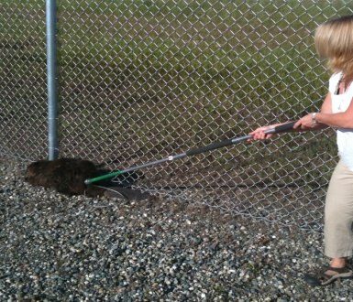
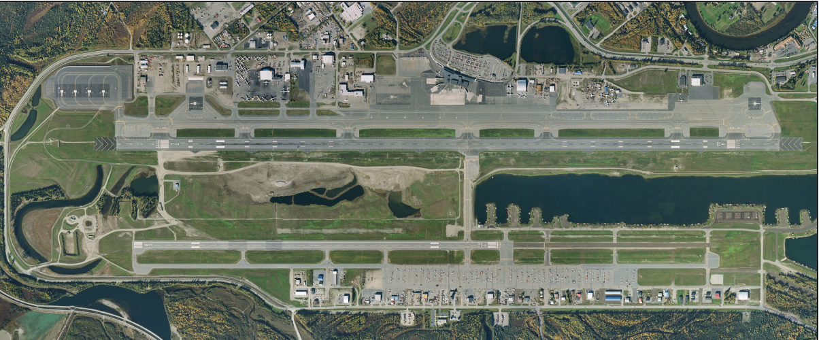
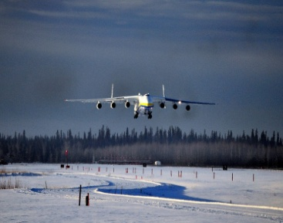
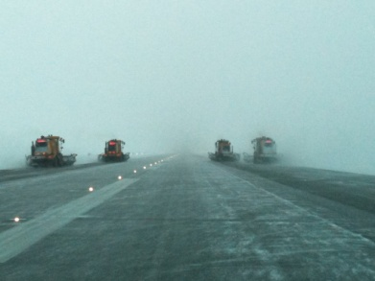
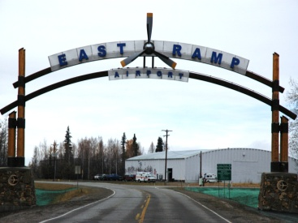
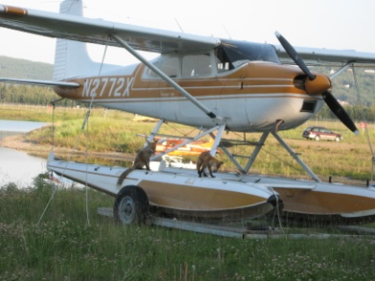
Fairbanks International Airport DDN
Providing interior Alaska's gateway to the world

Slide 3
FAI Stats
Part 139 certified
Small hub
24/7 ATCT/TRACON/AFSS
Class I/ARFF Index C
Four landing surfaces (2 paved,1 water, 1 ski)

Slide 4
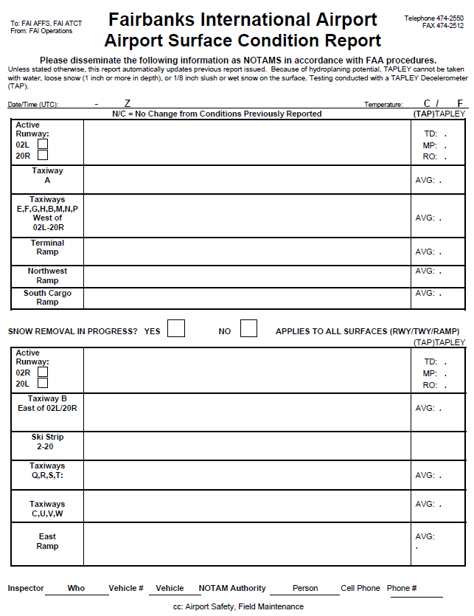
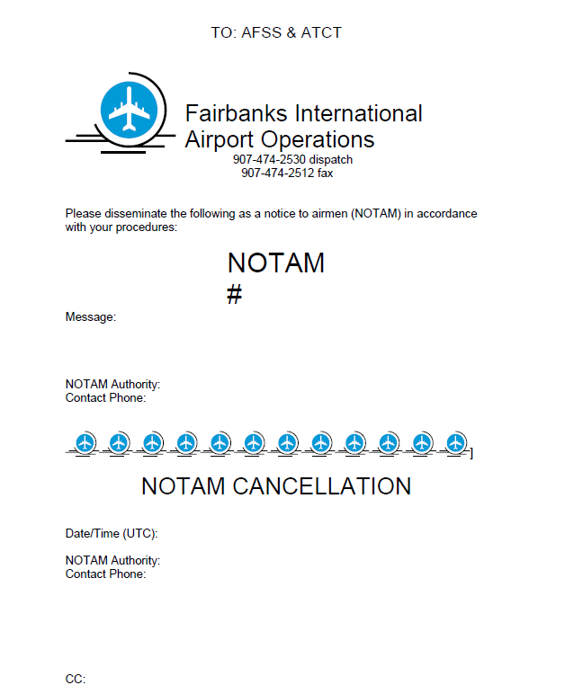
FAI NOTAM issuance-prior to DDN
Average time 30-45 minutes from discovery to publication.
Outdated, inefficient reporting system.
Familiar format
Data passed through many hands/systems before issuance.
Errors likely.

Slide 5
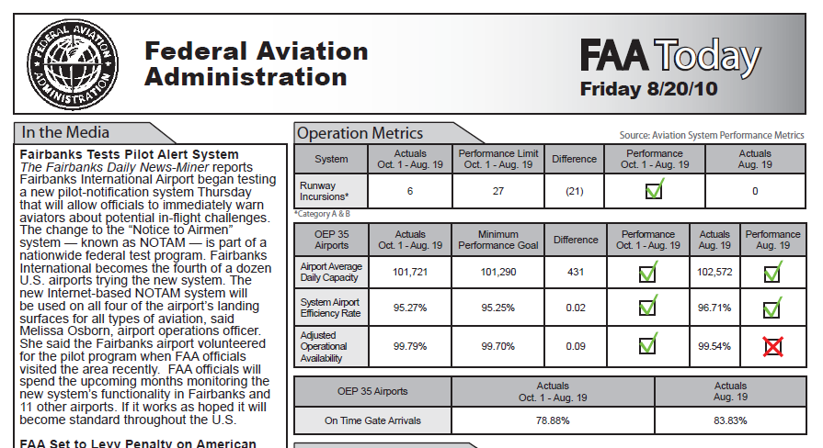
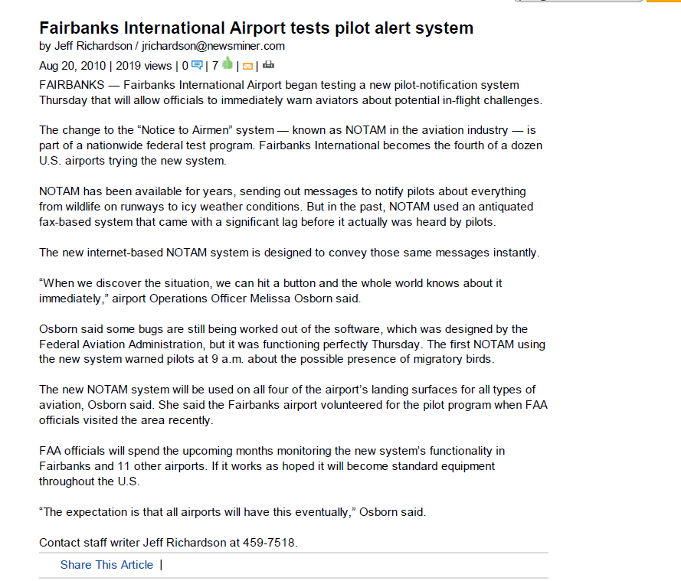
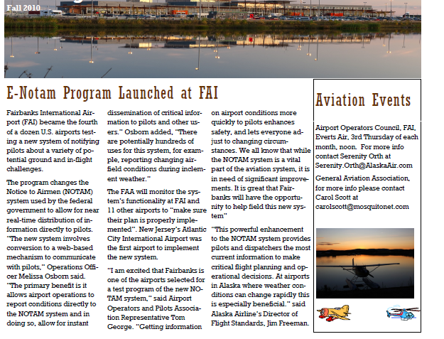
Conversion to DDN
October 2009
Introduction to DDN
April 2010
Data gathering
Airfield data, segment by segment
LOA’s, MOU’s and external processes
Alaska specific oddities
Ski strips, float ponds, edge cones
Runway closures are different here!
Internal processes
technology, internet connections, rules, laws, best practices, hazard avoidance
August 2010
DDN testing begins
Very press-worthy in Alaska!

Slide 6
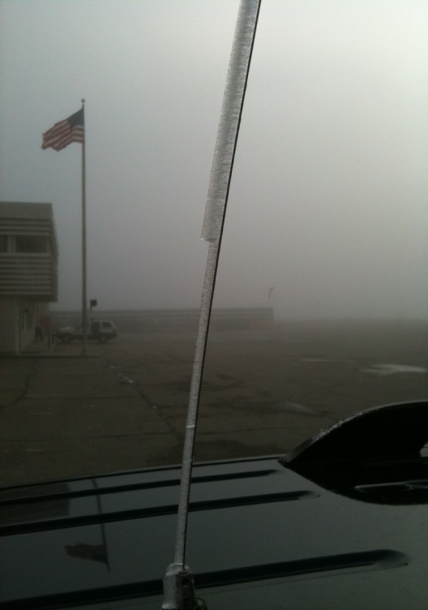
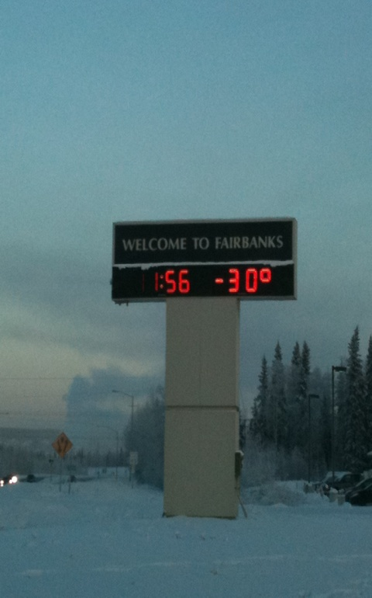
Winter Ops and DDN
Extreme weather + DDN = lots of changes
Originator now responsible for surface groupings, not FSS
Notifications to ATCT, air carriers, users
Surface condition end times
End result? Reaching out to FAA, users, other airports to seek guidance & find best practices.

Slide 7
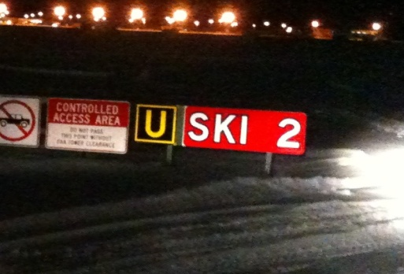
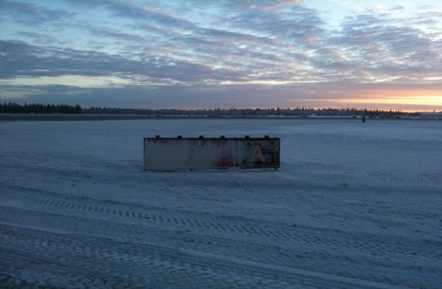
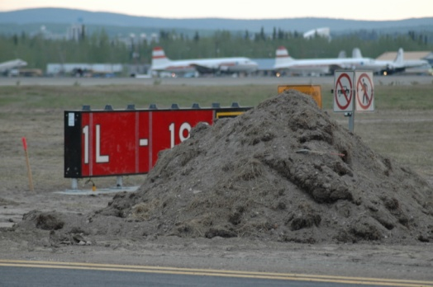
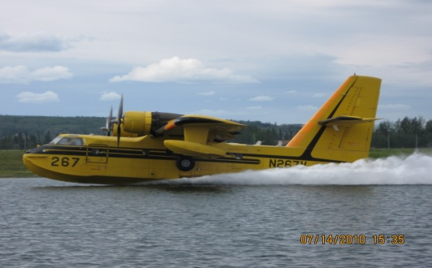
Challenges
Conversion from a one page fax summary to ATCT/users/maintenance
Interface navigation
Consistency in reporting/grouping NOTAMS
TALPA-ARC test (paper based)
Internal communication
Technology. In-vehicle distractions. Slow internet speeds.
Occasional outages

Slide 8
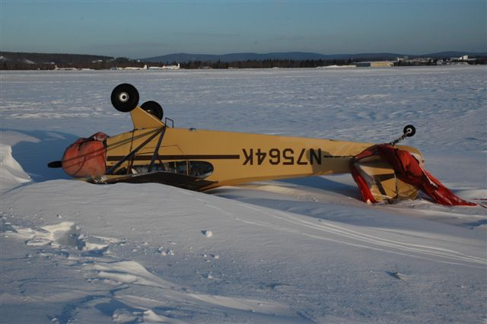
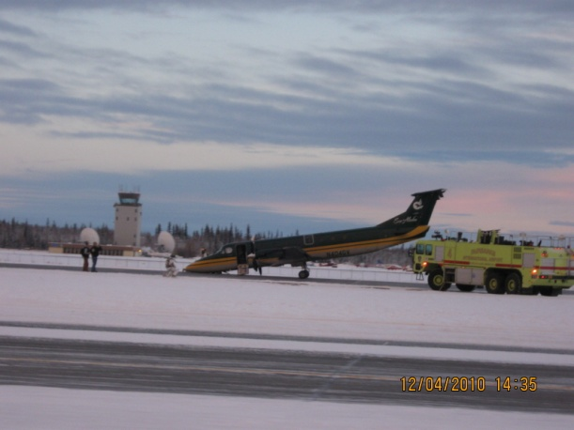
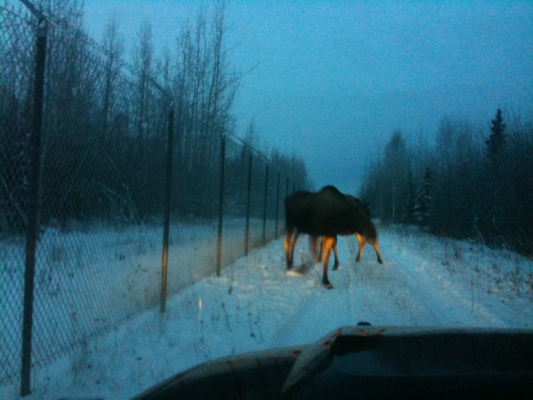
Benefits
Enhanced safety
Timely and accurate communication of critical information
Need for supplemental systems minimized
Originators have ‘ownership’ of NOTAMS issued.
Ability to stay in the airfield environment and continue assessments when conditions are changing rapidly.
Standardization

Slide 9
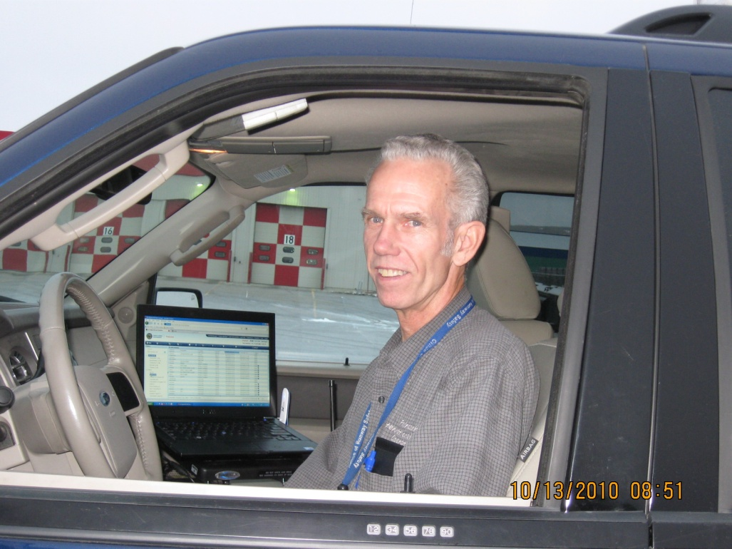
FAI Today
Acceptance and support of DDN
IT changes to facilitate field entries
Support from users and ATCT
Post season snow meetings to refine processes and expectations.
Legacy system still available, if needed

Slide 10
DDN Field Equipment
FAI originally used a laptop when in the Ops vehicle to enter Notams.
Laptop took up valuable space inside the vehicle and was bulky
Noticeable lag in connection time with method used to connect to the system.
Wires needed to keep battery reliably charged (and would become disconnected easily)

Slide 11
DDN Field Equipment
FAI currently uses iPads for entering Notam Information from the Ops vehicle
Connects via 3G with lag time less apparent than with the laptop connection.
Makes less of a footprint than the laptop and is easier to physically manage.
We’ve added a “Zagg” brand hardware keyboard for entry which is generally more accepted than the software keyboard.
Screen Protector is used
An iPad Stylus is being evaluated
Battery Time can last about 3 shifts between charges if necessary.
Two iPads are “Community Use” among Ops Personnel
Two Ops Officers in the office elected to have their own iPads for use with DDN.

Slide 12
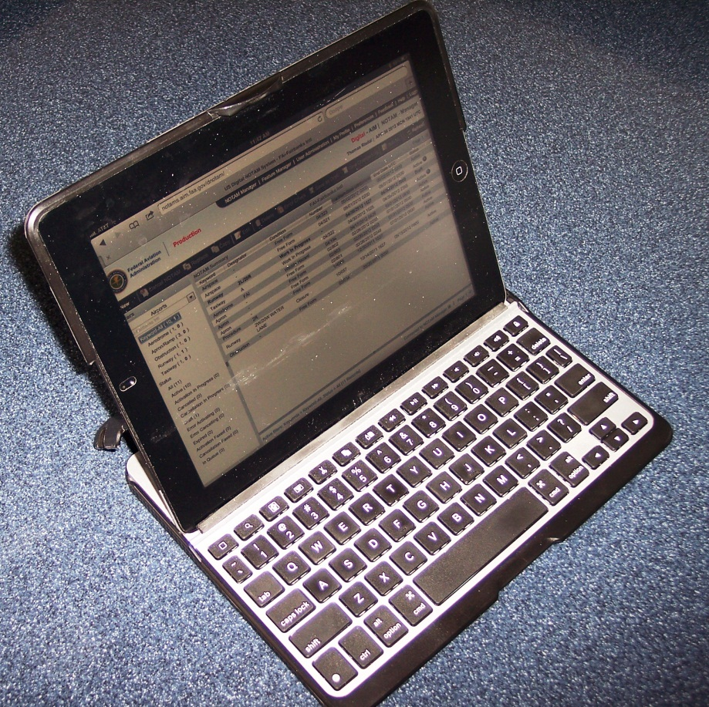
DDN Field Equipment
iPad with Zagg keyboard

Slide 13
DDN Field Equipment
iPad use
DDN Manager is very usable on the iPad
The DDN System in conjunction with the iPad makes for timely entering of Notams
It could perhaps benefit from a dedicated iPad Application optimized for iPad use.
There are some work-arounds and nuances that require some getting use to.
iPad isn’t only used for entering DDN info from the Ops rig. Phone directories, manuals and forms (bird strike) can be incorporated into iPad use. We are currently working to evaluate and develop this.

Slide 14
DDN Field Equipment

Slide 15
Recent Changes to WEF Times
Ending WEF time not required on FICON (Field Condition) and Friction Measurement Notams
Prior to this, every Notam needed an ending time.
Have not had a chance to use this very much before the end of the snow season but seen as an improvement.

Slide 16
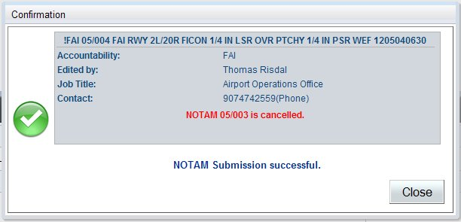
WEF Time Changes
Ending WEF Time
No Ending WEF Time

Slide 17
iPad DDN Manager Notam Entry Comments

Slide 18
iPad DDN Manager Notam Entry Comments

Slide 19
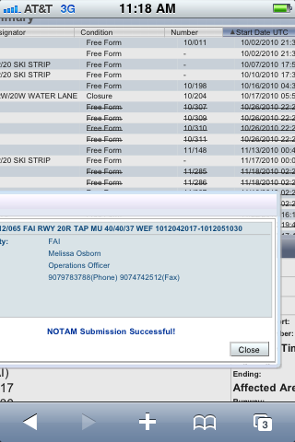
Comments & Suggestions
Feedback and the DDN Support is very good. Very responsive to suggestions and input.
Leadership, training & programming teams
Continue to facilitate communication by and between FAA, airports, users
Enhance or re-think winter condition menus
Mobile devices
Ensure ease of use in the field
Develop, evolve and integrate
Don’t make us go back!

Slide 20
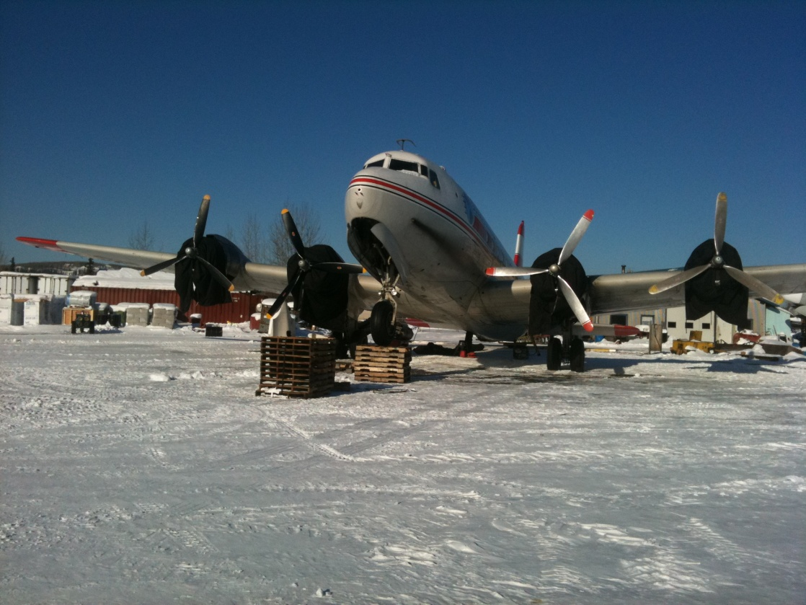
Questions?
Fairbanks International Airport
6450 Airport Way, Suite 1
Fairbanks, AK 99709
www.fai.alaska.gov

