Slide 1
Airport Federal Obligations & Planning
2012 Alaskan Region Airports Conference
Tuesday, May 8, 2012
Gabriel Mahns, Planning, Compliance & Certification

Slide 2
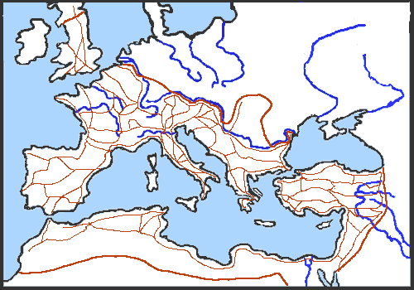
Roman Roads
Transportation is Civilization
Notes:
Transport enables trade between peoples, which in turn establishes civilizations.
Romans built over 53,000 miles
The Romans had a saying "All roads lead to Rome."
Image: http://www.historylink102.com/Rome/roman-roads.htm

Slide 3
Objective
Provide a safe and efficient System of Airports today and into the future
Protect the public interest in Civil Aviation
Infrastructure
Aircraft/Vehicles
Operations
Notes:
Promotes Aviation
Transportation can be divided into infrastructure, aircraft and operations.
The system has many subcategories.

Slide 4
Notes:
These are our airports – our system of airports
These airports & the link between them determines the quality of life of these communities
And in part it determines the success of the State & Country

Slide 5
Federal Financial Aid Obligations
Acceptance of Federal funding obligates airports to comply with an extensive list of grant assurances:
General Federal Requirements
Responsibility and Authority of the Sponsor
Sponsor Fund Availability
Good Title
Preserving Rights and Powers
Consistency with Local Plans
Consideration of Local Interest
Consultation with Users
Public Hearings
Air and Water Quality Standards
Pavement Preventive Maintenance
Terminal Development Prerequisites
Accounting System, Audit, and Record Keeping Requirements
Minimum Wage Rates
Veteran's Preference
Conformity to Plans and Specifications
Construction Inspection and Approval
Planning Projects
Safe & Secured
Operation and Maintenance
Hazard Removal and Mitigation
Compatible Land Use
Economic Nondiscrimination
Exclusive Rights
Fee and Rental Structure
Airport Revenues
Reports and Inspections
Use by Government Aircraft
Land for Federal Facilities
Airport Layout Plan
Civil Rights
Disposal of Land
Engineering and Design Services
Foreign Market Restrictions
Policies, Standards, and Specifications
Relocation and Real Property Acquisition
Access By Intercity Buses
Disadvantaged Business Enterprises
Hangar Construction
Competitive Access
Finance
Community
Notes:
Think of it as The 39 Commandments
These assurances are in part the path how airports need to managed
As an example, assurances tell us about minimum standards about how to work with
the Community -
Maintaining a safe and secured airport
How to mange the airport finances

Slide 6
Federal Financial Aid Obligations
Acceptance of Federal funding obligates airports to comply with an extensive list of grant assurances:
General Federal Requirements
Responsibility and Authority of the Sponsor
Sponsor Fund Availability
Good Title
Preserving Rights and Powers
Consistency with Local Plans
Consideration of Local Interest
Consultation with Users
Public Hearings
Air and Water Quality Standards
Pavement Preventive Maintenance
Terminal Development Prerequisites
Accounting System, Audit, and Record Keeping Requirements
Minimum Wage Rates
Veteran's Preference
Conformity to Plans and Specifications
Construction Inspection and Approval
Planning Projects
Operation and Maintenance
Hazard Removal and Mitigation
Compatible Land Use
Economic Nondiscrimination
Exclusive Rights
Fee and Rental Structure
Airport Revenues
Reports and Inspections
Use by Government Aircraft
Land for Federal Facilities
Airport Layout Plan
Civil Rights
Disposal of Land
Engineering and Design Services
Foreign Market Restrictions
Policies, Standards, and Specifications
Relocation and Real Property Acquisition
Access By Intercity Buses
Disadvantaged Business Enterprises
Hangar Construction
Competitive Access
Notes:
Assurances Shown in blue were highlighted at the OIG fraud prevention conference as challenging for sponsors
The 39 Commandments – AIP program is complex and it’s grant obligations require education and partnership
As an example let’s take a look at grant assurance 34 Policies, standards and specification

Slide 7
Airport Design Standards
FAA Advisory Circulars are mandatory for all Federally obligated airports:
  Planning—e.g., runway length, runway/taxiway separation, Runway Safety Areas (RSAs), Runway Protection Zones (RPZs), Object-Free Areas (OFAs), airspace review process, signage and marking requirements, etc.
  Engineering—e.g., pavement design standards, drainage, electrical and lighting requirements, surface treatment (grooving), etc.
  Construction—quality control for construction, operational safety during construction, NOTAM process, obstruction lighting, etc.
  Maintenance and operations—e.g., snow and ice control, runway surface condition monitoring, rubber removal, preservation of pavement markings, ARFF communications, etc.
Notes:
34 - Policies, Standards, and Specifications
More than 100 Acs Guidance letters and Order 10s of thousands of pages in guidance and policy.
Finance
Leasing & Contracts
Safety and Security
Environmental & Noise
Survey

Slide 8
Everyone in the System of Airports plays a role
Notes:
Everyone at each airport and local government, consultant community, and at the state and national level
Plays a role in the system to keep it safe, efficient and compliant.

Slide 9
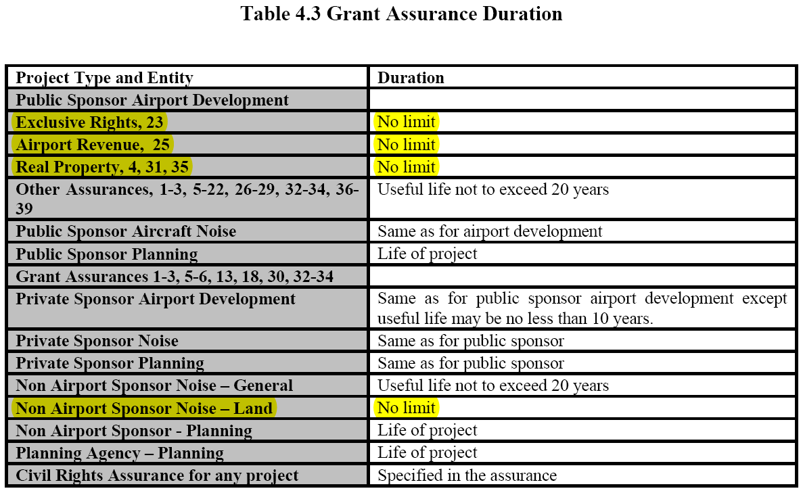
How long does the commitment last?
Notes:
Enduring obligations as l1996 as long the airport
Length of

Slide 10
Grant Assurance & Obligations
Grant Assurances are how we protect the federal investment
The Sponsor certifies with the grant application that it can comply with grant assurances.
Some kind of airport self assessment should have preceded the grant application
Airport self assessment can be done at any time and or as part of a planning process, or other efforts.
“If you are not prepared to be held accountable in every regard, then consider carefully before requesting and accepting Federal funds.”

Slide 11
Airport & System
Self Assessment
Inspect your airport from a Land Use Compliance perspective
  Review the ALP, Exhibit ‘A’, Airport and Zoning Ordinances, Minimum Standards, budget, leases, easements, permits and any other pertinent governing documents to ascertain consistency with the Assurances.
  Incompatible land uses in the airport environs and/or an absence of appropriate compatibility zoning
  Existing “through-the-fence” access for aircraft based off airport property and/or possible future requests for same
  Revenue diversion
  On-airport residential use
  Nonaeronautical local events closing the airport or a runway (such as drag racing on runways)
  Other activities inconsistent with a safe & self-sustaining airport
Notes:
These self assessment can be done as part of a planning process and or as part of other projects or efforts.
We have funded these at Cold Bay and Willow
ALP – Planning
Exhibit A – ROW - Design – Survey - Legal

Slide 12
Airport & System
Self Assessment
Planning for Compliance & Correction Plan:
  Inventory potential problems
  List and describe each existing or potential compliance issue
    Existing violations – recommend remedies/timeframe
    Potential violations – recommend strategies to avoid non-compliance
    Develop & implement strategy/program to educate sponsor’s decision-makers & general public

Slide 13
Planning for Compliance
Planning for compliance is a “voluntary compliance effort” from part of the sponsor
Planning provides the opportunity to identify current and up coming compliance issues and take proactive steps to prevent them
Making it part of a Master Plan allows for additional educational tools.
Sponsor’s support to resolve identified deficiencies is key. Education is the starting point.
Challenges of Voluntary Compliance:
  Concern’s of “airing dirty laundry”
  Consultants fear awkward position with their clients.
Notes:
13
Most important: The sponsor and FAA must be working together to develop corrective actions plans
We in FAA are committed to help and support sponsors that attempt voluntary compliance.

Slide 14
Every airport plays a role in the system

Slide 15
How Compliant is Our Alaska System of Airports?
Is the System as Safe & Efficient as it can be??
Notes:
With that I would like to leave you with the following questions.

Slide 16

Questions?

