Slide 1
Alaska Department of
Transportation & Public Facilities
Statewide Aviation
↑→↓
Land Use Compliance
DOT&PF’s (Sponsor’s) View
May 8, 2012

Slide 2
DOT&PF Has Learned
DOT&PF accepted federal $ = comply with specific Grant Assurances (GA’s)
Noncompliance = violation; AIP funding withheld; civil penalties; suit filed in US court
FAA Order 5190.6B - Airport Compliance Manual
DOT&PF and FAA working to establish clear P&Ps to correct LUC issues; avoid future issues

Slide 3
FAA GA’s - Guidance Highlights
Non-aviation use of airport land requires FAA concurrence and Fair Market Rent (FMR) (FMR @ remote locations difficult to determine; 17 AAC 45 non-aviation needs to be revised)
Any land use on or near an airport must be compatible with airport purposes
Off-airport zoning requires coordination throughout the state (State of Alaska, FAA, Municipal and Borough Governments)

Slide 4
252 Airports - Alaska Factors
82% of Alaskan communities = no road connection
40% of Alaska is wetlands (which is 60% of the nation’s total wetland ecosystems)
Lack of local material for development
60% of Alaska’s land mass is owned by the federal government and not available
44 million acres are Native Lands
DOT&PF/FAA selects optimal land for construction of airports

Slide 5
On Airport – What We Can Control
Our response to LUC issues of concern to FAA
Corrective actions – short and long term
Change non-aviation land use application processes and approvals
Change what lands are subject to Grant Assurances – seek other funding sources
Follow compliance planning program initiated by FAA
Educational Efforts
  Inside DOT&PF (LUC info being posted on Intranet)
  Training for DOT&PF and other sponsors (AAA & AAAE)
  Outreach and information to airport users and public

Slide 6
Land Use Inspections (LUI) by FAA – Page 1
Non-aviation use without FAA prior written approval
Non-aviation agreements may have rental rates lower than Fair Market Rent (FMR) and term lengths that are too long
Incompatible land uses: schools (Aniak on a contaminated site transferred to YKSD from the feds); living quarters (old FAA living quarters on FAA reserve; also Bettles’ incorporated city limits are the airport boundaries)
Free land use: public campground; public barge landing on airport boundary (river – Tanana); public rifle ranges; cemetery
Uses inconsistent with uses allowed in land-use contract
Non-compatible structures located within the obstacle free area (OFA) and runway protection zone (RPZ)

Slide 7
LUI Compliance Issues Cited by FAA –
Page 2
Fuel tanks not in compliance
Old federal buildings not removed from prior federal lease or current federal reserve areas
Sewage lift station building on airport within runway primary surface
Fence gates left open (non-Part 139)
Airport drawings not current
Brush not cleared
Aircraft parked off of aircraft parking apron
Encroachments, trespasses and abandoned property

Slide 8
Parties Impacted by LUI
Non-aviation use tenants/applicants (FAA approval + FMR)
Aviation-use tenants (open gates, non-av storage, fuel tank fixes)
DOT&PF
  M&O (open gates, brush not cleared, tanks not to code, aircraft parking)
  Design (ALP not current)
  Planning (planning for compliance)
  Leasing (tanks not to code, FMR/subrogation in non-av use contracts)
  ROW – (‘inherited/acquired’ encroachments/trespasses, land interest issues)
FAA & DOT&PF (AIP projects)

Slide 9
Corrective Action Plan Participants
DOT&PF Team:
(Lease Application Review Committee)
Leasing (C.A.P. coordination and contracts issues & enforcement, uses & rental rates)
Design (project design + ALP, PP – Ex. A)
Planning (MP, planning for compliance, project scope)
M&O (brushing, aircraft parking off of parking apron, local contract enforcement, hazards control)
ROW (inherited issues through land acquisition – cemetery, FAA LQ’s, existing utilities, RPZ protection-rights)

Slide 10
DOT&PF LUI Corrective Actions
Aniak: 2003 LUI – Complex issues due to land interests and widespread contamination (old White Alice Site).
Beaver: 2003 LUI – Issues Resolved/Closed 2008.
Bettles: 2009 LUI – No issues found (save call out of old FAA houses – now NPS – in front of BRL). 2010 DOT&PF request to FAA to close out LUI.
Chitina: 2008 LUI – Resolved 2011; Awaiting FAA Official Response to 1/14/2011 Closure Request.
Dillingham: 2010 LUI – Corrective Action Plan (CAP) submitted 3/21/2012.
Fort Yukon: 2005 LUI – Resolved/Closed 2009.
Girdwood: 2007 LUI – Draft CAP ready to send to FAA – ALP not current, non-aviation uses cited (well, utility pump station, dog sled operation) and non-av debris on aviation use lot. 2 out of 5 resolved.
Gulkana: 2006 LUI – 5 of 7 Resolved; ALP update and Gulkana Campground purchase not completed.
Igiugig: 2005 LUI – DOT&PF responded 2005 – working on village offices in Village Council lease and separate trespass issues in material site.
McCarthy: 2010 LUI – Resolved/Closed 2011.
Tanana: 2004 LUI – Out of 5 items cited, 3 resolved and 2 have CAPs proposed to FAA.
Willow: 2006 LUI – DOT&PF responded 2006; Master Plan underway-includes Planning for Compliance tasks.

Slide 11
Some Issues Noted by DOT&PF
Aniak – community too close to airport; AIP funds withheld
Bettles – airport boundary = City boundary; historic lodge on apron-front lot (NEPA and Section 106 impacts)
Cold Bay – residences on airport
Mekoryuk – wind turbine installation in line with approach slope of RW 23, approximately 2 miles from the threshold (fortunately, top of turbine blades are approximately 15’ below the horizontal/conical surface so not defined as obstructions.

Slide 12
Successes
Bethel – NG Readiness Center at FMR
2 DOT&PF employees attending FAA Recurrent Compliance Training
LUC Training and Resources made available during 2012
Dillingham – CAP response required a multidisciplinary effort
Leasing changing review processes to avoid future compliance issues

Slide 13
A Case Study – Or 3
Wrangell – a success story
Dillingham – a processing story
Gulkana – another story

Slide 14
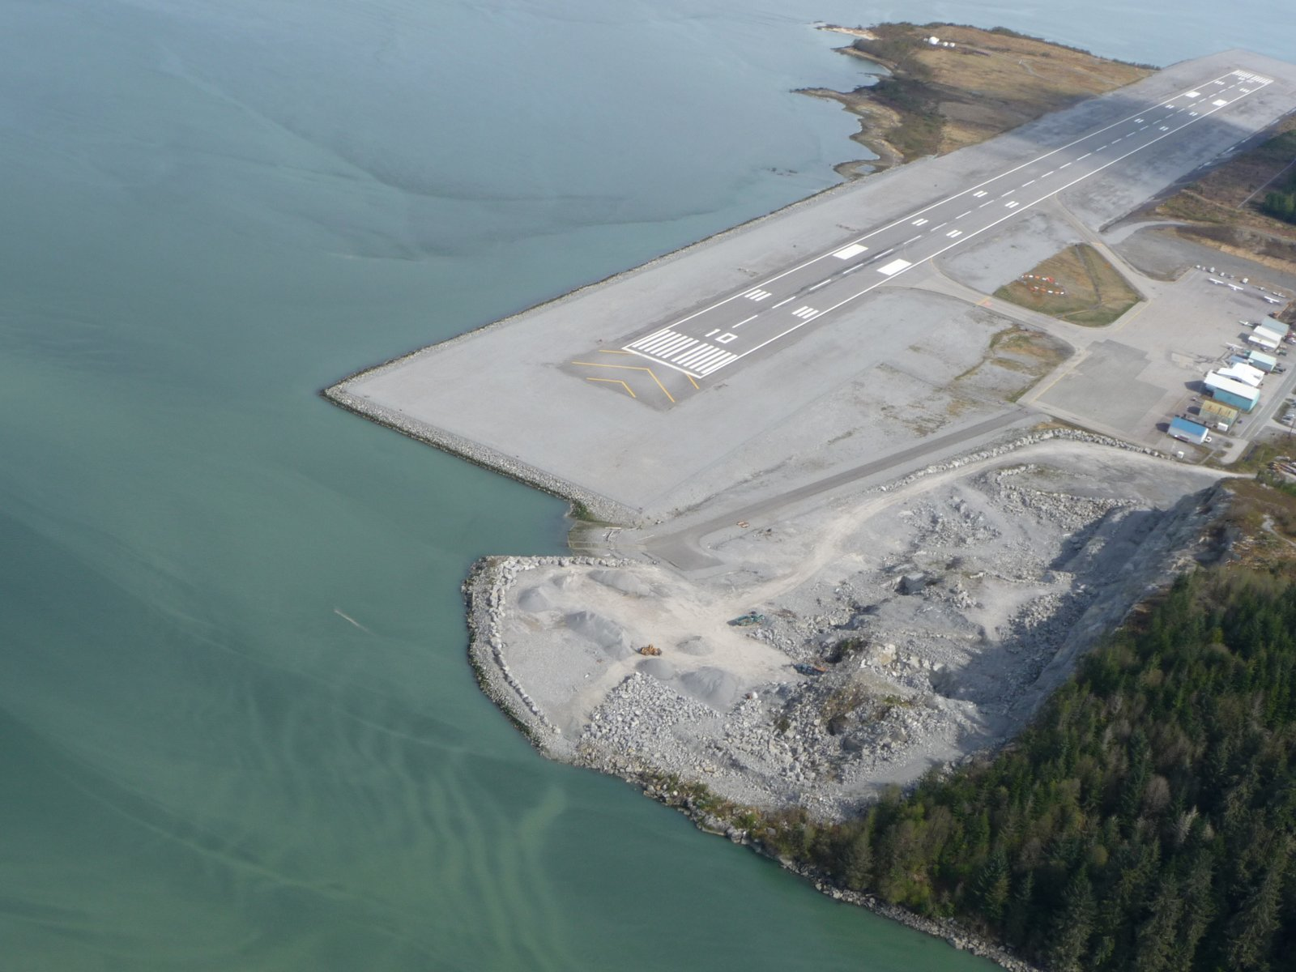
Wrangell Success = Quarry

Slide 15
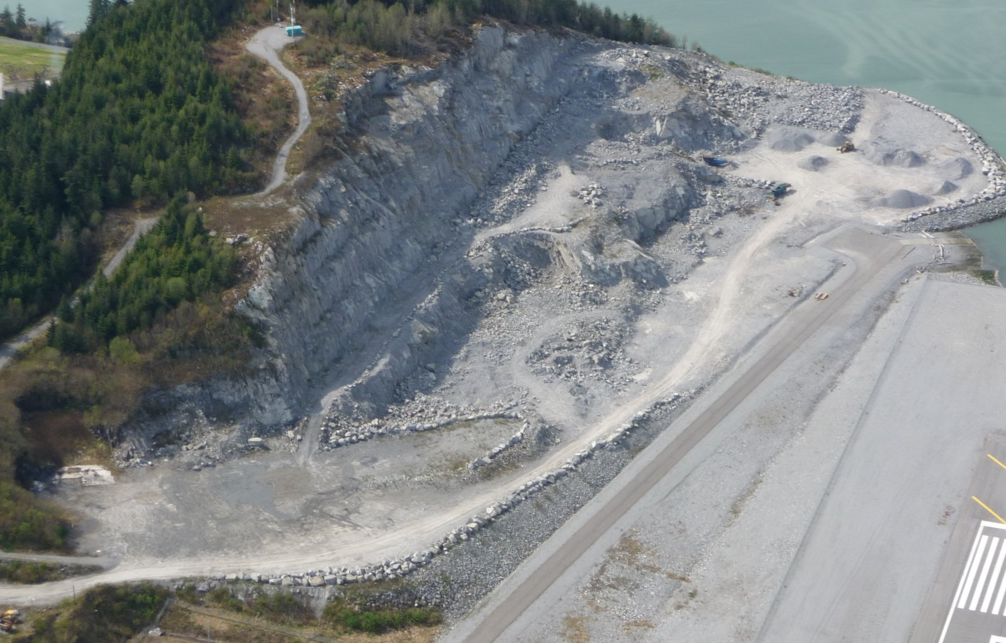
1) Sale of rock and marketable materials removed an obstruction.
2) FMV received for rock removed from quarry near R/W 10 end.

Slide 16
Dillingham – A Processing Story

Slide 17
DLG LUI Findings - Resolutions
1 Certification inspection items – road & tree obstructions
2 Residences within RPZ & airport property
3 Pending native allotment on airport – update @ 6 months
4 Private well – no rent
5 Aviation hangar w/ gift shop – no aircraft noted – local interviews indicated no aircraft operating
6 Cemetery boundary 75’ from runway edge and 30’ higher than runway elevation-protrudes RSA
7 Airport drawings not up to date: ALP, Property Plan – need LUP
1 Will fix access as part of upcoming project; trees removal 2012
2 ALP update shifts runway 150’ west to resolve RPZ issue
3 DOT&PF defending its title (DNR & BLM control)
4 Well to be closed and capped (M&O)
5 Gift shop within authorized uses – airport manager states aircraft operates and operates
6 Cemetery is outside the airport fence; upcoming project will shift runway 150’ west
7 ALP update in progress (Ex. A.); Land Use Plan being developed

Slide 18
Gulkana – Another Story

Slide 19
Gulkana LUI and Update
2006 FAA LUI found 7 compliance issues (AIP funding withheld):
  ALP not current (1)
  2 leases allow bachelor/watchmen quarters (2+3)
  2 tanks w/o fire extinguisher & debris on lot (4-6)
  ADNR Campground in holdover and not rent (7)
    (DOT&PF wonders about public use allowance in FAA regulations, but to-date have been told not applicable)
    Plan forward – buy the land on behalf of DNR so DOT&PF can release from the airport (w/FAA approval).

Slide 20
What is Required? – Team Work!
Statewide (all regions – all divisions) consensus needed on processes and shared data sets.
Entire airport team must be involved:
Lands Staff: ROW (Acquisition, Survey, Utilities) and Airport Leasing (land-use contracts)
Planning (regional and statewide)
Design
Maintenance & Operations (includes Safety & Security)
Environmental & Construction (as needed)

Slide 21
QUESTIONS?
Thank you for your attention.
Becky Calhoon Iles, SR/WA
Statewide Aviation Leasing Chief
(Rural Airports)
Alaska DOT&PF
(907) 451-5266
becky.iles@alaska.gov

