Slide 1
Strategic Thinking...
Strategic Speaking…
PIO Pre-season Webinar
April 25, 2012
Notes:
Waiting time….
Hello and thank you for joining us.
We have FIVE minutes until we get started.
THREE minutes until we get started.
ONE minute
Cue!
4/24/12

Slide 2
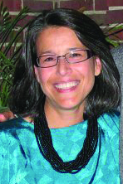
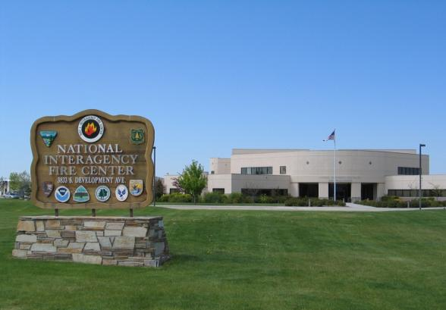
Roberta D’Amico
Moderator
Communication Director, NPS Fire and Aviation, NIFC
Notes:
Hello!
And welcome to Strategic Thinking… Strategic Speaking!
We are glad you are able to join us today. At last count we had XX number of people registered and we know some of you are participating in a group setting.
This is Roberta D’Amico, speaking to you live from Boise, Idaho. It’s my pleasure to be your moderator today.
Cue!
4/24/12

Slide 3
Webinar Topics
Themes and Messages
Social Media, Lessons Learned from the 2011 Fire Season
Predictive Services, Making It Work
Teachable Moments
Quick Hitters
Question and Answers
Notes:
We have a great line-up of speakers today covering topics of interest to all of us in wildland fire communications. The topics this year are a result of feedback received from you, so thank you for your comments. We appreciate hearing from you.
To kick us off I’m going to run through some basic technical information.
Right now, you should see two things on your screen. First, you should be able to see our presentation slide showing the webinar topics. You should also see a control panel on the right hand side of your screen.
To open and close the control panel, just click on the orange box with the white arrow at the top of the control panel. If you would like the control panel to remain open throughout the webinar, just leave it as it is. If you would like to minimize the control panel, click on the orange box with the white arrow.
The presentation slides can be viewed either as a window or as a full screen. You can change the size of the presentation either by clicking and dragging the lower right corner of the window or by going to the control panel and clicking on the round blue button with the square in the middle of it.
Cue!
4/24/12

Slide 4
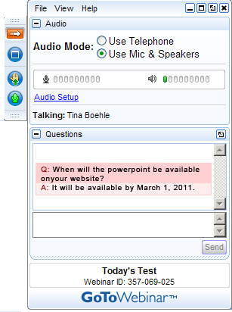
GoToWebinar Control Panel - AUDIO
Notes:
Participants on the webinar are in listen-only mode.
If you have a question about a presentation during the course of the webinar, you can ask it through the [Questions] panel on the GoToWebinar control panel. The slide you see in front of you is a question received during the webinar held last year.
To keep the webinar moving, we will queue up questions for response during the Q&A time at the end of the webinar. As you listen along, if you have a question, type in your question. Please let us know what organization / agency you are with and if you would like a specific presenter to answer your question. We plan on answering as many questions as possible.
Technology is our friend. However, if you are having technical difficulties, you can use that same question area to contact us for assistance.
We learned last year that some locations had challenges with their internet service. This year we have pre-posted this PowerPoint presentation on the NIFC PIO bulletin board. We are recording today's webinar session and we will post the full webinar with audio in approximately two weeks.
Now that the technology details are covered, lets move on to our great cast of speakers!
Cue!
4/24/12

Slide 5
Dan Smith
NWCG Vice Chair;
Fire Director,
National Association of State Foresters
Notes:
Roberta:
Our first speaker is Dan Smith. Dan has been employed as Fire Director for the National Association of State Foresters (NASF) since January 2007. In this job he represents 50 states and 8 territories, and works collaboratively with the federal wildland fire directors at the National Interagency Fire Center in Boise, Idaho.
He serves as a member of the National Multi-Agency Coordinating Group (also known as NMAC) and on the National Wildland Fire Coordinating Group (NWCG) Executive Board. Dan has 34 years experience in wildland fire and emergency response as a forester and fire fighter. As a type 1 national incident commander and as member of one of the national area command teams, Dan has been assigned to wildland fire and all risk incidents throughout the US. When not in Boise he resides with his wife in Swanquarter, NC.
Dan:
Good morning. Thank you for the opportunity to provide opening comments today for the 2012 NIFC Public Information Office webinar. On behalf of the NIFC Fire Directors, I express our appreciation to you for the great job you do in communications in our interagency world of wildland fire management. Interagency collaboration and communication is so critical to our success in all that we do in wildland fire across the U.S. While the interagency cooperation exhibited by the National Wildfire Coordinating Group, National MAC, and NIFC has been a model for others to follow over several decades we must recognize the value of maintaining it and dealing with challenges that face us today. Declining budgets, declining work force capacity, complex fire seasons and incidents can strain those relationships at times when it’s even more critical to sustain them. Your role in telling our story and providing internal and external communications is critical in those circumstances. It’s appropriate your focus this year is Strategic Thinking-Strategic Speaking.
Cue!
4/24/12

Slide 6
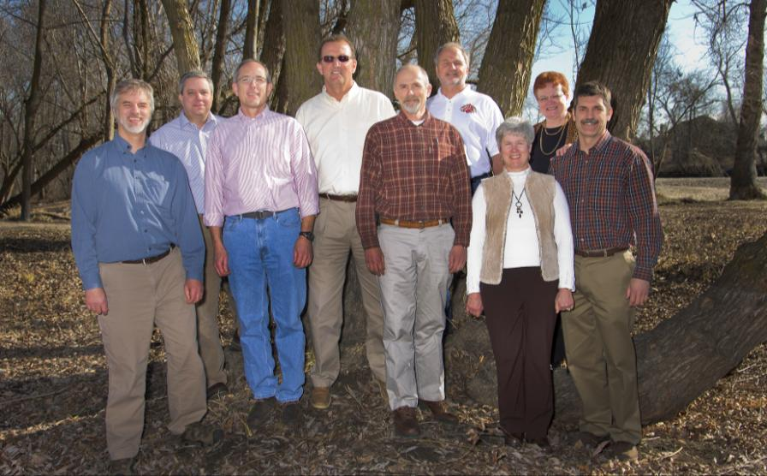
NWCG Executive Board
Left to Right: John Segar, Lyle Carlile, John Gould, Dan Smith, Bill Kaage, Jim Erickson, Karyn Wood, Bonnie Bradshaw, Aitor Bidaburu
Notes:
There are several national interagency initiatives underway to help us address the challenges that we are facing. The National Cohesive Wildland Fire Management Strategy and NWCG Work Force Succession planning effort are two of the key ones. Through the joint effort of the Cohesive Strategy we can bring attention to policies and actions needed to strategically approach the issue of effective wildland fire mitigation and response. We can restore and maintain resilient landscapes, create fire adapted communities and provide the right response to fire while protecting our fire fighters and the general public. The NWCG work force succession effort is creating a strategy to ensure that interagency fire staffing needs are met including staffing and management of incident management teams for the future. Once again your role in implementation of these initiatives, supporting fire management activities during the 2012 Fire Seasons, and telling our story will be pivotal to our continued success. Have a great day. Thanks.
Cue!
4/24/12

Slide 7
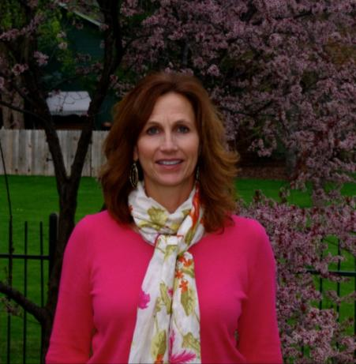
Jennifer Jones
Jennifer Jones Public Affairs Specialist U.S. Forest Service, Washington Office Fire and Aviation Management National Interagency Fire Center
Notes:
Thanks Dan.
Next we have Jennifer Jones.
Jennifer started her career with the U.S. Forest Service in 1988 as a public affairs specialist on the Boise National Forest. She has worked in a variety of public affairs positions with the Forest Service and the Bureau of Land Management in Boise and Washington, D.C. Jennifer worked for nine years as a public relations consultant before starting her current job at NIFC in 2009. She has worked in fire since the beginning of her career, including serving as PIO on a Type 1 Incident Management Team and chairing what is now the NWCG communication, education, and prevention committee. Jennifer is accredited in public relations by the Public Relations Society of America and has a masters degree in public administration.
Welcome Jennifer!
Cue!
4/24/12

Slide 8
Using Them To Think and Speak Strategically
National Fire Season Themes for 2012
Notes:
Thanks, Roberta!
I’m happy to be here to present the 2012 national fire season themes and talk to you about how you can use them to help you think and speak strategically about fire whether you’re working on your home unit or on an incident.
Thinking and speaking strategically sounds kind of scary. But it’s actually really easy. A strategy is simply a plan to accomplish a goal. So all we’re doing is encouraging you to have some goals and a plan in mind when you talk about fire to the public, the media, and other audiences. It’s the opposite of winging it, if that helps.
Why is it important to think and speak strategically ? There are lots of good reasons:
First, it enables us to leverage the attention that the public, media, and other audiences pay to us during wildfires. Aren’t there a few other things we’d like them to know about our agencies’ fire programs besides how many firefighters and aircraft we can call up?
Second, it enables us to represent not only ourselves but also the entire interagency fire community in a professional manner. Having some goals and a plan helps us resist the temptation to say or do whatever comes into our minds, which has had less than desirable results for some of us over the years!
Finally, strategic thinking and speaking can help us when we find ourselves in tough communication situations. Having some goals and a plan gives us a place to go when we’re on the conversational road to nowhere. I’m sure I’m not the only one who’s been there before!

Slide 9
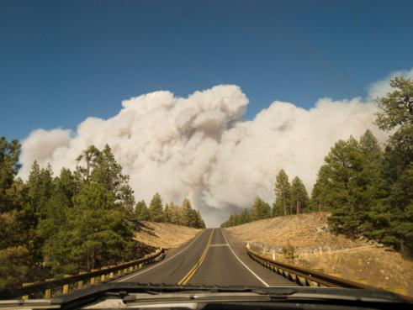
Available online at: www.nifc.gov/PIO_bb/pio_main.html
Notes:
We distributed the themes a few weeks ago, so many of you have probably already seen them. If you haven’t, they’re posted on the NIFC website in the PIO bulletin board.
Today, I’m going to talk to you about the strategic thinking behind the themes. Hopefully, that will spur you to do some strategic thinking of your own about how to tier from them – in other words, flesh them out with additional information, details, and examples that pertain to your unit or to incidents you’re working on so that you can speak strategically.
The themes have been approved by the National Multi-Agency Coordinating Group here at NIFC, which is comprised of representatives of the National Association of State Foresters and the U.S. Fire Administration as well as the federal wildland fire agencies.
The themes are designed to be used by anyone who speaks about fire, regardless of what agency they’re affiliated with; where they’re located; and what level of their organization they work in. They provide a means for the thousands of us across the country who communicate about fire to get on the same page. However, since all of the agencies involved in wildland fire have different missions, the themes can’t really be one size fits all. They’re meant to be tailored to fit your circumstances. With that, let’s look at ‘em.

Slide 10
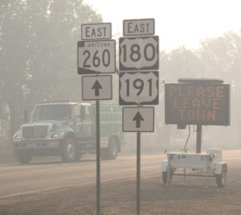
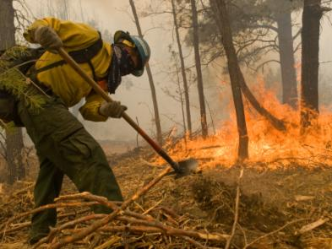
Keeping the public and firefighters safe is always our first concern.
Our commitment to safety is reflected in every fire management activity.
No structure, or natural or cultural resource, is worth the loss of a human life.
Notes:
At first glance, theme 1 sounds like a same old, same old safety message. But what we’re trying to get at here is the increasing emphasis on making risk informed decisions in fire management. The more firefighters, aircraft, and equipment we have working on fires, the higher the risk of an accident. Risk managers call that exposure.
So, instead of just putting as many resources as we can on fires, we’re thinking strategically, maintaining sound situational awareness, and developing sound objectives. Then, we’re trying to make sure that we have the right resources in the right place at the right time. Sometimes, that means making tough calls not to put firefighters, aircraft, and equipment in certain locations because the chances that they’re going to be effective are low and the risks of an accident are high.
You can tier from this theme and speak strategically on your unit or on an incident you’re working on by asking your fire management officer or incident commander what risks to firefighter and public safety exist and what fire management strategies and tactics they are using to reduce them. Then, use that information to explain the actions that are being taken to manage fires when you’re talking to the media, to the public, and to other audiences.

Slide 11
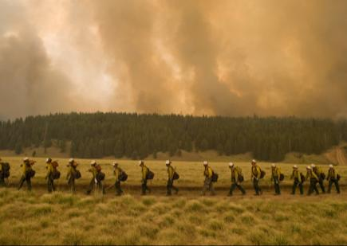
Fire is an essential ecological process and a natural change agent.
Many landscapes are out of ecological balance. Fire is one way of helping to restore that balance and help landscapes to become more resilient to threats.
Our focus is on minimizing damage and maximizing the benefits of wildland fire.
Notes:
Theme 2 highlights the role of fire in landscape restoration, which is key to implementing the federal wildland fire management policy. Landscape restoration is also one of the three elements of the National Cohesive Wildland Fire Management Strategy, which is an effort to seek national, all-lands solutions to wildland fire management issues in case you’re not familiar with it. The other two elements of the Cohesive Strategy are fire response and fire adapted communities. Fire response gets a lot of attention, while the other two elements often do not. We’re hoping you can find opportunities to talk about landscape restoration and fire adapted communities as well as fire response this fire season.
One way to tier from this theme is to check with your fire management officer or incident commander to see if there are places on your unit or the incident you’re working on where fires became easier to control once they burned into areas where prescribed fires have been conducted. Then, find ways to present that information to the media, the public, and other audiences.
This theme also reminds us that we need to talk about fire as a natural force, not an enemy, even when we’re fully suppressing it. When we use terms like “catastrophic” to describe wildfires and when we describe efforts to suppress them using combat terms like “battle,” it makes it awfully hard to explain why we’re not fully suppressing some fires and why we’re actually igniting prescribed burns.

Slide 12
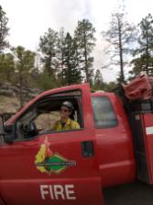
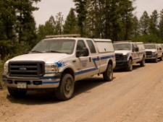
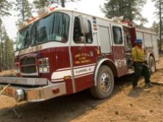
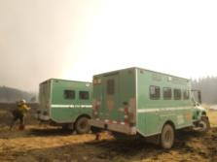
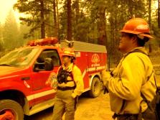
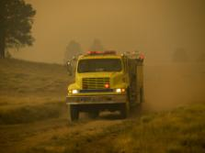
Teamwork and cooperation are essential in managing wildfire.
Wildfires know no boundaries. The response to wildfire will be coordinated among all affected agencies and landowners.
Pooling our resources helps keep costs down and effectiveness up.
Notes:
These pictures of all the different colored engines – which were all taken on the same fire last year –clearly illustrate how essential federal, state, local, and tribal partnerships are in managing wildfires these days. Recognizing and respecting the different missions and different needs of all partners is key to making this system work.
You can tier from this theme by asking your fire management officer or incident commander for examples of the different roles that cooperators are playing on your unit or on incidents you’re working on and the benefits of everyone working together. Then, look for opportunities to talk about them to the media, the public, and other audiences.
This theme also reminds us that we need to make sure that as PIOs and PAOs we are coordinating fire communications with our cooperators (that is a tongue twister!). This means taking all of the different missions and needs into consideration so that we craft appropriate communications objectives and messages.
These days, we need to think beyond our traditional wildland fire cooperators.
Many local governments have created Type 3 incident management teams that have developed significant capability to manage all-risk incidents. They have trained PIOs that may be more than willing to help you with fire communications if you’ll just ask.

Slide 13
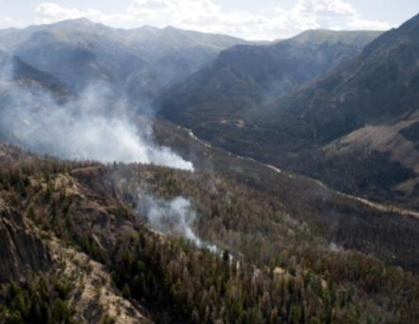
Fires are managed in different ways. The same fire may have several objectives, which can change as the fire spreads.
Our response to wildfire is based on its potential ecological, social and legal consequences.
Fires that threaten life, property and important natural and cultural resources will be put out as safely and quickly as possible.
Notes:
Theme 4 is related to theme 2 and essentially boils the 2009 changes in implementation of the federal wildland fire management policy into a few sentences.
Since the first lightning caused fires were managed to achieve resource management objectives in the 1970s, we’ve struggled to find the right words to describe what we’re doing.
We tried having a separate category for these fires - wildland fire use, fire for resource benefits, etc. In 2009 we decided to take a different approach and since then there are only two types of fires – wildfires, which are unplanned ignitions and prescribed fires, which are planned ignitions. But, we still see other terms being used to describe these fires, like long duration fires and multiple objective fires.
If you find yourself working on a fire that is being managed with a strategy other than full suppression on your unit or somewhere else, you can tier from this theme by explaining the objectives that have been identified and the trigger points, or management action points, which will cause the objectives to change if the fire reaches them. You can also talk about the careful planning that took place long before the fire started that has enabled it to be managed the way it is and the plans that are in place to protect public safety.

Slide 14
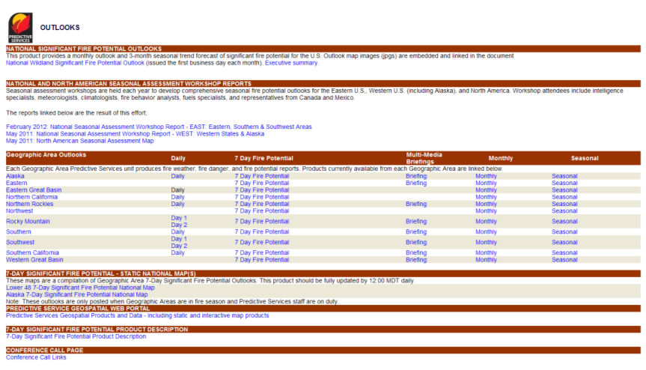
Fire seasons are influenced by several factors including weather, the amount and condition of fuels and sources of ignition.
This year’s fire season is especially challenging to forecast. Conditions have not been typical. We expect above-average activity in some areas, but it’s too early to determine exactly where.
http://www.predictiveservices.nifc.gov/outlooks/outlooks.htm
Notes:
Theme 5 – Our predictive services staff just aren’t sure what’s going to happen this fire season. This year, it will be important than ever for you to tier from this theme by keeping up on conditions in your area. You can do that by checking the significant fire potential outlooks that are posted on the first of each month on the NIFC and Geographic Area Coordination Center websites.
One thing we sometimes forget to mention when we’re talking about the potential for fires is the importance of ignitions in determining what kind of fire season we actually have. We can have high fire potential but if we don’t get big lightning busts or lots of human caused starts, we may not see much activity. Or, we can have low to moderate potential but get a lot of lightning or human caused starts and have a lot of activity.
Another way to tier from this theme is to develop local messages to prevent human caused starts.

Slide 15
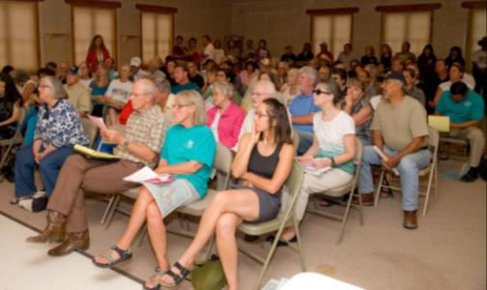
Firefighters count on the public to help reduce risk.
When residents of a fire-prone community clear brush, trees and other flammable materials away from their home, it helps keep residents and firefighters safe. A community that has adapted to fire is a better-protected community.
Firefighters appreciate the help given to them by people who are willing to do their part to reduce risk prior to a fire incident.
Notes:
Lastly, theme 6 reflects one of the other elements of the Cohesive Strategy, fire-adapted communities.
Make sure that you take advantage of having the public’s attention during wildfires to educate them about their roles and responsibilities to prepare themselves, their homes, and their communities for wildfires. Also be sure to call attention to the individuals and communities who have done a good job at this.
Tier from this theme by finding out what is being done on your unit, or on the unit with jurisdiction over the incident you’re working on, to help communities become fire adapted. Familiarize yourself with Firewise; Ready, set, go; and other programs that help communities become fire adapted and talk about them at every opportunity.
Also tier from this theme by asking your fire management officer or incident commander if there are examples of homes that have survived because defensible space was created around them. Bring them to the attention of the media, the public, and other audiences.

Slide 16
How you can use the themes to think and speak strategically:
Develop tiered messages for your unit and/or incident.
Deliver tiered messages when you are speaking to key external audiences.
Notes:
Now that you’ve heard about some of the strategic thinking that went into developing the national themes, again, we encourage you to do some strategic thinking of your own. Identify some goals that you would like to accomplish on your unit or on incidents you’re working on and create a plan to achieve them.
A lot of effort went into developing these themes – but they’re not worth the computer screen they were keyboarded on if they’re not used by PIOs and PAOs in the field this fire season.

Slide 17
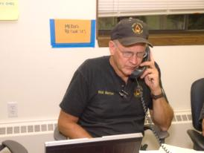
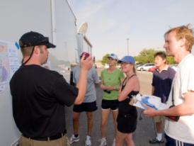
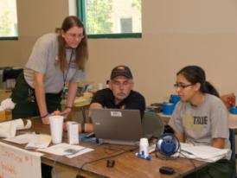
Thank You
Thank you for all the great work that you do in wildfire communications!
We are here to help!
jejones@fs.fed.us
(208) 387-5437
Notes:
I’ll look forward to your questions and comments at the end of the presentations. Thank you!

Slide 18
Michelle Fidler
NPS Fire Communication and Education Specialist
Notes:
Michelle Fidler is a NPS Fire Communication and Education Specialist with the National Park Service. She is based at Saguaro National Park in Tucson, AZ, where she supports NPS units in AZ, NM, TX, and OK. She is a Type 1 public information officer and worked with Joe Reinarz's Type 1 Southwest Incident Management Team in 2011 on incident including the Wallow Fire, the largest fire in AZ's history, and the Las Conchas fire, the largest fire in NM's history.

Slide 19
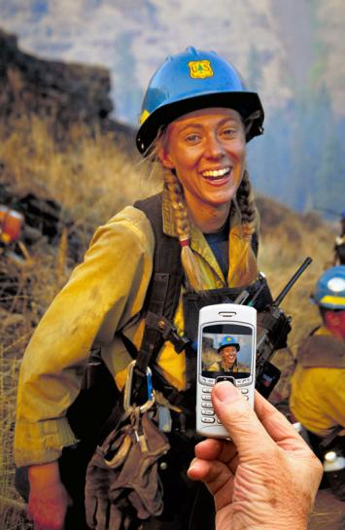
A SIMPLE Approach to Social Media
S
I
M
P
L
E
trategize
mplement
onitor
lan
everage
valuate
Notes:
Using social media on incidents can be intimidating, but today I want to give you a SIMPLE approach to working social media into your communication strategy.
This approach incorporates 6 key steps – Strategize, Implement, Monitor, Plan, Leverage and Evaluate.

Slide 20
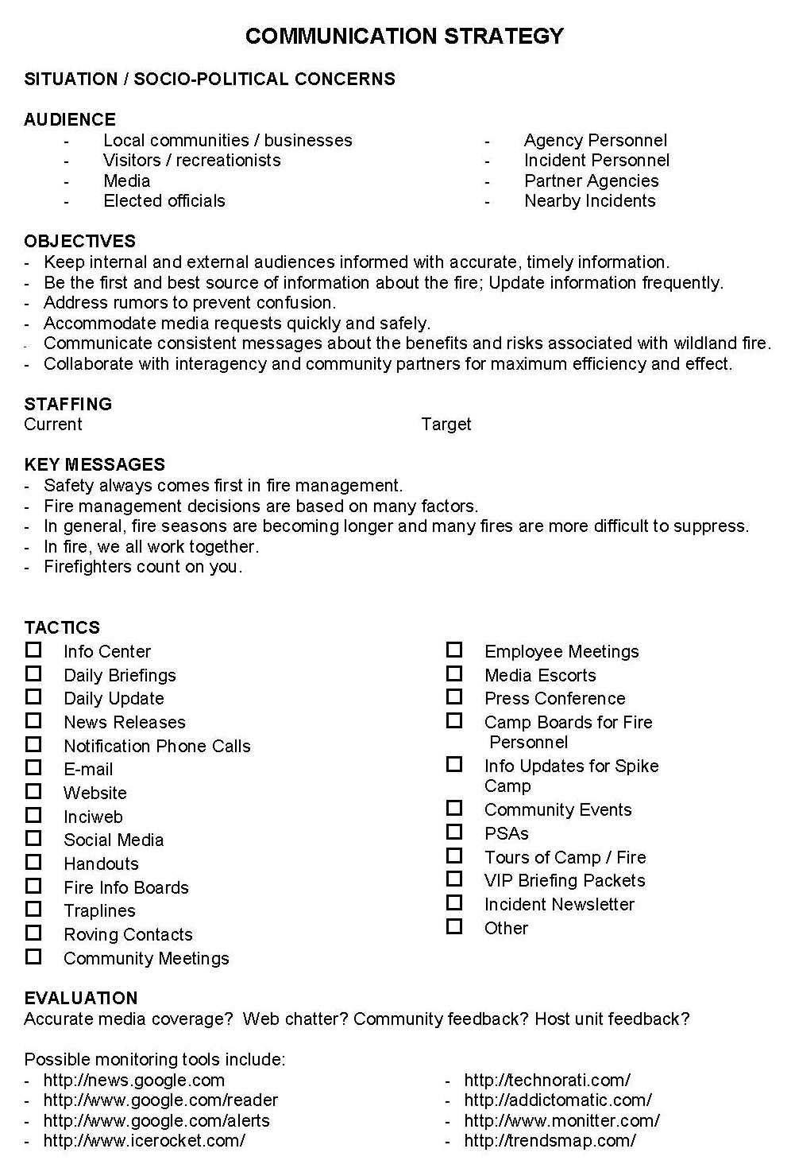
Strategize
Social media tools are tactics as part of the overall information strategy
Reasons to use social media
To reach online / mobile audiences
Evacuees and their friends and family
Absentee homeowners
Residents that are out of town
Tourists & Recreationists
Elected officials
Incident personnel
Ability to meet audience needs
High resolution maps and images for media use
Backup sources of info when one system crashes
Ability to update from the field
2012 PIO Incident Organizer – p. 10
Notes:
As public information officers, we recognize the importance of developing a communication strategy (example - 2012 PIO Incident Organizer – p. 10) for our incident. Each incident is different and our strategies and tactics may evolve through the duration of the incident.
There is no one size fits all strategy for incorporating social media into your plan.
Social media tools may come and go; and you’ll want to choose the tools that meet your needs and objectives for any given incident.
Social media tools are not a silver bullet that will address all your needs, but just like traplines, news releases and media interviews, they are tactics that can be incorporated as part of the overall incident info strategy to reach your target audiences.
Since not everyone has access to social media, any information posted to a third-party social media Web site should also be provided in another publicly available format such as Inciweb or the host unit website.
Some reasons to use social media may include:
To reach online / mobile audiences
Evacuees and their friends and family
Absentee homeowners
Residents that are out of town
Tourists & Recreationists
Elected officials
Incident personnel
Social media can also help us meet our audience’s needs
For example we found that Flickr served as a useful tool to provide high resolution maps and images to the media
Social media tools can also serve as a backup source of information when one system crashes
Another advantage is we have more flexibility to provide incident updates from the field
Bottom line: If social media tools help you meet your objectives, you can use them to your advantage.

Slide 21
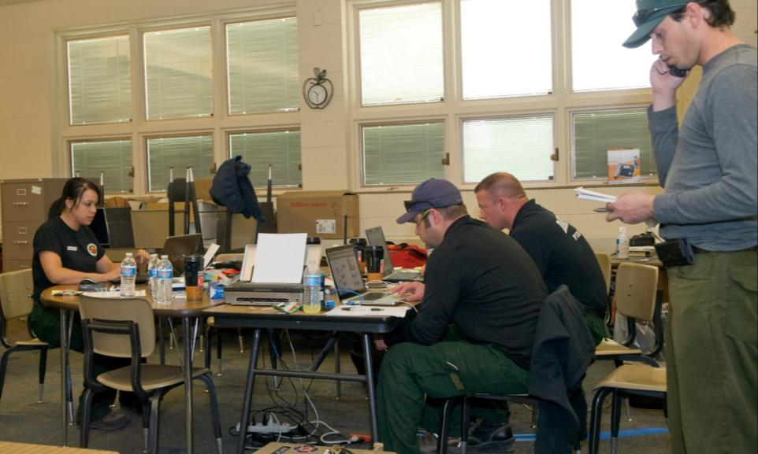
Case Study The E-Trapline Unit on the 2011 Wallow Fire
Lead PIO
E-Trapline
Community
Media
Call Center
Info Center
E-mail
Inciweb
Twitter
Flickr
Internal Texts to PIOs
Media Monitoring
E-Trapline
Photo by Kari Greer
Notes:
Last year the Wallow Fire had one of the largest contingencies of public information officers on an incident, and we tiered down our info organization accordingly to help maintain span of control.
-One of our information units we coined the “e-trapline” unit.
- The unit handled all of our electronic communications, including e-mail, Inciweb, Twitter, Flickr, internal text messages to our Public Information Officers (PIO)s, and media monitoring.
-While the Community unit was engaging and disseminating information via a traditional trapline to reach our local communities at the grocery stores, coffee shops, post offices, etc. the E-trapline unit focused on a series of electronic communications where PIOs provided accurate, timely updates to our online & mobile audiences.
- They also monitored electronic communications and gathered information we could use to help us adapt our communication strategy accordingly and in real-time.
Our staffing was flexible, depending on needs, however due to the significant demand for information on such a large scale incident, we had a minimum of 3 PIOs assigned to the unit at any given time.
When we had significant updates on evacuations, etc. we verified the information and had the messages approved before releasing them.
We found it especially helpful to embed one of our PIOs in operations to help us get updates and confirm or deny rumors.
Using internal text messages helped us make sure our PIOs got the same updates in the field; we recognized not all PIOs had text capabilities but they were generally teamed up with another PIO that did have access; however the Info Center always activated a PIO phone tree simultaneously to make sure everyone received critical updates.
Like all PIO operations, staying flexible was key, and we had to adapt when multiple teams were assigned to the fire, ultimately area command took on many of the social media functions.

Slide 22
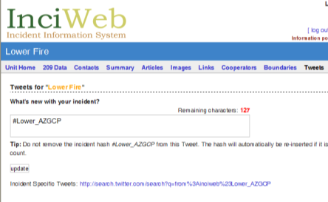
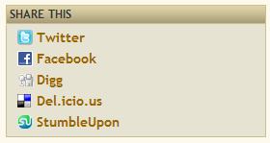
Implement Social media tactics after host unit and IC have approved their use
Twitter
Use existing resources
Host unit accounts
IMT accounts
Interagency accounts
Built-in Inciweb Tools
Twitter
Video (Coming Soon!)
Built in sharing tools
Host Unit Account
@AS_NF
Inciweb
IMT Accounts
@T1SWIMT
@AreaComTeam3
@AreaComTeam4
Notes:
Once you’ve identified your tactics in your communication strategy and they’re approved by the host unit and Incident Commander (IC), you can begin implementing them.
- In many cases, you can use existing host unit accounts. These accounts are helpful because they’ve already been approved, key audiences are already following them, and they can be used as a consistent source throughout the incident.
- You may also have accounts set up for your incident management team that you can use.
There may also be interagency accounts available for your use. For example in AZ we share interagency fire info via the @wildlandfireAZ twitter account and that info appears as a Twitter widget on our interagency fire info webpage, wildlandfire.az.gov as well as on the Southwest Coordination Center’s Incident Information page (http://gacc.nifc.gov/swcc/information/information.htm)
Inciweb (http://www.inciweb.org) also has several built-in tools
- For instance, every time you update your Inciweb new releases, announcements, or maps, the main @Inciweb twitter account (http://twitter.com/inciweb) automatically posts a message with your headline and a link to your article or images
There’s even an option to send additional tweets directly from Inciweb that will also post to the main @Inciweb twitter account
- A new feature on Inciweb this year will be the ability to upload videos
Inciweb also includes built-in sharing tools, so that visitors to the site can share info with their friends on Twitter, Facebook, etc.
You can learn more about Inciweb tools by participating in an upcoming webinar training session.

Slide 23
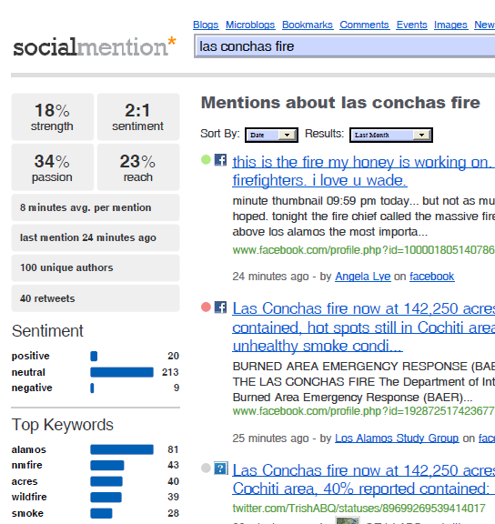
Monitor Social media to identify rumors, track trends, and document public sentiment
Monitor key sites
Partner agencies
Local media
Elected officials
Community leaders
Wildland fire sites
General monitoring
Google.com/Alerts
SocialMention.com
Icerocket.com
Addictomatic.com
Notes:
Even if you don’t engage in social media directly, it’s essential to monitor social media, just like we monitor news stories, to help identify rumors, track trends, and document public sentiment.
You can do this several ways. One way is by identifying key sites like partner agencies, local media, elected officials, community leaders, and wildland fire sites and monitoring them directly.
You can also use general monitoring tools like google alerts, socialmention, icerocket, or addictomatic.
By monitoring electronic communities and gathering information (ie rumors, underserved communities, trends, etc.) we can assess and adapt our communication strategies appropriately and in real-time.

Slide 24
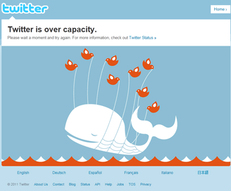
Plan Ahead and Be Flexible
Got a Contingency Plan?
Ask partner agencies for help getting the word out
Send a PIO off-site where power/internet is available
What about Transition?
Coordinate with other teams / area command
Document how-to protocols, passwords, etc.
Provide a link to new source for info / home unit
Notes:
We all know that technology can be our friend, but we also know all technology inevitably fails. We need to plan ahead and be flexible.
We need to think about: What are we going to do if a social media platform crashes? How will we adapt if we lose power or internet? Do we have a contingency plan?
One solution might be to ask your partner agencies for help getting the word out
Another option might be Send a PIO off-site if you need to
For example on the Las Conchas fire, our Incident Command Post (ICP) moved to a new location. But I stayed in our initial location at a host unit office to maintain our electronic communications until I was able to verify electronic communications were fully functional at the new ICP.
It’s also important to think about how you will transition with other teams and/or back to the home unit.
- You’ll want to coordinate with other teams and area command on which accounts you’ll be using and how they’ll be updated.
Be sure to document how-tos, protocol, passwords, etc. and include them in your transition plan.
If you stop updating an account, be sure to refer people to where they can find current info.
Regardless of what happens behind the scenes, it’s important to do what we can to provide a seamless flow of information for the public.

Slide 25
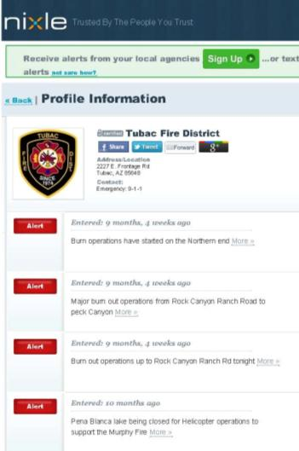
Leverage Existing Resources
State/local interagency
County Emergency Mgmt
Sheriff’s Dept
Local Fire Dept
Volunteers
Notes:
Even if you aren’t able to engage directly, you can leverage existing resources to work for you.
Partner agencies are force multipliers and can share info & serve as a backup.
For example, here in AZ the the AZ Department of Emergency Management’s Emergency Information Network posts all of our news releases to their accounts. If Inciweb crashes, we can refer people to AZEIN.gov as a backup.
Many county emergency management agencies, sheriff's departments, and local fire departments also have accounts .
For example, the Tubac Fire District used Nixle , a free notification service, during the Murphy Fire (http://local.nixle.com/tubac-fire-district/). While there aren’t currently agreements in place for federal agencies to use services like these, many local agencies have access to similar services and can help us get our messages out.
On the Wallow Fire we had an extensive e-mail list and needed to send out multiple critical alerts a day. All of the e-mail services we tried tagged us as spammers and we were unable to distribute our messages. We ultimately developed a shorter e-mail list to send messages to a few key contacts and force multipliers that could help us distribute the word to a broader audience. We also worked with NIFC to set up a trial account with SendWordNow, an emergency alert service that enabled us to send mass e-mails.
NIFC is currently working on establishing a Broad Purchase Agreement for the 2012 season that would enable PIOs who need mass email/text messaging services to be able to request them via NIFC similar to the way we can request photographers and videographers on incidents.

Slide 26
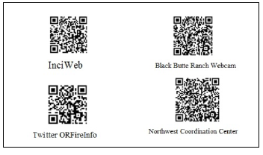
Case Study The Deployment of Trusted Digital Volunteers in the 2011 Shadow Lake Fire
Hand-picked group of trusted remote volunteers with social media skills
Volunteers only posted content approved by lead PIO
Volunteers monitored rumors and maintained documentation
Notes:
Another case study from last year was the deployment of trusted digital volunteers on the Shadow Lake Fire in Oregon.
A NIMO team used a hand-picked group of trusted remote volunteers with social media skills
Volunteers only posted content that was approved by the lead PIO
Volunteers also monitored rumors and maintained documentation
(More info http://www.nifc.gov/PIO_bb/sm/TrustedDigitalVolStDHPalen.pdf)
Later in the webinar, Kris Ericksen will be talking more about using volunteers as part of a Virtual Operations Support Team.

Slide 27
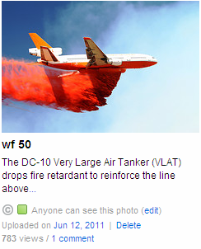
Evaluate Site stats from Twitter, Flickr, etc.
@AS_NF reached 24,632 people with 50 most recent tweets (as of 6/15)
675 new @AS_NF Twitter followers in <8 days
AS-NF photos viewed 672,673 times in 10 days
In a single day (June 9th), Flickr photos were viewed over 144,477 times
Flicker images that were tweeted were viewed nearly 2x as many times
Notes:
As we know, evaluation is an important component of our communication strategy.
Many social media tools have built in site statistics that we can track.
For example on the Wallow Fire, the Apache-Sitgreaves NF twitter account (http://twitter.com/AS_NF) reached close to 25,000 people with just 50 messages
The account also gained almost 700 new followers in just over a week
Photos on the host unit’s Flickr accout were viewed almost 700,000 times (http://www.flickr.com/photos/apachesitgreavesnf)
On one day alone, photos were viewed over 144,000 times
The Flickr image on the right was tweeted (using the tweet-from-flickr option), and was viewed nearly twice as many times
Ultimately what we learned was there was value in using multiple social media tools and harnessing them to work together.

Slide 28
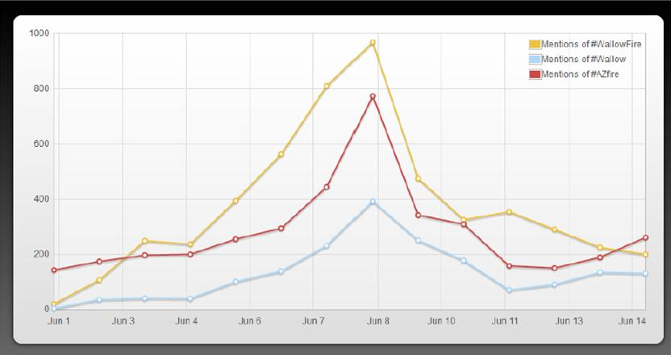
Evaluate Trends with analytic tools like Socialmention.com
1,000 mentions of #WallowFire
800 mentions of #Azfire
400 mentions of #Wallow
Notes:
We also used other evaluation tools like socialmention.com to help evaluate trends.
For example, we were able to determine the #WallowFire hashtag was more effective than the #Wallow hashtag.
Regardless of the analytic tools you use, the key is using them in real-time to help you indentify factors that can contribute to your success.

Slide 29
2011 Fire Season Lessons Learned
Social media tools are essential tactics on large incidents
You can’t control social media; Learn how to harness it to work for you
If you don’t engage, others will fill the void
Notes:
-A key lesson learned on the Wallow Fire was social media tools are essential tactics on large incidents.
We can’t control social media, but we can harness it to work for us.
And if we don’t engage, others will fill the void.
- On the Wallow Fire, our team didn’t use Facebook as we didn’t have approval to use it.
However we monitored Facebook and found out it was essentially the online coffee shop and the place to be to share fire information.
We discovered there were more than a dozen community Facebook pages or groups focusing on the Wallow Fire that were established including one called “AZ Wallow Fire Information.”
Without having an official presence, we found that others were telling the fire story for us, and we found it challenging when we were unable to engage to correct inaccurate information.
Ultimately there is no one size fits all solution to incorporating social media on incidents. Our goal should be do what we can, with what we’ve got, where we are. And if we can’t do that, we can ask for help from others that can.

Slide 30
Case Study 2011 Las Conchas Fire Twitter List
@NMFireInfo/LasConchasFire
@SantafeNF
@LosAlamosNatLab
@NMStateForestry
@VallesCaldera
@BandelierNPS
@NMDHSEM
@ACT1FireInfo
@T1SWIMT
@SWIMT1
@pnw2
@RedCrossNM
@BLMNIFC
Notes:
A significant challenge we ran into last year was working on large incidents that impacted multiple jurisdictions.
Numerous partner agencies were providing official information via twitter throughout the incident, so our team helped set up a twitter list to help provide the public with a source for consolidated information.
We used the interagency @NMFireInfo twitter account as a central place to host the list (http://twitter.com/NMFireInfo/lasconchasfire ) and included the link to the list in our updates and on Inciweb.
This is just one example of how you can work with existing interagency resources to make them work for you.

Slide 31
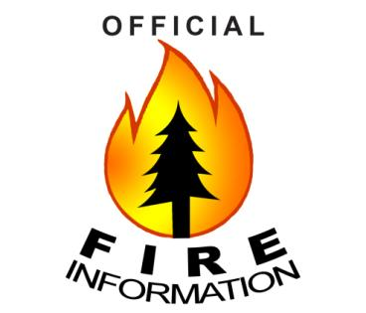
NEW! Official Fire Information Logo
Logo available on NIFC PIO Bulletin Board
http://www.nifc.gov/PIO_bb/ social_media.html
Use it to “brand” official information sites in a non-agency logo, interagency way
Notes:
- This year there’s a new official fire information logo available on the NIFC PIO bulletin board. (http://www.nifc.gov/PIO_bb/social_media.html)
Those of us in the information business realize there is value to being an “official” source.
Toward that end, this logo is an attempt to create a way to “brand” official information sites in a non-agency logo, interagency way.
You can use this logo as the avatar on social media sites, on business cards, on bulletin boards, and even on your letterhead
This logo is merely a suggestion. It was not created nor approved by a large group, but by a few PIO’s interested in finding a way to brand “official information”; and get something out in time for the 2012 fire season. Use it if you think it will help your communities understand WHICH information is from the official source.

Slide 32
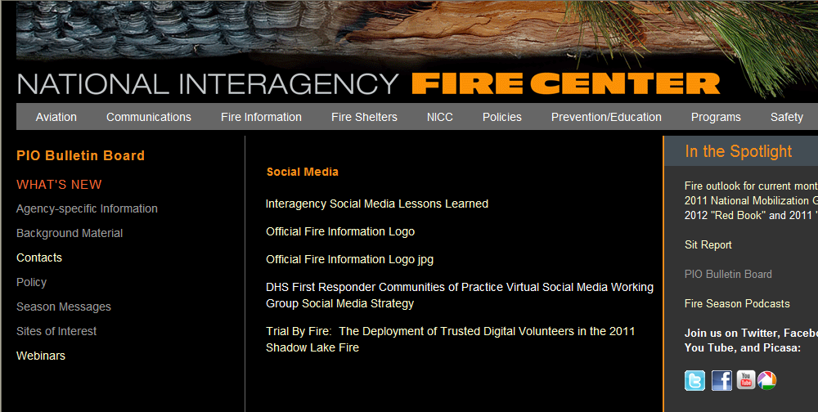
Social Media Resources
http://www.nifc.gov/PIO_bb/social_media.html
Notes:
The logo and additional information and resources are available on the NIFC PIO Bulletin Board. (http://www.nifc.gov/PIO_bb/social_media.html)

Slide 33
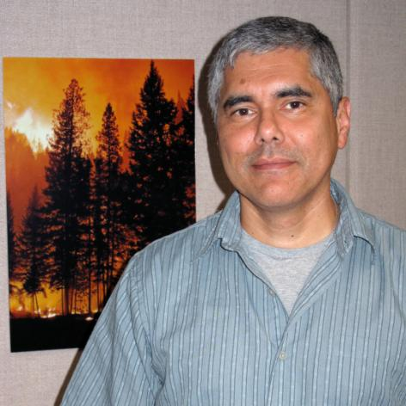
Ed Delgado
Predictive Services, Program Manager
Notes:
Ed Delgado has been a meteorologist for 26 years. He began his career with the National Weather Service, working through the ranks at offices in Texas, Colorado, North and South Carolina. In the early 90s, he became involved in fire weather and its unique challenges. In 2001, Ed joined the BLM as the Predictive Services meteorologist in Salt Lake City. In addition to managing the Predictive Services program in the Eastern Great Basin, Ed’s contributions to interagency fire and fuels programs include the Real-time Observations Monitor and Analysis Network (ROMAN), the National Fuel Moisture Database (NFMD) and the Online 7-day Outlook. Ed became the National Predictive Services Program manager in 2011.

Slide 34
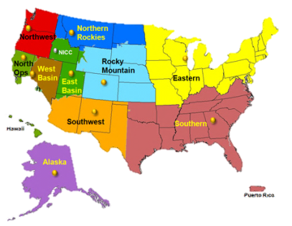
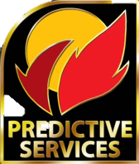
Predictive Services Who and where we are…
Interagency decision support unit.
Meteorologists, Intelligence Coordinators, Fire Analysts
National program manager at NICC
Units at each Geographic
Area Coordination Center

Slide 35
Predictive Services What we do…
Support for operational management of and strategic planning for wildland firefighting resources.
Three primary functions:
Fire weather and climate.
Fuels and fire danger.
Fire activity and resources intelligence.

Slide 36
Predictive Services What we do…
Products and services:
Weekly, monthly and seasonal outlooks.
Daily assessments of critical fire conditions.
Briefings for multi-level decision support.
Fuels and fire behavior advisories.
Research and development.

Slide 37
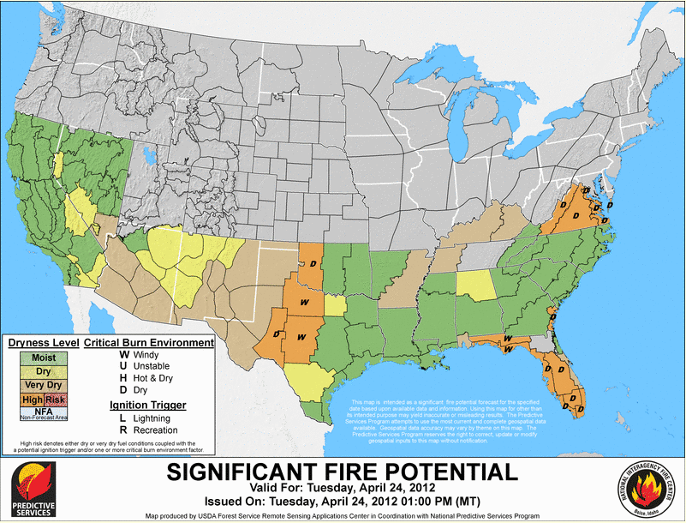
Predictive Services Products…
7-day (Weekly) Outlook
Assesses potential for significant fire based on fuels condition and weather.
Identifies high risk events
such as lightning, strong
winds, low relative
humidity, etc.
National and regional outlooks produced daily.

Slide 38
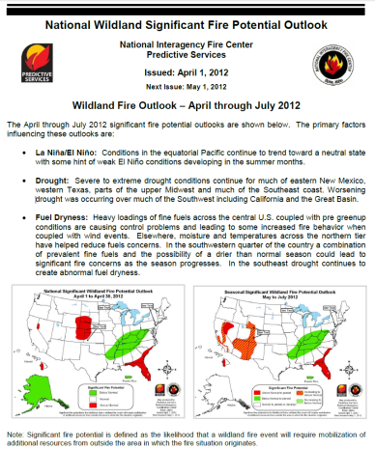
Predictive Services Products…
Monthly Outlook
Assesses potential for significant fire based on medium to long term climate and fuels trends.
National and regional
outlooks released first
business day of month.

Slide 39
Predictive Services How these can help you…
Briefing/talking points.
Executive summary for monthly.
Local and regional emphasis.
Consistent message throughout fire organization.
Routinely updated.

Slide 40
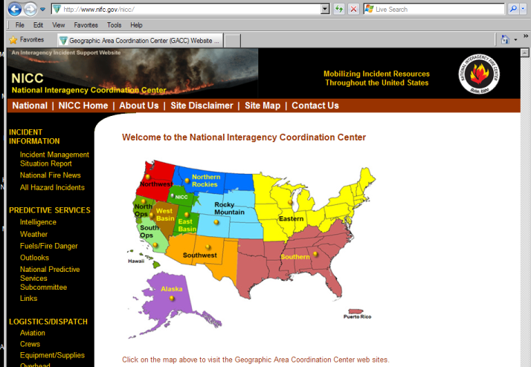
Predictive Services Where you can find…
http://www.nifc.gov/nicc/

Slide 41
Predictive Services To contact…
To contact national or regional Predictive Services units:
NIFC Fire Information Hotline
208-387-5050

Slide 42
Kris Eriksen
National Incident Management Organization Portland Team
Public Information Officer
Notes:
Kris Eriksen started her career in fire as a summer job while she was in college. 28 years later, she is now with the National Incident Management Organization (NIMO) team based out of Portland, Oregon. Kris has been deployed with the Alaska Type 1 Incident Management Team, as well as other National Type 1 and 2 teams, responding to many of the nation’s largest wildland fires and all-hazard assignments. She is an advocate of advancing the use of social media in wildland fire.

Slide 43
OST
Virtual Operations Support Team
Notes:
Introduction
I want to share a teachable moment that I hope will help IMT’s better manage social media needs when, as we all know, agencies are marginally supportive and the availability of fire PIO’s with sufficient skills is limited. I believe the answer is VOSTS and I want to explain what a VOST is and how we used it on the Shadow Lake Fire in 2011.
Next slide: Lets look at the use of Social Media in emergencies in general

Slide 44
SMEM Landscape Social Media in emergencies
IMT’s and other emergency managers have started to realize the critical role social media can play in communicating with their community and the rest of the world in an emergency or disaster.
Communities have higher expectations around official emergency information being available and provided in a timely manner.
The public expects official use of social media streams, and they expect emergency managers to monitor and respond to requests for information over these streams as well.
However, few emergency management organizations including IMT’s are equipped to do this kind of social media monitoring and communication at scale.
Notes:
First lets focus on the expectations of the public. I’m not going to try to convince you to use social media but I think its important that we all acknowledge that Social Media can play a critical role in information dissemination. Its now part of the public’s expectations, and, most important to me, that fact that Social Media is a 2-way form of communication, is critical.
Our standard information sites like Inciweb, have no feedback loop. We also have to acknowledge, however, that we don’t have enough of the skills in our wildland fire ranks to engage the way we should with Social Media.
However, the skills are available on the WWW, and just as people volunteer for the Red Cross, they will volunteer to help IMT’s on fires.
Next slide: Let me explain what could be help for both of these problems

Slide 45
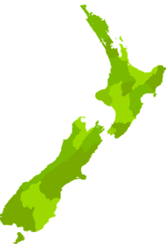
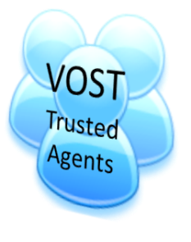
What is a VOST?
Trusted agents, with significant and proven social media skills, that are organized and under the direction of incident personnel.
VOST can help expand an IMT’s ability to engage with the public during emergencies, and as part of the recovery phase.
=
Engaged Community
Resources
+
Emergency
Management
Agency
or
IMT
Notes:
I believe one possible answer is VOST.
Virtual Operations Support (VOS), as applied to emergency management and disaster recovery, is an effort to make use of new communication technologies and social media tools by allowing a team of skilled, trusted agents to lend support via the internet to those on-site who may otherwise be overwhelmed by the volume of data that can be generated during a disaster.
In the case of wildland fire applications, VOSTS are volunteers and they are not located in the area of the disaster.
Next slide: This is not really a new idea

Slide 46
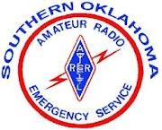
Using additional trained resources is NOT a new idea!
In conjunction with the Digital Operations Center, the Red Cross also announced the creation of a Digital Volunteer Program.
Amateur Radio volunteers continue to support communication for the emergency operations center (EOC) in the US.
Notes:
Amateur Radio volunteers have supported communications for emergency operations centers (EOC) across the US for years.
And, recently, in conjunction with the Digital Operations Center, the Red Cross announced the creation of a Digital Volunteer Program. The Red Cross’s digital volunteers will play a critical role in working to verify and curate an incredible volume of data during disasters, notifying Digital Operations Center staff of online trends and situational information that guide disaster-response information efforts. Equally important, they will engage with people affected by disasters, providing them with critical incident & safety information.
Next Slide: So how do volunteers fit into the wildland fire information picture?

Slide 47
How can a VOST assist your IMT?
Listen
Filter
Aggregate
Your Incident Management Team
Questions/
Tasks
VOST Trusted Agents
Lead PIO or assigned web person
Answers/
Response
Tasked
Information finding
Spot Trends
Information dissemination
Autonomous
Monitoring public voice
Amplifying official message
Gathering
Notes:
Communication between the IMT and the VOST is two way and uses any real time collaborative format available. Skype, email, texting, Groupme, Yammer, whatever.
The value of a VOST is that it can conduct a mix of tasks determined by a previously agreed to Leaders Intent and protocol document. There is Directed Tasking:
This is primarily information dissemination – the push
And the VOST has some Autonomous Capabilities, things they can do without checking with the IMT PIO
To amplify official messages - Post and re-tweet messages, pushing updated links out to all other sites
Feeding back the public’s issues and concerns so they can be addressed
Follow social and traditional media trends and report back
Document the social media conversation – especially if a critical event occurs
Push out key messages provided by the team, each day
Next slide: So lets look at how the IMT/VOST organization is structured.

Slide 48
How it works
IMT PIO
Skype , Dropbox,
Gmail, Gdocs
VOST
Members
All information about the fire is generated by the IMT PIO's.
Public
VOST pushes information to the public.
VOST captures concerns and issues from the public.
VOST feeds back issues, questions and results of monitoring to the IMT PIO.
VOST builds all social media sites, monitoring methods and communication structures for the group.
VOST converts info to lengths useable for various sites. Altered info is approved by IMT.
PIOs push information for the public to the VOST using a variety of methods & tools.
Any changes made to that info by the VOST are submitted to IMT PIO for approval.
Notes:
The most important point is that the VOST doesn’t generate ANYTHING. All information about the incident is generated by the team. The VOST only serves to push the information out, a force multiplier, and to cross populate all social media sites.
If there are any changes made to the information by the VOST, they are submitted to the IMT for approval.
The PIO’s generate and push information to the VOST using a variety of tools: Skype, dropbox, gmail. Gdocs, whatever the team agrees to use.
The VOST itself builds all the tools the team has agreed to use. It also feeds, maintains and monitors all these tools.
It also pushes out information or messages for the IMT. It also plays a critical role in looking for issues or concerns, or comments from the public and feeding those back to the team. The VOST also looks for and can feed or link to local social media sites including those already established on the local agency unit.
Next slide: Here’s how a VOST worked on the Shadow Lake Fire in Sisters Oregon in Sept of 2011

Slide 49
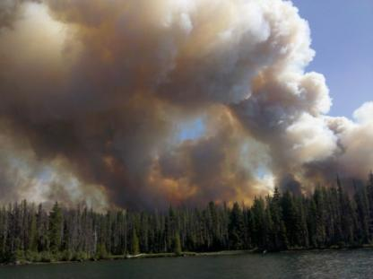
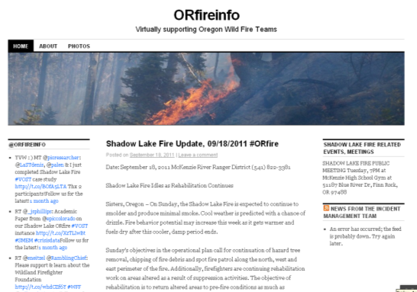
Shadow Lake Fire
Organized group of
Volunteers who:
Set up
Posted
Updated
Monitored
Documented
Tools used: Blog, Facebook, Twitter, Flicker
Notes:
The VOST was formed last minute on the way to the fire as an experiment. I sent out a call on my Twitter account looking for people who might want to help and the VOST was formed. It was a group of between 6 and 8 volunteers who set up, posted, updated, monitored and documented all social media for the fire 24/7 for 19 days. We called everything ORFireinfo because I weren’t sure if it was allowed. I knew I wasn’t supposed to start fire specific SM accounts but I wasn’t sure is having someone else start them, would be ok! I did check with my IC and he was supportive. This year, with a bit more flexibility, everything will have the fire name to increase searchability.
Next Slide: Here’s how the VOST organization itself was structured

Slide 50
VOST Cycle
Disaster occurs/event selected
Decision to activate VOST team
VOST does a pre-launch sweep of incident area to determine need.
Set tasks, priorities, schedule, finalizes tools/platforms
VOST functions under Incident command principles & works for the IMT PIO
Documentation is compiled, AAR done, VOST is demobed
VOST communicates between activations to stay current on tools/platforms & protocols
Inspired by think disaster
Notes:
A VOST functions under ICS principles:
There is a lead who is the IC. The VOST keeps a virtual 214 or unit log
The cycle begins when an incident occurs. A decision is made to do a pre-launch sweep of the incident area to see if there is enough social media activity to justify deploying the VOST.
When activated, the VOST sets up a schedule for supporting the IMT and begins setting up the social media tools it has decided to use. Then it begins work under the direction of the Incident PIO.
Deactivation, discussion, documentation, AAR
After the incident is over, documentation is gathered, an AAR is done and the VOST is demobed. Between incidents, backchannel discussion continues as the VOST discusses what worked & what didn’t, document and report, share with the #SMEM and #VOST groups.
Analytics are also going to be important for all of us to collect in the next few years as we work to prove the value of social media and make the use of social media on fires more acceptable. A VOST can help with those analytics.
VOSTs should conduct exercises between activations to stay current on tools and social media platforms.
Next Slide: Here are some last things to remember

Slide 51
Things to keep in mind
A VOST should be organized pre-season to build relationships, determine structure and tools, and agree to protocols.
No, there is no guarantee everyone will stay inside the protocols. Same as in your PIO shop.
If you are the lead and you are Forest Service, you might have your VOST team fill out Volunteer Agreements, just to be safe.
Notes:
While I did create my VOST on the fly, that was because it was an experiment, but the VOST I ended up with was actually already established. In the case of any of you who might be interested its important that a VOST be established pre-season. Its also important that the lead PIO provide clear leaders intent and protocols. There is a sample on the PIO Bulletin Board at NIFC.Gov.
I get asked this a lot, and no, there is no guarantee every one will follow the rules. But that’s why building the team pre-season and having a few calls is important – you need to get to know people.
Next slide: Volunteer agreements might be a good idea if you are FS. My team will be doing them this year.

Slide 52
Things to keep in mind
The Eriksen VOST, this year has added Pinterest and crowdsourcing as tools we will be trying, along with Facebook, Twitter, Flickr and a Wordpress blog.
Details about the Shadow Lake VOST are available on the PIO BB at www.nifc.gov, under Background Material, under Social Media.
Notes:
We are adding some new tools this year.
There is a research paper done by a Univ of Colorado Ph.D candidate on the VOST at Shadow Lake available on the PIO BB.
My VOST has agreed to help build some VOSTs for wildland fire teams. One of the PNW teams is already working with its new VOST, a second NIMO team is using one and the Alaska team is considering one. If you are interested in having a VOST or have more questions, please contact me.
Next slide: My email is on the screen.

Slide 53
Things to keep in mind
If you are interested in having a VOST to assist your team this summer, we can help you build one. Contact Kris Eriksen at:
keriksen@fs.fed.us
208-869-7685
Notes:
Thanks Kris!

Slide 54
Randy Eardley
Randy Eardley
Deputy Chief, External Affairs
Bureau of Land Management,
NIFC
Notes:
Now we have Randy Eardley. He began his career in wildland fire in 1974 as a crew member on a wildland engine. In subsequent years he worked in a variety of roles on the fireline including several years as an Air Attack. Later, after a 7-year hiatus from fire to work as a journalist, he returned to his Air Attack role in 1992 and then combined his fire and communication experience and skills in roles in mitigation and education and public affairs. He has been with the BLM at NIFC since 2003 and is currently deputy chief of external affairs.

Slide 55
Quick Hitters
Miscellaneous PIO Issues and Information
Notes:
Good morning. My name is Randy Eardley, and I’m sort of the clean up hitter in today’s webinar. I’m going to cover a few topics that are important—but not deserving of a segment of their own in the webinar.

Slide 56
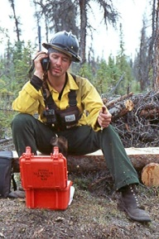
ICS Form 209
ICS Form 209 is changing to the NIMS Form 209.
Existing 209 outdated, doesn’t comply with NIMS standards, and doesn’t meet IT security needs.
Existing 209 does not facilitate info sharing and coordination between agencies and responders.
Notes:
The ICS Form 209 is changing to the NIMS Form 209.
Essentially, this change will expand the capability of the 209 so that it better expresses non-wildfire incidents.
The existing 209 is outdated—it does not adequately meet the needs of wildfire reporting.
The 209 form also needs to comply with federal NIMS standards, and it needs to comply with IT and information security needs as well.
The 209 also needs to improve in terms of coordination and information sharing between agencies and responders.

Slide 57
Changes to 209
Slightly larger and more comprehensive
Will report all-hazard incident status information
Will provide more info on incident threats to public
Will allow more depth in reporting of resources assigned
Notes:
The changes will make the 209 slightly larger and a lot more comprehensive, especially for reporting all-hazard incident.
Status summaries are going to be divided to reflect the status of members of the public affected by an incident, and how responders are being affected by the incident.
Status summaries are also going to disclose more information than what we’re used to seeing related to fire.
For example, in addition to fatalities and injuries, status summaries will also allow reporting on evacuations, sheltering in place, sheltering at a safe off-site location, immunizations, and quarantines (due to disease outbreaks).
209s will also allow responders to more specifically report on aspects of the incident that threaten the public.
209s will also be given much more depth in reporting Resources assigned to the incident. (Up to 21 resource types can be reported.)

Slide 58
Changes to 209
Key Points
209 is going to look different
209 going to contain more information, especially in regard to non-fire incidents
209 will still remain the source of official information about an incident
Notes:
In summary, the good old 209 is going to look different, and it’s going to contain more information—especially pertaining to non-fire incidents. But the 209 will still remain the main source of official information about the incident.

Slide 59
Incident Management Situation Report
The IMSR, or familiarly, the “Sit Report” is being improved.
Confusion in understanding true scope of large fire activity in the “multiple objectives” era.
Metrics like “% contained” are meaningless when a team is not trying to contain a fire.
For past few years, number of large fires managed for multiple objectives was the only info on IMSR.
Notes:
For several years, the national Incident Management Situation Report (IMSR) has illustrated the confusion inherent in reporting wildland fires in the “Multiple Objectives” era.
For the past three years, fire managers have had the ability to manage a fire for simultaneous, multiple objectives.
Part of a fire could be receiving suppression action, while another part of the same fire might be under monitoring only.
This complicated reporting of those fires, because metrics like “percent contained” is not meaningful if the fire is only being monitored.
The number of large fires being managed under a multiple objective strategy was the only information the IMSR disclosed about these fires. It was impossible to tell (from a national perspective) how much land these fires were burning, how many resources were assigned to these fires, and the status of these fires.

Slide 60
Changes to IMSR
New table this year – “Other Fires”
Summarize info about large fires managed for multiple objectives.
Aggregated by geographic area, not individual fire.
Acres burned, crews/engines/helicopters, total personnel assigned.
Other Fires table is updated every Friday in IMSR.
Notes:
This year, the IMSR is going to include a new table called “Other Fires.”
This table will summarize information about large fires being managed for other than full suppression.
The table will disclose these fires by geographic area and will show the cumulative acres burned; crews assigned; engines assigned; helicopters assigned; and total personnel assigned. These metrics will reflect Other Fire activity by geographic area, not by individual fire.
This table will be updated every Thursday, which means new information will be posted in the Friday version of the IMSR (during normal IMSR reporting periods).

Slide 61
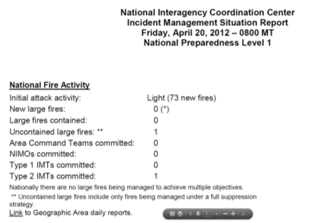
Changes to IMSR
Launch date depends on changes to 209, but should start seeing changes in IMSR in May.
Key Points
Accurate info about large fires managed for multiple objectives has been lacking due to reporting system.
New data table will help alleviate that and allow users to better grasp national picture of large fires.
Notes:
When the IMSR is changed depends on changes to the 209. We’ll probably start seeing the new table in the IMSR in May, but that’s not etched in stone.
In summary, the IMSR has had one hand tied behind its back due to the reporting system. It hasn’t told us very much about large fires being managed for objectives other than full suppression. But a new table in the IMSR—called “Other Fires”—should help alleviate that issue.

Slide 62
Election Year
Large fires may attract more attention in 2012
Discuss treatment of VIP visitors with host agency during in-briefing.
Be willing to equally inform candidates and incumbents about wildland fire.
Notes:
Large fires may attract more attention this year than they normally do. Candidates for elected office sometimes seize the news value of large fires during an election year.
Discuss VIP visits with your host agency when you are inbriefing. Make sure the local administrator and PAO have communicated their expectations for handling visits or requests from candidates to the team.
Watch out for ideological debates. Fringe candidates may attack peripheral issues related to your fire to get their names in the news. Stay in your lane. You represent the incident, not the local Forest, National Park, etc. Let the local unit explain their policies.
A helicopter flight requested just to let a VIP take a look at the fire may not be mission-critical. But if a seat on an operational recon flight is available, then it may be appropriate for a passenger to go.
Always be willing to teach elected officials and candidates about wildland fire. If they want to learn why a fire is burning especially fiercely, or how a collection of resources work together to contain a 10,000 acre fire, take the time to explain.

Slide 63
PIO Qualifications
Several NIMS “I” and “IS” courses now required for
PIO qualifications at all levels
Depending on your agency, some course are required
now and some by October this year.
Those already qualified do not need to go back and
take courses; only to advance
Need to stay on top of this; check with unit training
Officer or IQCS lead.
Notes:
You can work as a PIOF(T) as long as you have an initiated task book and an annual refresher. Training and task book must be completed to be fully qualified. Task books expire 3 years from date of your first trainee assignment.
Several NIMS “I” and “IS” courses are now required for BLM red-carded PIOs. (For BIA, those requirements will be formalized in September.) The NIMS course requirement applies to new PIOFs or PIOFs and PIO2s seeking to advance their qualifications. Those already qualified do not need to go back and get these courses.
Key point: If you are a non-Forest Service carded PIO, some new training is going to be required by October this year. The required courses are all offered online.
If DOI carded PIOs don’t get the I and IS courses done in time, you may find your PIO qualification in suspension. Talk to your unit training officer or the person who maintains your quals in IQCS for more information. Best advice: get these course (online) done and get a copy of the completion certificate to your training officer.

Slide 64
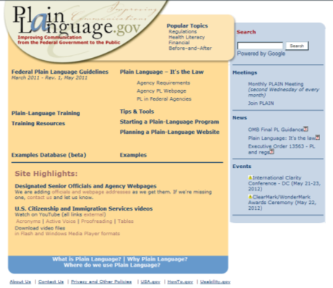
Plain Language
A lot of external audiences don’t understand jargon.
Speak and write clearly.
Help IC and staff members do the same.
www.plainlanguage.gov has a lot of resources.
Notes:
We’ve heard a reminder from field PIOs that plain, clear English is the vaccine that inoculates communicators from the deadly disease called jargon. A lot of the people we provide information for don’t understand our jargon.
For example, would you understand this if you were Joe Rancher or Jane Q. Public?
“The IMT has deployed crews along the fire’s heel and leeward flanks to construct indirect line and conduct backfiring ops as RH and other airmass indicators dictate.”
Or how about this?
“We’re managing about 40% of this fire for resource benefits, while the remainder is being managed under a long duration, full suppression framework.”
We are in an era where fire managers can choose to manage many fires for resource benefits. We commonly use terms like multiple objectives, full suppression, limited suppression and point protection.
Though many of our audiences understand these (and other) terms, many others do not, so let’s remember to communicate clearly. And let’s help our ICs and other members of command and general staff communicate clearly when they are representing our fires.
www.plainlanguage.gov is a good resource for improving your writing.

Slide 65
PIO Bulletin Board
http://www.nifc.gov/PIO_bb/pio_main.html
Lots of info there especially for you.
Statistics
Job aids
Briefing materials
Tool kits
Well worth spending ten minutes exploring the site.
Let your agency contact know if there are things you’d like to see on the PIO Bulletin Board!
Notes:
It’s there, it has a lot of stuff, and you should be familiar with it.
http://www.nifc.gov/PIO_bb/pio_main.html
The PIO Bulletin Board was created as an aid to PIOs of all kinds. It has information every PIO can use (like wildland fire statistics, media interview guides, and fact sheets on a variety of issues). The PIO BB also has a plethora of agency-specific information (like agency talking points, tool kits for communication issues, and incident organizers).
If you’ve never visited the PIO BB, we’d encourage you to spend five to ten minutes exploring the site. We think you’ll be glad you did.

Slide 66
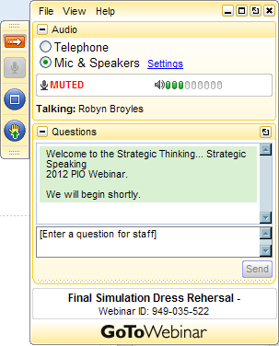
GoToWebinar Control Panel QUESTIONS
If you have already queued up a question, great!
Or you can type in your question now.
Please let us know what organization / agency you are with and if you would like a specific presenter to answer your question.
Notes:
Thank you, Randy!
We have a spot of time to take a few questions and we do have some questions lined up.
We will address as many questions as we can in the time remaining. If we are unable to answer your question, we will get back to you. We will also roll up the questions received and post the questions and answers on PIO Bulletin Board.
On your screen you’ll see the Control Panel. If you have already queued up a question, great! Or you can type in your question now. Again, please let us know what organization / agency you are with and if you would like a specific presenter to answer your question.
Great questions!
Cue!

Slide 67
Thank You
Thank you!
Visit us at:
www.nifc.gov/PIO_bb.html
Notes:
In closing, a big thanks to all of our speakers. And an extra special thanks to the cast behind the scenes who were critical in producing this webinar. It was a team effort.
And thank you for your participation in the webinar today. Your input and participation enables us all to be successful.
This webinar has been recorded and will be posted on the NIFC website on the PIO bulletin board at the URL on the slide within the next two weeks. Be sure to check the PIO bulletin board for other information throughout the summer fire season.
Before we sign off – a reminder to take care of yourself, your colleagues and the communities you are serving. Safety begins with each and every one of us.
Thanks again, everybody, and enjoy the rest of your day!

