Slide 1
U.S. Census Bureau
Foreign Trade Division
Understanding & Using
Foreign Trade Statistics
June 26, 2012

Slide 2
U.S. Census Bureau
Welcome!
Ryan Fescina Glenn Barresse
Chief, Methods Research & Chief, Special Projects Branch
Quality Assurance Branch Glenn.A.Barresse@Census.gov
Ryan.M.Fescina@census.gov (301) 763-6993
(301) 763-7039

Slide 3
U.S. Census Bureau
Overview & Export Specific Information
Lindsay Kuberka
Commodity Analysis Branch
Lindsay.M.Kuberka@census.gov

Slide 4
What do the statistics measure?
The physical movement of goods between:
  United States, Puerto Rico, U.S. Virgin Islands
  Foreign countries.

Slide 5
What’s not Covered in Statistics?
  Monetary gold
  U.S. government to U.S. government
  Imports of articles repaired under warranty
  Intangibles
  Personal and household effects
  Low valued transactions

Slide 6
The Harmonized System (HS)
Harmonized Tariff Schedule of the U.S. Annotated for Statistical Reporting Purposes (HTSUSA)
Statistical Classification of Domestic and Foreign Commodities Exported from the U.S. (Schedule B)

Slide 7
The HS System
17,000+ HTSUSA & 8,000+ Schedule B codes
  Periodically revised
  Structure:
    2 digit Chapter
    4 digit Heading
    6 digit sub heading
    8 digit legal
    10 digit statistical

Slide 8
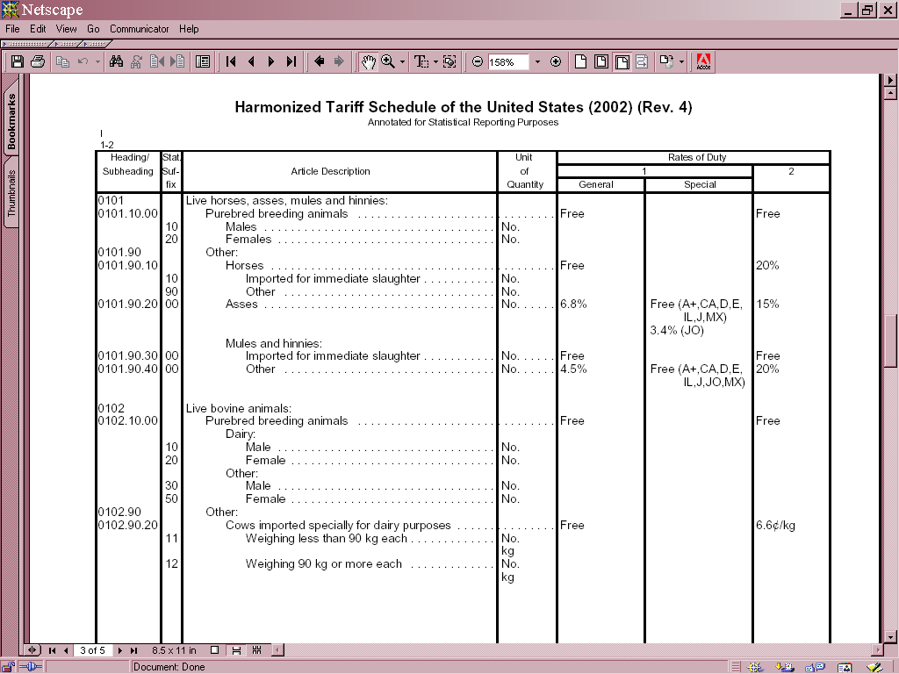
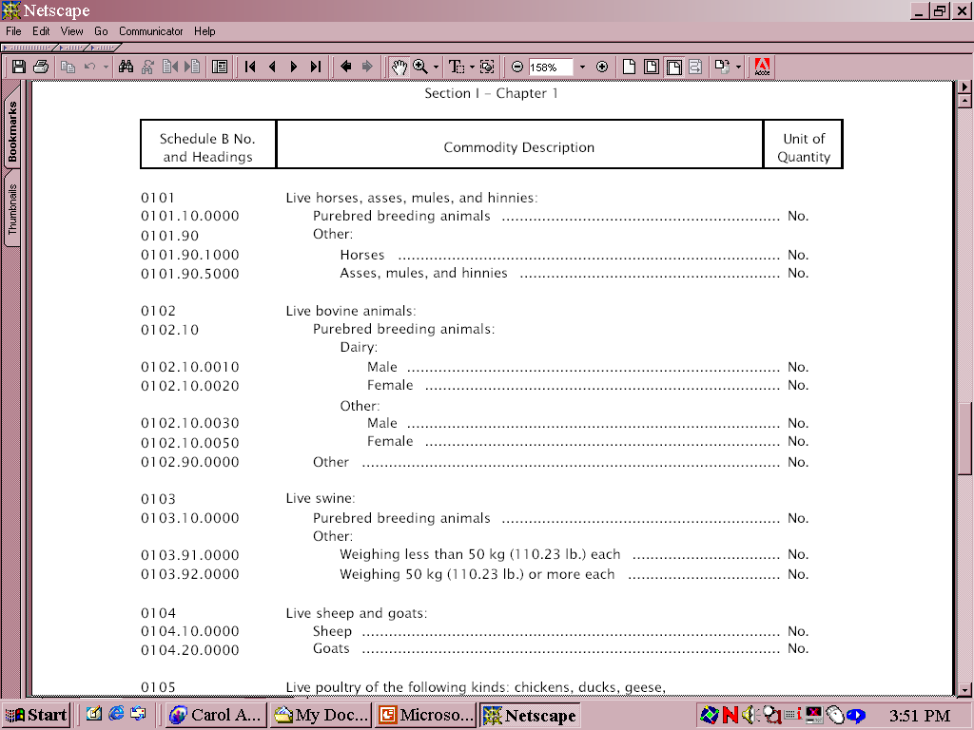
The HS System

Slide 9
What is the difference?
Export codes (Schedule B) are maintained by the U.S. Census Bureau.
Import codes are administered by the U.S. International Trade Commission (USITC).
Import Codes CAN be used to classify Exports, but Exports codes CAN NOT be used to classify goods for import (Imports has a lot more detail!!)

Slide 10
Changes to the HTSUSA & Schedule B
Changes occur three different ways:
WCO changes affect the HS (4 or 6 digit) level
Legislation – affects the legal (8-digit) level
  Imports only
484(f) committee – affects the statistical (10-digit) level
  USITC, Commerce, Customs and Border Protection (CBP)

Slide 11
Related vs. Non-related
Statistics cover the physical movement of goods, regardless of if item is sold
When a U.S. manufacturer exports merchandise to their company in France or to a non-related purchaser in Russia, both are counted as trade

Slide 12
Export Specific Information

Slide 13
Valuation
F.A.S. Export Value (free alongside ship)
Value of export at port based on transaction price, including inland freight, insurance other charges incurred (before loaded)
Excludes international freight, cost of loading merchandise and any other charges/costs beyond port of export

Slide 14
Leases
If merchandise exported for <12 months
  Non-statistical
  Leases > 12 months are statistical
Consignment - Temp. lease with option to buy
  Statistical
  Examples: artwork or aircraft

Slide 15
Repairs – Exports
Exporting items for repair
  Report Ch. 1-97 HS number of item
  Non-statistical
  AES export information code TE (temporary export for repair)
Exporting items repaired in U.S.
  Report HS 9801 and value of repair
  Report Ch. 1-97 HS number for replacements.
  Statistical

Slide 16
Import Specific Information
Matthew Frates
Commodity Analysis Branch
Matthew.Frates@census.gov

Slide 17
Topics
  Valuation
  Country Sub Code (CSC)
  Special Provisions
  Rate Provision Codes (RP)
  Repairs

Slide 18
Valuation
Customs Value
  Generally, price actually paid excluding:
    Duties
    Freight
    Insurance and other charges
  Relationship b/w parties should not influence value

Slide 19
Valuation (cont.)
CIF (cost, insurance, freight)
  CIF = Customs Value + Import Charges
  Excludes U.S. import duties

Slide 20
Valuation (cont.)
Dutiable Value
  Customs value of foreign goods subject to duty
  Where merchandise is a combination of U.S. and foreign goods, duty is applied only to the foreign value

Slide 21
Valuation (cont.)
To determine the dutiable value of a combination of U.S. and foreign goods:
    Example: 9802 provision
    U.S. value is included in statistics
      Value is total of domestic + foreign values
    U.S. Goods indicators show that a portion of the import is domestic materials
    Publication IM146A

Slide 22
Valuation (cont.)
Duty
  Collected by CBP
  FTD generally uses duty as reported to CBP

Slide 23
Country Sub-Codes (CSC)
Indicates a special program allowing for free or reduced duty
Examples: GSP, US-Chile Free Trade Agreement, NAFTA
CSC used:
  00 = no special programs claimed
  CA = Goods marked for Canada (NAFTA)
  MX = Goods marked for Mexico (NAFTA)
  Full list available on our website

Slide 24
Special Provisions
Chapter 98 & 99 for National use
  Ch 98 - duty free/reduction
  Ch 99 - legislation, executive and administrative actions

Slide 25
Special Provisions (cont.)
9801 - U.S. goods exported and returned not advanced or improved
  U.S. origin
  Previously exported from U.S.

Slide 26
Special Provisions (cont.)
9802 – Goods with components of U.S. origin
  U.S. goods assembled abroad
  Importers deduct value of U.S. goods from total Customs value

Slide 27
Special Provisions (cont.)
Dual Reporting of Codes
  Report 10-digit statistical reporting number
  Chapter 1-97
  Unit of quantity and value
  Followed by special provision
  Chapter 98

Slide 28
Special Provisions (cont.)
Dual Reporting of Codes
  9817.85.01
    Prototypes for development, testing, evaluation
    Free
  8422.11.0000
    Dishwasher, household
    2.4%
  8422.19.0000
    Dishwasher, other
    Free

Slide 29
Special Provisions (cont.)
Chapter 99
  Quotas
  Additional duties
  Temporary reductions

Slide 30
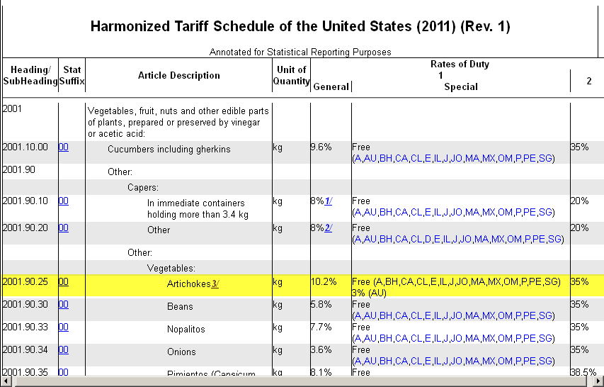



Slide 31
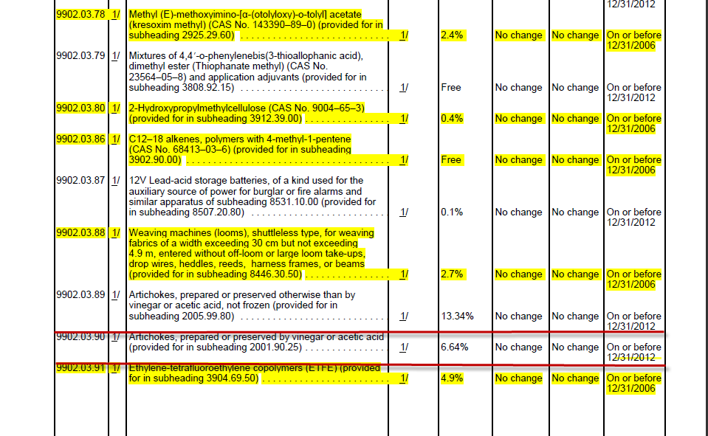
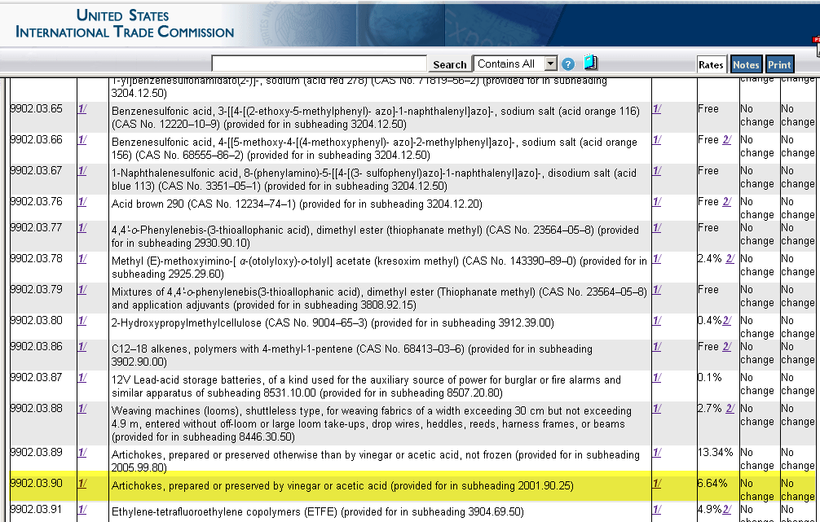
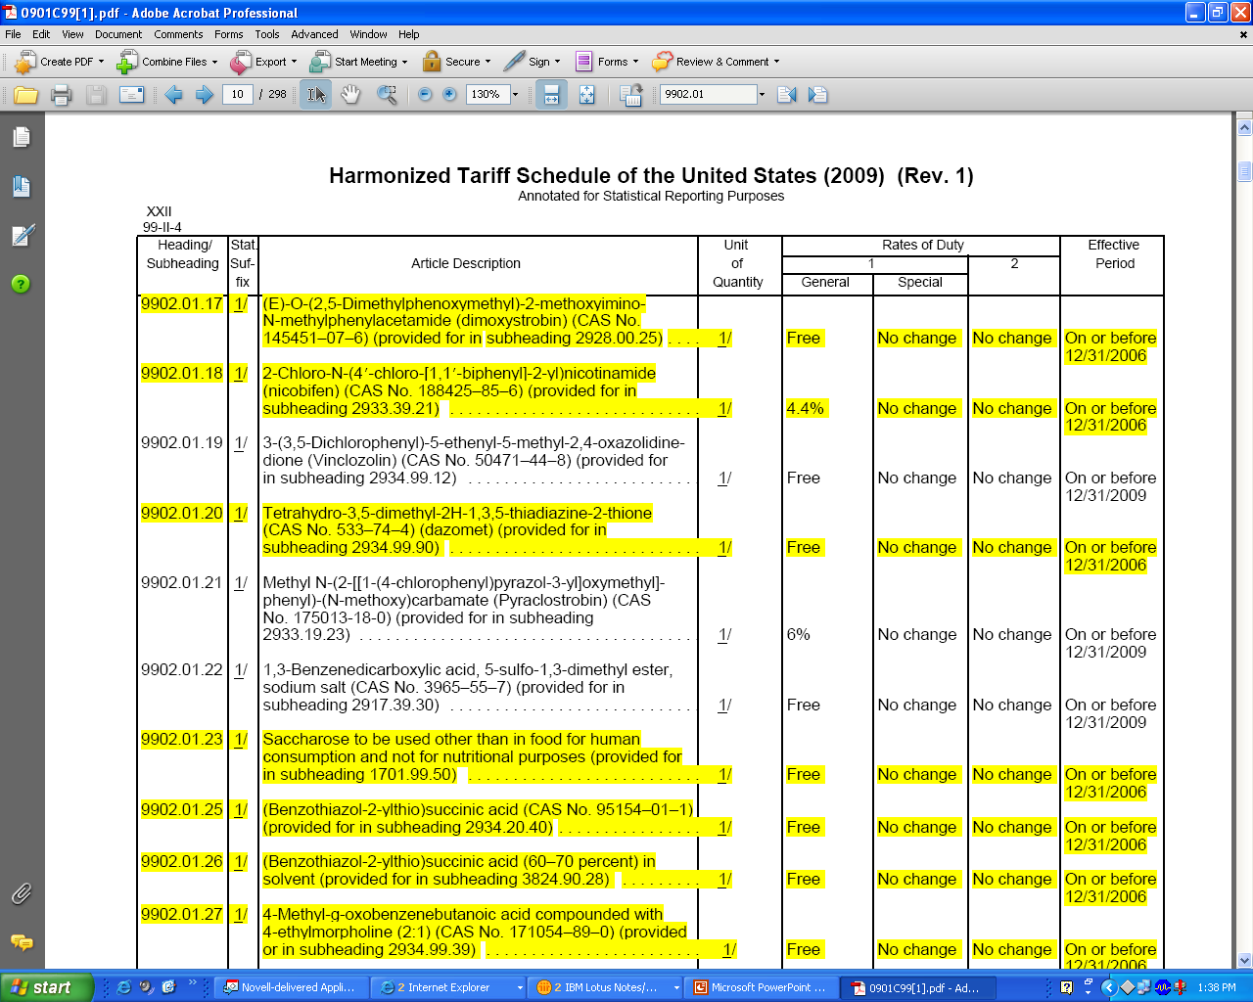
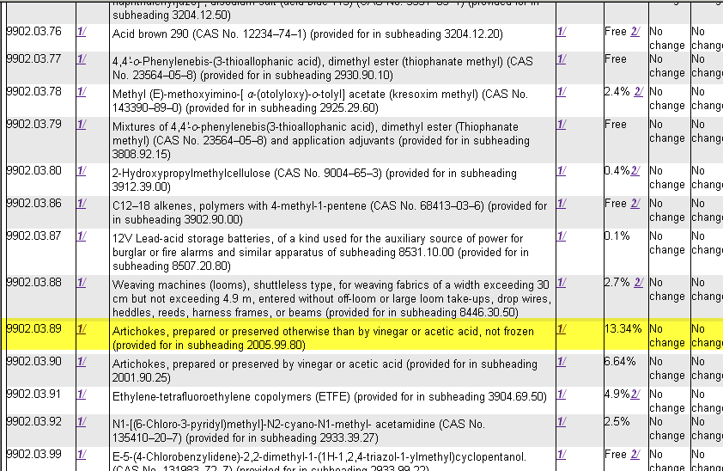
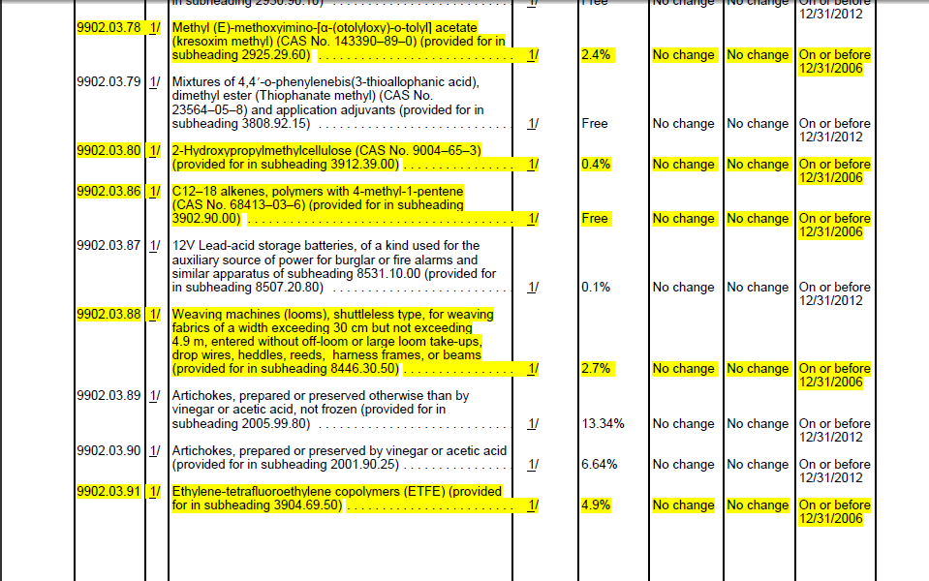
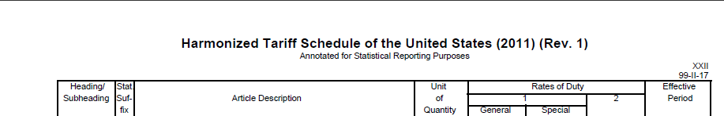

Slide 32
Special Provisions (cont.)
Dual Reporting of Codes
  Footnote 3 - See headings 9902.03.90
  Reduced or duty free rates
  9902.03.90 Artichokes
  Report 9902.03.90 – 2001.90.2500

Slide 33
Rate Provision (RP) codes
  RP codes indicate free or dutiable status
  Every line item is assigned a RP code
  RP code can relate back to Ch. 98 or 99
  Assigned by FTD

Slide 34
Rate Provisions (cont.)
Examples of RP codes:
  RP 17 = Free as articles imported for the handicapped. Imported under HTS subheadings 9817.00.92, 9817.00.94 & 9817.00.96
  RP 69 = Dutiable at rate prescribed in Rate of Duty columns of HTS Ch. 99. Duty reported
  Full list available on our website

Slide 35
Repairs – Imports
Importing repaired item
  Report Ch. 98 number and value of repair
    If under warranty – non-statistical
    If Non-warranty – statistical
      Also report Ch. 1-97 HS in order to determine duty
Importing item for repair
  Temporary imports – non statistical

Slide 36
Internet References
FTD
  http://www.census.gov/trade
Guide to Foreign Trade Statistics
  http://www.census.gov/foreign-trade/guide/index.html

Slide 37
Internet References (cont.)
Schedule B
  http://www.census.gov/scheduleb
HTSUSA
  http://www.usitc.gov/tata/hts/bychapter/index.htm

Slide 38
Internet References (cont.)
CSC
  http://www.census.gov/foreign-trade/reference/codes/csc.html
RP
  http://www.census.gov/foreign-trade/reference/codes/rp.html

Slide 39
Any Questions?

Slide 40
U.S. Census Bureau
Sources of Data
Wendy D Peebles
Data Collection Coordination Branch
Wendy.D.Peebles@census.gov

Slide 41
Topics
Coverage
Bonded Warehouses
Foreign Trade Zones (FTZs)
Sources of Import Data
Import Data Categories
Sources of Export Data
Export Data Categories
Kimberley Process (KP)

Slide 42
Coverage
Movement of goods into & out of:
  U.S. Customs Territory
  U.S. Virgin Islands
  Bonded Warehouses
  Foreign Trade Zones (FTZs)

Slide 43
Coverage (cont.)
Goods not included:
  U.S. trade with U.S. territories
  Trade between U.S. territories
  Trade between foreign countries and U.S. territories (other than Puerto Rico and Virgin Islands)
  In transit merchandise through the U.S.

Slide 44
Bonded Warehouses
Authorized by U.S. Customs
Payment of duties on goods are deferred until goods are moved into Customs territories
No duties if reshipped to foreign country

Slide 45
Foreign Trade Zones
A Foreign Trade Zone – is a restricted access site in or adjacent to a U.S. Customs port of entry
Two Types:
  General Purpose
  Subzones
Within zones, merchandise can be assembled, manufactured, repackaged, destroyed
Educational Mediums – Blogs, Newsletter, Videos, Frequently Asked Questions

Slide 46
Foreign Trade Zones (FTZs)
Operated as public utilities under the control of U.S. Customs
Goods are subject to duties if sent into Customs territory
No duties if reshipped to foreign country

Slide 47
Foreign Trade Zones (FTZs) (cont.)
Non-Privileged Foreign (NPF) Status—duties are based on the condition of the goods when it exits the zone
Privileged Foreign (PF) Status—duties are based on the condition of the goods when it first enters the zone

Slide 48
Sources of Import Data
Paper
(Puerto Rico Staff)
Electronic
Entry Summaries
(CBP Form-7501)
(ACS) ABI Entries
(CBP Form-7501)
Vessel Repairs
(CBP Form-226)
No electronic
equivalent
Foreign Trade Zones
Admissions
(CBP Form-214A)
CBP E-214

Slide 49
Sources of Import Data (cont.)
March 2012 data

Slide 50
Sources of Import Data (cont.)
March 2012 data

Slide 51
Import Data Categories
General Imports
Imports for Consumption
Warehouse Entries or FTZ Admission
2. Imports for Consumption
Imports for Consumption Warehouse or FTZ Withdrawals

Slide 52
Import Data Categories (cont.)
General Imports – measure the total physical arrivals of merchandise from foreign countries
  Entering consumption channels immediately
  Bonded warehouses or FTZs admissions

Slide 53
Import Data Categories (cont.)
Imports for Consumption – measure the total merchandise that has physically cleared through Customs
  Entering consumption channels immediately
  Withdrawal for consumption from bonded warehouses or FTZ

Slide 54
Import Data Categories (cont.)
Goods processed in a FTZ
Example: Petroleum entered in FTZ
  General import statistics would show Ch 27 when goods admitted to FTZ
  Petroleum is processed in the zone, creating byproducts Gasoline, Kerosene and Jet Fuel
  Therefore imports for consumption are based on what EXITS the zone, showing gasoline, Kerosene, and Jet Fuel.

Slide 55
Sources of Export Data
Electronic
Automated Export System
(AES)
Canadian Data Exchange

Slide 56
Sources of Export Data (cont.)
  March 2012 data

Slide 57
Sources of Export Data (cont.)
  March 2012 data

Slide 58
Export Data Categories
Domestic Exports
Foreign Exports (Re-exports)
Noncontiguous Exports

Slide 59
Export Data Categories (cont.)
Domestic Exports
  Merchandise grown, produced, or manufactured in the U.S.
  Foreign origin merchandise that has been changed from the form in which it was originally imported

Slide 60
Export Data Categories (cont.)
Foreign Exports (Re-exports)
  Foreign origin merchandise that has entered the U.S. for consumption
  At the time of exportation, the condition of the merchandise is the same as it was when imported

Slide 61
Export Data Categories (cont.)
Noncontiguous Exports
  Puerto Rico and Virgin Island trade with the U.S.
  Separate data product

Slide 62
Kimberley Process (KP)
A joint initiative to stem the flow of conflict diamonds.
Minimum requirements for its members
  Forgery-resistant certificate
  Tamper-proof packaging
  Trade with other KP Participants

Slide 63
Kimberley Process (KP) (cont.)
Clean Diamond Trade Act
Participating Countries
HTSUSA/Schedule B Number
  7102.10
  7102.21
  7102.31

Slide 64
Kimberley Process (KP) (cont.)
Imports must be entered by formal entry regardless of value
Exports must be filed in AES regardless of value
Export validation - confirmation

Slide 65
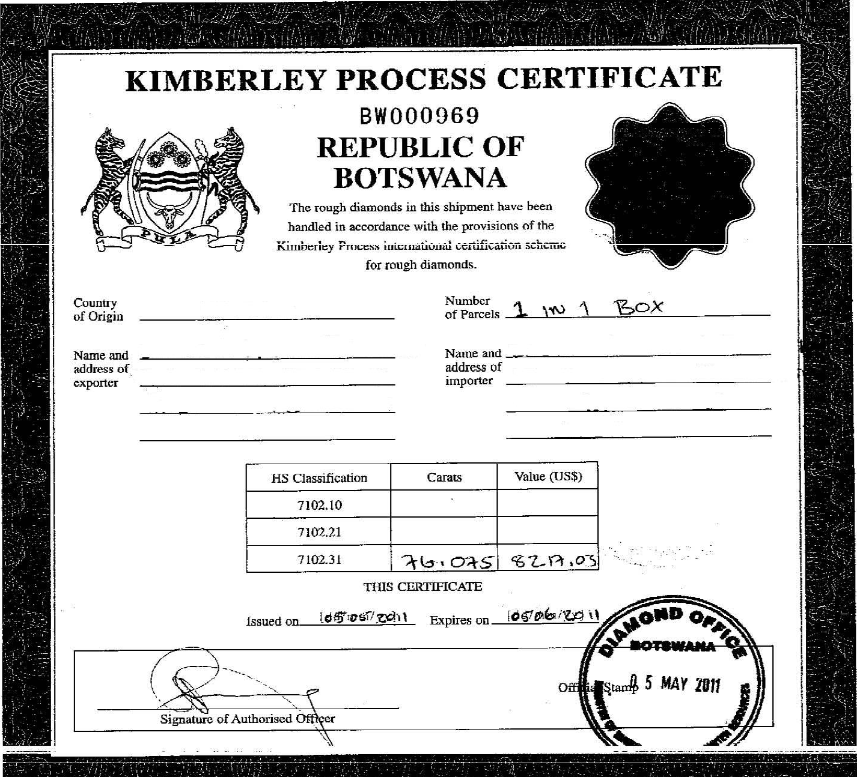
Kimberley Process (KP) (cont.)

Slide 66
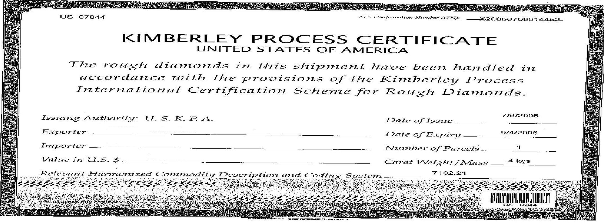
Kimberley Process (KP) (cont.)

Slide 67
Working Group on Statistics
Carolyn Francis – Chair of the Working Group of Statistics
Contact: Carolyn.t.Francis@census.gov or
301-763-7016
Responsible for Reconciliation of Data
Conferences
  Intercessional
  Plenary

Slide 68
Kimberley Process (KP) (cont.)
Resources
  www.KimberleyProcessStatistics.org
  (KP Rough Diamond Statistics)
  www.state.gov/e/eeb/diamonds
  (State Department Conflict Diamonds)
  www.KimberleyProcess.com
    (Main Kimberley Process)
  www.uskpa.org
  (U.S. Kimberley Process Authority)

Slide 69

Data Collection Coordination Branch
Questions!
(301)763-2259

Slide 70
Processing and Editing;
ACE portal
June 26, 2012
Andrew Chang
Methods Research and Quality Assurance
Andrew.Chang@census.gov

Slide 71
Topics
Processing/Editing
  Prepare for editing
  Editing
  Resolve errors
ACE Portal

Slide 72
Processing
Editing at Point of Collection
Alerts the filer of any discrepancies.
  Joint effort to maintain edits by the Census Bureau and CBP.
  Immediate feedback.
  Allows filers to respond to errors.

Slide 73
Processing
Combine sources
Reformat data to uniform structure.
Additional Non-statistical transactions are identified.
  Shipments to the U.S. Armed Forces
  Personal household goods
Low value records.

Slide 74
Processing
Statistical time periods
Statistical month
  Imports - Release date
  Exports - Clearance date
Carryover
Future month

Slide 75
Processing
Preliminary Alterations
Recode or convert commodities as necessary.
Quantity conversion
  lbs. to kg.

Slide 76
Processing
Apply Corrections to Data
  Corrections can be submitted by filer after the data are accepted.
    Example: Filer mistakenly placed $1 million in the value field and then reported a correction for that field of $100 thousand
  Corrections can be submitted by filer after the data are edited.

Slide 77
Editing
Overview
  Code Validations
  Relationship Edits

Slide 78
Editing
Code Validations
Examples of fields we validate codes for
  Harmonized System commodity.
  Country of origin.
  Foreign port.
  U.S. port.
  Special Program Indicators (imports).
  Etc…

Slide 79
Editing
Relationship Edits
Ratio
Range
Examples

Slide 80
Editing
Relationship Edits - Ratio Edits
Verify numeric data by computing ratios
Several types of ratio edits
  Value to quantity
  Quantity to shipping weight or value to shipping weight
  First quantity to second quantity for shipments requiring two quantities

Slide 81
Editing
Relationship Edits - Range Edits
  Ratio edits alone cannot identify all errors, range edits are used to validate data.
  [min,max]
  Shipping weight exceeds what the mode of transportation can carry
    Example: 1,400,000 kg shipped via air is impossible

Slide 82
Editing
Relationship Edits Examples:
Unit price example – Fireworks
  160 kg of fireworks valued at $40,000
    Unit price= $250/kg
  Acceptable range for ratio in our edit [$2.20/kg,$220.45/kg]
  This shipment fails the edit.

Slide 83
Editing
Relationship Edits Other Examples:
  Commodity Specific Range Edits.
    Focus on each individual commodity
      Example: 20 kg of diamonds unlikely
  Country of origin.
    Improbable Country Example: Bananas from Greenland

Slide 84
Editing
Commodity Specific Parameters
  2.5 million parameters
    17,000+ Import commodity codes
    8,000+ Export commodity codes
    ≈100 edit parameters per commodity
  Parameters are flexible to change

Slide 85
Error Resolution
Methods of Error Resolution.
Imputation.
  Automated program to determine eligibility for imputation
  Does not impute records of high impact
Analyst review.

Slide 86
Error Resolution
Imputation
Substitution or replacement of some value for a data point based on auxiliary information.
Edit will typically impute the quantity or shipping weight.

Slide 87
Error Resolution
Imputation
Fireworks example
  160 kg of fireworks valued at $40,000
    Unit price= $250/kg
  Acceptable range for ratio in our edit [$2.20/kg,$220.45/kg]
  Impute quantity to 1052.63kg based on factor
    Unit price= $38.11/kg

Slide 88
Error Resolution
Analyst review
Contact the filer
  Confirm correct classification, values, shipping weight, quantities and others fields.
Bypass the edits

Slide 89
Error Resolution
Analyst Review
Aggregate data by commodity to determine if total values and quantities are reasonable
Compare measures to previous months – look for missing or misreported data and identify processing problems

Slide 90
Any questions before I move on to the ACE portal?

Slide 91
ACE Portal
  Automated Commercial Environment (ACE) is a U.S. Trade processing system designed to consolidate and automate border processing while facilitating legitimate trade.
What is the ACE portal?
  ACE Portal is an interactive online tool that provides a user friendly gateway to access Customs information via the web.

Slide 92
ACE Portal
Differences in the data.
Data users see different data when comparing Census published data vs. ACE portal data.
  ACE will not see Census Bureau specific data.

Slide 93
ACE Portal
Differences in the data
Editing and imputing data occur after the data are extracted from the source.
ACE is not bidirectional.
Non-statistical data are not published in Census data.

Slide 94
ACE Portal
Differences in the data.
Census published data categorizes data by Entry Types:
    General Imports.
    Imports for Consumption .
The ACE Portal will contain all entry types.
    Double counting trade into and out of warehouses and Foreign Trade Zones.

Slide 95
ACE Portal
Differences in the data.
Time periods
  Census Published data classifies data by Statistical month.
    Carryover data are processed in current month then correctly allocated in yearly revisions.
    Future month-held until the appropriate processing month.
  ACE classifies by date.

Slide 96
Data Processing and Editing
Questions!
Andrew.chang@census.gov
(301)763-1022

Slide 97



The
United States – Canada Data Exchange
Eboné Norman
Process Coordination Staff
U.S. Census Bureau
June 26, 2012
Ebone.D.Norman@census.gov

Slide 98

What is the United States – Canada Data Exchange?
  Agreement between the governments of the United States and Canada
  based on a
  Memorandum of Understanding (MOU)

Slide 99
Who is Involved?
UNITED STATES
• U.S. Census Bureau (Census)
• U.S. Customs & Border Protection (CBP)
CANADA
• Statistics Canada (STC)
• Canada Border Services Agency (CBSA)

Slide 100
How Does It Work?
U.S. Exports to Canada =
Canadian Imports from the U.S.
and
Canadian Exports to the U.S. =
U.S. Imports from Canada

Slide 101
Why Was It Created?
• Rise in Export under coverage
Benefits:
• Decrease operating costs to process
Export Declarations
• Eliminate reporting burden of Exporters
• Location and language of both countries

Slide 102
U.S. and Canada Major Trading Partners
• Approx.14-15% of Total Imports Value from Canada
• Approx.19-20% of Total Exports Value to Canada
• Approx. 61-62% of Total Imports Value from U.S.
• Approx.71-72% of Total Exports Value to U.S.

Slide 103
What Are Some Differences in the Data Exchange?
• HS Recodes
• Vendor vs. Exporter

Slide 104
How Do We Receive Canadian Import Data?
• STC Transmits files twice per month
• Adjustments are required

Slide 105
What Kind of Adjustments?
• Freight Charges
• Currency Conversion
• Exports of Foreign Goods to Canada
• Exports of U.S. Goods to Canada from
Third Party Countries
• Revisions

Slide 106
Freight Charges
• Included in U.S. Exports
• Excluded in Canadian Imports
• Added to compensate for difference in valuation

Slide 107
Currency Conversion
• U.S. Federal Reserve’s
monthly exchange rate
• STC converts to U.S. dollars/Foreign Trade
Division (FTD) converts to Canadian dollars
• Files are transmitted

Slide 108
Exports of Foreign Goods to Canada
• Transmitted from STC
….Purchase Italian Shoes Sell Shoes to Canadian Store
U.S: Foreign Export to Canada
Canada: Import from Italy
• FTD includes these goods
in U.S. export statistics to Canada

Slide 109
Exports of U.S. Goods to Canada from Third Party Countries
• Transmitted from STC
….Sell American Clothes to Spain Sell Clothes to Canadian Store
U.S: Domestic Export to Spain
Canada: Import from U.S. (Spain 3rd Party)
• FTD excludes these goods from U.S. export statistics to Canada

Slide 110
Revisions
• Estimates for Late Arrivals
• Corrections from STC
• Corrections Made by FTD

Slide 111
Estimates for Late Arrivals
• STC sends with second transmittal
• Estimates replaced with actual values the following month in the
FT-900 press release only

Slide 112
Corrections from STC
• STC sends with second transmittal
• Corrections to data sent in first transmittal
• Prior Month Corrections

Slide 113
Corrections Made By Census
• Commodity analysts verify corrections with their STC counterparts
• Corrections made prior to publication, when possible

Slide 114

??? Questions ???
Eboné Norman
Ebone.D.Norman@census.gov

Slide 115
Partner Country
Diane Oberg
June 26, 2012
diane.c.oberg@census.gov

Slide 116
Topics
Definition of Partner Country
Special Cases
Trade Statistics do NOT Follow the Money
Why Bilateral Statistics Differ
Partner Country Reconciliation

Slide 117
Partner Country
  U.N. Concepts & Definitions
Exports – Country of Ultimate Destination as known at time of export
Includes:
  Exports of domestic merchandise
  Re-exports of foreign merchandise

Slide 118
Partner Country
Imports – Country of Origin
  Where grown, mined or manufactured
  Where last “substantially transformed”
  Multi-country production – attributed to single country of origin
Legal Definition – tariffs, quotas, preferences
    CROSS – Customs Rulings Online Search System

Slide 119
Imports from Country A
Include
  Goods produced in and exported from A
  Goods produced in A incorporating foreign components if “substantially transformed” under U.S. Rules
  Goods produced in A by affiliates of U.S. or foreign firms
  Used goods – still classed by country of origin

Slide 120
Imports from Country A
Need NOT have been exported from A
  A sells to distributor in B, who exports to C
    A: export to B
    B*: import from A; export to C
    C: Import from A
  A exports used U.S.-built aircraft to B
    A: export to B
    B*: import from United States
  *Not substantially transformed in B

Slide 121
Example -Imports from Canada
Need not have been exported from Canada
  Canadian wiring harnesses assembled in Mexico
  Then exported to United States

Slide 122
Trade Statistics Do NOT
Follow the Money
Goods manufactured in A under contract to firm from country B: country of origin = A
Firm in B purchases U.S. goods & directs shipment to A
    U.S: Export to A
    A: Import from U.S.
A country may not be involved in another country’s imports from it (e.g. used goods, distribution)

Slide 123
Special Cases
Re-imports – reported under HS 9801 – imports from country of shipment
Country of origin undetermined – imports from country of shipment

Slide 124
Transiting Goods
U.N. Guidelines – exclude in-transit goods from statistics
Shipper may choose to enter and re-export
  EX: Goods transiting U.S. between Canada & Mexico
    Import from Canada
    Re-export to Mexico

Slide 125
Bilateral Statistics
Will rarely match
UN Guidelines
  Country of Origin vs. Country of Destination
  Valuation
Reconciliation Studies – on web site

Slide 126
Major Sources of Discrepancy
Indirect trade/Re-imports/Re-exports/Multi-country production (Imports from A/Follow $)
System of Trade
Definition of Country

Slide 127
Major Sources of Discrepancy
Coverage Differences
Valuation Differences
Transshipments
Low-value shipments
Chapter 98/99

Slide 128
System of Trade
General Trade – as crosses border
Special Trade– excludes bonded warehouses and free trade zones
  Petroleum
  Alcohol
  Tobacco
  Other goods, especially with high taxes/tariffs

Slide 129
Definition of Country
Which territories/possessions are included
  e.g. Puerto Rico, U.S. Virgin Islands
ISO Coding Errors
  IR = Iran, IE = Ireland, IQ = Iraq
  CH = Switzerland, CN = China

Slide 130
Coverage Differences
Differences in commodities/types of transactions included
  Leases
  Repairs
  Confidentiality practices
  Re-imports
    U.S. – records by country of shipment
    Some countries – import from themselves
  Product-specific differences

Slide 131
Valuation Differences
Partner country imports are usually c.i.f.
  U.N. guidelines
  Will be higher than exports
Treatment of assists and other adjustments
Third party profit/markup

Slide 132
Transshipments
Goods exported to one country
Redirected without entry into original partner country
  E.g. European petroleum to Canada

Slide 133
Low Value Shipments
Many countries use low-value threshold
Some exclude without estimation

Slide 134
Chapter 98/99
Nationally Defined – may include:
  Confidentiality suppressions
  Re-imports
  Low value
  Repairs
  Values can be significant
  Partner country values likely in HS 1-97

Slide 135
Trade Data Reconciliations
Work with partner country to investigate discrepancies
Exchange published data
Exchange concepts and definitions
Do NOT change official statistics!

Slide 136
Trade Data Reconciliations
Estimate effect of conceptual differences
  Insurance & Freight
  Reimports/Reexports
  Imports via 3rd countries
  Geographical differences (e.g. PR/VI)
  Timing
  Coverage (e.g. containers)
  Repairs

Slide 137
2006 U.S.-China Analysis
In Million U.S. Dollars
U.S. Imports | 287,773
Chinese Re-exports | +2,971
Geographic Coverage | -648
Estimated Valuation Differences | -21,035
Indirect Trade | -44,058
Timing | +2,701
Unresolved | -24,232
Chinese Exports | 203,472

Slide 138
2006 U.S.-China Analysis
In Million U.S. Dollars
U.S. Exports | 55,224
U.S. Re-exports | -3,600
Geographic Coverage | -103
Insurance & Freight | +3,866
Repairs | -146
Unresolved | +3,968
Chinese Imports | 59,209

Slide 139
Contact Info
Diane Oberg
diane.c.oberg@census.gov
301-763-2223
Special Projects Branch
301-763- 3251

Slide 140

Port and
Method of Transportation Data
Bill Regina
June 26, 2012
U.S. Census Bureau

Slide 141
Objectives
Port data definition
Method of Transportation (MOT) types
Port and MOT edits/relationship
Data quality and other issues

Slide 142
What is a Port Code?
3022
“30” = Seattle, WA (general district)
“3022” = Spokane, WA (exact port)

Slide 143

Port Data
Definition
Exports
    Vessel or Air –
    The airport or seaport where the goods are loaded
    on the exporting carrier that is taking them out of
    the United States

Slide 144
Port Data
Definition,
Continued
Exports
    Overland (to a border country) –
    The port where the export crosses the U.S. border
    into a foreign country

Slide 145
Port Data
Definition,
Continued
Exports
    Overland (through a border country) –
    The port where the goods are loaded on the
    exporting carrier that is taking them out of the
    United States

Slide 146

Port Data Definition,
Continued
  Imports
  Port of Entry –
  The port where the goods clear
  U.S. Customs
  Port of Unlading –
  The port where the goods are unloaded from the
  conveying vessel or aircraft

Slide 147
Method of Transportation (MOT) types
MOT is based on how the merchandise arrives in or
departs from the United States.
    Vessel
    Air
    “Other”
    - Truck
    - Rail
    - Etc. (electricity, mail, pipeline)

Slide 148

Method of Transportation
(MOT)
  Method of Transportation (MOT) is identified by the
  method of conveyance that is used when the
  shipment crosses the border and enters the U.S.

Slide 149
Port and Method of Transportation (MOT) edits
  Are the data acceptable?
  Relationship editing:
  MOT vs. port
  MOT vs. commodity
  MOT vs. other data

Slide 150
Data Quality and Other Issues
Container information
Reported information:
missing, invalid, obsolete, or erroneous

Slide 151

Data Quality and Other Issues, Continued
User-Fee and Courier Ports
“Special” Districts
Published Method of Transportation
(MOT) totals at Ports

Slide 152
Questions?
Bill Regina
William.G.Regina@census.gov
(301) 763-7751

Slide 153

U.S. Census Bureau
Foreign Trade Division
Quality Issues
Chris Grieves
U.S. Census Bureau

Slide 154
Topics Covered
Uses of Foreign Trade Statistics
Quality Issues
Responses to Quality Issues

Slide 155
Uses of Foreign Trade Statistics
Accurate trade data are necessary for economic, commercial, and policy purposes.
Used by
  Government
  Non-Government

Slide 156
Government Uses
Develop the merchandise trade figures
    To appraise and analyze major movements and trends in international trade
    To evaluate and plan various programs
    To measure impact of tariff and trade concessions
Statistical base to implement and analyze operations under various international agreements
    E.g. NAFTA

Slide 157
Government Uses (cont.)
Meet legal and regulatory requirements
  Imports
    Correctly assess import duties
    Administer embargoes and quotas
    Restrict counterfeit items entering the country
    Implement control policies
  Exports
    Effectively administer control and regulatory policies for
    national security or foreign policy reasons
    implement export quotas or embargo programs
    administer short supply programs

Slide 158
Non-Government Uses
Users in industry, finance, research, and transportation
    Appraise the general trade situation and outlook
    Perform market share and penetration studies
    Aid in product and market development
    Measure the impact of competition
    Determine marketing strategies

Slide 159
Importance of Data Quality
Principal economic indicator
Wide and varied group of users
To use information wisely and appropriately need to understand limitations.

Slide 160
Topics Covered
Foreign Trade Statistics
Quality Issues
Responses to Quality Issues

Slide 161
Quality Issues
Reporting Errors
Documentation
Low Value
Carryover

Slide 162
Reporting Errors
Mistakes or omissions made by importers, exporters, or their agents when reporting import or export shipments
  Import information subject to greater scrutiny so more common with exports and duty free imports

Slide 163
Reporting Errors
Common Data Elements
  Quantity or shipping weight
  State of origin designation
  Commodity code
  Charges
Census Bureau utilizes edits to detect misreporting and send error messages to the filers

Slide 164
Reporting Errors
Reasons for Commodity Misclassification
  Typos
  Duty avoidance
  Not understanding the classification system

Slide 165
Reporting Errors
Charges
  Invoiced freight, insurance, or other charges
    If included in the invoice price must be included in the Customs Value
    If an importer does not know the exact value of all charges, must be estimated
    The filer must have documentation to exclude an item from Custom Value
  Result is actual value may be inaccurate

Slide 166
Quality Issues
Reporting Errors
Documentation
Low Value
Carryover

Slide 167
Documentation
Documentation issues can arise when shipments:
  move through an intermediary country
  consist of rail cars and/or locomotives

Slide 168
Documentation
Intermediary Country
  Canada
    Exports to Canada; no EEI required
    Exports where Canada is not the ultimate destination country; documentation is required
  Transiting Goods
    When under bond, excluded from trade statistics
    Sometimes entered into the US using import entry summary and an export declaration is filed

Slide 169
Documentation
Imports of Rail Cars
By law importers of rail cars and locomotives are not required to report their shipments, when duty free.
Statistics Canada (STC)
  established a voluntary survey
  included as a revision to Canada’s export trade data since late 2004

Slide 170
Quality Issues
Reporting Errors
Documentation
Low Value
Carryover

Slide 171
What do we mean by “Low Value”?
To reduce filer burden, value-based exemption levels have been in place for many years
Current exemption levels
  Exports - $2500 for all goods
  Imports - $2000 for most goods
        $250 for certain quota items
Filers not required to file full detail for data valued below exemption level

Slide 172
Quality Issues
Reporting Errors
Documentation
Low Value
Carryover

Slide 173
Carryover
Trade records received and/or processed too late for inclusion with records in the correct transaction month
Current carryover rate (2011 avg. of total value)
  0.13% exports
  0.63% imports

Slide 174
Topics Covered
Foreign Trade Statistics
Quality Issues
Responses to Quality Issues

Slide 175
Revisions
Each month in the FT900, the total import, export, trade balance and “end-use” totals for the prior month are adjusted for carryover
    SITC (Standard International Trade Classification) and country detail reports not revised at this time.

Slide 176
Revisions
Every June of the current year, FTD publishes an annual revision of the previous year
  Carryover correction
  Corrections resulting from data investigations
  Customs and Canadian revisions
  SITC and country detail reports are revised

Slide 177
Low Value Estimation
  Starting with January 2010 statistics, we implemented new LV estimation methodologies.
  Improvements with new methodology
    Estimate of courier low-value transactions
    Uses current month data to improve timeliness
    Effort to summarize eligible import data into detailed commodity statistics (similar to process on exports)

Slide 178
Automated Reporting
Effective July 2, 2008 all exports were to be filed through the Automated Export System (AES)
Imports can be electronically filed through the Automated Broker Interface (ABI) and the Automated Commercial Environment (ACE)

Slide 179
Benefits of Automated Reporting
Receive and compile data quickly
Reduce Error
  Exports (as of a 2001 study)
    57% of paper SEDs contain errors
    10% of AES records contain errors
  Imports (as of a 2001 study)
    37% of Customs Entry Forms 7501 contain errors
    8% of ABI records contain errors

Slide 180
Benefits of Automated Reporting
    Online, instant validation checks
    Reduction in carryover
    AES Compliance Review Program
    Eliminates Paper Documents

Slide 181
Conclusion
FTD continues to monitor the quality of data during collection, processing, and publication.
We are constantly exploring ways to further improve the quality of international trade data.

Slide 182

Questions ?
christopher.grieves@census.gov
(301) 763-6610

Slide 183
U.S. International Trade in Goods
Balance of Payments Basis
Marc Bouchard
U.S. Census Bureau Seminar
“Understanding and Using Foreign Trade Data”
Washington D.C.
June 26, 2012

Slide 184
Agenda
Definition
Dollar impact
Adjustments by type
Relative dollar magnitudes
Future adjustments

Slide 185
Goods on a Balance of Payments (BOP) Basis
BOP basis = Census basis + Net BOP adjustments
Why BOP adjustments are important:
  Convert trade data to conform to U.S. international and national accounts guidelines (BOP and GDP)
    Balance of Payments and International Investment Position Manual, 6th Edition (BPM6)
    System of National Accounts (2008 SNA)
  Supplement coverage of Census basis data
  Eliminate duplication of transactions recorded elsewhere in the international accounts

Slide 186
BOP Adjustments to Exports and Imports
BOP Adjustments to Exports and Imports, 2011 (In billions of dollars. Details may not sum to totals due to rounding.)
Exports of goods, Census basis |  | 1,480.4 | Imports of goods, Census basis |  | 2,207.8
Plus: BOP adjustments, net |  | 17.0 | Plus: BOP adjustments, net |  | 28.0
 | Goods procured in U.S. ports by foreign carriers | 18.1 |  | Goods procured in foreign ports by U.S. carriers | 14.5
 | Exports under U.S. military agency sales contracts, net | 1.1 |  | Imports by U.S. military agencies, net | 4.9
 | Repair of equipment | -4.2 |  | Repair of equipment | -3.1
 | Software revaluation | 0.2 |  | Software revaluation | 3.2
 | Private gift parcel remittances | 1.5 |  | Inland freight in Canada and Mexico | 6.8
 | Other adjustments | 0.2 |  | Other adjustments | -1.7
Equals: Exports of goods, BOP basis |  | 1,497.4 | Equals: Imports of goods, BOP basis |  | 2,235.8

Slide 187
Net BOP Adjustments

Slide 188
Goods Procured in Ports (Exports and Imports)
Additions of air and ocean carriers’ purchases of goods in foreign ports beginning with statistics for 1999
Currently limited to purchases of jet fuel and bunker fuel

Slide 189
Exports Under U.S. Military Agency Sales Contracts
Net value of two separate adjustments beginning with statistics for 1999:
  Deduction of goods recorded in Census data as exports under U.S. Foreign Military Sales (FMS) program
  Addition of primary source data on FMS goods provided to BEA by U.S. Department of Defense

Slide 190
Imports by U.S. Military Agencies
Net value of two separate adjustments beginning with statistics for 1999:
  Deduction of goods (petroleum and nonpetroleum) recorded in Census data as imports by U.S. military agencies
  Addition of petroleum purchases abroad by U.S. military agencies provided to BEA by U.S. Department of Defense

Slide 191
Repair of Equipment (Exports and Imports)
Deduction of equipment repair
  Census data include value of repairs (parts and labor) not covered by warranty
Classification of repairs in services, per international guidelines

Slide 192
Software Revaluation (Exports and Imports)
Additions to revalue certain software from media value to market value
Export adjustment covers the value of software embedded in smart cards, 2009 forward
Import adjustment covers the value of software embedded in smart cards and other media, such as CDs and multimedia DVDs, 1997 forward

Slide 193
Private Gift Parcel Remittances (Exports)
Addition of personal parcels shipped abroad via U.S. Postal Service (USPS) because Census data do not cover these items
BEA estimates value of parcels shipped abroad based on USPS historical data on the weights of parcels shipped to foreign countries
Offset to this credit entry is a debit entry to personal parcel shipments included in private remittances, as part of unilateral transfers

Slide 194
Inland Freight in Canada & Mexico (Imports)
Addition of freight charges to transport goods from their point of origin in Canada or Mexico to U.S. customs border
To make valuation for imports from Canada and Mexico consistent with U.S. and international guidelines and with U.S. imports from other countries
Inland freight charges obtained from supplemental information gathered by Census from Canada and Mexico

Slide 195
Other BOP Adjustments
Additions of electric energy transmitted to and from Mexico
Deductions of motion picture film to avoid duplication with services
Addition of nonmonetary gold to account for gold sold by foreign official agencies to private purchasers out of stock held at Federal Reserve Bank of New York (imports)
Addition of locomotives/railcars shipped from Canada and Mexico (imports)

Slide 196
BOP Adjustments to Exports

Slide 197
BOP Adjustments to Imports

Slide 198
BOP Adjustments under Consideration
Merchanting
  Represents the difference (margin) between the cost of goods bought and resold abroad without entering U.S. customs territory
  Adjustment would add the margin to Census-basis goods exports
  Currently margin is recorded in services

Slide 199
BOP Adjustments under Consideration
Goods for processing
  Goods sent abroad or brought into the U.S. for further processing without change of ownership
  Adjustments would deduct from Census-basis goods the value of the goods crossing the border without change of ownership
  Fee charged by processor would be added to manufacturing services exports/imports

Slide 200

U.S. Census Bureau
Foreign Trade Division
A Profile of U.S. Importing and Exporting Companies 2009-2010
Ryan Coleman
Special Projects Branch
June 26, 2012
U.S. Census Bureau
Notes:
Welcome back from lunch
Characteristics
- Types of companies
- # of employees
- Known Export Value

Slide 201
Profile of U.S. Importing and Exporting Companies 2009 – 2010
Released April 12, 2012
Export data available on FTD Website back to 1996
http://www.census.gov/foreign-trade/aip/index.html#profile
Notes:
Reports
1996 - 2008

Slide 202
Profile of U.S. Importing and Exporting Companies 2009 - 2010
What is the Profile?
Snapshot of importing and exporting companies within a given data year:
Who exports, imports or both exports and imports?
What countries do they export to or import from?
Where are they importing to or exporting from?

Slide 203

Profile of U.S. Importing and Exporting Companies 2009 - 2010
Partially $ponsored by the International Trade Administration (ITA)
Produced by linking export and import records to the Census Business Register
Notes:
Tak

Slide 204
Profile of U.S. Importing and Exporting Companies 2009 - 2010
Export exhibits in the Profile are created using the Exporter Database (EDB):
Export records are linked electronically to the Census Business Register by Employer Identification Number (EIN).
  Clerical matching for Canadian export records
From the Business Register we take company NAICS and employment

Slide 205
Profile of U.S. Importing and Exporting Companies 2009 - 2010
Composition of Total Export Value: 2010
Identified = Matched export records(Known export value)
Unidentified = Unmatched export records
Other = Low value est., revisions, Gov’t shipments
Notes:
What factors lead to not being able to match companies?
Factors that lead increased match rate: less(soon to be none) paper SEDs, matching process becoming more efficient, etc

Slide 206
Profile of U.S. Importing and Exporting Companies 2009 - 2010
The Profile will give data users access to key characteristics of U.S. Companies:
Company type – North American Industry Classification System (NAICS) based
  Manufacturers
  Wholesalers
  Other
  Unclassified
Company size – Number of Employees
  Small (0-99 employees)
  Medium (100-499 employees)
  Large (500 employees)

Slide 207
Profile of U.S. Importing and Exporting Companies 2009 - 2010
The Profile can give such information as:
Value exported by manufacturers in 2010
Canada’s known export value attributable to small companies
Number of exporters in Maryland for 2009 vs 2010

Slide 208
Profile of U.S. Importing and Exporting Companies 2009 - 2010
Employee Sizes:
Known Export Value ($1,137.6 bil.)
Number of Exporters (293,131)

Slide 209
Profile of U.S. Importing and Exporting Companies 2009 - 2010
2010 Export Concentration
% of Known Export Value

Slide 210
Profile of U.S. Importing and Exporting Companies 2009 - 2010
Import exhibits in the Profile are created using the Importer Database (IDB), similar to the EDB:
Import records are linked to the Census Business Register by the Importer Number
  Importer Number is based on EIN
From the Business Register we take employment and company types

Slide 211
Profile of U.S. Importing and Exporting Companies 2009 - 2010
2010 Total Import Value Composition
Identified = Matched import records(Known import value)
Unidentified = Unmatched import records
Other = Low value est., revisions

Slide 212
Profile of U.S. Importing and Exporting Companies 2009 - 2010
Top Company Concentrations: Imports Vs Exports

Slide 213
Profile of U.S. Importing and Exporting Companies 2009 - 2010
2010 Number of Companies that Only Export, Only Import, or do Both
Importing Companies Only
(101,008)
Exporting Companies Only
(212,491)
Companies Exporting and Importing
(80,640)

Slide 214
Profile of U.S. Importing and Exporting Companies 2009 - 2010
Trade to and from Selected Countries for Companies that both Export and Import to those Countries
Number of Companies
Known Value ($B)

Slide 215
Profile of U.S. Importing and Exporting Companies 2009 - 2010
Supports federal, state, and local government export promotion programs (e.g. the National Export Initiative)
Provides comprehensive data on small and medium companies
Assists private-sector providers of import and export services in targeting their products

Slide 216
Profile of U.S. Importing and Exporting Companies 2009 - 2010
Data users sometimes want specific data not in the Profile.
Example:
Exhibit 1a of the Profile categorizes large exporting companies as 500+ employees
Data user requested data on large exporting companies with additional size category breakouts

Slide 217


Profile of U.S. Importing and Exporting Companies 2009 - 2010
The Profile Team
Joseph Kafchinski
Ryan Coleman
Joseph DeCampo
(301)763-3629

Slide 218
Profile of U.S. Importing and Exporting Companies
Any Questions?

Slide 219
U.S. Census Bureau
Foreign Trade Division
State and Sub-State Data Series
Joseph DeCampo
June 26, 2012
U.S. Census Bureau

Slide 220
Background
Exports
  State Data
    Origin of Movement Data
    ZIP based Data
  Sub-State Data
    Metropolitan Data
Imports
  State Data
    State of Destination Data
Data Limitations

Slide 221
Export State Data
Origin of Movement (OM) State – Based on Origin State
Available 1987 – Present
Origin of Movement (OM) – ZIP Code Based
Available on website starting with January 2006 statistics

Slide 222
Origin of Movement State Data
Based on the state in which the goods begin their journey to the port of export
Example:
Goods warehoused in GA  transported to a FL port to be shipped to a foreign country. OM state is……GA

Slide 223
Origin of Movement State Data
Does not necessarily represent the production origin of U.S. export merchandise
For shipments with multi-state origins, report the state from which the commodity with the greatest value begins its journey; if unknown, then report consolidation state.
Example:
Auto parts produced from many states are consolidated in TX to be exported to Mexico. OM state is…… TX

Slide 224
Origin of Movement State Data
Available in our monthly FT-900 Press Release, Supplement, Exhibit 2
  State value for Manufacturing and Non-Manufacturing (NAICS)
  http://www.census.gov/foreign-trade/Press-Release/current_press_release/exh2s.pdf

Slide 225
Origin of Movement State Data
Downloadable Historical Data (1995-present)
  http://www.census.gov/foreign-trade/statistics/state/origin_movement/index.html
Top 25 Commodities and Countries
  http://www.census.gov/foreign-trade/statistics/state/data/index.html

Slide 226
ZIP Based State
The ZIP Code of the U.S. Principle Party in Interest (USPPI) is used to assign State.
Does not necessarily represent the location of the USPPI
Effective October 2008, the USPPI should report the address from which the goods begin the journey to the port of export
For shipments with multiple origins, report the address from which the commodity with the greatest value begins its journey; if unknown, then report consolidation address.

Slide 227
ZIP Based State
ZIP Code State examples:
Goods warehoused in GA  transported to a FL port to be shipped to a foreign country. ZIP state is ...GA
Auto parts produced from many states are consolidated in TX to be exported to Mexico. ZIP state is…… TX

Slide 228
ZIP Based State
Similar to Origin of Movement table in Supplement, Exhibit 2; is available on our website
  State value for Manufacturing and Non-Manufacturing (NAICS)
Downloadable Historical Data (2006-present)
  http://www.census.gov/foreign-trade/statistics/state/zip/index.html
  For more information, please contact our Data Dissemination Branch at 301-763-2311.

Slide 229
Export State Data Comparisons (2011)
OM State vs. ZIP Based State
(Millions of Dollars)
State | State OM | ZIP OM | Pct Difference
Wyoming | 1,224.5 | 458.0 | 166.7%
Hawaii | 909.2 | 451.6 | 101.3%
Alaska | 5,238.3 | 3,092.4 | 69.4%
Louisiana | 55,124.0 | 32.999.9 | 67.0%
West Virginia | 9,002.2 | 5,402.6 | 66.6%
. | . | . | .
Michigan | 50,802.3 | 69,919.3 | -27.3%
Connecticut | 16,198.1 | 23,349.9 | -30.6%
Minnesota | 20,276.1 | 31,453.5 | -35.5%
South Dakota | 1,454.7 | 3,196.4 | -54.5%
District of Columbia | 1,055.3 | 4,277.4 | -75.3%

Slide 230
Export State Data
Additional export state data:
  USATrade Online
Monthly OM & ZIP state data is available for purchase.
  State by 4-Digit NAICS Commodity by Country (Total, Air, Vessel, & Containerized Vessel)
  State by 6-Digit HS Commodity by Country (Total, Air, Vessel, & Containerized Vessel)
  For more information, please contact our Data Dissemination Branch at 301-763-2311.

Slide 231
Export State Data
Other products …
Manufacturing and Construction Division (MCD) : Gives exports by state, NAICS and major economic sector. Available online at http://www.census.gov/mcd

Slide 232
Sub-State Data
Available for export data.
Data historically based on Metropolitan Area (MA).
Core Based Statistical Areas (CBSAs) are defined by Office of Management & Budget (OMB) for metro and micro areas.
New definitions for CBSAs were announced by OMB in June 2003.

Slide 233
Sub-State Data
CBSAs based on ZIP code of US Principle Party in Interest (USPPI).
CBSAs now cover areas of 10 to 50 thousand population, which were not covered by Metropolitan Areas.
CBSA codes increase coverage to about 93% of the population vs. 80% with MAs.

Slide 234
Sub-State Data
Per a contract arrangement, we produce Sub-State data for the International Trade Administration (ITA) which they release.
  To date, we have provided 3-digit ZIP Code & CBSA Metro totals for 2005 - 2010 Export data to ITA.

Slide 235
Sub-State Data
Next Steps…
Prepare 2011 tables for ITA.
The current contract calls for CBSA by 3-digit NAICS, CBSA by Destination, 3-digit NAICS by CBSA, and other tables of trade totals.
ITA currently posts data at following address:
  http://ita.doc.gov/td/industry/otea/metro/

Slide 236
Import State Data
Based on the State of Destination
  State value for Manufacturing and Non-Manufacturing (NAICS)
Available as of January 2010 statistics
    Historical tables available starting with January 2008 data
A new table added to our monthly FT-900 Press Release, Supplement, Exhibit 2as

Slide 237
State of Destination Data
  State where the merchandise is destined, as known at the time of entry summary filing.
  Import destination does not indicate where the goods are consumed or used.
  The state code should be derived from the standard postal two-letter state or territory abbreviation.

Slide 238
State of Destination Data
FT-900 Press Release
    http://www.census.gov/foreign-trade/Press-Release/current_press_release/exh2as.pdf
  Downloadable Historical Data (2008-present)
    http://www.census.gov/foreign-trade/statistics/state/destination_state/index.html

Slide 239
State of Destination Data
Additional import state data:
  USATrade Online
Monthly data available for purchase
    Import state data by 6-digit HS by Country (Total, Air, Vessel, & Containerized Vessel)
    Import state data by 4-digit NAICS by Country (Total, Air, Vessel, & Containerized Vessel)
  For more information, please contact our Data Dissemination Branch at 301-763-2311.

Slide 240
State Data Limitations
  Data reported at the time goods enter or leave U.S.
    State data do not track interstate flows of goods.
  Census Bureau discourages the use of these state data to calculate state trade balances.
  Import sub-state data will not be available.
Please visit our website for detailed data limitations information:
http://www.census.gov/foreign-trade/aip/elom.html

Slide 241
For more information:
Special Projects Branch
Foreign Trade Division
(301) 763-3629
www.census.gov/foreign-trade/www/

Slide 242
Any Questions?

