Slide 1

FACILITY PROGRAM
ARNG Directorate Briefing
Presented by COL Carlton Day, Chief, SIG
29 SEP 2011

Slide 2
AGENDA
MILCON
READINESS CENTER STUDY
BRAC
OMNG
ENERGY
MILCON Sight Picture
MILCON Sight Picture

Slide 3
ARMY NATIONAL GUARD (ARNG)
THE ARNG FOOTPRINT, FY2012!
ARNG REAL PROPERTY INVENTORY SUMMARY
NUMBER OF LAND/PARCELS = 3,2239
NUMBER OF BUILDINGS = 26,132
NUMBER OF STRUCTURES = 48,574
NUMBER OF LINEAR STRUCTURES = 25,341
NUMBER OF DIFFERENT:
COMMUNITIES = 2,899
TRAINING CENTERS = 110
LAND ACRES = 2.0 MILLION
STATE OWNED = 1.4 MILLION
DOD OWNED = 0.6 MILLION
NUMBER OF READINESS/RESERVE
CENTERS = 2,645
STATE OWNED= 2,182
LEASED = 55
ON ENCLAVE SITES = 99
ON OTHER LICENSED SITES = 309
BUILDING SQUARE FEET = 165.6 MILLION
100% FED SUPPORT = 84.4M SF
75% FED/25% STATE SPT = 9.2M SF
50% FED/50% STATE SPT = 60.2M SF
100% STATE SUPPORT = 13.3M SF
PLANT REPLACEMENT VALUE
TOTAL VALUE = $44.0 BILLION
OTHER BUILDINGS/FACILITIES
TRAINING FACILITIES = 12,151 = 42.5M SF
GROUND VEHICLE MAINT BUILDINGS = 786 = 11.7M SF
AVIATION SUPPORT BUILDINGS = 286 = 8.6M SF
USPFO BUILDINGS = 384 = 3.9M SF
SITES
ACTIVE ARNG SITES = 3,114
ENCLAVE SITES = 130
MILITARY CONSTRUCTION PROGRAM SUPPORTS STATIONING THE FORCE!!

Slide 4
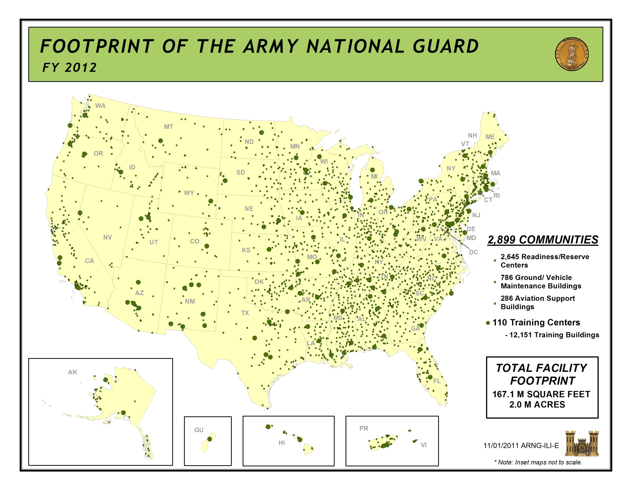

Slide 5
Funding by Category
FY13 Appropriation Request
$606M
P & D
20$M
UMMC
15$M
Transformation
182.1$M
Recapitalization
163.2$M
Deficit Construction
7$M
Range &Training Facilities
34.5$M
16 December 2011
5
Notes:
5

Slide 6
MILCON Budget - MCNG
FY09-10 Appropriation/FY11-17 Request
FY09: (Emerging requirement $147M/ARRA $50M)
16 December 2011
6
Notes:
Slide taken from December 2011 Congressional staff brief.

Slide 7
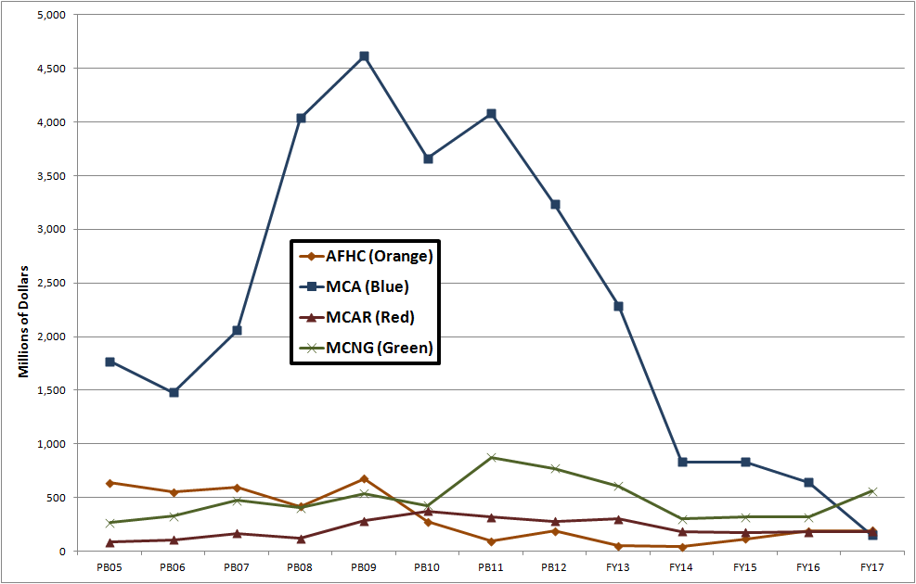
Army MILCON Funding Profile
2005 – 2017
Program Requirement Through President’s Budget
BES 13-17
Does not
include BRAC
15 December 2011
7

Slide 8
MILCON Project Execution
39 of 40 @ 99.1% of $395M
53 of 53 @ 100% of $478M
62 of 63 @ 98.7% of $853M
40 of 40 @ 100% of $505M
45 of 48 @ 93.1%
of $835M
$ Millions
ARNG-ILI / COL Rick Nord
16 December 2011
8

Slide 9
Joint Construction
FY | STATE | LOCATION | TITLE | PARTNER(S)
2007 | AL | Mobile | AFRC | USMCR
2007 | CA | Morena Valley | AFRC | USAR, USNR, USMCR
2009 | GA | Dobbins ARB | AFRC | ANG
2009 | IN | Lawrence | RC | USMCR
2009 | SC | Eastover | JFHQ | ANG
2009 | SD | Rapid City | AFRC | ANG
2010 | MA | Milford | AFRC | ANG
2010 | NE | Lincoln | RC | ANG
2010 | TX | Bergstrom Airport | FMS | USAR
2010 | TX | Bergstrom Airport | AFRC | USAR, USNR, USMCR
2011 | DE | New Castle | AFRC | ANG, USNR
2011 | MA | Hanscom AFB | AFRC | ANG
2011 | VI | St. Croix | RC | ANG
2012 | IN | Indianapolis | JFHQ | ANG
2014 | ME | Augusta | JFHQ | ANG
2016 | VA | Sandston | JFHQ | ANG
2017 | IA | Davenport | AFRC | USAR
49 of 61 ARNG Lead BRAC Projects are also Joint Construction
OSD (RA) was instrumental in coordinating with OSD Comptroller to ensure execution of the two Texas projects in FY10
ARNG will comply with DODI 1225.8 and submit a coordinated DD Form 1391 and MOA. We will ensure the funds are transferred to the project's lead component in a Program Budget Decision/Resource Management Decision.

Slide 10
ARNG Aging Facilities
Facility Inventory is out dated
  Most built before 1960
  Built for Cold War strategic reserve mission
  Smaller units with less equipment
  Do not meet current building codes or standards
  Do not support modern training, simulator, or class room requirements
  Readiness Centers are the key facility that supports ARNG Readiness
Space Shortage
  The ARNG is 41.8% short in facilities space overall
  Readiness Centers are 32.7% short of space
Demographics
  1950 to 2000 the ARNG recruiting and retention population shifted from rural to metropolitan
  Much of the current RC inventory is in the wrong place resulting in square footage deficit
Energy Consumption and Sustainment
  Older facilities are less energy efficient and more expensive to maintain
Notes:
1. Many of our current facilities were built for a different place in time. Meant to support a nation mobilizing for war with the Soviet Union, they are not conducive to supporting the high operations tempo required for today’s missions
2. We owe it to our soldiers to provide the best facilities to support their efforts.
3. Current estimates are $45 – 60 billion, but we need to confirm this number.
4. In the mean time, Army initiatives displace TAG priorities and conditions continue to erode.

Slide 11
ARNG Aging RCs
Number of Readiness Centers
Facility Age (Years)
In 10 years many of our RCs will be beyond the DoD 67 year lifespan for facilities
Notes:
What’s more, a large number of our facilities built during the Cold War build-up are going to reach their 67 year lifespan in the near future.
That does not mean that they will fall to the ground, but it does mean that they are becoming increasingly inefficient and difficult to maintain. They barely sustain the mission today. That will only get worse.
This bill is coming due. Let’s see how we got here and where this is going.

Slide 12
Aging Readiness Centers
70
60
50
40
67 yrs.
Age of Facility
2010
2020
2030
2040
Fiscal Year
MILCON Investment and Aging
ARNG anticipated annual MILCON investment $350M/year over the next decade
Result – by 2035 the ARNG Average Facility Age will be 67 years old
$350M/year MILCON Funding replaces ½ % of the facility inventory per year
1 ½ % of the facility inventory replaced annually to maintain currency
4 % requirement to modernize ARNG Facility Inventory
Notes:
The current status of our RCs is 40.5 years. Plotting their aging on a “straight line” shows that we will reach the 67 year maximum age – on average – in about 2035.
That is not very far out.
But, wait…

Slide 13
Army Facility Investment Strategy and Army Stationing 2020
Facility Investment Strategy (FIS)
  Sustain Required Facilities
  Dispose of Excess Facilities
  Improve Existing Facility Quality
  Build-out Critical Facility Shortfalls
  Inform MILCON program build through strategy
  Contraction rather than expansion
Army Stationing 2020
  MILCON deemphasized as a stationing solution
  Emphasized disposal of excess facilities
  Emphasizes RC use of excess AC facilities
Both FIS and Army Stationing 2020 assume ARNG facility inventory is in the same condition as AC facilities and have benefited from the same level of investment over the last decade

Slide 14
Readiness Center
Transformation Study
Study directed by Congress in FY11 NDAA report language
Study for the first eight states has been funded
Documents the total requirement for ARNG RCs
Provides buy out plan for ARNG RCs
Provides list of validated requirements for Congressional Adds & NGREA (Like Account)
Data supports efforts in the MILCON POM

Slide 15
ARNG, AGAUS/CofG/TAG Strategy
Crosswalk
Army National Guard Track with Department of the Army
MILCON Process
BRAC 2015 ?
Adjutant’s General Association of the United States and Council of Governors
interaction with Congress
Restore Congressional Adds
MILCON - NGREA like Account
State Adjutant General’s
Facility Divestment, Realignment, Master Planning
Army Stationing 2020
Notes:
Committee Members
Vice Chair is open
CFMOs - support
COL Scott Ayres, CFMO, IA ARNG
COL Cliff Silsby, CFMO, KS ARNG
NGB Support - collaborative
COL Rick Nord, NGB, Installation Division Chief
LTC Don McFadden, NGB

Slide 16
BRAC 2005
Most focused ARNG construction program since 1960 affecting 4.3% of Readiness Center Inventory
  Built 125 modern facilities shared with USAR
  211 Army National Guard (ARNG) Facility closures
55 BRAC projects ARNG construction lead
  2 BRAC projects executed in FY06
  - 8 BRAC projects executed in FY07
  - 16 BRAC projects executed in FY08
  - 14 BRAC projects executed in FY09
  - 15 BRAC projects executed in FY10
All ARNG BRAC projects met 15 Sep 11 BOD as required by BRAC Law

Slide 17
FUTURE BRAC
BRAC 2015?
  Recommended in BRAC 2005
  Three Star Programming Group recommended study in FY 12
Small Base Reduction
  Consolidate smaller bases into larger bases
  60 to 75 mile radius
  Small equals less than 300 civilians
  Three Star Programming Group recommended Service Working Groups select site for POM 14-17
  ARNG Benefits
  Replaces outdated facilities
  Opportunity to re-posture misplaced ARNG facilities
  Consolidation with USAR or other reserve components
  Need to establish a process to identify ARNG facilities and partnerships to replace old and inefficient facilities

Slide 18
Facility Operations
Engineering Services bumps up in FY12 providing a much needed funding increase which will reduce requirement to migrate funds for utilities, etc.

Slide 19
Sustainment
Army is maintaining sustainment funding at 90% of FSM
Maintaining 90% is essential to the ARNG

Slide 20
Restoration and Modernization
In FY11 the ARNG received a $40M congressional increase to the appropriation to $56M
The ARNG currently has a backlog of critical R&M requirements. Current funding levels provided a ramp that projected significant headway toward achieving Army goal of Facility Quality “Q2” for all facilities.
In the absence of adequate funding ARNG will continue to progressively increase risk of further deterioration to facilities due to the deferment of Restoration and Modernization requirements.
Notes:
In the past we have received little or no funding for restoration and modernization in the POM. Restoration is used to fix neglected facilities and modernization is used modify facilities for the current use. There has been a push within ACSIM and IMCOM to increase these accounts. As you can see starting in FY14 we have a little money in the program.
Please get your projects into PRIDE so we can use them to justify our requirement???????????

Slide 21
Energy Program
ARNG has stayed under the energy reduction glide path in FYs 08-10 but exceeded the mark for FY11.
Many of the low cost/no cost efforts are or have been implemented such as awareness programs and upgrades to systems and facilities with sustainment dollars.
R&M investments within aging facilities are now required to facility energy system upgrades.
Notes:
Based on the FY 2003 baseline data for energy intensity, the ARNG stayed under the reduction goal glide path for FY08, 09 and 10. During this time, the real property inventory increased while the consumption decreased overall. The ARNG’s actual energy intensity reduction for FY11 was .06% while the inventoried increased 1.6%. States do invest in facility upgrades with sustainment dollars but only when a system is at the end of its life cycle. With migrating sustainment dollars into restoration and modernization projects, other investments were accomplished. Although in FY11, the ARNG did receive RM funding but not for specific renewable energy projects. The funding executed in FY11 was accomplished with end of year funds. The majority of these FY11 dollars were for the advanced metering program. The FY12 begins the cycle of funding for these type of projects. Requirements have been identified but fall well below the critical level of funding for most years in the FYDP. Without adequate levels of funding in this program, the ARNG will not meet the federal or DoD energy reduction goals.

Slide 22
Thank you for your continued support

