Slide 1
Reserve Component Facilities Update
COL Michael Bennett
Chief
Environmental Programs Division
16 Dec 11

Slide 2
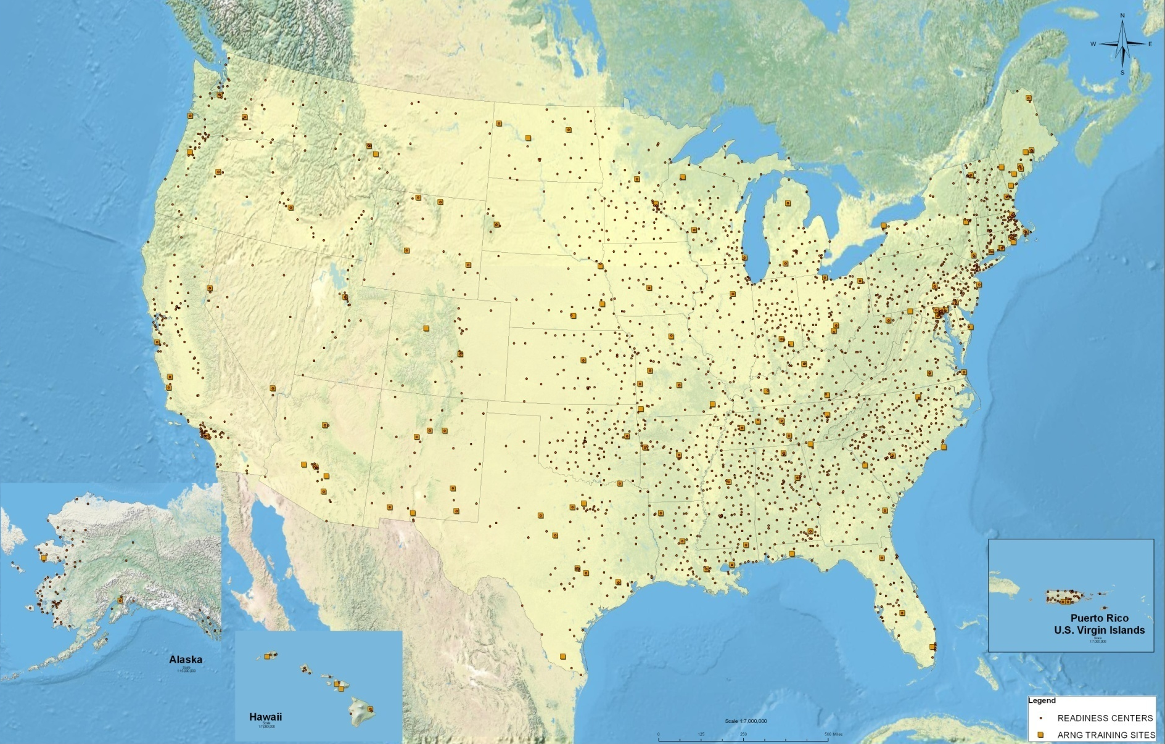
ARNG Environmental Program Reach
$115-$130 M/Yr Program
Consult with 579 Federally Recognized Tribes
107 INRMPS
643 Maintenance Facilities
2522 Readiness Centers
256 Operational Range Assessments Periodic Reviews
3 EIS Underway
50 ICRMPS
2.6 Million Acres
$2.15 M Forestry/Agriculture
Program
16 States with 53 Compliance Cleanup Sites
140 Training Sites
50 States with DERP projects
9 ACUB Sites
550 Federally Reimbursed State Employees
56 Phase II Operational Range Assessments
448 Munitions Response Sites
102 T&E Species Managed
53 Pest Management Plans
2 Power Generation Platforms
EPAS & eMS Audits at 18 Installations/yr
863 Permits Issued

Slide 3
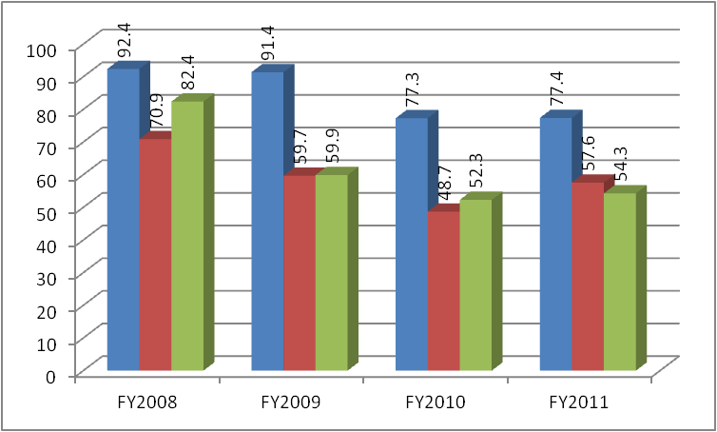
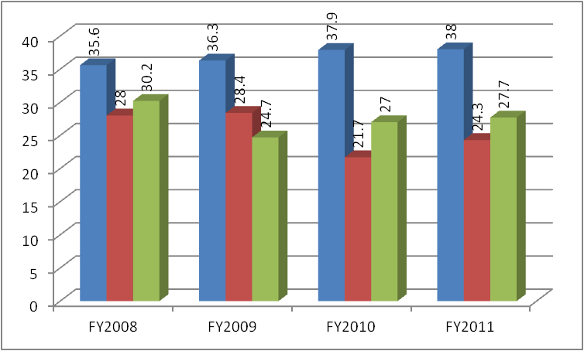
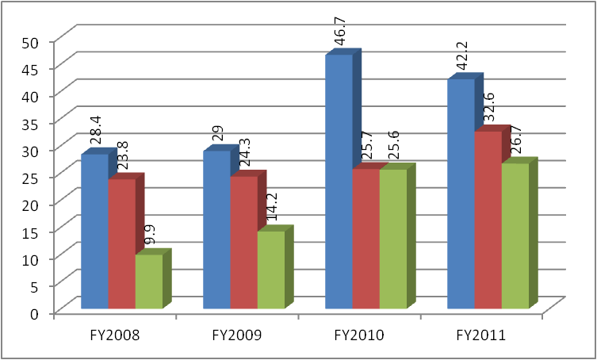
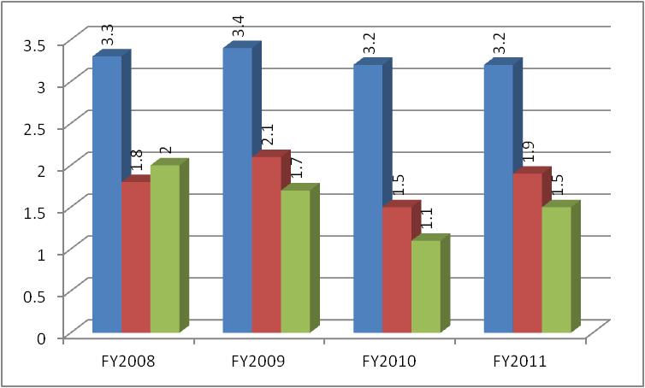
Environmental Funding
Compliance (VENC/VENQ.56)
Conservation (VENN/VENQ.53)
Env Spt To Ranges & Munitions (VEMR/ENVR)
Pollution Prevention (VEPP/VENQ.54)
Requirements
Funding
Executed/Funded

Slide 4
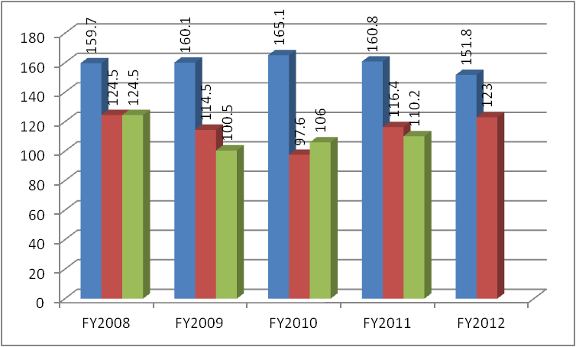
Environmental Funding
Requirements
Funding
Executed/Funded

Slide 5
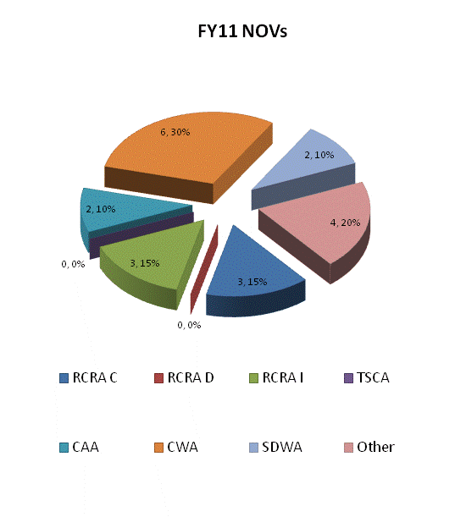
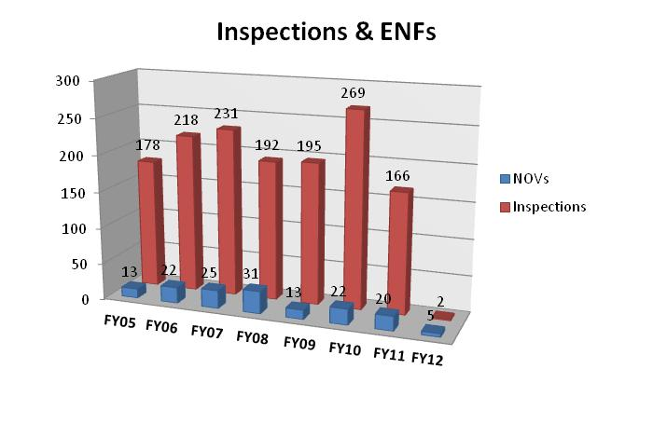
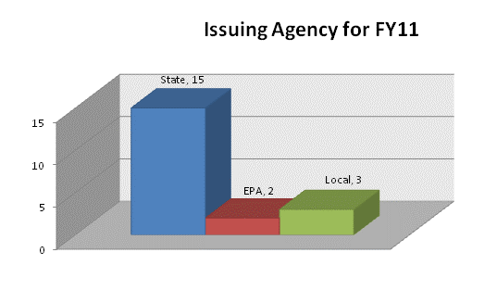
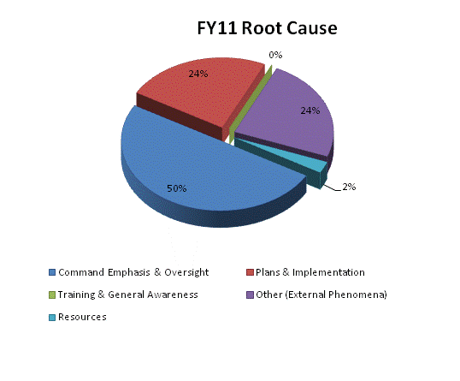
Compliance

Slide 6
Success
Completed a comprehensive update of the 2006 ARNG NEPA handbook. The new 2011 handbook has been well received by State ARNGs and introduces several NEPA efficiencies called for by the Council of Environmental Quality. These efficiencies allow for quicker review of actions in support of MILCON.
Completed an ARNG Environmental Condition of Property (ECOP) handbook in 2011. The handbook clarifies the requirements and process for ECOP completion.
ARNG completed 16 EAs and 64 RECs and 75 ECOP documents in support of MILCON, real estate, training and environmental actions in FY11
NEPA Efficiencies Supporting MILCON:
Standard timeline for Environmental Assessment is reduced from 291 days to 196 days
Partnering with Army Environmental Command to ensure the ARNG is included in Army-wide Programmatic Environmental Assessments (EA)
Reduced the Record of Environmental Consideration (REC) from nine pages to five allowing for faster completion and review of MILCON projects with minor environmental impacts

Slide 7
Success
Completed external and conformance audits of 380 facilities for 18 States. Audits ID’d 1100 environmental compliance deficiencies and corrective actions. Key program in achieving eMS re-declaration by 30 Sep 12 IAW DODI, 12 Oct 2010 IAW DA ACSIM EPAS/EMS Memorandum, and EOs 13423/13514.
The ARNG continues to enhance its GIS capabilities supporting Federal/State requirements across the Training, Installations, and Environmental communities. ARNG's web-based mapping application, fulfills the requirement to view Common Installation Picture (CIP) data. Consolidated software license through Army IDIQ provides substantial cost savings.
Centrally managed a contract with a laboratory to perform perchlorate sample analysis and coordinated with 38 state/territories to complete two rounds of drinking water sampling at 112 ARNG drinking water systems. As a result, the ARNG is in compliance with the sampling requirements of the 2006 DoD Perchlorate Policy and now posses data required to prepare for the impending maximum contaminant level for perchlorate. By centrally managing the sampling and analysis, the 38 ARNG avoided the time and effort that would have otherwise been needed to obtain and contract the atypical laboratory analysis. In addition to the time and effort savings, there was a cost savings due to the number of samples being performed by one lab.
Developed and issued a P2 policy allowing States and Territories who have incorporated pollution prevention (P2) planning into their environmental management system to no longer be required to have a stand-alone pollution prevention plan. Army Regulation (AR) 200-1 requires Installations to maintain an updated P2 plan, but does not specify the format of the plan. This policy is expected to reduce manpower and financial burdens on the States/Territories.

Slide 8
FY 2012 Goals/Initiatives
Restoration & Cleanup
Achieve 100% of metrics for the Compliance-related Cleanup (CC) program contained in the Army Environmental Cleanup Strategic Plan
Continue Operational Range Phase II Assessments (56 required)
Initiate Operational Range Assessment Periodic Reviews (~200 required)
Complete NDNODS Site Inspections
Training & Infrastructure
FY12 Sikes Act Reauthorization. This would resolve applicability issue to ~1/2 of our training sites. Language included in both House and Senate version of FY12 NDAA
Ensure all environmental documentation in support of MILCON is completed in advance to allow on time execution of projects

Slide 9
FY 2012 Goals/Initiatives
Training & Infrastructure
Prepare guidance for Integrated Natural Resource Management Plans INRMPs) and Native American Consultation (NAC).
Ensure no net loss of training capabilities due to proposed species or critical habitat listings under the Endangered Species Act (ESA).
Complete a Cold War Era Context Study to preclude State Historic Preservation Offices (SHPO) from making the determination that all of them are eligible. This will potentially enable us to go back to the Keeper to have them re-evaluate properties they previously determined eligible.

Slide 10
FY 2012 Goals/Initiatives
Compliance
Determine BMPs and requirement to achieve compliance with the Chesapeake Bay TMDL.
The ARNG is continuing to work with Army Petroleum Center (APC) to ensure Defense Logistics Agency-Energy (DLA-E) pays for Environmental Compliance Requirements at Capitalized Fuel Sites. DLA-E should be funding Environmental Compliance requirements at Capitalized sites. In FY11, ARNG requested approximately $48K from DLA-E for environmental compliance requirements.

Slide 11
ARNG Readiness & Environmental Protection Initiative/ Army Compatible Use Buffer 2003-2011
Installations: Camp Roberts, CA; Camp Blanding, FL; Camp Ripley, MN; Fort Custer, MI; Camp San Luis Obispo, CA; Camp Shelby, MS; Fort Pickett, VA; Camp Rilea, OR; and Camp McCrady (MAJIC), SC
Obligated ACUB funding thru 2011: $40,198,325. (ARNG: $15,775,625, Army: 1MIL, and DOD REPI: $23,423,700)
Executed ACUB funding thru 2011: $29,327,527 military and $102 million partner
Total acres protected approximately 57,311

Slide 12
National Environmental Policy Act
Current Actions
Programmatic Environmental Impact Statement (EIS) for the South Texas Training Center
TXARNG is examining the environmental and social concerns related to acquiring approx. 22K acres in support of training
Emerging issue is land use; ability for ARNG to train while owner-retained mining rights are potentially executed
Draft EIS due for release in the spring of 2012
Environmental Impact Statement for the Military Training Activities at Naval Weapons Systems Training Facility (NWSTF) Boardman
Navy is lead on action to expand and enhance ranges in Boardman, OR
Draft EIS due for release in summer of 2012
Legislative Environmental Impact Statement (LEIS) for the Limestone Hills Training Area Land Withdrawal
Final LEIS published in NOV 2011
Land action is moving to next phase; draft legislation is in review at DASA I&H

Slide 13
Challenges
General Fund Enterprise Business System transition
Installation Management Reform
HQ Army Environmental System
Cold War Era buildings
Defense Environmental Restoration Program (DERP):
DERP funded NDNODS Site Inspections tracking for FY12 completion.
Critical path issue: future year funding for any remedial efforts associated with the NDNODS Site Inspections will be programmed in Compliance-related Cleanup (CC) Program. Limited funding results in prioritization and delay of remediation activities based on risk.
~350 sites w/current cost-to-complete estimate = ~$250M
High regulatory interest due to nature of sites.

Slide 14
Back-up

Slide 15
Army National Guard Environmental Programs Division
MISSION
The Environmental Programs Division supports military readiness by obtaining and providing resources, guidance, and customer assistance while protecting human health and environment to ensure Army National Guard compliance with all applicable laws, regulations, and policies.
FUNCTIONS
Identify and Defend Requirements
Issue Policy and Distribute Resources
Manage Programs and Activities
Manage Regulatory Compliance
Conserve Resources
FOCUS AREAS
Training Lands, Facilities, Federal Military Support, Clean-up

Slide 16
Army National Guard Environmental Programs Division
Environmental
Programs - HQ
4 AGR
2 DAC
2 Contractor
PERSONNEL RECAP
AUTH
AGR……… 21
CIV………. 29
CONTR…. 15
Chief, (AGR)
Compliance Branch
Chief, (DAC)
Training &Infrastructure
Branch
Chief, (DAC) Cleanup & Restoration
Branch
Chief, (AGR)
Requirements &
Analysis Branch
4 AGR
7 DAC
3 Contractors
5 AGR
12 DAC
4 Contractors
3 AGR
5 DAC
3 Contractors
5 AGR
3 DAC PM
3 Contractor
AGR – Active Guard Reserve/Military
DAC – Department of Army Civilian

Slide 17
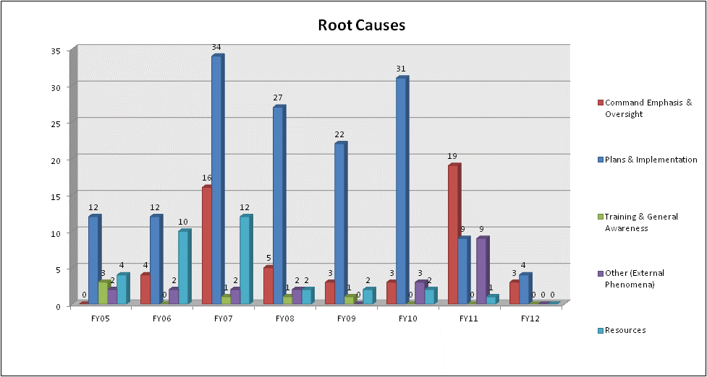
Compliance
Notes:
Optional

Slide 18
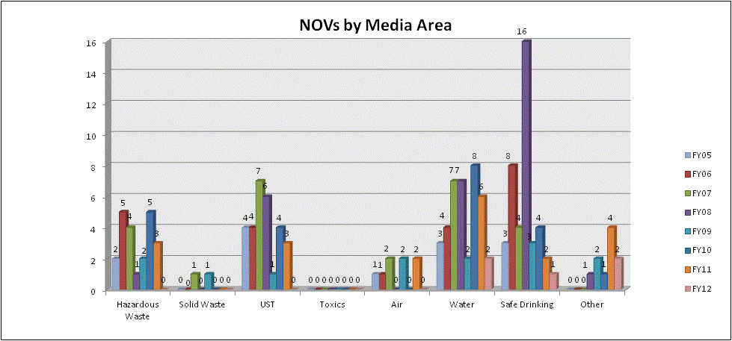
Compliance
Notes:
Optional

Slide 19
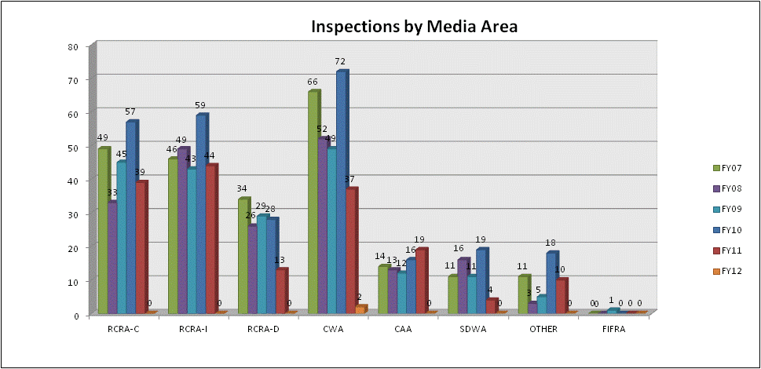
Compliance
Notes:
Optional

Slide 20
Cleanup and Restoration
Operational Range Assessments (ORA):
Part of the Army’s Sustainable Range Program
Department of Defense Directive 4715.11 (10 May 2004)
“…Ensure the long-term viability of operational ranges while protecting human health and the environment.”
Department of Defense Instruction 4715.14 (30 Nov 2005)
“… Determining whether a release or substantial threat of a release of munitions constituents of concern from an operational range to an off-range area creates an unacceptable risk to human health or the environment.”
Phase I Assessments (Qualitative) results: 56 range complexes required Phase II Assessment
27 Phase II Assessments (Quantitative) underway
Remaining sites to be contracted and started in FY12
5 Year Review requirement for ALL complexes
OSD work group still defining the future of ORA
Working ARNG G3 integration

Slide 21
Cleanup and Restoration
Compliance-related Cleanup (CC):
Purpose: To perform appropriate, cost-effective cleanup to protect human health and the environment, and to sustain operational readiness and training.
FY11 obligated ~$17M to CC Program sites in 14 states
Camp Edwards/MMR included in CC Program
MMR management and execution transitioned from US Army Environmental Command to ARNG Directorate and MA ARNG
Impact Area Groundwater Study Program employees migrated to state employment.
MMR has high regulatory, public, and political interest; drives actions
MMR requires MILCON dollars for groundwater treatment systems; regulatory driven to accomplish within 18 mos of regulatory signature of Record of Decision
J-1 Range Groundwater Treatment Record of Decision signed

Slide 22
Cleanup and Restoration
Defense Environmental Restoration Program (DERP):
Purpose: To perform appropriate, cost-effective cleanup to protect human health and the environment for DERP eligible sites; funding provided under special Congressional appropriation (2020)
FY11 $20,563,888.75 obligated to ARNG project sites
FY12 programmed ~$50M
FY11 ~$1.6M obligated to ARNG Program Management
FY12 programmed ~$1.1M in Program Management funds
Majority of workload is in the Military Munitions Response Program
Non-DoD (owned) Non-Operational Defense Sites (NDNODS)
Site Inspections underway. These are sites with potential historic munitions use within the public domain (property not owned by DoD). Currently funded under DERP. Planned migration to CC at completion of Site Inspections.

