Slide 1
Fueling Innovation through the Power of APIs
by
Ivor D’Souza
and
NLM API Experts
June 6, 2012

Slide 2
Panelists and their APIs
Eric Sayers – Entrez utilities
Loren Frant – MedlinePlus Connect
Steven Emrick – UMLS Terminology Services
Olivier Bodenreider – drug-related APIs
David Hale – Pillbox
Nicholas Ide – Clinical Trials
Francois Lang – MetaMap

Slide 3
More Experts…
Dianne Babski – NLM API Showcase
Stephanie Dennis – MedlinePlus Connect
Suresh Srinivasan – Terminology services

Slide 4
Something for Everyone!
Learn about NLM APIs and data sets
Meet NLM’s API Experts
Network with fellow attendees

Slide 5
How do Application Programming Interfaces (APIs) fuel innovation?
How do
Application Programming Interfaces (APIs)
fuel innovation?

Slide 6
Fueling Innovation through the power of APIs

Slide 7
Fueling Innovation through the power of APIs

Slide 8
Fueling Innovation through the power of APIs

Slide 9
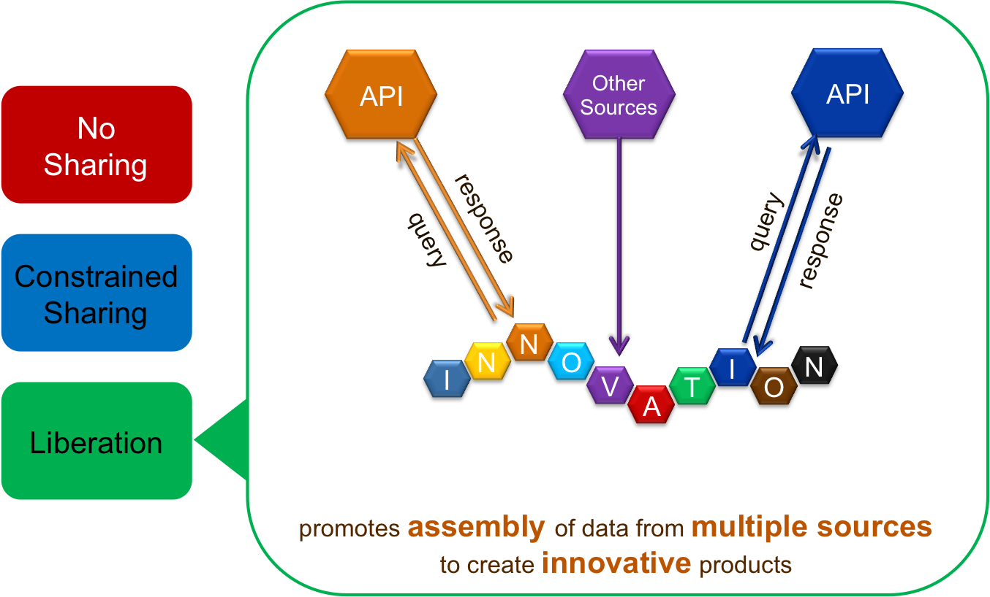
Fueling Innovation through the power of APIs

Slide 10
Fueling Innovation through the power of APIs

Slide 11
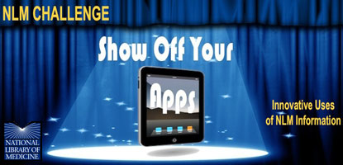
April 12 – August 31, 2011

Slide 12
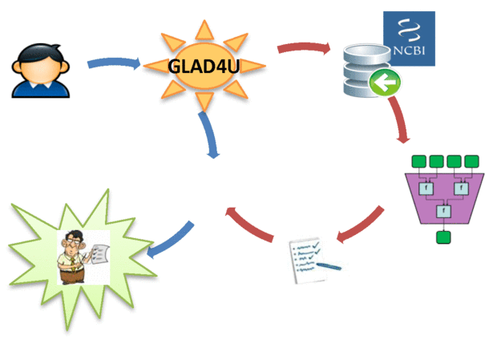
NLM Show Off Your Apps API Winners
GLAD4U
Gene list automatically derived for you
http://bioinfo.vanderbilt.edu/glad4u

Slide 13
NLM Show Off Your Apps API Winners
Website for searching and investigating biomedical literature
http://www.quertle.info

Slide 14
NLM Show Off Your Apps API Winners
Semantic search engine and biomedical knowledgebase application
http://www.nlmplus.com

Slide 15
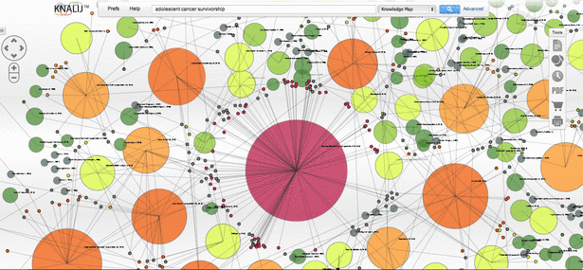
NLM Show Off Your Apps API Winners
KNALIJ: ‘Big Data’ visualization tool
http://knalij.com

Slide 16
Innovators like you are fueling innovation through the power of APIs
Innovation
Innovators like you are fueling
through the power of APIs
http://www.nlm.nih.gov/api

Slide 17
Todd Park wants you to be a Health Data Innovator

Slide 18
INNOVATORS Get Ready!
INNOVATORS Get Ready!

Slide 19
Activity Format

Slide 20
Polynesian Islands
Notes:
MAP – MODERATOR and USER – single sided regular paper

Slide 21
Image

Slide 22
Innovators BE ALERT! API presentations to begin NOW
Innovators
BE ALERT!
API presentations to begin NOW

Slide 23
Sample Challenge Question
A personal health record (PHR) system displays the list of medications prescribed to a patient based on the proprietary drug vocabulary Micromedex RED BOOK (code 111574).
You want to enrich the system with drug information for patients.

Slide 24
NLM API Overview Chart
Notes:
MAP – MODERATOR and USER – single sided regular paper

Slide 25
NCBI E-Utilities
by
Eric W. Sayers, PhD
NCBI/NLM/NIH

Slide 26
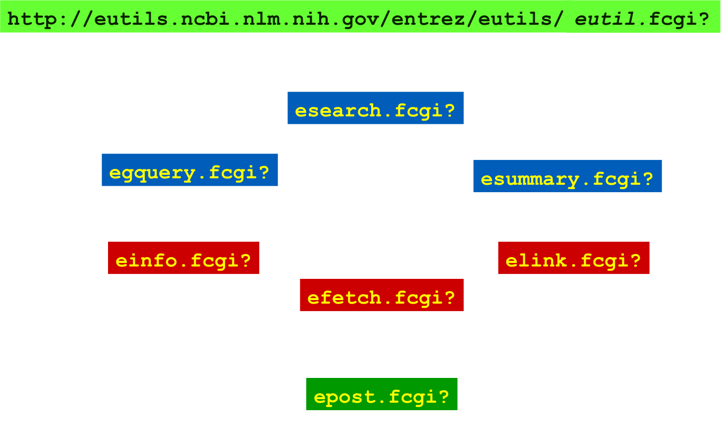
The E-utilities

Slide 27
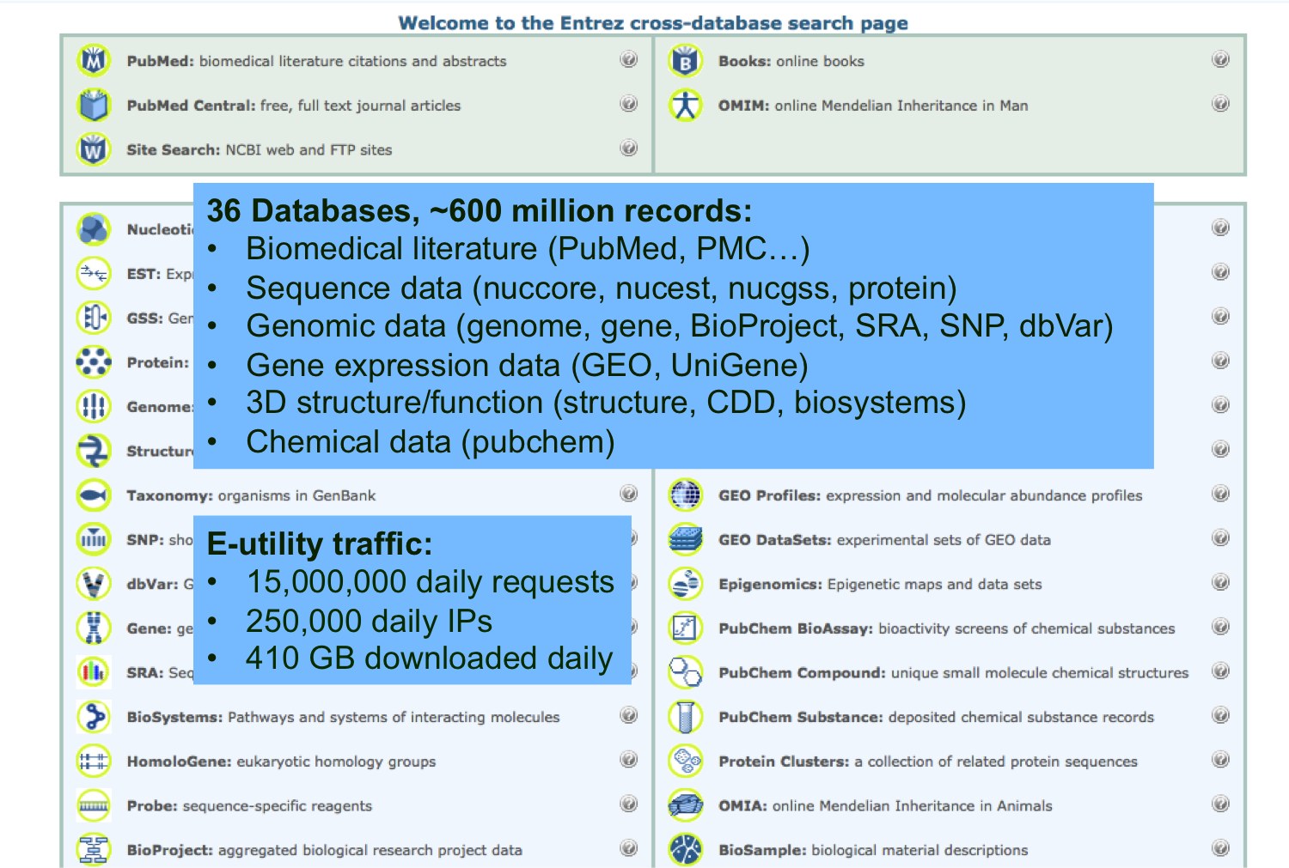
E-Utilities: Data Available

Slide 28
Databases for Today…
PubMed – biomedical literature abstracts
PubMed Central (PMC) – full text articles
Gene – summary of data about a particular gene (sequences, function, expression, etc.)
PubChem – chemicals and drug screens

Slide 29
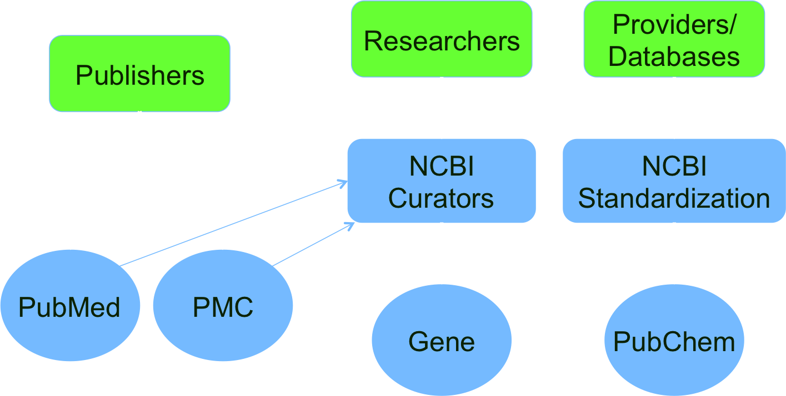
Sources of Data

Slide 30
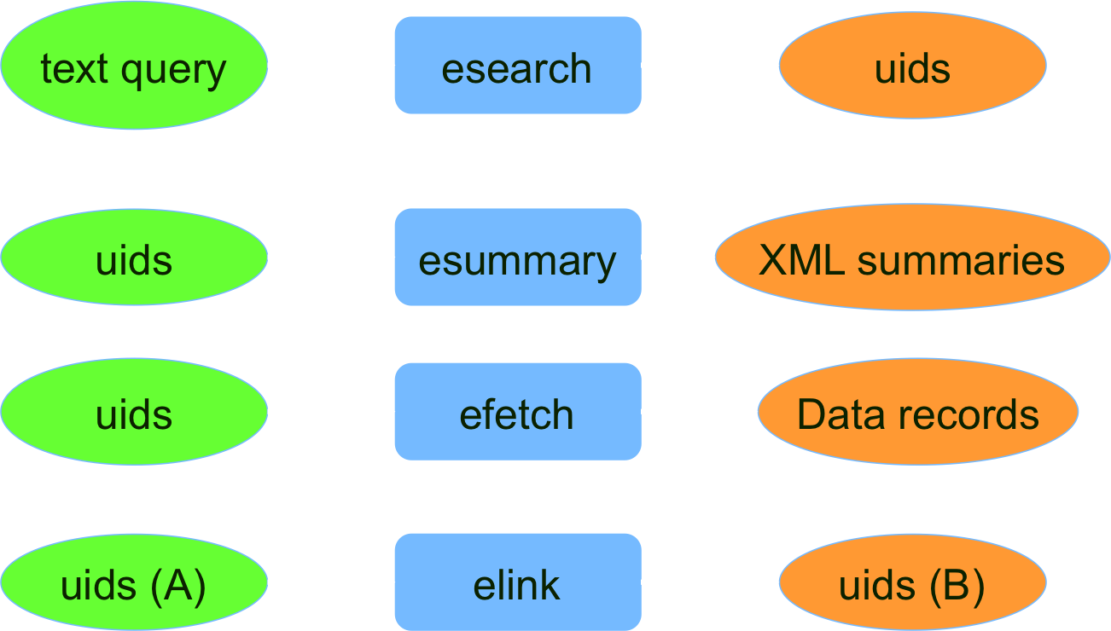
Selected E-Utility Functions

Slide 31
Examples
Esearch
esearch.fcgi?db=pccompound&term=leflunomide
Esummary
esummary.fcgi?db=gene&id=<geneID>
Efetch
Efetch.fcgi?db=pmc&id=<pmcID>&retmode=xml
Elink
elink.fcgi?dbfrom=pubmed&db=pmc&id=<pmid>

Slide 32
For More Information
Documentation
eutils.ncbi.nlm.nih.gov
E-mail announce list
http://www.ncbi.nlm.nih.gov/mailman/listinfo/utilities-announce/
Technical support
eutilities@ncbi.nlm.nih.gov

Slide 33
NLM API Overview Chart
Notes:
MAP – MODERATOR and USER – single sided regular paper

Slide 34
MedlinePlus Connect
by
Loren Frant
Loren.Frant@nih.gov

Slide 35
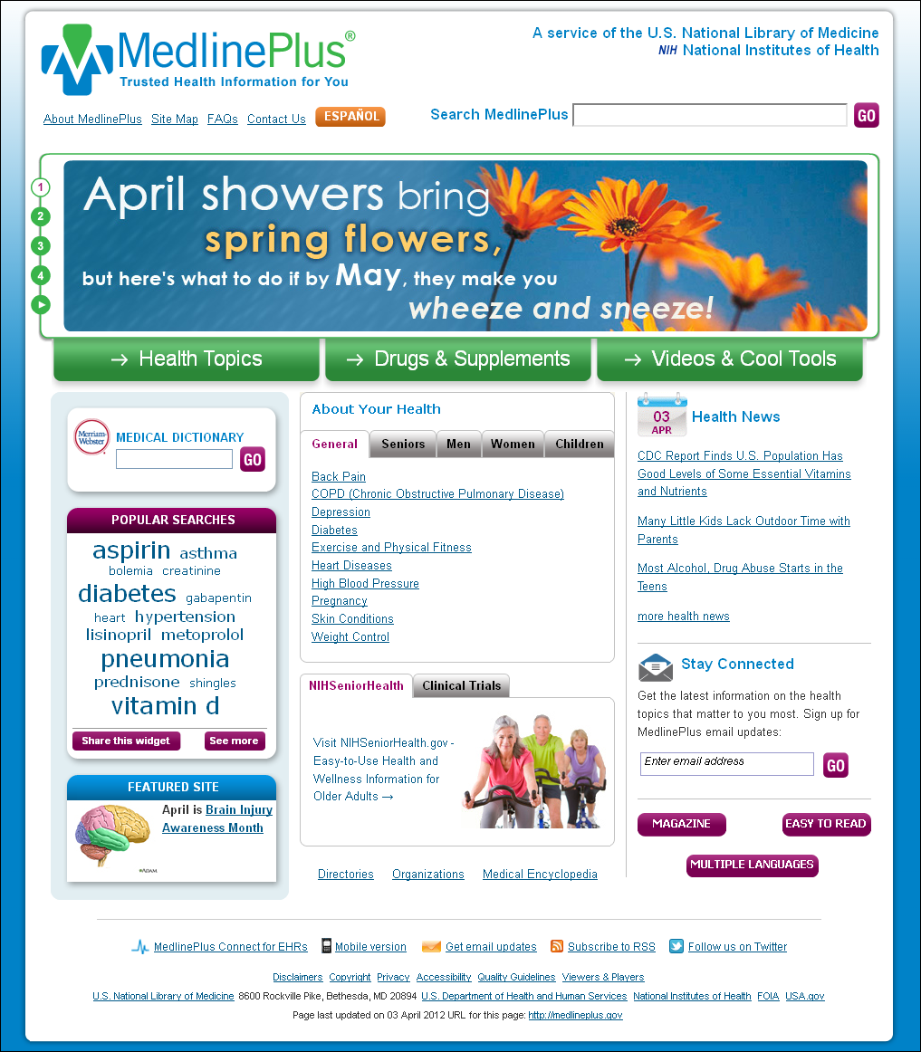
MedlinePlus.gov
Reliable, authoritative
Consumer-friendly
No ads
Updated daily
Strict quality guidelines
English and Spanish
Links to information in >40 languages
Multimedia, news, images, encyclopedia, tutorials and more…

Slide 36
MedlinePlus Connect

Slide 37
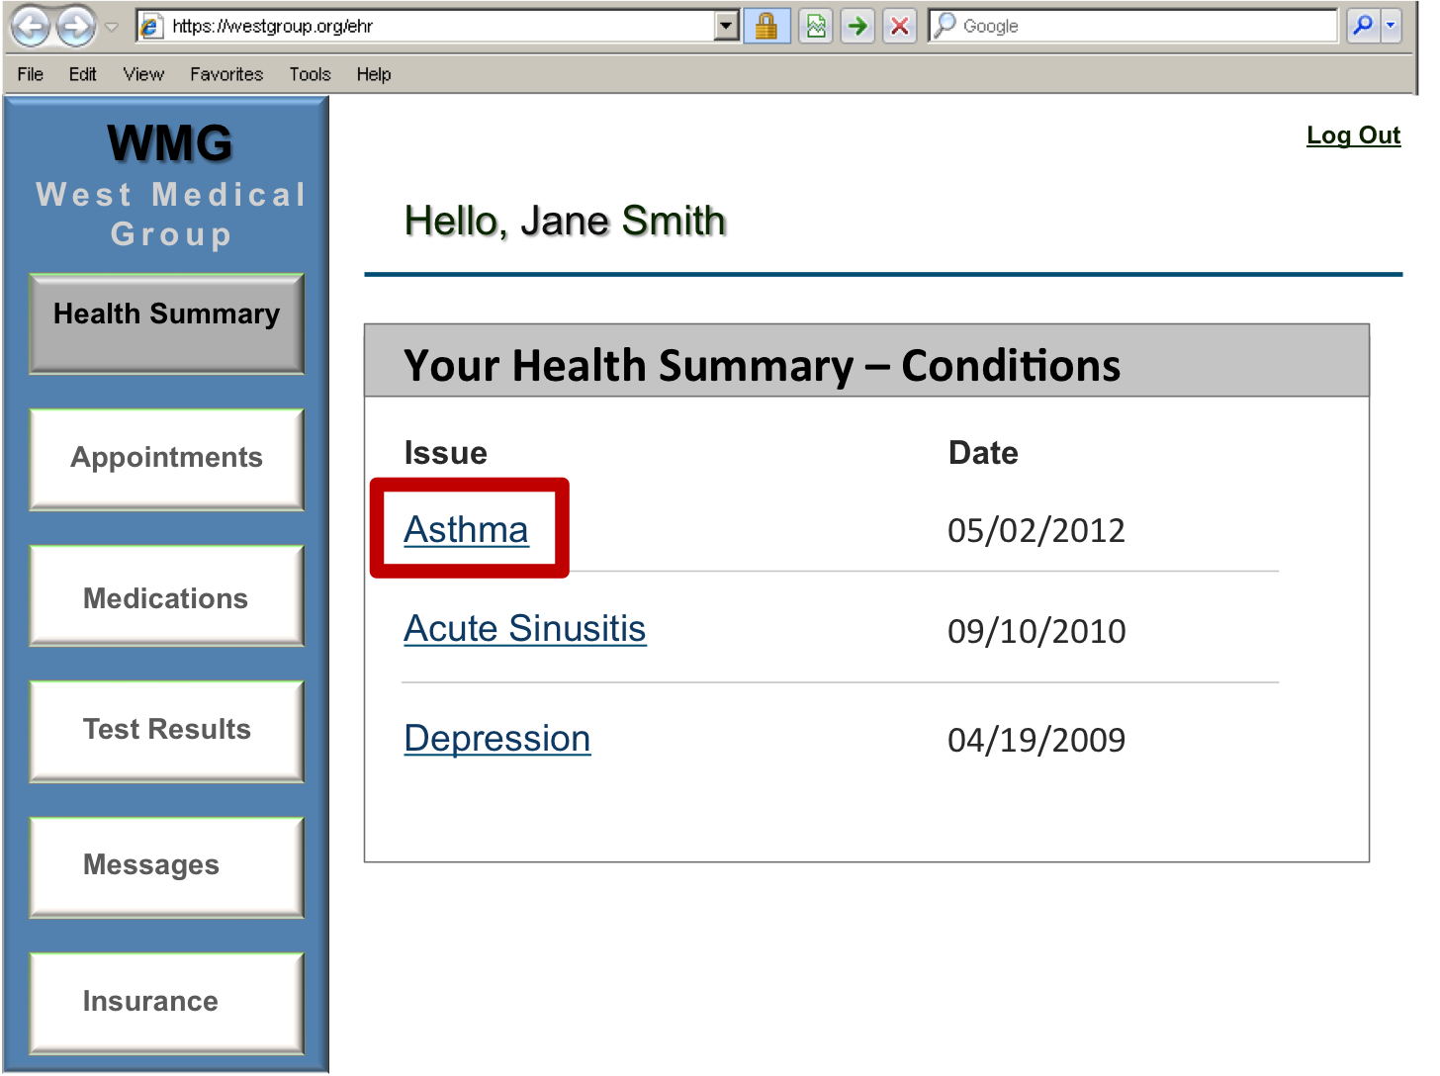
Your Health Summary

Slide 38
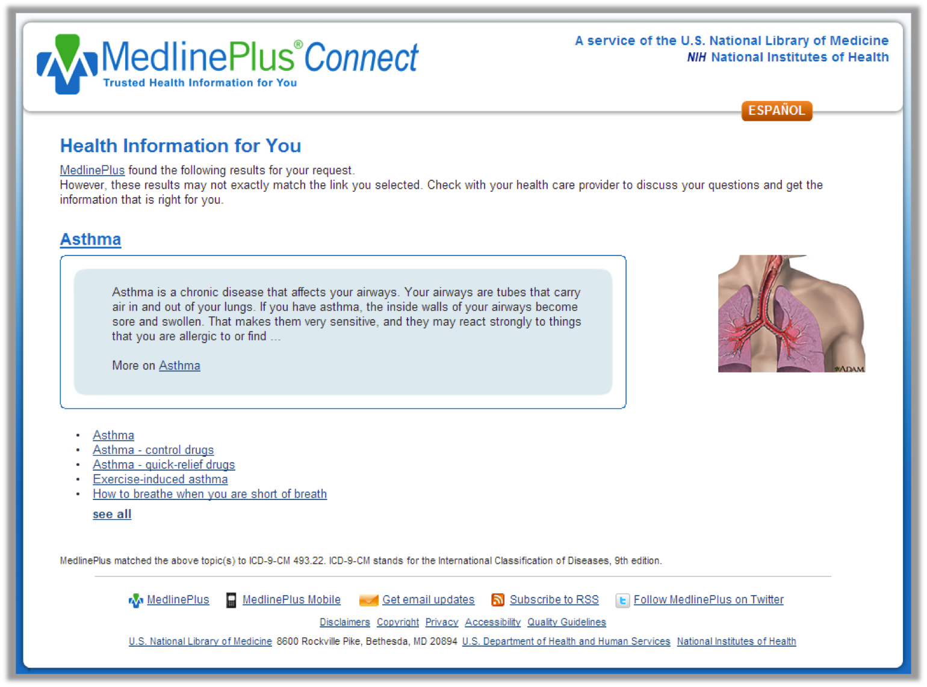
MedlinePlus Connect – Health Information

Slide 39
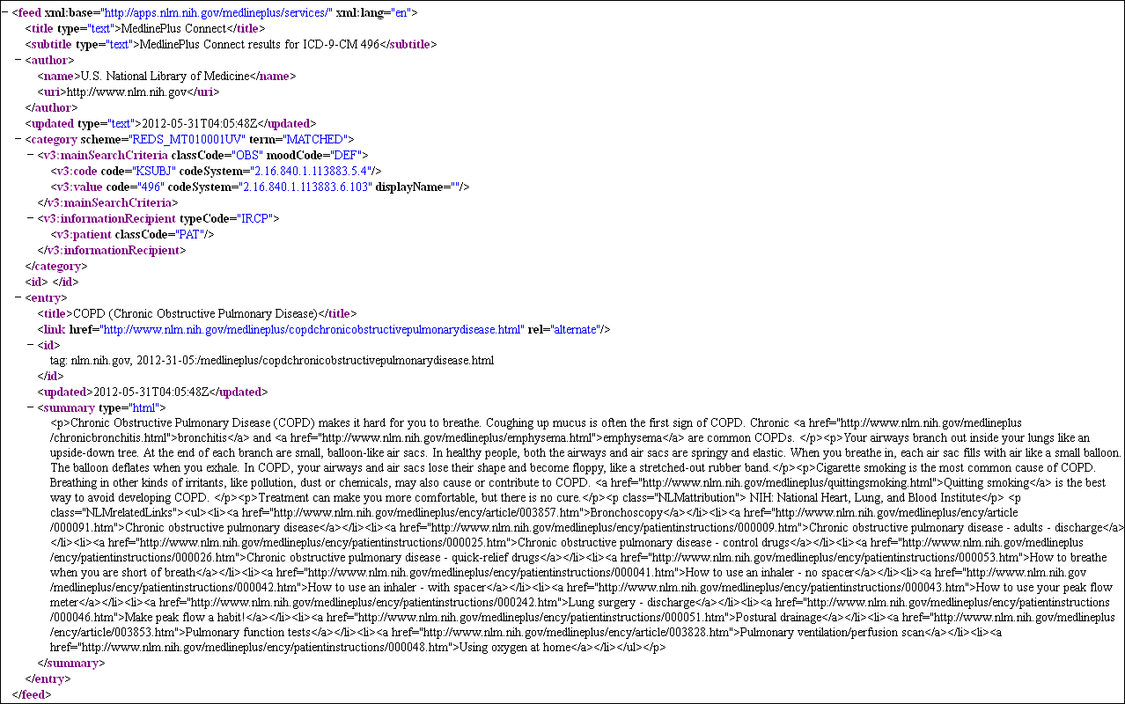
MedlinePlus Connect Web Service

Slide 40
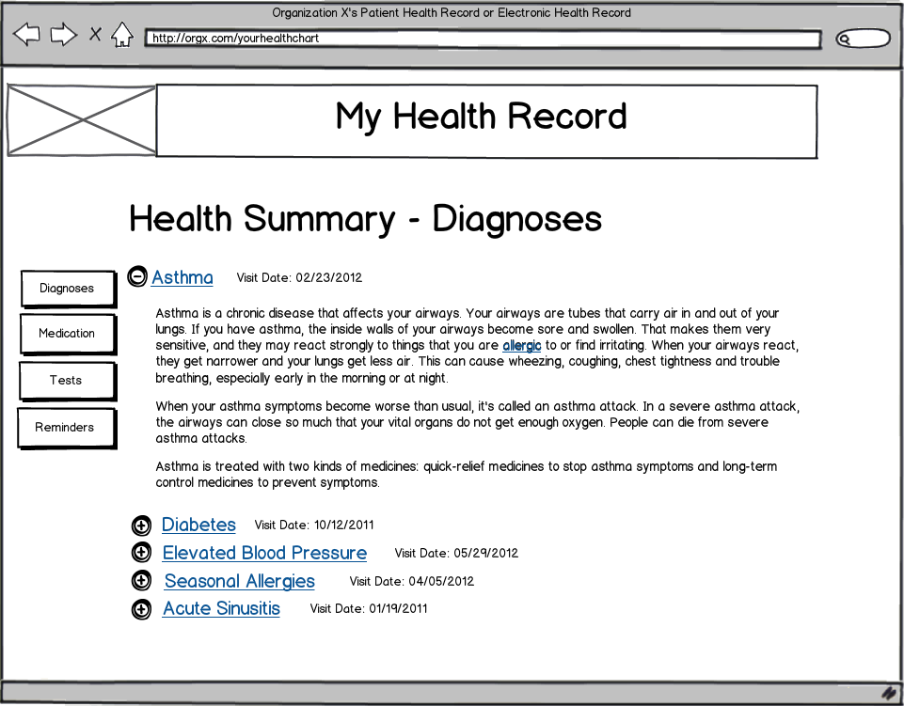
My Health Record

Slide 41
MedlinePlus Connect Requests
Type of Request | Code System | Languages
Diagnosis (Problem) | ICD-9-CM SNOMED CT | English Spanish
Medication | RXCUI NDC | English
Lab Test | LOINC | English Spanish

Slide 42
MedlinePlus Connect Web Application Request
http://apps.nlm.nih.gov/medlineplus/services/mpconnect.cfm?mainSearchCriteria.v.cs=2.16.840.1.113883.6.42&mainSearchCriteria.v.c=493&mainSearchCriteria.v.dn=Asthma&informationRecipient.languageCode.c=en

Slide 43
Step by Step
http://apps.nlm.nih.gov/medlineplus/services/mpconnect.cfm
Base URL: Do you want to use the Web Service or Web Application?

Slide 44
Step by Step
http://apps.nlm.nih.gov/medlineplus/services/mpconnect.cfm?mainSearchCriteria.v.cs=2.16.840.1.113883.6.42
Code System:
Which type of code are you sending?

Slide 45
Code System
ICD-9-CM
mainSearchCriteria.v.cs=2.16.840.1.113883.6.103
mainSearchCriteria.v.cs=2.16.840.1.113883.6.2
mainSearchCriteria.v.cs=2.16.840.1.113883.6.42
SNOMED CT CORE Problem List Subset
mainSearchCriteria.v.cs=2.16.840.1.113883.6.96
RXCUI
mainSearchCriteria.v.cs=2.16.840.1.113883.6.88
NDC
mainSearchCriteria.v.cs=2.16.840.1.113883.6.69
LOINC
mainSearchCriteria.v.cs=2.16.840.1.113883.6.1
mainSearchCriteria.v.cs=2.16.840.1.113883.11.79

Slide 46
Step by Step
http://apps.nlm.nih.gov/medlineplus/services/mpconnect.cfm?mainSearchCriteria.v.cs=2.16.840.1.113883.6.42&mainSearchCriteria.v.c=493
CODE:
What is the specific code for which you need information?

Slide 47
Step by Step
http://apps.nlm.nih.gov/medlineplus/services/mpconnect.cfm?mainSearchCriteria.v.cs=2.16.840.1.113883.6.42&mainSearchCriteria.v.c=493&mainSearchCriteria.v.dn=Asthma
TEXT:
Do you have text to accompany the code?

Slide 48
Step by Step
http://apps.nlm.nih.gov/medlineplus/services/mpconnect.cfm?mainSearchCriteria.v.cs=2.16.840.1.113883.6.42&mainSearchCriteria.v.c=493&mainSearchCriteria.v.dn=Asthma&informationRecipient.languageCode.c=en
LANGUAGE:
Do you want the response in English or Spanish?

Slide 49
Request Structure
Base URL - Web Application
http://apps.nlm.nih.gov/medlineplus/services/mpconnect.cfm
Base URL - Web Service
http://apps.nlm.nih.gov/medlineplus/services/mpconnect_service.cfm
Code System mainSearchCriteria.v.cs
Specific Code mainSearchCriteria.v.c
Text mainSearchCriteria.v.dn
Language informationRecipient.languageCode.c

Slide 50
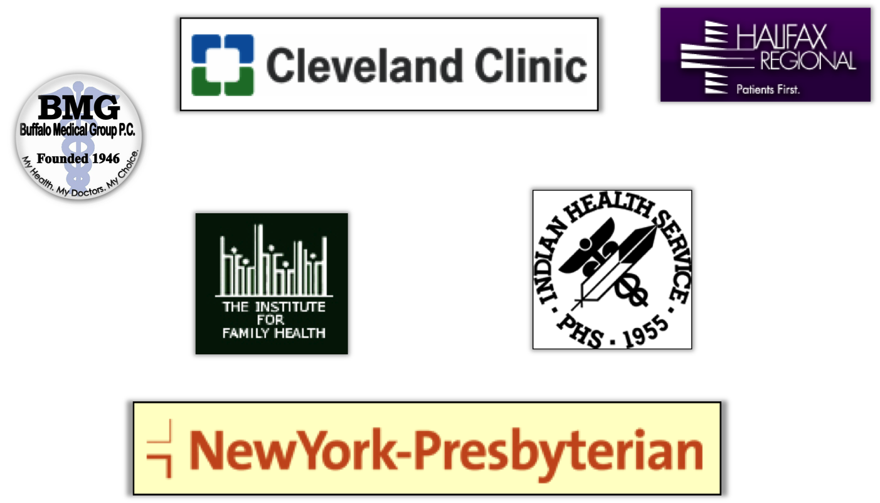
Medical Centers

Slide 51
Medical Business Solutions

Slide 52
http://medlineplus.gov/connect
Technical how to’s
Sample list of users
Demonstration pages
Email list – please join!
http://www.nlm.nih.gov/medlineplus/connect/emaillist.html

Slide 53
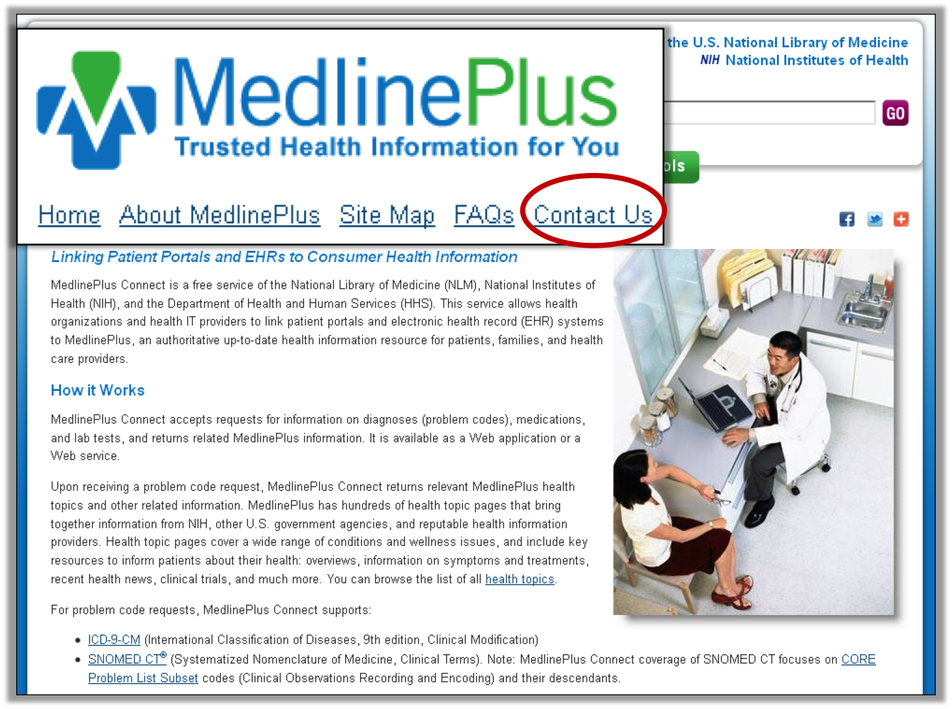
MedlinePlus Contact

Slide 54
NLM API Overview Chart
Notes:
MAP – MODERATOR and USER – single sided regular paper

Slide 55
UMLS Terminology Services API 2.0
by
Steven Emrick
Head, Terminology QA & User Services
National Library of Medicine

Slide 56
Overview
Background - What is the UMLS?
What is the UMLS Terminology Services?
How do I access UMLS data with the API?

Slide 57
History of the UMLS
[Lindberg & al., Methods, 1993]
[Humphreys & al., JAMIA, 1998]
Started at NLM, 1986
«[…] the UMLS project is an effort to overcome two significant barriers to effective retrieval of machine-readable information.
The first is the variety of ways the same concepts are expressed in different machine-readable sources and by different people.
The second is the distribution of useful information among many disparate databases and systems.»
Notes:
The UMLS dates from 1986, when then newly appointed NLM Director, Dr. Donald A.B. Lindberg, testified to Congress at the Library’s budget appropriations asking for some additional seed money. The first 4 years were spent

Slide 58
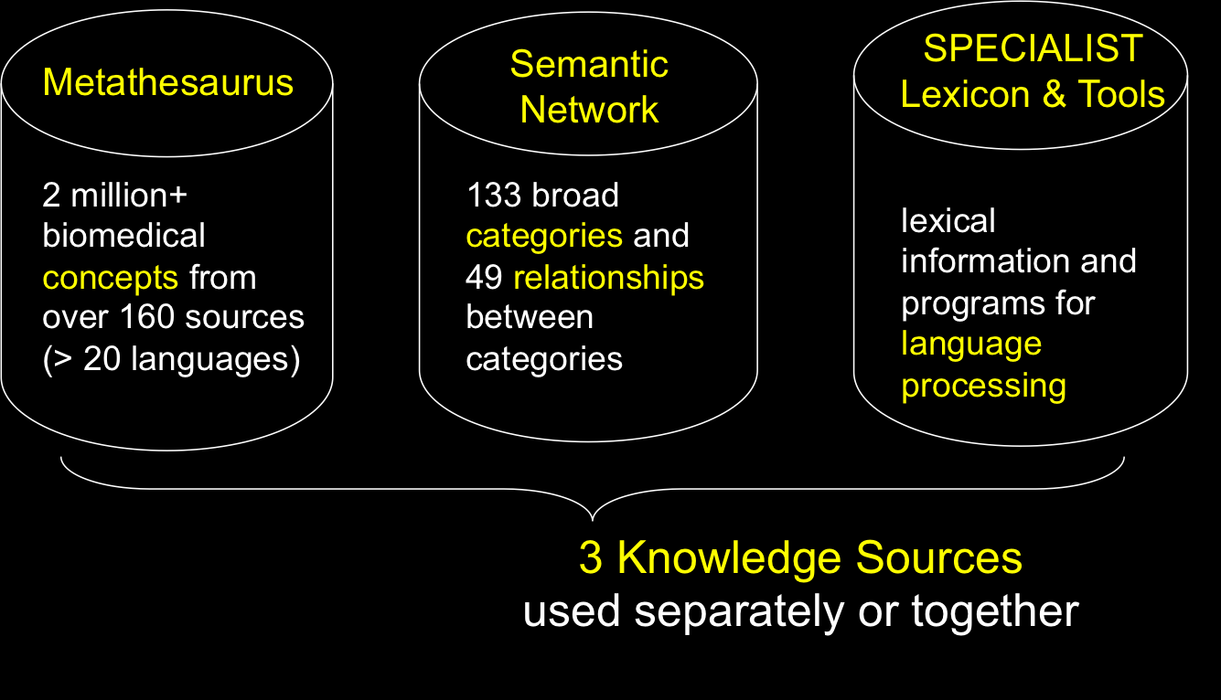
The UMLS Consists of…
Content
Categorization
Normalization
Notes:
knowledge sources = data files and associated tools.
Users may use any one or all 3 knowledge sources.
independently, or in conjunction with each other.

Slide 59
Metathesaurus Growth Over the Years

Slide 60
UMLS Terminology Services

Slide 61
UTS Metathesaurus Browser https://uts.nlm.nih.gov

Slide 62
Concept Report – ‘psoriasis’

Slide 63
UTS API 2.0
Allows searching of UMLS Metathesaurus and Semantic Network
Simple installation (import WSDLs and you’re ready to go)
Code snippets in documentation can help you get started

Slide 64
https://uts.nlm.nih.gov/home.html#apidocumentation
UTS API Documentation

Slide 65
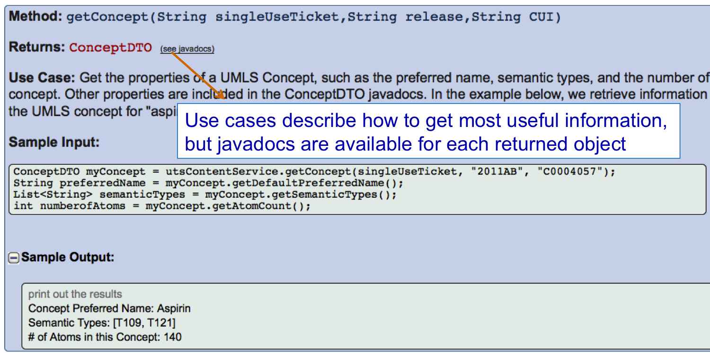
Use the API to retrieve concept information

Slide 66
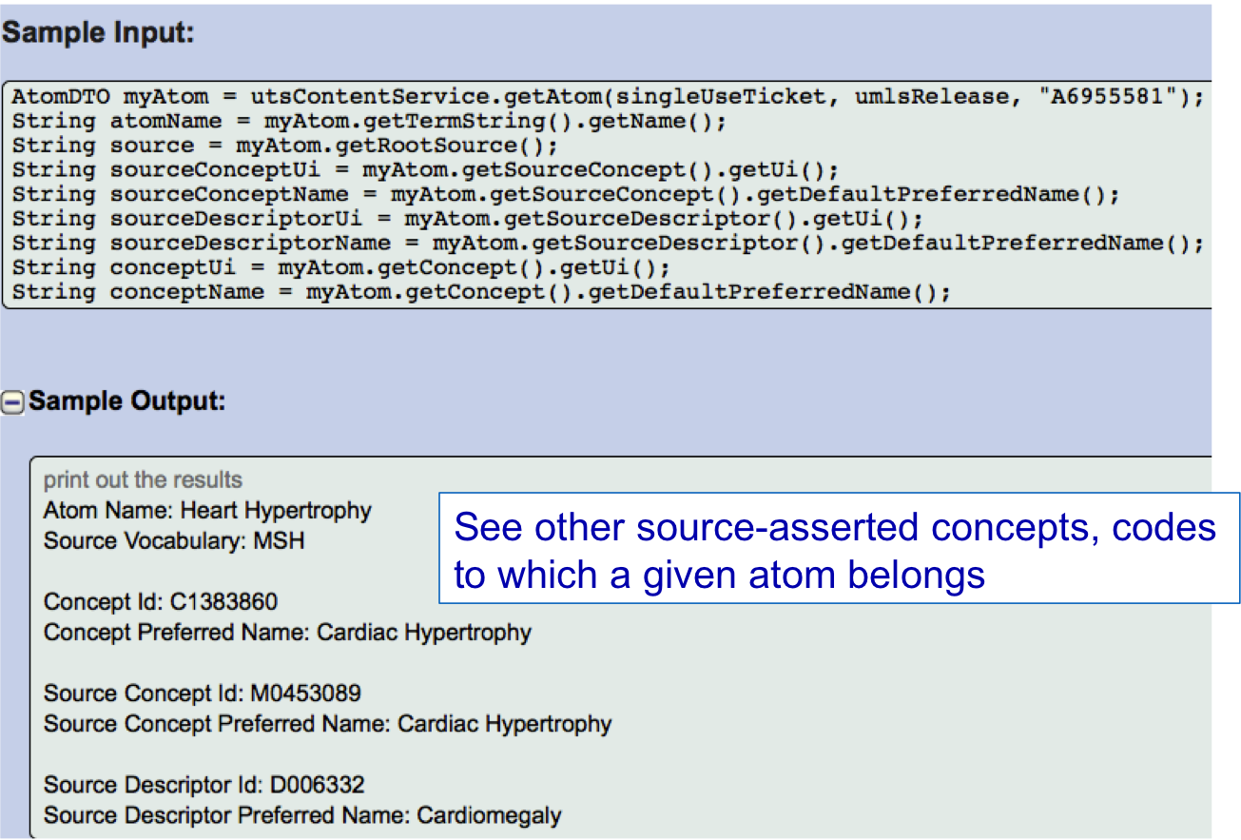
…retrieve atom information

Slide 67
Filter out unwanted information

Slide 68
Questions?
General UMLS Customer Support
http://www.nlm.nih.gov/research/umls/support.html
or
Contact Steve Emrick –
Email: emricks@mail.nih.gov
Phone: (1) 301 496 8707
Relevant links –
UTS home – https://uts.nlm.nih.gov
UMLS home – http://www.nlm.nih.gov/research/umls
UMLS Listserv – http://list.nih.gov (umlsusers-l)

Slide 69
NLM API Overview Chart
Notes:
MAP – MODERATOR and USER – single sided regular paper

Slide 70
APIs to Drug Information Sources
by
Olivier Bodenreider

Slide 71
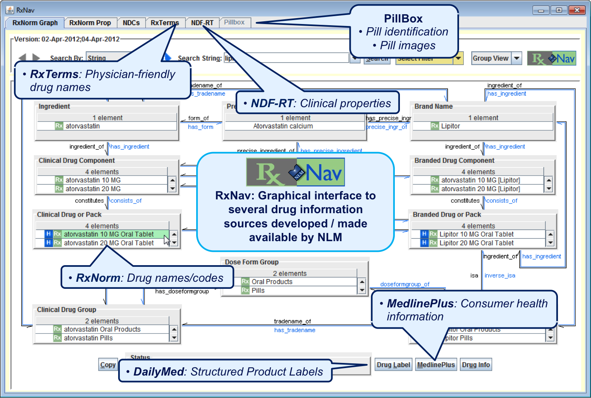
RxNav
http://rxnav.nlm.nih.gov/

Slide 72
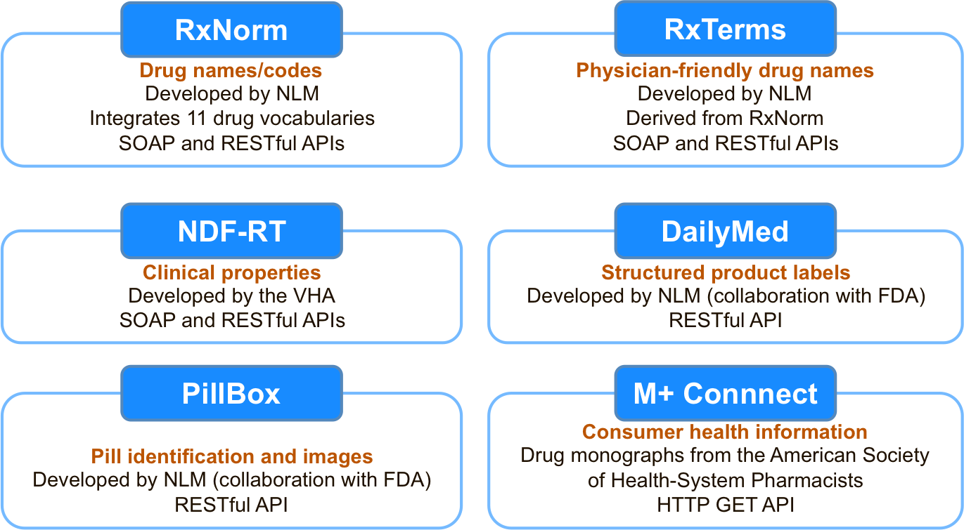
APIs to Drug Information Sources

Slide 73
What Information Can I Get Through These APIs?
RxNorm – Drug names/codes
Spelling suggestions for drug names
Exetan -> Exelon
Find the ingredients of a branded drug
Lipitor -> atorvastatin
RxTerms – Physician-friendly drug names
Lipitor 20 MG Oral Tablet -> LIPITOR (Oral Pill) / 20 mg
NDF-RT – Clinical properties
Mechanism of action, physiologic effect, …
Pharmacologic classes
Amoxicillin -> Penicillins
Drug-drug interactions
DailyMed – Structured Product Labels
Indications, contra-indications, adverse reactions, …

Slide 74
Applications DrugDiary iPhone app
Uses the RxNorm and RxTerms APIs to create medication lists

Slide 75
Documentation
For RxNav and the APIs
http://rxnav.nlm.nih.gov/
Examples of implementation
For Java, PERL, .NET
Other resources
Webinar, Slides
See: http://mor.nlm.nih.gov/pubs/pres.html

Slide 76
Contact Information
Email: RXNAVINFO@LIST.NIH.GOV
Web: http://rxnav.nlm.nih.gov/
Lister Hill National Center for Biomedical Communications Bethesda, Maryland - USA

Slide 77
NLM API Overview Chart
Notes:
MAP – MODERATOR and USER – single sided regular paper

Slide 78
Pillbox: Drug Identification and Reference
David Hale
Project Manager
david.hale@nih.gov

Slide 79
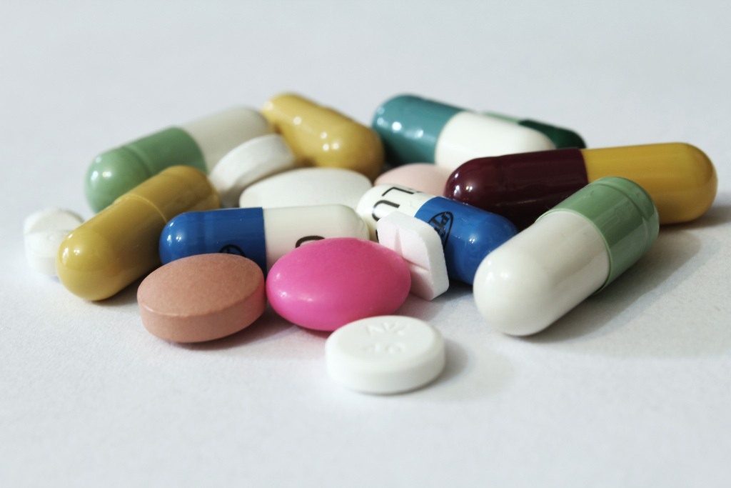
Image of Pills
(c) http://www.flickr.com/photos/emagineart/4742089272/

Slide 80
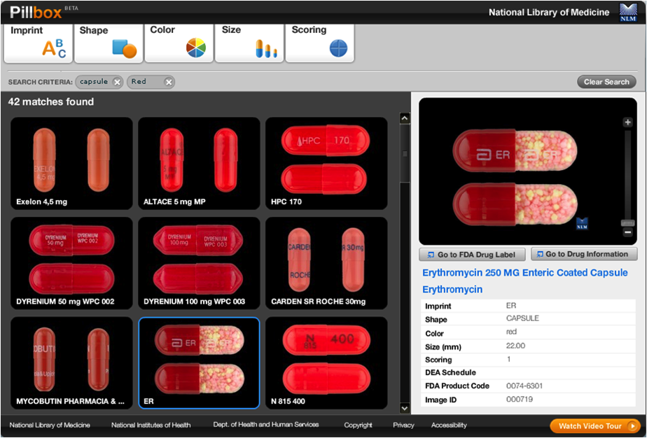
Pillbox Screenshot
http://pillbox.nlm.nih.gov/

Slide 81
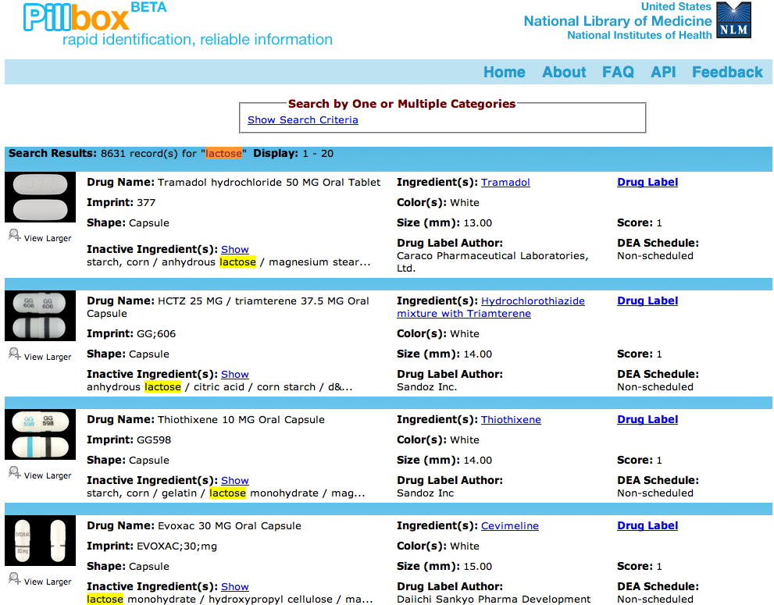
Pillbox Screenshot
http://pillbox.nlm.nih.gov/

Slide 82
Pillbox API Search Parameters
Physical appearance
Imprint, Color, Shape, Size, Score
Drug Name/Ingredients
Inactive ingredients
NDC9 (National Drug Code)
DEA schedule
Manufacturer/Distributor
RXCUI (RxNorm Concept Unique Identifier)

Slide 83
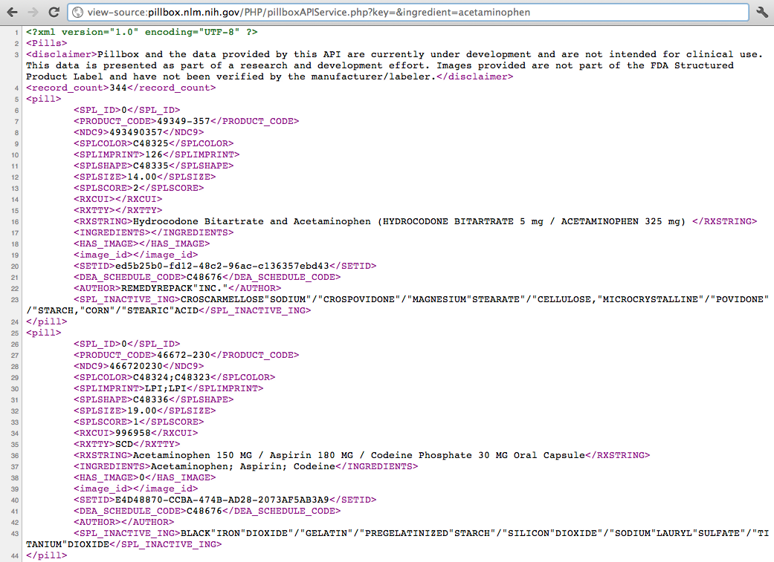
Pillbox Sourcecode
http://pillbox.nlm.nih.gov/API-documentation.html

Slide 84
Additional Info Returned
Normalized drug name
Search other drug info databases
SETID
link to drug label at DailyMed

Slide 85
Image of Pill

Slide 86
Image of “Key” Sculpture
(c) http://www.flickr.com/photos/wneuheisel/3923470620/

Slide 87
pillbox.sql

Slide 88
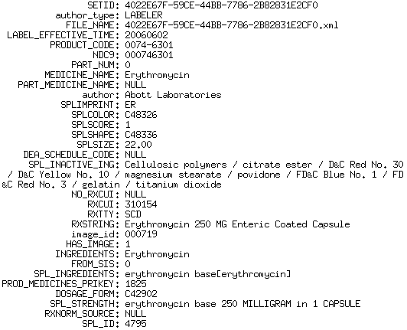
Example of Erythromycin record

Slide 89
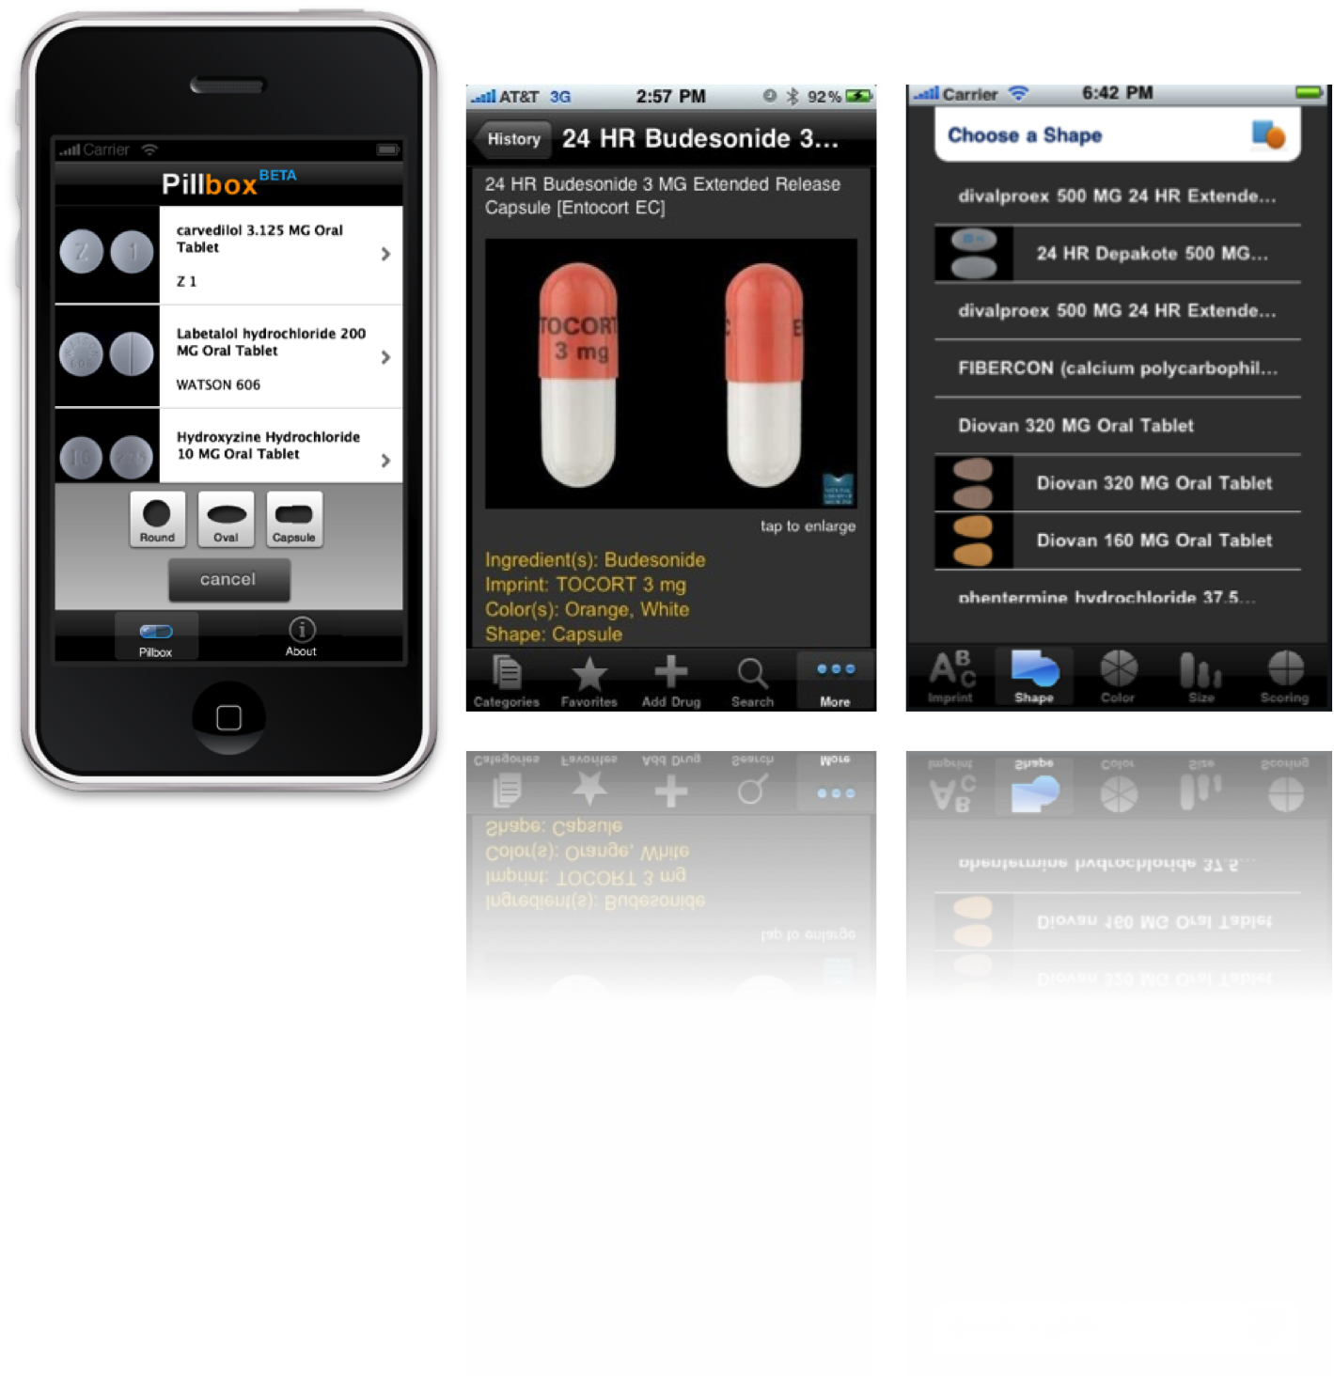
Image of Pillbox iOS App

Slide 90
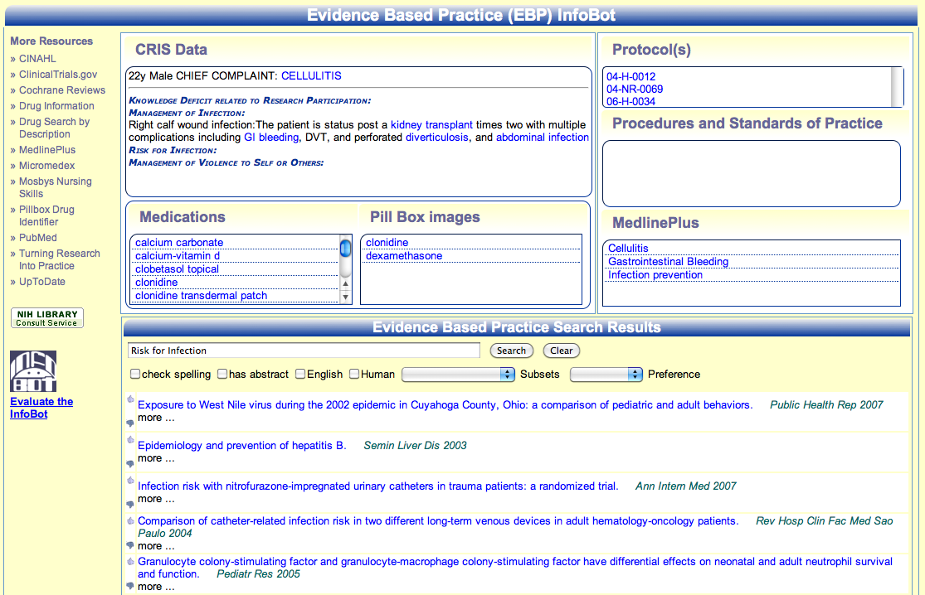
Image of EBP InfoBot

Slide 91
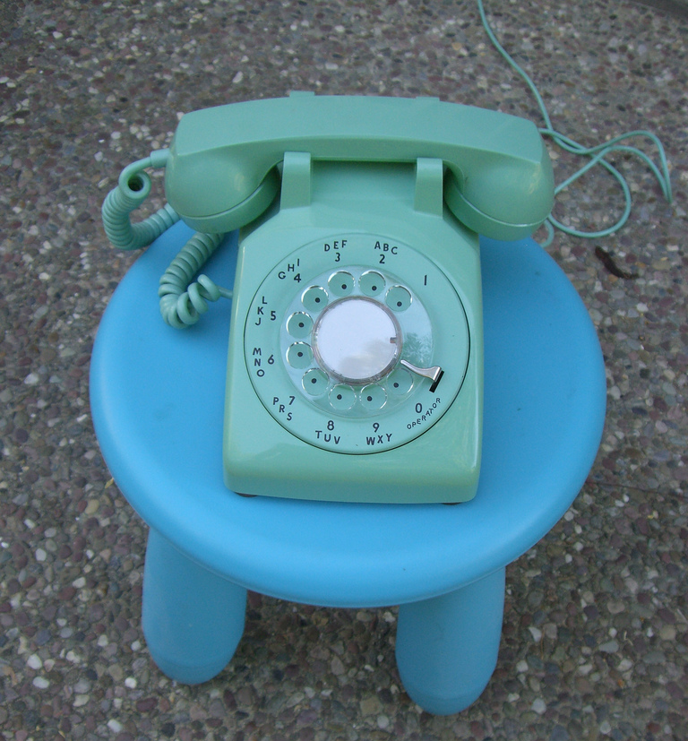
Image of a rotary phone
(c) http://www.flickr.com/photos/tornatore/2712409712/

Slide 92
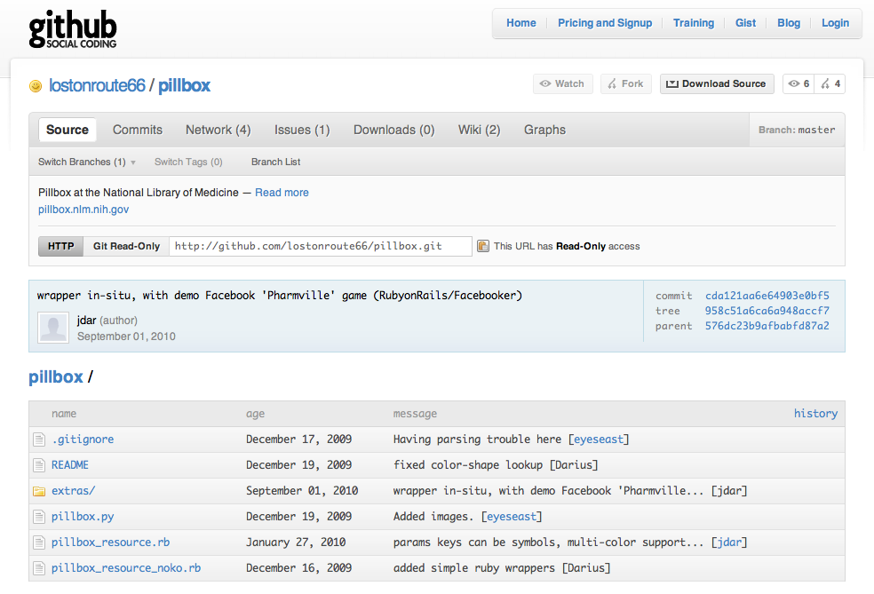
Github coding for Pillbox
https://github.com/lostonroute66/pillbox

Slide 93
NLM API Portal www.nlm.nih.gov/api Pillbox pillbox@mail.nih.gov
David Hale
Pillbox Project Manager
david.hale@nih.gov

Slide 94
NLM API Overview Chart
Notes:
MAP – MODERATOR and USER – single sided regular paper

Slide 95
ClinicalTrials.gov
by
Nicholas Ide

Slide 96
ClinicalTrials.gov: Overview
Registry and results database of clinical studies conducted around the world
More than 126,000 studies
Updated daily, new studies and updates
Sponsors required by law to submit information
Summary information on protocol
Basic results for some studies
No patient level information
Information is as provided by sponsors
(Sanity checking by NLM)

Slide 97
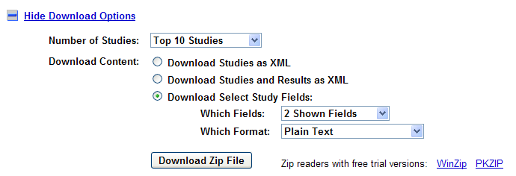
ClinicalTrials.gov: Interactive
Download options - link at bottom of search results.
retrieve entire XML for all studies
retrieve selected fields either in XML or tab delimited format

Slide 98
ClinicalTrials.gov: Searches

Slide 99
ClinicalTrials.gov: XML Output

Slide 100
Sample XLM Output
<?xml version="1.0" encoding="UTF-8" ?>
<search_results count="375">
<query>lupus [ALL-FIELDS]</query>
<clinical_study>
<order>11</order>
<score>0.96813</score>
<nct_id>NCT01498406</nct_id>
<url>http://ClinicalTrials.gov/show/NCT01498406</url>
<title>Vitamin D Status, Disease Specific and Quality of Life Outcomes in Patients With Cutaneous Lupus</title>
<status open="Y">Recruiting</status>
<condition_summary>Cutaneous Lupus Erythematosus</condition_summary>
<last_changed>January 3, 2012</last_changed>
</clinical_study>
<clinical_study>
<order>12</order>
<score>0.96805</score>
<nct_id>NCT00222183</nct_id>
<url>http://ClinicalTrials.gov/show/NCT00222183</url>
<title>Cutaneous Lupus Erythematosus and Elidel</title>
<status open="Y">Recruiting</status>
<condition_summary>Lupus Erythematosus, Cutaneous; Lupus Erythematosus, Discoid</condition_summary>
<last_changed>April 5, 2007</last_changed>
</clinical_study>
…
Sample XML Output

Slide 101
ClinicalTrials.gov: ZIP file

Slide 102
ClinicalTrials.gov: Documentation
Background information
http://clinicaltrials.gov/ct2/info
Various ways to get XML
http://clinicaltrials.gov/ct2/info/linking#xml
FAQ
http://www.nlm.nih.gov/services/faqctgov.html
Help on search syntax
http://clinicaltrials.gov/ct2/help/help
Questions ?
Email: register@clinicaltrials.gov

Slide 103
NLM API Overview Chart
Notes:
MAP – MODERATOR and USER – single sided regular paper

Slide 104
MetaMap
Named-entity recognition
by
Francois Lang

Slide 105
MetaMap
Research application
Named-entity recognition
Identify UMLS concepts in input text
Knowledge-intensive approach
Natural Language Processing (NLP)
Can restrict results to
Clinical Drugs
Disease/Syndromes
Chemicals
Sign/Symptom, etc.

Slide 106
2011 Frequency of Use
> 150,000 website requests
124 countries
> 1,000 application downloads

Slide 107
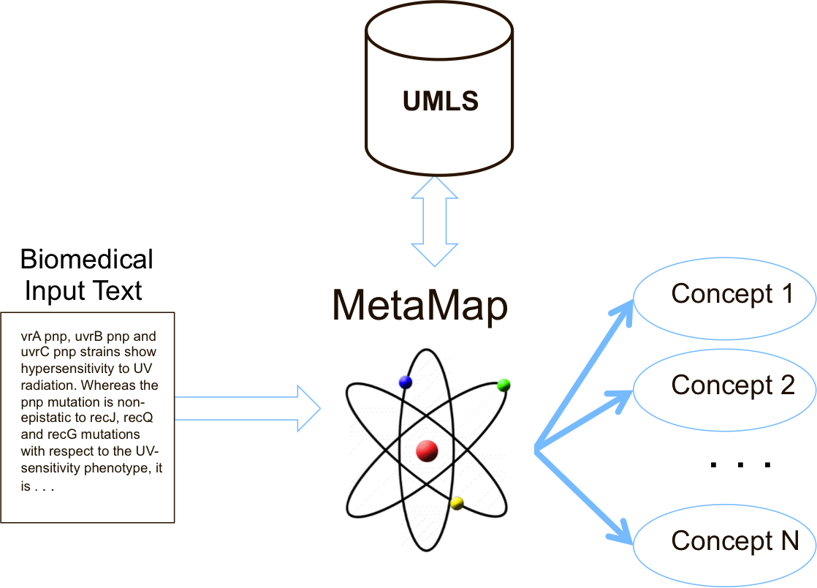
High-Level Architecture

Slide 108
MetaMap Processing Examples
Input: Heart attack
Output: Myocardial Infarction
Input: Pain on the left side of the chest
Output: Left sided chest pain

Slide 109
MetaMap Requirements
Linux, MacOS, or Windows
Our website for Internet access
UMLS Terminology Services (UTS) License:
http://www.nlm.nih.gov/databases/umls.html#license_request

Slide 110
For More Information…
http://metamap.nlm.nih.gov
http://skr.nlm.nih.gov
metamap@nlm.nih.gov

Slide 111
Sample Challenge Question
A personal health record (PHR) system displays the list of medications prescribed to a patient based on the proprietary drug vocabulary Micromedex RED BOOK (code 111574).
You want to enrich the system with drug information for patients

Slide 112
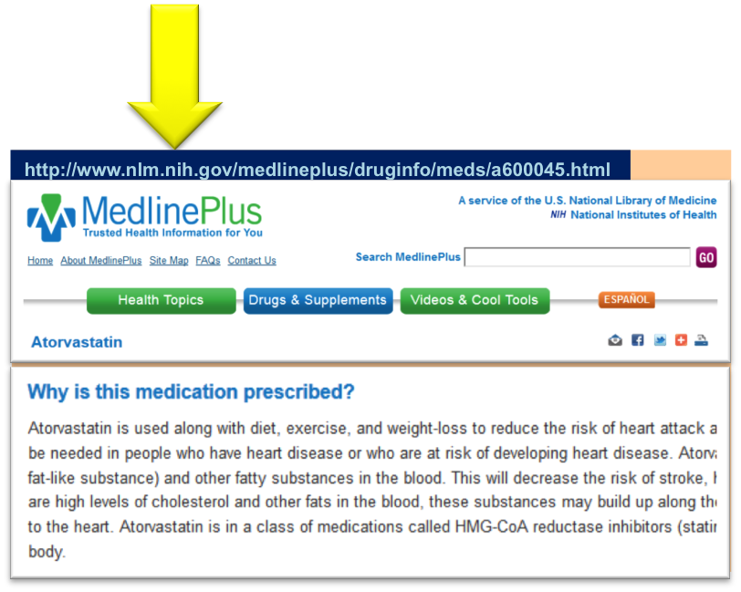
Sample Challenge Question
A personal health record (PHR) system displays the list of medications prescribed to a patient based on the proprietary drug vocabulary Micromedex RED BOOK (code 111574).
You want to enrich the system with drug information for patients.

Slide 113
NLM API Overview Chart
Notes:
MAP – MODERATOR and USER – single sided regular paper

Slide 114
RxCUI in MedlinePlus Connect

Slide 115
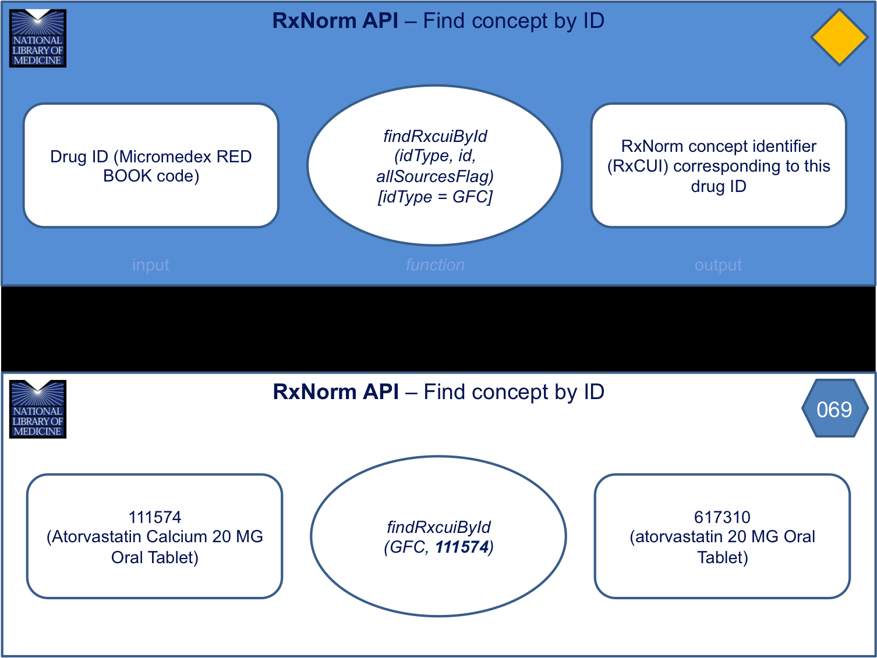
RxNorm API – Find concept by ID

Slide 116
MedlinePlus Connect API – Get MedlinePlus information for a drug

Slide 117
Solution

Slide 118
NDF-RT API & RxNorm API

Slide 119
Up Next…

Slide 120
NLM API Overview Chart
Notes:
MAP – MODERATOR and USER – single sided regular paper

Slide 121
Up Next…

Slide 122
Answers to Challenge Questions

Slide 123
Scenario 1
Notes:
MODERATOR PACKAGE- regular paper single sided

Slide 124
Scenario 2 Part A
Notes:
MODERATOR PACKAGE- regular paper single sided

Slide 125
Scenario 2 Part B 1
Notes:
MODERATOR PACKAGE- regular paper single sided

Slide 126
Scenario 2 Part B 2
Notes:
MODERATOR PACKAGE- regular paper single sided

Slide 127
Scenario 2 Part B 3
Notes:
MODERATOR PACKAGE- regular paper single sided

Slide 128
Scenario 3 Part A
Notes:
MODERATOR PACKAGE- regular paper single sided

Slide 129
Scenario 3 Part B
Notes:
MODERATOR PACKAGE- regular paper single sided

Slide 130
Scenario 3 Part C
Notes:
MODERATOR PACKAGE- regular paper single sided

