Slide 1

COMMERCIAL CREW PROGRAM
COMSTAC May 2011
E. Mango
Commercial Crew Program Manager
May 2011

Slide 2

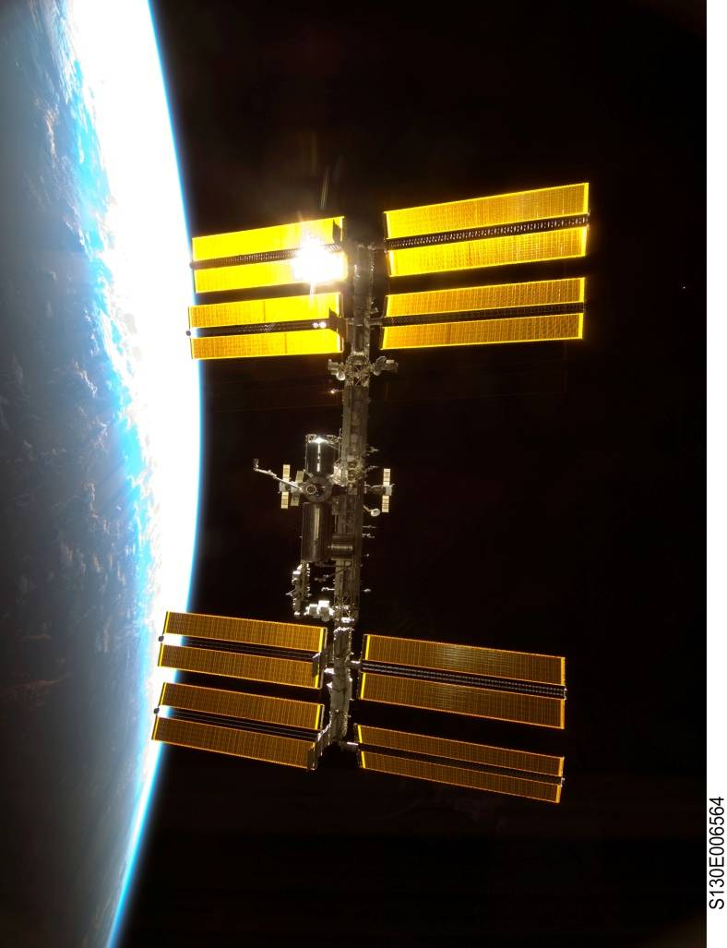
Program Approach
Fiscal Year
2011 | 2012 | 2013 | 2014 | 2015 | 2016 | 2017 | 2018 | 2019 | 2020
Demo/Test Flights
Commercial Crew
Initial Design
Critical Design
Certification
Missions
The 2010 NASA Authorization Act established commercial crew as the primary means for ISS crew transportation.
The program objective is to facilitate the development of a U.S. commercial crew space transportation capability for achieving safe, reliable, and cost effective access to and from LEO and the International Space Station (ISS) by late 2016.
  Use a non-traditional acquisition and partnering approach
  Competition is a fundamental aspect of the strategy
  NASA could purchase commercial services to meet its ISS crew transportation needs

Slide 3
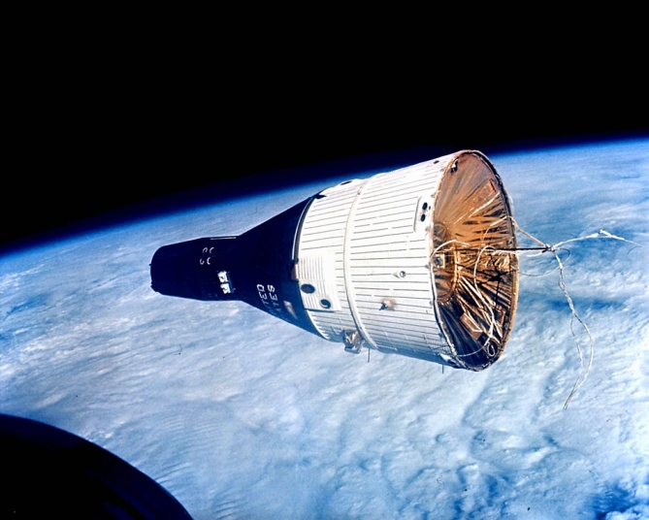
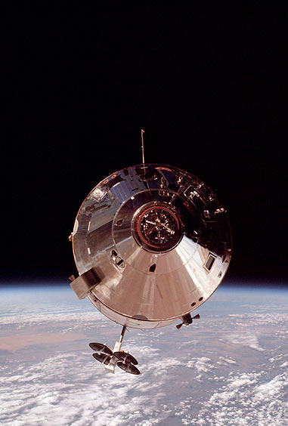
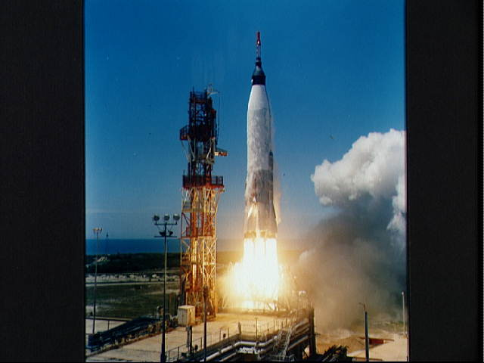
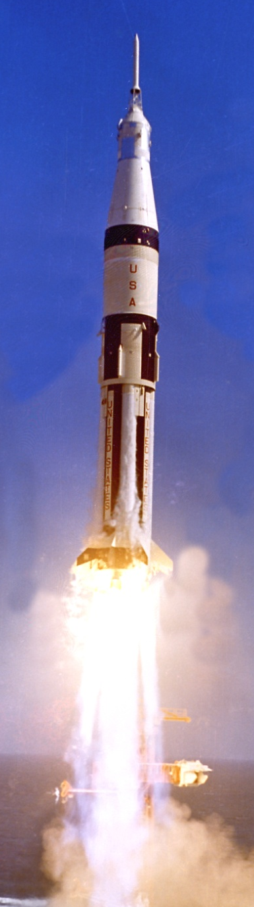
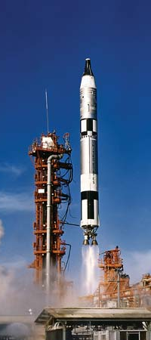
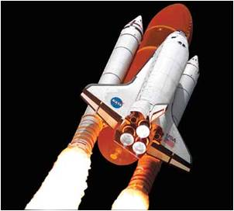
Commercial Crew Program (CCP)
CCP is leading NASA’s efforts to develop an American-made commercial capability for crew transportation and rescue services to the station following this year's retirement of the space shuttle fleet.
  Kennedy Space Center will host the program office dedicated to enabling commercial human spaceflight capabilities.
  Program Manager will reside at KSC
  Deputy Program Manager located at JSC
Program Mission
  Manage the investment in the development of end-to-end transportation systems
  Manage the CTS (Crew Transportation System) certification process
  Lead the technical and programmatic partner integration and approval functions

Slide 4
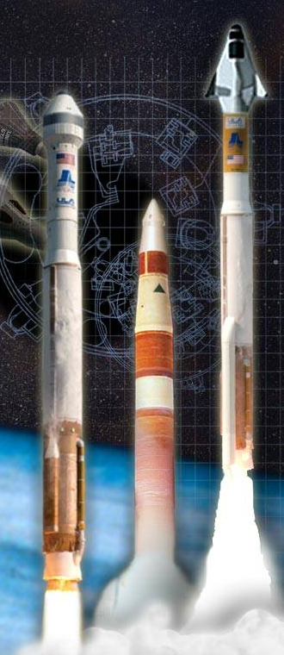

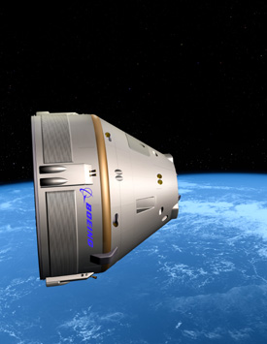

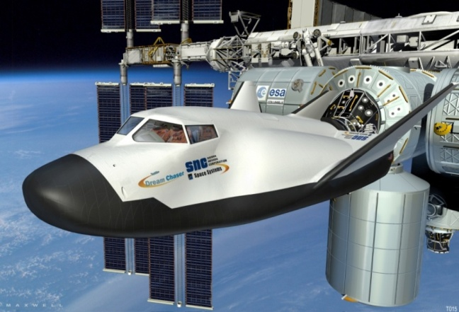


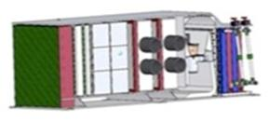
Commercial Crew Development
Phase 1 Initial Design Concepts

Slide 5
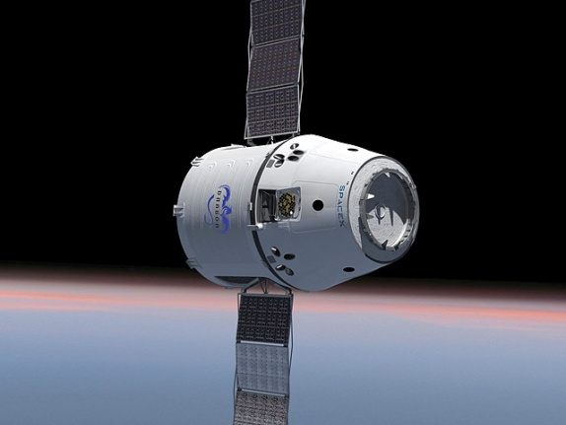
Commercial Crew Development
Phase 2 Maturing Design Elements

Slide 6


Slide 7
FAA Collaboration
  NASA/FAA collaboration is already underway
    Rotational assignment for CCP representative at FAA headquarters
    FAA representative at CCP Office at KSC
    Supporting the planning for the FAA/AST Technical Center at KSC
    NASA is supporting FAA definition of regulations for crew and participant safety
    FAA is participating in CCP safety certification requirements development
    Both Agencies are ensuring compatibility between NASA requirements and FAA regulations
    FAA participates in CCP milestone reviews

Slide 8
Agency Missions
Differing Agency missions lead to different priorities and approaches
  NASA:
    Customer and Partner for Design, Certification and Services
    Responsibility for the safety of its crews
    Mission success requirements beyond crew safety
  FAA:
    Regulator Agency
    Promotes new, broad and varied industry interests
    Must allow the industry to develop
    Current focus on the safety of public and spacecraft occupants

Slide 9
Role of FAA Licensing
FAA Licensed missions for CCP is desired state
  NASA and FAA must ensure public safety and crew safety are balanced
  Collaboration efforts in full swing between CCP and FAA/AST
  Requires verification that FAA regulations are compatible with NASA requirements
  Development of criteria for ensuring safe and smooth licensing approach
Must involve collaboration between NASA and the FAA to enable licensing of launches and entries that:
  Facilitates appropriate allocation of liability/risk between Government and Commercial Partner (CP)
  Eliminates duplicate and conflicting Government requirements imposed on CP
  Takes maximum advantage of both NASA and FAA knowledge and experience

Slide 10
Guiding Considerations
Assurance of Public Safety and Crew Safety for NASA-contracted missions must be preserved
  Controls (regulatory or contractual) must provide an effective balance between crew safety and protecting the public
  NASA is accountable for crew safety
  NASA/FAA will work with the Range and the CP for the appropriate range safety capabilities while working to balance any flight-related risks to crew safety
  Criteria for FAA license will be determined and accepted by each Agency
Liability protection for commercial providers can be accommodated either by FAA licensing or NASA contract mechanisms

Slide 11

Program Roadmap
A continued strong NASA and FAA relationship is paramount for all CCP missions. For all missions:
  NASA collaborates with FAA to transfer knowledge, build expertise, and share resources
  Approach includes increasing FAA Licensing authority
Development/Test Missions
ISS Services Missions
Transportation to/from LEO
  NASA develops contractual requirements for certification
  NASA supports FAA development and evolution of regulations
  Compatibility between Public Safety and Crew Safety
Hybrid
Approach
FAA Licensed
Launch/Entry
NASA CTS Certification
Timing of FAA License approach based on Criteria :
  Collaboration between NASA and FAA critical to defining Criteria for initial Test and Service Missions

Slide 12
Advantages/Challenges
Advantages
Planned approach balances Government obligations with advantages to CPs
Supports goal to achieve safe commercial human space flight
Enables earliest opportunity for FAA license while meeting all safety obligations
Minimizes duplication of processes without compromising crew or public safety
Draws on available Government skills and expertise, regardless of policy and regulatory approach
Challenges
Licensing approach criteria will need close and diligent collaborate
Timeframe for FAA regulations governing crew/participant safety
Mixed-NASA Crews must also be fully endorsed by the approach

Slide 13

Summary
NASA and the FAA are committed to collaborating on a unified approach to ensuring public and crew safety
  NASA/FAA already established working relationship and developing MOA
  NASA/FAA are striving for compatibility between NASA requirements and FAA regulations
NASA and the FAA are discussing a overall licensing approach in support of the Program Roadmap
Together, NASA and the FAA will enable FAA licensing for NASA crew and non-NASA transportation launches and entries in support of mature Commercial Human Space Flight Operations

