Slide 1
Airport Management Jane Dale Executive Director Alaska Airports Association

Slide 2
Alaska Airports Association
The first state-wide Airport Association in Alaska.
The Association relies on membership dues, revenue from education classes, sponsorships, and volunteer efforts for operation.
Current Membership is over 100.

Slide 3
AkAA’s Goal:
Bring individuals interested in airports and airport management together
Support and Create Education Opportunities
Encourage the Publics Understanding and Value of Airports
Support Improvements to Airports

Slide 4
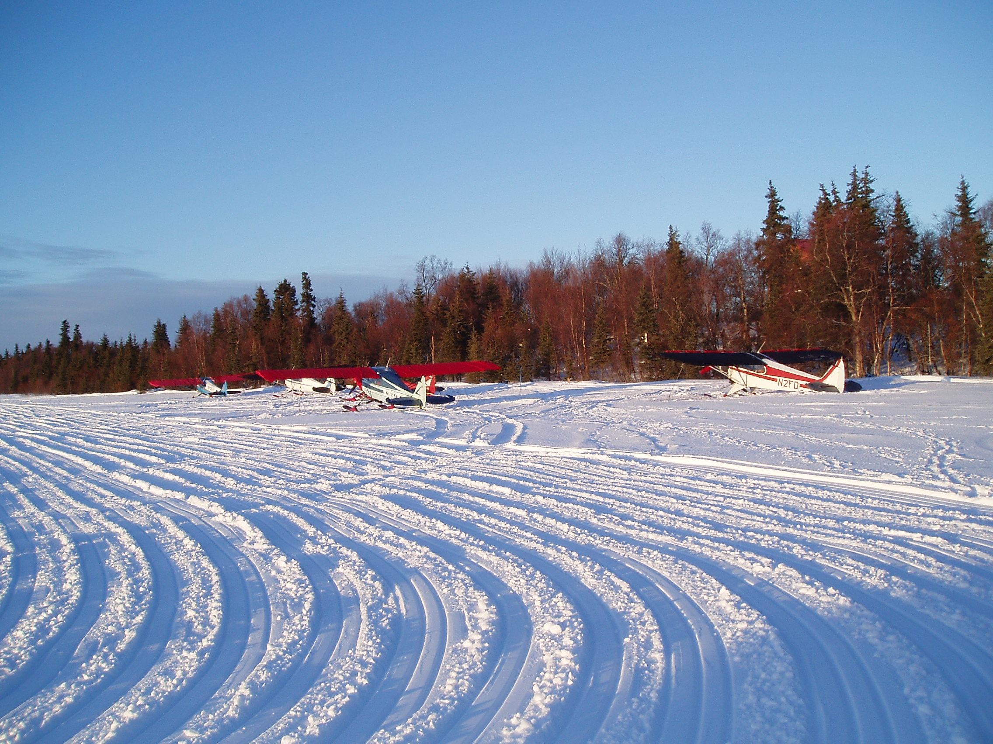
Private Airports
Education Opportunities:
The membership identified Airport Management Issues and AkAA developed workshops.

Slide 5
Alaska Airports Association
Issues:
Community Land Use Planning
Airport Operations
Tall Structures/Towers
Neighbour and tenant relations
Leasing Issues
Airport Operation Costs and Adequate Budgets

Slide 6
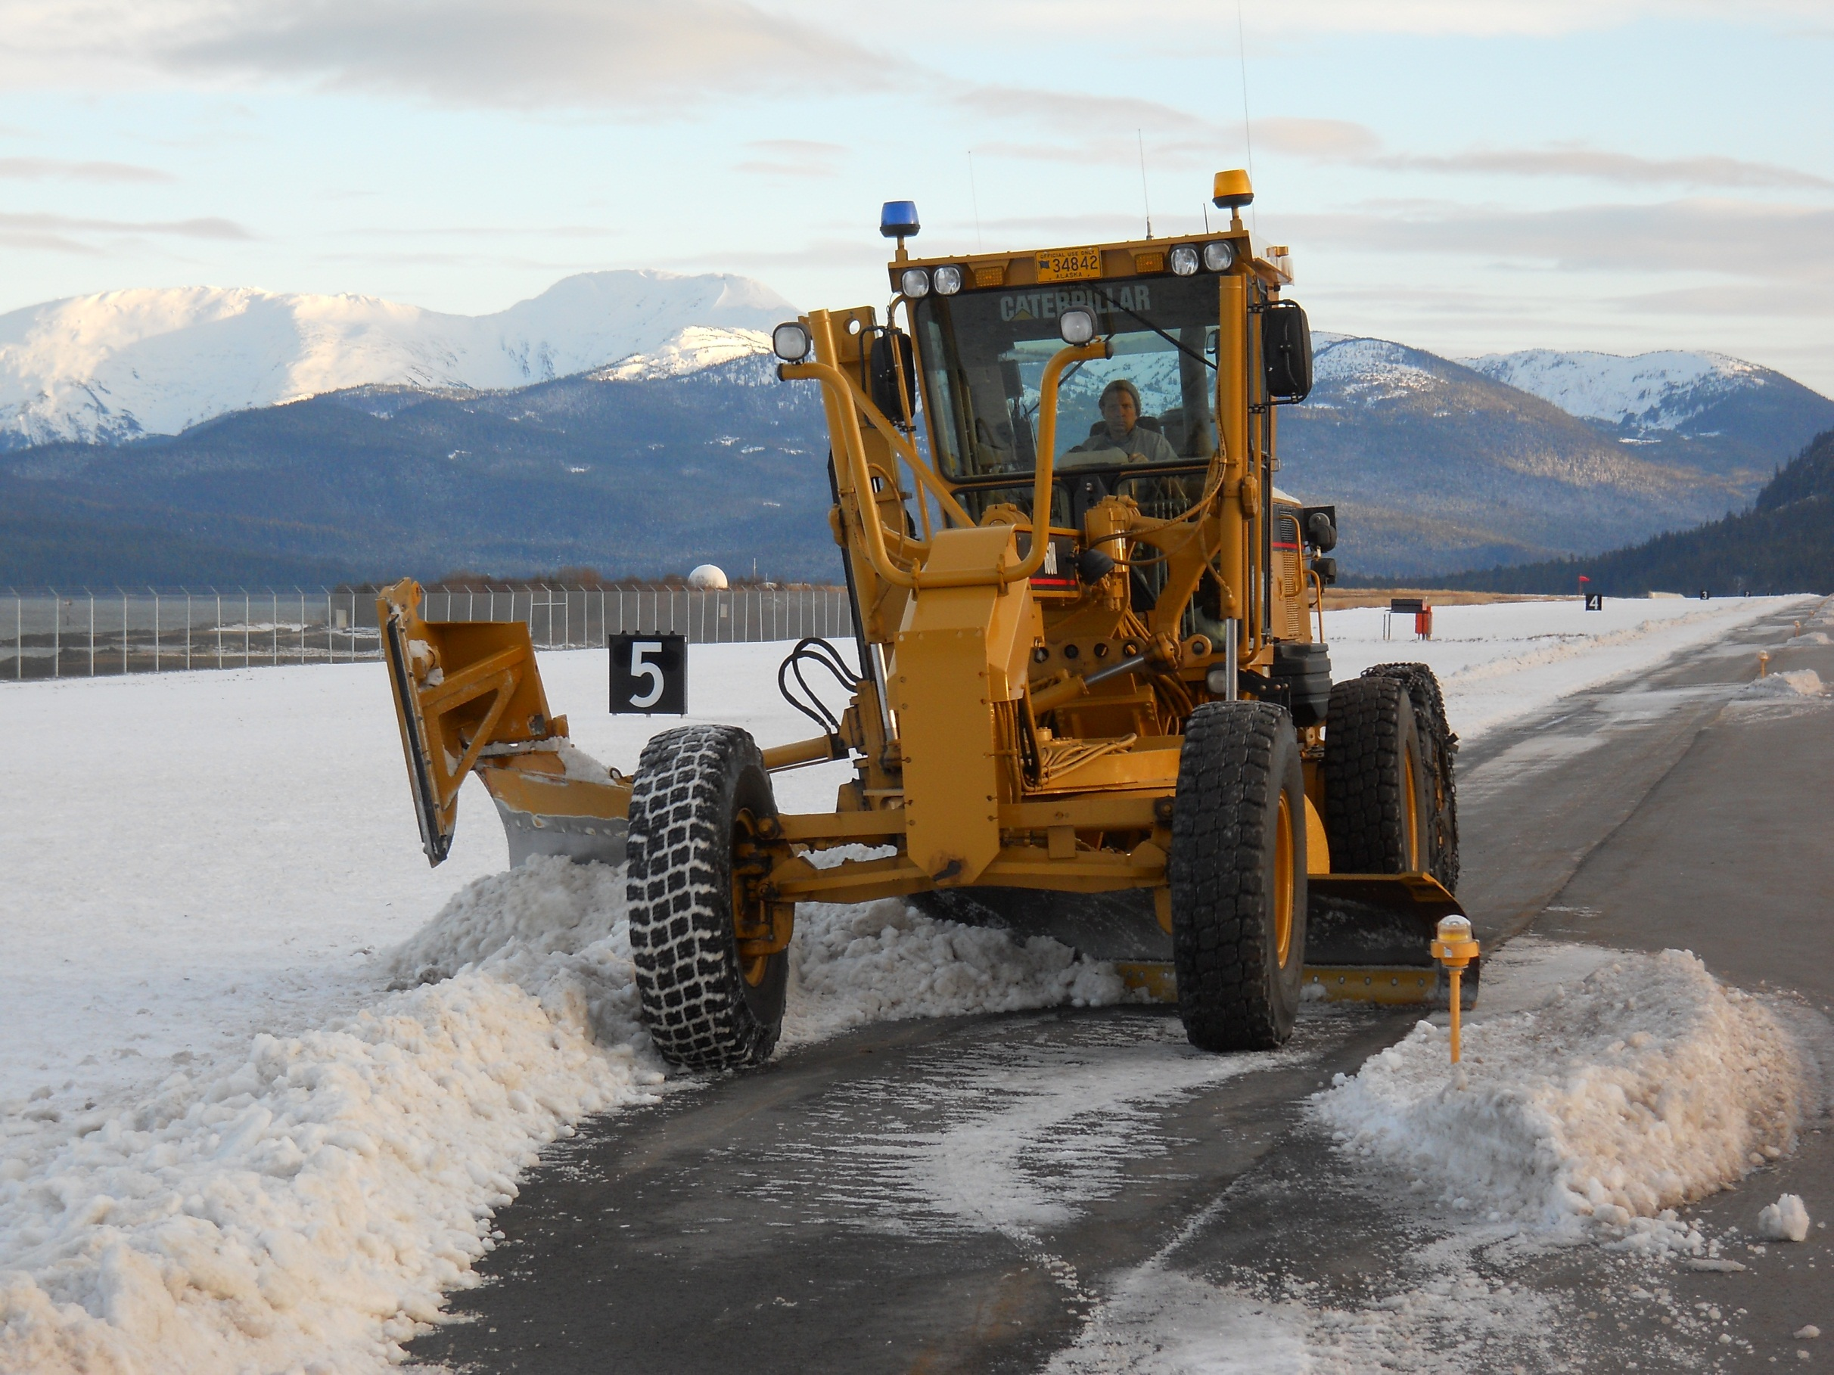
The Alaska Airports Operation Practicum

Slide 7
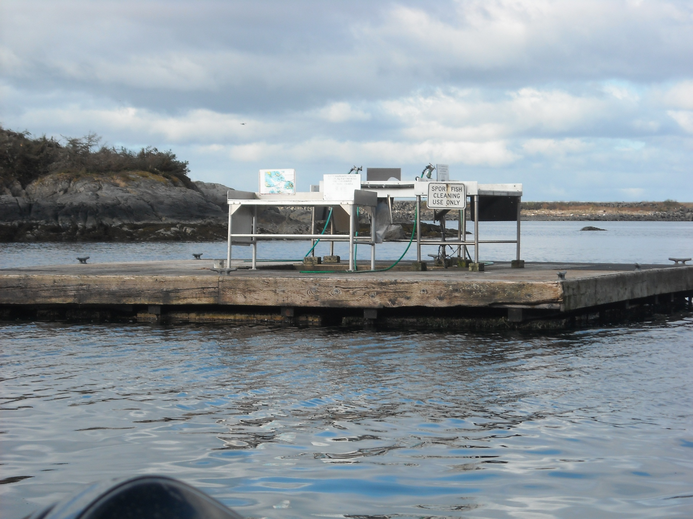
Compatible Off Airport Land Use

Slide 8
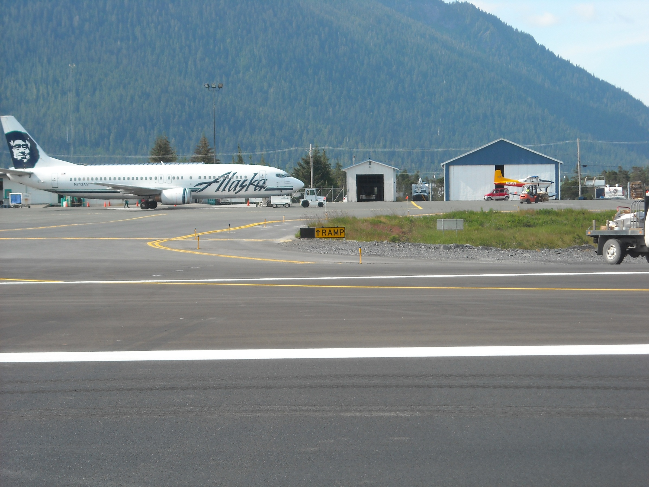
Property Management Workshop

Slide 9
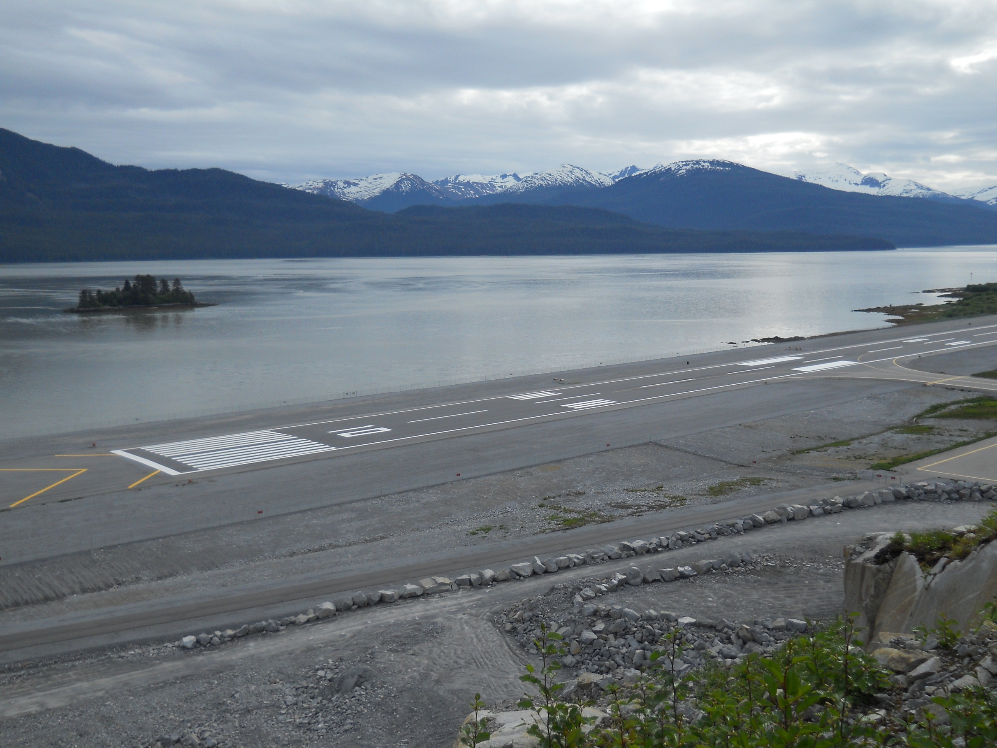
p
Strategic Planning

Slide 10
Alaska Airports Association
Future Classes:
June 27,28 &29
Basic Airport Management
July 30 – Aug 2
Alaska Airport Operation Practicum I (2.5 day)
Safety Management Systems (1 day)
October 2-5
Alaska Airport Operation Practicum II – (2 days)
Grant Assurances – (1 day)
Compatible Off-Airport Land Use – (1 day)

Slide 11
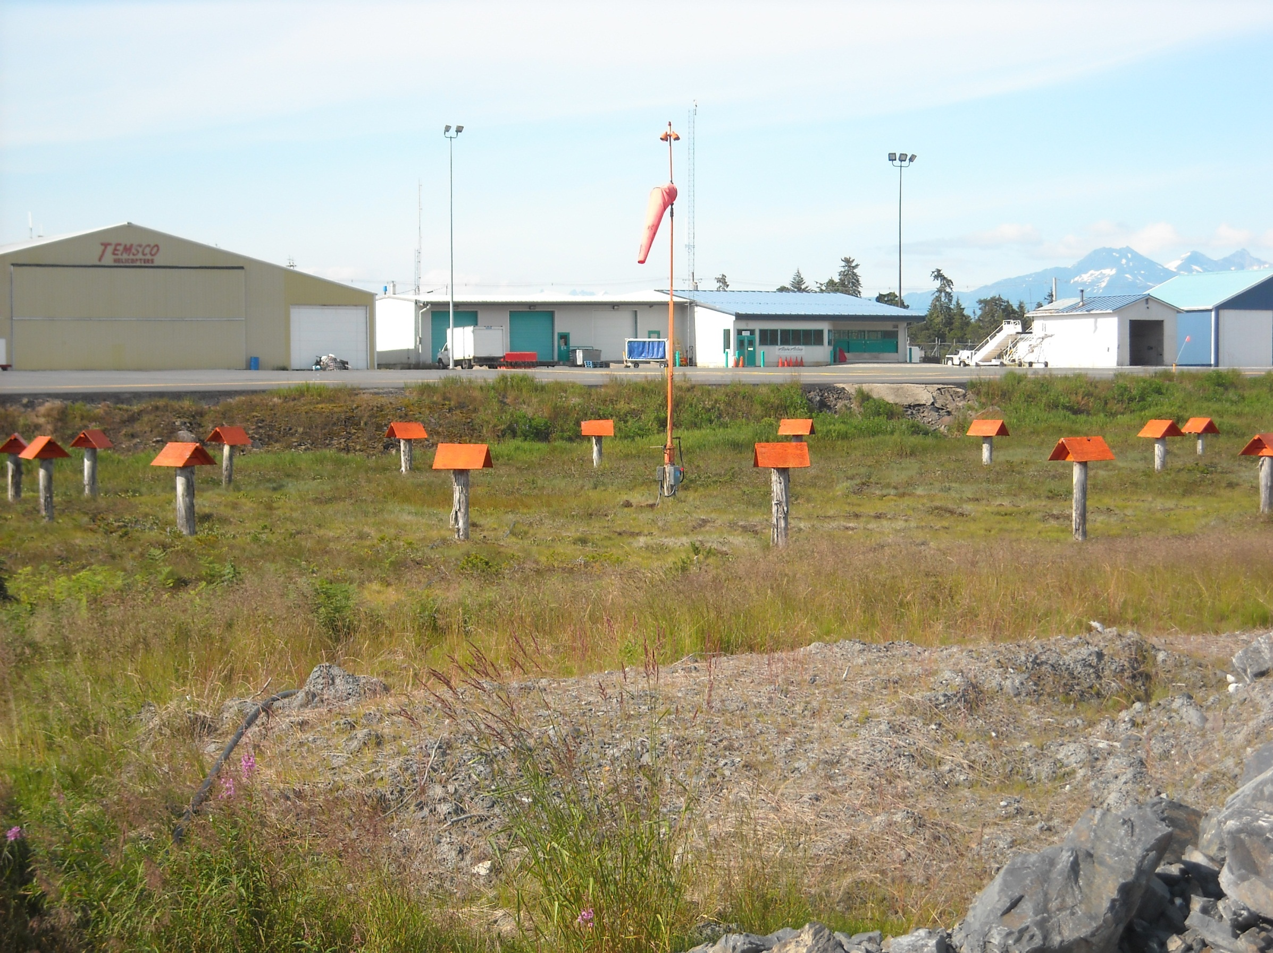
http://www.surveymonkey.com/s/MJLBCFL
To Contact us visit, www.akairports.org
Link to AkAA Education Survey:

