Slide 1
National Information Center on Health Services Research & Health Care Technology
National Library of Medicine
Webinar Part II
HTA-CER-PM-PCOR: Converging on What Works for Patients
September 7, 2011
Clifford Goodman, PhD
The Lewin Group
Falls Church, Virginia USA
clifford.goodman@lewin.com
1

Slide 2
Main Topics
Health technology assessment (HTA)
Comparative effectiveness research (CER)
Personalized medicine (PM)
Patient-centered care
Patient-centered outcomes research (PCOR)
Implications of the convergence
2

Slide 3
What Is Health Technology Assessment?
HTA is the systematic evaluation of properties, effects, or other impacts of health care technology.
The main purpose of HTA is to inform policy making for technology in health care.
HTA may address the direct and intended consequences of technologies, as well as the indirect and unintended consequences of technologies.
HTA is conducted by interdisciplinary groups.
HTA uses explicit analytical frameworks and a variety of methods.
3

Slide 4
Properties and Impacts Assessed by HTA
Main categories:
Technical properties
Safety
Efficacy and effectiveness
Cost and other economic attributes
Social, legal, ethical, or political impacts
4

Slide 5
Efficacy vs. Effectiveness
Efficacy
Benefit of using a technology for a particular health problem in ideal conditions of use, for example, in a strict protocol of a randomized controlled trial or at a “center of excellence.”
Effectiveness
Benefit of using a technology for a particular health problem in general or routine conditions of use, for example, in a community hospital.
5

Slide 6
Measuring Efficacy/Effectiveness
Health outcomes/endpoints (“benefits” and “harms”)
  mortality
  morbidity
  adverse events
Quality of life, also:
  functional status
  patient satisfaction
Intermediate (including surrogate*) endpoints
  e.g., blood pressure, lab values, EKG, (“biomarkers”)
Accuracy of tests (screening, diagnosis, monitoring)
  sensitivity
  specificity
  predictive value positive, negative
*True surrogate: highly, reliably predictive of health outcomes

Slide 7
Three Main Groups Of Methods
Primary data collection
  Collect original data, for example, using clinical trials or observational studies (prospective or retrospective)
Secondary / integrative analyses
  Combine (synthesize or integrate) data from existing sources
Economic analyses
  Weighing costs and benefits (outcomes or other results)
7

Slide 8
Why Comparative Effectiveness Research?
Evidence of inappropriate use of health care technologies, including over-use, under-use, and improper use
Evidence of large variations in practice
Evidence for FDA market approval/clearance often not sufficient to support clinical and policy decisions; typically:
  More about efficacy than effectiveness
  Excludes priority populations (elderly, multiple co-morbidities, etc.), active comparator, and ability to conduct subgroup analyses
Inconsistent, insufficiently rigorous evidence for many technologies not regulated by FDA (e.g., surgical procedures)
Lack of evidence on “head-to-head” comparisons of alternative interventions for particular health problems
Lack of evidence in “real-world” practice (efficacy vs. effectiveness)
Continued rapid increases in health care costs
8

Slide 9
Strength of Evidence Summary for Radiation Treatments of Clinically Localized Prostate Cancer
Comparisons | Freedom from biochemical (PSA) failure | Disease specific survival | GU/GI Toxicity
RT vs NT | Insufficientª | Insufficient^{b} | Insufficient^{c}
SBRT vs EBRT | Insufficientª | Insufficientª | Insufficientª
SBRT vs HDRBT | Insufficientª | Insufficientª | Insufficientª
SBRT vs LDRBT | Insufficientª | Insufficientª | Insufficientª
EBRT vs HDRBT | Insufficientª | Insufficientª | Insufficientª
EBRT vs LDRBT | Insufficient^{b} | Insufficient^{c} | Insufficient^{b}
LDRBT vs HDRBT | Insufficient^{c} | Insufficient^{c} | Insufficient^{c}
Comb. RT modalities | Insufficient^{c} | Insufficient | Insufficient^{d}
Intra SBRT | Insufficient^{c} | Insufficient | Insufficient^{c}
Intra EBRT | Moderate^{e} | Insufficient^{c} | Moderate^{e}
Intra LDRBT | Insufficient^{f} | Insufficient^{c} | Insufficient^{b}
BT: brachytherapy; RT: radiation therapy; NT: no (or no initial) treatment; EBRT: external beam RT; HDRBT: high dose rate BT; LDRBT: low dose rate BT; SBRT: stereotactic body RT; GU: genitourinary; GI: gastrointestinal
ªNo study available; ^{b}Results inconsistent across studies; ^{c}Only one study; ^{d}Predominantly C quality studies; ^{e} >2 B quality RCTs that reported similar results (significant difference or no difference); ^{f}Only 1 RCT + 1 retrospect. study.
Source: Tufts Evidence-based Practice Center. Radiation Therapy for Localized Prostate Cancer: An Update. Prepared for AHRQ. Aug. 13, 2010. Data presented to MEDCAC, April 21, 2010.

Slide 10
Main Attributes of CER
Direct (“head-to-head”) comparisons of alternative interventions (as opposed to comparison with placebo or indirect comparisons)
Applies to all types of interventions
  pharma, biotech, devices/equip’t, medical and surgical procedures; organization, delivery, management, financing
Effectiveness (in realistic health care settings) rather than efficacy (in ideal circumstances)
Emphasizes health care outcomes (e.g., morbidity, mortality, symptoms, QoL, adverse events) rather than intermediate/surrogate endpoints
Enables subgroup analyses to yield findings for particular patient groups, including priority populations
No (US) consensus regarding role of economics
10

Slide 11
What Is CER? – FCCCER (1)
Comparative effectiveness research is the conduct and synthesis of research comparing the benefits and harms of different interventions and strategies to prevent, diagnose, treat and monitor health conditions in “real world” settings. The purpose of this research is to improve health outcomes by developing and disseminating evidence-based information to patients, clinicians, and other decision-makers, responding to their expressed needs, about which interventions are most effective for which patients under specific circumstances.
Source: Federal Coordinating Council for Comparative Effectiveness Research. Report to The President and The Congress. June 2009.
11

Slide 12
What Is CER? – FCCCER (2)
To provide this information, comparative effectiveness research must assess a comprehensive array of health-related outcomes for diverse patient populations and subgroups.
Defined interventions compared may include medications, procedures, medical and assistive devices and technologies, diagnostic testing, behavioral change, and delivery system strategies.
This research necessitates the development, expansion, and use of a variety of data sources and methods to assess comparative effectiveness and actively disseminate the results.
Source: FCCCER 2009.
12

Slide 13
What Is CER? - IOM
[T]he generation and synthesis of evidence that compares the benefits and harms of alternative methods to prevent, diagnose, treat, and monitor a clinical condition or to improve the delivery of care.
The purpose of CER is to assist consumers, clinicians, purchasers, and policy makers to make informed decisions that will improve health care at both the individual and population levels.
CER’s distinguishing characteristics include informing a specific clinical or policy decision, comparing at least two approaches or interventions, describing results at the subgroup level, measuring benefits in real-world populations, and applying appropriate methods and data sources.
Source: Institute of Medicine. Initial National Priorities for Comparative Effectiveness Research, 2009.
13

Slide 14
Timeline to CER: Evolved, Not New
Pharmacoeconomics⁵
(1989)
Health Technology
Assessment²
(1974)
Coverage with
Evidence Development⁸
(2006)
Outcomes Research³
(1986)
Evidence-based
Medicine⁶
(1990)
1940
1970
1980
1990
2000
2010
1st Randomized
Control Trial¹
(1948)
Effectiveness Research⁴
(1988)
Comparative Effectiveness
Research⁷ (2003, 2009)
¹ RCT of streptomycin for pulmonary tuberculosis, sponsored by Medical Research Council (UK): 1948.
² Origin of TA (not focused on health) in 1965: US Congressman Daddario; first “experimental” HTA by National Academy of Engineering in 1969 (multiphasic screening); Office of Technology Assessment published first HTA in 1974
³ Patient Outcomes Assessment Research Program (later, PORTs) initiated by NCHSR (later renamed AHCPR; now AHRQ) in 1986 (“promote research with respect to patient outcomes of selected medical treatments and surgical procedures for the purpose of assessing their appropriateness, necessity and effectiveness “)
⁴ HCFA (later renamed CMS) Effectiveness Initiative: 1988
⁵ Early published appearance of “pharmacoeconomics”: Bootman et al. 1989
⁶ “Evidence-based”: Eddy 1990; “Evidence-based medicine”: Guyatt et al. 1992
⁷ Medicare Prescription Drug, Improvement, and Modernization Act of 2003 (MMA) specifies AHRQ role in “comparative clinical effectiveness”; American Recovery and Reinvestment Act of 2009 (ARRA) authorizes major national investment in CER
⁸ CMS draft guidance in 2005; formalized in 2006. Medicare and other payers began linking coverage to clinical research in 1990s
Source: C. Goodman © 2009 The Lewin Group

Slide 15
CER Methods “Toolkit” (Evolving)
Clinical Trials
Randomized clinical trials
Practical (pragmatic) clinical trials
Other non-randomized controlled trials
Adaptive clinical trials and other trial designs
Other, e.g., randomized consent, regression discontinuity, combined single-subject (“n of 1”) trials
Observational Studies (prospective or retrospective)
Population-based longitudinal cohort studies
Patient registries
Claims databases
Clinical data networks
Electronic health record data analyses
Post-marketing surveillance (passive and active)
Syntheses of Existing Evidence
Systematic reviews (comparative effectiveness reviews)
Meta-analyses
Modeling
15

Slide 16
Priority Conditions
Arthritis and nontraumatic joint disorders
Cancer
Cardiovascular disease, including stroke and hypertension
Dementia, including Alzheimer's disease
Depression and other mental health disorders
Developmental delays, attention-deficit hyperactivity disorder, and autism
Diabetes mellitus
Functional limitations and disability
Infectious diseases, including HIV/AIDS
Obesity
Peptic ulcer disease and dyspepsia
Pregnancy, including preterm birth
Pulmonary disease/asthma
Substance abuse
Source: Agency for Healthcare Research and Quality, 2010
16

Slide 17
Priority Populations, Health Disparities
Priority populations:
Racial and ethnic minorities
People with disabilities
Children
People with multiple chronic conditions
Elderly
Health disparities:
Significant gaps or differences in the overall rate of disease incidence, prevalence, morbidity, mortality, or survival rates in the priority population as compared to the health status of the general population
Source: Federal Coordinating Council for Comparative Effectiveness Research. Report to The President and The Congress. June 2009.
17

Slide 18


Slide 19
CER Strategic Framework
Source: FCCCER. Report to The President and The Congress. June 2009.
19

Slide 20

June 2009
20

Slide 22
What is Personalized Medicine?
Personalized medicine (PM) is the tailoring of medical care to the particular traits (or circumstances or other characteristics) of a patient that influence response to a heath care intervention. These may include genetic, sociodemographic, clinical, behavioral, environmental, and other personal traits, as well as personal preferences. PM does not refer to the creation of interventions that are unique to a patient, but the ability to classify patients into subpopulations that differ in their responses to particular interventions.

Slide 23
Examples of Personalized Medicine
CYP2C9 and VKORC1 genetic testing for warfarin anticoagulation response for patients with atrial fibrillation, mechanical heart valves, deep vein thrombosis, etc.
HER-2/neu receptor testing for trastuzumab for breast cancer
BRCA 1,2 testing for pharmaceutical and surgical prevention options for and surveillance for breast cancer
KRAS testing for use of EGFR inhibitors (e.g., cetuximab, panitumumab) for colon cancer
Alternative procedure techniques (gastric banding, gastric bypass, etc.) for bariatric (morbid obesity) surgery
23

Slide 24
Timeline: Getting to Personalized Medicine
Pharmacoeconomics
(1989)
1st RCT
(1948)
HTA
(1974)
Outcomes Research
(1986)
“Pharmacogenetics”
(1959)
CED
(2006)
EBM (1990)
1950
1960
1970
1980
1990
2000
2010
DNA Structure Described
(1953)
Genetic Code Cracked
(1967)
CYP450 Metabolic Enzymes Identified
(1977)
Effectiveness Research
(1988)
Human Genome Sequenced
(2003)
CER
(2003, 2009)
Source: C. Goodman © 2009 The Lewin Group

Slide 25
Incorporating PM Into National CER Priorities
In top tier of IOM’s CER priorities:
Compare the effectiveness of genetic and biomarker testing and usual care in preventing and treating breast, colorectal, prostate, lung, and ovarian cancer, and possibly other clinical conditions for which promising biomarkers exist.
Source: Institute of Medicine. Initial National Priorities for Comparative Effectiveness Research, 2009.

Slide 26
CER and PM: Contradiction?
CER has been largely oriented toward population-based evaluations and applications. In contrast, PM focuses on using individuals’ genomic information and other personal traits to inform their health care decisions.

Slide 27
The Trouble With Averages
Like other forms of evaluation of health care interventions, CER generally has focused on identifying interventions that are effective, on average, across a broad patient population. However,
  Interventions that yield a statistically significant treatment effect across a study population may not necessarily work for all treated patients; they may be ineffective for some patients and harmful for others.
  Interventions that do not yield a statistically significant treatment effect across a study population―and that may be dismissed as ineffective―may work for certain subsets of the population.

Slide 28
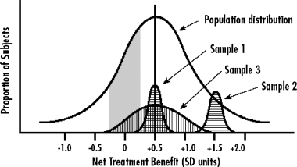
Heterogeneity of Treatment Effects
Distribution of individual treatment effects in the population (large unshaded curve) and in three hypothetical samples (shaded curves)
Sample 1 is centered but fails to reflect the diversity of the population in terms of net treatment benefit. Sample 2 is composed of individuals who happen to derive much more net benefit from the treatment than does the average member of the population. Only sample 3 is broadly representative of the population in terms of risk, responsiveness, and vulnerability.
Source: Kravitz RL, Duan N, Braslow J. Evidence-based medicine, heterogeneity of treatment effects, and the trouble with averages. Milbank Q 2004;82(4):661-87.

Slide 29
Heterogeneity of Treatment Effects
“It is far more important to know what person the disease has than what disease the person has.” ─ Hippocrates, ca. 460–370 BC
“Variability is the law of life, and as no two faces are the same, so no two bodies are alike, and no two individuals react alike and behave alike under the abnormal conditions which we know as disease,” ─ Sir William Osler, 1849-1919

Slide 30
Designing CER for PM
For CER to contribute to PM, it will have to emphasize priorities and study designs that account for individuals’ genetic, sociodemographic, clinical, behavioral, environmental, and other personal traits that mediate the impact of screening, diagnostic, therapeutic, and other interventions on patient outcomes
That is, CER designs and analytical methods should be capable of detecting important treatment effects and adverse outcomes for the patient subgroups representing those individuals.

Slide 31
PM Interventions Subject to Evidence Req’ts
PM interventions are subject to prevailing requirements for rigorous evidence demonstrating how well they work compared to standard care.
  Increasingly, this means showing that an intervention has some direct, or least demonstrably indirect, favorable impact on health outcomes in real-world practice settings.
  For genetic/genomic testing and other aspects of molecular-based PM, this means demonstrating not only technical accuracy of a test, but further downstream impact on health care decisions and outcomes.

Slide 32
Genetic Test Validity and Utility
Analytic validity of a genetic test defines its ability to accurately and reliably measure the genotype of interest.
Clinical validity of a genetic test defines its ability to detect or predict the associated disorder or clinical status (phenotype). May also include how well test predicts metabolic response to a therapy.
Clinical utility of a genetic test defines its ability to influence medical, personal, or public health decisions and/or improve health outcomes (effectiveness and adverse events in real-world settings) compared to not testing.

Slide 33
EGAPP Hierarchy of Data Sources and Study Designs
Source: Teutsch SM, Bradley LA, Palomaki GE, et al. The Evaluation of Genomic Applications in Practice and Prevention (EGAPP) initiative: methods of the EGAPP Working Group. Genet Med 2009;11(1):3-14.

Slide 34
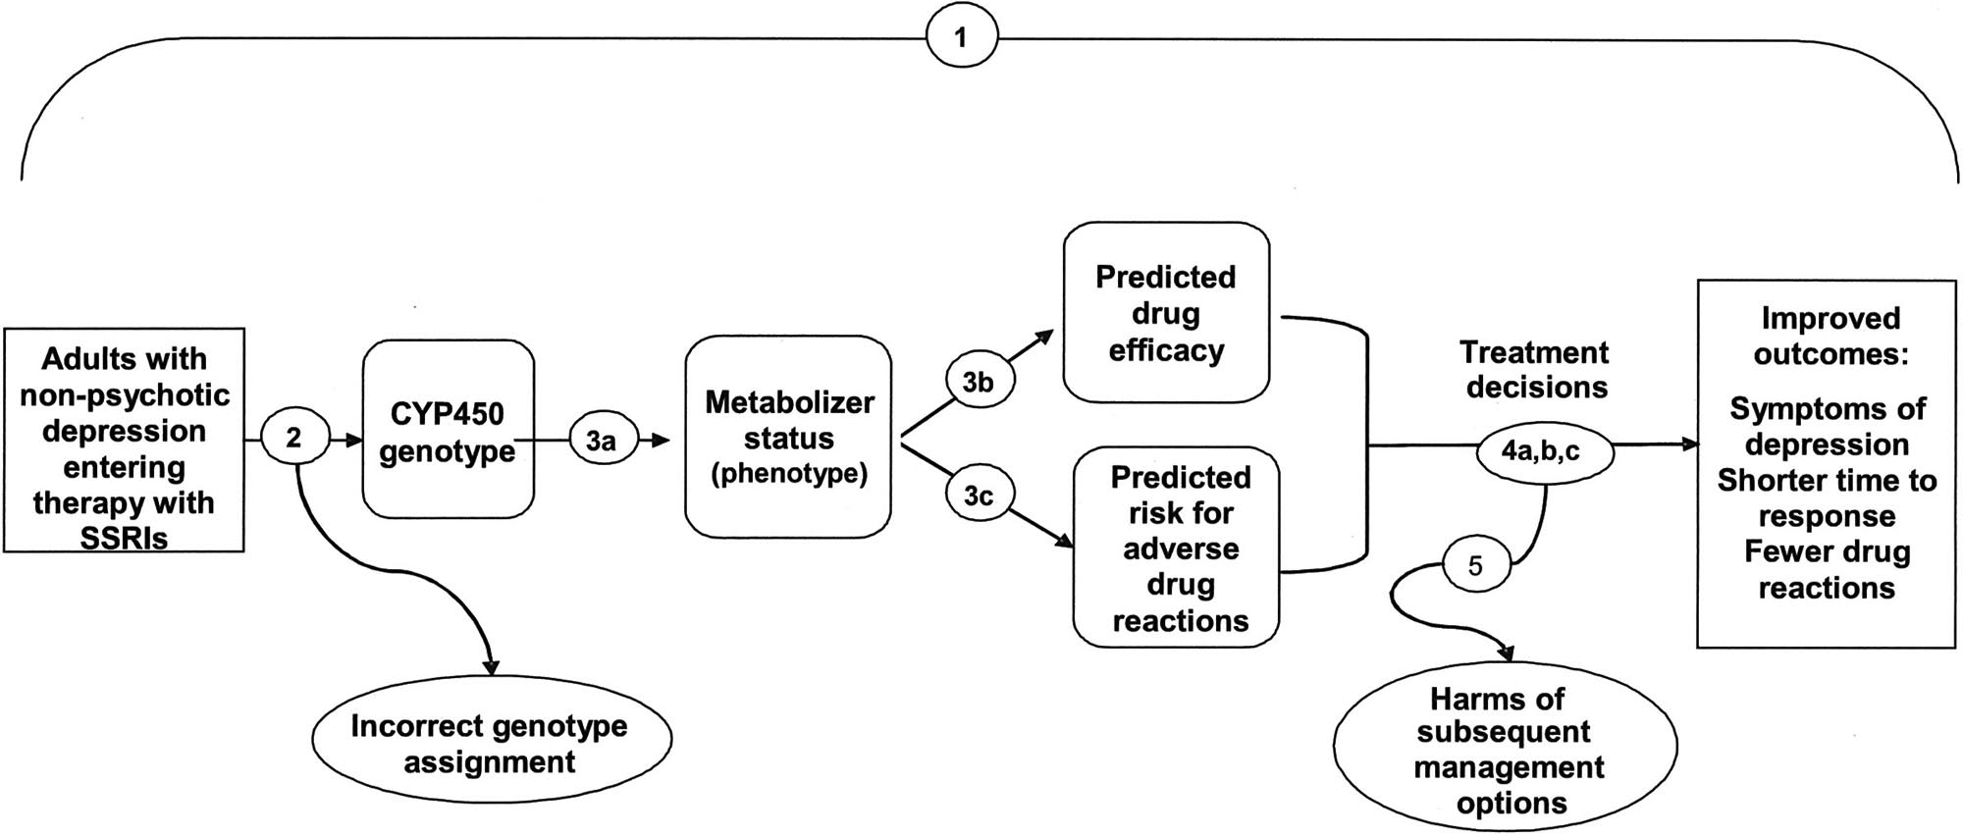
Analytical Framework: CYP450 for SSRIs
(See next slide for key questions by number)
Source: Teutsch SM et al. EGAPP Working Group. Genet Med 2009;11(1):3-14.

Slide 35
Analytical Framework: CYP450 for SSRIs
The numbers correspond to the following key questions:
Overarching question: Does testing for cytochrome P450 (CYP450) polymorphisms in adults entering selective serotonin reuptake inhibitor (SSRI) treatment for nonpsychotic depression lead to improvement in outcomes, or are testing results useful in medical, personal, or public health decision-making?
What is the analytic validity of tests that identify key CYP450 polymorphisms?
Clinical validity: A, How well do particular CYP450 genotypes predict metabolism of particular SSRIs? B, How well does CYP450 testing predict drug efficacy? C, Do factors such as race/ethnicity, diet, or other medications, affect these associations?
Clinical utility: A, Does CYP450 testing influence depression management decisions by patients and providers in ways that could improve or worsen outcomes? B, Does the identification of the CYP450 genotypes in adults entering SSRI treatment for nonpsychotic depression lead to improved clinical outcomes compared to not testing? C, Are the testing results useful in medical, personal, or public health decision-making?
What are the harms associated with testing for CYP450 polymorphisms and subsequent management options?
Source: Teutsch SM et al. EGAPP Working Group. Genet Med 2009;11(1):3-14.

Slide 36
What Is Patient-Centered Care?
“The term ‘patient-centered medicine’ was introduced by Balint and colleagues (Balint et al., 1970), who contrasted it with ‘illness-centered medicine’. An understanding of the patient’s complaints, based on patient-centered thinking, was called ‘overall diagnosis’, and an understanding based on disease-centered thinking was called ‘traditional diagnosis’.”
Sources:
Stewart M, et al. Patient-Centered Medicine: Transforming the Clinical Method. 2nd ed. United Kingdom: Radcliffe Medical Press; 2003.
Balint M, et al. Treatment or Diagnosis: A Study of Repeat Prescriptions in General Practice. Philadelphia, PA: JB Lippincott; 1970.
See also: Berwick DM. What 'patient-centered' should mean: confessions of an extremist. Health Aff (Millwood) 2009;28(4):w555-65.
36

Slide 37
Measuring Patient-Centered Care
Main dimensions of patient-centered care
Disease and illness experience (patient-as-person)
Whole person (biopsychosocial perspective)
Common ground (sharing power and responsibility)
Patient-doctor relationship (therapeutic alliance)
Source: Hudon C et al. Measuring patients' perceptions of patient-centered care: a systematic review of tools for family medicine. Ann Fam Med 2011;9(2):155-64. Based on Stewart M et al. Patient-Centered Medicine: Transforming the Clinical Method. 2nd ed. United Kingdom: Radcliffe Medical Press; 2003; Mead N, Bower P. Patient-centredness: a conceptual framework and review of the empirical literature. Soc Sci Med 2000;51(7):1087-110.
37

Slide 38
Measuring Patient-Centered Care
Examples of patient-centered care measures:
Patient Perception of Patient-Centeredness (PPPC): patient perceptions of patient-centered care during the last visit with a family physician; has 14 items*
Consultation Care Measure (CCM): patients’ perceptions of patient-centered care during the last visit with a family physician; 5 subscales: communication and partnership, personal relationship, health promotion, positive and clear approach to the problem, interest in effect on life*
CAHPS (originally, Consumer Assessment of Health Plans Survey): brief general measure comparing overall quality of interpersonal care across health care settings; includes some patient-centered care domains: access (getting care quickly, getting needed care), provider communication
See, e.g.,: Epstein RM, Street RL Jr. The values and value of patient-centered care. Ann Fam Med 2011;9(2):100-3; Hudon C et al. Measuring patients' perceptions of patient-centered care: a systematic review of tools for family medicine. Ann Fam Med 2011;9(2):155-64.
38

Slide 39
Measuring Patient-Centered Care
Although the topic of patient-centered care is gaining prominence among clinicians and policymakers, its measurement tools are limited
New measures are under development
No single measure will be adequate for capturing relevant aspects across clinical settings and populations
Patients, their families, clinicians, and health systems should be involved in developing patient-centered care measures
Source: Epstein RM, Street RL Jr. The values and value of patient-centered care. Ann Fam Med 2011;9(2):100-3.
39

Slide 40
What Are Patient-Centered Outcomes*?
Outcomes that patients experience in real-world settings
They are patient-oriented rather than disease- or physician-oriented, e.g.:
  Health status
  Functional status
  Quality of life
  Quality of death
  Symptoms; pain, nausea
  Psychosocial well-being
*Related term: “patient-reported outcomes” (PROs)
40

Slide 41
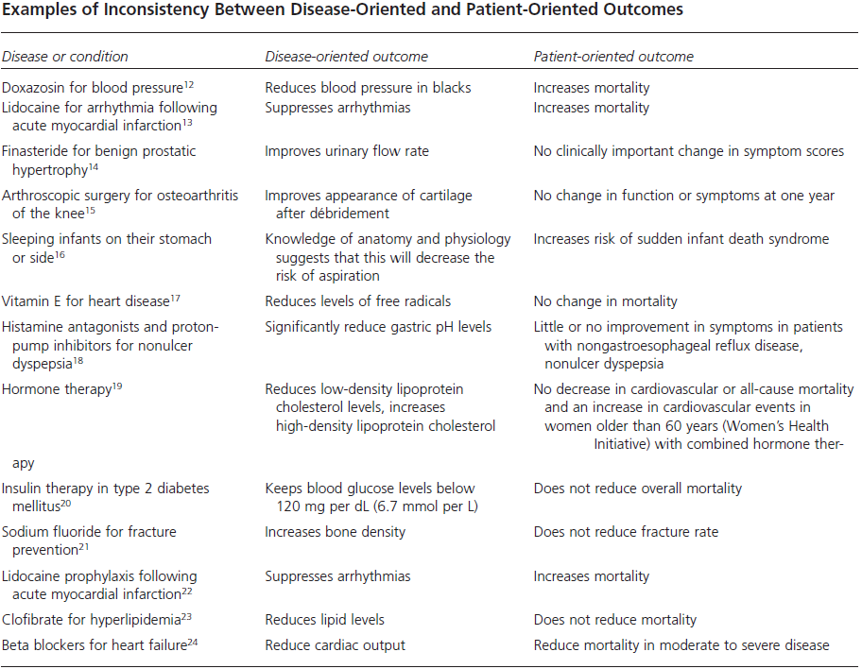
What Are Patient-Centered Outcomes?
Ebell MH et al. Strength of recommendation taxonomy (SORT): A patient-centered approach to grading evidence in the medical literature. Am Fam Physician 2004;69:548-56.
41

Slide 42
What Are Patient-Centered Outcomes?
Examples of generic instruments
CAHPS (formerly Consumer Assessment of Healthcare Providers and Systems)
EuroQol (EQ-5D)
Health Utilities Index
Nottingham Health Profile
Quality of Well-Being Scale
Short Form (12) Health Survey (SF-12)
Short Form (36) Health Survey (SF-36)
Sickness Impact Profile
There are numerous condition-specific instruments, e.g., in angina, asthma, epilepsy, kidney disease, migraine, vision
42

Slide 43
Patient-Centered Outcomes Research Institute
Formed to implement a national CER agenda, it emphasizes patient-centeredness
Established by the US Congress in The Patient Protection and Affordable Care Act, Sec. 6301, March 23, 2010
Independent, non-profit organization to identify research priorities; establish, implement research agenda
Overseen by 21-member Board of Governors, including the Directors of AHRQ and NIH; 19 members appointed by Comptroller General; assisted by expert advisory panels and methodology committee
Mission: “PCORI helps people make informed health care decisions – and improves health care delivery and outcomes – by producing and promoting high integrity, evidence-based information – that comes from research guided by patients, caregivers and the broader health care community.”

Slide 44
What Is Patient-Centered Outcomes Research?
Patient-centered outcomes research (PCOR) helps people make informed health care decisions and allows their voice to be heard in assessing the value of health care options. This research answers patient-focused questions:
Given my personal characteristics, conditions and preferences, what should I expect will happen to me?
What are my options and what are the benefits and harms of those options?
What can I do to improve the outcomes that are most important to me?
How can the health care system improve my chances of achieving the outcomes I prefer?
Source: Patient-Centered Outcomes Research Institute. Working definition of patient-centered outcomes research. July 2011.
44

Slide 45
To Answer These Questions, PCOR:
Assesses the benefits and harms of preventive, diagnostic, therapeutic, or health delivery system interventions to inform decision making, highlighting comparisons and outcomes that matter to people
Is inclusive of an individual's preferences, autonomy and needs, focusing on outcomes that people notice and care about such as survival, function, symptoms, and health-related quality of life
Incorporates a wide variety of settings and diversity of participants to address individual differences and barriers to implementation and dissemination
Investigates (or may investigate) optimizing outcomes while addressing burden to individuals, resources, and other stakeholder perspectives
Source: Patient-Centered Outcomes Research Institute. Working definition of patient-centered outcomes research. July 2011.
45

Slide 46
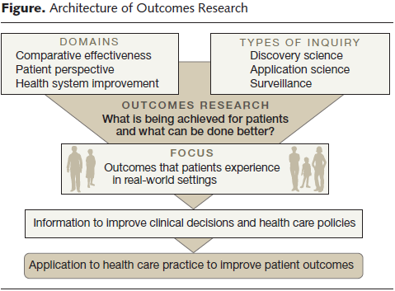
Patient-Centered Outcomes Research – A Framework
Source: Krumholz HM. Real-world imperative of outcomes research. JAMA 2011:306(7):754-5.
46

Slide 47
Timeline: Getting to PCOR
“Patient-Centered Medicine”
(1970)
PCORI
Established
(2010)
Pharmacoeconomics
(1989)
1st RCT
(1948)
HTA
(1974)
Outcomes Research
(1986)
“Pharmacogenetics”
(1959)
CED
(2006)
EBM (1990)
1950
1960
1970
1980
1990
2000
2010
DNA Structure Described
(1953)
Genetic Code Cracked
(1967)
CYP450 Metabolic Enzymes Identified
(1977)
Effectiveness Research
(1988)
Human Genome Sequenced
(2003)
CER
(2003, 2009)
PCORI
Defines “PCOR”
(2011)
Source: C. Goodman © 2011 The Lewin Group

Slide 48
Implications of HTA-CER-PM-PCOR
Evidence standards are generally rising and being used more broadly, with emphasis on:
  Health outcomes, especially patient-oriented outcomes
  Evidence from real-world settings
  Detecting treatment effects in patient subgroups
  Priority populations and those subject to health disparities
Increasing acceptance of non-RCT, observational data for certain evidence questions
  More work in developing observational data sources and related methods is needed
Development of predictive instruments to measure patient-centered care and patient-centered outcomes
Greater interest in comparative effectiveness of organizational, delivery, management, financing interventions

Slide 49
Implications of HTA-CER-PM-PCOR
PCORI in US is focusing great attention on patient-centeredness, including:
  Patient and other stakeholder involvement in research agenda, study design, dissemination of findings, and applying findings in practice to improve outcomes
  Data resources and methods development for PCOR
Redefining value and shifting direction of innovation; choices about technology development are influenced by:
  Need to validate technologies in head-to-head comparisons with health outcomes data in real settings
  More cost-constrained health care systems
  As outlook for “block-buster” technologies diminishes; increased potential in high-value therapeutics for patient subgroups identified via genomics/personalized medicine

Slide 50
National Information Center on Health Services Research & Health Care Technology
National Library of Medicine
Webinar Part II
HTA-CER-PM-PCOR: Converging on What Works for Patients
September 7, 2011
Clifford Goodman, PhD
The Lewin Group
Falls Church, Virginia USA
clifford.goodman@lewin.com
50

