Slide 1

The Integrated Ocean Observing System (IOOS®)
High Frequency Radars
Dr. Samuel Walker
Integrated Ocean Observing System Program
NOAA, National Ocean Service
November 3, 2010

Slide 2
System
Technology
Applications

Slide 3
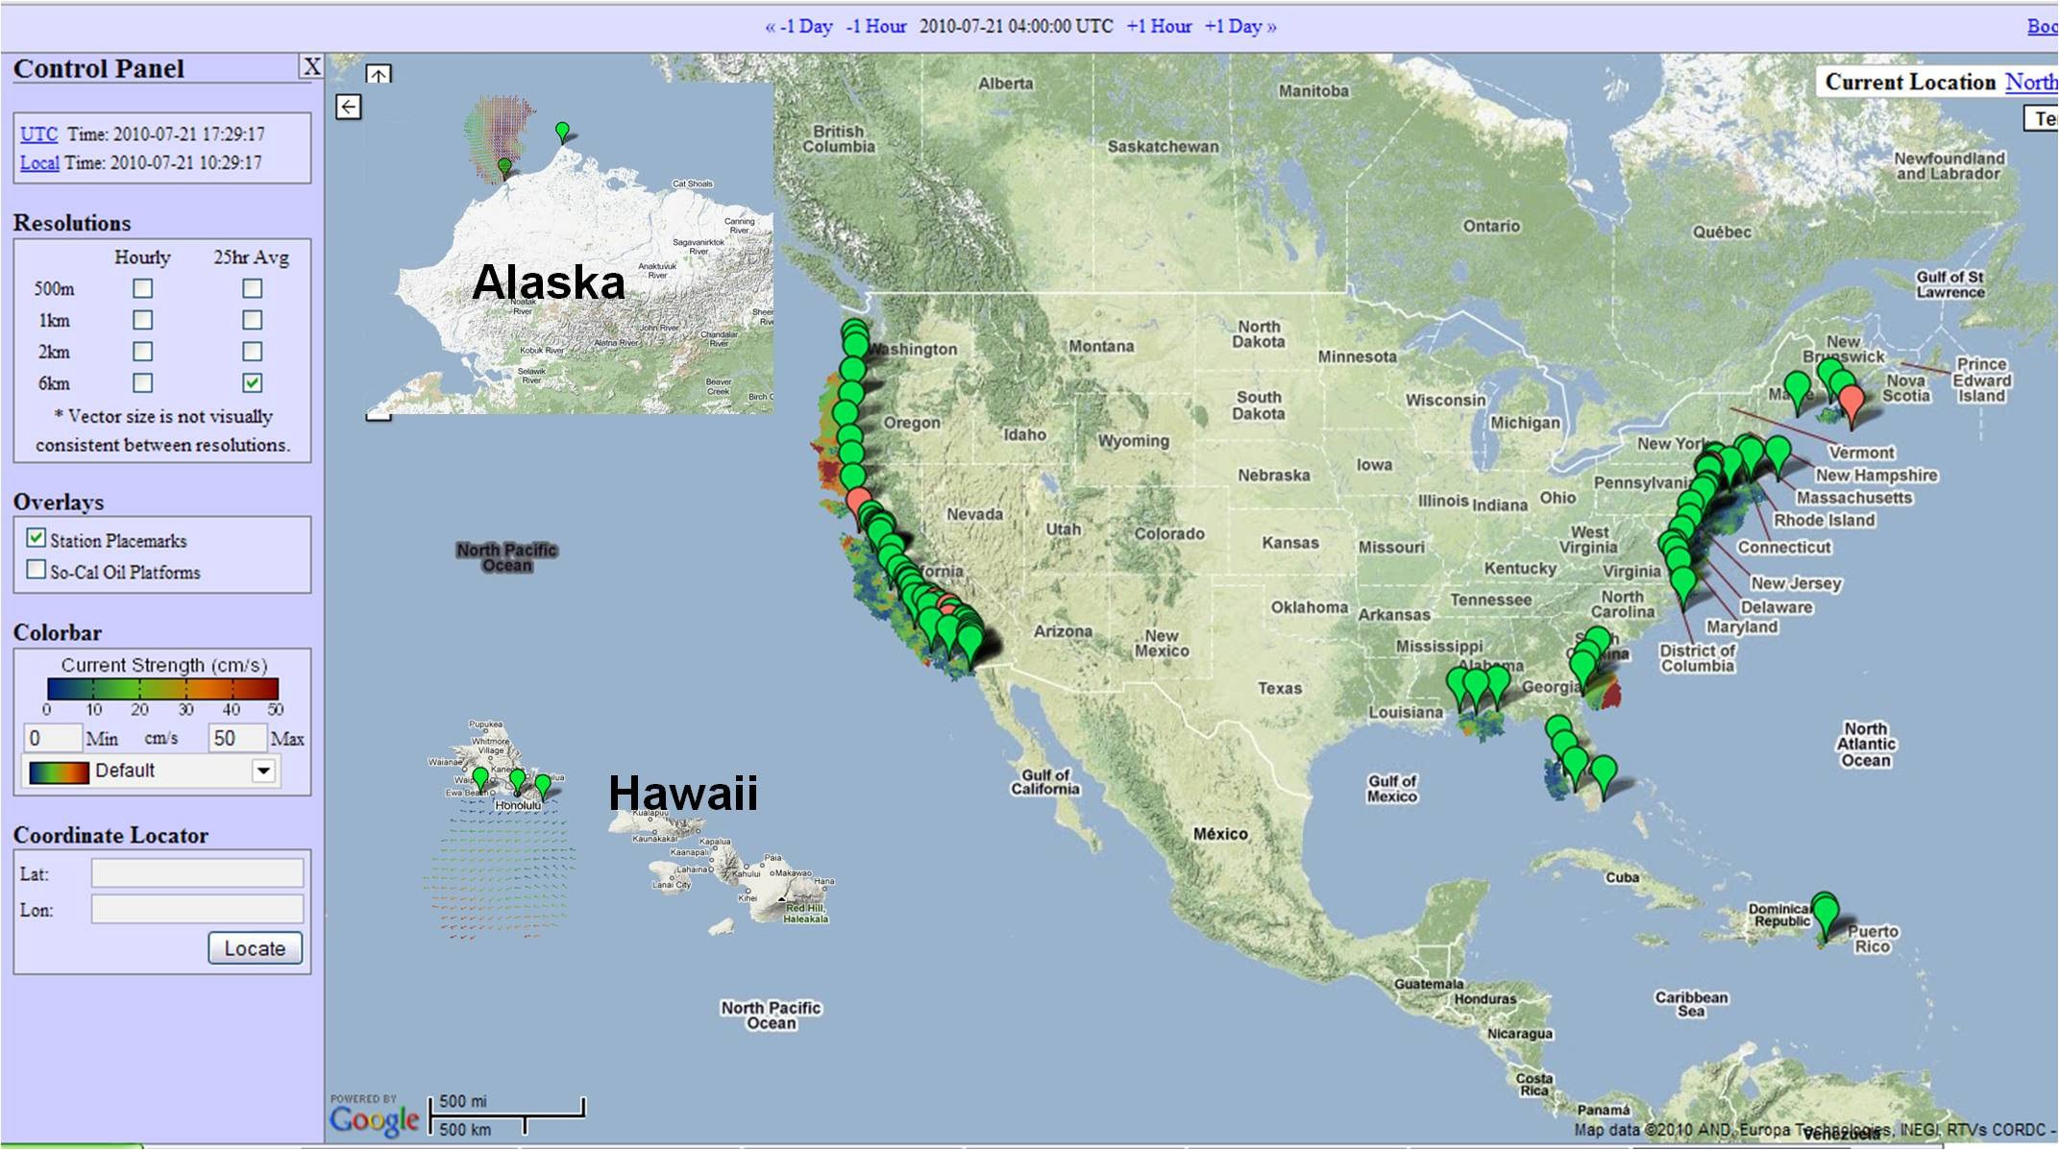
IOOS® National HF Radar (HFR) Network
Over 100 sites currently operating
National Surface Currents Mapping Plan
(http://www.ioos.gov/hfradar)

Slide 4
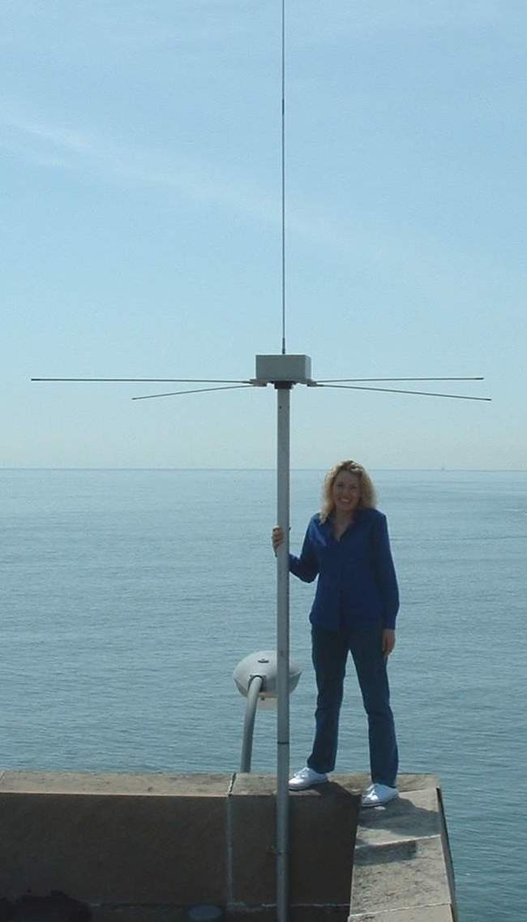
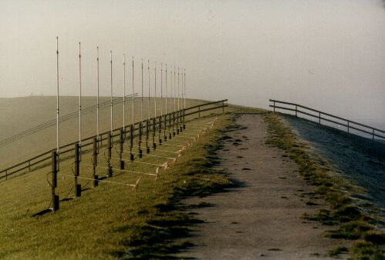
HF Radar: Overview of Systems
Direction-Finding Radar
Beam-Forming Radar
- Where Am I?
- Broad Beam
Compact Antenna
Wave Info Limited
How Fast Am I Going?
Narrow Beam
Large Antenna
Wave Info Easier
CODAR
WERA
$105-125K
$150-200K
Notes:
95% of systems in US are compact “CODAR” systems as in the left-hand picture
Wave measurements more straightforward w/phased array.
Probably will want a combination of both systems for a large network at complete build-out.
5mHz systems ~200km max range

Slide 5
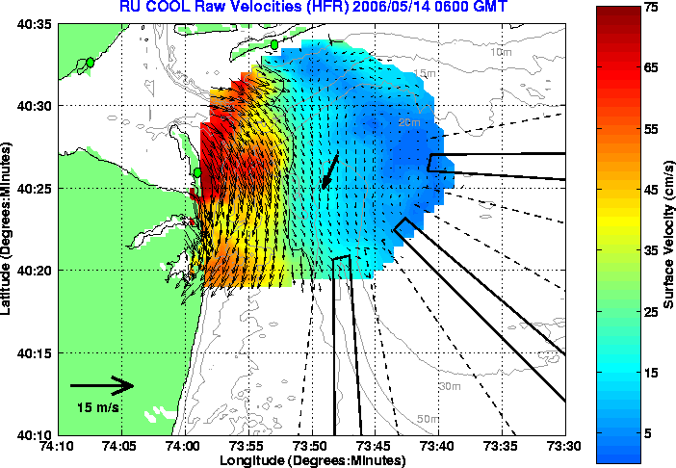
HF Radar: Overview of Specifications
Uses radio wave backscatter to produce radials
Current direction and velocity
Regions of overlap also provide ancillary wave structure/height data
Delivers real-time surface current data:
Velocity Resolution: 2 to 4 cm/s * Range Resolution: 0.2 to 6 km **
Temporal Resolution: 10 to 60 min Range Extent: 1 to 200+ km *
Velocity Accuracy: 5 to 10 cm/s
*Depends on Transmit Frequency, Signal Processing ; ** Depends on RF bandwidth

Slide 6
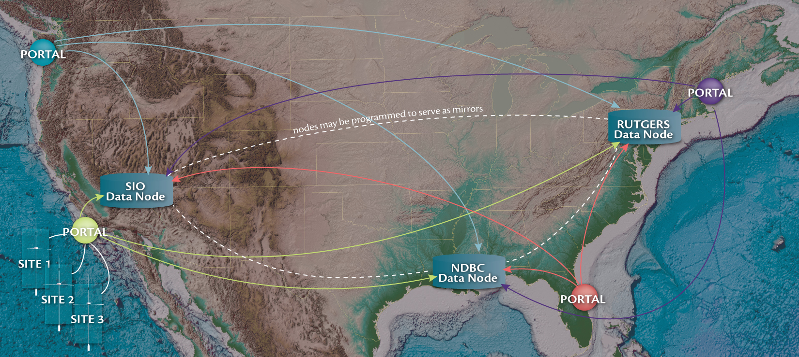
HFR Data Flow and Management
Primary Portal: http://hfradar.ndbc.noaa.gov

Slide 7
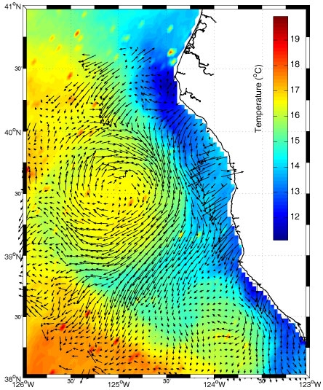
HFR Provides Decision Support
“Floatable Events”:
Oil Spill/Tarball Trajectories
Search and Rescue
Marine Debris Tracking
HAB Tracking
Ice Transport
Outfall Monitoring
Larval/Phytoplankton Tracking
Other Uses:
Map/Quantify Coastal Dynamics
Model Validation
Circulation Modeling Input
Costal and Marine Spatial Planning
“Mendocino Eddy”
HFR circulation with SST
Halle et al 2010 (in review)

Slide 8
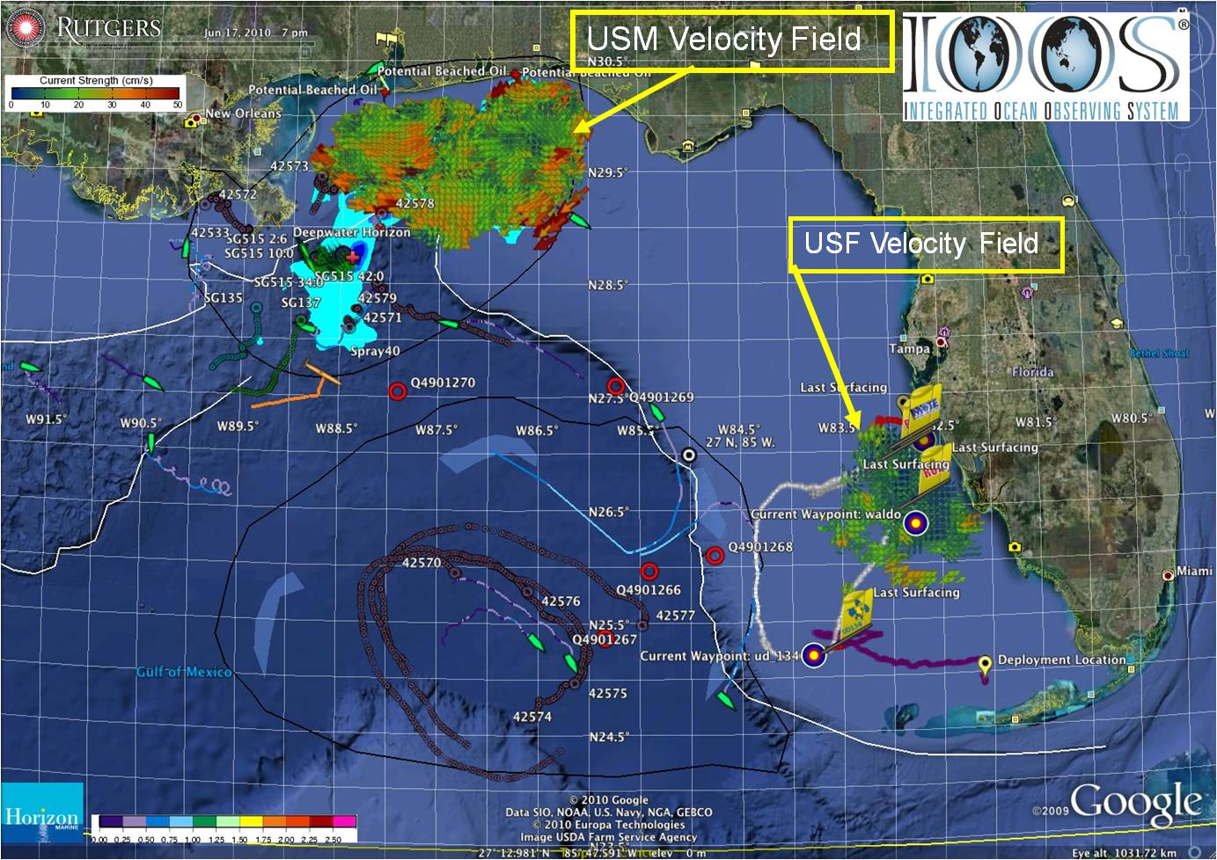
Oil Spill Trajectory Forecasting
Ingested & distributed by IOOS national HF radar data servers at Scripps & NOAA/NDBC
Collected using CODAR SeaSonde® HF radar systems (USM, USF)
Chronology
2006
2007
20 Apr
30 Apr
2 May
2 May – Cap of DWH Well
Safe Seas Exercise
HFR support to COSCO Busan
Data received by IOOS National Servers & NOAA/OR&R/ERD
HFR used daily for trajectory forecasting
USM: radars restored
2 of 3 USM radars: not operational, scheduled maintenance

Slide 9
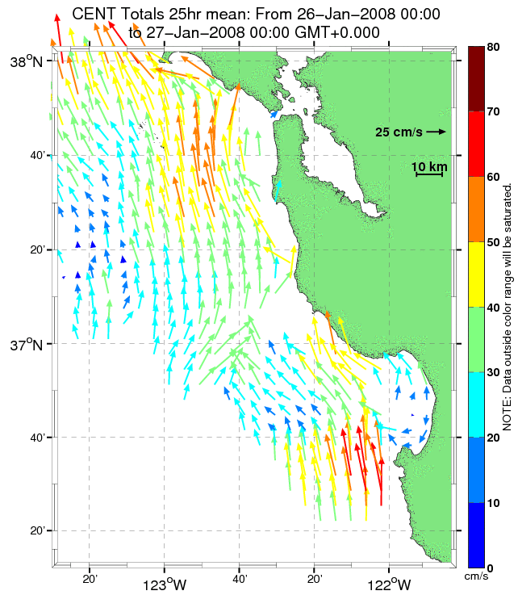
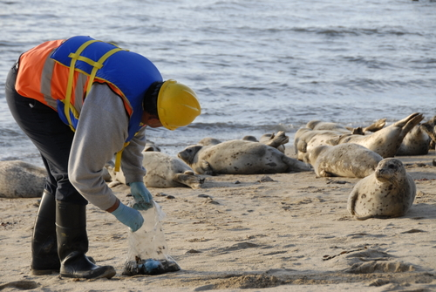
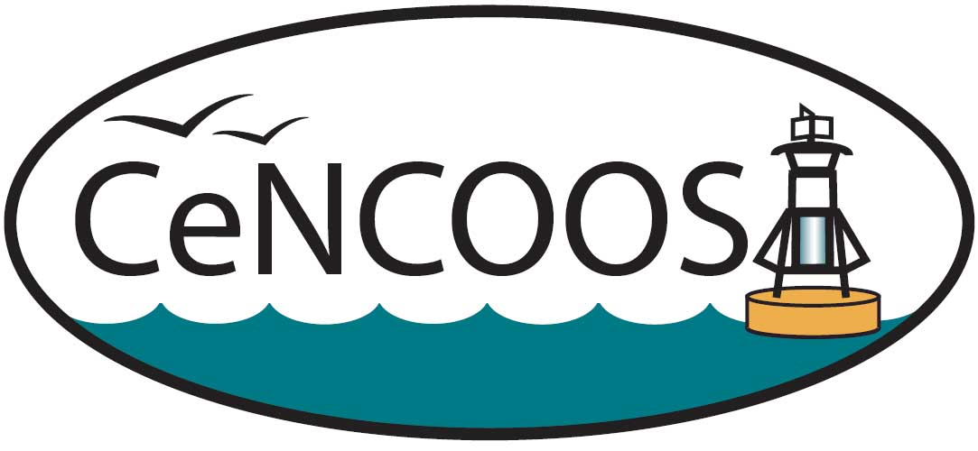

Projection of Wintertime Tarball Events
Predictable events - based on strong, persistent flow from the south
Allows staging of response
Jeffrey D. Paduan
Naval Postgraduate School
Notes:
New product motivated by tarball events: a three-day trajectory plot
When flow is strong toward the north for more than a few days, tarball events can be expected along the central coast

Slide 10
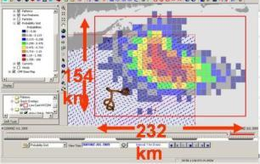
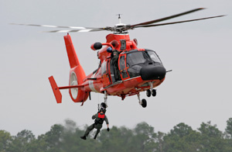
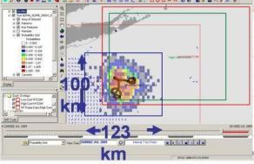
Search and Rescue (SAR)
Integrated into USCG Operational SAR in Mid-Atlantic
Nationwide adoption in 2011
Refines search zone
96 hr: Without HFR (36,000 Km²)
96 hr: With HFR (12,000 Km²)

Slide 11
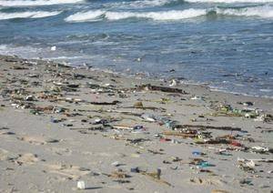
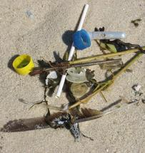
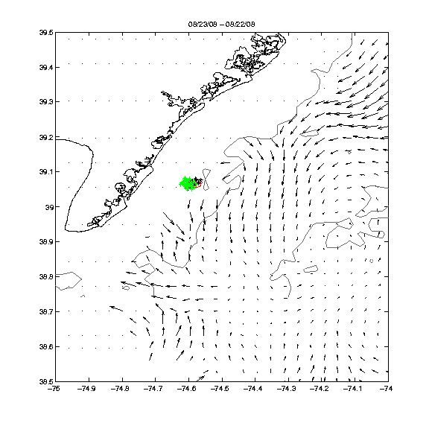
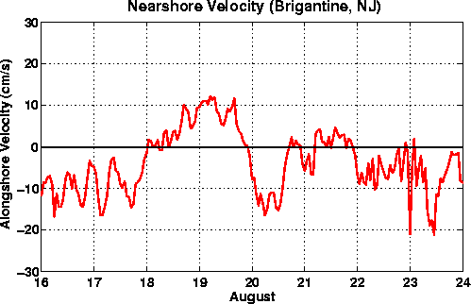
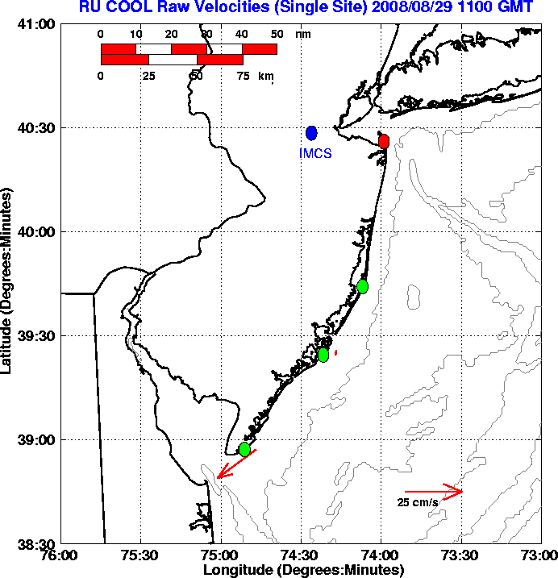
Tracking of Marine Debris
Proactive public health actions after a known spill/release
Enhances forensic investigations by indicating source locations
Allows tracking of floating material
Notes:
Slide 1: the HF radar estimated source for the needles that washed up in Avalon NJ in 2008. The images show that the source was local as indicated by the relatively week alongshore currents in the day before the incident (plot on lower right). The green spot on the lower left image sows the source, and the black dots show the location. We had to use the offshore coverage because we presently don't have inshore coverage.
Slide 2-3: the tracking of a trash (floatable )spill during labor day weekend in 2007. This shows the influence of wind and nearshore currents in understanding possible sources and fate of the spill.

Slide 12
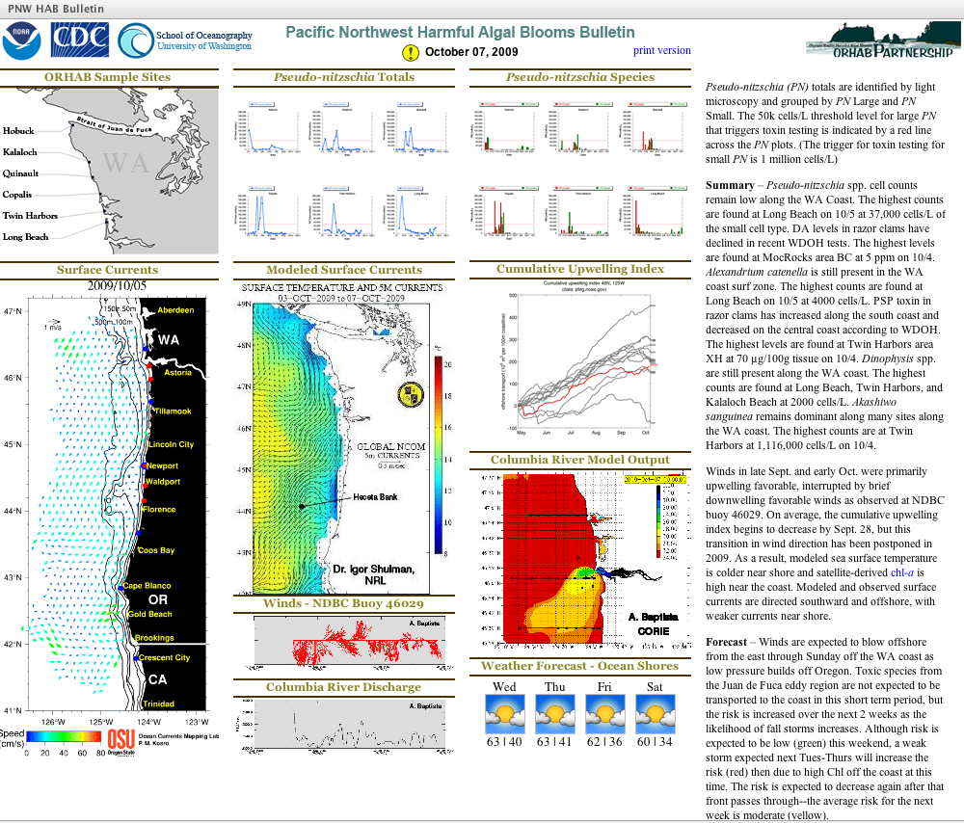
Support for Harmful Algal Bloom Events
Tracking of HABs
Prediction
Public health implications
Combines with other data sets for decision-making
Vera L. Trainer, NOAA Fisheries
Barbara M. Hickey, University of Washington

Slide 13
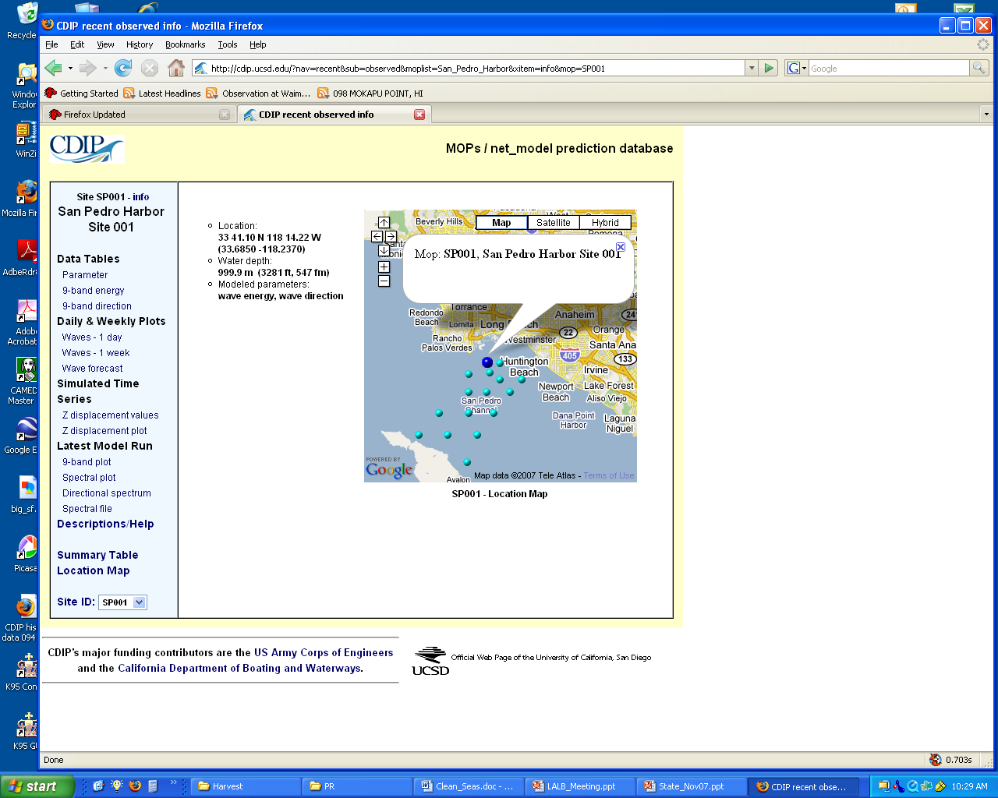
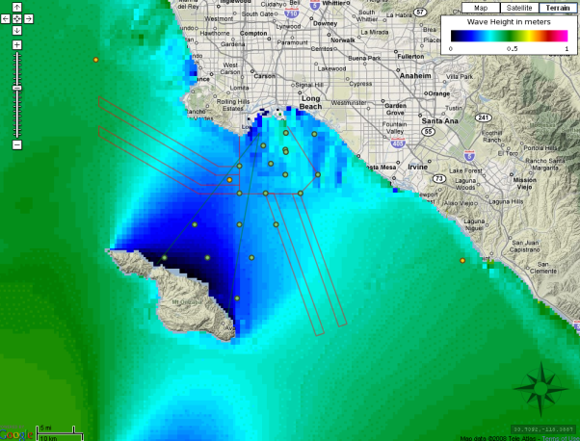
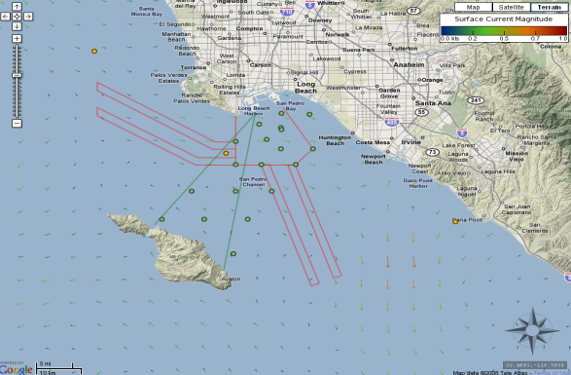
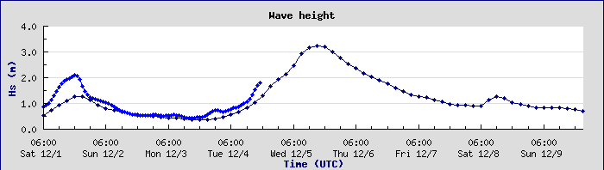
Maritime Transportation-San Pedro Channel
CDIP provides waves
3 day wave forecast
Automated notification when threshold exceeded
SCCOOS provides currents

Slide 14
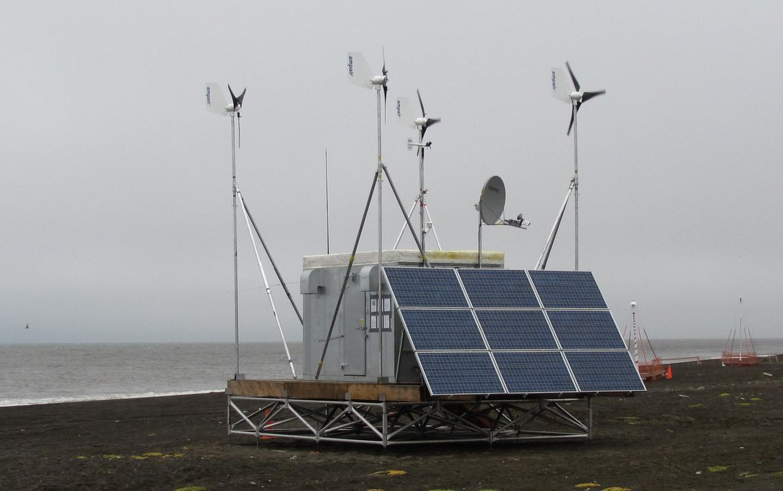
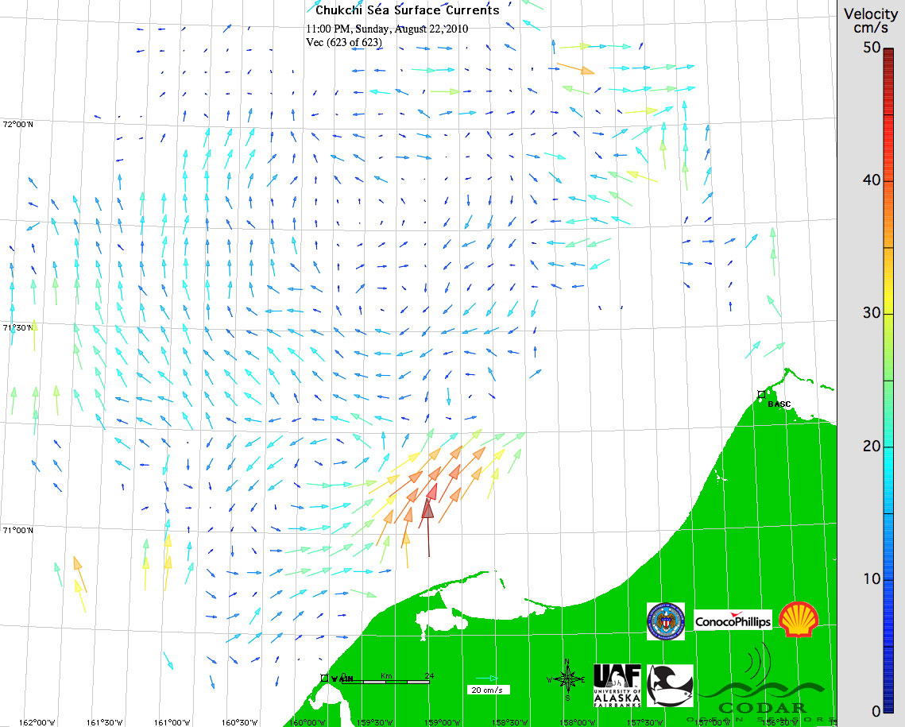
Arctic Applications
Tracking of ocean dynamics in harsh environments
Surface ice transport
Ruggedized power and communications module
Solar and wind power
Mobile platform for rapid deployments
Notes:
A portable, modular power and communications system designed to provide data transfer and electrical power to HF radars along remote arctic and sub-arctic coastlines using solar & wind energy. The lack of power is the only limitation to widespread use of HF radar along Alaska’s coasts. This system has delivered 100% of the power required from wind alone. It is easily deployed anywhere in Alaska.

Slide 15

Emerging HFR Applications
With relevance to Ecosystem-Based Management (EBM), Coastal and Marine Spatial Planning (CMSP)…
Mesoscale flow features – persistence of large eddies
Inter-annual Variability – changes in alongshore transport
Divergence & Convergence (fronts) – interfaces in the ocean
Upwelling & Phytoplankton – spatial structure of pelagic habitat
Larval Dispersal & MPAs – population connectivity
Juvenile Salmon Survival – early ocean phase (transport & food)
Terrestrial Runoff – subsidies & contaminants
John Largier
Bodega Marine Laboratory, UC Davis
Notes:
Physical features
Ecological importance

Slide 16
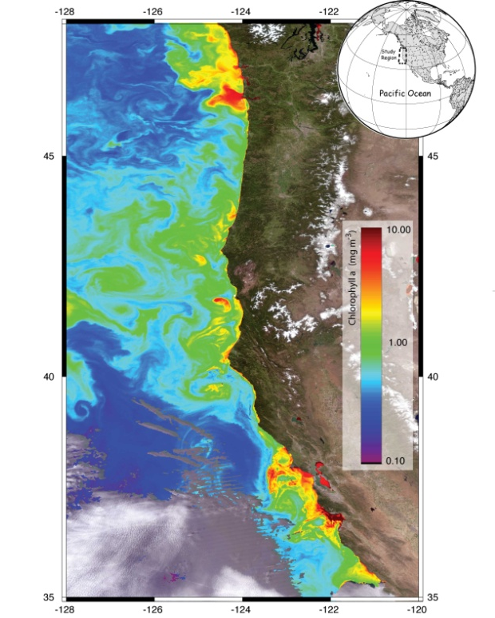
Monitoring Mesoscale Flow Features
Can now map, quantify and track features like eddies and jets
Implications for a range of practical and research activities
Map biological aggregation zones
“Mendocino Eddy”
HFR circulation with SST
Halle et al 2010 (in review)

Slide 17
Upwelling and Phytoplankton
Space and time pattern in flows, temperature and phytoplankton concentration.
Upwelling – southward flow of cold nutrient-rich waters.
Relaxation – northward flow of warmer, plankton-rich waters from south.
Largier et al., 2006 (DSR)

Slide 18
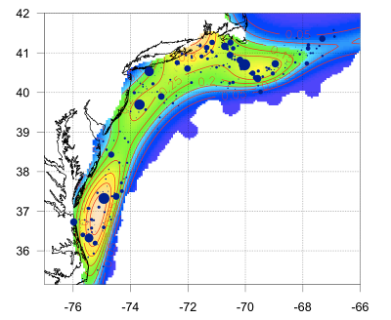
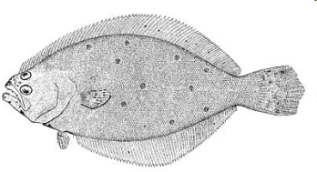

Biological Monitoring and Prediction
Winter
Spring
Probability of egg occurrence
Use HFR for particle trajectories
Larval dispersal and MPAs
Similar uses for spawning and migration studies
Autumn
Summer
Gong et al., 2009. JGR

Slide 19
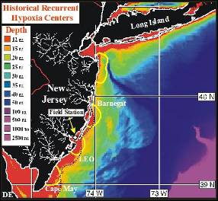
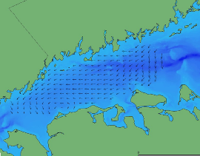
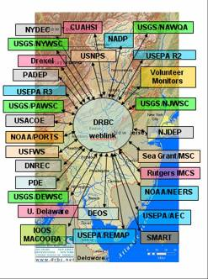
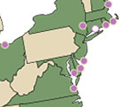
Decision Support for Water Quality Projects
NJ Coast Hypoxia
LIS Water Quality
Delaware River Basin NWQMN Pilot Study
NERRS Monitoring
Monmouth County Health
MARCOOS

Slide 20
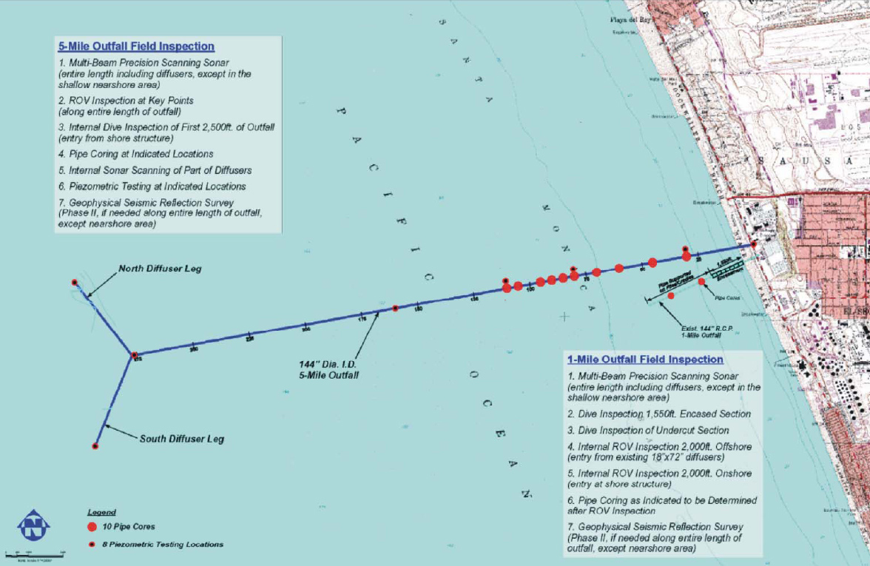
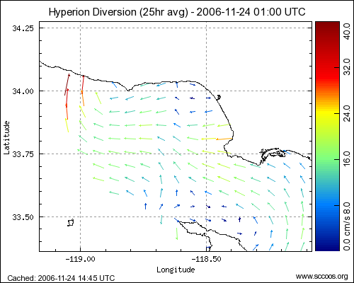
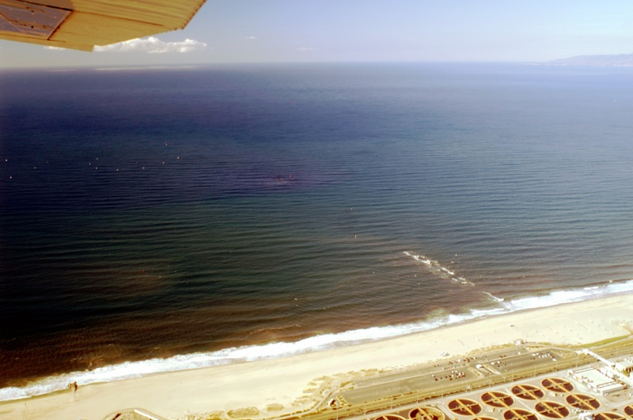
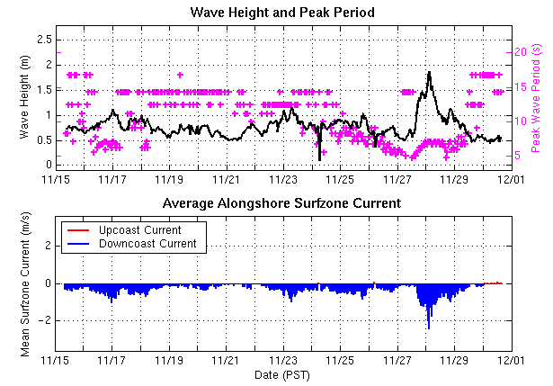
Decision Support for Water Quality Projects
Inspection of Hyperion Outfall Pipe
~Billion gallons of sewage to be diverted to an in-shore outfall
Concern about extent of impact and public health risks
Offshore and surf zone circulation had to monitored
Real-time trajectory tool implemented at surfacing outfall

Slide 21
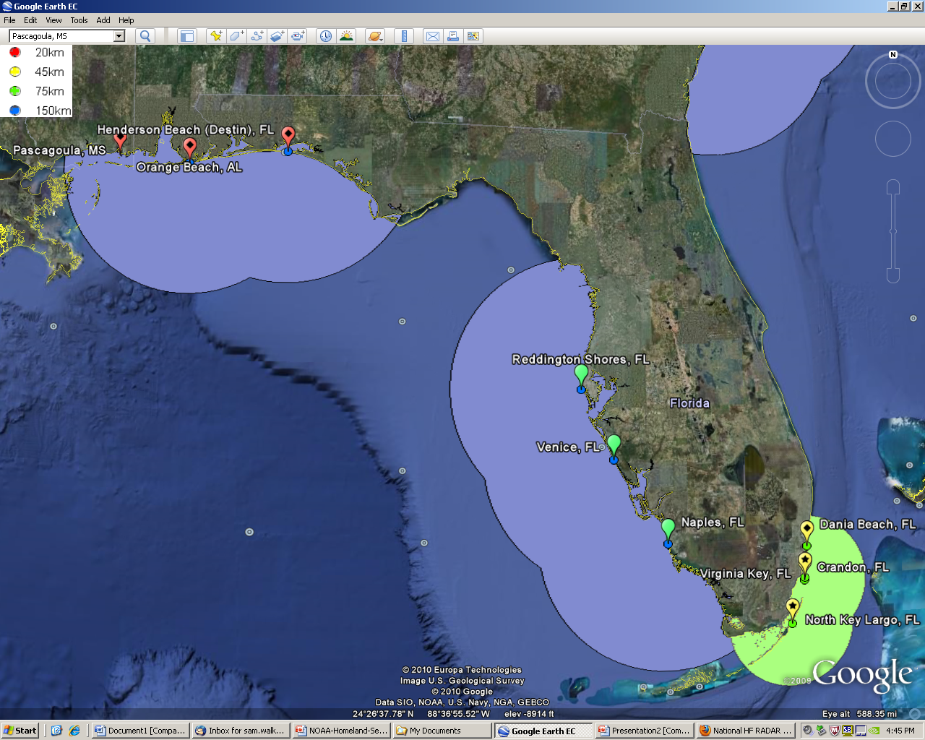
HF Radar: Summary of Benefits
Model input/validation
Consistent data formats
Predictive data
Non-invasive
Fine spatial/temporal scales
Shore-based (easily serviced)
Wide range of applications
Repetitive measurements
Easy integration with other ocean observing data
Direct measure of buoyant particles or objects
Indirect measure of deep circulation patterns

Slide 22
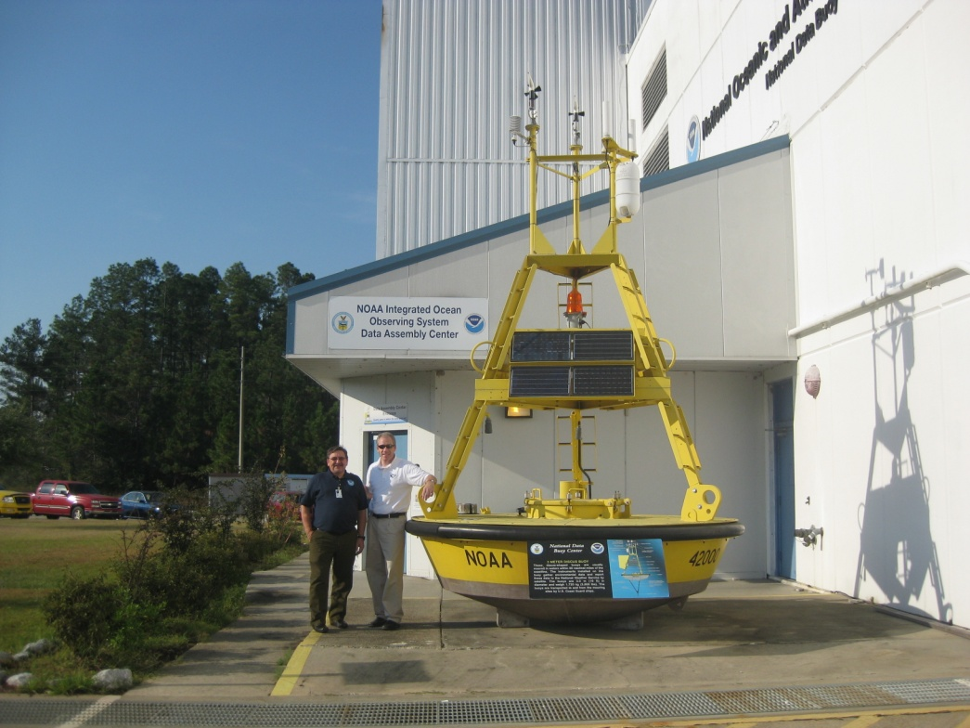
Questions and Discussion
http://www.ioos.gov
IOOS Program Director:
Zdenka Willis (zdenka.s.willis@noaa.gov)
HFR Program Coordinator:
Dr. Jack Harlan (jack.harlan@noaa.gov)
Dr. Sam Walker (sam.walker@noaa.gov)

