Slide 1
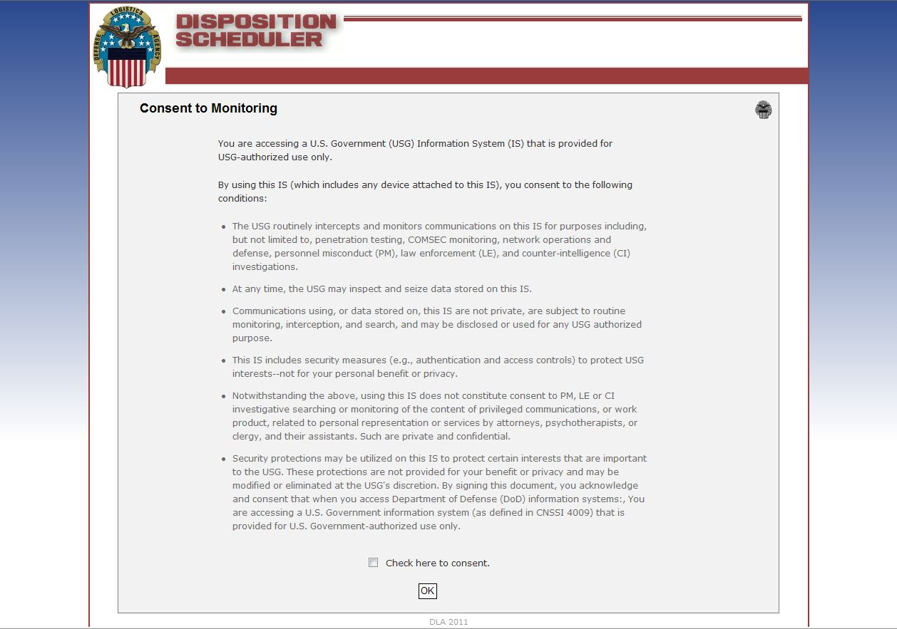
New DLA Disposition Services Local Scheduler

Slide 2
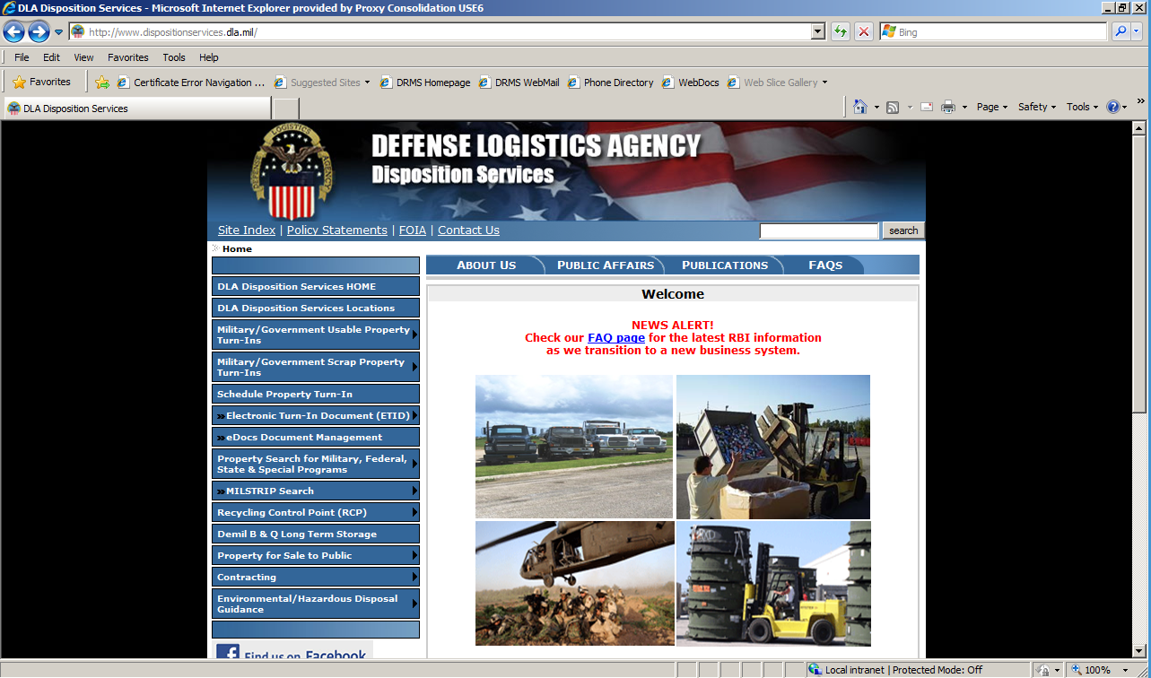
Local Customer DLA Disposition Service
Scheduler Turn-in Procedures
Go to:
http://www.dispositionservices.dla.mil
Click Here

Slide 3
Consent to monitoring page
Click Here

Slide 4
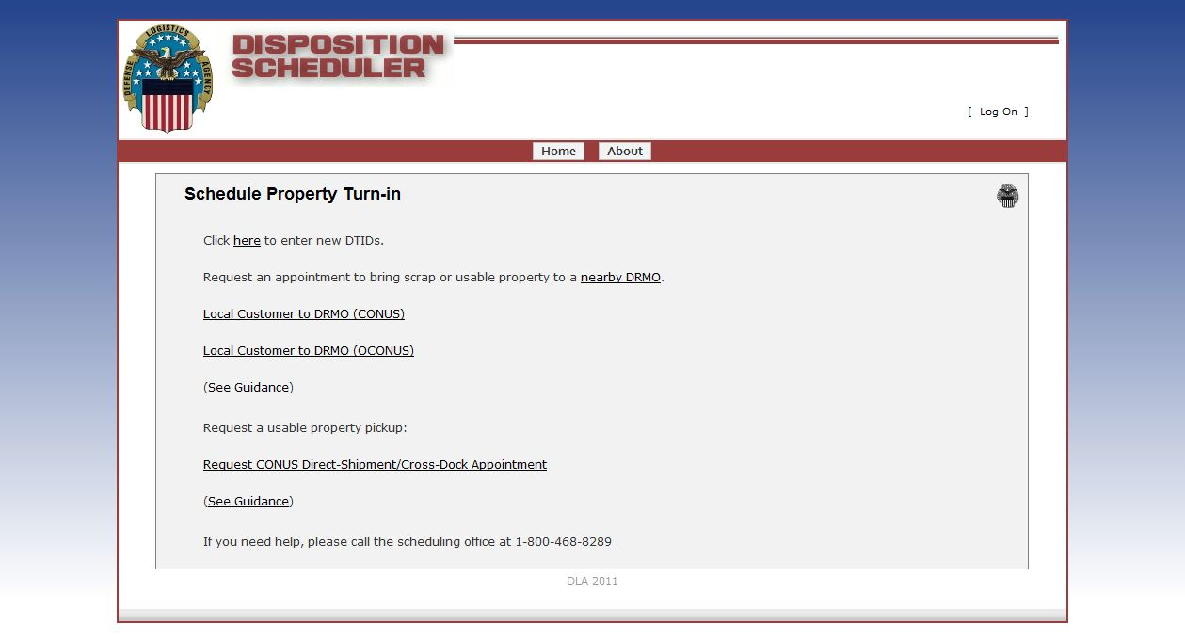
Type of turn in page
At this point the decision needs to be made:
  Local Customer CONUS (Generator arranged transportation to Field Activity)
  Local Customer OCONUS (Generator arranged transportation to Field Activity)
  Cross dock customer (Generator arranged transportation to Field Office)

Slide 5
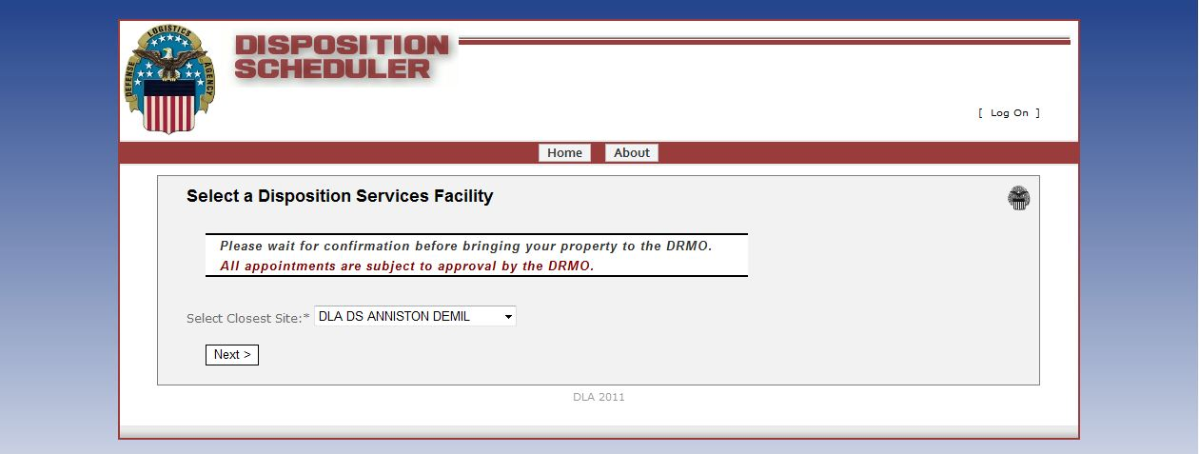
Local DLA Disposition Service
Selector Page
Click the drop box arrow and select the DLA Disposition Services site that is closest to your local.
Then click the “Next” button

Slide 6
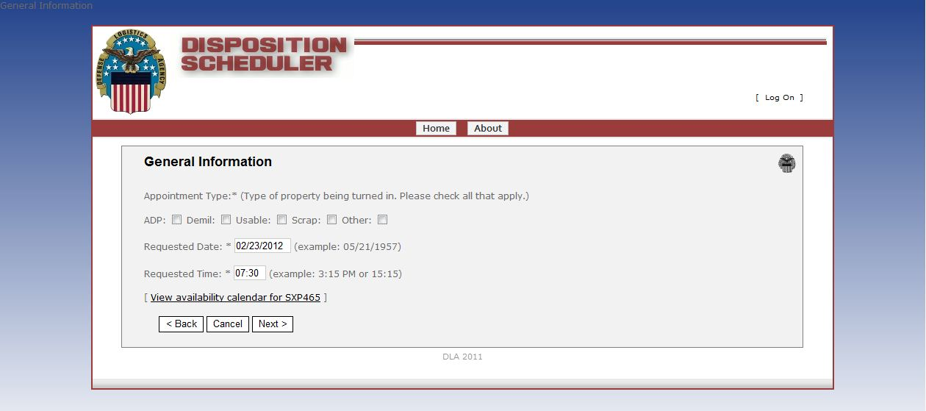
Local DLA Disposition Service
Site Dates Available
Use the check boxes to select the types of property to be turned in
Select the date / time you want to turn in the property
  The date shown is the next available
  If next available does not work for you there is a link to the calendar click that link and select the next available that will work for you

Slide 7
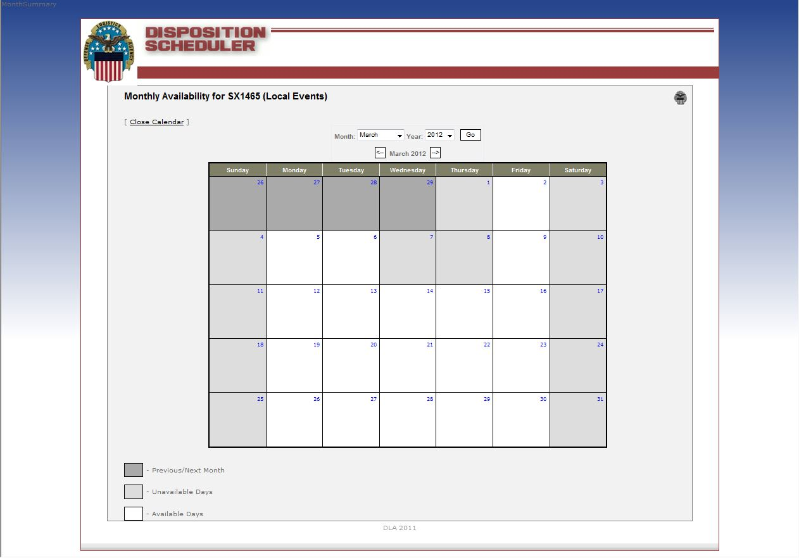
Local Scheduler Calendar
Insert pic of calendar here
Dates shows in white are available dates. Dates that are shown in light grey are unavailable. Dates in dark grey are from Previous or following months.

Slide 8
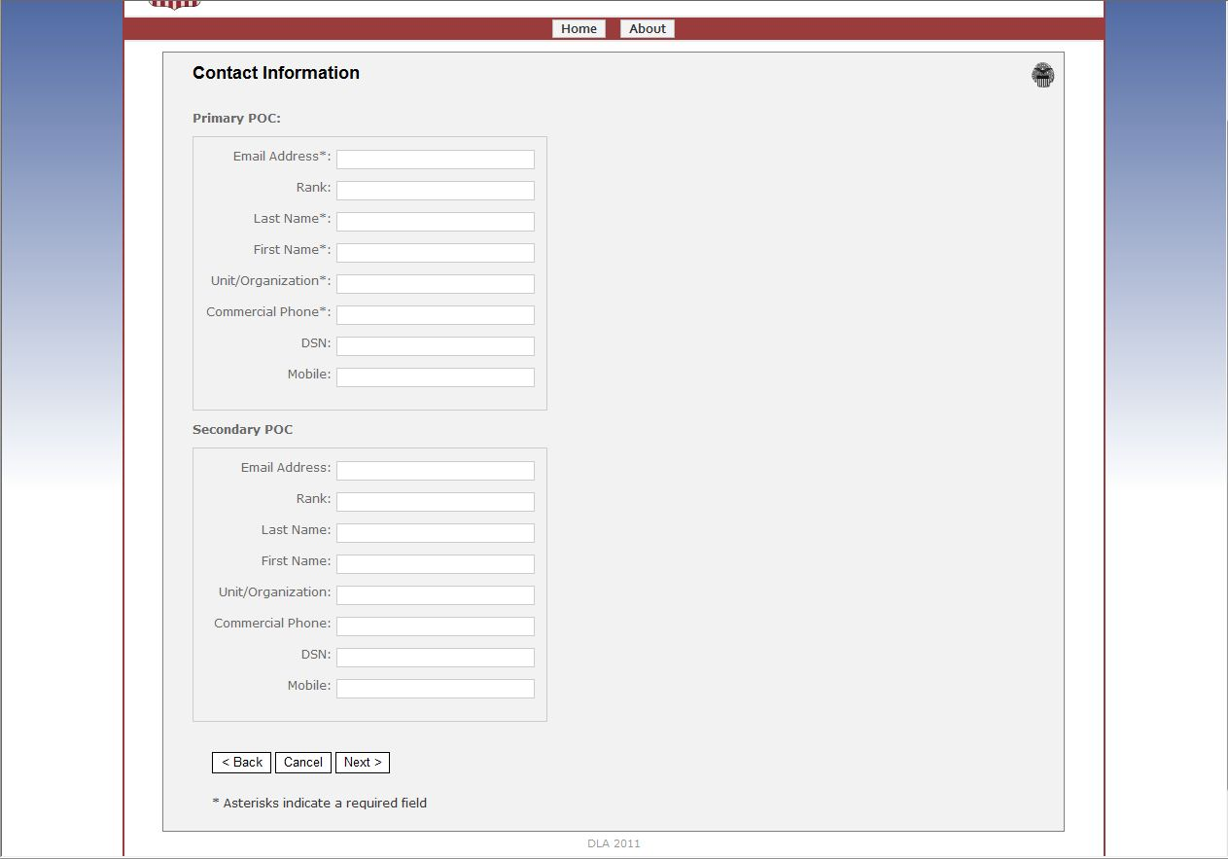
Contact Information

Slide 9
Contact Information Continued
Required Fields
Secondary POC is optional

Slide 10
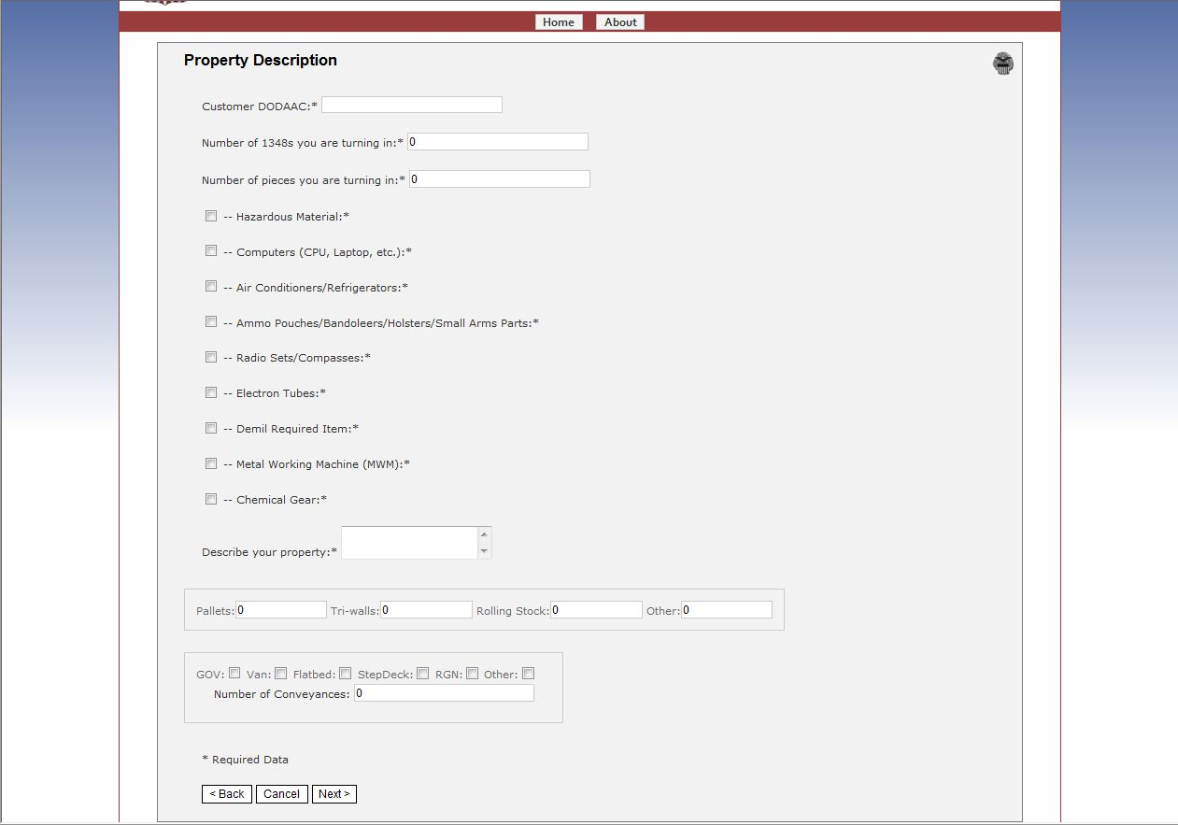
Property Description
Required Fields

Slide 11
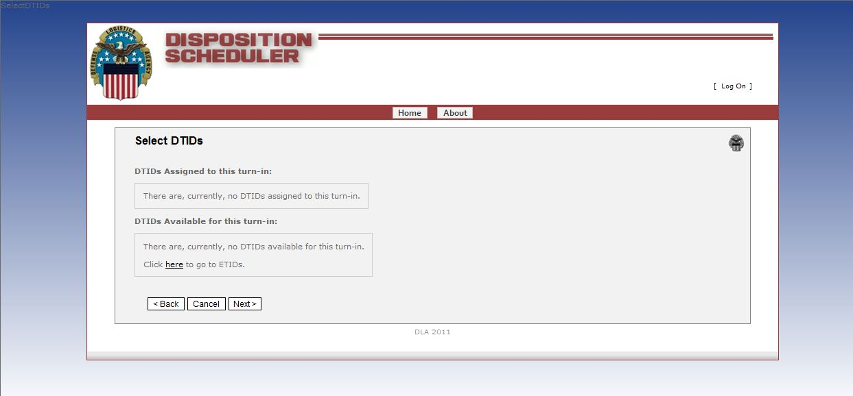
Select DTID
If there are DTID’s that are already in the system for your agency they will show up on this page to select and assign to this shipment

Slide 12
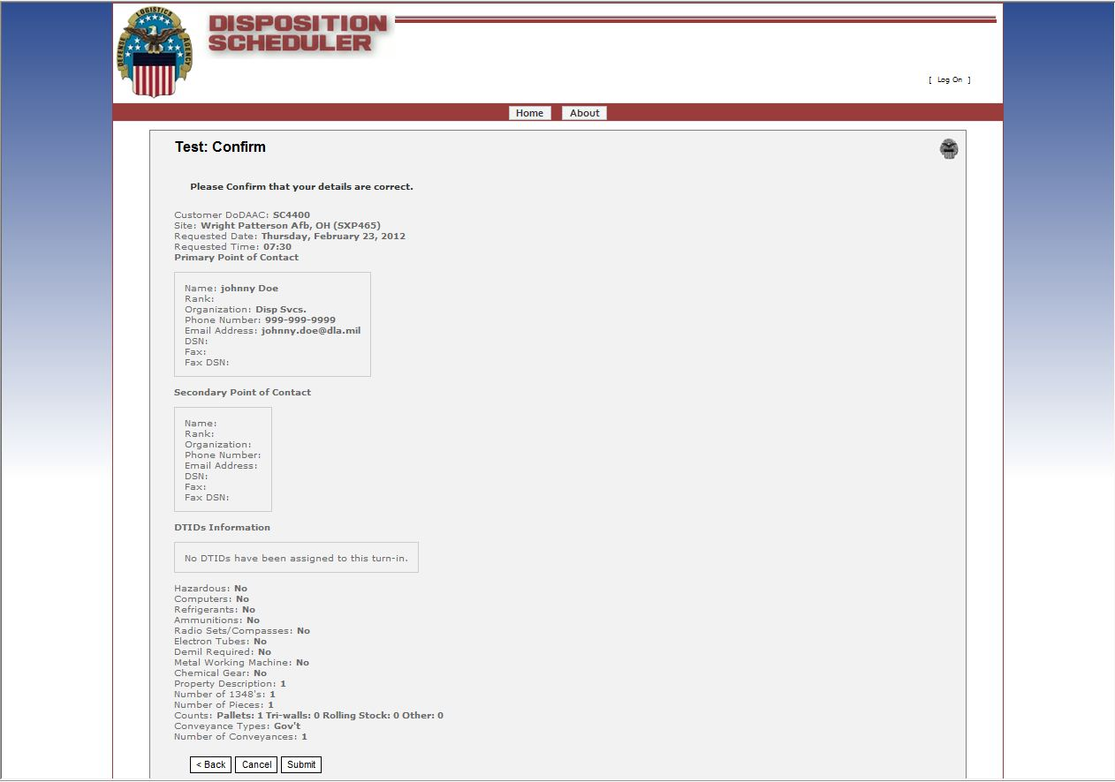
Confirmation Page
After review of this page you must click the “Submit” button

Slide 13
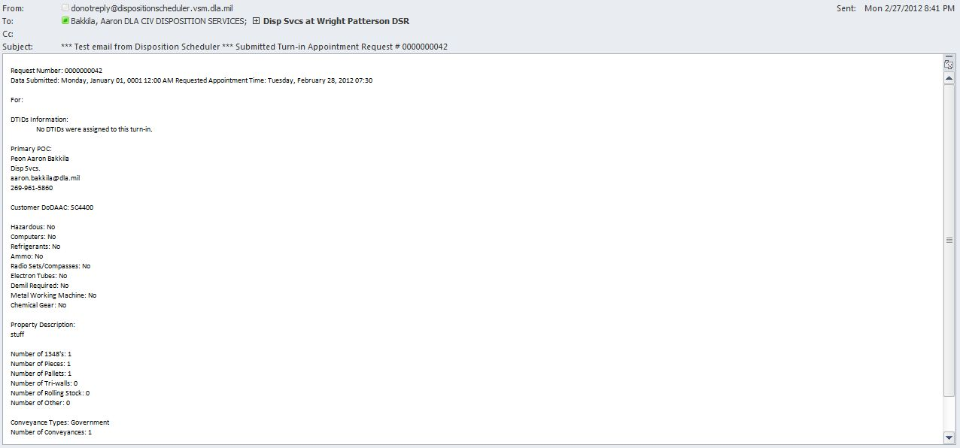
Automatic Confirmation E-mail

