Slide 1
ETID
Electronic Turn-in Document
CUSTOMER
OVERVIEW
FEB 2012
Notes:
The following slides show some of the look and functionality of the customer side.

Slide 2
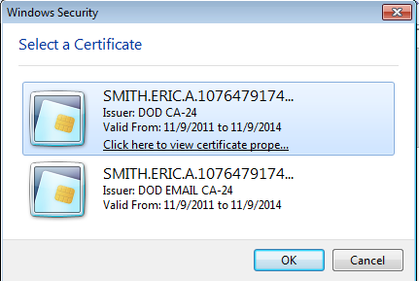
ETID is now accessed through the BSM portal link:
External Portal: https://business.dla.mil
Internal Portal: https://pep1.bsm.dla.mil/irj
Notes:
Users will access ETID through the BSM portal.
Note URL for the portal. Different URLs for external (outside DLA) and internal (within DLA) users.

Slide 3
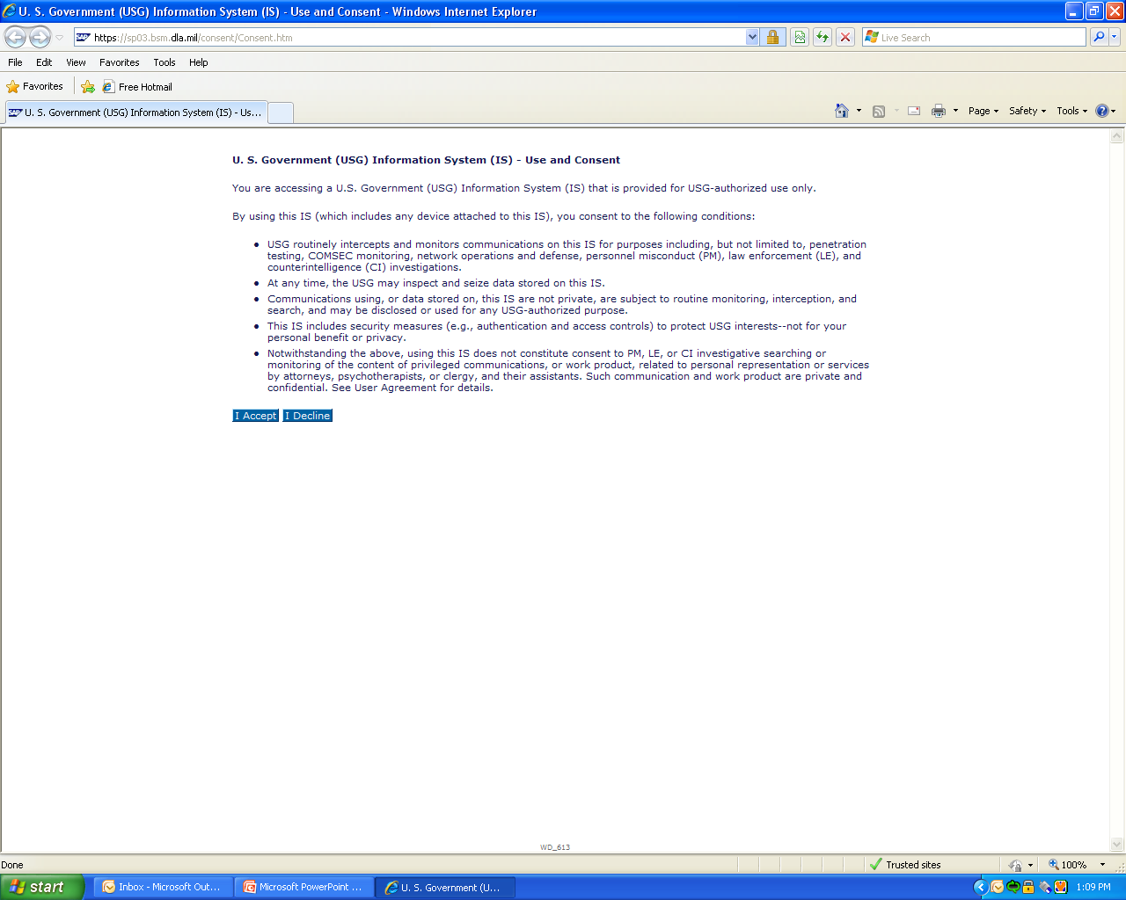
SELECT “I Accept”
Notes:
General Government Use and Consent screen.

Slide 4
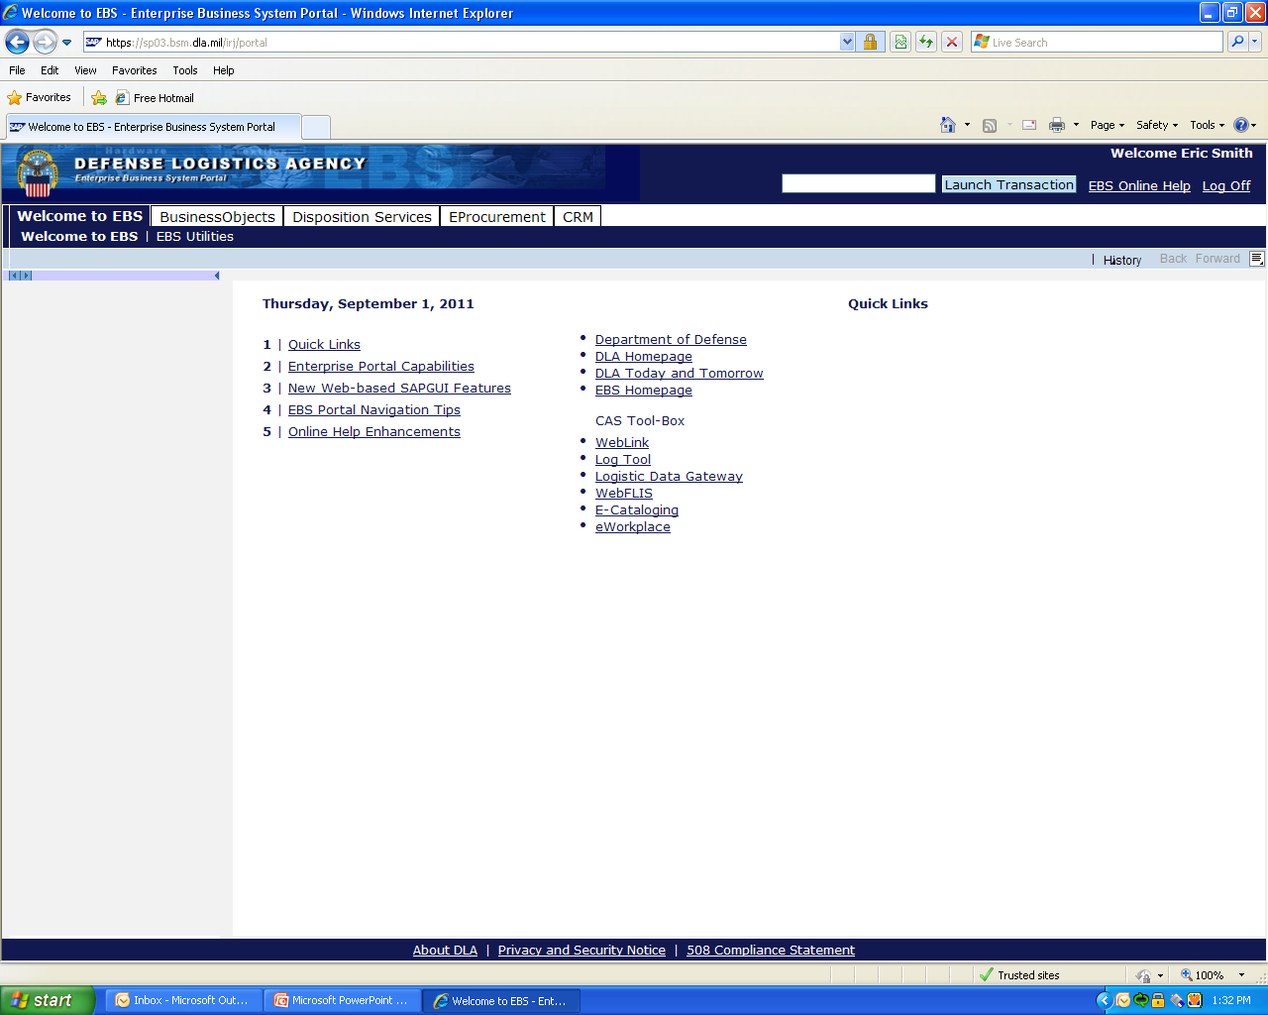
SELECT “Disposition Services”

Slide 5
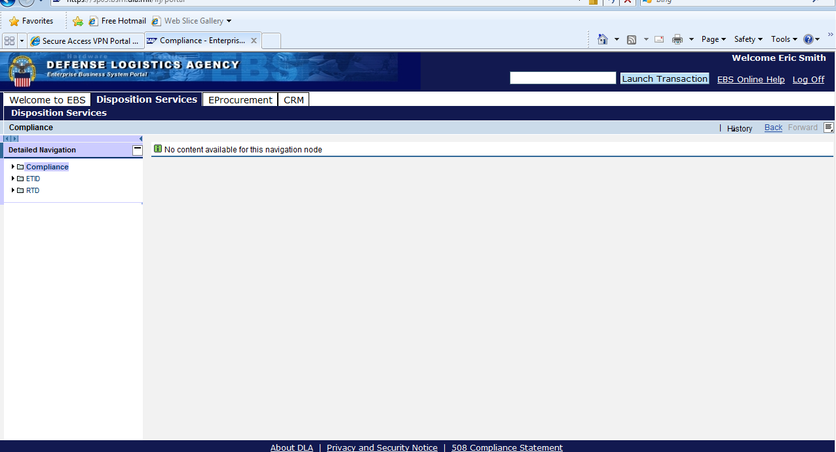
SELECT “ETID”
Notes:
All Disposition Service applications you have access to will display on the left.
Select ETID.

Slide 6
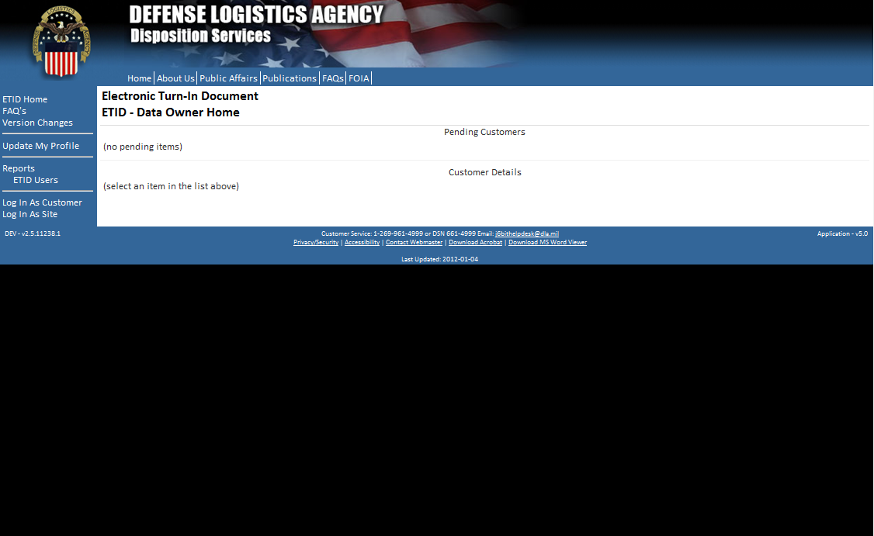
Customer Home Page
This is the ETID Customer Home Page. Customers have options to update their profile or log in as a customer.
Notes:
ETID customer home page. Customers will use an modified AMPS process to request access.

Slide 7
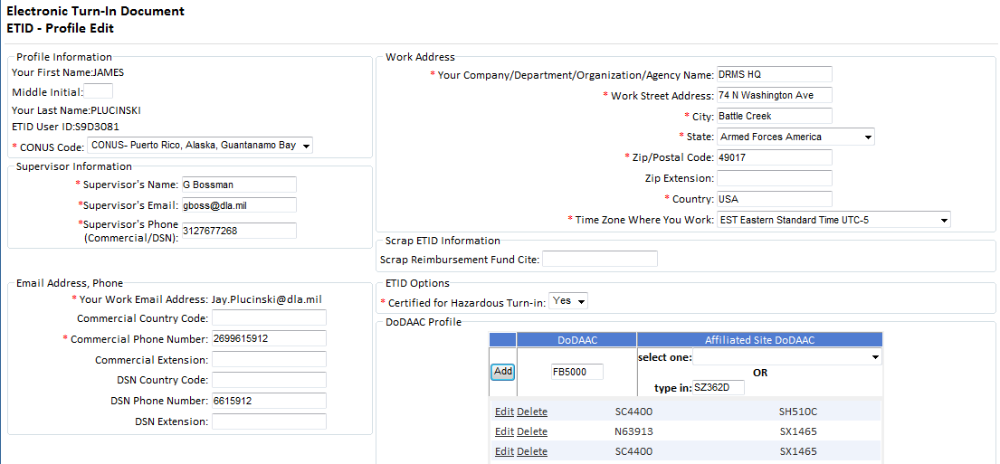
If ETID will be used for hazardous answer YES
Customers must enter both their DoDAAC and a Site DoDAAC. To turn in hazardous property, they must answer “Yes” to the Certified for Hazardous Turn-in question in their profile and complete additional profile information.
Notes:
Customers have to fill out profile information. Additional profile information will be required for hazardous property. Customers will need a DoDAAC profile. To set up their profile, customers will enter their activities’ DoDAAC along with a site DoDAAC

Slide 8
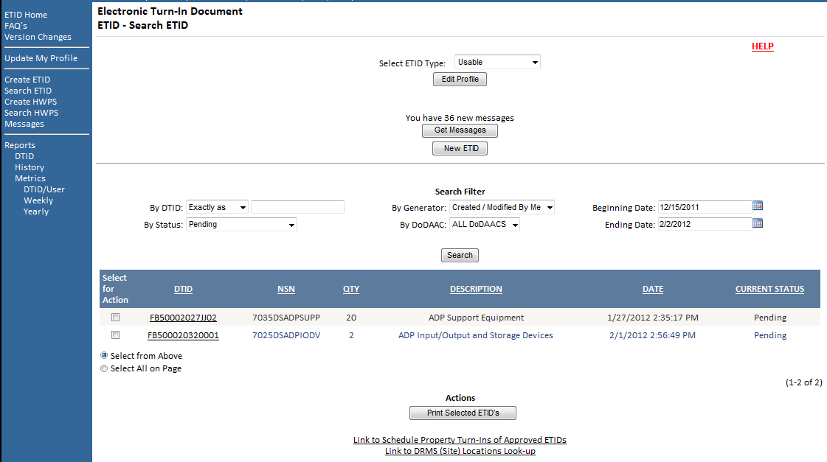
Customer can select the ETID Type. They can produce listings of ETIDs using the Search Filters. To create an ETID, select “New ETID”.
Note Navigation links on left and links on bottom.
Notes:
Customer screen will look similar to a site users screen.
They will select the ETID Type. Choices are Usable, Scrap, Hazardous Waste, Hazardous Material and Hazardous Special Service
Customers can obtain listings by adjusting their filters.
There are links to schedule turn ins and look up Site Contact information at the bottom.
They have navigation links on the left.

Slide 9
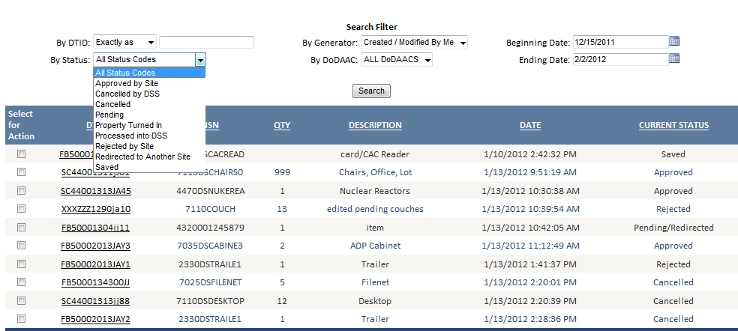
Status Codes in ETID for Customers. ETIDs are tracked in the system by the changes in Status Codes.
Notes:
There are new status codes for the customer side of ETID. Customers can now cancel approved ETIDs and save ETIDs.

Slide 10
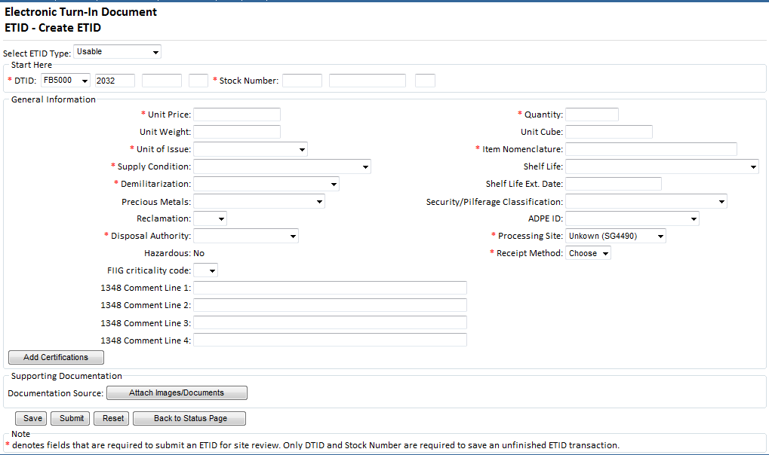
The input screen has been redesigned to fit on one screen. Customers will enter DTID information, General Item Information, Certifications, and can also add Attachments.
Notes:
The create new ETID input screen has been redesigned to fit on one screen.
Customers can upload attachments for an ETID.

Slide 11
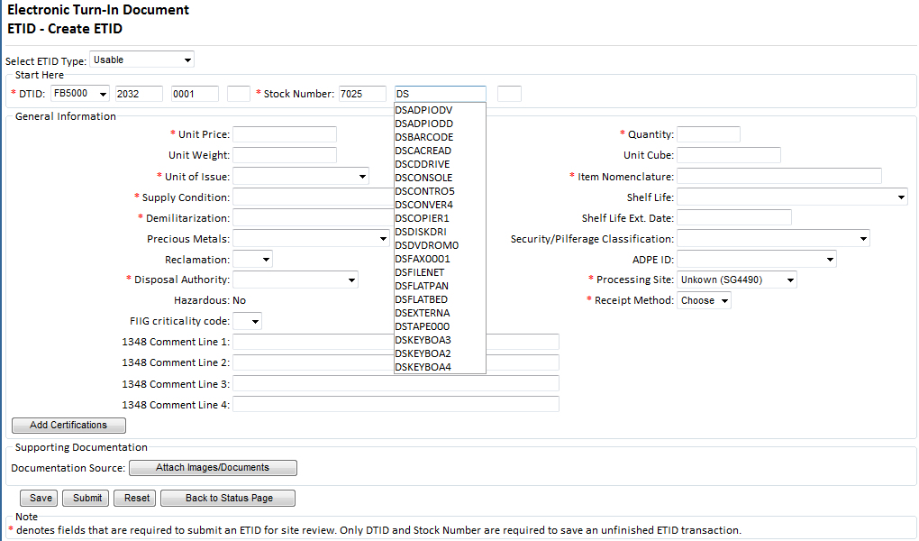
NSNs will continue to pre-populate characteristics if used. Standardized LSNs have been incorporated into ETID. LSNs choices listed are based on FSC entered.
Notes:
NSNs will pre populate certain characteristics as it did with old ETID.
The standardized LSNs have been incorporated into ETID. Customers will get a drop down of the standardized LSN based on the FSC entered in the stock number.

Slide 12
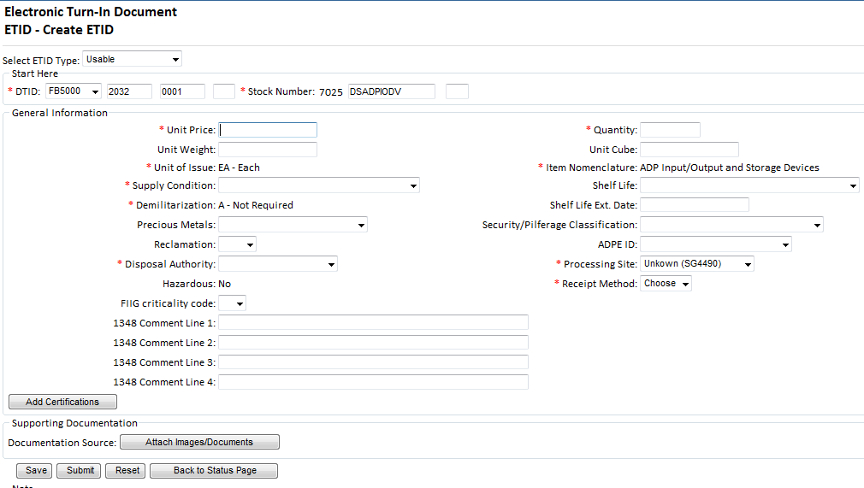
When a LSN is chosen, Item Nomenclature, Unit of Issue and Demil Code will populate.
Notes:
Basic LSN information will populate ETID.

Slide 13
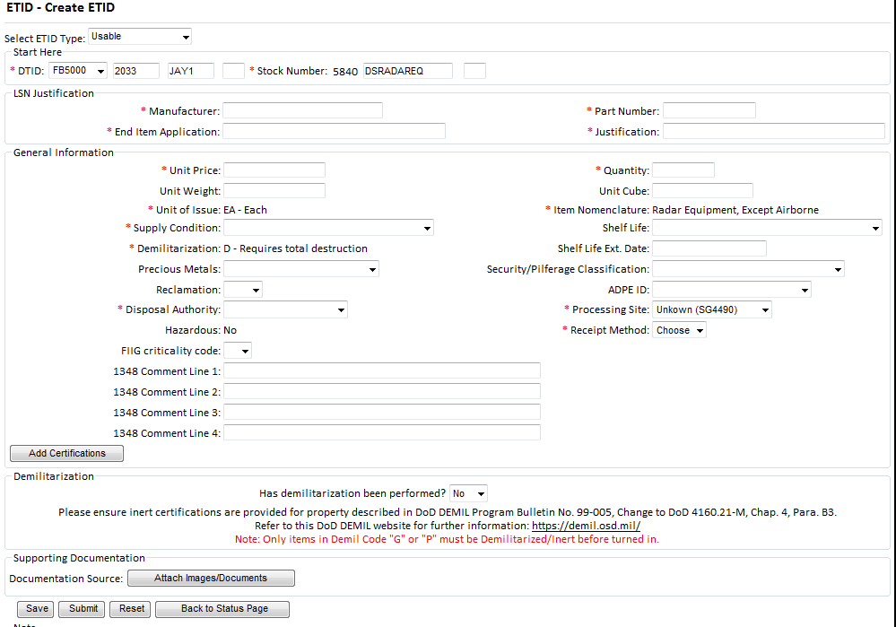
Additional LSN information required for critical FSCs.
Notes:
If a critical FSC LSN is entered, the required additional information will appear.

Slide 14
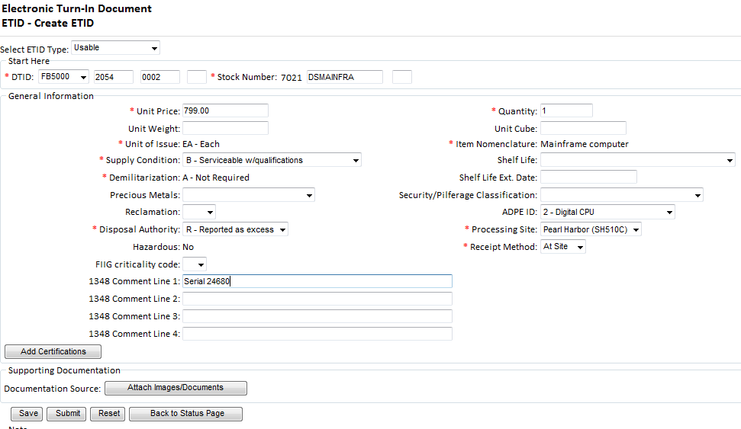
To attach a certification.
Notes:
To attach a certification to an ETID, Click “Add Certification”.

Slide 15
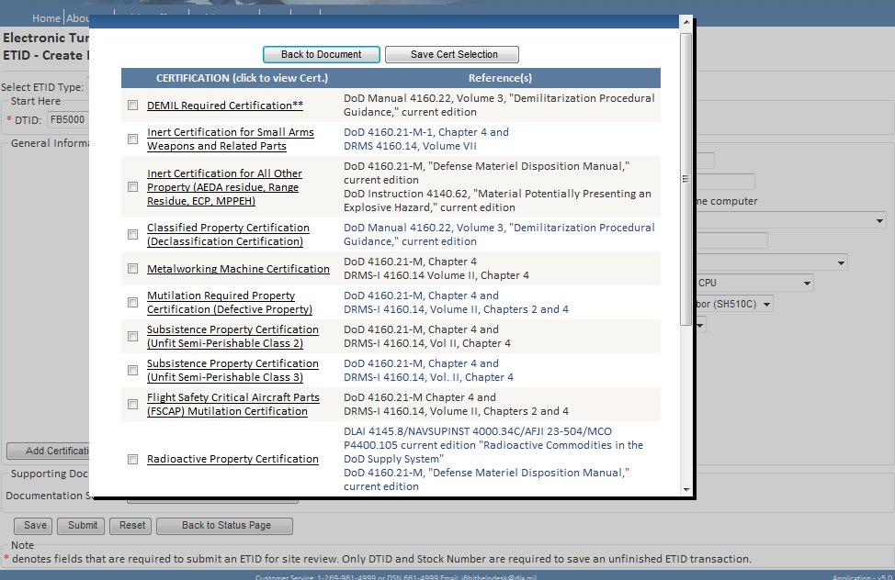
Check the box to the left of the certification title. Click “Save Cert Selection”. To view a certification, click on the certification title.
Notes:
Check the box to the left of the certification you wish to attach to an ETID.
Click on the Title of the certification to view the certification.
After the selection is made, click on “Save Cert Selection” and then “Back to Document”.

Slide 16
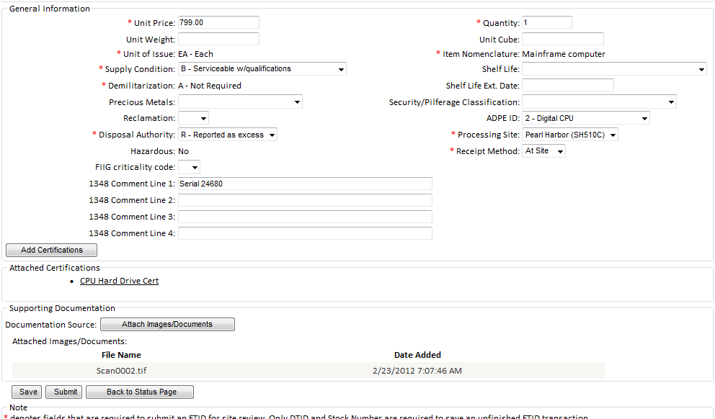
To view a selected certification, click on certification title

Slide 17
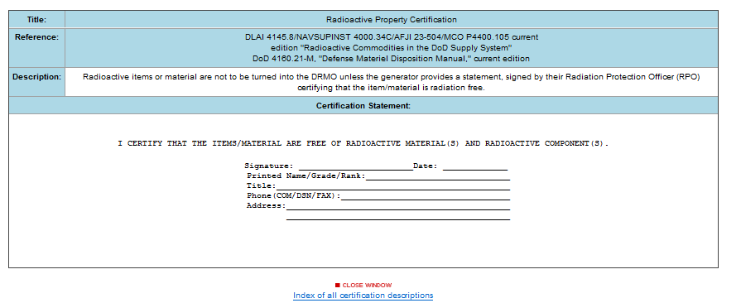
After viewing a certification, select “Close Window” to go back to the ETID.
Notes:
Click on “Close Window” to return to the ETID.

Slide 18
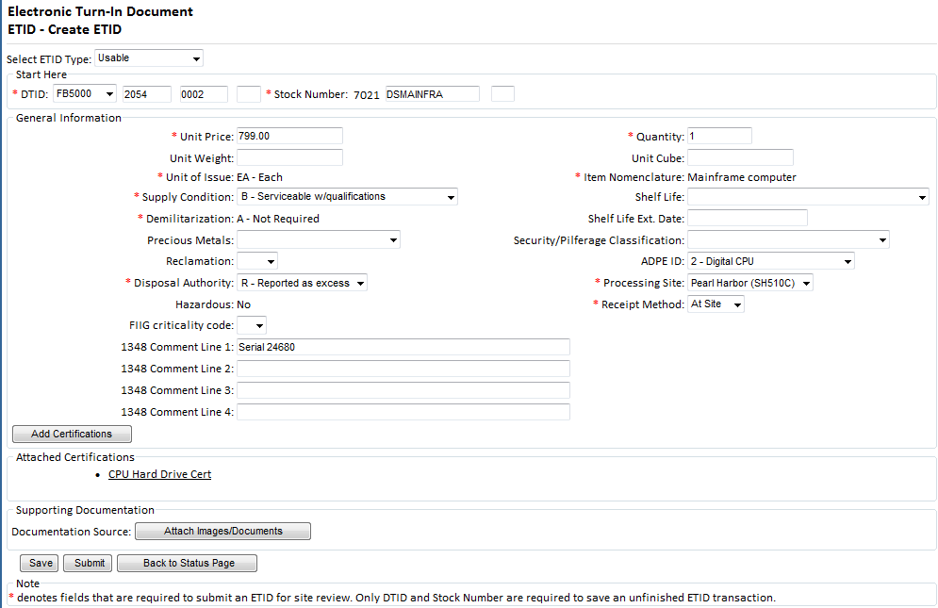
To attach a document or image to an ETID, click on “Attach Images/Documents.
Notes:
To attach a document or image to an ETID (ie. Demil F Instructions).

Slide 19
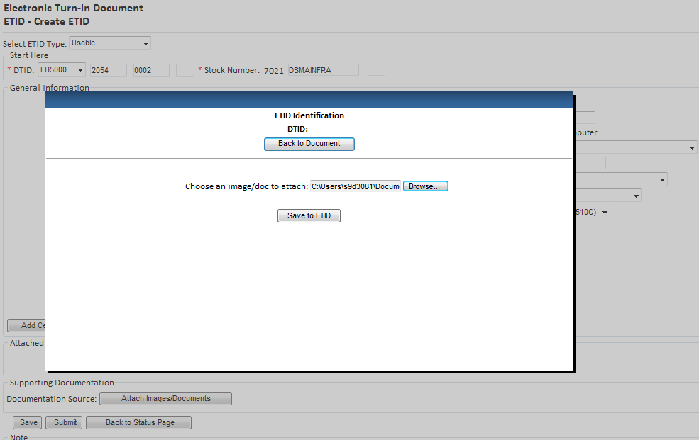
3
1
2
Select the file to upload by selecting Browse. Save the uploaded File. To return back to ETID, select “Back To Document”
Notes:
Select the file to upload by selecting Browse.
Save the uploaded File.
To return back to ETID, select “Back To Document”

Slide 20
To view any uploaded Documents/Images click on button
Notes:
The ETID will list the file name and date of the uploaded attachment. To view an uploaded attachment, select “Attach Images/Documents”

Slide 21
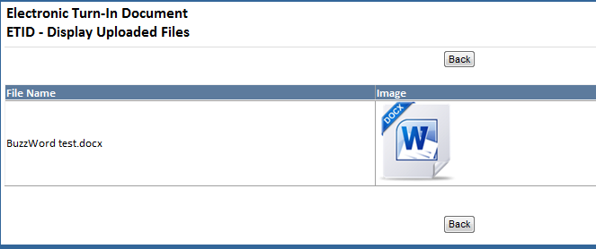
Click on image to view respective documents. After closing windows, select “Back”.
Notes:
When you click on an image, the uploaded image will open up in another window to view.
Select “Back” to return to the ETID.

Slide 22
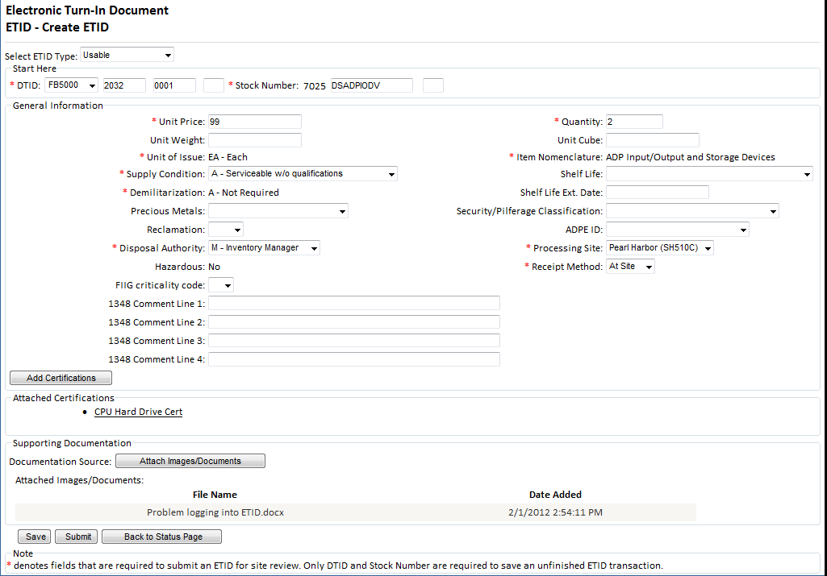
An ETID can be Saved or Submitted. An ETID can be saved unfinished and then finished later or saved finished and submitted later.
Notes:
In addition to submitting ETIDs, customers can now save an ETID.
Customers can save an unfinished or finished ETID.

Slide 23
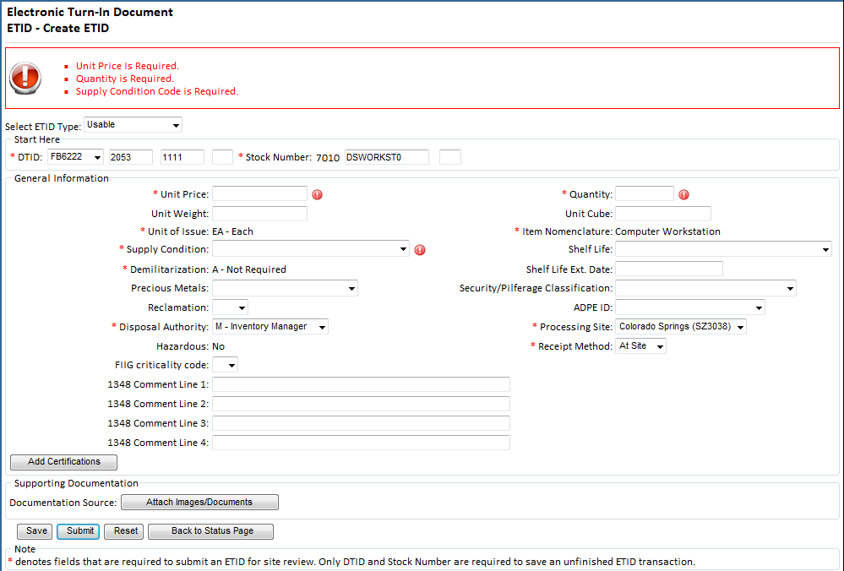
Error messages will be given at top if ETID not correct or complete when submitted.
Notes:
ETID has edits to check that all required information has been entered and is in the proper format. These edits are applied when an ETID is submitted and a customer is informed of any errors.
By placing your mouse on the red !, additional information about the error can be obtained.

Slide 24
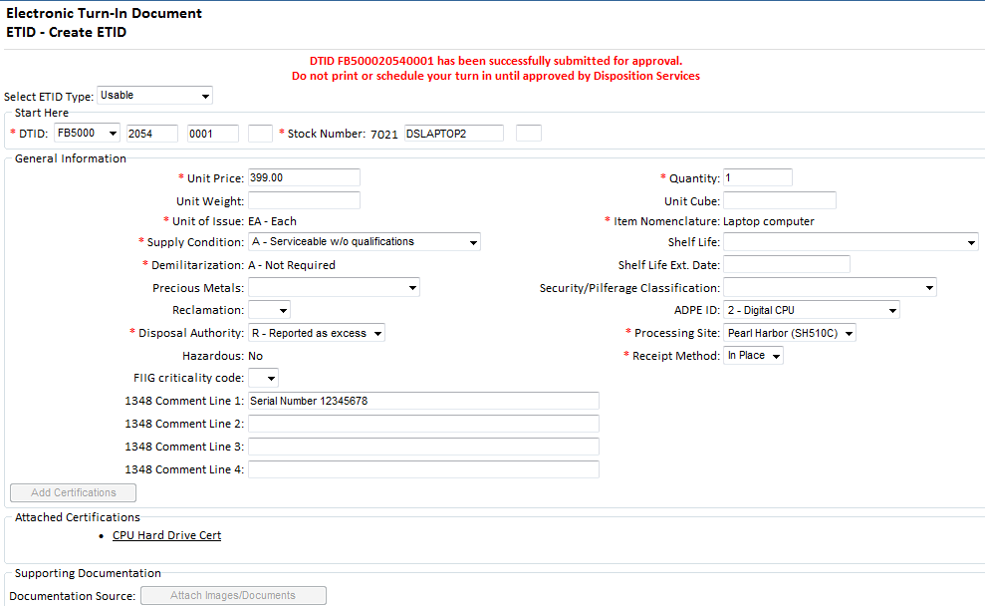
Message after submitting an ETID.
Wait for Disposition Services Site review.
Notes:
This is the message customers will see when they submit an ETID for Site approval.
Do not print or schedule your turn in until your ETID has been approved by Disposition Services.

Slide 25
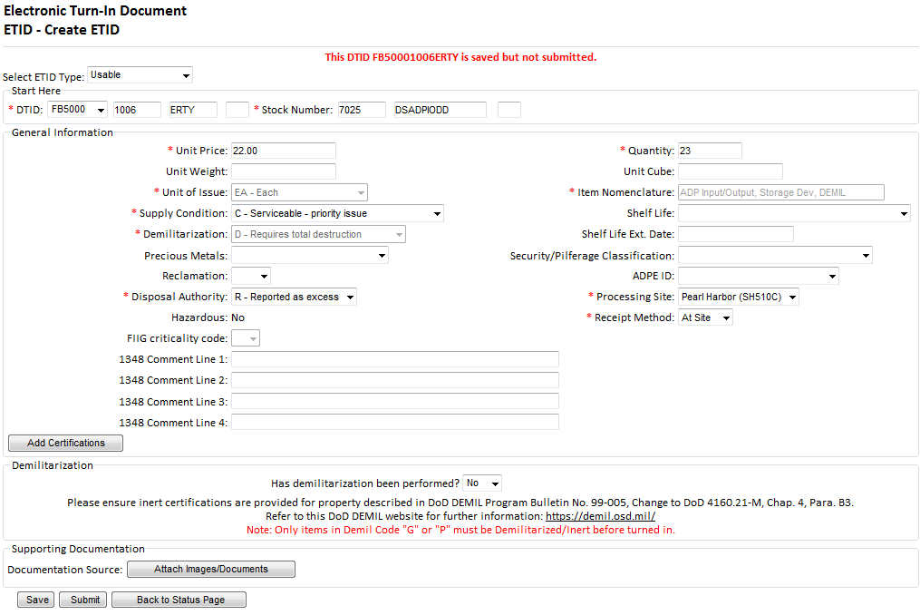
Message for a finished ETID that is saved.
Notes:
When a customer saves an ETID that is considered complete, they will see this message.

Slide 26
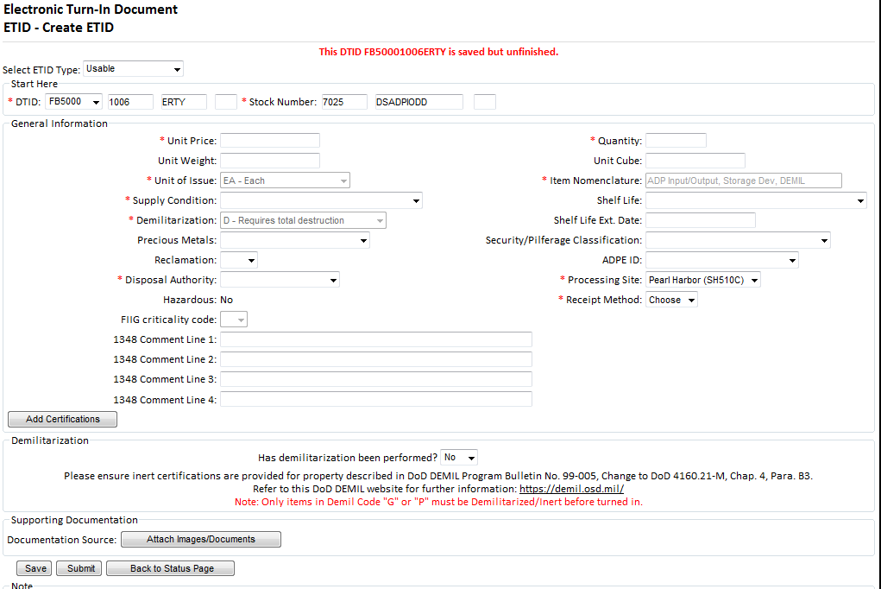
Message for a saved but unfinished ETID. This ETID can be completed later and submitted.
Notes:
When a customer saves an ETID that is not finished, they will get this message.

Slide 27
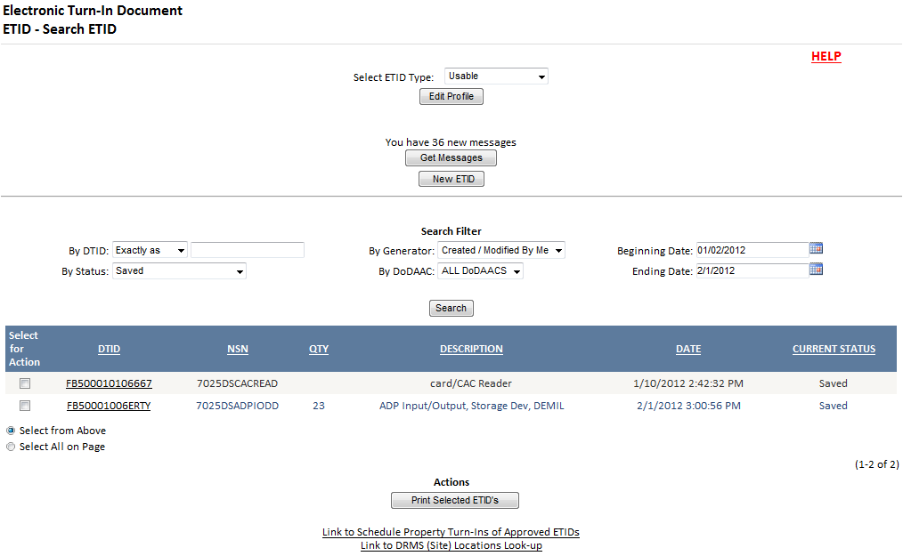
To finish or submit a saved ETID, select the desired ETID.
Notes:
Customer can filter on “Saved” Status code to see their saved ETIDs.
To finish or submit a saved ETID, customer will click on the DTID number.

Slide 28
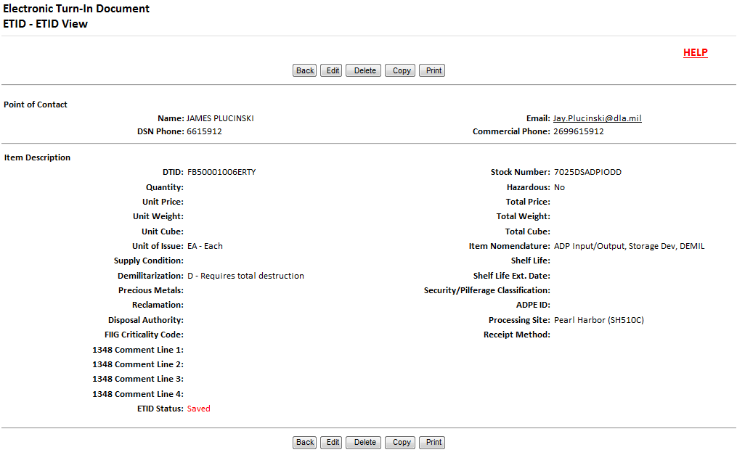
Select ‘Edit’ to finish and/or submit a Saved ETID.
Notes:
In the view screen, customer will select edit to finish or submit a saved ETID.

Slide 29
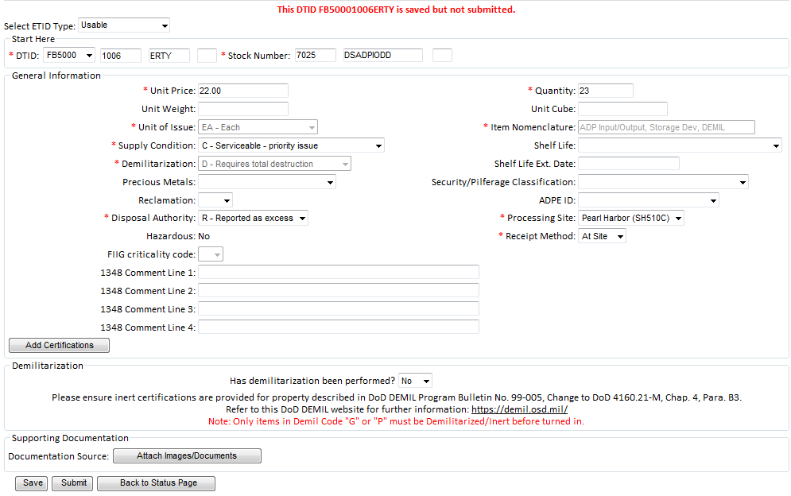
Customers can make edits and select Submit or Save.
Notes:
Customer will finish the ETID. They can select certifications or attach attachments if necessary.
Customers can re-save if desired or submit for site review.

Slide 30
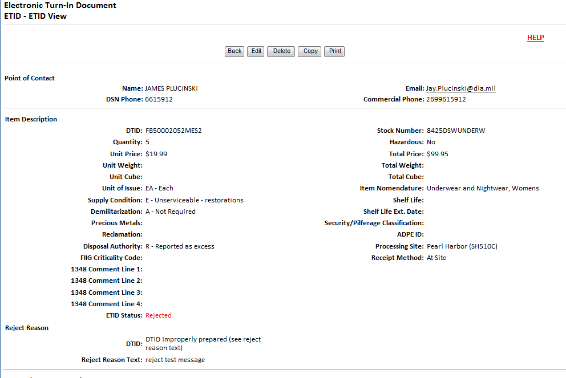
Customers can Edit, Delete, or Copy ETIDs in Pending, Rejected or Redirected Status.
Notes:
Customers can edit, delete, or copy Pending, Pending/Redirected, or Rejected ETIDs

Slide 31
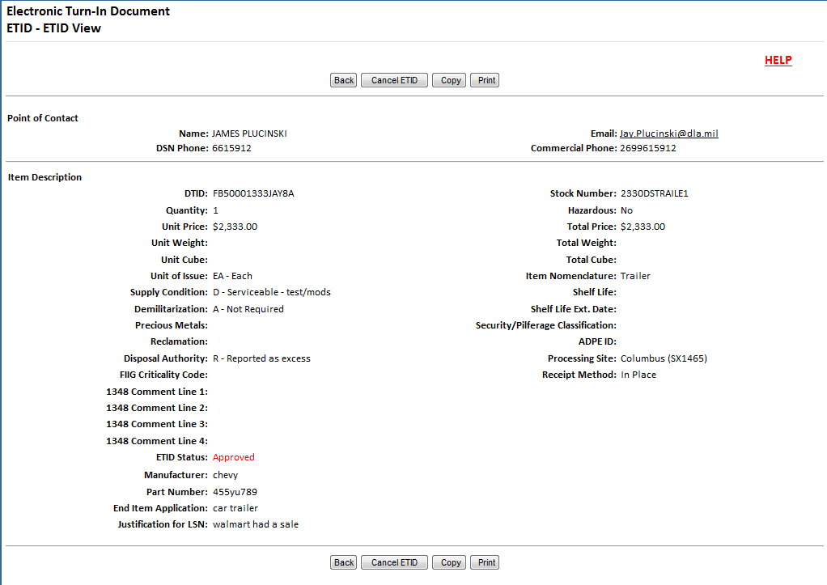
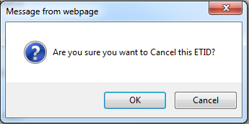
Customers can Cancel Approved ETIDs. Customers will also get messages when approved ETIDs that qualify for Intransit Control tracking are not received within 90 days.
Notes:
Customers can now cancel an approved ETID.
When a customer cancels an approved ETID, the status will be updated in ETID and the cancellation request will be sent to DSS and processed in DSS.
PMR and Intransit records will be updated.
Also, customer will receive intransit control follow-ups for ETID that have been approved but not turned in. They will cancel approved ETIDs to close out these intransit follow ups

Slide 32
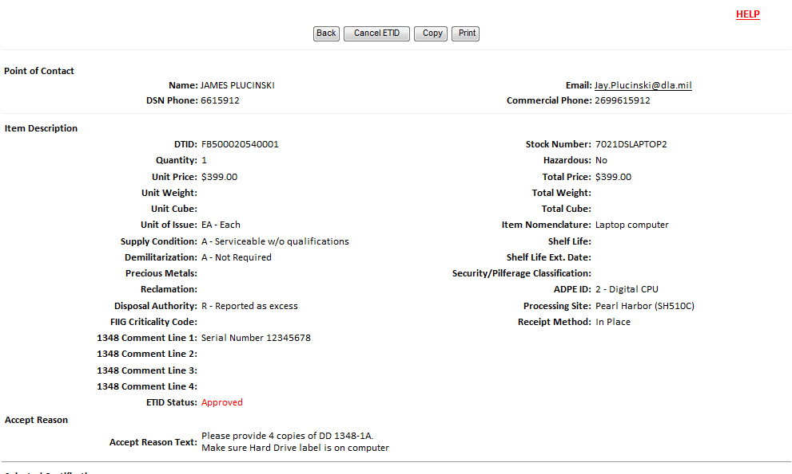
Customers may also receive information related to an approved ETID. View an approved ETID to check for additional information.
Notes:
Customers may also receive information related to an approved ETIDs and its turn in. This can be helpful information from your turn in Site about your turn in. View an approved ETID to see any additional information.

Slide 33
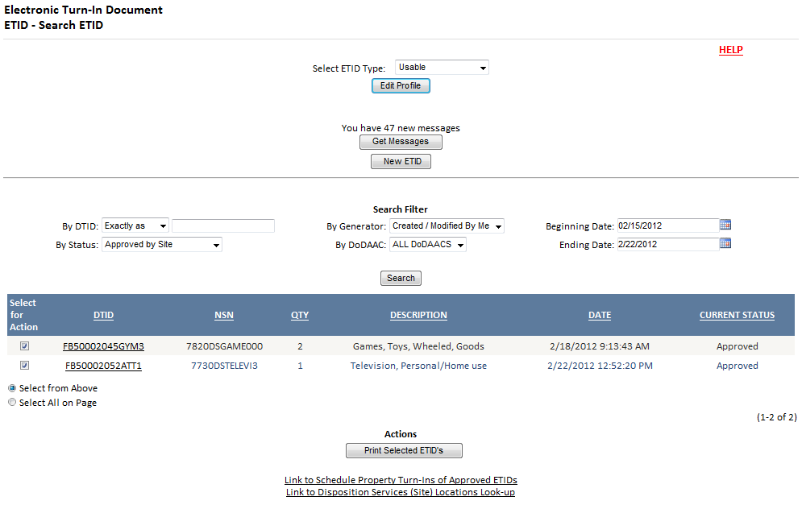
Customers can Print Approved ETIDs. Customers should wait for ETIDs to be reviewed before they print.

Slide 34
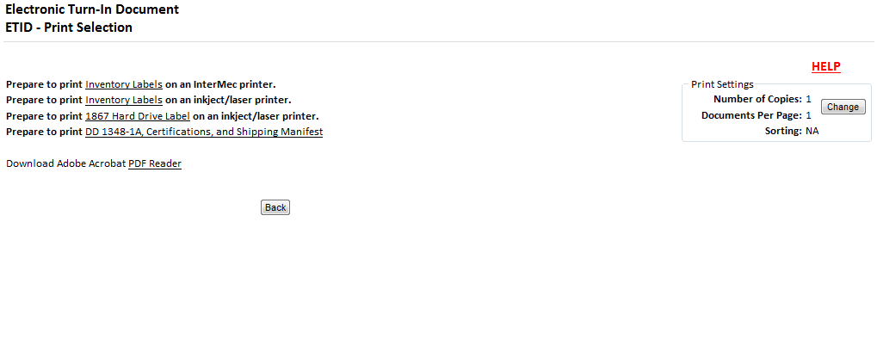
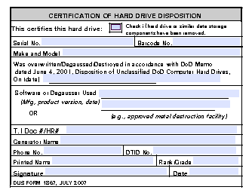
New
After you select print, you can choose what you want to print. You can print labels, DD 1348-1A, Certifications, and a Shipping Manifest. Customers can now print a DLIS 1867 Hard Drive Label.
Notes:
You can still print inventory labels, DD 1348-1, certifications, and a shipping manifest.
The capability to print the DLIS 1867 Hard Drive Label has been added as a printing option in ETID. The label will open up in a pdf and can be completed by customers.
Data (ie., DTID number) will not pre populate from the ETID to the label.

Slide 35
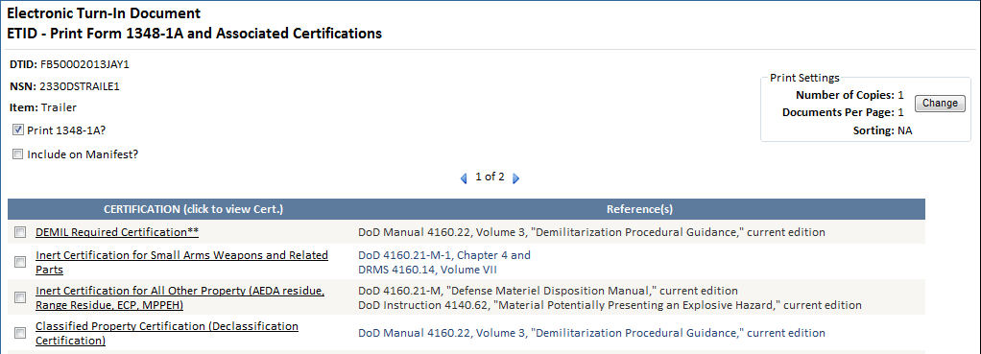
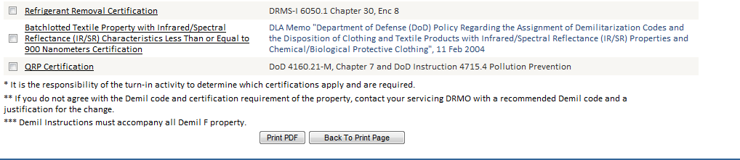
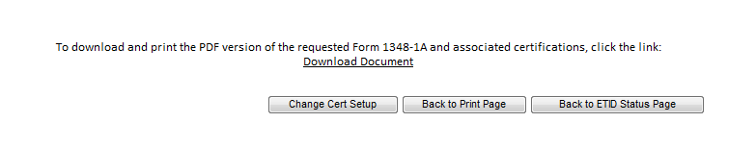
Notes:
The printing process will flow the same as it has in ETID.
Choose a manifest if needed.
Check/uncheck certifications as needed
Select Print PDF
Click on Download Document

Slide 36
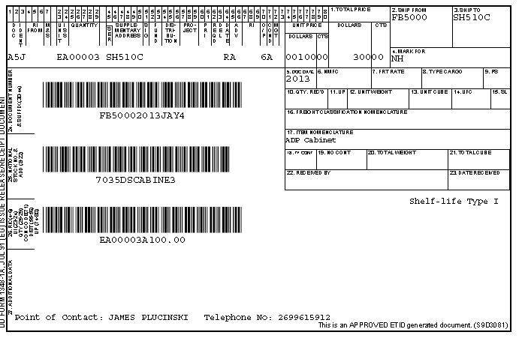
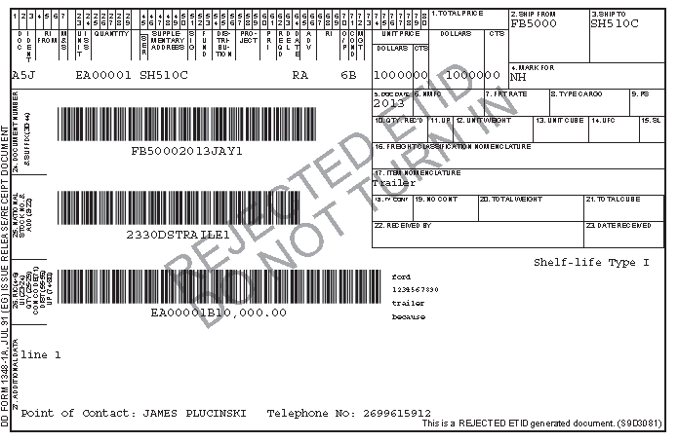
The 1348-1A in ETID now has 3 bar codes
Rejected ETIDs now have a watermark.
Notes:
Samples of 1348-1A.
The 1348-1A will contain a 3rd barcode in block 26 for the information previously printed in ETID (quantity, UI)
Rejected ETIDs will contain a watermark when printed to prevent these rejected ETIDs from being turned in.

Slide 37
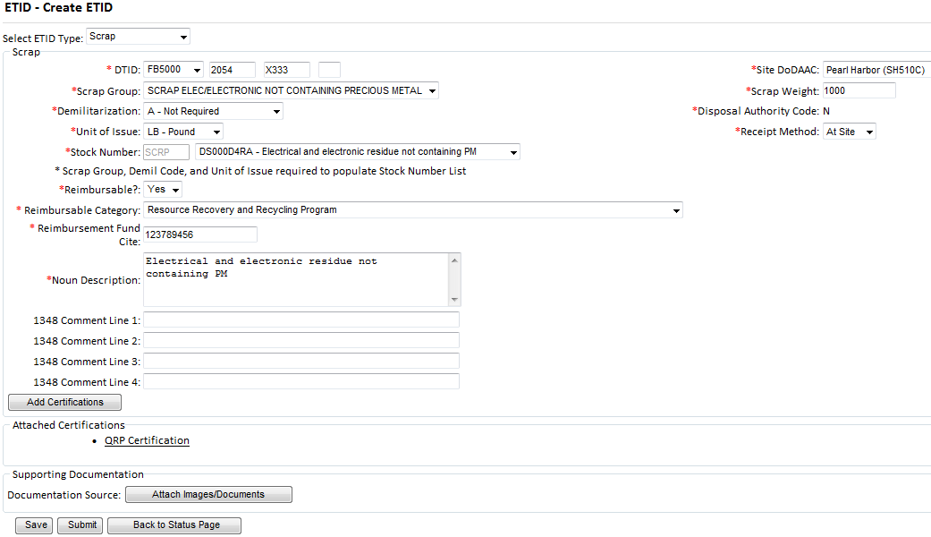
ETID has a scrap module.
Drop down choices assist customer in completing the scrap turn ETID. A QRP certification is also available.
Notes:
Scrap has its own module in ETID. Customers will turn in scrap by utilizing the standardized LSNS for scrap. Drop down choices will assist customer in completing the scrap turn in ETID.

Slide 38
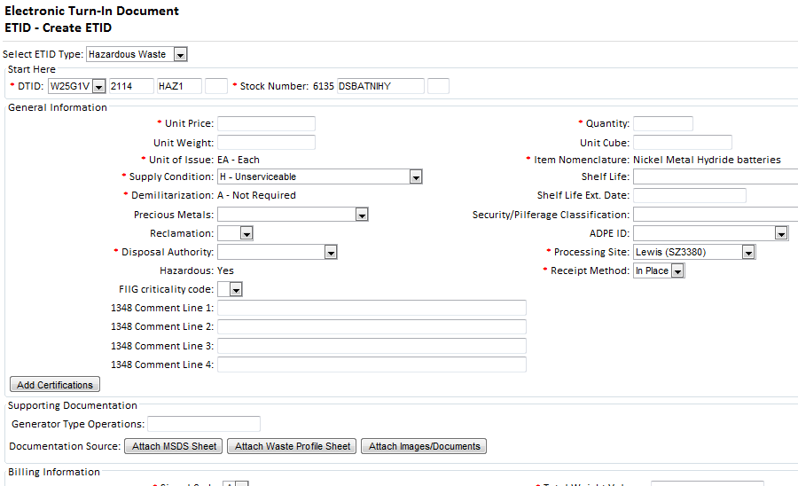
ETID has a Hazardous Waste Module.
Select and Attach Supporting Documentation.
Enter additional required HW information.
Notes:
ETID has a Hazardous Waste Module for turning in hazardous waste. Users will complete the required necessary information for the hazardous waste including supporting documentation. Supporting documentation can be a hazardous waste profile sheet or material safety data sheet. Users can certify that they will provide a hard copy of the support documentation, attach it within the ETID, or create a hazardous waste profile sheet within ETID.

Slide 39
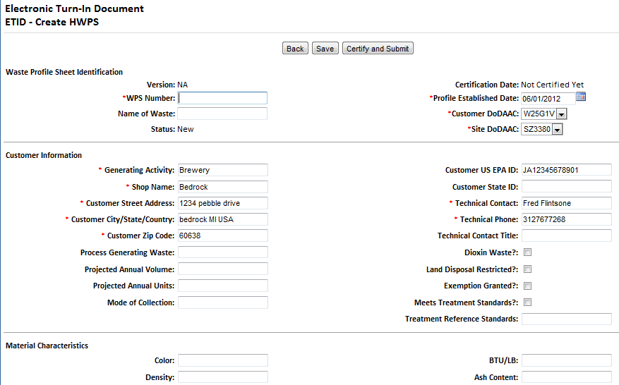
Your can create a Hazardous Waste Profile Sheet (HWPS) within ETID.
You can save a HWPS. Certify (or Re-Certify) and Submit your HWPS to be authorized for use by the Disposition Services Site.
Notes:
Users can create a hazardous waste profile sheet (HWPS) within ETID to accompany an hazardous waste turn in. Users must certify and submit the HWPS before attaching it to an ETID. Customers can now re-certify a HWPS as necessary and can create different versions of a HWPS using the same HWPS number.

Slide 40
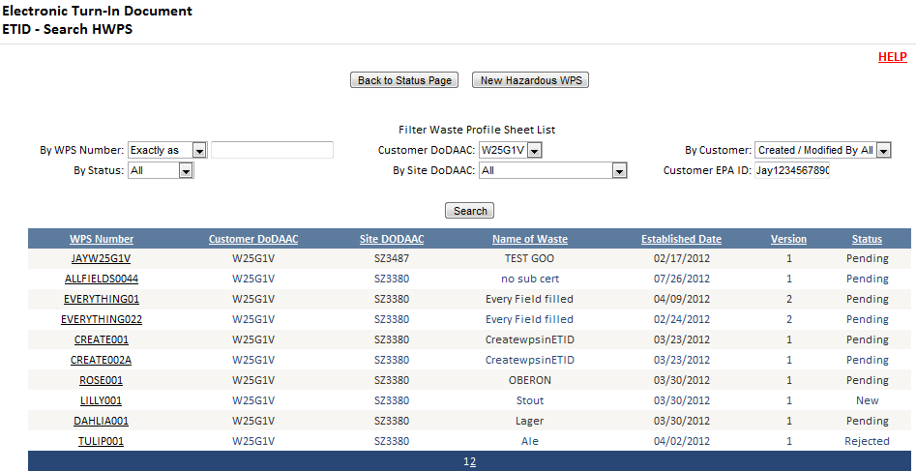
Your can manage, view, and sort Hazardous Waste Profile Sheets (HWPS) within ETID. You can create multiple versions of a HWPS, copy a HWPS, and recertify a HWPS.
Notes:
If you click on the “View Hazardous Waste Profile List” Button in the hazardous waste module, you can sort and then view hazardous waste profile sheets created in ETID. When viewing a hazardous waste profile sheet you can then edit or copy a profile sheet.

Slide 41
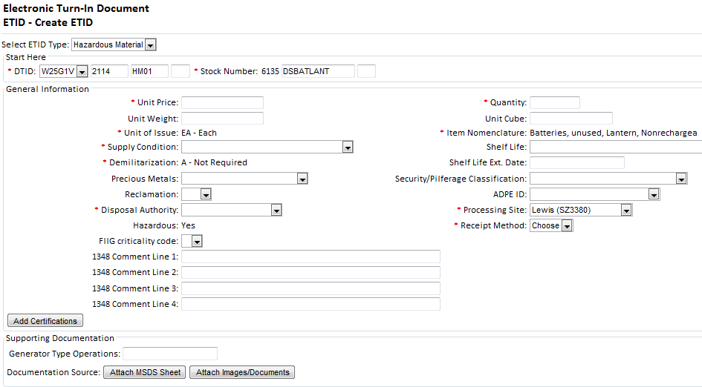
ETID has a Hazardous Material Module for turning in hazardous material. Select and Attach Supporting MSDS Documentation.
Enter additional required HM information.
Notes:
There is a hazardous material module in ETID to turn in hazardous material. Users will complete the necessary information for the hazardous material including supporting documentation. Supporting documentation is normally a material safety data sheet (MSDS). Users can choose to provide a hard copy, upload an MSDS or reference a HMIRS MSDS number.

Slide 42
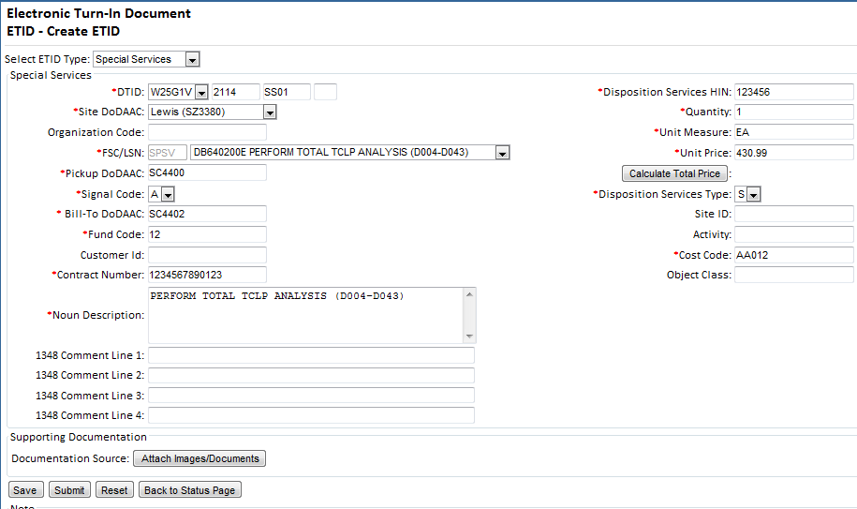
ETID has a Special Service Request module for submitting requests under your disposal contract. Drop down choices assist customer in completing the Special Service Request.
Notes:
The special services module is used to request a special services performed under your hazardous disposal contract.

Slide 43
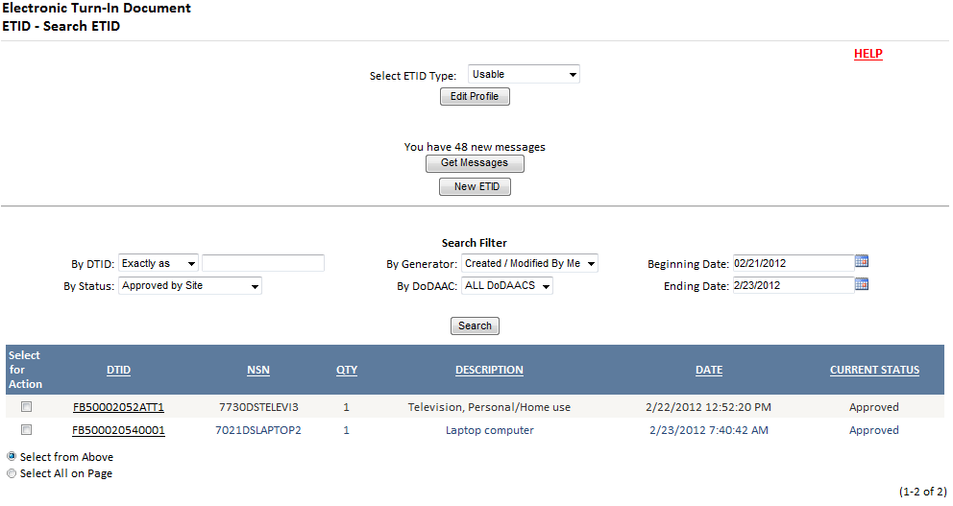
Get Messages provides a central location to view/process ETID’s based on actions taken by Disposition Services Sites. It can be used as an alternative way to managing ETIDs in lieu of by Status Code.
Customers will receive messages notifying them that an ETID has been approved, rejected, or redirected.
Notes:
The message center in ETID will work in the same manner as it worked in the previous version of ETID.
Get Messages can be used as an option for managing ETIDs. It provides the option to manage ETIDs based on actions taken or required rather than by status codes.

Slide 44
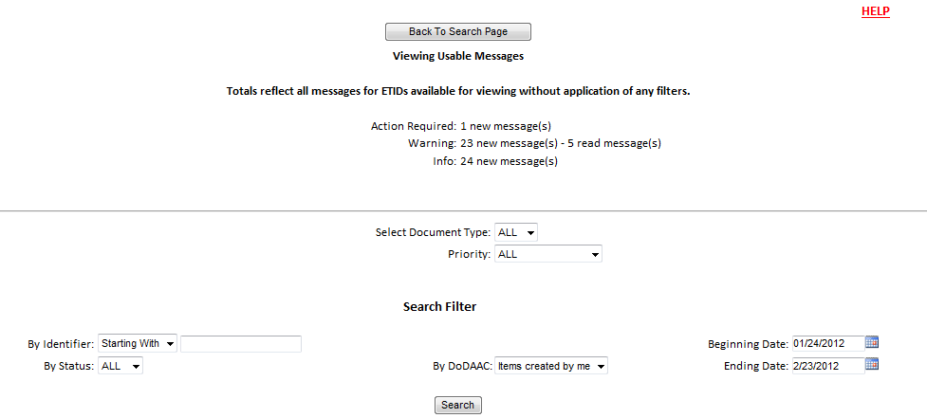
The “ETID – Messages” screen provides a summary of messages by priority. “Action Required” means some action identified in the message will be required of the user. “Warning” and “Info”, inform of some action that has been taken on an ETID or WPS, but no further direct action is required.
You can use the filters to get listings of messages.
Notes:
In addition to generating messages for actions that are needed, the message center will also send messages that provide information concerning actions on an ETID.
The message center will give you a break out of messages by priority.
Users will use the filters to obtain listing of messages. You can sort by Document Type or Priority.

Slide 45
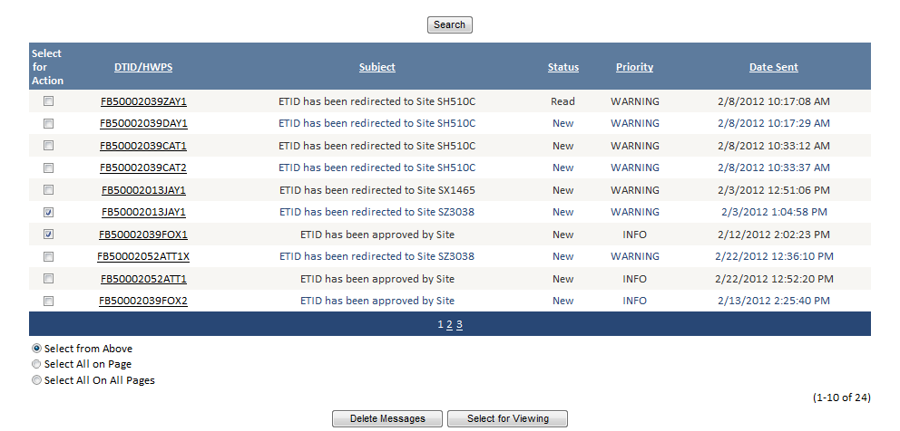
ETIDs related to a message may be viewed. To view an ETID from the Message center check the box and select “Select for Viewing” or click on the DTID number.
Notes:
You can also sort by other criteria.

Slide 46
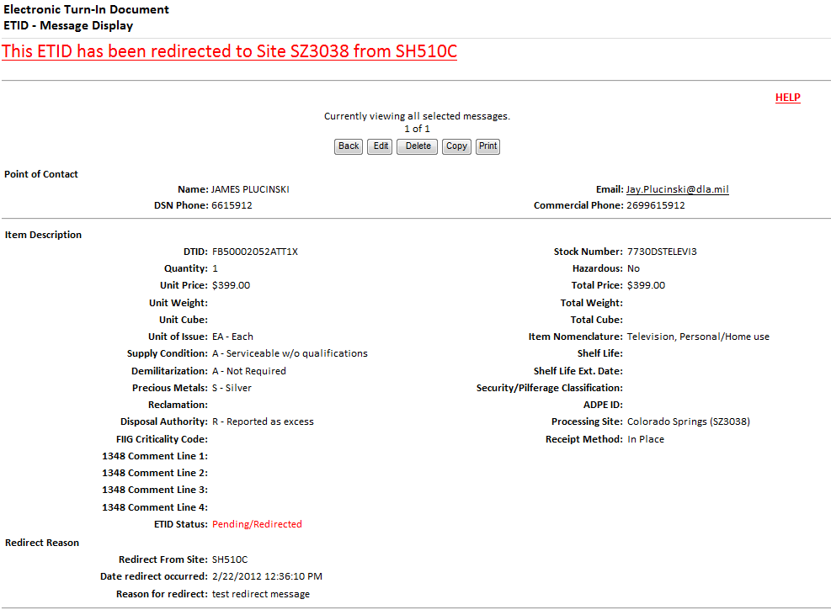
Note the message given in red at the top of the screen. Action buttons allow a customer to take various actions based on the ETID status.
Notes:
When an ETID is viewed in the message center, you will see the message at the top of the ETID.
Click on an action button as necessary.

Slide 47
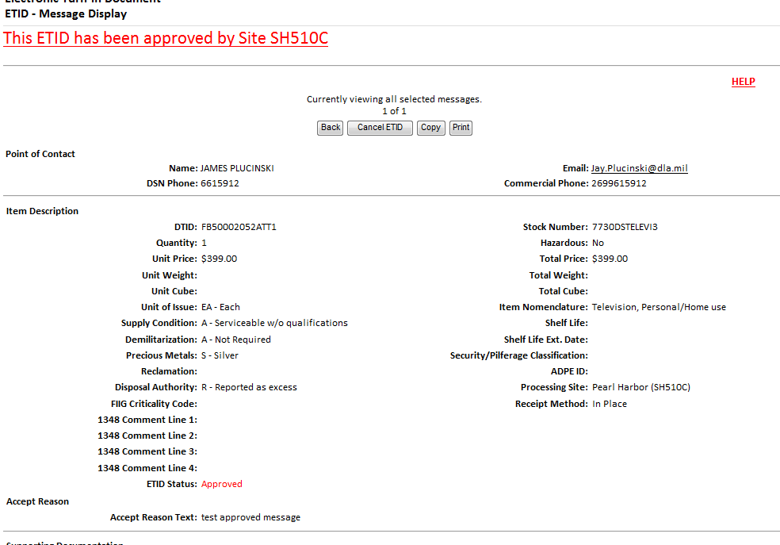
When you view a ETID, the status of a message will change from “New” to “Read”. For action required messages, the action taken will automatically delete the message.

Slide 48

Read messages can be deleted. For Action Required messages, the action taken will automatically delete the message.
Notes:
After reading your messages, they can be deleted by selecting the read messages and clicking on “Delete Messages”. For Action Required messages, the action taken will automatically delete the message.

Slide 49
For additional information on using ETID:
Contact your local Disposition Service Site for questions regarding specific turn-ins
http://www.dispositionservices.dla.mil/drmo/drmo-locations.shtml
For Customer Support:
By email: DLA Contact Center
By Phone: 1-877-352-2255
Notes:
Reference sources

