Slide 1
Implementation of a Mandatory Employee Influenza Vaccination Program in a Rural Tribal Health Care Facility
Deborah A. Farrell BSN
Jane A. Oski, MD, MPH
Epidemic Response Team
Tuba City Regional Health Care Corporation

Slide 2
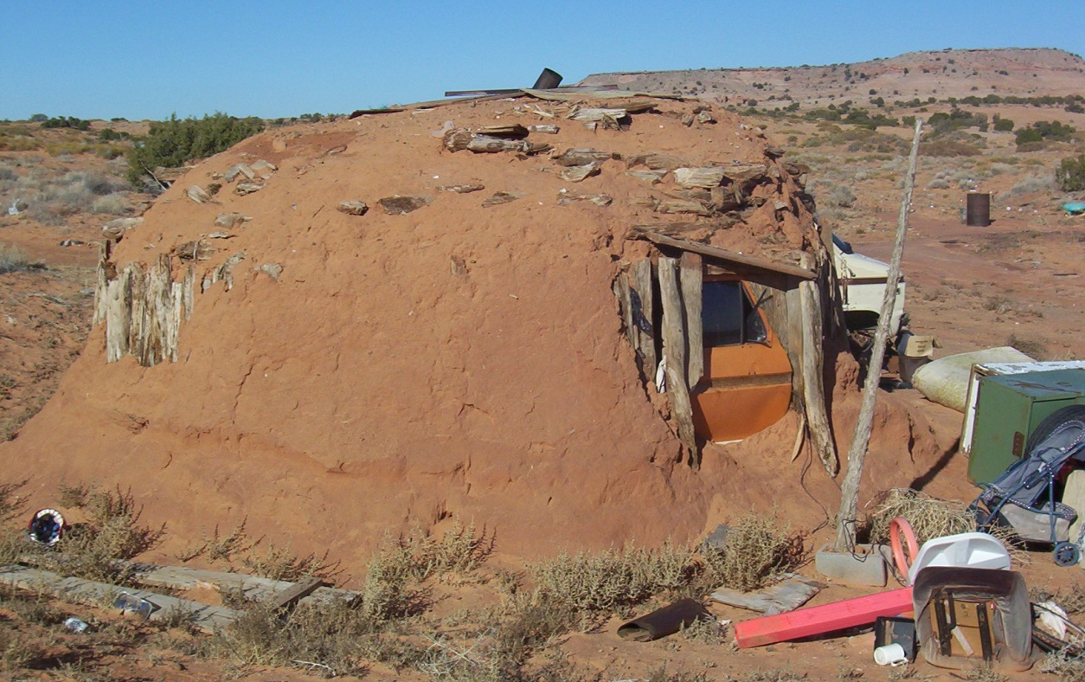
The Setting
Tuba City Regional Health Care Corporation (TCRHCC) is a 55-bed tribal facility located on the Navajo Nation in northeastern Arizona.
The facility employs an average of 1076 health care personnel (HCP) and provides approximately 180,000 outpatient visits per year.
The majority of HCPs are American Indians (AI) with close ties to the community and extensive clan relationships.
Notes:
The majority of professionals including non-Natives live in government provided housing and due to the closeness of the community, both have an increased opportunity for exposure and transmission. A small percentage of employees commute long distances from outlying areas.

Slide 3
Problem
In the 2009 Influenza A (H1N1) Pandemic, the mortality rate for American Indians (AI) and Alaska Natives (AN) was 4 times higher compared to other racial/ethnic populations.
Disproportionate number of H1N1 influenza deaths among AI/AN’s in 12 states representing 50% of the AI/AN population.
Total 426 deaths with 42 (9.9%) among AI/AN’s.
Majority of the AI/AN deaths:
Arizona (16) & New Mexico (8).
50% of the total AI/AN population
falls into one of the categories of
increased risk for medical
complications from influenza.

Slide 4
HCP Influenza Vaccination
The CDC estimates HCP vaccination rates at 30% to 40%.

Slide 5
Mandatory Employee Vaccination
Just do the right thing!

Slide 6
Planning/Implementation
Feb 2010: Epidemiology Response Team (ERT) identifies need for change.
May: Nurse Executive Council unanimously passes policy.
July: Medical Executive Committee passes policy by a 20-5 vote.
August: Senior Leadership passes policy.
Sept: Communication to staff.
Oct 7: >500 employees vaccinated.
Incentive: $5 Subway cards.
Oct 8 – 31: Mobile cart & flexible hours
to capture remaining emp.
Nov 1: 97% vaccinated.
2% declined & wearing masks.
1% unaccounted.

Slide 7
Sustaining
Balance between forces achieved
Departmental enforcement
Potential hires notified
Feedback and recognition to
staff
Monitoring

Slide 8
Implications for Advanced Practice Nurses
The Advanced Practice Nurse is the agent of change.
Respected and regarded as a leader among staff.
Knows who to influence, when to influence, and how to influence.
Possess education, skills and integrity to make the change happen.
Sometimes you just need to lead and the others will follow.

Slide 9
Acknowledgements
Nursing Executive Council
Medical Executive Committee
Human Resources
TCRHCC Employees!!!!

