Slide 1
Influenza-like Illness (ILI) Surveillance
Jim Cheek, MD, MPH, FACPM
Director, Div of Epi & Disease Prev
Indian Health Service
james.cheek@ihs.gov

Slide 2
Influenza Surveillance in the US
Information | System
Virology | WHO/National Respiratory and Enteric Virus Surveillance System
Outpatient illness | US Outpatient Influenza-Like Illness Network
Hospitalizations | Emerging Infections Program
 | New Vaccine Surveillance Network
Mortality | Pediatric (nationally notifiable disease)
 | 122 Cities Mortality Reporting System
Geographic spread | State and Territorial Epidemiologist reports
Notes:
There are a number of systems for influenza surveillance in the US. In order to have comparable national data, we designed our system to be comparable to the system monitoring outpatient illness, ILINet.

Slide 3
Indian Health Service Influenza Awareness System (IIAS)
IIAS electronically monitors:
  Outpatient influenza-like illness (ILI)
  ILI hospitalizations
  Influenza vaccine coverage
  Potential influenza vaccine adverse events
Operational within 3 weeks of first reported pH1N1 cases in 2009
Operating continuously since that time
Notes:
We developed a new surveillance system called…

Slide 4
Operation of IIAS
What | Software update of Resource and Patient Management System (RPMS)
How | Automated search of the health information system (RPMS) for ILI visits
Where | Any I/T/U facility with software installed
Who | Outpatient visits to participating facilities
When | Daily retrospective RPMS database search
Notes:
Let me cover the operation of the IIAS…

Slide 5
Flow of Surveillance Information
Provider
Patient
EMR
Paper chart
Visit data transcribed
Feedback
RPMS
IIAS data extraction
IHS Division of Epidemiology
Analysis & report creation
IHS partners
(Tribal, state, federal)
Notes:
This illustrates the flow of surveillance information in the system:

Slide 6
IIAS ILI Case Definition
Outpatient visits with:
  1. ILI-related ICD-9 code + temp ≥ 100°F
  OR
  2. influenza-specific ICD-9 code
ILI-related ICD-9 codes include:
  Acute upper/lower respiratory tract infections
  Viral disease symptoms
Notes:
Key to any surveillance system, and as I mentioned, the most difficult aspect of developing electronic surveillance is determining a valid and reliable case definition. After a bit of trial and error, we developed the following ILI case definition:

Slide 7
ILI-Related ICD-9 Code Set
079.99 Viral infection, NOS
382.00 Acute otitis media
382.9 Otitis media, NOS
460 Acute nasopharyngitis [common cold]
461.8 Other acute sinusitis
461.9 Acute sinusitis, NOS
462 Acute pharyngitis
463 Acute tonsillitis
464.00 Acute laryngitis
464.10 Acute tracheitis
464.20 Acute laryngotracheitis
465.0 Acute laryngopharyngitis
465.8 Acute laryngopharyngitis, multiple sites
465.9 Acute laryngopharyngitis, NOS
466.0 Acute bronchitis
466.19 Acute bronchiolitis, NOS
478.9 Upper respiratory tract disease, NOS
480.9 Viral pneumonia, NOS
485 Bronchopneumonia, NOS
486 Pneumonia, NOS
490 Bronchitis, NOS
780.6 Fever
780.60 Fever, NOS
786.2 Cough
Notes:
You can see from this list of ILI-related ICD-9 codes that most of the codes we used are fairly non-specific

Slide 8
How good is IIAS?
Good!
Evaluation of IIAS
  Sensitivity=96.4%
  Specificity=97.8%

Slide 9
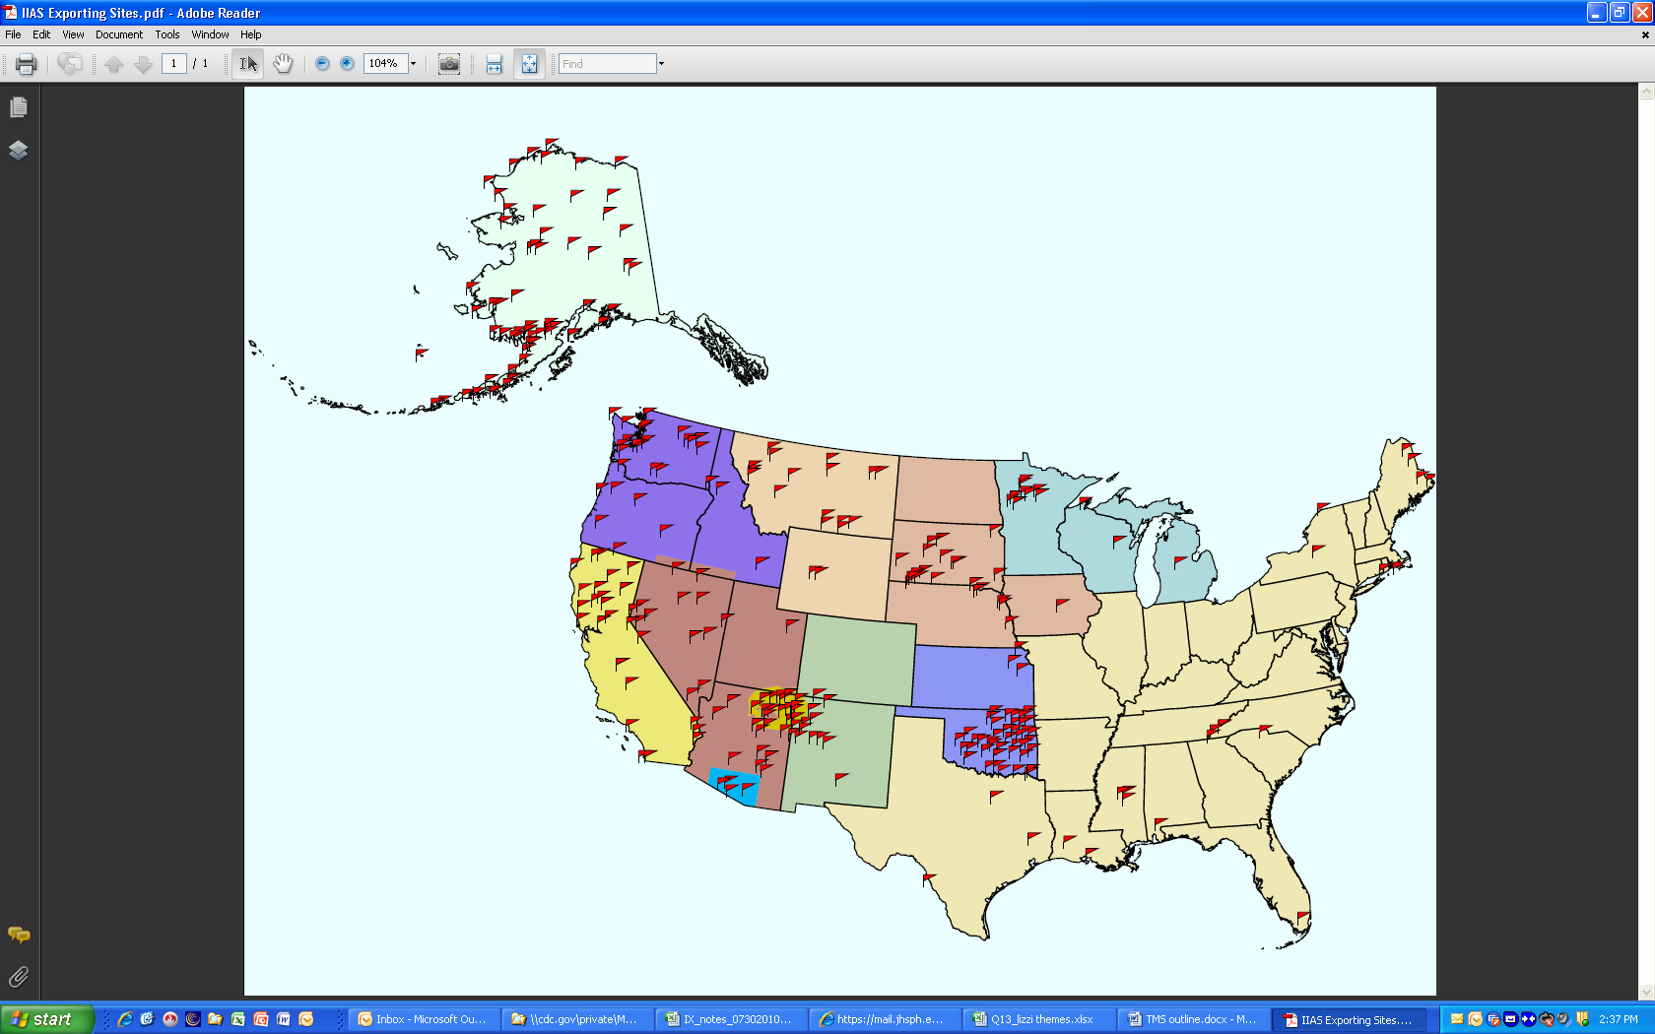
Participating Facilities
Approximately 60% (300/498) of IHS/Tribal facilities participate
Notes:
You can see from this map of participating facilities that data come from throughout the US.

Slide 10
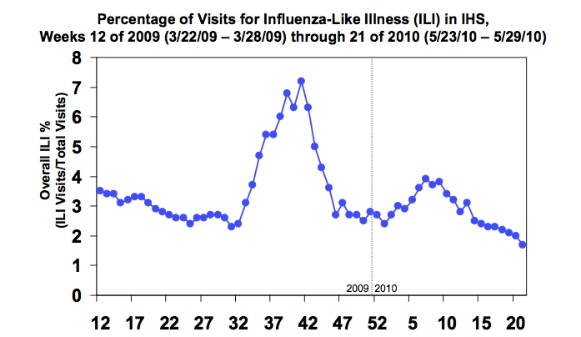
Percentage of Visits for Influenza
Notes:
What are some of the products? This is an example of a weekly national summary of ILI visits showing the peak of the outbreak in 2009.

Slide 11
New ILI percentage of visits for Influenza

Slide 12
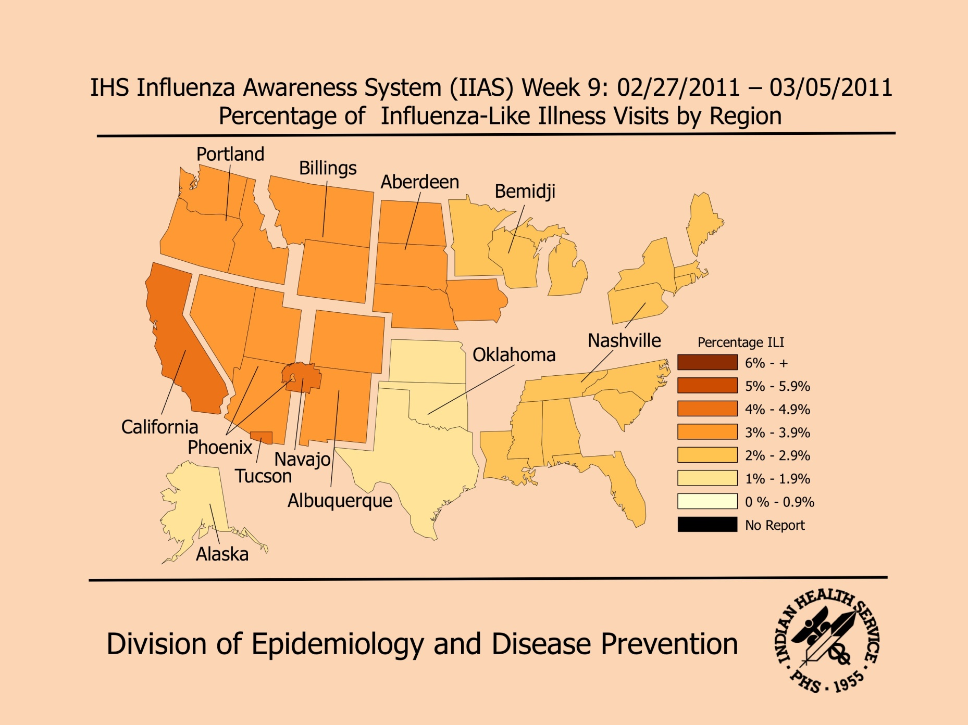
IHS Influenza Awareness System (IIAS)
Notes:
This shows the latest refinements incorporated in the national reports produced weekly. By the way you can access this all at ihs.gov/flu

Slide 13
Example of Data Shared with Local Site
Example of Data Shared with Local Site
Notes:
This is an example of data shared with the local sites—the feedback to local providers.

