Slide 1
General Services Administration Shared Cloud Platform model Informational Brief
June 2012
Sonny Hashmi – GSA Deputy CIO

Slide 2
TOPICS
Business Challenge
GSA’s Cloud Based Approach
Force.com Enterprise Platform
Risks of weak shared services model
Best Practice – GSA Cloud Center of Excellence
Cloud App Governance
App Dev Process
Lessons learned

Slide 3
Business Challenge
Traditionally de-centralized IT environment
Proliferation of tools, applications and technology
Complexity
Lack of governance/control
Cost
2500+ mid-tier Domino applications to serve 12,000 people
1000+ non-platform apps (.net, Java, Sharepoint)
Hundreds of regional/local servers

Slide 4
GSA’s cloud based approach
2010 – GSA decision to leverage cloud computing to modernize enterprise IT services
Phase 1: Email, Team Collaboration, Sharing, Storage, Mobility, infrastructure, hosting.
Phase 2: Mid-tier Apps, Social Collaboration, CRM, KM
2011 – Phase 1 largely completed
Public facing websites (data.gov, usa.gov) hosted with CSPs
Migrated to Google Apps for Email/Collaboration/Storage
Migrating ITSM and MDM to cloud for mobility
2012 – Phase 2 underway
Implemented Salesforce.com as enterprise platform

Slide 5
GSA’s cloud based approach
1:few Document Collaboration
Team/Project Sites
Address Book
Email
Instant Messaging
Video Chat
Mailing Lists
Document Sharing
Google Voice/VOIP
Smartphone/Tablet Integration
Phase 1
Workflow/Approvals
GSA-wide sharing
Communities of interest
Collect input from crowd
Find Expertise
Crowd-sourcing
Customer Portals
Idea Factory
Knowledge Base
Team/org folders
Phase 2

Slide 6
Force.com enterprise platform
Core Capabilities:
Social Collaboration – Connect the Dots across GSA
Knowledge and Content Management
Automate core business processes and workflow
Application platform – Agile platform reduces app TCO by 75%+
CRM – Customer portals and capabilities, service management, call centers, etc.

Slide 7
Shared Cloud Platform Risks of weak shared services model
Inefficient use of resources
Duplication of tasks
Poor communication and visibility
Inability to maximize ROI and adoption
Lack of insight into all associated costs
Lowers ability to achieve adoption and deployment success
Platform knowledge and specialty skillsets are splintered
Divides core components of platform across internal customers

Slide 8
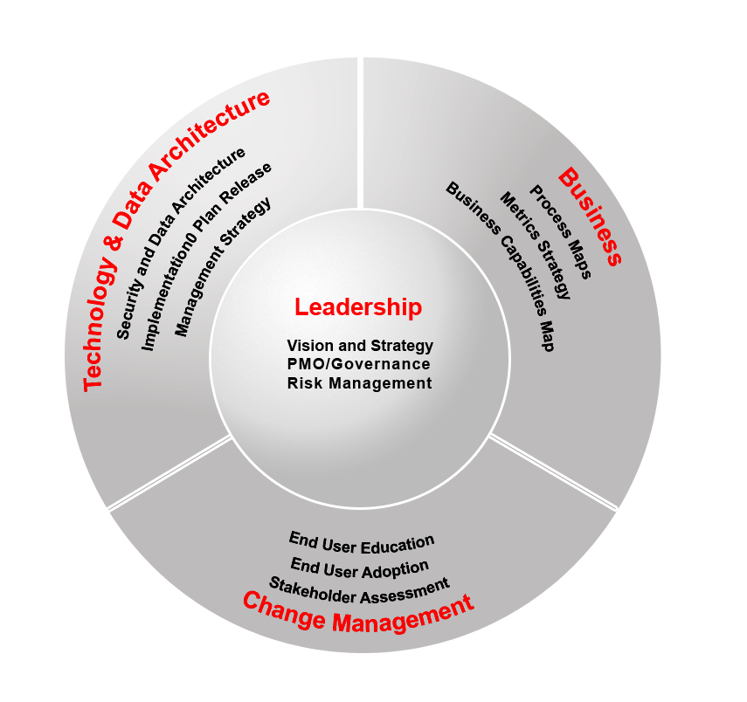
Shared Cloud Platform Best Practice – GSA cloud center of excellence
Drive global and large organizational projects
Drive strategic technology adoption through leadership and execution.
Ensure consistent experiences for our customers
Create best practices and processes, and monitor adherence
The purpose of the COE is to provide a governance framework of policies, procedures & standards to ensure effective execution of projects/programs and provide strategic decision support & alignment - bridging the tactical with the strategic

Slide 9
Business Governance and ITEC
Business
Committee
Function A
Business Committee
Function B
Business Committee
Function C
Eg. Workspaces, Acquisitions, Personnel, Administration
Salesforce PMOs and Development teams
GSA Center of Excellence
– Platform Strategy, Architecture, Best Practices, Org Strategy, standards
Platform Capabilities
Social Collaboration
Content Management/KM
CRM/Portals
Workflow Engine

Slide 10
Shared Cloud Platform App Dev Process Consistency – Agile Methodology
Phases and Sub-Phases
Key Activities
Phase 1
Concept development
and Planning
1. Create and Approve application package 2. Assign Platform and Overall Priority 3. Approve for Detailed Review
1. Finalize Detailed Requirements 2. Establish LOE 3. Technical Review Board Approval 4. Sprint Assignment
1. Development Kickoff 2. Start of 8 week Sprint Cycle 3. Iterative Development with Customer 3. Outcome is Production Ready code 4. Test Cases Ready
1. Conduct QA 2. Perform UAT 3. Defect's Fixed 4. Documentation (technical, program and security) Finalized
1. Go-Live Review with Technical Review Board 2. Deployment Steps Taken 3. Training Released 4. Security Audit Performed
Discovery
Concept
Dev
Review
Phase 2
Requirements Analysis
and Design
LOE/
Detailed
Design
Technical
Design
Review
COE
Phase 3
Development
Develop
Plan
Develop
Code
Phase 4
Integration
And Testing
QA
UAT
Phase 5
Implementation
Go-Live
Gate
Review
Release
Closure

Slide 11
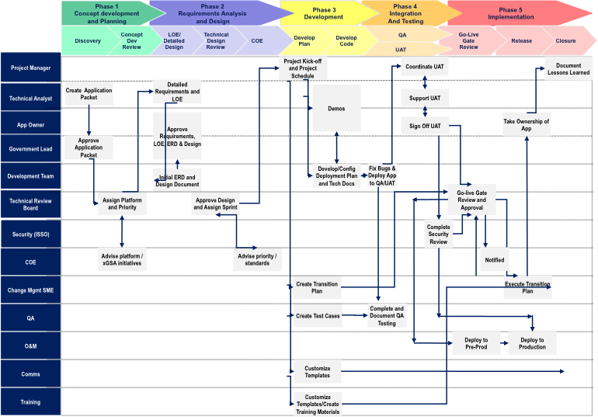
Shared Cloud Platform App Dev Process Consistency – Agile Methodology

Slide 12
Where we are today
force.com Applications Statistics
26 Production Apps Built in less than 6 months
Another 44 Applications in pipeline
Average 6-8 weeks development cycle
Functioning Technical Governance and De-duplication.
Cross-BU partnership to reduce costs and reuse resources - Shared services O&M model

Slide 13
Case Study – Engine behind FedRAMP assessments
FedRAMP Assessment App Case Study
Sponsor: OCSIT
Scope: Inter-Agency App with sensitive data (moderate), strong authentication.
Highly Visible initiative for GSA with tight deadline
Estimated Traditional Cost: $400K-$600K, 6 months
Delivered in 8 weeks, <$100K

Slide 14
Lessons Learned
Leveraging a shared platform requires establishing technology governance
Rights and responsibilities
Business Prioritization
Funding and Service Charge-back
Data Governance, sharing and interfacing
Shared cloud platform models can shared significant costs and improve business performance
Over $9M in cost avoidance through building 26 apps so far
Average Time-to-value is 6-8 weeks vs. 6 months previously
Center of Excellence should have strict guiding principles, tech. governing authority and cross-org representation

