Slide 1
Stage 2 EHR Certification: NLM Vocabulary Update
Betsy Humphreys, MLS, FACMI
Deputy Director
National Library of Medicine
National Institutes of Health
Department of Health and Human Services
Presented to the HIT Policy Committee February 29, 2012

Slide 2
Proposed Stage 2 certification criteria
**SNOMED CT – problem list
*LOINC – laboratory tests
*RxNorm – medications, med. allergies
CVX – vaccines
OMB Standard – race & ethnicity
ISO 639-1:2002 – preferred language
ICD-10-CM – cause of death
**ICD-10-CM or ICD-9-CM – encounter diagnosis
* today’s focus

Slide 3
Problem list
Target: SNOMED CT (SCT)
Assets available from NLM (US Member of IHTSDO)
SCT International Release (in English & Spanish)
SCT problem subsets
CORE (frequently seen) problems subset
Nursing problem list subset
US extension to SCT next release Mar 2012
KP Convergent Medical Terminology (CMT) problem subsets (6 to date, 13,000+)
Download site for all content sets
UMLS-enhanced API access to SCT new version Mar 2012
SCT web browser

Slide 4
Problem list
Target: SNOMED CT (SCT)
Issue: Rate/speed of new content additions
IHTSDO actions:
Selection/training of Consultant Terminologists
Initial 5 last year (includes Jim Case, NLM)
Applications for next group due March 2, 2012 (see http://www.ihtsdo.org)
Distributed editing –
1st step: Feb. 2012: consultant terminologists can edit lnt. Release directly
Gradual expansion to other consultant terminologists & vetted editors
NLM actions:
US extension to SNOMED CT Next release March 2012
US SNOMED CT Content Request System New version Feb 2012

Slide 5
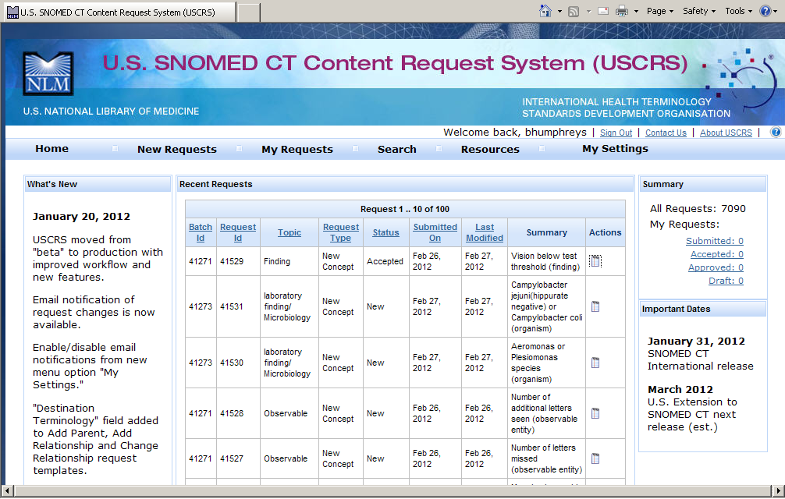
U.S. Snomed CT Content Request System (USCRS)

Slide 6
Problem list (continue)
Target: SNOMED CT (SCT)
Issue: Transition from use of ICD-9-CM for problems
Available from IHTSDO:
Conceptual mapping FROM SCT TO ICD-9-CM
Available from NLM:
Synonymous mappings in UMLS Metathesaurus
April 2012: Trial map for evaluation
FROM heavily used ICD-9-CM (based on CMS data) TO SCT
~40% will NOT be 1-to-1 mappings

Slide 7
Problem list (Cont.)
Target: SNOMED CT (SCT)
Issue: Use of SCT to generate encounter diagnoses (in ICD-10-CM or ICD-9-CM) for billing/statistics
Available from IHTSDO:
Conceptual mapping from SCT to ICD-9-CM
Available from NLM:
Synonymous mappings in UMLS Metathesaurus
Old (2008) rule-based map FROM SCT subset TO ICD-9-CM
?? Is it a priority to update /improve this??
NEW: FROM SCT subset to ICD-10-CM, with demonstration tool
TODAY: From 7,277 SCT concepts
June 2012: Complete initial map. From ~15,000 SCT concepts
Leverages procedures, data & tools from the IHTSDO and UK NHS Terminology Centre and data from Kaiser Permanente’s CMT donations

Slide 8
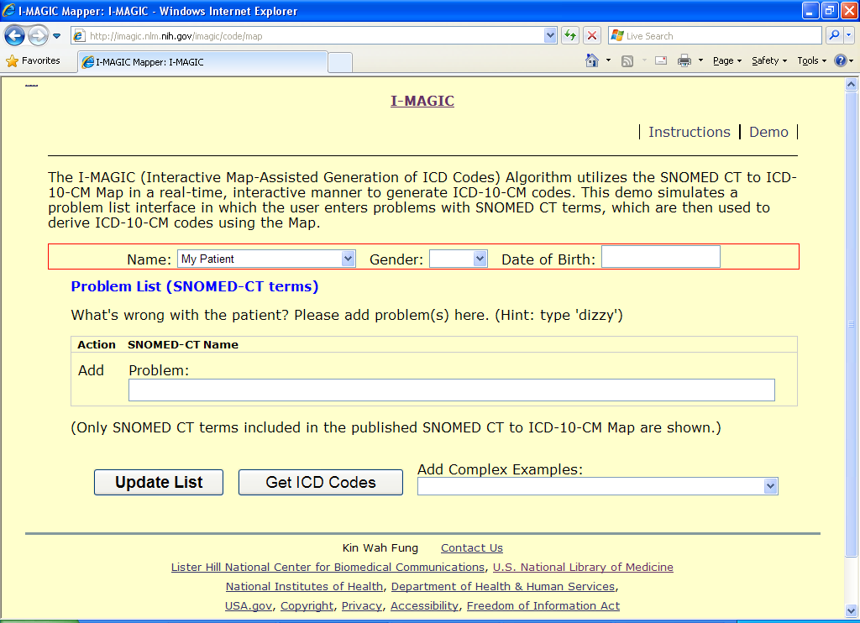
I-magic

Slide 9
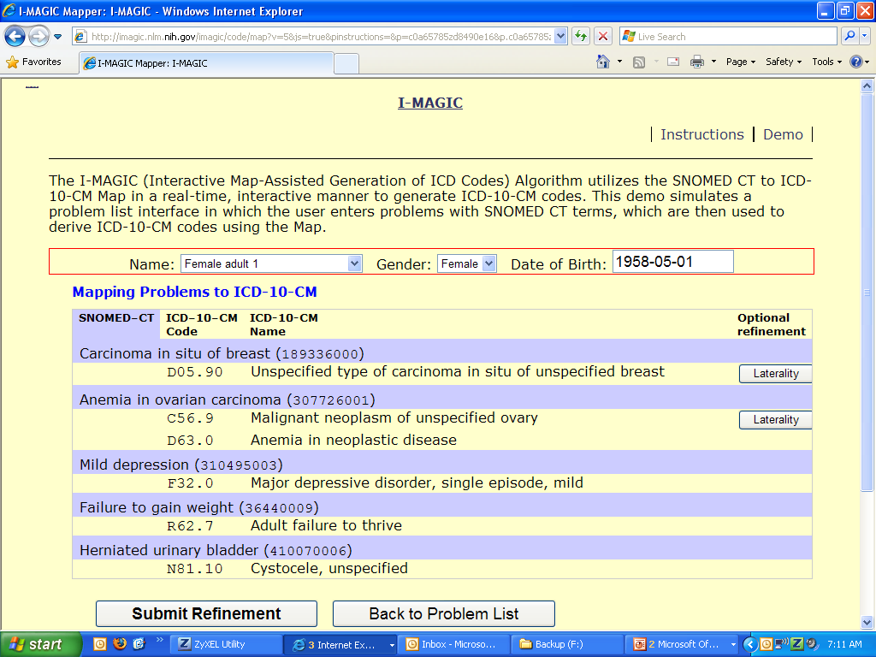
http://imagic.nlm.nih.gov/imagic/code/map

Slide 10
Medications, medication allergies
Target: RxNorm
Assets available from NLM:
RxNorm – monthly – complete release
RxNorm – weekly – drugs newly approved by FDA
RxNorm Current US Prescribable Subset
RxTerms interface terminology for orders, medication lists
RxNav browser, API
?? What else needed to support MU??

Slide 11
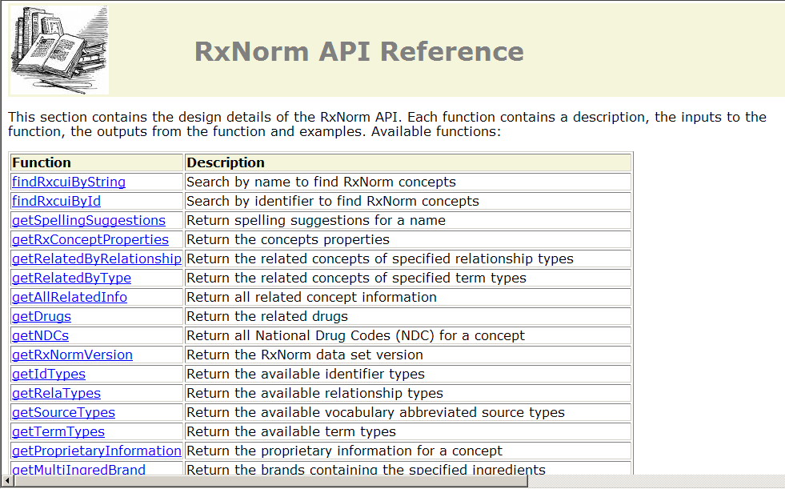
Medications and medication allergies

Slide 12
Tests and measures
Target: LOINC
Assets available (from Regenstrief Institute):
LOINC (in multiple languages)
Top 2000+ Lab Observations & Mapper’s Guide
Common Lab Orders Value Set
Subsets for Test Panels & Assessment Forms (including CMS survey instruments)
RELMA tool - searching (in multiple languages) & mapping
??Other high priority convenience subsets??
??API use cases beyond code/term resolution??

Slide 13
Discussion
Other activities that could promote/support MU of SNOMED CT, RxNorm, LOINC?
Additional high priority convenience subsets?
API use cases?
Use of subsets in certification?
Future Topic
Value set creation, validation, maintenance, dissemination

Slide 14
Selected NLM Contacts- https://ned.nih.gov/search/search.aspx
SNOMED CT– Jim Case
SNOMED CT subsets, mappings – Kin Wah Fung, Vivian Auld
NLM-IHTSDO interface – Vivian Auld, Jan Willis
UMLS/SCT APIs, downloads, browsers– Suresh Srinivasan
LOINC content, subsets – Clem McDonald
NLM-Regenstrief interface – Vivian Auld
RxNorm – Stuart Nelson, John Kilbourne
RxTerms – Kin Wah Fung
RxNav browser, drug terminology/info APIs – Olivier Bodenreider
NLM vocabulary services customer support – Steve Emrick

