Slide 1

NLM Value Set Authority Center
eMeasures Issues Group (eMIG)
May 24, 2012
NLM
Curation and delivery of value sets for eMeasures

Slide 2
Overview
Motivation for a Value Set Authority Center at NLM
NLM Terminology services
  In support of value set curation
  In support of value set development
Value set repository
Value set delivery

Slide 3
Between eMeasures and Code Systems
Value Sets
eMeasures
eMeasure
development
Code Systems
Value set
curation

Slide 4
Motivation Value set development
Value set development requires integration with terminology services
  Find codes using synonyms, approximate matches, …
  Exploit the structure of code systems
      All procedures requiring fluoroscopy
      All drugs containing “Macrolides” as an ingredient

Slide 5
Motivation Value set curation
Value set curation
  Ensure referential integrity
    All codes in a VS are valid codes in the corresponding code system
      2474318017 (urine screen for chlamydia) – code for the term (wrong)
      412761009 (urine screen for chlamydia) – code for the concept (OK)
    Update VSs when the code systems are updated (no “stale” codes)
      346892 (Amoxicillin 25 MG/ML Oral Suspension) – obsolete code
      313797 (Amoxicillin 25 MG/ML Oral Suspension) – active code
  Avoid duplication
    Find value sets having similar members
      In the same code system
      Across code systems (using UMLS concept mappings)
      Between intensional and extensional definitions

Slide 6
Motivation Value set delivery
Value set delivery
  Authoritative
    Curated value sets
    Latest version
      Previous versions archived & available for reference
  Format
    Human-readable format
      Web site, HTML-based
    Machine-readable format
      Web service, XML-based

Slide 7
Between developers and consumers of VSs
Phase 2
Phase 1
Authorship
Curation Delivery
Consumption
Integration with Authoring Tool(s) to support value set authorship
Web page population for human consumption
Controlled Value Set Repository & Validation Engine
API
Free-standing, web-based value set authoring tool(s)
Web download / web services for machine consumption
API
Value Set / Measure Authors
Consensus Organization(s)
NLM
ONC
Consensus Org(s)
NLM
Vendors
Providers
Public Health Orgs
Courtesy of J. Reider (ONC)

Slide 8
Terminology at NLM
NLM has a long tradition of integrating terminologies
  Unified Medical Language System (UMLS)
  RxNorm
NLM provides terminology services
  UMLS Terminology Services (UTS) API
  RxNorm API
NLM is involved in terminology development
  In house development
    Medical Subject Headings (MeSH)
    U.S. extension of SNOMED CT
  Funding support
    SNOMED CT, LOINC, …

Slide 9

Terminology services UMLS
Unified Medical Language System (UMLS)
  Contains all major terminologies required for MU2
  (SNOMED CT, RxNorm, LOINC, …)
  Updated twice a year (May and November)
  Provides terminology services (UTS = UMLS Terminology Services)
    Search by name, by code
      Exact, normalized, approximate matches
      Within or across code systems
    Access to the structure of a code system
      Hierarchical and other relations

Slide 10
Terminology services UMLS (cont.)
Unified Medical Language System (UMLS)
  Multiple interfaces
    Graphical – UTS browser
    Application Programming Interface (API)
  Ensures protection of intellectual property
    UMLS license agreement
    UTS authentication

Slide 11

Terminology services RxNorm
RxNorm
  Integrates names and codes from multiple drug information sources
  (First DataBank, Multum, SNOMED CT, NDF-RT, Structured Product Labels,…)
  Updated monthly (with weekly additions)
  Provides terminology services (similar to UTS)
  Multiple interfaces
    Graphical – RxNav browser
    Application Programming Interface (API)

Slide 12
Terminology services and value set curation
Terminology services are useful for value set curation
  Referential integrity
    Identify if a code exists in a code system
      Including specific versions
      Map obsolete codes to current codes
    Identify if a term corresponds to a code
  Similarity
    Identify similar value sets
      Across code systems through UMLS mappings
      Between intensional and extensional definitions
Value set curation also involves
  Informing VS developers of changes to the code systems
  Coordinating with VS developers for validating changes

Slide 13
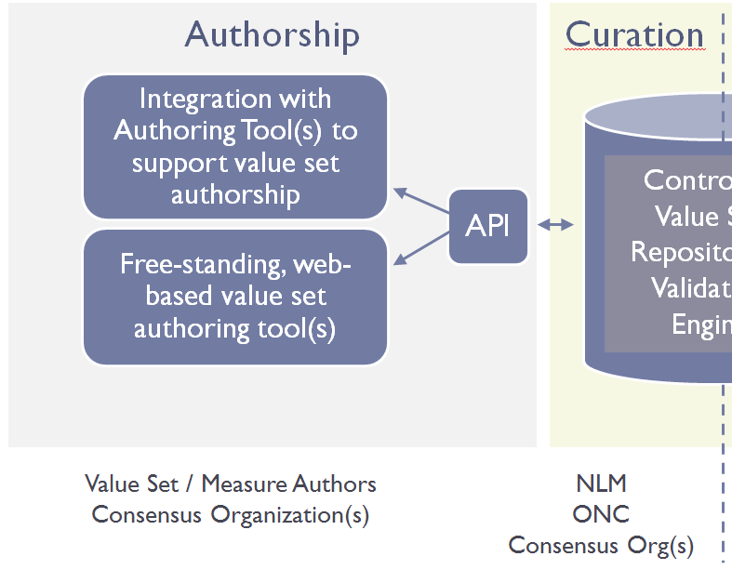
Terminology services and value set development
Interface between terminology services and value set authoring tools
  Integration through APIs (Phase 2)
  Ensure referential integrity
  Access to the latest version of code systems
  VS authoring tools can focus on VS, not terminology

Slide 14
Value set repository Charateristics
One-stop shop for all value sets for MU
Authoritative source
  Curated value sets
  Latest version (& archived previous versions)
Publicly available
  But does not mean value sets are in the public domain; copyrights and, in some cases licensing restrictions, apply
Used by
  eMeasure developers (check existing value sets)
  Value set developers (get terminology, validate value sets)
  eMeasure implementers (get curated value sets)

Slide 15
Metadata for value sets
Several metadata schemata
  CTS2 (Common Terminology Services)
  IHE SVS (Sharing Value Sets)
  …
Major metadata elements
  Value set identification (OID) + version
  Code system + version
  Author
  Creation date
  Purpose
  eMeasures associated with
  …

Slide 16
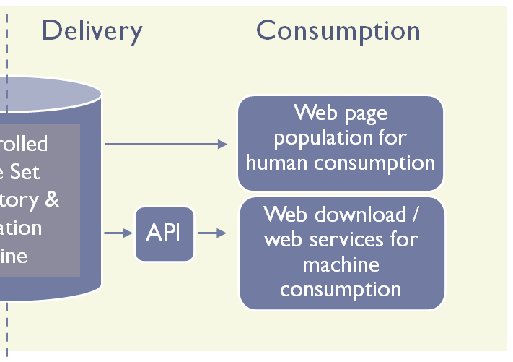
Value set delivery
Search for published value sets
  By name, identifier (OID), members (codes)
    Additional metadata
    (author, date, measure(s), message segment(s), etc.)
Retrieve value sets and their metadata
  Human consumption
    Web display
    HTML-based
  Machine consumption
    Download
    + Access through an API
    XML-based

