Slide 1
Modeling Recession Effects and the Consequences for Seasonal Adjustment
Demetra Lytras
Office of Statistical Methods and Research for Economic Programs

Slide 2
Motivation
Are the regARIMA models used fitting the recession data well? Can intervention effects improve model fit?
Is the seasonal pattern changing? How can we account for this?

Slide 3

X-13A-S Outlier Types
Additive Outliers
1 for t = t₀
0 for t ≠ t₀
Level Shifts
  Series shifts suddenly, continues on at new level
– 1 for t < t₀
0 for t ≥ t₀

Slide 4
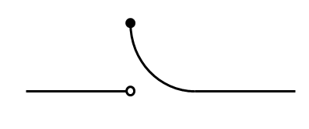
X-13A-S Outlier Types
Temporary Changes
  Series shifts suddenly, then slowly declines to original level
0 for t < t₀
α^{t - t0} for t ≥ t₀

Slide 5
X-13A-S Outlier Types
Ramps
  Series is at one level, slowly shifts to another, and continues on at the new level
  Ramps have a start date (t₀) and an end date (t₁)
– 1 for t ≤ t₀
(t – t₀) / (t₁ – t₀) – 1 for t₀ < t < t₁
0 for t ≥ t₁

Slide 6

X-13A-S Outliers
Ramps cannot be detected automatically by X-13. AO, LS, and TC can.
Automatic identification of outliers uses a critical value generally around 4.

Slide 7
How X-13 Uses Outliers
X-13A-S adjusts the original series for outliers.
The outlier-adjusted, calendar-adjusted, forecasted series is the input to the X11 procedure.
After seasonal adjustment, outliers are put back into the seasonally adjusted series.

Slide 8
Data
23 monthly time series
Sector: | Retail / Wholesale | Imports / Exports | Construction | Manufacturing
Number of series: | 10 | 7 | 5 | 1
Average length of steep decline: | 6 | 4 | 28 | 3

Slide 9
Current Models
Level shifts and additive outliers with large critical values.
Two series had ramps.
These largely coincide with X-13A-S’s automatic outlier identification’s choices.

Slide 10
Suggested Method
A more systematic search for interventions in this period.
For short declines (four or fewer months), series of level shifts.
For longer declines, ramps.

Slide 11
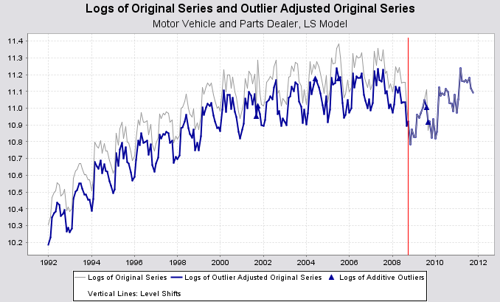

Slide 12
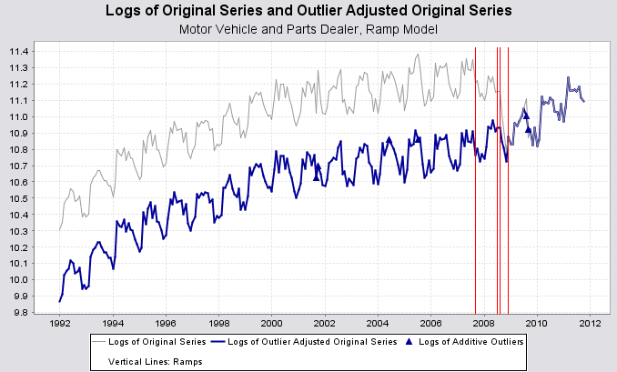

Slide 13
Interventions for Short Declines
1) Run the current spec. Examine graphs of trend and seasonal adjustment to estimate start and end of decline.
2) Fit level shifts to all these months. Look for outliers over the entire series with default critical value and hard-code them.

Slide 14
Interventions for Short Declines
3) With outlier identifications turned off, try shifting the start/end points of the LS sequence. Compare fits with AICC and t-statistics of the level shifts (with t = 2).
4) Once a model is chosen, redo outlier detection.

Slide 15
AICC
AICC is a model fit diagnostic based on likelihood statistics.
When comparing AICC, the lower value is preferred.
Can’t be used to compare models with different outlier sets; can be used to compare a model with and without an intervention.

Slide 16
Interventions for Short Declines, Results
Number of new level shifts: | 0 | 1 | 2 | 3
Number of series | 4 | 4 | 2 | 1
Decline in AICC | -- | 3, 4, 4, 5 | 7,20 | 38

Slide 17
Largest Difference in Seasonally Adjusted Series
Series | Year | Month | Seasonally Adjusted Series | Seasonally Adjusted Series with Level Shift Sequence | Percent Difference in Seas Adj Series
Telecommunications Equipment Imports | 2008 | 10 | 3,764,737,800 | 3,806,310,900 | 1.10%
Industrial Organic Chemicals Exports | 2008 | 7 | 3,161,369,200 | 3,236,461,700 | 2.40%
Engines and Parts for Cars Exports | 2009 | 2 | 1,495,445,900 | 1,460,894,100 | -2.30%
Automobile Manufacturing | 2008 | 11 | 6,100 | 6,200 | 1.70%
Petroleum and Petroleum Products, Wholesale Inventories | 2009 | 10 | 18,600 | 18,700 | 0.90%
Furniture, Furnishings, Electronics, and Appliances, Retail Inventories | 2006 | 10 | 31,100 | 31,400 | 0.80%
Machinery, Equipment, and Supplies, Wholesale | 2008 | 10 | 29,600 | 29,800 | 0.80%

Slide 18
Largest Differences in the Month-to-Month Percent Changes
Series | Year | Month | Month-to-Month Percent Change | M-to-M Percent Change, Level Shift Model | Difference in the M-to-M Percent Change
Telecommunications Equipment Imports | 2011 | 1 | 3.90% | 2.70% | 1.20%
Industrial Organic Chemicals Exports | 2006 | 4 | 21.40% | 24.60% | -3.20%
Engines and Parts for Cars Exports | 2009 | 2 | 8.80% | 5.80% | 2.90%
Automobile Manufacturing | 2008 | 12 | -10.10% | -12.80% | 2.80%
Petroleum and Petroleum Products, Wholesale Inventories | 2009 | 11 | 8.30% | 6.50% | 1.80%
Furniture, Furnishings, Electronics, and Appliances, Retail Inventories | 2006 | 11 | 0.40% | -0.60% | 0.90%
Machinery, Equipment, and Supplies, Wholesale | 2010 | 11 | 2.60% | 1.30% | 1.30%

Slide 19
Interventions for Longer Declines
1) Graph series, seasonally adjusted series, trend. Estimate start and end date for ramp(s).
2) Replace outliers in the decline with this ramp. Do outlier identification over the series. Hard-code the selected outliers.

Slide 20
Interventions for Longer Declines
3) Turn off outlier identification. Shift start/end dates of ramp; compare fit with AICC.
4) With selected ramp, identify outliers over the ramp interval with a lower critical value.

Slide 21
Interventions for Longer Declines, Results
Series | Old Outliers | New Outlier Set | AICC Decline
South New Homes Sold | No outliers | 1 ramp (38 m), 1 LS | 20.0
General Merchandise (Department store) Construction | No outliers | 1 ramp (8 m) | 6.7
Northeast Single Family Housing Starts | 1 TC | 1 ramp (36 m), 2 AO, 1 TC | 23.5
New Multifamily Construction | No outliers | 1 ramp (21 m) | 28.0
Building Permits MW Single Family | 1 AO, 1TC | 1 ramp (36 m), 2 AO, 3 TC, 1LS | 29.4
Petroleum Imports | 2 LS | 1 ramp (6 m), 1 AO | 11.2
Computer Accessories Exports | 1 LS | 1 ramp (6 m) | 5.6
Metals and Minerals, Wholesale Inventories | 2 LS | 1 ramp (12 m), 2 LS | 13.8
Motor Vehicle and Motor Vehicle Parts, Wholesale | 1 AO, 2 LS | 2 ramps (10 m), 1 LS | 24.6
Miscellaneous Durable Goods, Wholesale | 2 LS | 1 ramp (4 m), 1 LS | 11.9
Petroleum and Petroleum Products, Wholesale | 1 LS | 1 ramp (6 m) | 8.4
Motor Vehicle and Parts Dealers, Retail Sales | 1 LS | 2 ramps (15 m) | 27.6

Slide 22
Largest Differences in the Seasonally Adjusted Series, Construction
Series | Year | Month | Seasonally Adjusted Series | Seasonally Adjusted Series with Ramp | Percent Difference in Seas Adj Series
South New Homes Sold | 2008 | 6 | 22,800 | 22,300 | -2.40%
General Merchandise (Department store) Construction | 2009 | 6 | 400 | 300 | -2.40%
Northeast Single Family Housing Starts | 2008 | 11 | 3,700 | 3,400 | -7.60%
New Multifamily Construction | 2011 | 3 | 1,100 | 1,100 | -1.10%
Building Permits MW Single Family | 2008 | 4 | 8,700 | 9,100 | 4.60%

Slide 23
Largest Differences in the Seasonally Adjusted Series, Imports/Exports and Retail/Wholesale
Series | Year | Month | Seasonally Adjusted Series | Seasonally Adjusted Series with Ramp | Percent Difference in Seas Adj Series
Petroleum Imports | 2009 | 12 | 21,157,087,900 | 20,419,927,800 | -3.50%
Computer Accessories Exports | 2007 | 6 | 2,648,372,500 | 2,680,234,800 | 1.20%
Metals and Minerals, Wholesale Inventories | 2007 | 9 | 25,100 | 25,200 | 0.30%
Motor Vehicle and Motor Vehicle Parts, Wholesale | 2008 | 12 | 19,700 | 20,100 | 2.00%
Miscellaneous Durable Goods, Wholesale | 2008 | 8 | 22,900 | 22,300 | -2.60%
Petroleum and Petroleum Products, Wholesale | 2008 | 12 | 30,400 | 29,500 | -3.10%
Motor Vehicle and Parts Dealers, Retail Sales | 2008 | 12 | 54,600 | 54,200 | -0.80%

Slide 24
Largest Differences in the Month-to-Month Percent Changes, Construction
Series | Year | Month | Month-to-Month Percent Change | M-to-M Percent Change, Ramp Model | Difference in the M-to-M Percent Change
South New Homes Sold | 2009 | 8 | 3.50% | 6.40% | -2.90%
General Merchandise (Department store) Construction | 2009 | 7 | -4.80% | -2.70% | -2.10%
Northeast Single Family Housing Starts | 2008 | 1 | 21.50% | 31.40% | -9.90%
New Multifamily Construction | 2011 | 6 | -1.30% | 0.00% | -1.30%
Building Permits MW Single Family | 2008 | 4 | 13.20% | 19.80% | -6.60%

Slide 25
Largest Differences in the Month-to-Month Percent Changes, Exports/Imports and Retail/Wholesale
Series | Year | Month | Month-to-Month Percent Change | M-to-M Percent Change, Ramp Model | Difference in the M-to-M Percent Change
Petroleum Imports | 2009 | 12 | 11.80% | 8.20% | 3.60%
Computer Accessories Exports | 2009 | 7 | 6.40% | 5.10% | 1.30%
Metals and Minerals, Wholesale Inventories | 2006 | 11 | 1.00% | 0.80% | 0.20%
Motor Vehicle and Motor Vehicle Parts, Wholesale | 2008 | 1 | 4.10% | 1.80% | 2.30%
Miscellaneous Durable Goods, Wholesale | 2009 | 8 | 3.00% | -1.10% | 4.20%
Petroleum and Petroleum Products, Wholesale | 2009 | 4 | 5.00% | 8.60% | -3.60%
Motor Vehicle and Parts Dealers, Retail Sales | 2008 | 9 | -4.30% | -5.60% | 1.40%

Slide 26
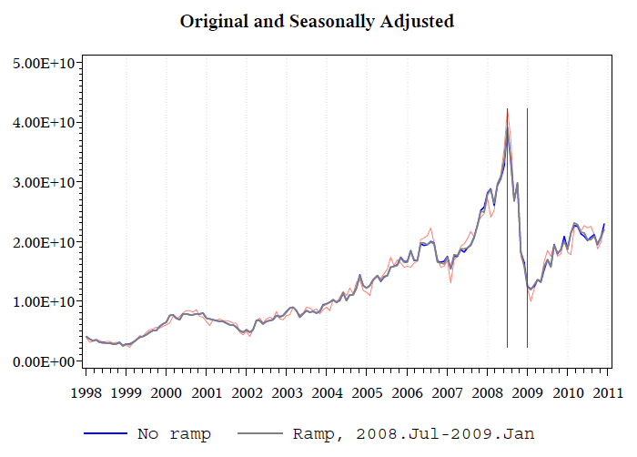
Petroleum Imports

Slide 27
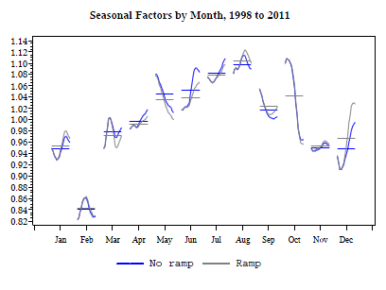
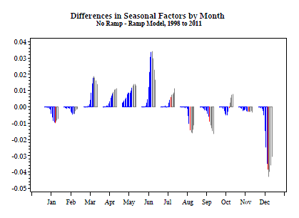

Slide 28
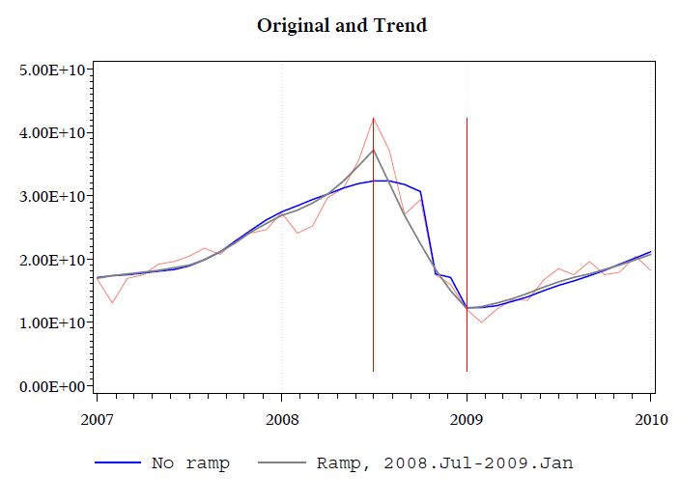

Slide 29
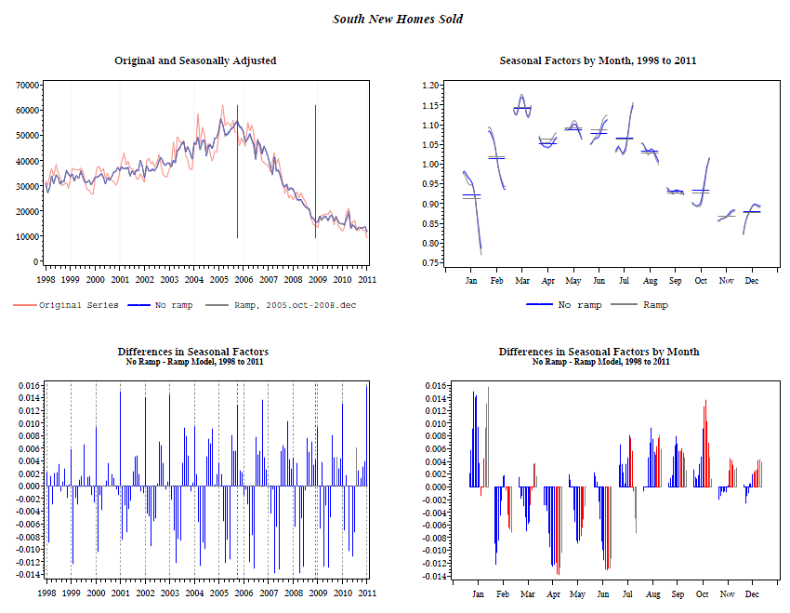
Construction

Slide 30
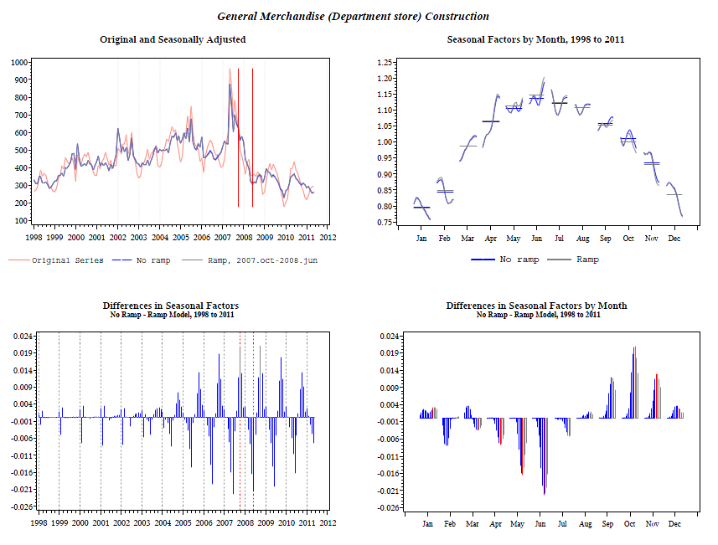

Slide 31
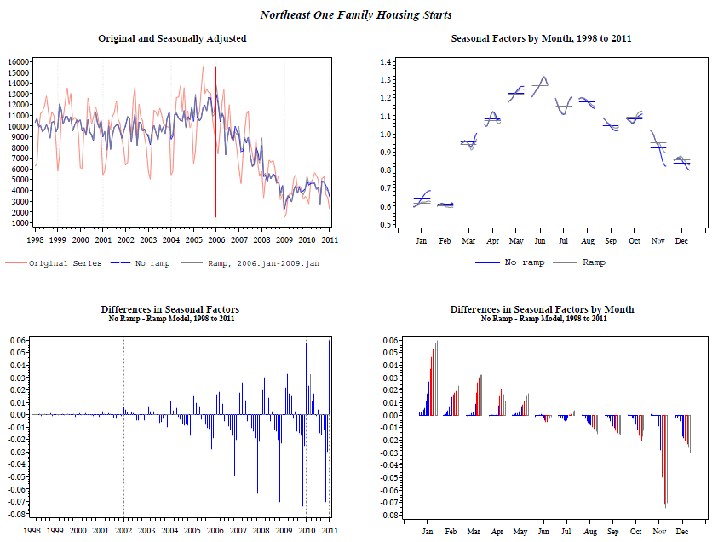

Slide 32
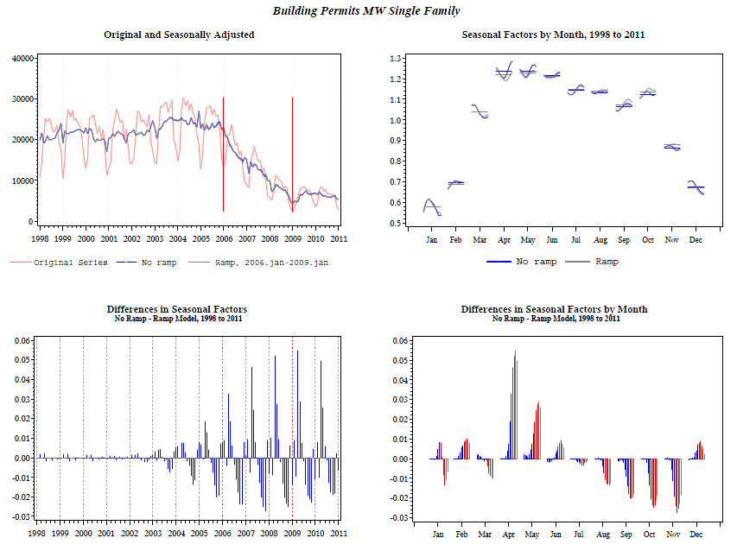

Slide 33
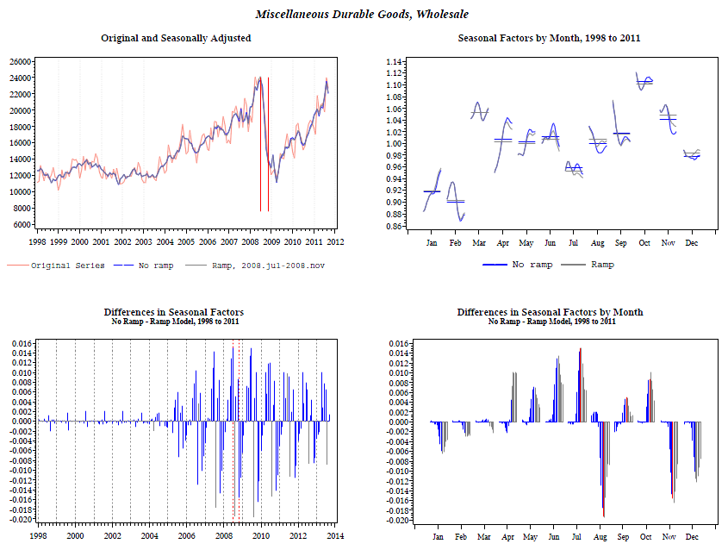

Slide 34
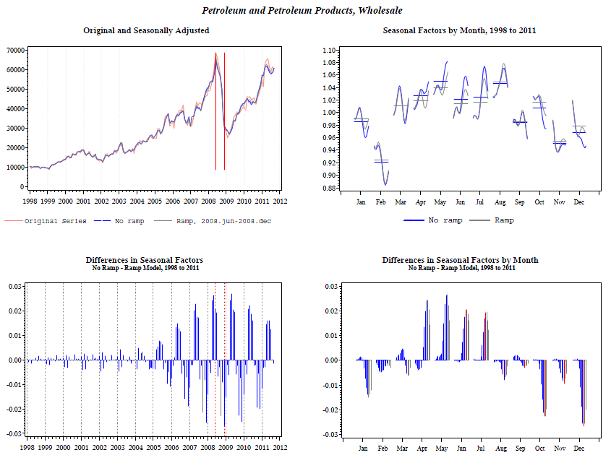

Slide 35
Revisions to Quarterly Percent Change in Selected Census Series, 2008q4
Auto Manufacturing Shipments
WS Machinery, Equipment, and Supplies Sales
Retail Motor Vehicle and Parts Dealer Sales
WS Petroleum and Parts Sales
WS Miscellaneous Durable Goods Sales
WS Motor Vehicle and Parts Sales
Telecommunications Equipment Imports
Crude Petroleum Imports
Industrial Organic Chemicals Exports
Engines and Car Parts Exports
Computer Accessories Exports
Multifamily Construction
General Merchandise Construction
Single Family Building Permits (MW)
Single Family Housing Starts (NE)
New Homes Sold (South)
-Shelly Smith, DOC

Slide 36
Revisions to Quarterly Percent Change in Selected Census Series, 2011q1
Auto Manufacturing Shipments
WS Machinery, Equipment, and Supplies Sales
Retail Motor Vehicle and Parts Dealer Sales
WS Petroleum and Parts Sales
WS Miscellaneous Durable Goods Sales
WS Motor Vehicle and Parts Sales
Telecommunications Equipment Imports
Crude Petroleum Imports
Industrial Organic Chemicals Exports
Engines and Car Parts Exports
Computer Accessories Exports
Multifamily Construction
General Merchandise Construction
Single Family Building Permits (MW)
Single Family Housing Starts (NE)
New Homes Sold (South)
-Shelly Smith, DOC

Slide 37
Revisions to Quarterly Percent Change in Selected Census Series, 2011q4
Auto Manufacturing Shipments
WS Machinery, Equipment, and Supplies Sales
Retail Motor Vehicle and Parts Dealer Sales
WS Petroleum and Parts Sales
WS Miscellaneous Durable Goods Sales
WS Motor Vehicle and Parts Sales
Telecommunications Equipment Imports
Crude Petroleum Imports
Industrial Organic Chemicals Exports
Engines and Car Parts Exports
Computer Accessories Exports
Multifamily Construction
General Merchandise Construction
Single Family Building Permits (MW)
Single Family Housing Starts (NE)
New Homes Sold (South)
-Shelly Smith, DOC

Slide 38
Summary
Intervention outliers resulted in a better model fit for most series
Changes to the seasonally adjusted series vary by sector, series

Slide 39
Has the Seasonal Pattern Changed?
Include a seasonal change-of-regime regressor with the regARIMA model.

Slide 40
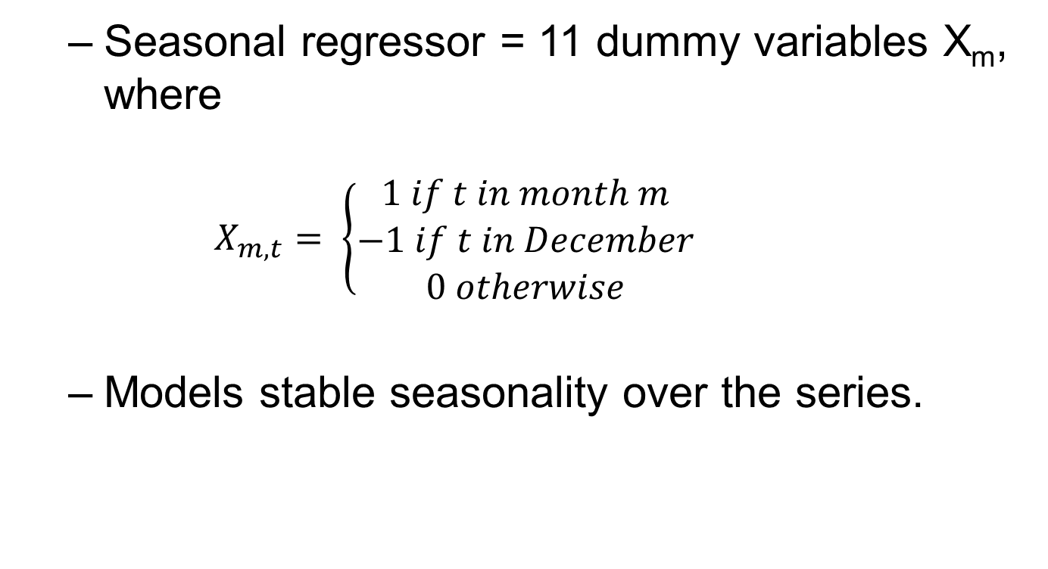
Seasonal Regressors
  Seasonal regressor = 11 dummy variables X_{m}, where
    $$X_{m,t}= \left\{\begin{aligned}1 if t in month m \\ −1 if t in December \\ 0 otherwise\end{aligned}\right.$$
  Models stable seasonality over the series.

Slide 41
Change-of-Regime Seasonal Regressors
Seasonal regressors fit to data only on and after time t₀, and zero before.
Fit along with a seasonal ARIMA component, measures whether there is a fixed seasonal pattern after time t₀ not accounted for by the ARIMA model.

Slide 42
Method
Checked for significance of c-o-r seasonal effects with
  Regime change at start of decline
  Regime change at end of decline
  Model without ramp
  Model with ramp (even for short-decline series)

Slide 43
No change in seasonal pattern for 14 series (p = 0.05)
Construction | Building Permits MW Single Family
 | Multi-family New
Manufacturing | Automobile Manufacturing
Imports/Exports | Computer Imports
 | Telecommunications Equipment Imports
 | Television Receivers Imports
 | Industrial Organic Chemicals Imports
Retail/Wholesale | Metals and Minerals Inventories
 | Petroleum and Petroleum Products Inventories
 | Furniture, Home Furnishings, etc, Inventories
 | Miscellaneous Durable Goods
 | Motor Vehicle and Parts Dealers
 | Grocery Stores
 | Gasoline Stores

Slide 44
Agreement in all four scenarios that there is a change in 5 series
Construction | South Sold
Imports/Exports | Petroleum Imports
 | Engines and Parts for Cars, Exports
Retail/Wholesale | Motor Vehicle, Parts and Supplies
 | Machinery, Equipment, and Supplies

Slide 45
Disagreement in 4 Series
General Merchandise (Department store) VIP
  Additional tests indicate a significant change only when series is modeled with ramp.
Northeast One Family Housing Starts
  Additional tests indicate significant change only when change is at decline start.

Slide 46
Disagreement in 4 Series
Exports of Computer Accessories
  Additional tests indicate all four scenarios have a significant change.
Petroleum and Petroleum Products Sales
  Only one scenario remains significant after additional tests.

Slide 47
What to do when series has significant change in seasonal pattern.
Shorten the seasonal filter.
Lengthen the seasonal filter.
Include the c-o-r seasonal effects in the seasonal factors.

Slide 48
Seasonal Filter Changes
Sector | Series | Original Filter | Shorter Filter | Longer Filter
Construction | South Sold | s3x5 s3x5 s3x5 s3x9 s3x9 s3x9 s3x5 s3x9 s3x9 s3x5 s3x9 s3x5 | 3x5 | 3x9
Imports/ Exports | Petroleum Imports | s3x5 s3x5 s3x5 s3x9 s3x9 s3x5 s3x9 s3x5 s3x9 s3x5 s3x9 s3x5 | 3x5 | 3x9
 | Engines and Parts for Cars, Exports | 3x5 | 3x3 | 3x9
Retail/ Wholesale | Motor Vehicle, Parts and Supplies | X11default | 3x3 | 3x9
 | Machinery, Equipment, and Supplies | x11default | 3x3 | 3x9

Slide 49
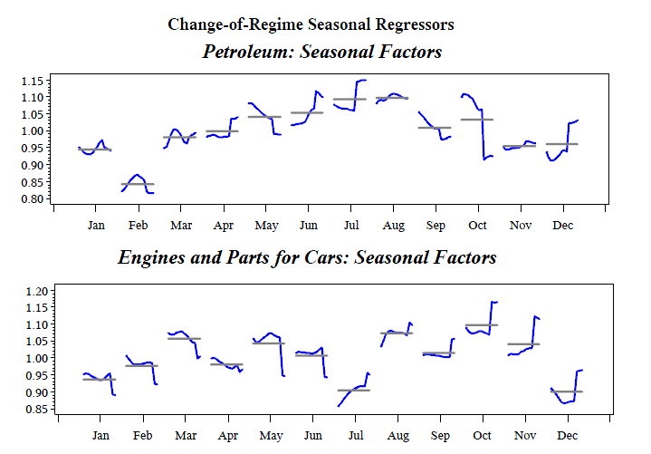

Slide 50
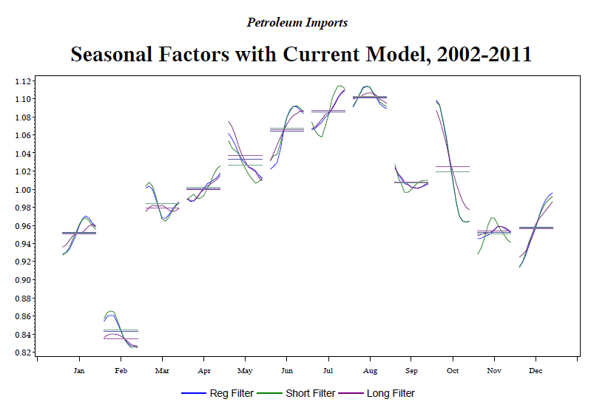

Slide 51
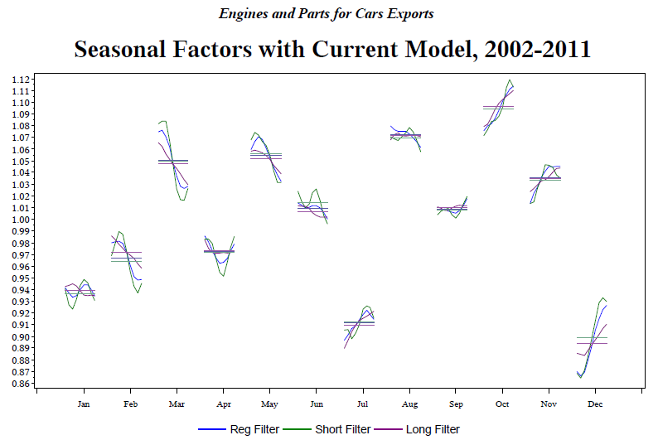

Slide 52
Summary
Including the change-of-regime regressor leads to large, sudden changes in the new regime
  Start of the change is dependent on when you start the modeling of the drop
Still investigating whether shorter or longer filters lead to a better adjustment

Slide 53
Contact
Demetra.p.Lytras@census.gov

