Slide 1
Adding Pronouns
Name Badges
A guide for UNT staff using Outlook
Notes:
Kathleen

Slide 2
Why add your pronouns?
Adding pronouns to your correspondence creates space for people you correspond with to feel safe asking for you to use the correct pronouns when referring to them. Also, at the Pride Alliance, we encourage people not to assume they know the pronouns of the people they’re emailing. Often, “guessing” someone’s pronouns based off their name can lead to misgendering – the harmful act of using the wrong pronouns or gendered titles on someone. We also recommend not using gendered terms like Mr., Ms., Sir, or Ma’am unless you know the person you are writing to wants you use those terms.

Slide 3
How do I know what my pronouns are?
Great question! Knowing what pronouns are right for you can be complex. Pronouns are sometimes connected to one’s gender identity. A simple way to learn the pronouns that are best for you is to answer the question, “How do I like people to refer to me when they aren’t using my name?”. Do you prefer people to say things like, “She is so cool!,” “He is so great!,” “I enjoy their presence!,” “Ze is the bee’s knees!,” or something else? You can check out some pronoun options here: https://www.minus18.org.au/pronouns-app/ or here: https://www.mypronouns.org/

Slide 4
Encounter an Issue?
We’re here to help!
Email Alex Sylvester at alex.sylvester@unt.edu for support.

Slide 5
Navigate to: https://printingservices-untedu.presencehost.net/customer_portal/document_library.html

Slide 6
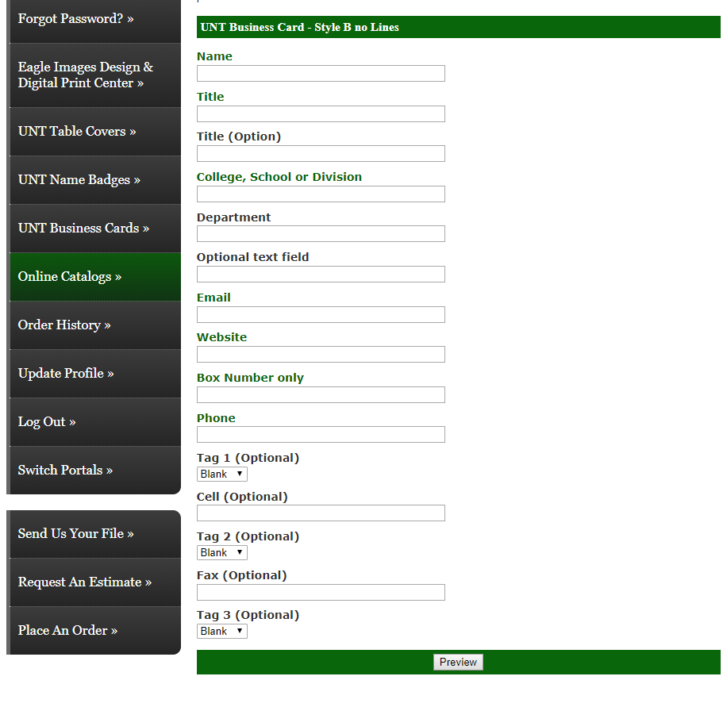
You may need to make a profile to use this website.
After logging in, you will select a business card style and quantity before adding your information including pronouns.

Slide 7
Enter your information, and in the field for “Title (Option)” enter the text:
Pronouns: your, pronouns, here
(example: “Pronouns: she, her, hers”)

Slide 8
Click preview.

Slide 9
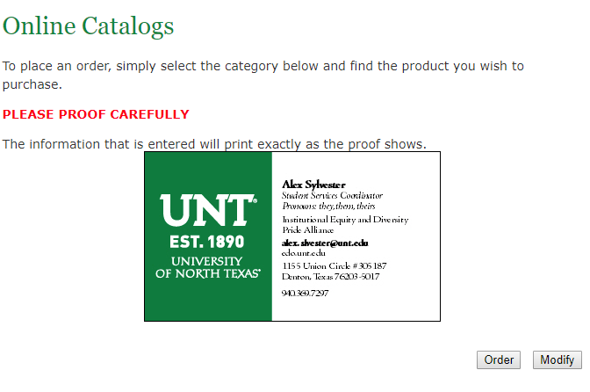
Review your order, and then click order when ready.

Slide 10
Encounter an Issue?
We’re here to help!
Email Alex Sylvester at alex.sylvester@unt.edu for support.

