Slide 1
First Fridays
with the
University Budget Office
March, 2019

Slide 2
AGENDA
Icebreaker
Gallup Survey Kick-Off
Annual Inventory Process/Timeline
Upcoming HUB Spot Bid Fair
Facilities Work Orders and Helpful Hints
FY20 Tuition and Fee Recognition/Timing Changes
Save and Soar
Announcements/Reminders
Open Forum – Q&A

Slide 3
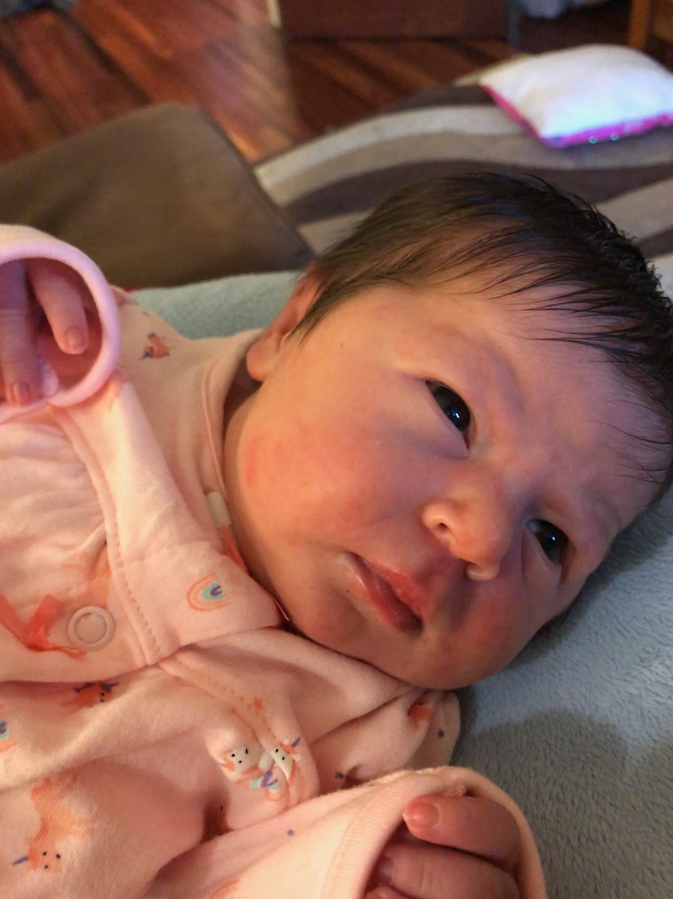
Congratulations to Karla and Kerry Romine on their new baby girl.
Welcome Emery!

Slide 4
April Fools Just Passed!
Write down the best prank you have ever orchestrated!
Best one gets a prize!

Slide 5
Employee Engagement – Gallup Survey 2019
Notes:
Combined with the Q12, we also ask the NPS question which stands for Net Promoter Score. This year will be the first year we have asked open-ended questions on our Engagement Survey.

Slide 6
Gallup Q12
Q1. I know what is expected of me at work.
Q2. I have the materials and equipment I need to do my work right.
Q3. At work, I have the opportunity to do what I do best every day.
Q4. In the last seven days, I have received recognition or praise for doing good work.
Q5. My supervisor, or someone at work, seems to care about me as a person.
Q6. There is someone at work who encourages my development.
Q7. At work, my opinions seem to count.
Q8. The mission or purpose of my institution makes me feel my job is important.
Q9. My colleagues are committed to doing quality work.
Q10. I have a best friend at work.
Q11. In the last six months, someone at work has talked to me about my progress.
Q12. This last year, I have had opportunities to work and grow.
Notes:
This will be our third year taking the Gallup Employee Engagement Survey. Each question in the Gallup Q12 evaluates an issue that affects the employee engagement level.

Slide 7
NPS & Open Ended Questions
NPS: On a scale of 0-10, how likely are you to recommend UNT to a friend or colleague as a great place to work?
1. What changes would you make to improve your institution?
2. What is the most important action your supervisor could take to positively impact your engagement?
3. Over the next year, what should UNT System concentrate on to improve this institution as a best place to work?
Notes:
Combined with the Q12, we also ask the NPS question which stands for Net Promoter Score. This year will be the first year we have asked open-ended questions on our Engagement Survey.

Slide 8
Notes:
As well as looking at the responses to each Q12 question, this is what we are looking for: Engaged, Not Engaged and Actively Disengaged. These are our results from 2018 and in gray, from 2017.
When our trainers do engagement courses they describe engagement like a boat. UNT is a boat and the associates are the rowers. Engaged employees are rowing forward, Not Engaged employees are just sitting holding their oars in their lap, and actively disengaged employees are rowing backwards. Our goal is to move the not engaged employees to engaged and sometimes that’s just adjusting one or two work conditions. Making sure they have all the tools they need, or being clear about their job responsibilities. The Actively Disengaged are difficult to move, but the more engaged employees we have the more likely we are to sail forward.

Slide 9
Gallup 2019
Begins: Friday, April 5th
Ends: Wednesday, April 17th
Changes:
Data for teams of 4 or more (previously it was 10).
Open-ended questions.
Faster turnaround on results.
Notes:
Combined with the Q12, we also ask the NPS question which stands for Net Promoter Score. This year will be the first year we have asked open-ended questions on our Engagement Survey.

Slide 10
Questions?
Notes:
Combined with the Q12, we also ask the NPS question which stands for Net Promoter Score. This year will be the first year we have asked open-ended questions on our Engagement Survey.

Slide 11
Annual Inventory Process/Timeline
Who has a role?
Inventory Coordinator: visually inspect assets not assigned to you and sign the annual physical inventory certification form.
Custodian: make the asset available to the coordinator in a timely manner.
EIS Department Managers: attest that the work has been completed by the coordinator and complete the annual physical inventory certification form.

Slide 12
Annual Inventory Process/Timeline
What are we counting/certifying?
Controlled and Capital equipment ONLY (has a UNT tag/number).
Someone other than the custodian has completed visual confirmation of the asset.
Inventory assigned to your department in EIS (list to be sent to each coordinator from Assistant Director Property Management).

Slide 13
Annual Inventory Process/Timeline
Why do we have to do this; I don’t have time?
Required by State law
Annual requirement
Complete inventory
UNT has over 30,000 assets (large financial investment)
When is the window open for the process?
May 1 – June 15, 2019
No longer in the month of April (user feedback)
Escalation procedures after 6/15/19 for late submissions

Slide 14
Annual Inventory Process/Timeline
How can I do this as efficiently as possible?
Consider setting up a central area for custodians to bring by their portable assets (laptops/cameras/tablets).
Use handheld scanner to populate the tag number into EIS.
Keep inventory updated: accurate location and custodian is paramount.
Break the inventory into manageable pieces.
Recruit help when needed.

Slide 15
Upcoming HUB Spot Bid Fair

Slide 16
State Senator West’s Spot Bid Fair
Every year State Senator Royce West hosts a “Doing Business Texas Style: Spot Bid Fair”
Hundreds of HUB Vendors gather and place informal bids/quotes on procurement opportunities brought by State Agencies
Opportunities include commodities and other services.
Timeframe: items you need between late-May and end of FY.
Does not commit you to making the purchase.
The HUB Program will compile and submit on your behalf

Slide 17
UNT System HUB Program Staff
Greg Obar, Director of Operations & HUB Coordinator
940.369.5647
Greg.Obar@untsystem.edu
Lisa Martinez-Tovar, HUB Specialist
940.369.5580
Lisa.Martinez-Tovar@untsystem.edu
Gabriel Carranza, HUB Specialist
940.369.5528
Gabriel.Carranza@untsystem.edu
Steve Hill, Director of Business Development for UNT
Assists UNT with all manner of external vendor issues

Slide 18
Facilities Work Orders and Helpful Hints

Slide 19
Facilities Overview
•

Slide 20
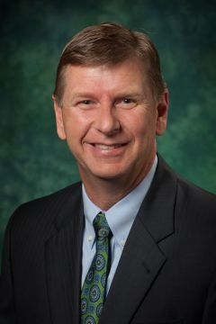
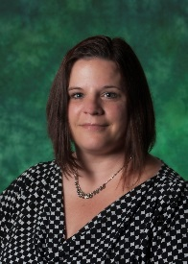
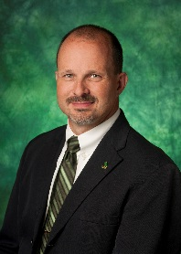
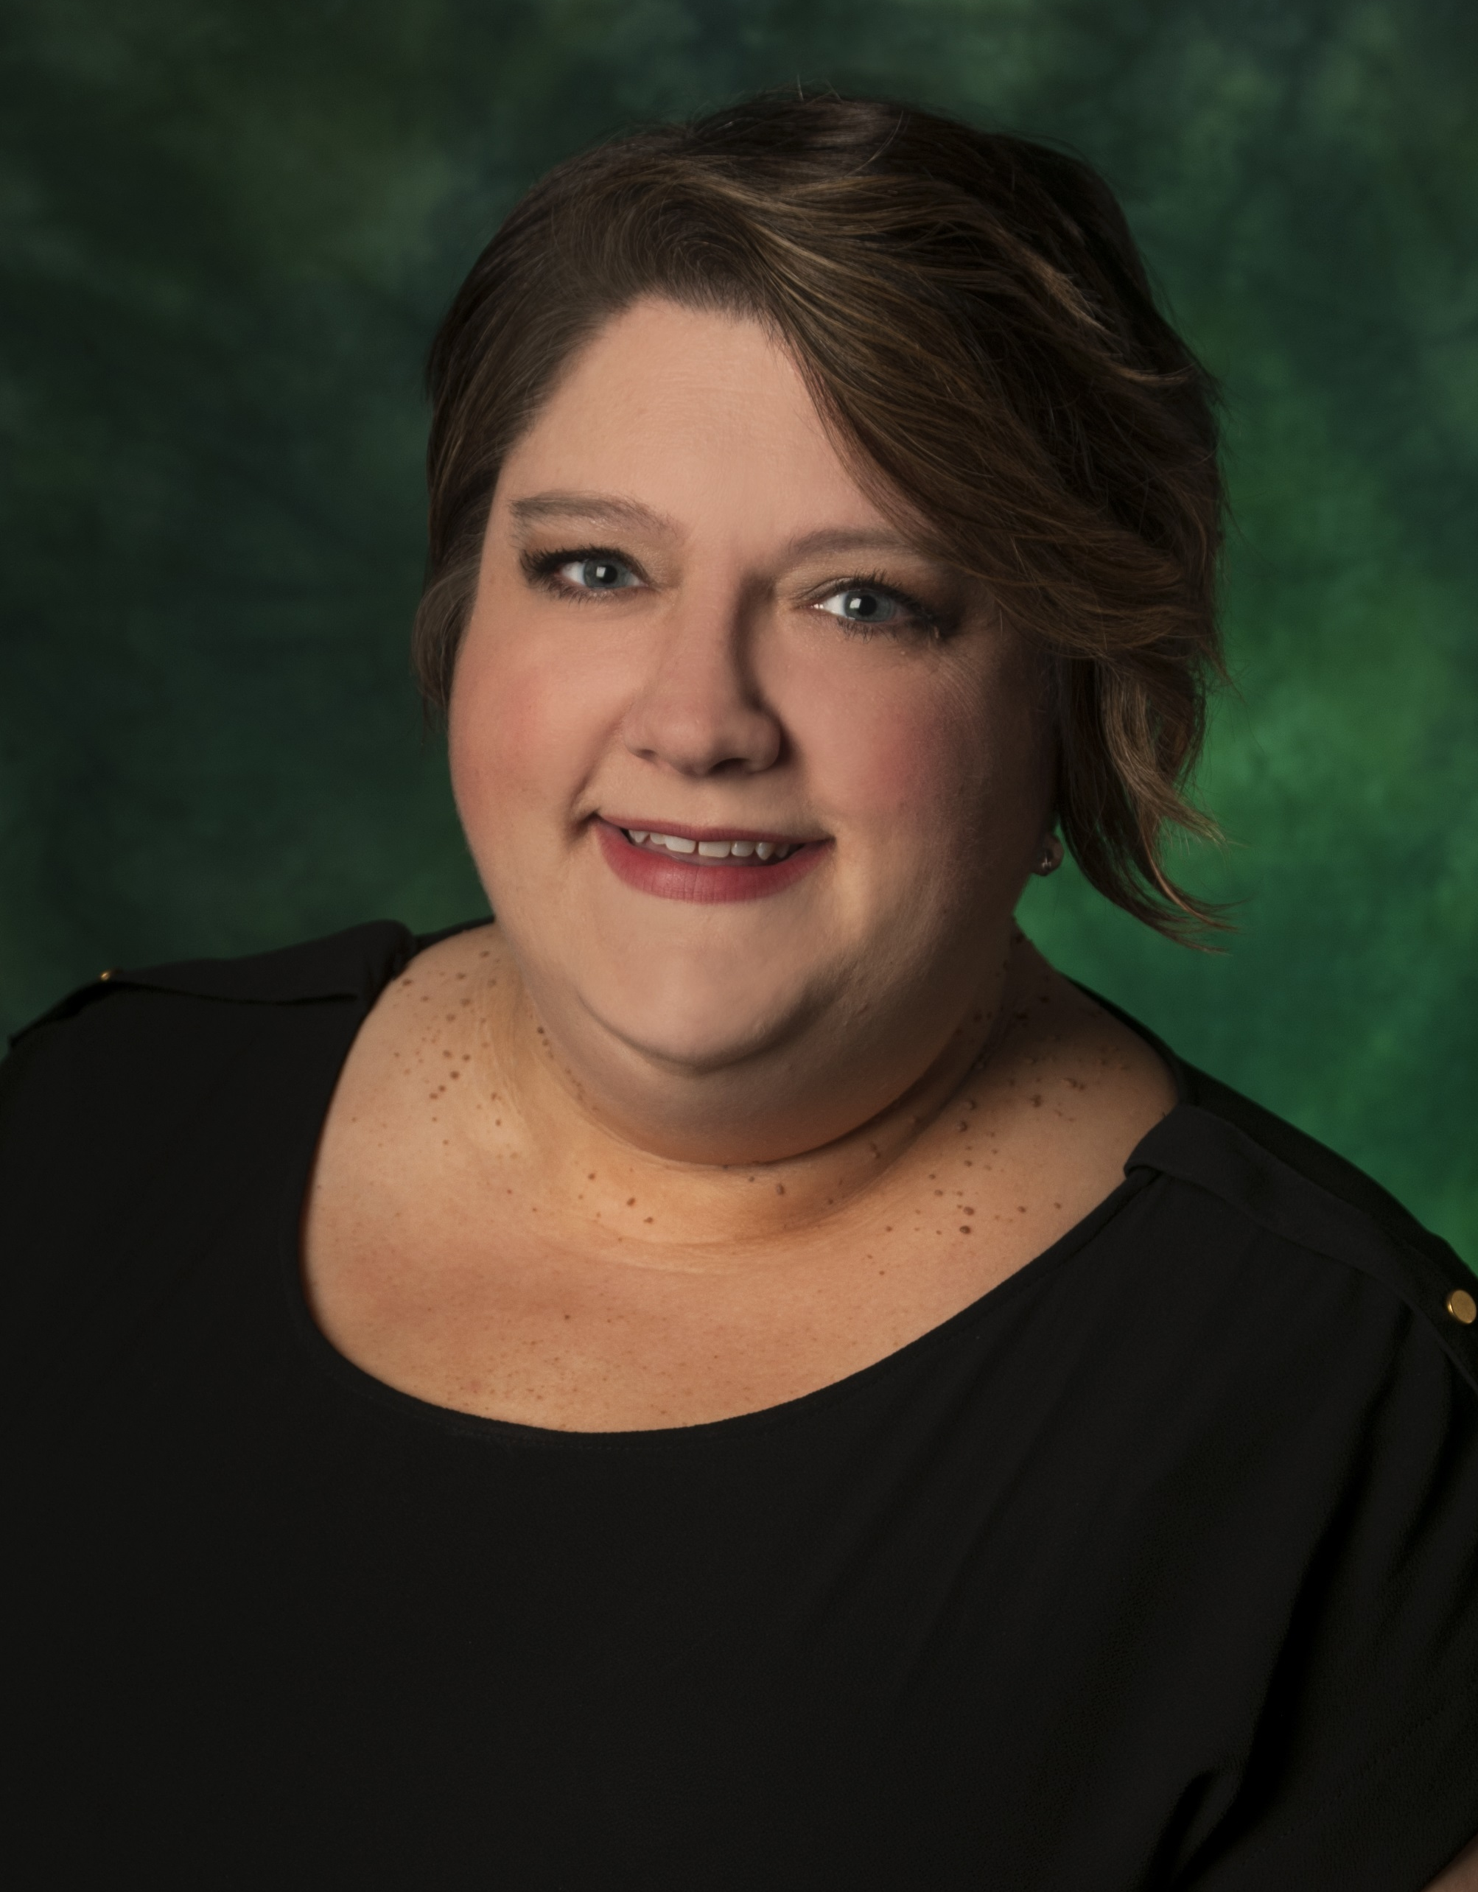
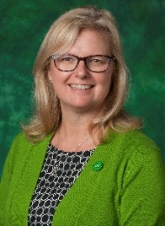
UNT Facilities Organization
David Reynolds
Associate Vice President
565-3990
Rob Pearson Nicole Savage
Personnel and Leasing Manager Executive Admin. Coordinator
369-7097
Chad Crocker Hilary Liscano
Sr. Director, Facility Maintenance Helen Bailey Director, Fac. Support and Services
Director, Fac. Planning Design & Construction
565-3992 369-5333
369-7886

Slide 21
UNT Campus
7.5 Million+ Gross Square Feet (gsf)
E&G ~ 3.3M gross square feet (gsf)
Auxiliary ~ 3.7M gsf
904 Acres
176 Facilities
25% increase in gross square feet since 2007

Slide 22
Texas University Physical Plants*
* THECB and other sources

Slide 23
O&M of Plant Spending per FTSE
School | 2013 $/FTSE | 2014 $/FTSE | 2015 $/FTSE | 2016/FTSE | 2017/FTSE | 2018/FTSE
UT Austin | 3,265 | 3,144 | 3,516 | 3,584 | 3,983 | 4,314
A & M | 2,591 | 3,061 | 2,352 | 2,853 | 2,503 | 2,654
UTSA | 1,826 | 1,667 | 1,839 | 1,726 | 1,797 | 1,644
UT Dallas | 1,873 | 1,924 | 1,663 | 1,687 | 1,574 | 1,641
A & M Commerce | 1,350 | 1,341 | 1,389 | 1,495 | 1,525 | 1,613
Texas State | 1,292 | 1,283 | 1,339 | 1,382 | 1,276 | 1,437
Texas Tech | 1,337 | 1,317 | 1,291 | 1,410 | 1,416 | 1,458
UNT | 948 | 1,064 | 1,176 | 1,251 | 1,249 | 1,377
UT Arlington | 1,229 | 1,255 | 1,154 | 1,090 | 1,040 | 1,031
Source: Annual THECB Sources and Uses Report

Slide 24
O&M of Plant Spending
School | 2013 Plant O & M ($M) | 2014 Plant O & M ($M) | 2015 Plant O & M ($M) | 2016 Plant O & M ($M) | 2017 Plant O & M ($M) | 2018 Plant O & M ($M)
UT Austin | 150.8 | 150.8 | 164.9 | 167.2 | 186.9 | 203.8
A & M | 115.7 | 145.4 | 118.5 | 149.2 | 136.2 | 148.0
UTSA | 44.1 | 38.07 | 42.2 | 41.2 | 43.4 | 42.0
UT Dallas | 31.0 | 34.02 | 32.0 | 34.8 | 35.2 | 37.9
A&M Commerce | 12.1 | 11.6 | 12.8 | 14.6 | 14.9 | 15.3
Texas State | 37.4 | 38.47 | 41.0 | 43.9 | 41.2 | 46.5
Texas Tech | 39.1 | 39.12 | 40.1 | 45.1 | 45.6 | 47.7
UNT | 27.9 | 31.65 | 32.6 | 39.2 | 39.6 | 44.0
UT Arlington | 32.6 | 33.58 | 32.5 | 32.2 | 33.3 | 34.2
Source: Annual THECB Sources and Uses Report

Slide 25
O&M of Plant / FTSE
$ per FTSE
millions
Source: THECB

Slide 26
High Risk Space Highlighted By Work Orders
Operational strain of high risk space revealed by reactive work order cost and frequency
Reactive Work Order Cost By Building
600
Low Cost, High Frequency
Chilton Hall
Most Costly Reactive Work Orders
Building | Total Cost | Age
Discovery Park* | $ 120,164 | 25-50
Hurley Admin | $ 56,176 | Over 50
Willis Library | $ 70,337 | 25-50
Chilton Hall | $ 70,202 | 25-50
Music Bldg | $ 64,050 | 25-50
Coliseum | $ 61,077 | 25-50
Chemistry Bldg | $ 59,887 | 10-25
BLB | $ 83,768 | Under 10
High Cost, High Frequency
500
BLB
400
Music Bld
W.O. Count
Hurley Admin
300
Willis Library
Chemistry Building
200
Coliseum
100
Low Cost, Low Frequency
High Cost, Low Frequency
$350 $400 $450
-
$-
$50 $100 $150
$200 $250 $300
Average Cost ($)/ W.O.
$500

Slide 27
Work Satisfaction Meets High Expectations
Facilities department work meets the high expectations of majority of customers
Expectations
Satisfaction
10% ^{2%} 5%
5% 3%
19%
20%
Very Low Expectations
Low Expectations
Moderate Expectations
High Expecations
Very High Expecations
Far Below Expectations
Below Expectations
Meets Expectations
Exceeds Expecations
Far Exceeds Expecations
31%
52%
53%
Source: Sightlines: Gordian Company
© 2017 Sightlines, LLC. All Rights Reserved.

Slide 28
Facilities Support & Services
Procurement
Uniforms
P-Cards
Work Control
565-2700
TMA Training
TMS Assistance
Joyce Courtney
Division Budget
Officer
Contract Initiation
Project Budgeting
Angela Alberts
Accounting
Specialist

Slide 29
Billing Issues? Please contact:
Hilary Liscano
or
Joyce Courtney
Common questions:
Facilities bills at the end of each month.
We are currently reconciling old projects,
if there are remaining funds they will be
returned to you.

Slide 30
Examples of Facilities Maintenance Funded Repairs
Building exterior including gutters, roofs, windows and doors and associated hardware
Building and room keys
Sidewalks/steps/handrails
Exterior lighting
Utilities: electrical, water, natural gas and sewer systems
Life Safety Generators
Water Service and domestic water distribution system including water fountains and restroom fixtures
Electrical Service and distribution system including light fixtures, outlets, switches and circuit breakers
HVAC Systems in support of comfort heating/cooling
Maintenance and repair of floors, walls, and ceilings space due to condition/age only
Furniture in 110 Classrooms
Elevators and chairlifts
Fire alarm and suppression systems
Pest control services
Custodial services
Care of lawns, trees and shrubs
Examples of Billable Services
Renovations, improvements, alterations and new construction
Fabrication of cabinets, shelves, signs
Maintenance and repair of special classroom equipment
Redundant cooling/heating systems in support of dept. needs
Specialized filtration systems (HEPA filtration)
Redundant water heaters in support of departmental needs
Emergency Generators in support of departmental needs
Uninterrupted power systems (UPS) in support of dept. needs
Process cooling systems in support of dept. equipment cooling
Growth Chambers
Sterilizers/Autoclaves
Distilled/Reverse Osmosis water systems
Refrigerators/Freezers/Microwaves
Movable furniture
Book Cases
Audio visual equipment
Sound systems
Departmental security systems
Decorative plants
Non-standard landscaping
Auxiliary maintenance and repair requests
Occupant or departmental requested renovation/remodel
Paint/flooring when part of a requested renovation/remodel
Asbestos abatement when part of a requested
renovation/remodel project

Slide 31
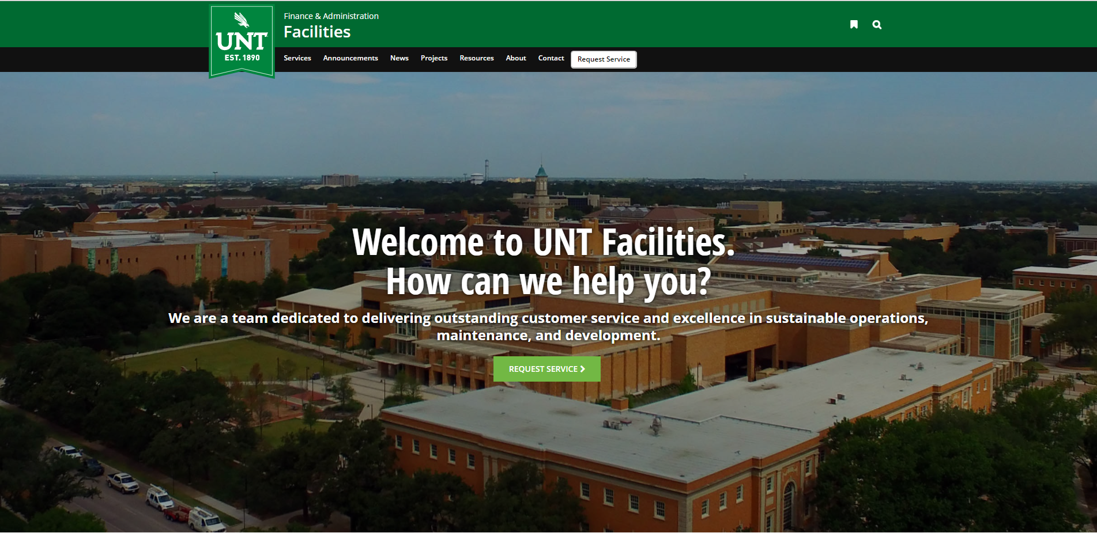
To Place a Work Order: www.facilities.unt.edu
UNT FACILITIES @UNTFacilities
To check status, technician comments: https://unt-isd.webtma.net/home-req.html
search by Work Order Number

Slide 32
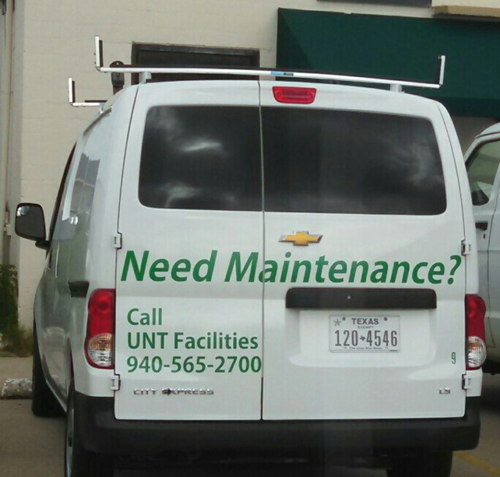
Facilities Maintenance
Work Control
work.control@unt.edu
940-565-2700
Twitter: @UNTFacilities
Call us!
UNT FACILITIES @UNTFacilities

Slide 33
Facilities Q & A
If Facilities returns funds, will they cross Budget Years? YES if they are non-central funds; anything on fund 830001 closes year-end.
Is there a charge for a Facilities work order estimate? NO
Are there limitations to Department’s requests if they are willing to pay? Yes: both financial as well as safety measures
Other items to note:
Facilities is working toward sending invoices so departments can budget.
Enhancement requests made close to August will likely be turned down due to the high volume of requests made previously in the year.
Requests are reviewed weekly during team meetings – if you send in a request Wednesday afternoon, expect to hear back the following Wednesday.

Slide 34
FY20 Tuition and Fee
Recognition/Timing Changes
Current Practice
Tuition & Fee revenue is recognized when billed (except Fall) due to change of fiscal year.
Future Practice
Tuition & Fee revenues will be recognized in the period when the term/semester commences, regardless of when billing occurs.
Why make this change?
Better alignment of revenue with expenses
Spring Tuition will be deferred until January
Summer II will be deferred until July

Slide 35
Save and Soar Tuition Plan Beginning Fall 2019
R. Joey Saxon, Ed.D. Associate Vice President Student Financial Services

Slide 36
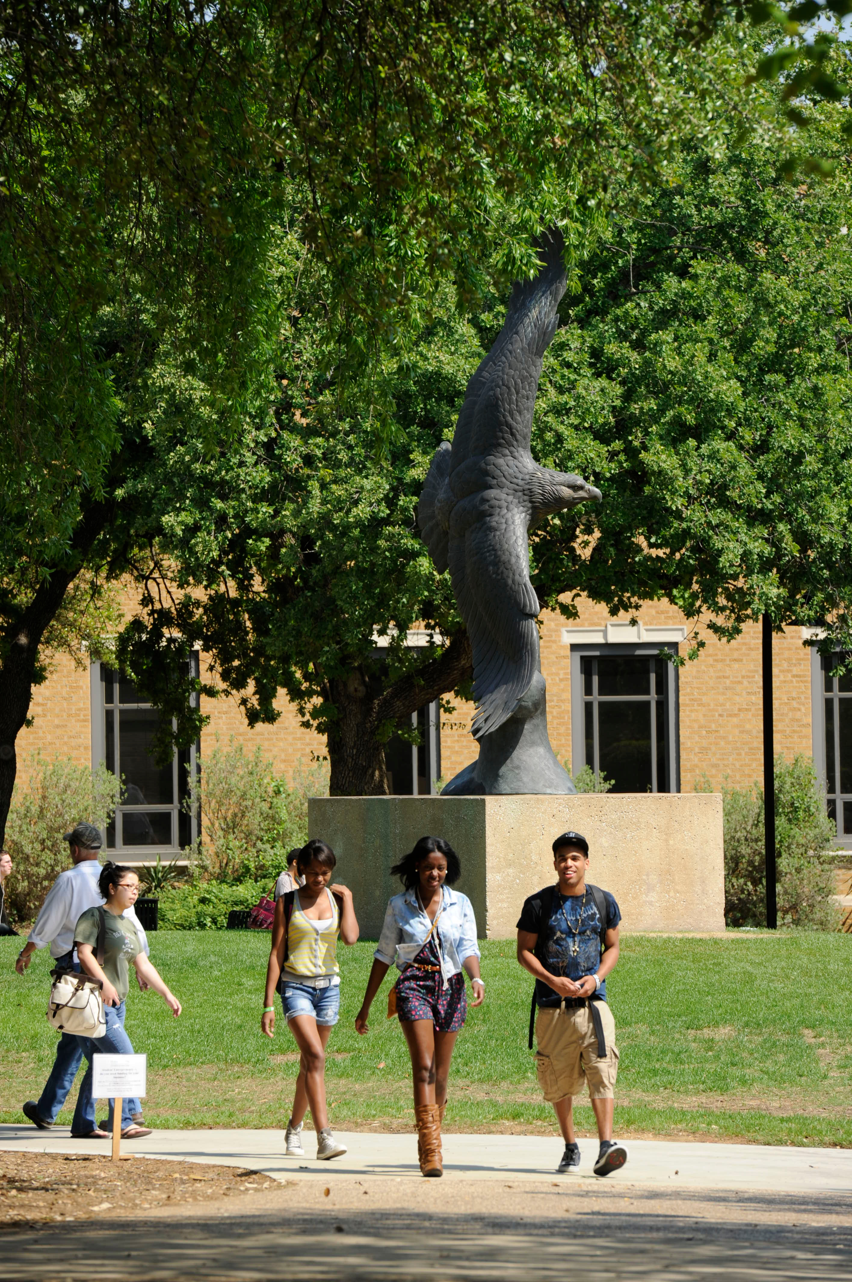
Process
Established Tuition and Fee Review Committee in Spring 2018.
Represented academic and administrative areas.
Completed various financial assessments.
Reviewed all tuition and fees assessed by UNT.

Slide 37
Process
Completed student surveys and focus groups.
Compared UNT costs to other colleges and universities.
Compared UNT fixed rate tuition plan to others.
Submitted recommendations to UNT Administration for proposed changes beginning with the Fall 2019 semester.

Slide 38
Save and Soar Tuition Plan New Fixed Rate Tuition Plan

Slide 39
Save and Soar Tuition Plan
New Fixed-Rate Tuition Plan beginning in the Fall 2019 semester.
Approved by Board of Regents in November 2018.

Slide 40
Save and Soar Tuition Plan
Plan details are based on feedback from the UNT community and a thorough evaluation of the current Eagle Express Tuition Plan.
Save and Soar is designed to encourage continuous enrollment and timely graduation.
Participants can save money, reduce potential loan debt and take classes during the Summer semester and Winter Session at a discounted rate.

Slide 41
Save and Soar Tuition Plan - Details
Available to incoming (Texas residents) first-time freshmen and undergraduate transfer students beginning Fall 2019.
Students are provided an opportunity to opt-in to the program before the payment deadline in their first semester.

Slide 42
Save and Soar Tuition Plan - Details
Participants will pay a slightly higher amount for Board Designated Tuition and any applicable Differential Tuition.
No more than 2% over the traditional Board Designated Tuition rate and Differential Tuition rates their first semester.
The Board Designated Tuition and any applicable Differential Tuition rates will be locked-in and not increase for 4 years (12 consecutive semesters).

Slide 43
Save and Soar Tuition Plan - Tuition Discount
$100 discount per semester credit hour in Board Designated Tuition in the Winter Session for students enrolled for 15 or more semester credit hours the previous Fall semester.
$100 discount per semester credit hour in Board Designated Tuition in the Summer semester for students enrolled for 15 or more semester credit hours the previous Spring semester.

Slide 44
Save and Soar Tuition Plan - Housing Discount
First-time freshmen living in UNT Housing and enrolled in at least 15 semester credit hours during the previous Spring semester will receive a 40% discount in housing rates during their first Summer semester.

Slide 45
No Impact for Eagle Express Participants
Participants will continue to receive the benefits of their designated locked-in tuition and fees until they reach the end of their 12th consecutive semester.
Participants will remain eligible to receive the financial graduation incentive in their final semester if they meet requirements.
Eagle Express Tuition Plan will be closed for new participants at the end of the 2018-2019 academic year (Summer 2019).

Slide 46
Informing Incoming Students
Website: SaveandSoar.unt.edu
Information distributed through Orientation programs.
Informational cards mailed to Fall 2019 admitted FTIC and Transfer students.

Slide 47
Informing Incoming Students
Informational email will be sent to eligible students upon first registration.
Advisors are encouraged to mention the program to new students.

Slide 48
Comments or Questions?
Additional Comments or Questions?
Email: saxon@unt.edu

Slide 49
Announcements/Reminders

Slide 50
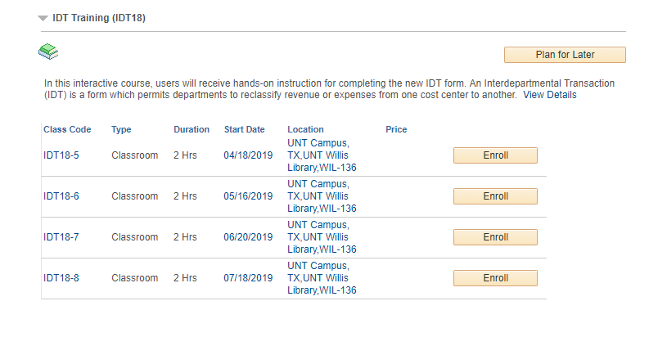
Announcement
Upcoming IDT Training/Testing Dates
Registration is open on the MyLearning Portal

Slide 51
Announcement
COGNOS Reporting Challenges
THANK YOU for your patience as we worked through the challenges
What we know
Nightly data load from EIS to BBA database longer than usual or not complete
Server performance issues
14 times this calendar year you’ve been without reports
What we’re doing (short-term)
Removed non-essential tables from the data load
Patched the server
What we’re doing (long-term)
Investing in new database (decrease the load time)
Looking into different server
Create a duplicate file so in “worst case” scenario you have old data

Slide 52
Visio 2016 Training
Date: May 3rd
Time: 9:00 – 10:30am
Learn about the basic features and functions in a lab setting for hands on application.
Learning Objectives:
Navigate and customize the user interface
Review diagraming shapes, shortcuts and best practices
Create basic and cross functional flowcharts
Explore themes, formatting and graphic elements
To Register:
Visit MyLearning.unt.edu.
Click on Find Learning.
Enter code Visio2016-3 to sign up for the course.

Slide 53
Announcement
University Budget Office Is Moving to the SSB!
What to Expect:
Our entire office will be “Offline” 4/10-4/12 (phones and email).
The primary phone line x3233 will be FWD to Gylynn Hanson in Bob Brown’s office for urgent items; for all other messages:
Please send requests via email: budget.office@unt.edu
Thank you for your patience, as we transition to our new space!
We will work diligently to answer all requests in a timely manner, and continue to communicate with Campus via our website and
Budget News Emails!

Slide 54
Open Forum – Q&A

Slide 55
Thank You.

